Slide 1
Ancient
Rome
AIM: Who influenced Roman society to make it the envy of the Ancient World?
Do Now:
Define the following terms in your notebook:
    * Roman Republic
    * Twelve Tables
    * Augustus
    * Pax Romana
Mr. Ott – BETA 2011-12

Slide 2
The
Roman Empire:
27 BCE - 476 CE

Slide 3
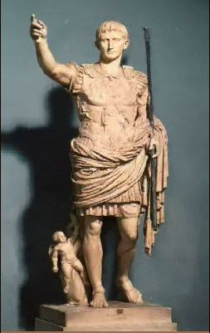
Octavian Augustus:
Rome’s First Emperor

Slide 4
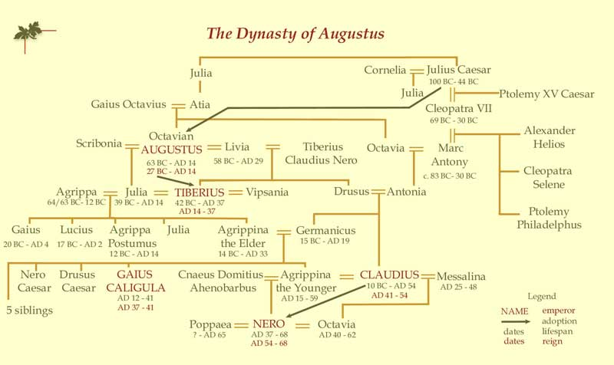
The First Roman Dynasty

Slide 5
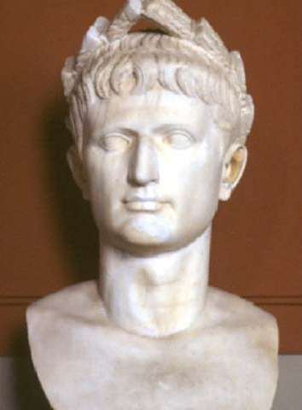
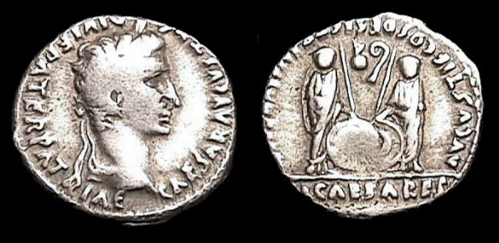
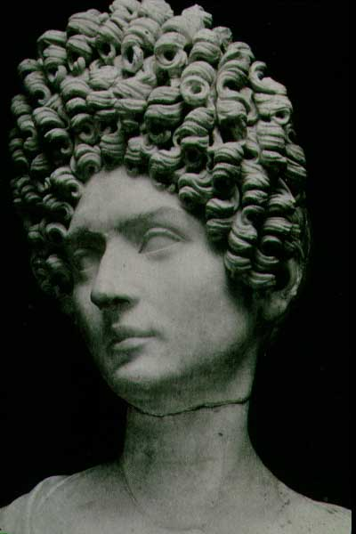
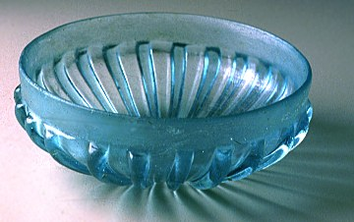
Pax Romana: 27 BCE – 180 CE

Slide 6
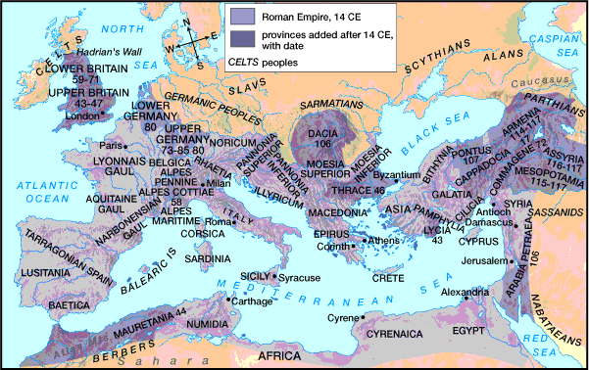
The Greatest Extent of the Roman Empire

Slide 7
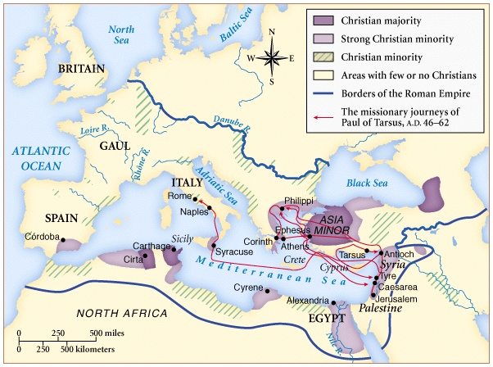
The Rise of Christianity

Slide 8
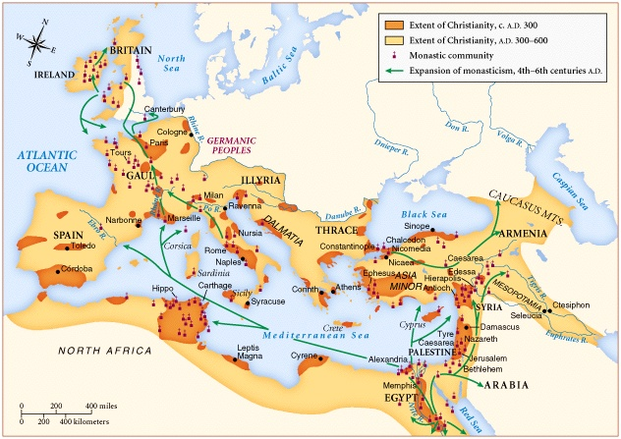
The Spread of Christianity

Slide 9
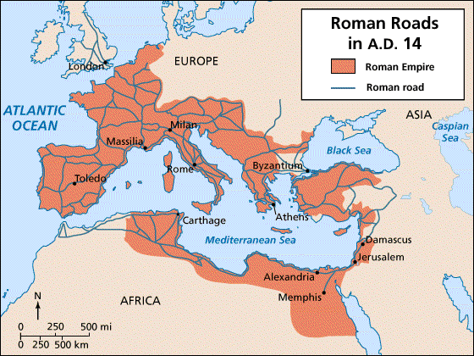
Imperial Roman Road System

Slide 10
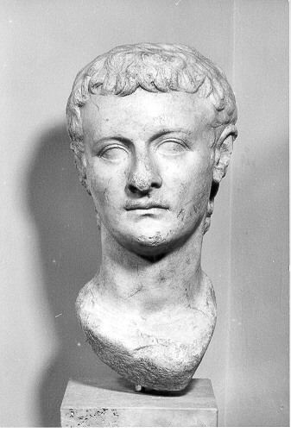
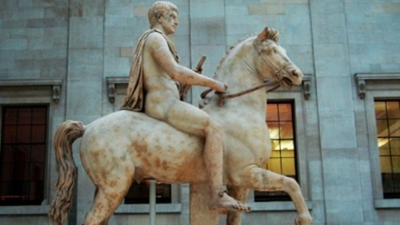
Caligula
Mentally disturbed
Assassinated after short brutal reign

Slide 11
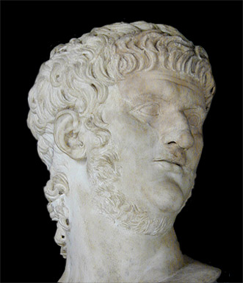
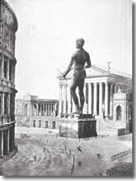
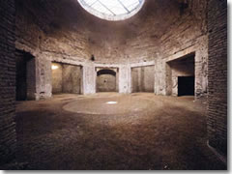
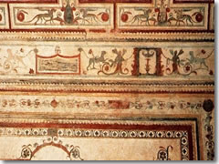
Nero
Good administrator but vicious
Murdered many
Persecuted Christians
Committed suicide
Frescoed grotteschi ("grotesques") in Nero's Domus Aurea.
The Aula Ottagona (Octagonal room) of Nero's Domus Aurea in Rome.

Slide 12
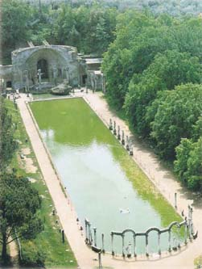
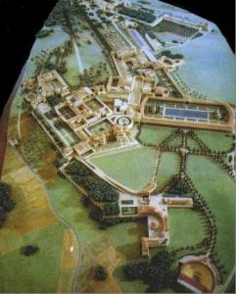
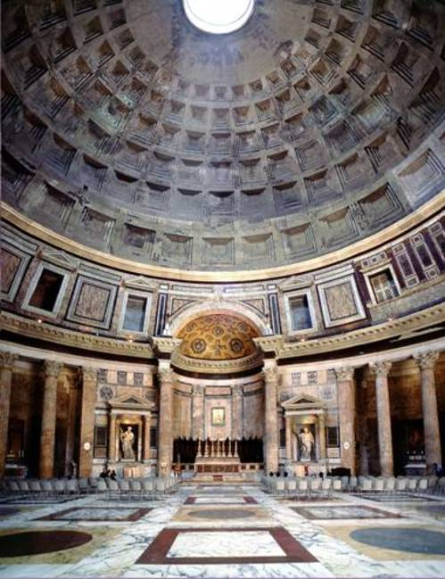
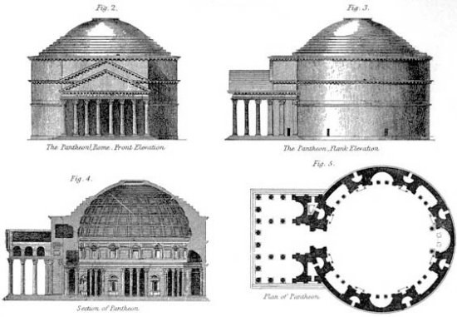
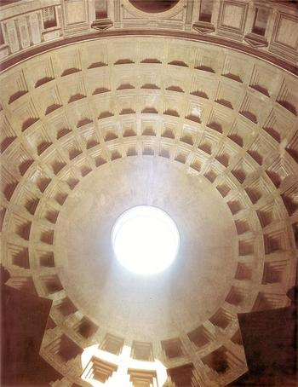
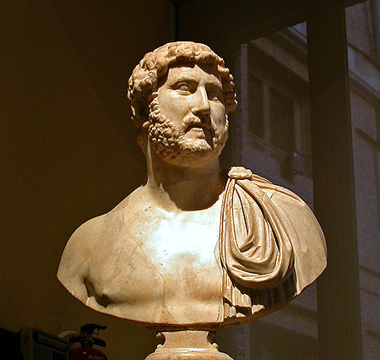
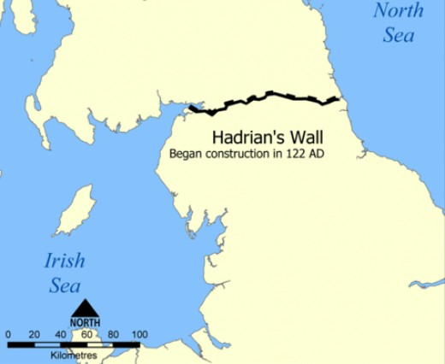
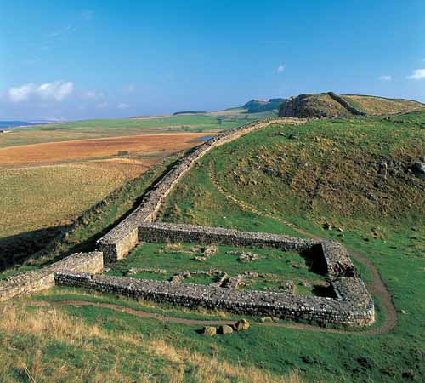
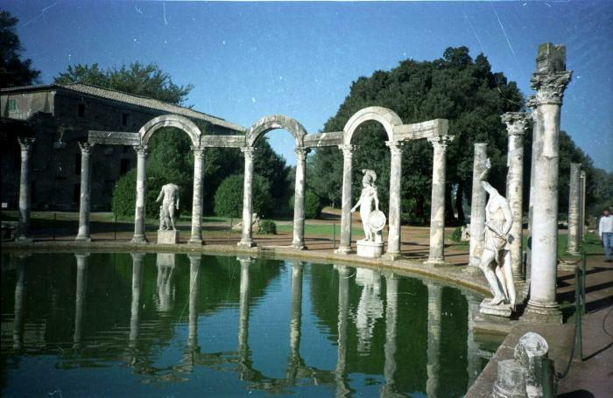
Hadrian
Consolidated earlier conquests
Reorganized the bureaucracy
Great Builder (Pantheon, Hadrian’s Wall, Tivoli Complex)
Britannia (Britain)

Slide 13
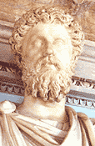
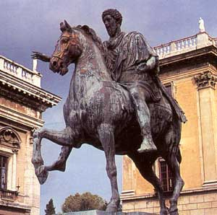
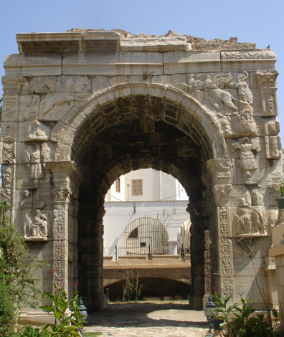
Marcus Aurelius
Brought empire to height of economic prosperity
Defeated invaders
Wrote philosophy

Slide 14
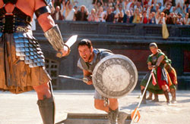
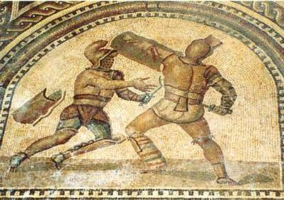
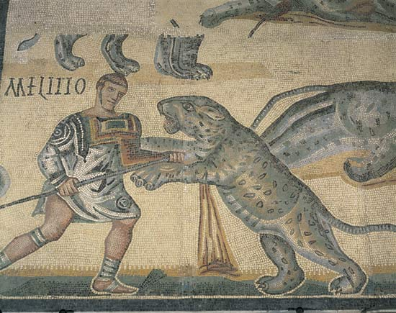
Gladiators
Condemned criminals
Prisoners of war
Slaves
Free men

Slide 15
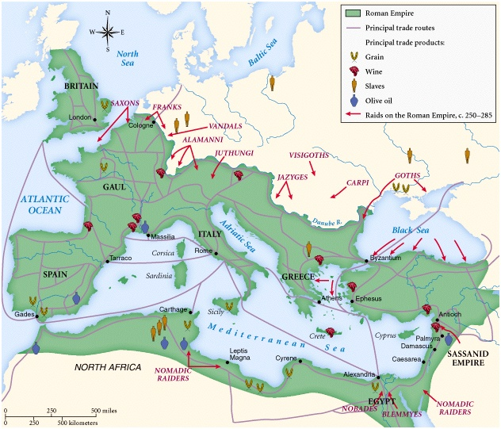
The Empire in Crisis: 3c

Slide 16
The Legacy of Rome
Republican Government
Roman Law
Latin Language
Roman Catholic Church
City Planning
Romanesque Architectural Style
Roman Engineering
    Aqueducts
    Sewage systems
    Dams
    Cement
    Arch

