Slide 1
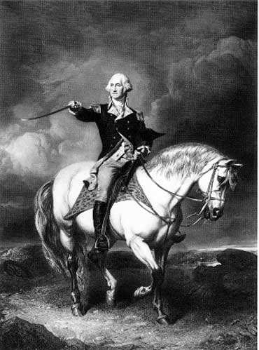
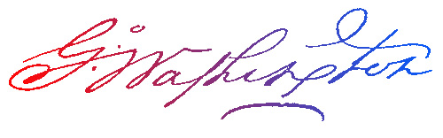
George Washington
The Model Citizen
Part 1

Slide 2
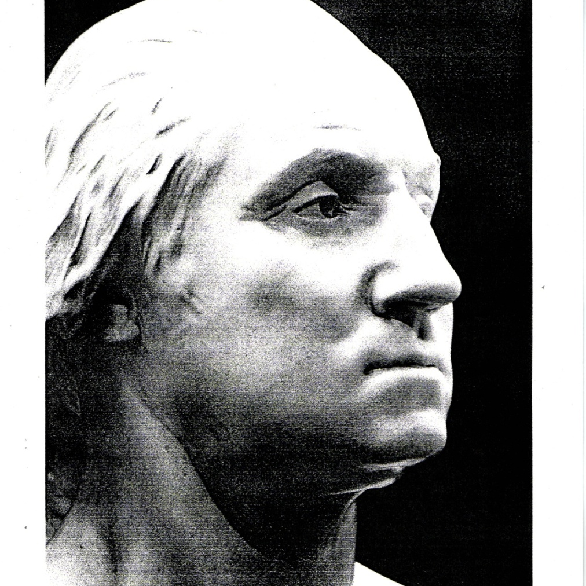
Born: February 22, 1732 in Westmoreland County, Virginia
Died: December 14, 1799 in Mount Vernon, Virginia
Married to: Martha Dandridge Washington

Slide 3
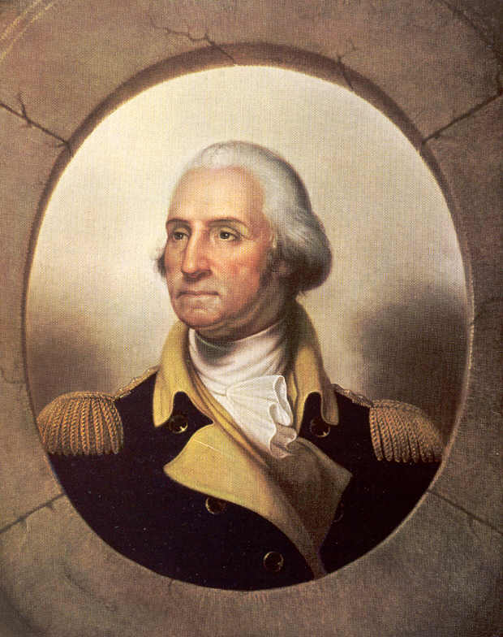
ACCOMPLISHMENTS
Surveyor
Farmer/Planter
  Tobacco, Fruit, Grains, Vegetables
Colonel in French & Indian War
Commander in Chief – Continental Army
Winter at Valley Forge, PA
Completes British Defeat at Yorktown
President of the Constitutional Convention
Promotes the new Constitution
Becomes 1st President Unanimously

Slide 4
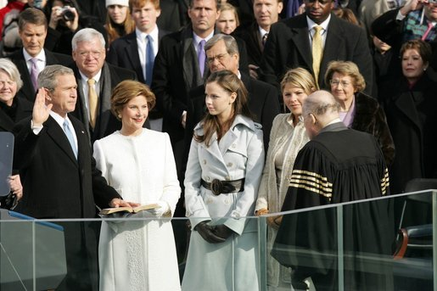
Inauguration
It all begins with this oath
Presidential Oath of Office
"I, ___________do solemnly swear
that I will faithfully execute the office of President of the United States,
and I will to the best of my ability,
preserve, protect, and defend the Constitution of the United States."
So Help Me God.

Slide 5
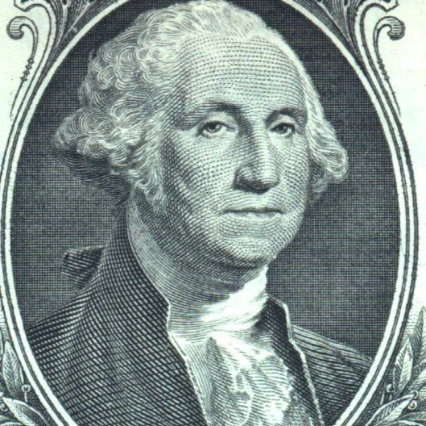
What is a precedent?
An act , rule or procedure used by a President that may be used by other Presidents.

Slide 6
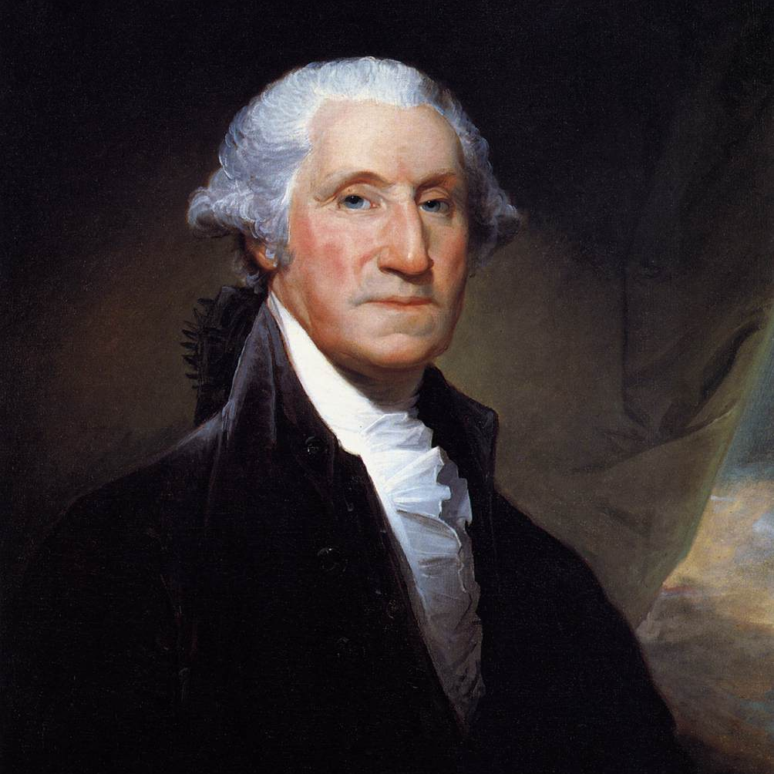
How did George Washington set the course for future presidents?
CABINET
INAUGARATION SPEECH
# OF TERMS IN OFFICE
COMMANDER-IN-CHEIF
Notes:
As President, Washington respected the idea of separation of powers. He carefully tread in dealing with Congress and the Supreme Court. He also tried to avoid political parties, though by 1796 two had already arisen. However, foreign policy became a major concern for President Washington. The French Revolution was destabilizing Europe and led to war between France and Great Britain. Washington listened to his advisors, yet made his own decision on America’s involvement on the international stage. He believed that to protect the interests of the young country, America remain neutral in international affairs.
President Washington set countless precedents for future presidents: like creating a cabinet of advisors, sending the troops out to quell insurrections like the Whiskey Rebellion, no President ever visited the Senate again, a President only served only two terms until 1940, giving a Farewell Address, among countless other principles and procedures.
Introduce the concept of “precedent” by asking students what the word means. Ask students to explain how precedents are used in our government. After a few minutes, elicit student responses to this point.
Critical Thinking Questions:
What were the circumstances that led to the establishment of the precedents during the Washington presidency?
What are the short and long term impacts of the precedents?

Slide 7
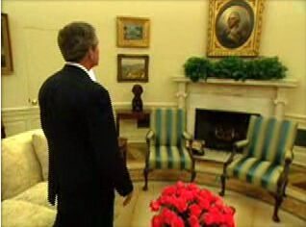
aNOTHER precedent?
(Almost)
Washington did not want to get paid to be President, but Congress insisted.
"I walk on untrodden ground. There is scarcely any part of my conduct which may not hereafter be drawn into precedent."

