Slide 1

The Weimar Republic
1919-1933

Slide 2
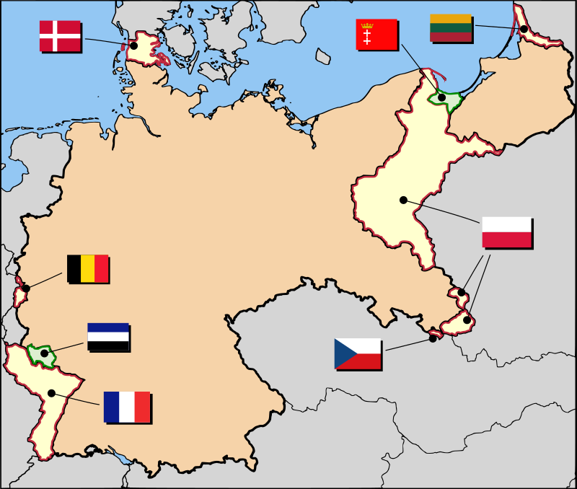
The Treaty of Versailles (1919)
‘War guilt’ clause imposed (Article 231)
Massively reduced military capability
Reparations (payments) fixed at a very high
level
Loss of all German Colonies & some land
All of this led to BIG problems from 1919

Slide 3

The Treaty of Versailles (1919)
Massively reduced military capability
Germany loses disputed land on borders
Germany loses all of their colonies
‘War guilt’ clause (Article 231) imposed
Reparations fixed at a very high levels
All of this led to BIG problems
from 1919

Slide 4
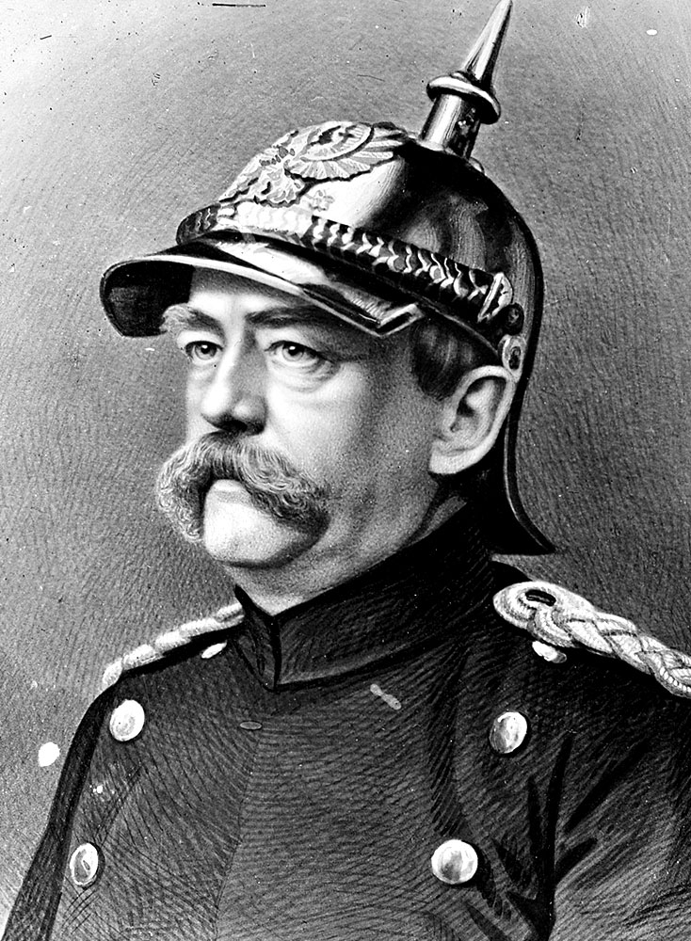
the Republic’s foundations
Kaiser Wilhelm II abdicates
Paul Von Hindenburg, commander of German forces, and others who signed treaty called the “November Criminals”
Generals didn’t set record straight
New government called Weimar Republic was formed (only named that in 1933)
Notes:
The final pressure for the Kaiser’s abdication came from General von Hindenburg.

Slide 5
Setting Up Weimar Government
Reichstag - German parliament
President - chose among candidates by public
Members of Reichstag - choose a party and party chooses members
  Called proportional voting
Majority Party in Reichstag chooses Chancellor, or Prime Minister
Whenever there was controversy, could call for new election 14 years - 20 different elections
Notes:
The people voted for a political party
The party leaders then elected members to the Reichstag in proportion to the number of votes they got nationwide.

Slide 6
Germany’s Constitutional MONARCHY
Kaiser Wilhelm II
(hereditary monarch)
appoints
Calls/dismisses
controls
Reichstag
(elected)
which can stop laws proposed by the government, but can’t make laws
Government
Chancellor
Ministers
The Army
Electors
Men over 25 can vote

Slide 7
The Weimar Constitution of 1919
Electors
All men and women over the age of 20 can vote
Bill of Rights
promises all Germans equality before the law and political and religious freedom
elect
safeguards
Reichstag
(elected)
Freidrich Ebert
(elected President)
from which is selected
Government
Chancellors and Ministers
must have a majority in the Reichstag and do as the Reichstag says
The Army

Slide 8
Weimar Constitution
56 articles that spelled out rights
  Freedom press, speech, religion
  Gave women right to vote and hold office
  Many laws discriminated against gays and Gypsies
  (Roma and Sinti)
  Article 48 - allowed the President to suspend the
  Reichstag in times of national emergency
  Article 109 - All Germans equal in front of the law
  Article 111 - All Germans enjoy the freedom to move
  and settle anywhere
  Article 118 - Every German can express opinion freely
  in word, writing, print or image

Slide 9
Political THREATS TO THE REPUBLIC
1920
Berlin Putsch
Attempted by Wolfgang Kapp & Genral Walther Luttwitz
Military Refuses
to Join & Fight
FAILED
1920
NAZI PARTY
Formed
National Socialist German Workers Party (NSDAP)
Nov. 8, 1923
Munich Beer Hall Putsch
Led by Hitler & the Nazis
FAILED
Putsch – Uprising/Overthrow
Notes:
On March 13, 1920, the Erhardt Brigade, a rebellious military unit, marched into Berlin as part of the first serious rightist attempt to destroy the Republic and seize power. This brigade, a Freikorps unit that had fought in the Baltic under Captain Hermann Erhardt, had refused orders to demobilize. It was greeted in Berlin by the civil servant Wolfang Kapp and General Walther Lüttwitz who proclaimed a new government of national unity. The Social Democratic leadership proved unable to get regular military units to engage the Erhardt Brigade. Although General Walther Reinhardt, the Prussian Minister of Defense, was willing to use troops against the rebels, most troops took their cue from General von Seeckt, the Army chief of Staff, who told the Social Democratic leaders that troops would not fire on other troops. President Friedrich Ebert and his cabinet fled to Dresden and then to Stuttgart where they called on their supporters to stage a general strike. Prussian trade unionists responded to the strike call in large numbers, while civil servants struck a neutral pose waiting to see if the coup succeeded. The strike was extremely effective in bringing transportation and commerce to a standstill. Within four days, convinced they could not govern, Kapp and Lüttwitz fled Berlin. Ebert and his cabinet then returned to Berlin and the Weimar Republican government was back in place. Germany’s fragile democracy had survived but the failure of anti-Republican judges to impose harsh punishments on the plotters, and the lack of support from military leaders, indicated major problems for the new government. Judges did not impose harsh punishments on plotters, Lack of military support, Showed that the new government was weak
---------------------------------------------------------------------------------------------------------------------------------------------------------------------------------------------------------------------------------------------------------
On November 8th, 1923, the Bavarian government held a meeting in a Munich beer hall. Adolf Hitler arrived with armed stormtroopers, jumped onto a table, fired two shots in the air and told the audience that the National Revolution had begun. The next day he and 3,000 armed Nazi supporters clashed with Police. When shots were fired Hitler fled. Arrested two days later, he was sentenced to five years imprisonment. Although Hitler was still an Austrian citizen, the Bavarian officials decided not to deport him. A sympathetic judge allowed Hitler to use the trial as a political podium to present his radical views. His minimal sentence was to be served in a comfortable prison fortress where he would write “Mein Kampf”

Slide 10
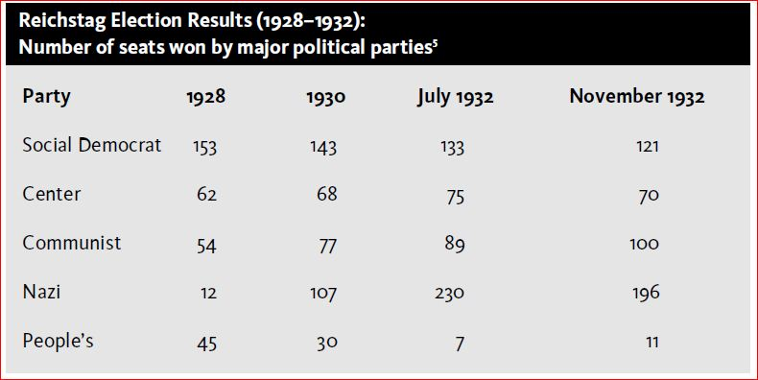
Election 1928
Notes:
By 1928, the economy had improved, mainly because of the Dawes Plan. Germany had joined the League of Nations and was no longer reguarded by the world as an outcast.
Germans seemed less interested in Hitler’s ideas that the Jews and the rest of the world were to blame for Germany’s problems. In the 1928 elections,
the Nazi Party only received 2 percent of the votes.

Slide 11
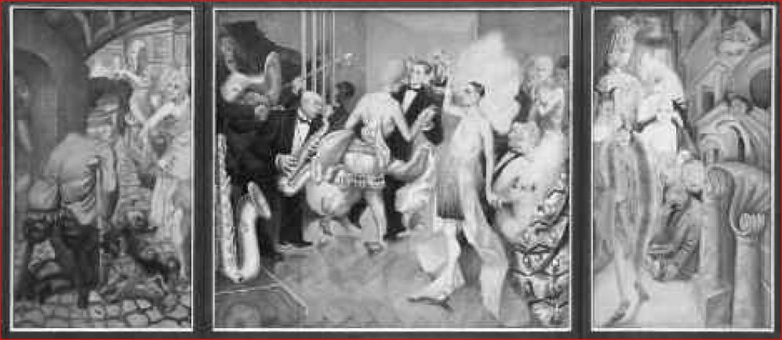
Culture in Weimar
Metropolis by Otto Dix 1928
Notes:
Otto Dix painted Metropolis to represent the cultural life of many German cities during the Weimar
Republic. Throughout the 1920s in Germany, the arts flourished. The number of dance halls (cabarets), art
galleries, and movie houses increased. While some Germans were excited by this artistic growth, other
Germans saw the music, films, and images as evidence that German culture was becoming immoral and out
of control. Even though the Weimar Constitution said that Germans had the right to freedom of expression,
many artists, including Otto Dix, were fined or arrested for producing work that was considered “anti-
German” by judges.

