Slide 1
Gladiator
The Truth behind the movie

Slide 2
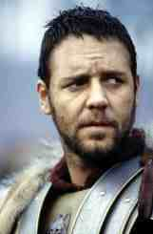
Did Maximus Really Exist?
No, but he represents the faction of Rome at this time that upheld a sense of obligation to the state and respect for duty and virtue

Slide 3
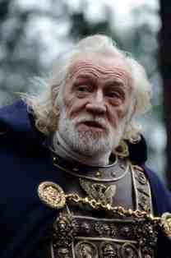
Marcus Aurelius
Marcus Aurelius was emperor from 161 to 180 BC
A stoic philosopher
Did fight along the Roman frontier
Wrote “The Meditations”

Slide 4
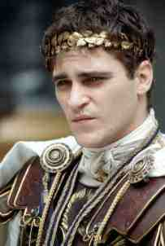
Commodus
Stranger than the character in the movie
Died in a training “accident”, not fighting as a gladiator
Historians agree that he might have killed his father
Called himself the new Romulus, declared a new Golden Age

Slide 5
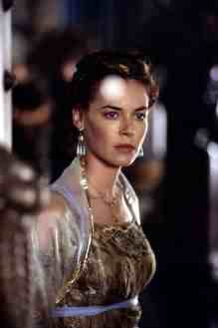
Lucilla
Her husband, Lucius Verus, was co-consul with Marcus Aurelius
First time in Roman history that the Roman Emperor had the formal appearance of two joint emperors
Lucilla was banished to Capri after plotting to assassinate Commodus. He had her executed

Slide 6
The Political Reality of the Film
There was at this time some political sentiment towards restoring more rights to the Senate and the people of Rome. This is represented in the characters of Senator Gracchus and Maximus, both of whom are fictional but capture the sentiment of the political culture of the times.

Slide 7
What do Classicists think of the film?
Kathleen Coleman, the Harvard classicist who was the consultant to Gladiator was not entirely pleased with the final result.
It is always helpful if you regard a film like this as memorializing the spirit of the times rather than representing history
This is fiction inspired by historical events

Slide 8
Any Mistakes in the Film?
Romans did not use stirrups, but the actors had to, to reduce the danger while filming riding scenes
There were no tractors in the Roman world, but tractor trails appear in Maximus’s wheat fields
There is a big debate over the “Thumbs Up/Down” usage
In reality, “Thumbs Up” probably meant “Kill the gladiator!” and “Thumbs Down” meant “Put down your weapon.”

Slide 9
Other Errors
Women were not allowed at that time to attend gladiatorial events
Horses were never used to carry slaves
The Romans did not have German shepherds as dogs at that time
Colosseum is correct size on the inside, but twice as big on the outside.
In reality, the Romans lost, not won the battle against Germania that is shown in the opening scene.

Slide 10
The Life of the Gladiator
Was the fighting as lawless as the movie portrays it to be?
No, in fact the movie portrays the crowd as desperate for blood and the gladiators as desperate to survive
But the reality was quite different, as this would not have been a profitable business if the fights were staged the way they were in the film

Slide 11
Marcus Aurelius and the Gladiator
The events drained the treasury, hence Marcus Aurelius reduced the frequency of the games
Commodus, however, did fight as a gladiator but his opponents always let him win since he was emperor (Herodian)

Slide 12
The Significance of the Games at this time
At this time, the gladiatorial combat was considered a religious events, that were morally appropriate for young children to watch
Games promoted honor, bravery and fearlessness in the face of death
This type of entertainment was considered intellectual, therefore, as opposed to going to other entertainments

Slide 13
New Research on Gladiatorial Games Reveals
At this time, referees were posted in the arena to make sure of a fair fight. Unbeatable odds would not have been a good show for the crowd
Food and healthcare was provided; if you develop a layer of fat over muscle, you stand a better chance of sustaining minor cut wounds
Training camps were closed – gladiators spent three years there training and could not leave, but that did not stop women, even ones from good families, from sneaking into the camps

Slide 14
Gladitorial Games, Part II
Games can best be compared to today’s modern boxing matches
Well organized, short fights with refs
Weapon selection and pairing of partners very carefully monitored
Main difference between this sport and modern boxing is that sometimes the gladiators were fighting for their lives.

Slide 15
Other Bizarre Behaviors of Commodus
Put snakes in the bread baskets that were used to hand food out to people at the gladiatorial games
Renamed Rome “Colonia Commodiana”
Renamed the months of the year after himself
Renamed the Senate Commodian Fortunate Senate
Claimed to be descended from Hercules
Wore lion’s skin and carried a club like the god
Forced Senators to watch him cut the heads off of ostriches
His 12 –year rule was called “a greater curse to the Romans than any pestilence or crime” by one Roman historian.

Slide 16
Conclusion
Although this is a fictional story, and many details from history are changed in order to make the story suit the Hollywood sensibility, the film still has merit in that it captures the humanity and spirit of that period in Roman history.

