Slide 1


Map Skills – Part 4
Explore The World

Slide 2

Lesson Objectives
Different Kinds of Maps:
Political
Physical
Elevation
Relief
Historical Distribution

Slide 3
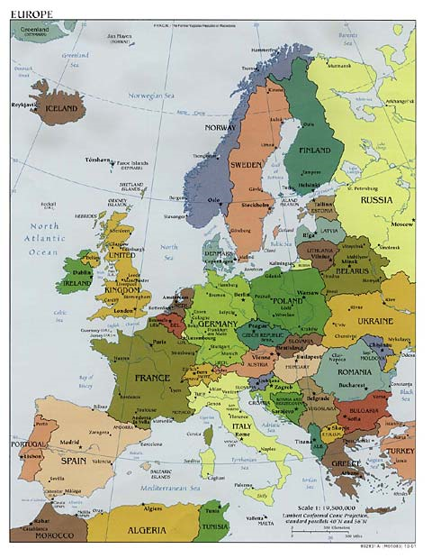
Political Map
Cities
Countries
Boundaries
States
Turn to pages 118-119 in Agenda Book

Slide 4
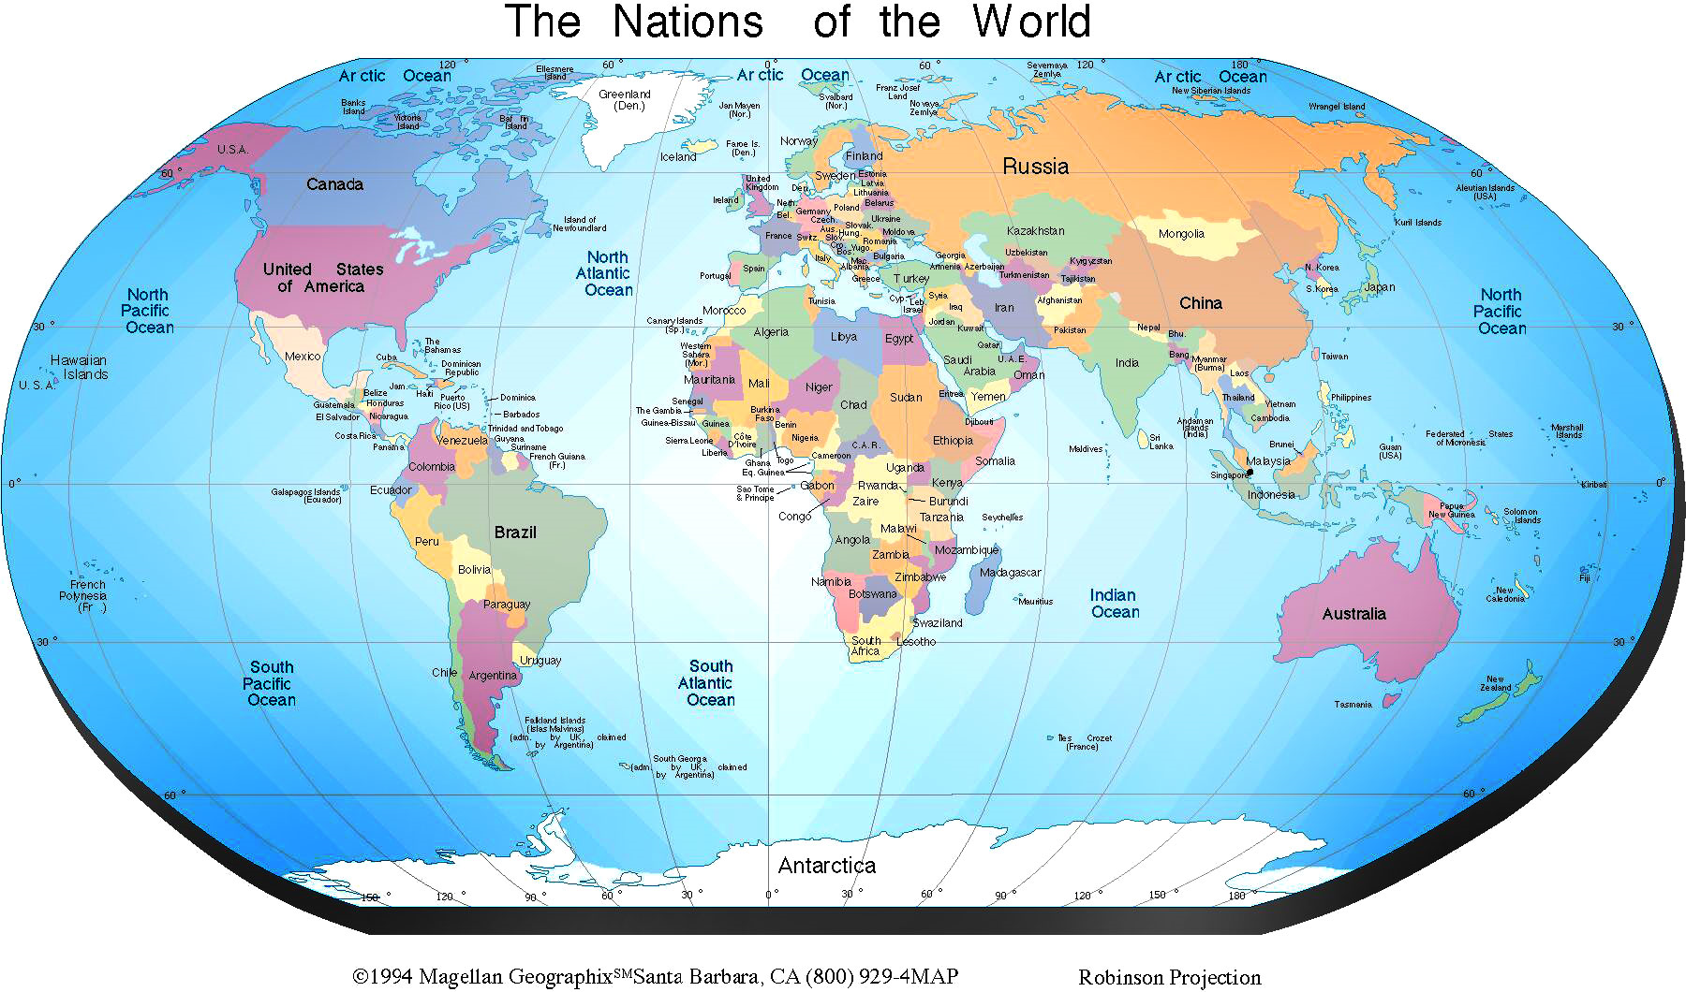
What Kind of Map is It?
Each Map differs in the information being displayed
Look at the title to determine the subject.

Slide 5
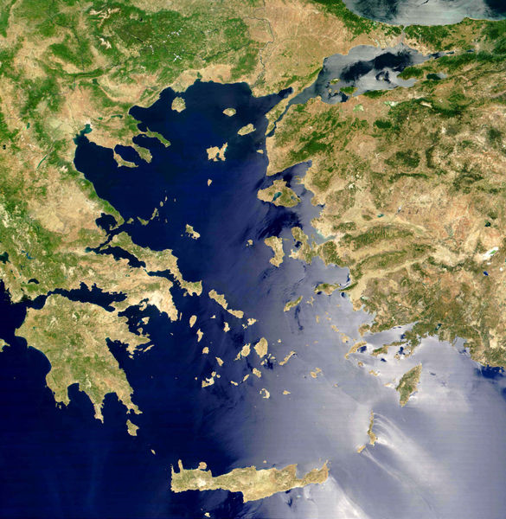
Physical Map of Greece
Physical Map
Displays Earth’s Natural Features:
Mountains/Hills
Rivers/Lakes
Oceans
Deserts
Forests

Slide 6
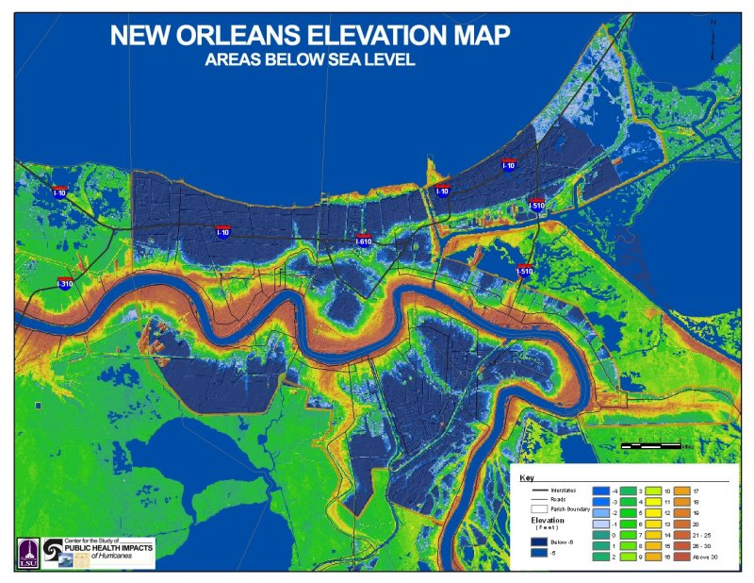
Elevation Map
Shows at what height a location is at.

Slide 7
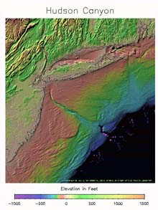
Hudson Canyon
Relief Map
Shows Elevation (Height) above/below Sea Level
Color Coded Changes:
Lighter– No Elevation
Medium – Gradual (Little)
Darker –Sharp Elevation
Elevation in Feet

Slide 8
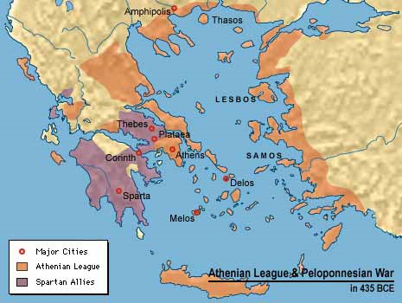
Historical Map
Shows Events that happened in the past

Slide 9
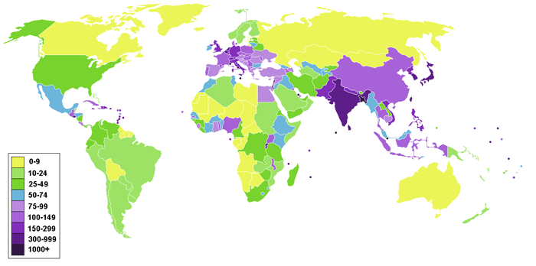
Distribution Map
How Something is Spread or Distributed Across an Area.

