Slide 1
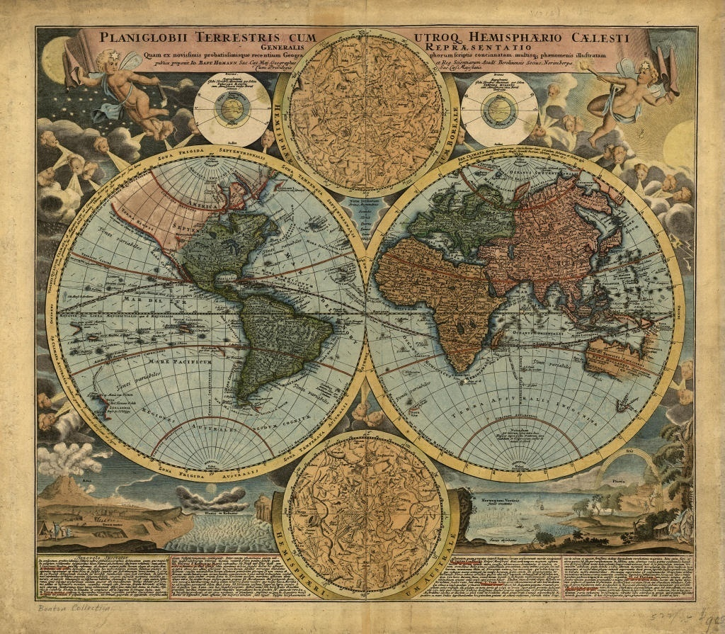
AIM: What are the important features included in a map?
Do Now: Complete the Compass Rose Worksheet

Slide 2
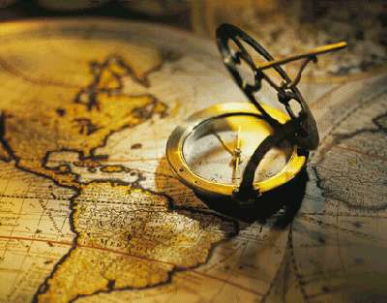

Map Skills – Part 4
Explore The World
AIM: What are the important features included in a map?
Do Now: Complete the Compass Rose Worksheet

Slide 3
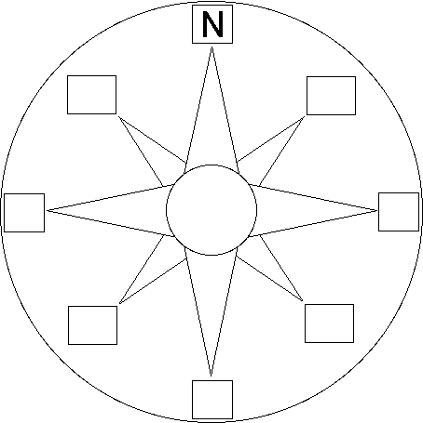
Direction Review
NW
NE
W
E
SW
SE
S

Slide 4
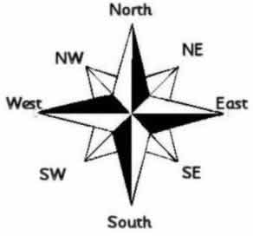
Direction
A compass is a tool that helps the user know what direction one is headed.
On a map a compass rose helps the user locate the direction of places.
Cardinal Directions: North, South, East , and West
Intermediate Directions (In between directions): Northeast, Northwest, Southeast, Southwest.
These directions help to describe the location of places in relation to other places on a map.

Slide 5
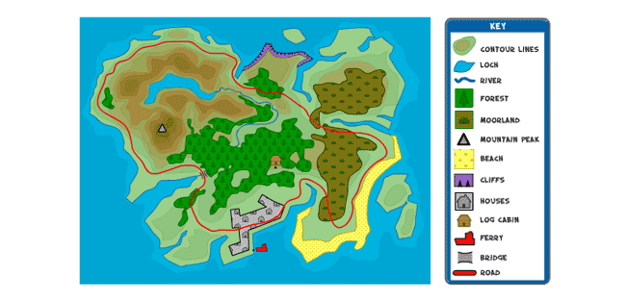
Legend/Map Key
A legend/map key helps to unlock the secrets of a map.
Objects and colors in a legend/map key represent something on a map.

Slide 6
Maps are made to scale which means that there is a direct connection between a unit of measurement on a map and the actual distance.
Scale

Slide 7
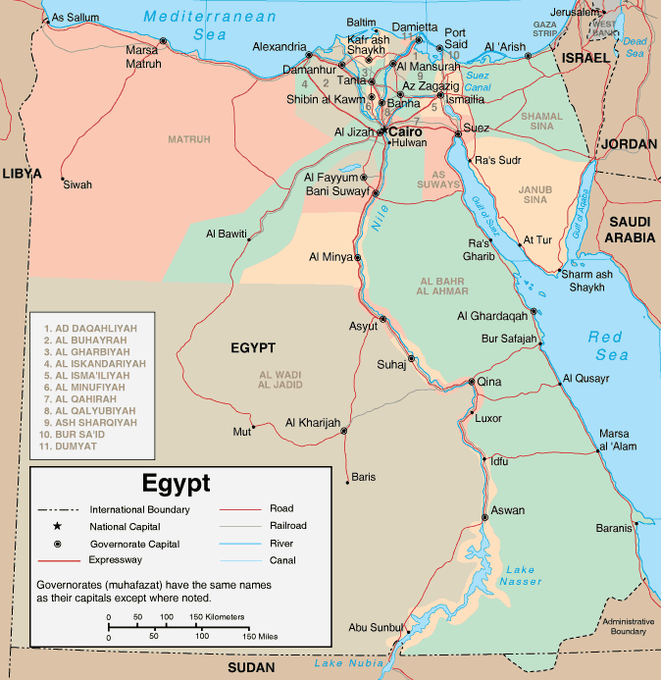
Ex: Each inch on a map represents 150 miles on this map of Egypt.
We find that information in the Legend or Map Key.
Scale changes from Map to Map

