Slide 1
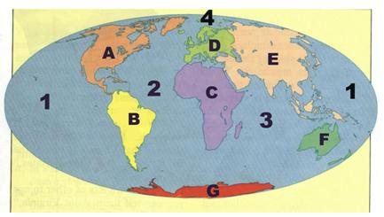
World Review
Do Now:

Slide 2
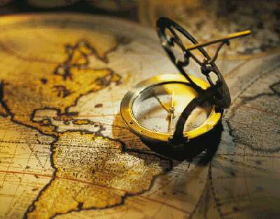
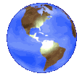
Map Skills - Part 2
Explore The World

Slide 3
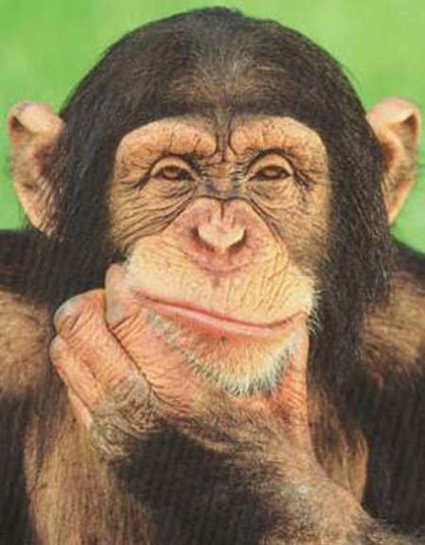

Lesson Objectives
Elements of maps:
  Latitude
  Longitude
  Hemispheres

Slide 4

How do We Measure Our Place on the Globe?
Lines
What are
Those Lines Called?
Latitude
Longitude

Slide 5
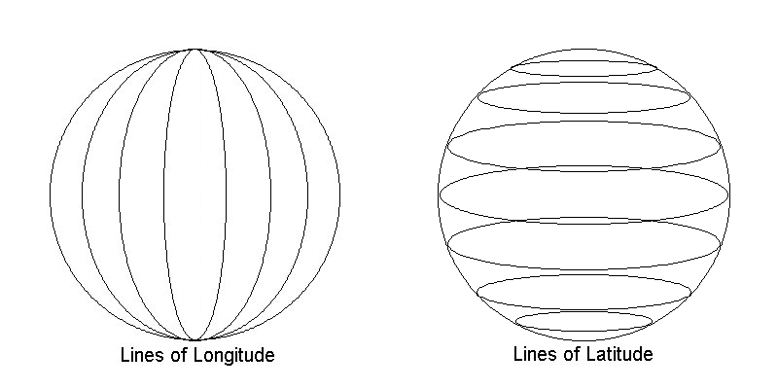
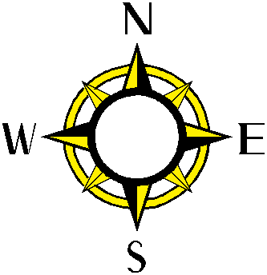
Latitude & Longitude
Latitude lines run East and West
Longitude lines run North and South
All lines are measured in units of
measurement called Degrees

Slide 6
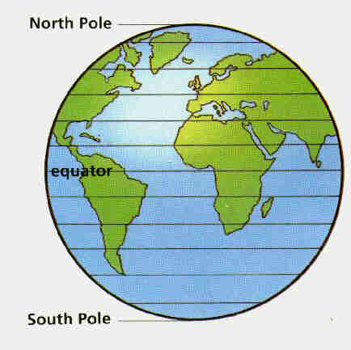
Latitude Lines/Parallels
Drawn East to West
Measured
North and South
of the Equator
N
W
E
EQUATOR
S

Slide 7
Latitude Lines/Parallels
The Equator is known as the Starting Point/Baseline for measuring Latitude.
The Equator is and imaginary line located
at Zero Degrees - 0° Latitude.
The Equator looks like a belt across the World. It is the halfway point between the North and South Poles.
N
W
E
EQUATOR
S

Slide 8
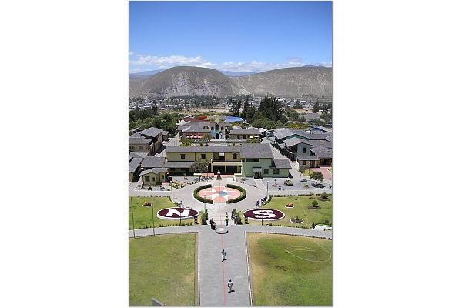
La Mitad del Mundo
(The Middle of the World)
QUITO, Ecuador

Slide 9
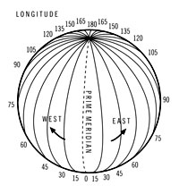
Longitude/Meridians
Drawn from North to South.
Measured from East and West of the Prime Meridian.
The Prime Meridian is the Starting Point/Baseline for measuring Longitude.

Slide 10
Longitude/Meridians
The Prime Meridian is and imaginary line located
at Zero Degrees - 0° Longitude.
It runs through the United Kingdom, France, Spain, western Africa, and Antarctica.
Longitude lines are known as the “long” lines.

Slide 11
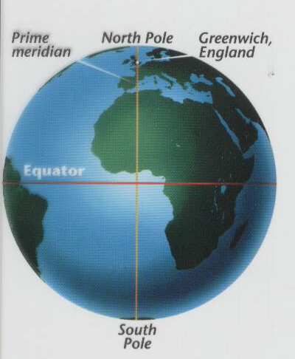
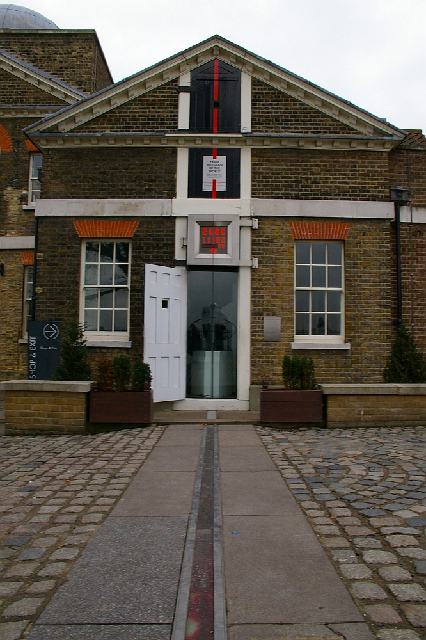

Slide 12
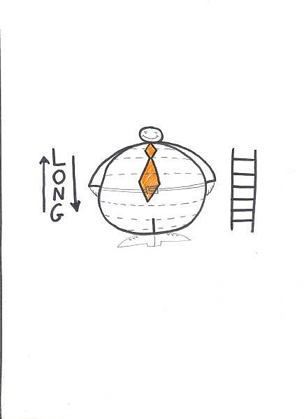
Latitude &
Longitude
Review

Slide 13
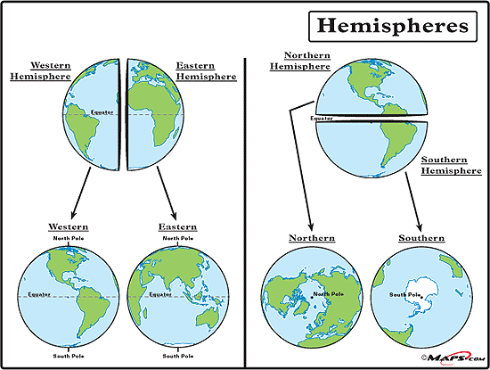
Hemispheres
Using the
Equator & the
Prime Meridian
we can cut the
Earth into
Four (4)
Hemispheres.
The Four (4) Hemispheres are:
  Northern
  Southern
  Eastern
  Western

