Slide 1
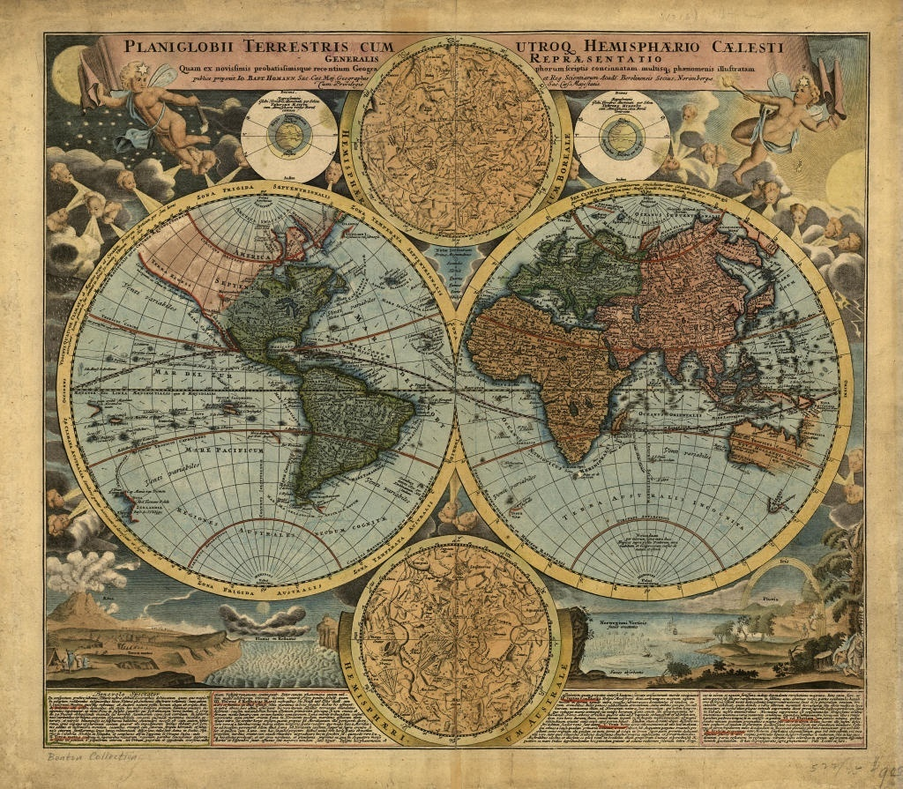
Do Now: What is Geography?
Geography is the study of the earth and the relationship between the earth and people.

Slide 2
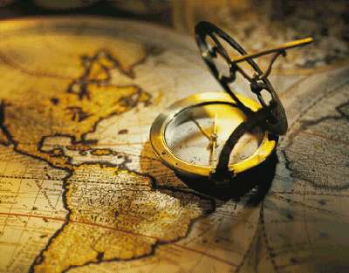

Map Skills Part 1
Explore The World

Slide 3
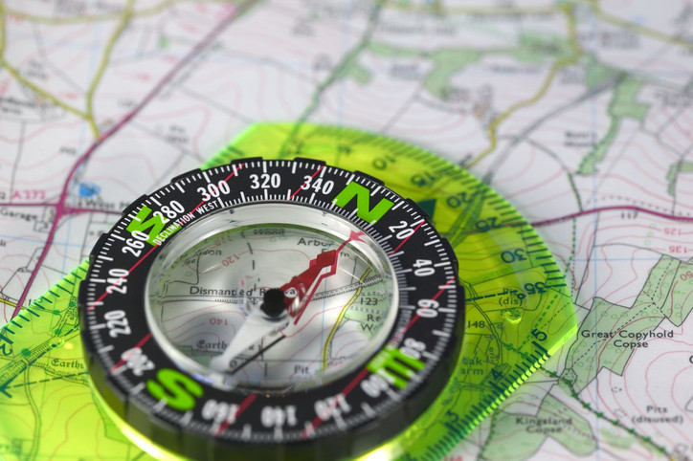
Lesson Objectives
Introduction
to Maps:
Earth-Map Relationship
Different Maps
Continents
Oceans

Slide 4
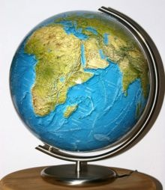
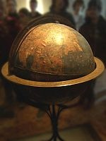
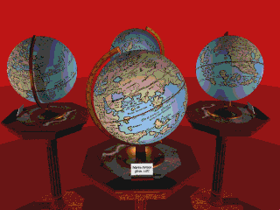
The Earth - Map Relationship
What Shape is the Earth?
Round/Sphere/Globe
What Shape is a map?
Flat/Rectangle
What happens when you try to make a map to represent a globe?
It is always Distorted in some way.

Slide 5
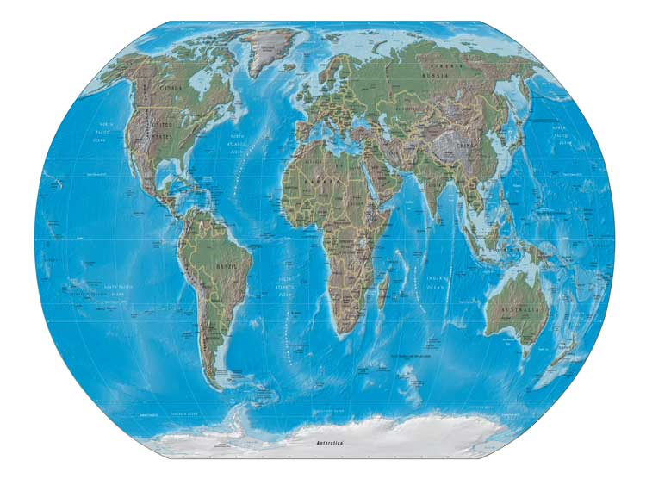
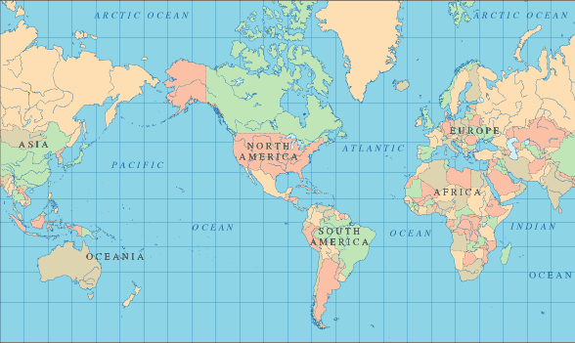
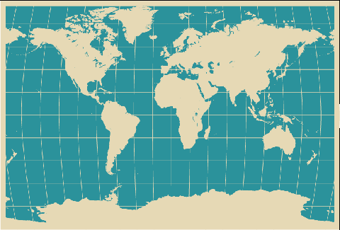
Different Kinds of Maps

Slide 6
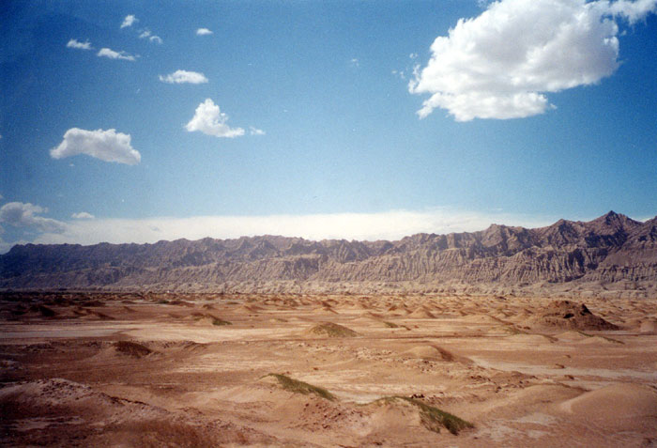

Continents
7
How Many Continents Are There? _____
Can You Name Them?
____________________ 5. __________________
____________________ 6. __________________
____________________ 7. __________________
____________________
North America
Asia
South America
Australia
Europe
Antarctica
Africa

Slide 7
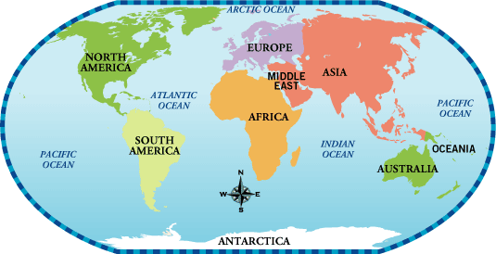

Slide 8


Oceans
4
How Many Oceans Are There? _____
Can You Name Them?
____________________
____________________
____________________
____________________
Atlantic Ocean
Pacific Ocean
Indian Ocean
Arctic Ocean
Notes:
means the "Sea of Atlas." The oldest known mention of this name is contained in The Histories of Herodotus around 450 BC.

Slide 10
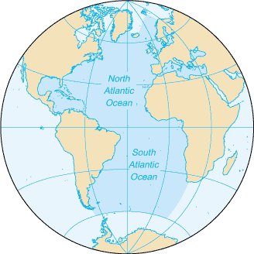
Atlantic Ocean
North America
Europe
ATLANTIC
OCEAN
South America
Africa
Antarctica
Notes:
means the "Sea of Atlas." The oldest known mention of this name is contained in The Histories of Herodotus around 450 BC.

Slide 11
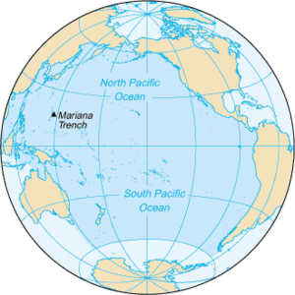
Pacific Ocean
Asia
North America
ATLANTIC
PACIFIC OCEAN
Australia
South America
Antarctica
Notes:
means the "Sea of Atlas." The oldest known mention of this name is contained in The Histories of Herodotus around 450 BC.

Slide 12
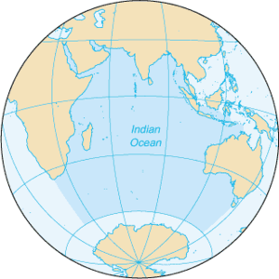
Indian Ocean
Asia
Africa
INDIAN OCEAN
Australia
Antarctica
Notes:
means the "Sea of Atlas." The oldest known mention of this name is contained in The Histories of Herodotus around 450 BC.

Slide 13
Arctic Ocean
North America
ARCTIC OCEAN
Europe
South America
Africa
Antarctica
Notes:
means the "Sea of Atlas." The oldest known mention of this name is contained in The Histories of Herodotus around 450 BC.

Slide 14
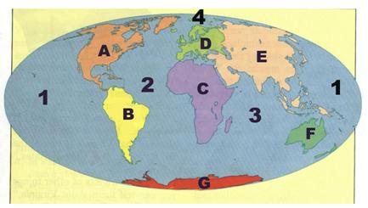
World Review
Do Now:

