Slide 1
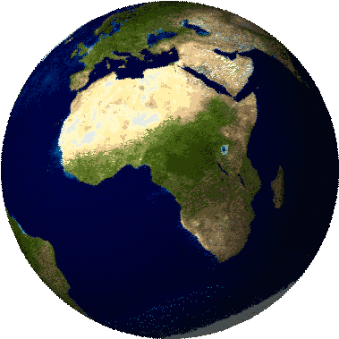
The Five Themes of Geography

Slide 2
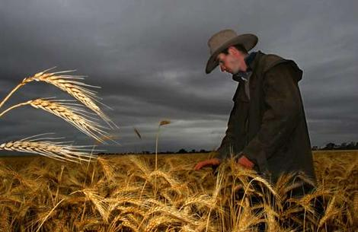
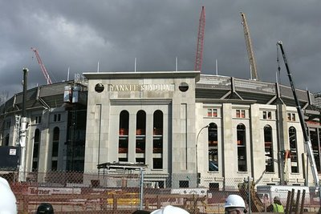
What is Geography?
The study of the relationship between the people and the earth.

Slide 3

The Five (5) Themes of Geography
Location
Place
Human-Environment
Interactions
Movement
Regions

Slide 4
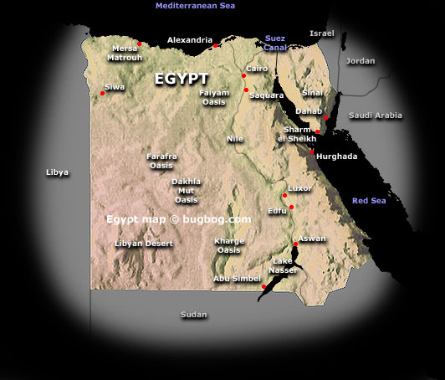
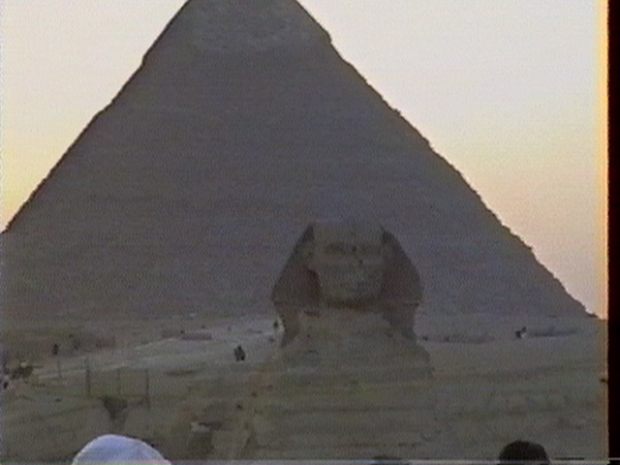
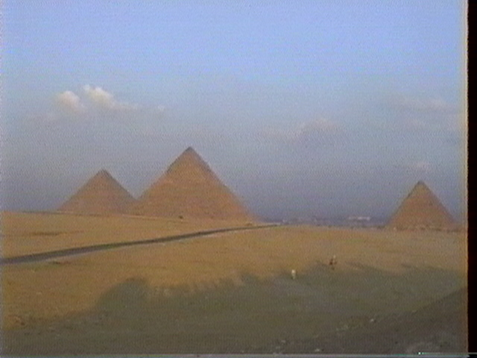
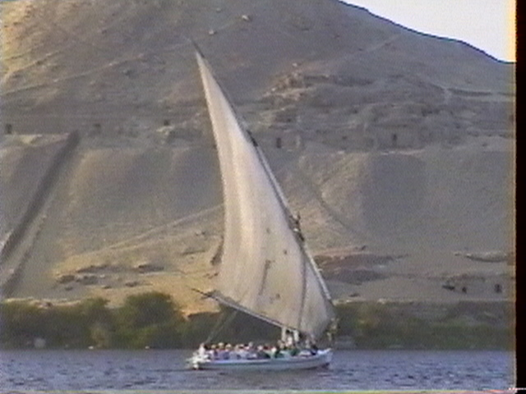
Location
Where am I?
Where was I
in relation to
someone
in Centereach?

Slide 5
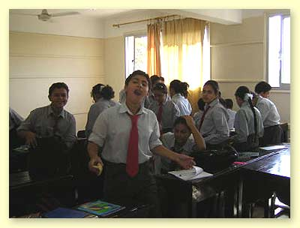
Place
What makes school at Dawnwood Middle School different than School in Egypt?

Slide 6
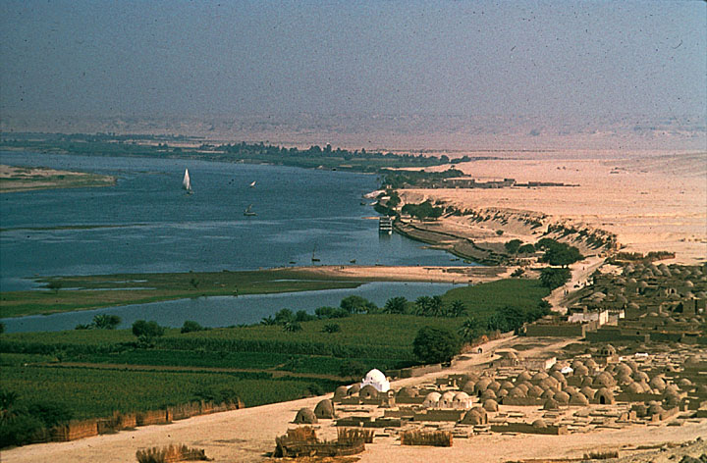
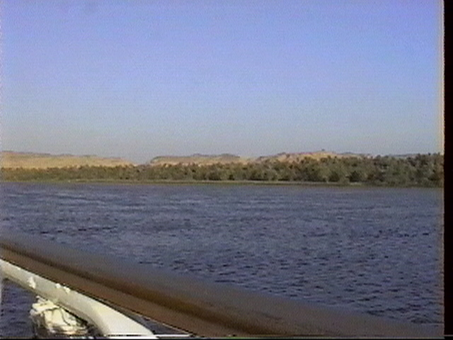
Human-Environment Interactions
How do People interact to their environment?
  Depended on It?
  Modify It?
  Adapt to It?
The Nile River - Egypt
Notes:
Hail to thee, O Nile! Who manifests thyself over this land,
and come to give life to Egypt!
Mysterious is thy issuing forth from the darkness.
Watering the orchards, to cause all the cattle to live,
You give the earth to drink, inexhaustible one!
Lord of the fish, during the inundation,
You create the grain, you bring forth the barley,
Assuring perpetuity to all life.
If you cease your toil and your work,
Then all that exists is in anguish.
If the gods suffer in heaven, then the faces of men waste away.
Then He torments the flocks of Egypt,
And great and small are in agony.
But all is changed for mankind when He comes.
He stanches the water from the eyes,
and watches over the increase of His good things.
Where misery existed, joy now manifests itself.
You are the august ornament of the earth,
Lifting up the heart of women in labor,
And loving the multitude of the flocks.
O inundation of the Nile, offerings are made unto you,
Men are immolated to you, great festivals are instituted for you.
Come and prosper! O Nile, come and prosper!
O you who make men to live through his flocks
And his flocks through his orchards!
Come and prosper, come, O Nile, come and prosper!

Slide 7
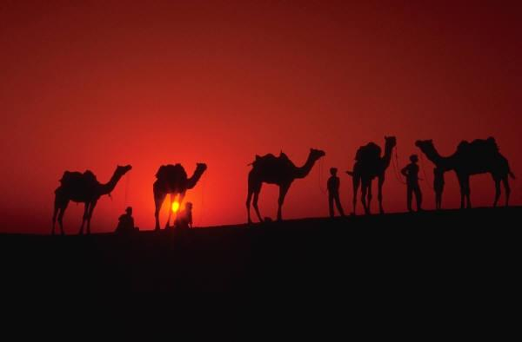
Movement
How do people move from one place to another?
  Today?
  In Ancient Times?
  In Prehistoric Times?
How do goods/ideas travel from one place to another?

Slide 8
region
Why do we call the
United States the
United States?
Formal
By Government or Administration
Why do we call it this school: Dawnwood Middle School?
Purpose
For a Specific Need
What do we call the area in the middle between Europe, Africa, and the Orient (The East)?
People’s
View
Make it easier to Explain

Slide 9
Review: The Five (5) Themes of Geography
Location
Place
Human-Environment
Interactions
Movement
Regions

