Slide 1
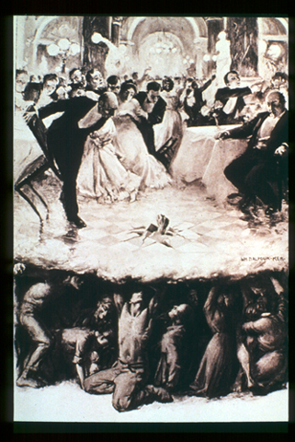
The Russian Revolution Peace, Land, & Bread

Slide 2
The Players

Slide 3
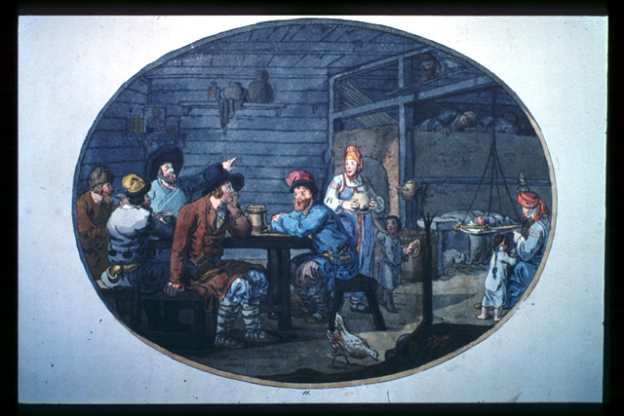
The Peasants

Slide 4
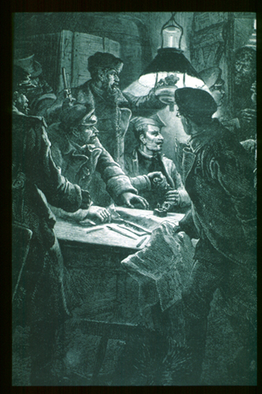
The Intelligentsia The Intellectuals

Slide 5
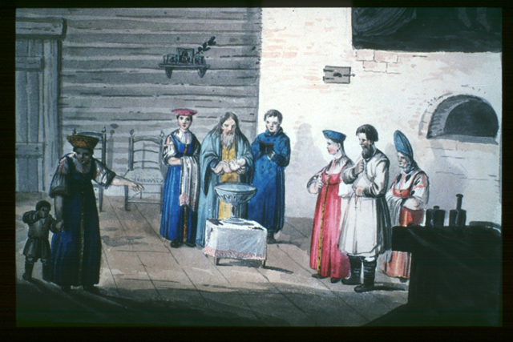
The Clergy

Slide 6
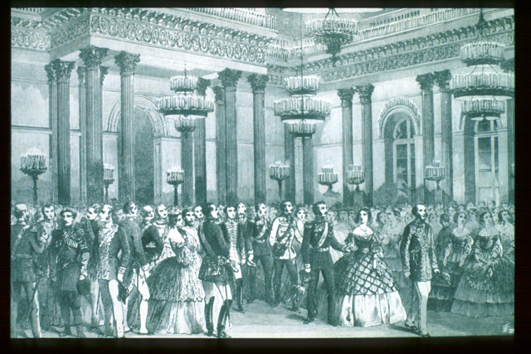
The Nobility

Slide 7
The saga

Slide 8
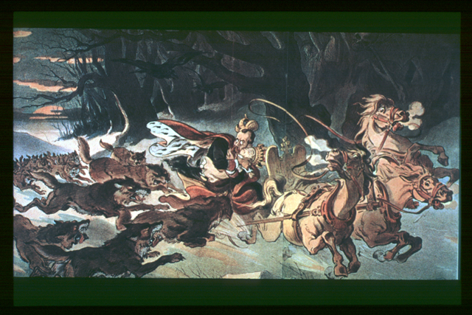
The Reign of Czar Nicholas II

Slide 9
Czar Nicholas II
Oblivious to & isolated from nation’s problems and needs; avoided diplomatic duties & political involvement; believed in power of tradition and authority--> “autocracy, orthodoxy, & nationality”
Instituted a program of fear to control opposition: created a vast network of spies, censored the press, outlawed all languages but Russian, persecuted ethnic minorities, & executed a wave of pogroms--organized violence against Jews
Result: a nation of instability & discontent
Liberals (intellectuals) wanted democracy, a constitution, & rights
Ethnic minorities wanted autonomy (independence)
Peasants wanted land reform
Workers wanted better working conditions
Humiliating loss to Japan in Russo-Japanese war; exposed government’s incompetence

Slide 10
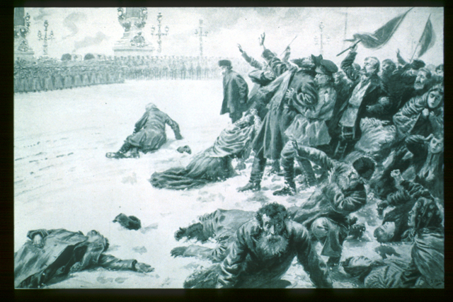
Bloody Sunday

Slide 11
Revolution of 1905
Bloody Sunday. One Sunday in January, 1905, unarmed workers peacefully marched toward the czar’s Winter Palace with a petition for a constitution, the right to form unions, and better working conditions; czar not home, guards got nervous and opened fire, killing 500-1000 marchers, hence “Bloody Sunday.”
Revolution of 1905. Bloody Sunday sparked a series of violent & destructive riots & revolts collectively called Revolution of 1905. Workers struck, soldiers mutinied, and peasants burned & looted nobles’ homes. Stopped normal daily life and czar had to hide in a rural estate.
Soviets. Intelligentsia (radical, well-educated middle class) organized workers, peasants, & soldiers into soviets (councils.) These gained popularity and created a threat to Czar’s power
Short-lived Changes. Nicholas II conceded to make changes & did 2 things:
Granted freedom of conscience, speech, assembly, & press; in reality, spy network effectively nullified these freedoms
Formed Russia’s first legislature, the Duma, which would approve all laws. The Duma was a group of moderates who wanted a constitutional monarchy. Czar retained power via control of military & secret police and dissolved four Dumas.

Slide 12
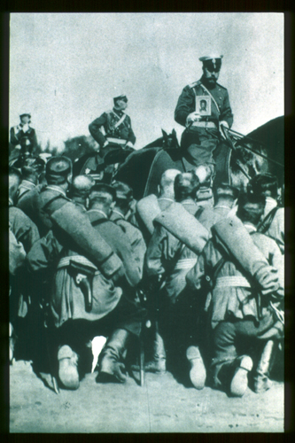
World War I

Slide 13
Role of WWI in Revolution
Entry into WWI. Russia enters WWI for a variety of reasons & enjoys early success because of large army; eventually suffers devastating losses due to lack of ammunition, training, & technology
Rasputin. Czar spends time at the front; wife Czarina runs country & allows Rasputin, an illiterate but “miraculous” monk (and playboy) to make policy decisions & give positions to friends--exposes more corruption in government
Discontent. Peasants & workers unhappy with lack of food & goods, soldiers with lack of weapons & supplies. Russia averaging 30,000 deaths per month in war. Soldiers deserting front & nobles going berserk with lack of leadership.

Slide 14
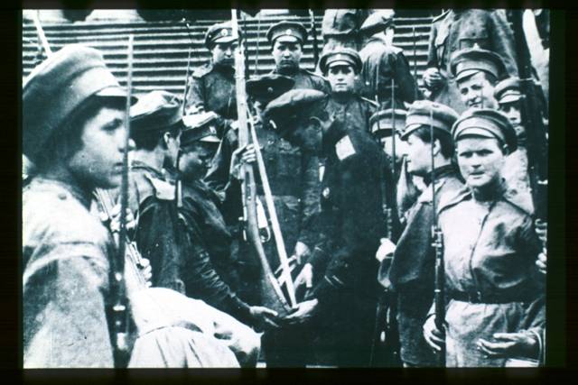
February Revolution

Slide 15
March Revolution 1917
The Women’s March. On International Women’s Day in 1917, women took to the street to demand “peace and bread.” Revolt joined by soldiers & palace guards; grew over several days & eventually Duma joined in protest demanding, “down with monarchy” & “bread for all”
Petrograd Soviet. Soviet in Petrograd, the capital, gains power as leading force of revolution; the Duma knew that the Petrograd Soviet was seat of power
Czar Abdicates Throne. While at the front, Czar is oblivious to troubles back home. When trying to return home by train, railroads are seized by Petrograd Soviet & czar willing to compromise with a constitutional monarchy--too little, too late. Nicholas II abdicates throne from railroad car & Romanov dynasty ends.
Provisional Government. Duma establishes a temporary government, the Provisional Government, headed by Alexander Kerensky, leader of P.Soviet. Loses power when he decides to keep Russia in war despite losses & protests against war.

Slide 16
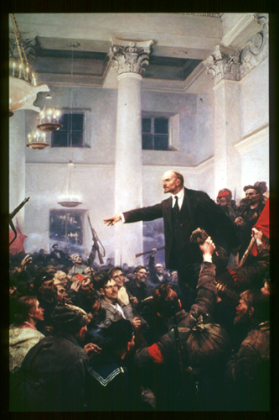
Lenin & the Bolshevik Revolution

Slide 17
The Bolshevik Revolution
Lenin. Radical Marxist who led Bolsheviks, radical revolutionaries, to power but exiled to central Europe for 19 years. Came back to Russia as Germany’s “secret weapon” during WWI to cause chaos & force Russia into surrender. Opposed to Mensheviks who were more moderate & wanted to open membership to anyone.
Peace, Land, Bread. Lenin & Bolsheviks were opposed to WWI & when he returned to Russia, immediately demanded “peace, land, & bread” for peasants, workers, & soldiers. Bolstered support for soviets but alienated moderate Marxists.
The Red Guard. To defeat the Provisional Government & establish a Marxist state, Lenin put Trotsky, a former Menshevik, in charge of Bolshevik militia known as The Red Guard. Red Guard stormed Winter Palace & arrested Kerensky & other government leaders. Bolsheviks assume power & revolution over in hours
Sweeping Changes. Within days, Lenin made 2 major changes:
Nationalized all land (re-distributed to peasants) & factories (control to workers)
Signed Treaty of Brest-Litovsk, ending Russia’s involvement in war
Civil War. Russians opposed to radical policies of Bolsheviks formed opposition known as the White Army. To defeat White Army, Lenin instituted “war communism” & the Cheka, arresting & killing all enemies of the revolution. 15 million die in war.

Slide 18
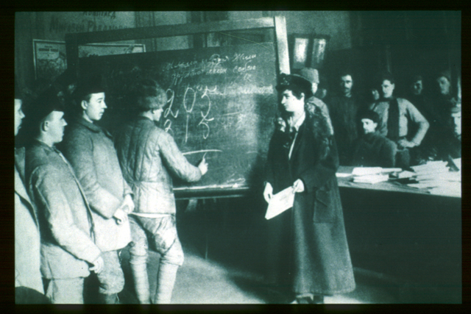
Lenin & The Soviet Union

Slide 19
From Russia to the USSR
Big Dreams. Lenin hoped to transform Russia from a backward, feudal society to a modern, industrialized nation. Also wanted it Marxist--free of poverty, unemployment, homelessness, illiteracy, & class divisions
Tough Reality. Faced huge obstacles in making dream reality: lost 1/2 population to WWI & Civil War; wages dropped to 1/10 previous levels, inflation at 1000%; foreign blockade of goods; cities became ghost towns.
Economic Changes: New Economic Policy. Lenin’s answer was to “take one step back to go to two steps forward”: small-scale capitalism. Later, under Stalin, full-scale communism got under way.
Political Changes: Communist Party & USSR. Instituted equality between men and women, abolished titles & rank; gave right to vote to all citizens; stripped church of its power. To create classless society, CP built schools & medical facilities for all--career opportunities for men and women. Re-structured country politically--created a union of self-governing republics known as the Union of Soviet Socialist Republics.

