Slide 1

Syllabus Day 2016
Welcome to Constitutional Law
Upon the subject of education, not presuming to dictate any plan or system respecting it, I can only say that I view it as the most important subject which we as a people can be engaged in.—-Abraham Lincoln (1832).

Slide 2

Course Description:
The Constitutional Law course will improve student connections to people, places, and events Globally and in United States history from Ancient Greece to Ancient Rome, to the Fall of Rome and development of Monarchy to limited government defined in the Magna Carta in the Middle Ages, the emergence of free-thinking in the Enlightenment, the emergence of constitutionalism on British government, the effects of the Enlightenment on pre-colonial government in the British Thirteen Colonies, to the Revolutionary War and the Declaration of Independence, to early American government and finally to US Constitutionalism and the cases in the Supreme Court, and finally controversial topics relating to civil rights. We will be exploring each of these time periods and events using various mediums including print, photographs, video, and on-line learning. Students are engaged to read and understand historical content and concepts as a historian and to develop critical historical thinking skills aligned with the common-core and the Stanford Reading Like a Historian project. This course will terminate in the US History & Government NYS Regents exam for a higher score.

Slide 3

Academic Expectations (including learning habits and skills):
• Students will explore, analyze, synthesize, and evaluate, various points-of-view to historic content using primary and secondary sources.
• Students will supplement the writing process for Thematic and DBQ essays with content specific vocabulary, details, analysis, and point-of-view.
• Students will use periodization of events to make connections to historical events, places, and people.
• Students will acquire vocabulary in-context relating to Global History & Geography and construct well- organized essays.
• Students will apply and evaluate the four (4) categories of historical thinking using PEGS (political, economic, social, and geography) within multiple choice, essay, and DBQ assessments.
• Students will develop and apply critical thinking to historic events, people, and places.
• Students will complete all assignments listed as well as all classwork, quizzes, and exams.

Slide 4

Behavioral Expectations (including classroom norms and routines):
• Students will come to class prepared with pen, notebook, homework, worksheets, and course materials daily.
• Students will speak in-turn and create an atmosphere of calm debate.
• Students will be respectful to their classmates’ point-of-view.
• Students will have a do-now to complete as soon as they enter the classroom, so be ready to work when you walk in.
• Students will respect all Park East HS and NYCDOE rules & regulations while in the classroom.
• Students will be placed in collaborative groups and sometimes have choices as to group members in the groups they are participating in, and sometimes will not. This will insure students learn to work collaboratively will many different levels and types of learners they will face in college and in the workplace.

Slide 5


Course Materials/Required Texts
Mr. Ott’s Classroom Wiki
(www.mysocialstudiesteacher.com/wiki)
JupiterEd /Jupiter Grades
Selected Primary & Secondary Sources
Course Requirements/Grading Policy:
Classwork – 30%
Homework – 20%
Quizzes – 25%
Tests /Projects - 25%
Course Calendar and Marking Period Assignments are located on the Classroom Wiki @ www.mysocialstudiesteacher.com/wiki/ and JupiterEd/Jupiter Grades.

Slide 6
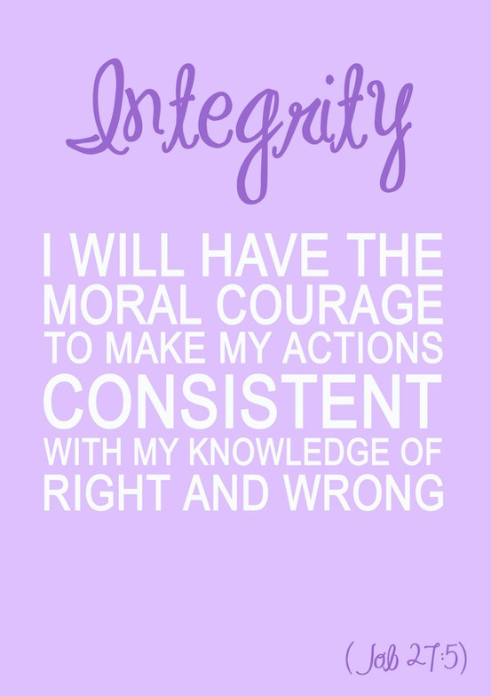
Academic Integrity Statement
All students are expected to act with civility, personal integrity, respect other students’ dignity, rights and property; and help create and maintain an environment in which all can succeed through the fruits of their own efforts. An environment of academic integrity is requisite to respect for self and others and a civil community.
Academic integrity includes a commitment to not engage in or tolerate acts of falsification, misrepresentation or deception. Such acts of dishonesty include cheating or copying, plagiarizing, submitting another persons’ work as one’s own, using Internet sources without citation, taking or having another student take your exam, tampering with the work of another student, facilitating other students’ acts of academic dishonesty, etc.

Slide 7
Good Luck All Year!

