Slide 1
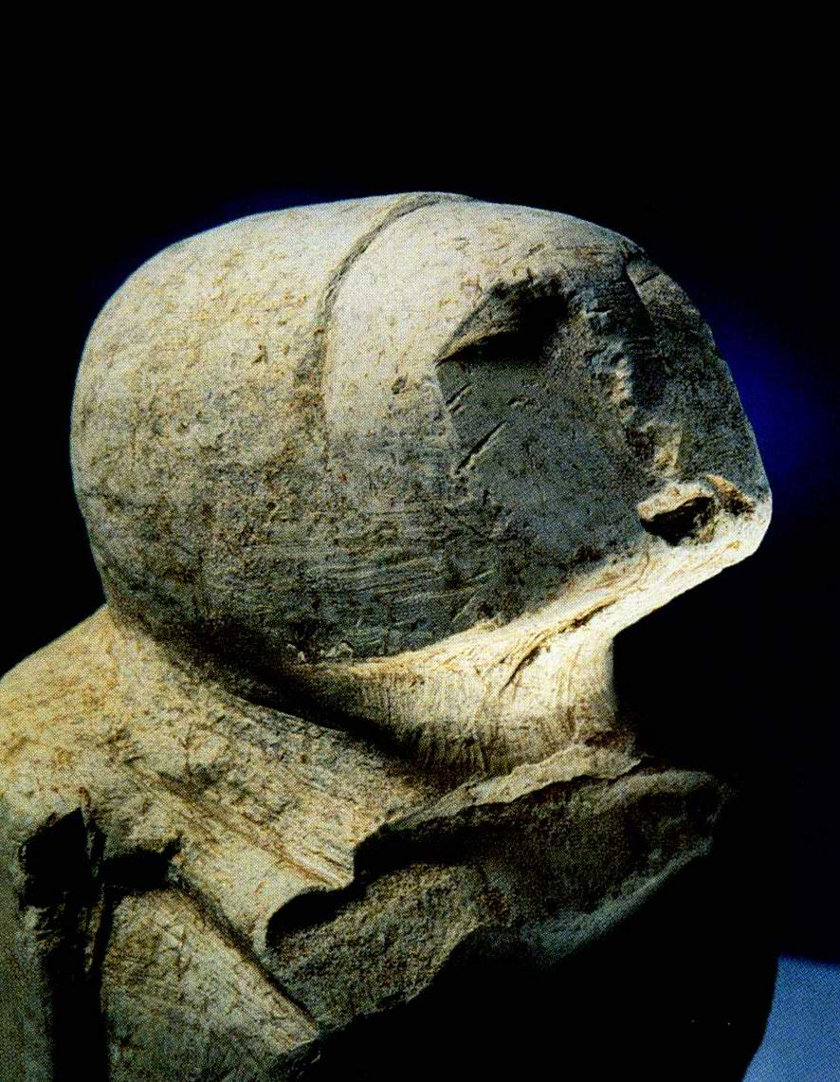
AIM: What are the characteristics of the Paleolithic and Neolithic?
Do Now: Neolithic Revolution Worksheet
Answer Both Questions

Slide 2
The New
Stone Age
Neolithic

Slide 3
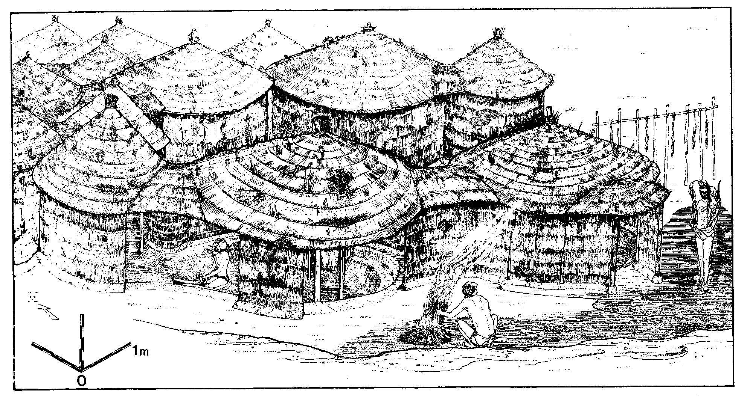
People starting living in small villages.
What do you think caused this change from moving from place to place?

Slide 4
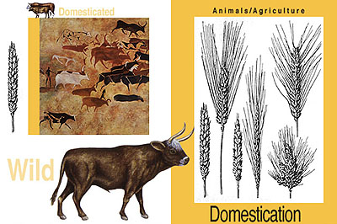
Domestication
To train something to be useful to people.
= Agriculture

Slide 5
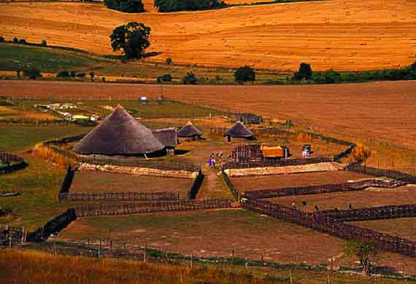
Agriculture
= Farming

Slide 6
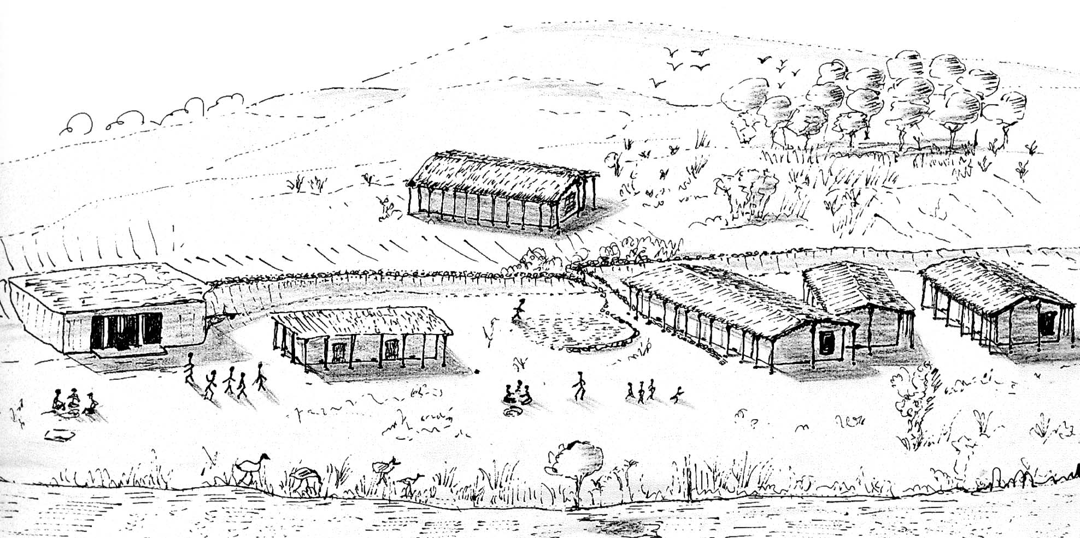

Slide 7
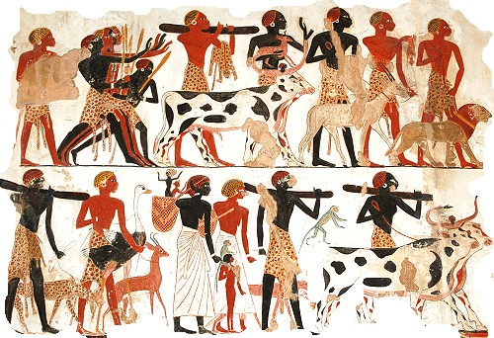
Too much farming
Too many crops
= Surplus
Surplus is an extra
supply of something.

Slide 8

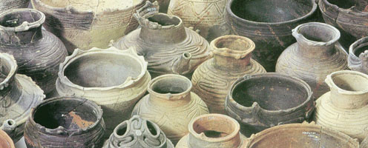
specialization
Some People:
Farmed
Ground Wheat
Made into Flour
Made Tools
Made Mud Bricks
Made Pottery (Pots)
Different people started producing/making different things and had different jobs.

Slide 9
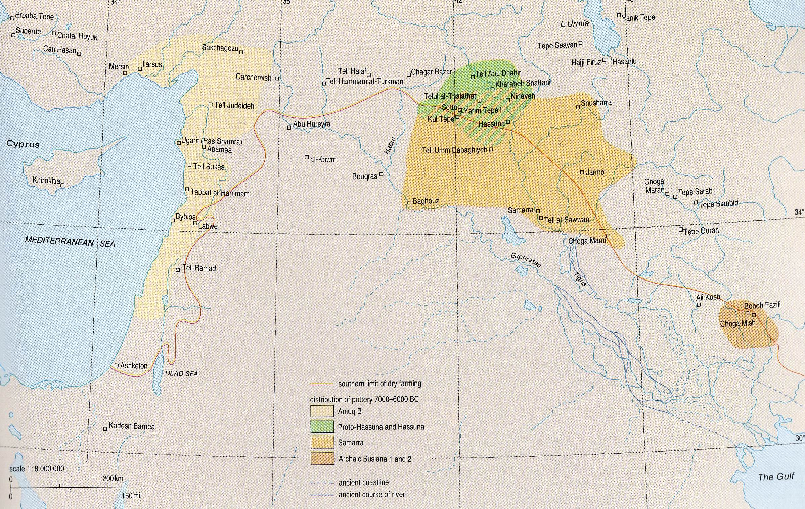
Pottery makes it possible to define cultural areas than is possible with stone tools alone.

Slide 10
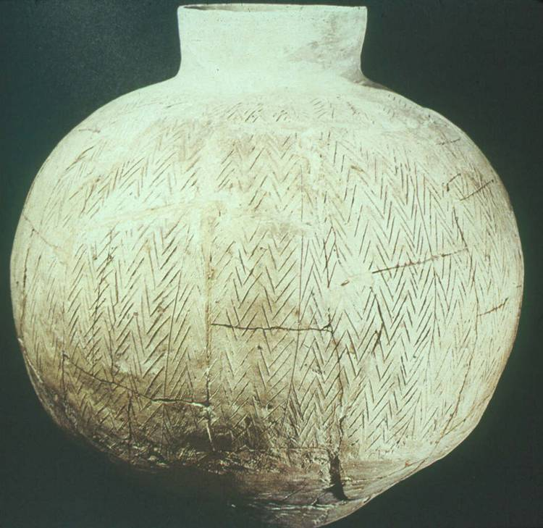
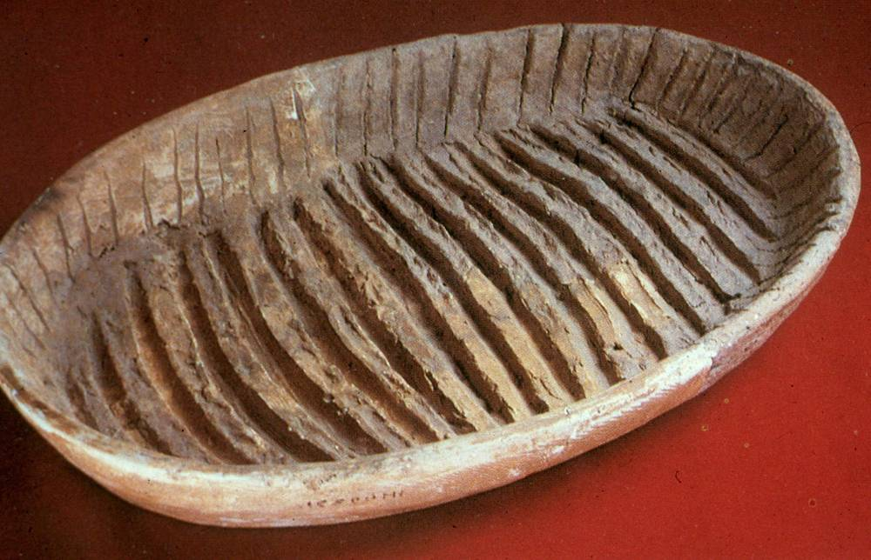
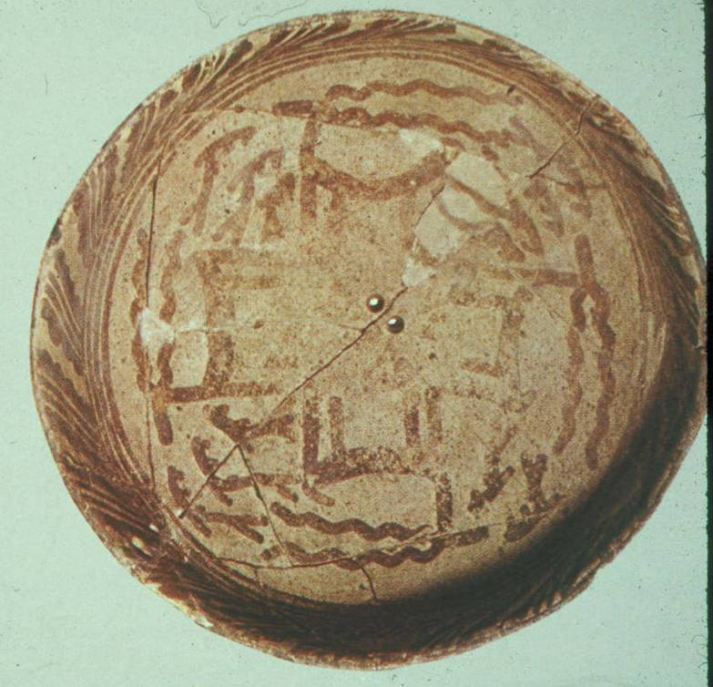
Hassuna (above)
Samarra (right)

Slide 11
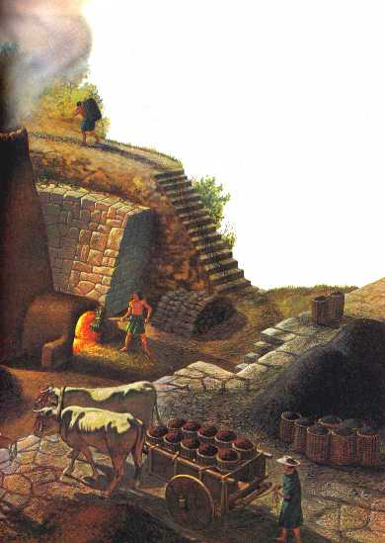
Too much surplus
Of at least 1 thing –
& A want FOR
something else
= Trade
Trade is an exchange of goods.

Slide 12
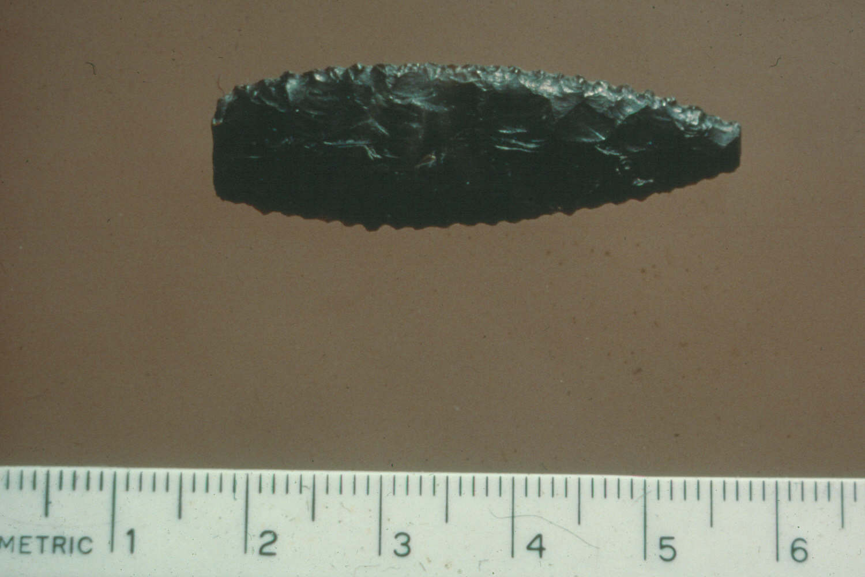
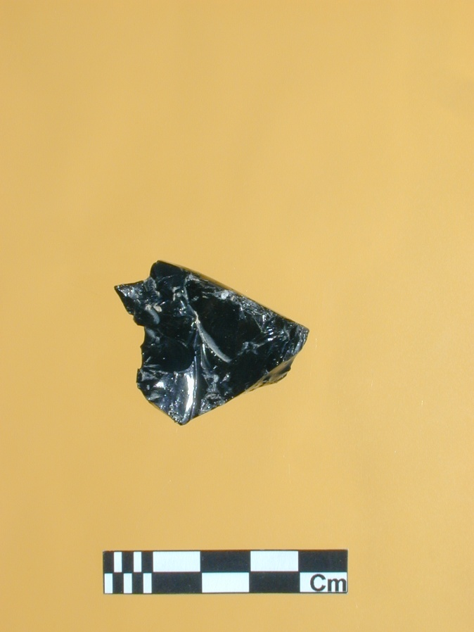
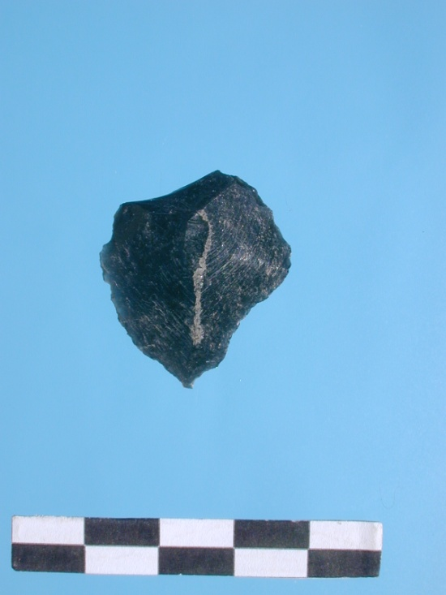
Long-distance “trade” in the Neolithic is seen in the distribution of obsidian (volcanic glass)

Slide 13
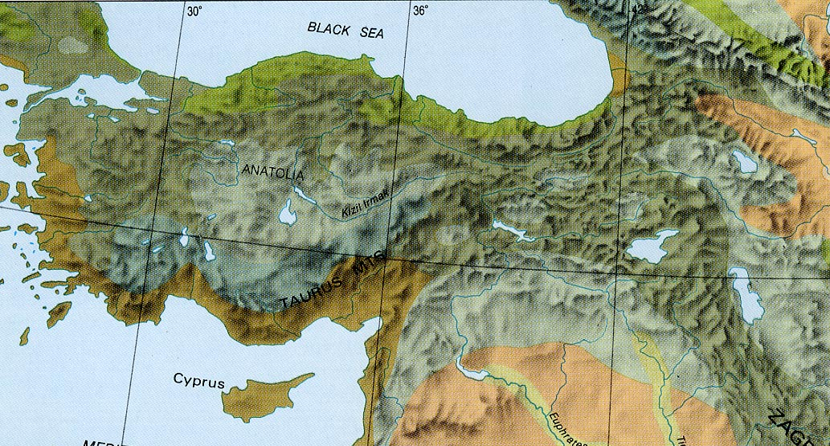
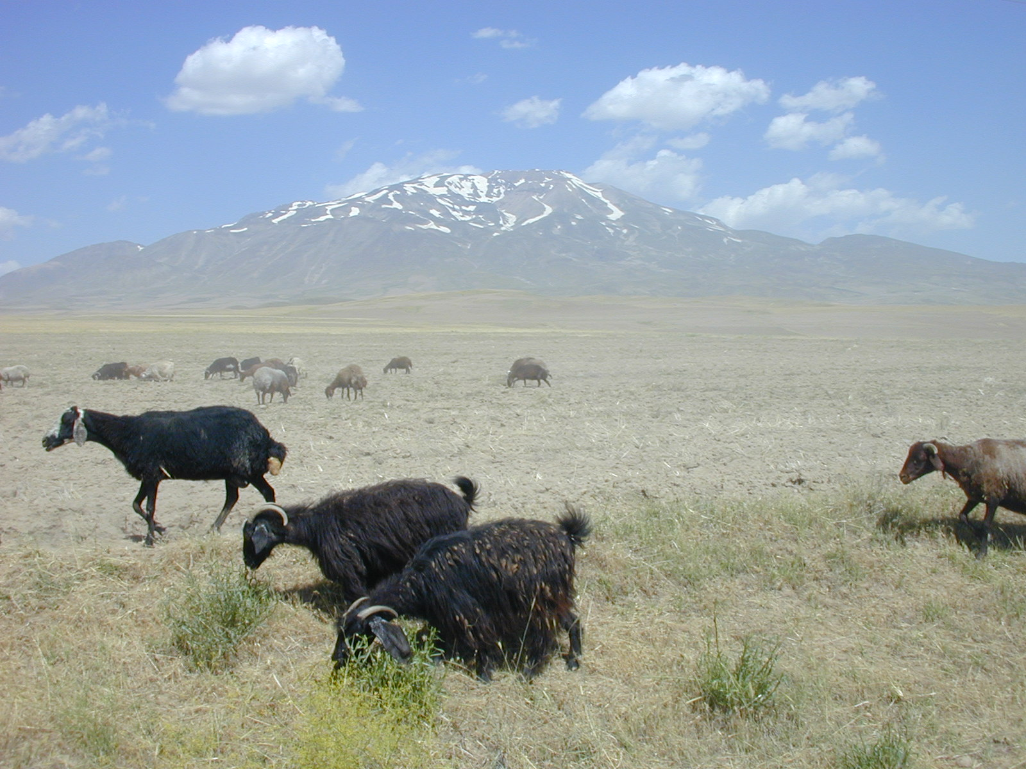
Obsidian is produced by volcanoes, and the only volcanoes in the Near East are in Turkey
Süphan Dağ

Slide 14
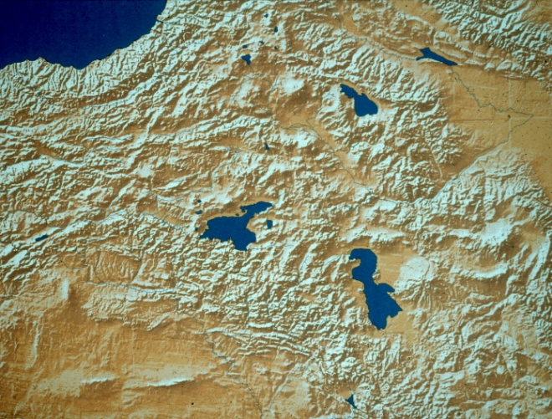
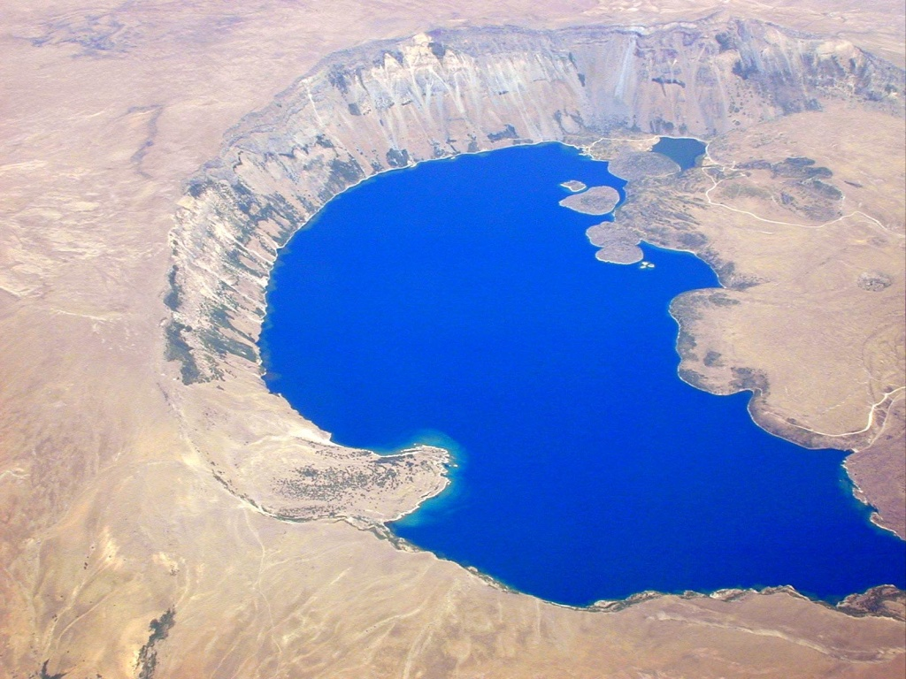
Each volcano produces its own chemical type of obsidian, which can be identified
Nemrut Dağ

Slide 15
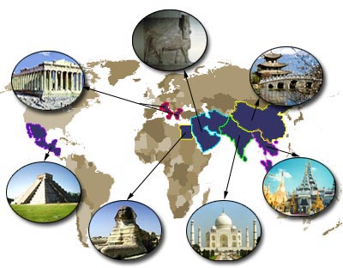
How Civilizations are Formed
Civilization
Trade
Specialization
Surplus
Agriculture (Farming)
Domestication

Slide 16
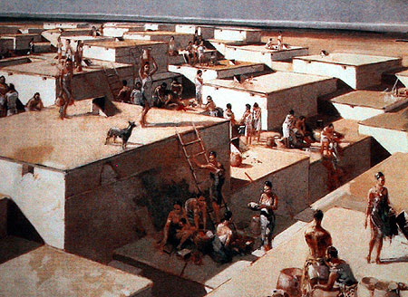
Çatal Höyük
One of World’s First Farming Communities

Slide 17
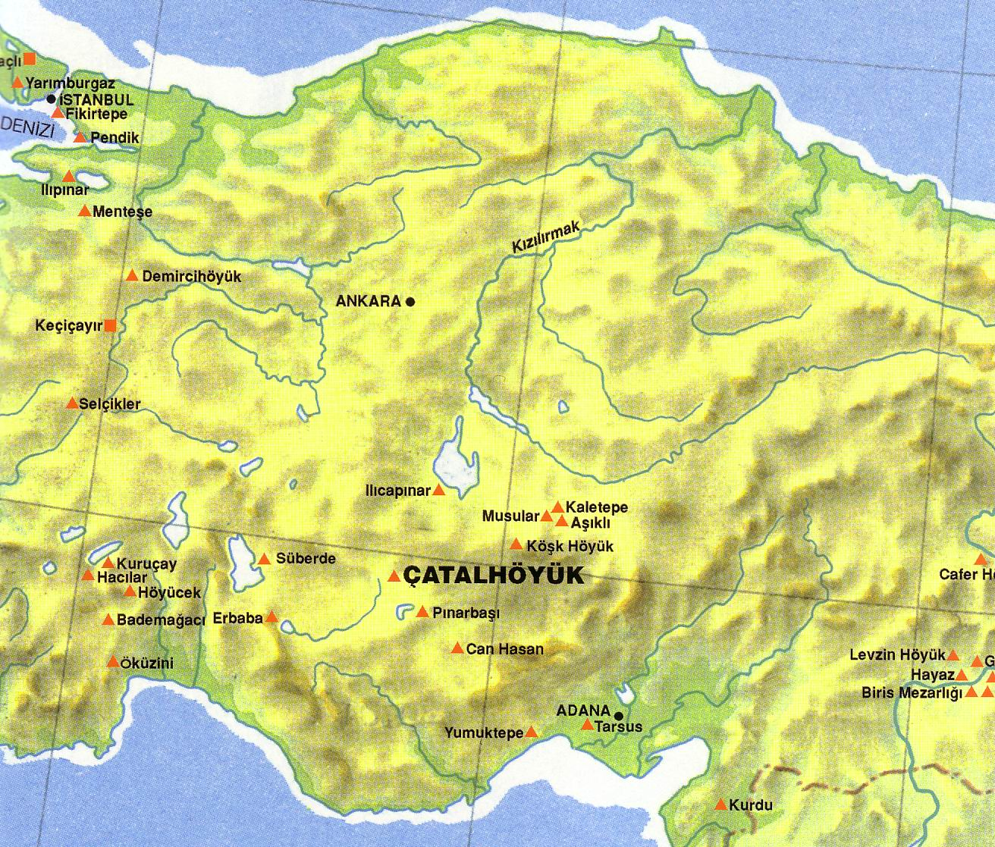

Slide 18
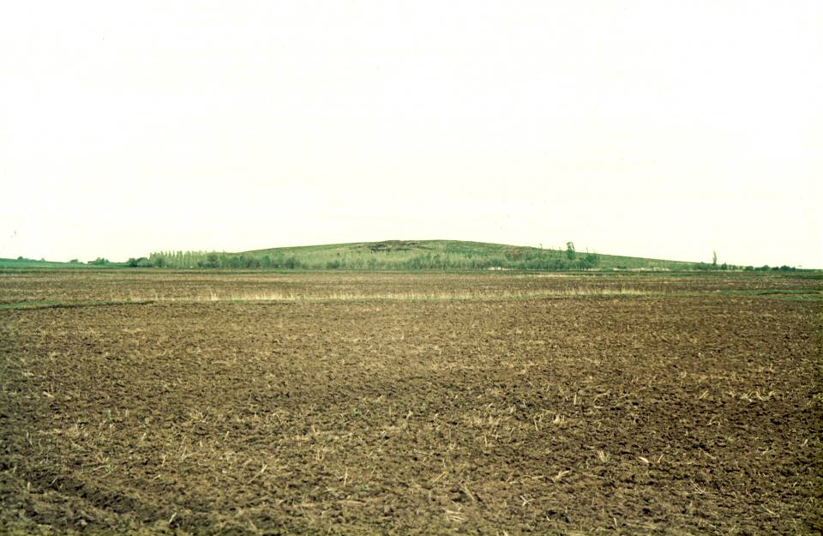

Slide 19
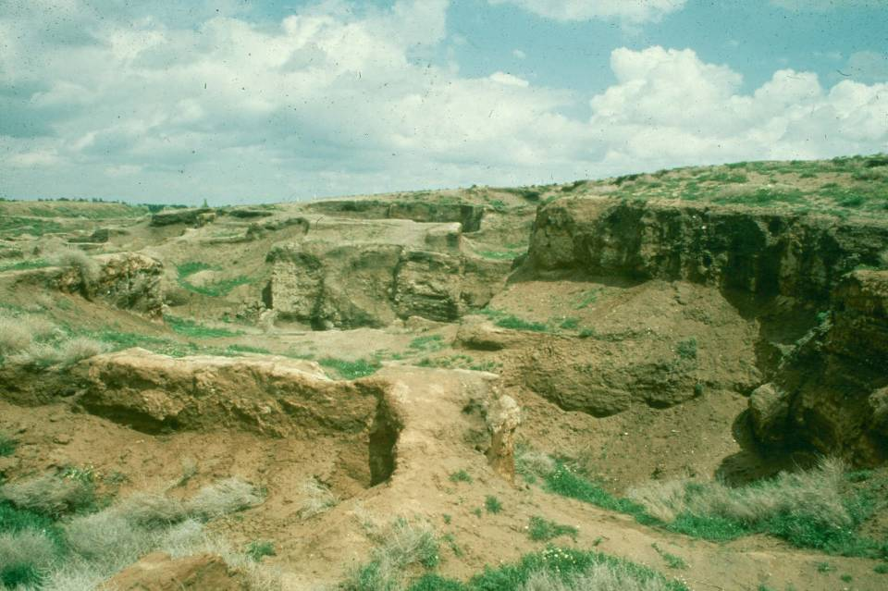

Slide 20
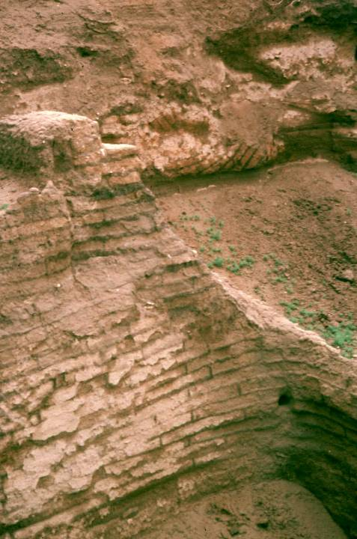

Slide 21
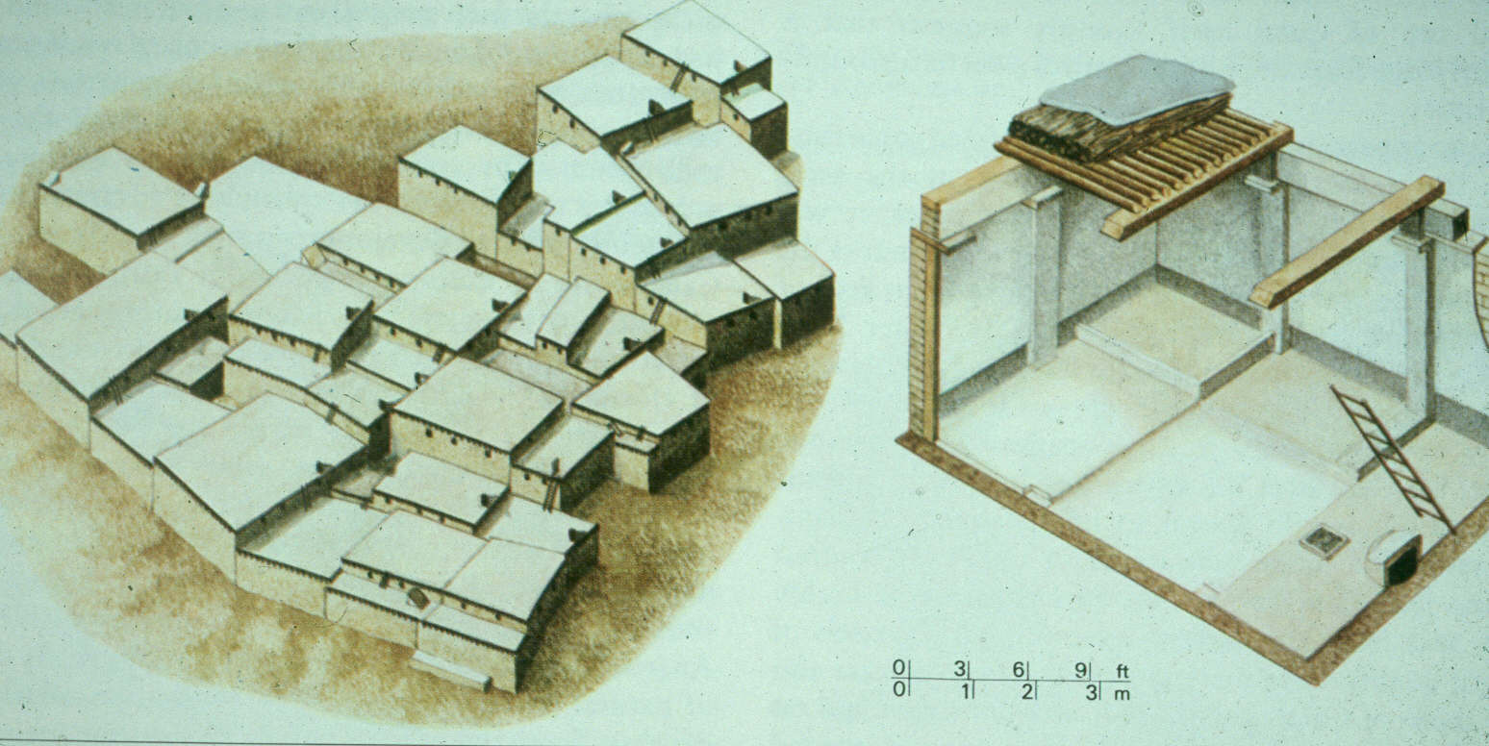
Çatal Höyük was occupied for roughly a millennium (1000 Years) 6500-5500 BCE, and pottery is found in most of its levels.

Slide 22
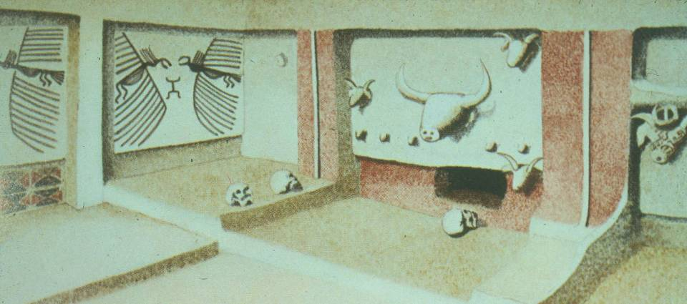

Slide 23
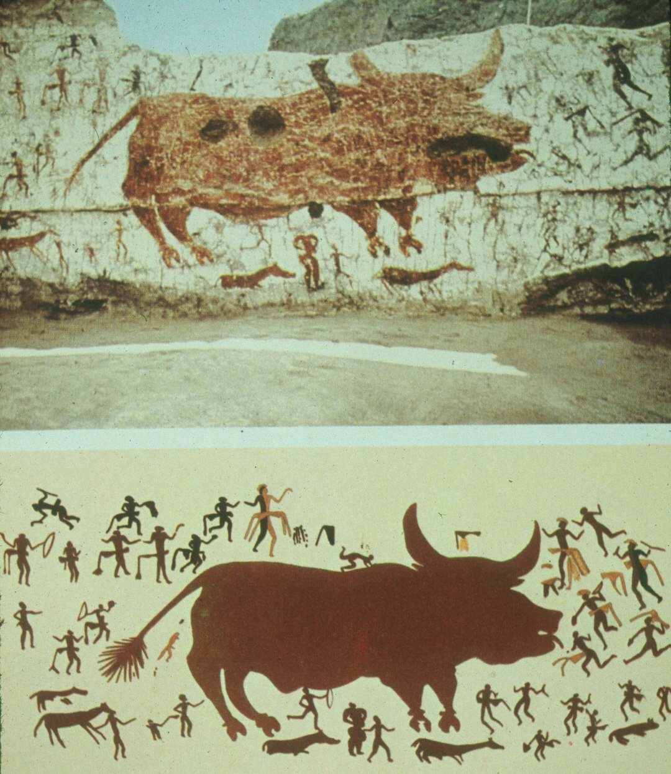
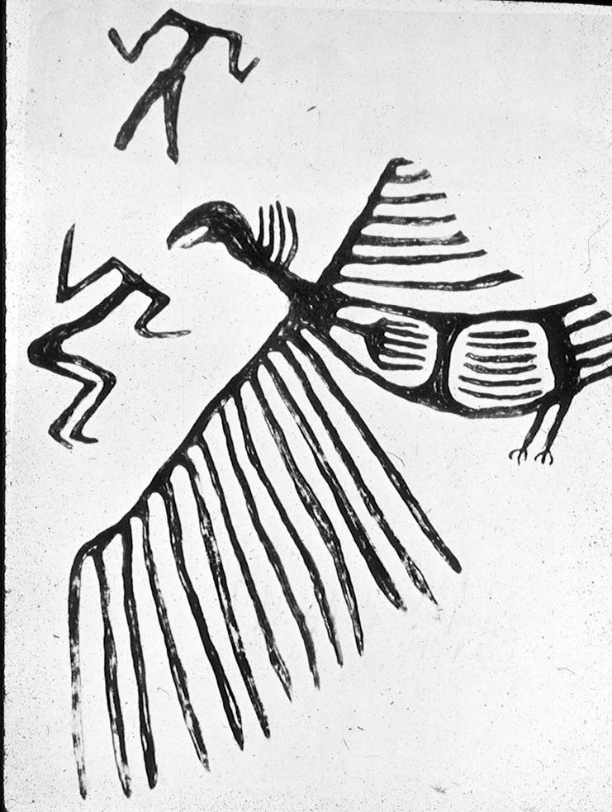
Some of its houses are elaborately decorated with wall paintings

Slide 24
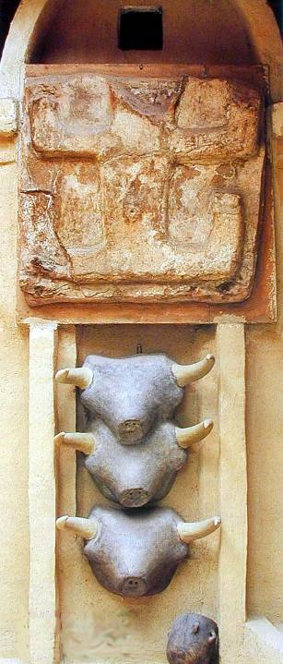

Slide 25
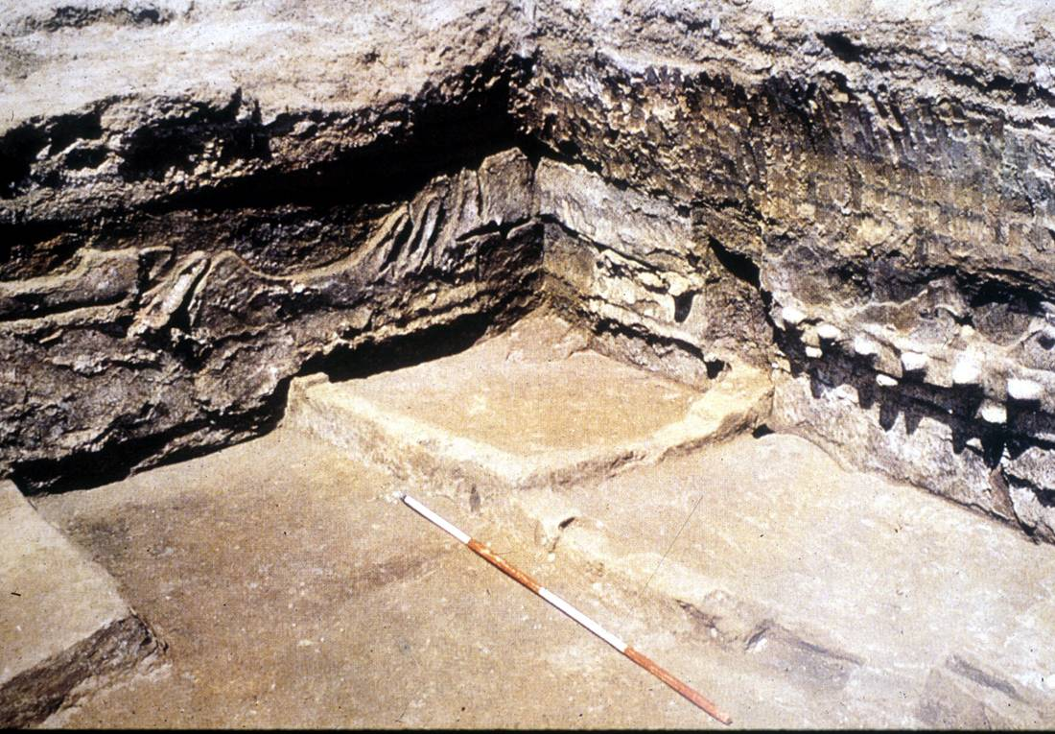
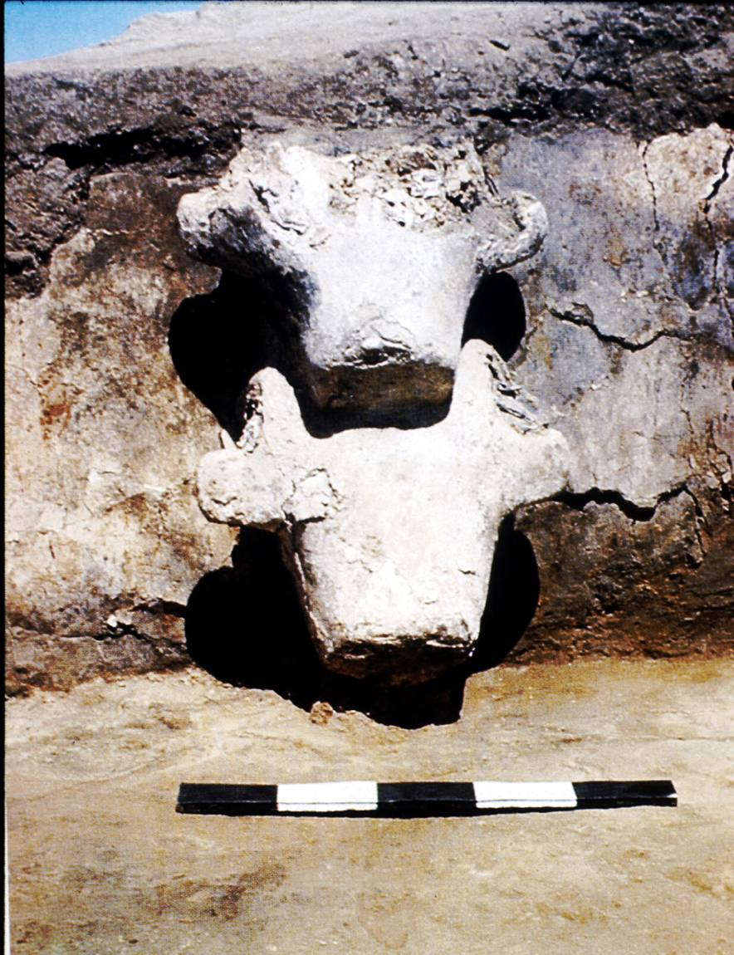
There are also sculptural decorations formed over animal skulls and human burials beneath the floors of the houses.

Slide 26
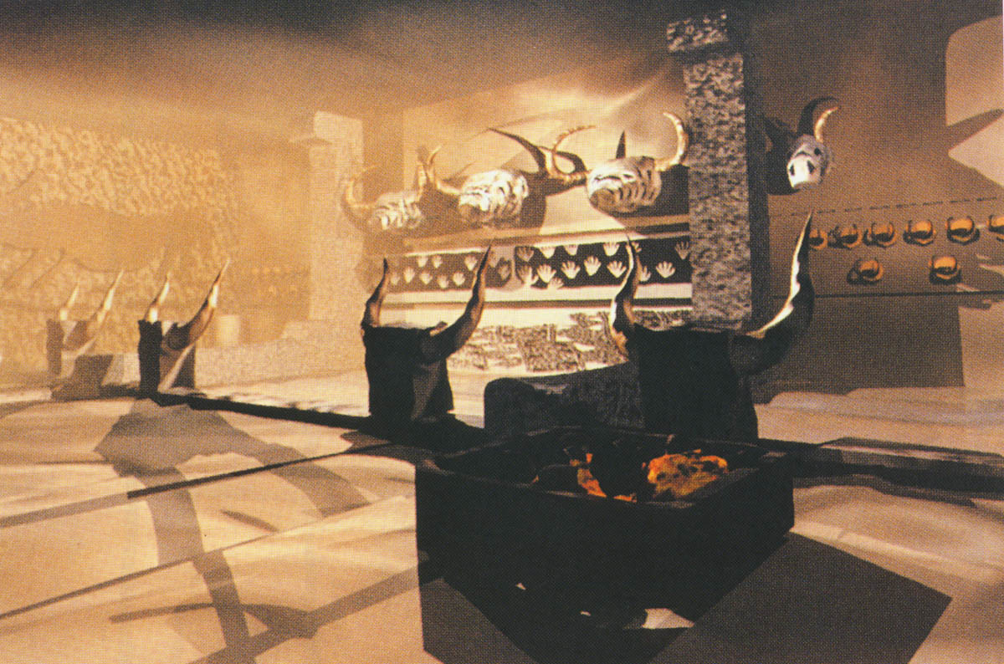

Slide 27
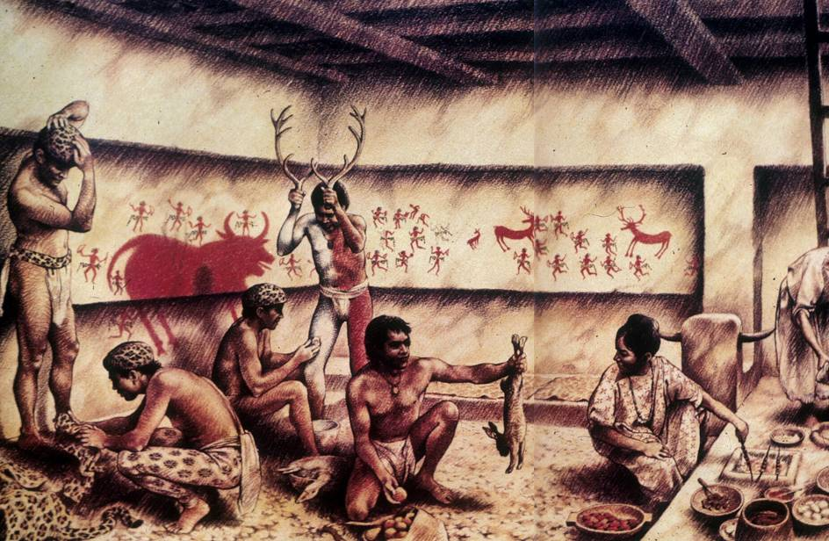

Slide 28
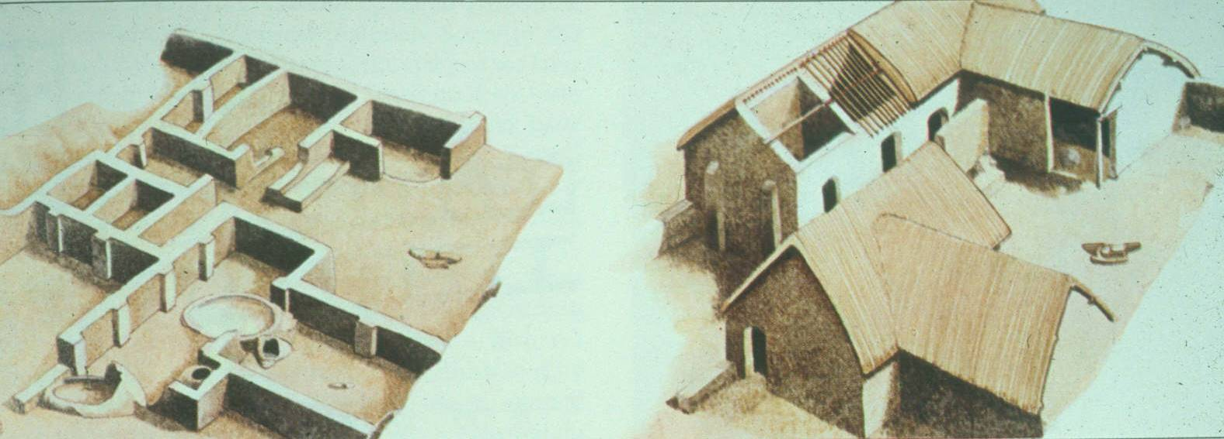
Most sites of this period are simple villages.

Slide 29
NEOLITHIC REVOLUTION
Before
People were Nomadic (Moved
from Place to Place)
Hunted & Gathered
for Food
After
People Lived in Villages
Farmed
Domesticated Plants & Animals
Surplus developed

