Slide 1
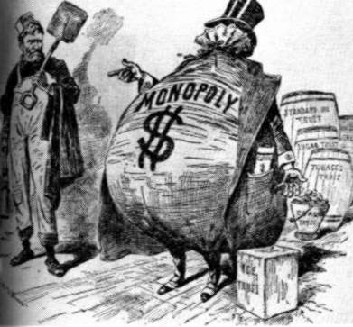
Robber Barons vs. Captains of Industry
Industrialists are men who owned very large businesses or industries.
* Pros and Cons of Industrialists
* Treatment of workers
*Antitrust Movement
AIM: What is the difference between a Robber Baron and a Captain of Industry?
Do Now: Write in your notebook.
What did Adam Smith say in his book “Wealth of Nations” about capitalism and government?
Mr. Ott @ BETA 2011-12

Slide 2
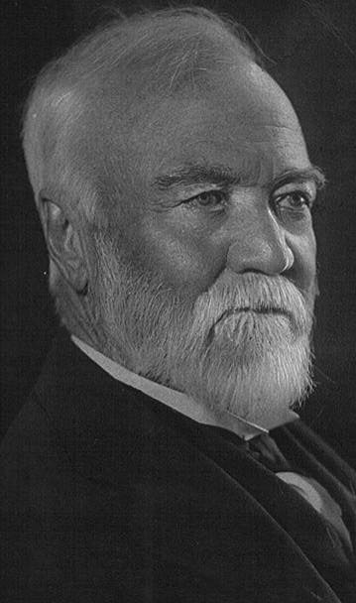
Andrew Carnegie (1835-1919) Steel Industry
Learned system of management on the Pennsylvania Railroad.
Used the new Bessemer furnace technology to begin vertically and horizontally integrating his firm in the steel industry.
Used cost accounting to guide his pricing strategy and drive costs down.
Andrew Carnegie
Courtesy of The General Libraries, The University of Texas at Austin.

Slide 3
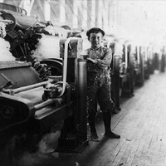
Andrew Carnegie Steel Industry
He increased the “throughput” velocity to gain economies of scale and to fully utilize his resources.
The result was a declining price of steel for the consumer.
Andrew Carnegie’s his first job was in a textile mill like this.

Slide 4
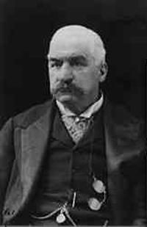
J.P. Morgan -- Banking
Symbol of Wall Street
1893 – 1/3 of U.S. Railroads
Forms U.S. Steel (1901)
70% of Steel Industry

Slide 5
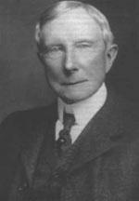
John Rockefeller and Standard Oil Trust
To monopolize the oil industry he forms the Standard Oil Trust
A trust is an organization of businesses designed to operate like a monopoly
His corporation Standard Oil owned about 88% of the oil industry in the US in 1890

Slide 6
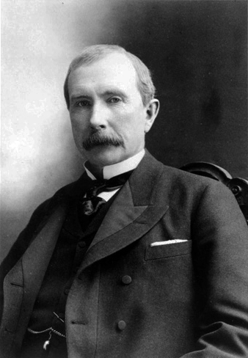
J.D. Rockefeller -- Oil
Monopoly
1870 – Standard Oil is born
1872 – “Cleveland Massacre”
1879 – 90% refining business
Trust
1882 – Standard Oil Trust is born
Anti-Trust Movement begins

Slide 7
John Rockefeller and Standard Oil
Recognized the potential of the oil industry
Very hard worker
Spent all profits from the company to improve production
Philanthropy- gave over $500 million to charities
Made deals with the railroads to charge competitors more
Lowers prices to force other companies out of business-then raised prices
Low pay for workers
Sabotaged competitors
Paid government officials in the Senate

Slide 8
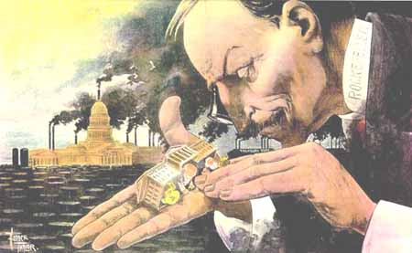

Slide 9
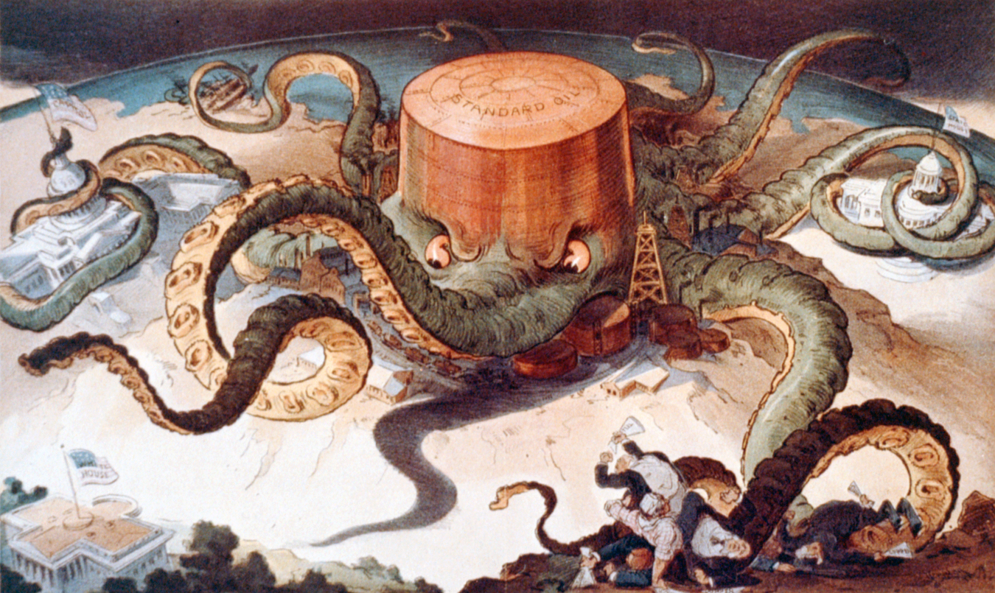

Slide 10
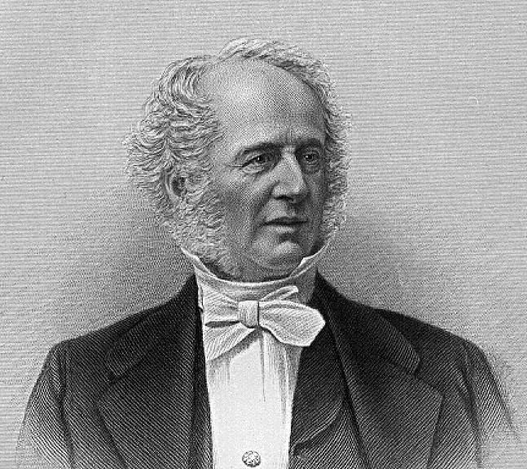
Big Business and Its Changing Environment
The social conscience of the 19th century entrepreneur gave rise to individual philanthropy:
Ezra Cornell – his money founded Cornell University.
William Colgate – college changed its name to his as result of his generosity.
John Hopkins – founded John Hopkins University.
Cornelius Vanderbilt – founded Vanderbilt University.
Cornelius Vanderbilt

Slide 11
Big Business and Its Changing Environment
More Philanthropists
Joseph Wharton – grant enabled first business school at University of Pennsylvania.
Edward Tuck – gift to Dartmouth started Amos Tuck School of Administration & Finance.
Leland Stanford – honored his son with a university
John Stevens – provided for the Stevens Institute of Technology.
James B. Duke – Trinity College (later renamed for the family).
Daniel Drew – promise of funds led to Drew University.
Moses Brown – founded Rhode Island College; became Brown University in 1804.

Slide 12
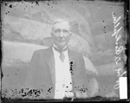
Big Business and Its Changing Environment
Famous Philanthropists
John D. Rockefeller – given half a billion dollars by the time of his death as well as establishing the Rockefeller Foundation.
Rockefeller is pictured here in 1907 beside a building.
John D. Rockefeller
Chicago Daily News negatives collection, DN-0051595. Courtesy of the Chicago Historical Society

Slide 13
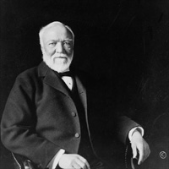
Big Business and Its Changing Environment
Famous Philanthropists
Andrew Carnegie – gave away $350 million by the time of his death in addition to his libraries, university, and the Carnegie Foundation.
Andrew Carnegie
Courtesy of The General Libraries, The University of Texas at Austin.

Slide 14
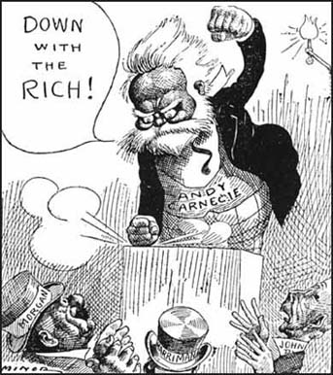
Working Conditions
Laborers were immigrants, blacks, women, and children
10-12 hour days, six days a week
Accidents were frequent, deaths occurred
Low wages

Slide 15
Justifications for Industrialists’ Extreme Wealth
Social Darwinism
Herbert Spencer
Based on Charles Darwin’s theory of evolution
Those who are rich are more fit, than those who are poor
Attempted to use science to explain social classes
Gospel of Wealth
Andrew Carnegie – U.S. Steel
God gave wealth to the most capable people
It is the duty of the wealthy to give money to help the poor
Carnegie gave millions of dollars away to establish libraries, colleges, and museums

Slide 16
Anti-Trust Movement
The public began to dislike trusts
Prices were high on important products
Trusts were responsible for a corrupt government
Although Congressmen liked trusts they needed to please the public
Passed the Sherman Antitrust Act
Made it illegal to form a trust or monopoly
Act was not effective because the act did not clearly define a trust

Slide 17
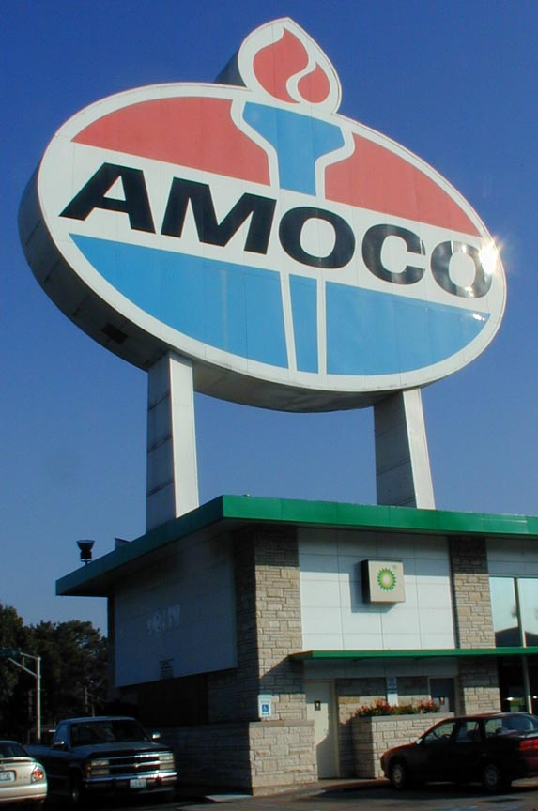
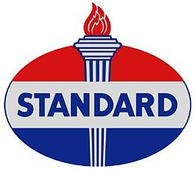



Slide 18
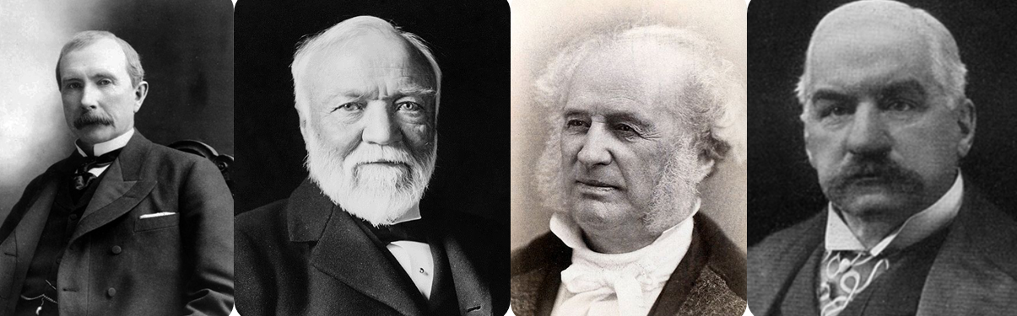
Opposing View Points
Captains of Industry
Created Jobs
Increased production
Provided cheap products
Gave money back to the community
Robber Barons
Exploited workers
Corrupted the government
Greedy

Slide 19
Exit Pass
In a paragraph, evaluate if Industrialists should be viewed as captains of industry or as robber barons.
Use details from your notes to support your answer.

