Slide 1
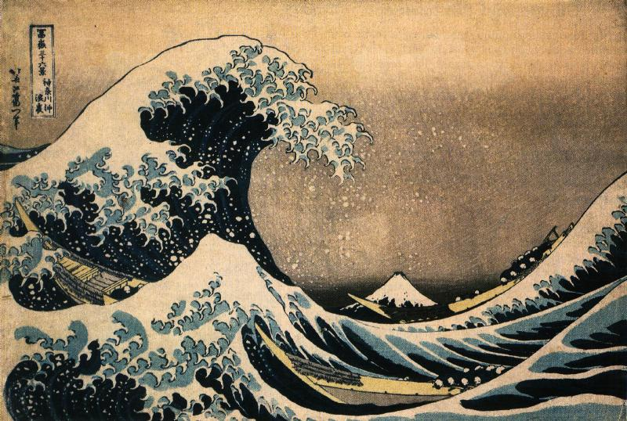
The Meiji Restoration

Slide 2
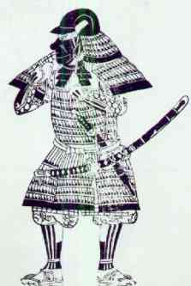
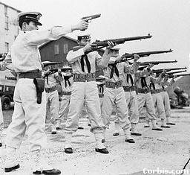
Photograph Interpretation / Compare and Contrast
AIM: To understand the transition from feudal to modern Japan.
Do Now: Explain how these images show a change in Japanese society.
Figure A
Figure B

Slide 3
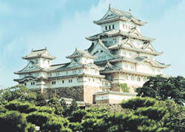
Let’s Go Back In Time… Tokugawa Period (1600-1868)
Centralized feudalism
___________________
Ruled by Shogun
Capital City of Edo (Tokyo)
Rigid Social Structure
Belief Systems
Shintoism
- Zen Buddhism
- Prohibited Christianity
Himeji Castle: Built in 1600s

Slide 4
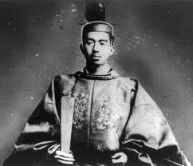
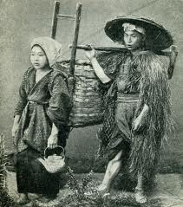
Japanese Social Structure
Emperor
Shogun
Daimyo
Samurai
Farmers
Artisans
Merchants

Slide 5
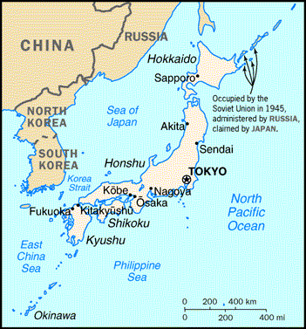
Geography of Japan
What geographic features enabled Japan to pursue a policy of isolationism?
What are some positives and negatives of the geography of Japan?

Slide 6
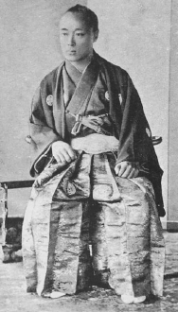
Fall of Tokugawa Shogunate
Reasons for the fall:
Western civilization had arrived and was threatening to gain power there.
Samurai upset at “surrendering” to Westerners.
Tokugawa Shogunate seen as weak for ending 250 years of isolation.
Some Daimyo saw this as an opportunity to change the social structure.
The Last Shogun, Tokugawa Yoshinobu

Slide 7
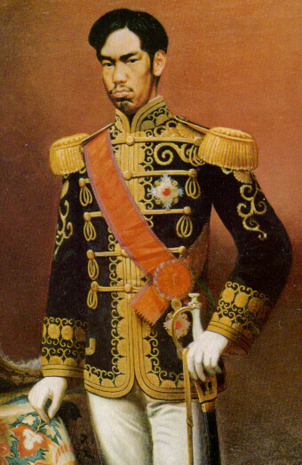
If Not The Shogun, Then Who?
The presence of the West triggered nationalist unrest. Who will most of the people in Japan turn to for leadership? Why?
Need a hint? Think back to the traditional social structure in Japan.
People of all classes appealed to the ________ for support.
They used the slogan sonno joi “Revere the ________, expel the barbarians.”
emperor
emperor
Emperor Mutsuhito, Meiji.

Slide 8
Compare These Two Figures
Do Now:
1. What are the similarities and differences between the two men?
2. What adjectives would you use to describe each ruler?

Slide 9
Emergence of the Emperor
The Shogunate was defeated and a new emperor named __________was proclaimed.
Mutsuhito
This period is known as the Meiji
Restoration– Meiji meaning ______________.
enlightened rule
Over the next generation the whole society and its institutions were transformed to serve the needs of _____________.
modernization
Emperor Mutsuhito, Meiji.

Slide 10
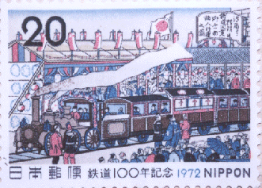
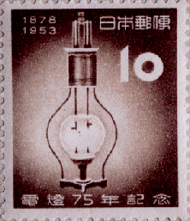
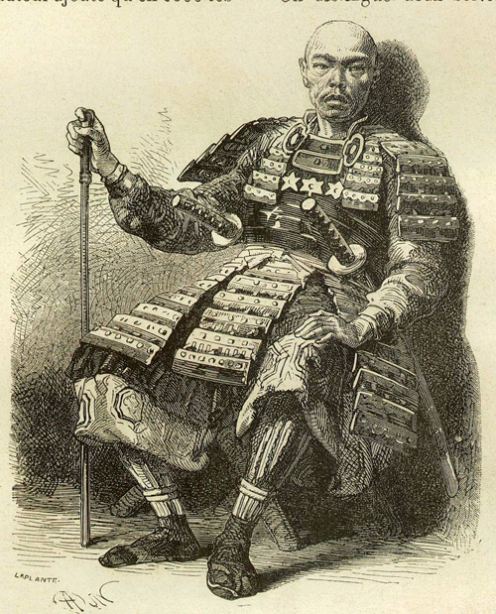
Changes During The Meiji Restoration
Major Changes:
Abolished feudalism
Eliminated samurai armies
Reformed education
Created a centralized gov’t and encouraged loyalty to the emperor
Japan's 1st Western-style constitution (1889), followed by the country's first elected Diet.
Adopted Western technology
Opened up trade (ended isolation)
Notes:
Fukoku Kyohei: “Enrich the country and strengthen the military”
Emperor promises to institute political and social reforms and work to strengthen the nation.

Slide 11
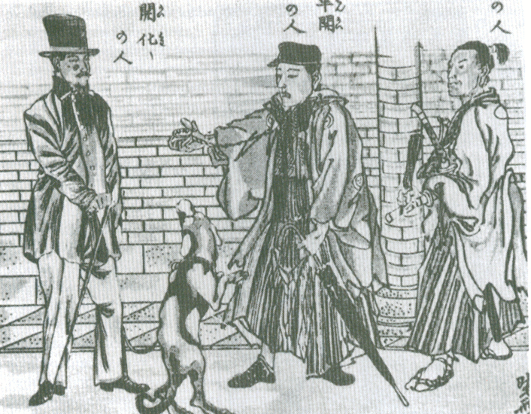
Hiking Through The West, 1870
How does this image show a change in the way
the Japanese view the West?

Slide 12
Strains of Modernization
Problems:
Poor living standards existed in crowded cities
Political differences led to instability and frequent assassinations of leaders
Constant questioning and debate about ______________
Disgruntled _________ class
Need for raw materials
Westernization
Samuarai

Slide 13
Strains of Modernization
Solutions:
Urged loyalty to the Emperor as a center of _______________
Sino-Japanese War 1894-1895
Russo-Japanese War 1904
Imperialism of Korea: Annexed in 1910
national identity

Slide 14
Final Thoughts
technology
Western ____________ was adopted which allowed the Japanese to fully ______________ in less than 50 years. By the end of the Meiji Restoration, the Japanese no longer feared that they would be _____________. Rather, they set out to practice imperialism themselves to obtain power and ________ __________. Japan was quickly emerging as a world-class power using western technology and methods while still maintaining its ___________ _________ values.
industrialize
imperialized
natural
resources
traditional
cultural
Meiji Restoration
This period was known as the _____ _____________.

Slide 15
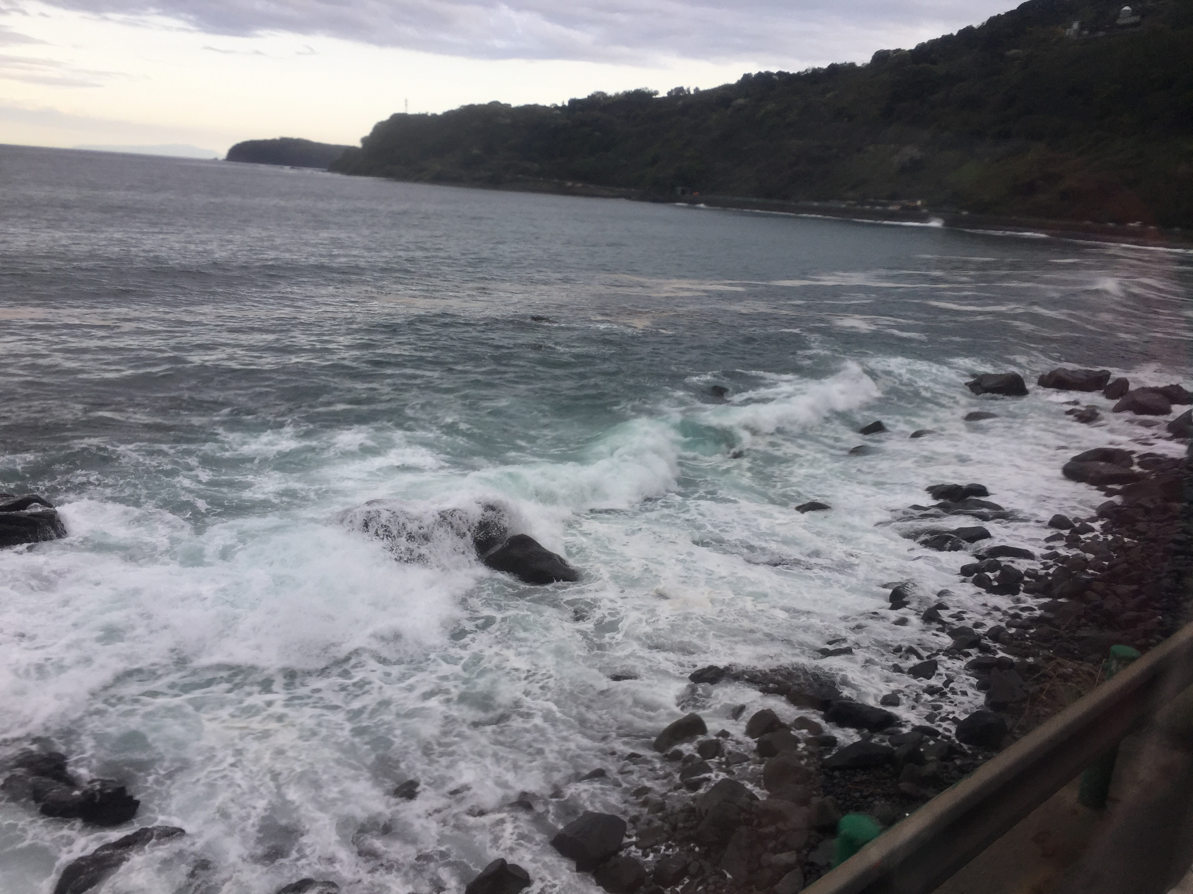

Slide 16
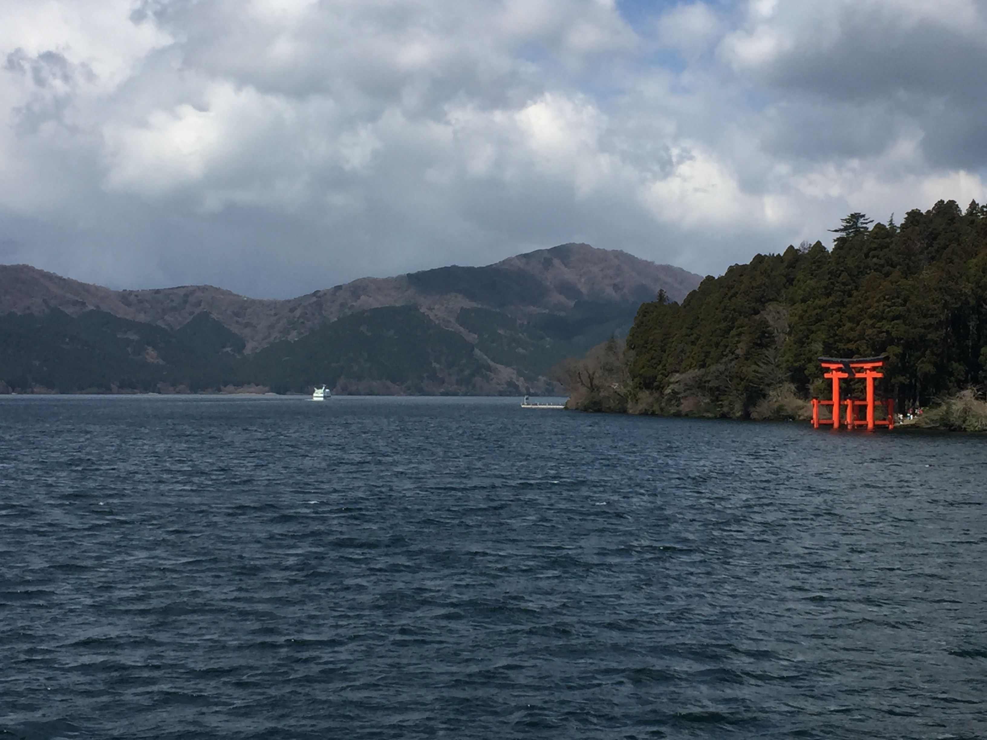

Slide 17
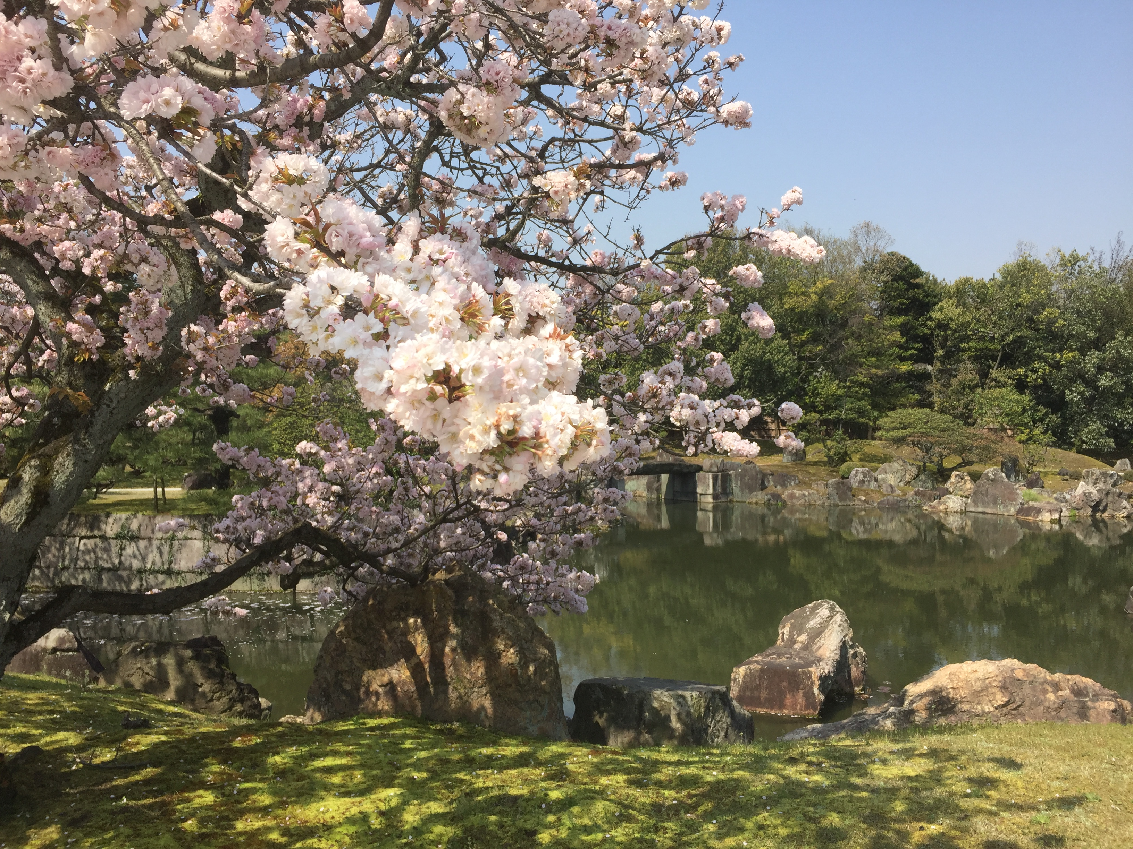

Slide 18
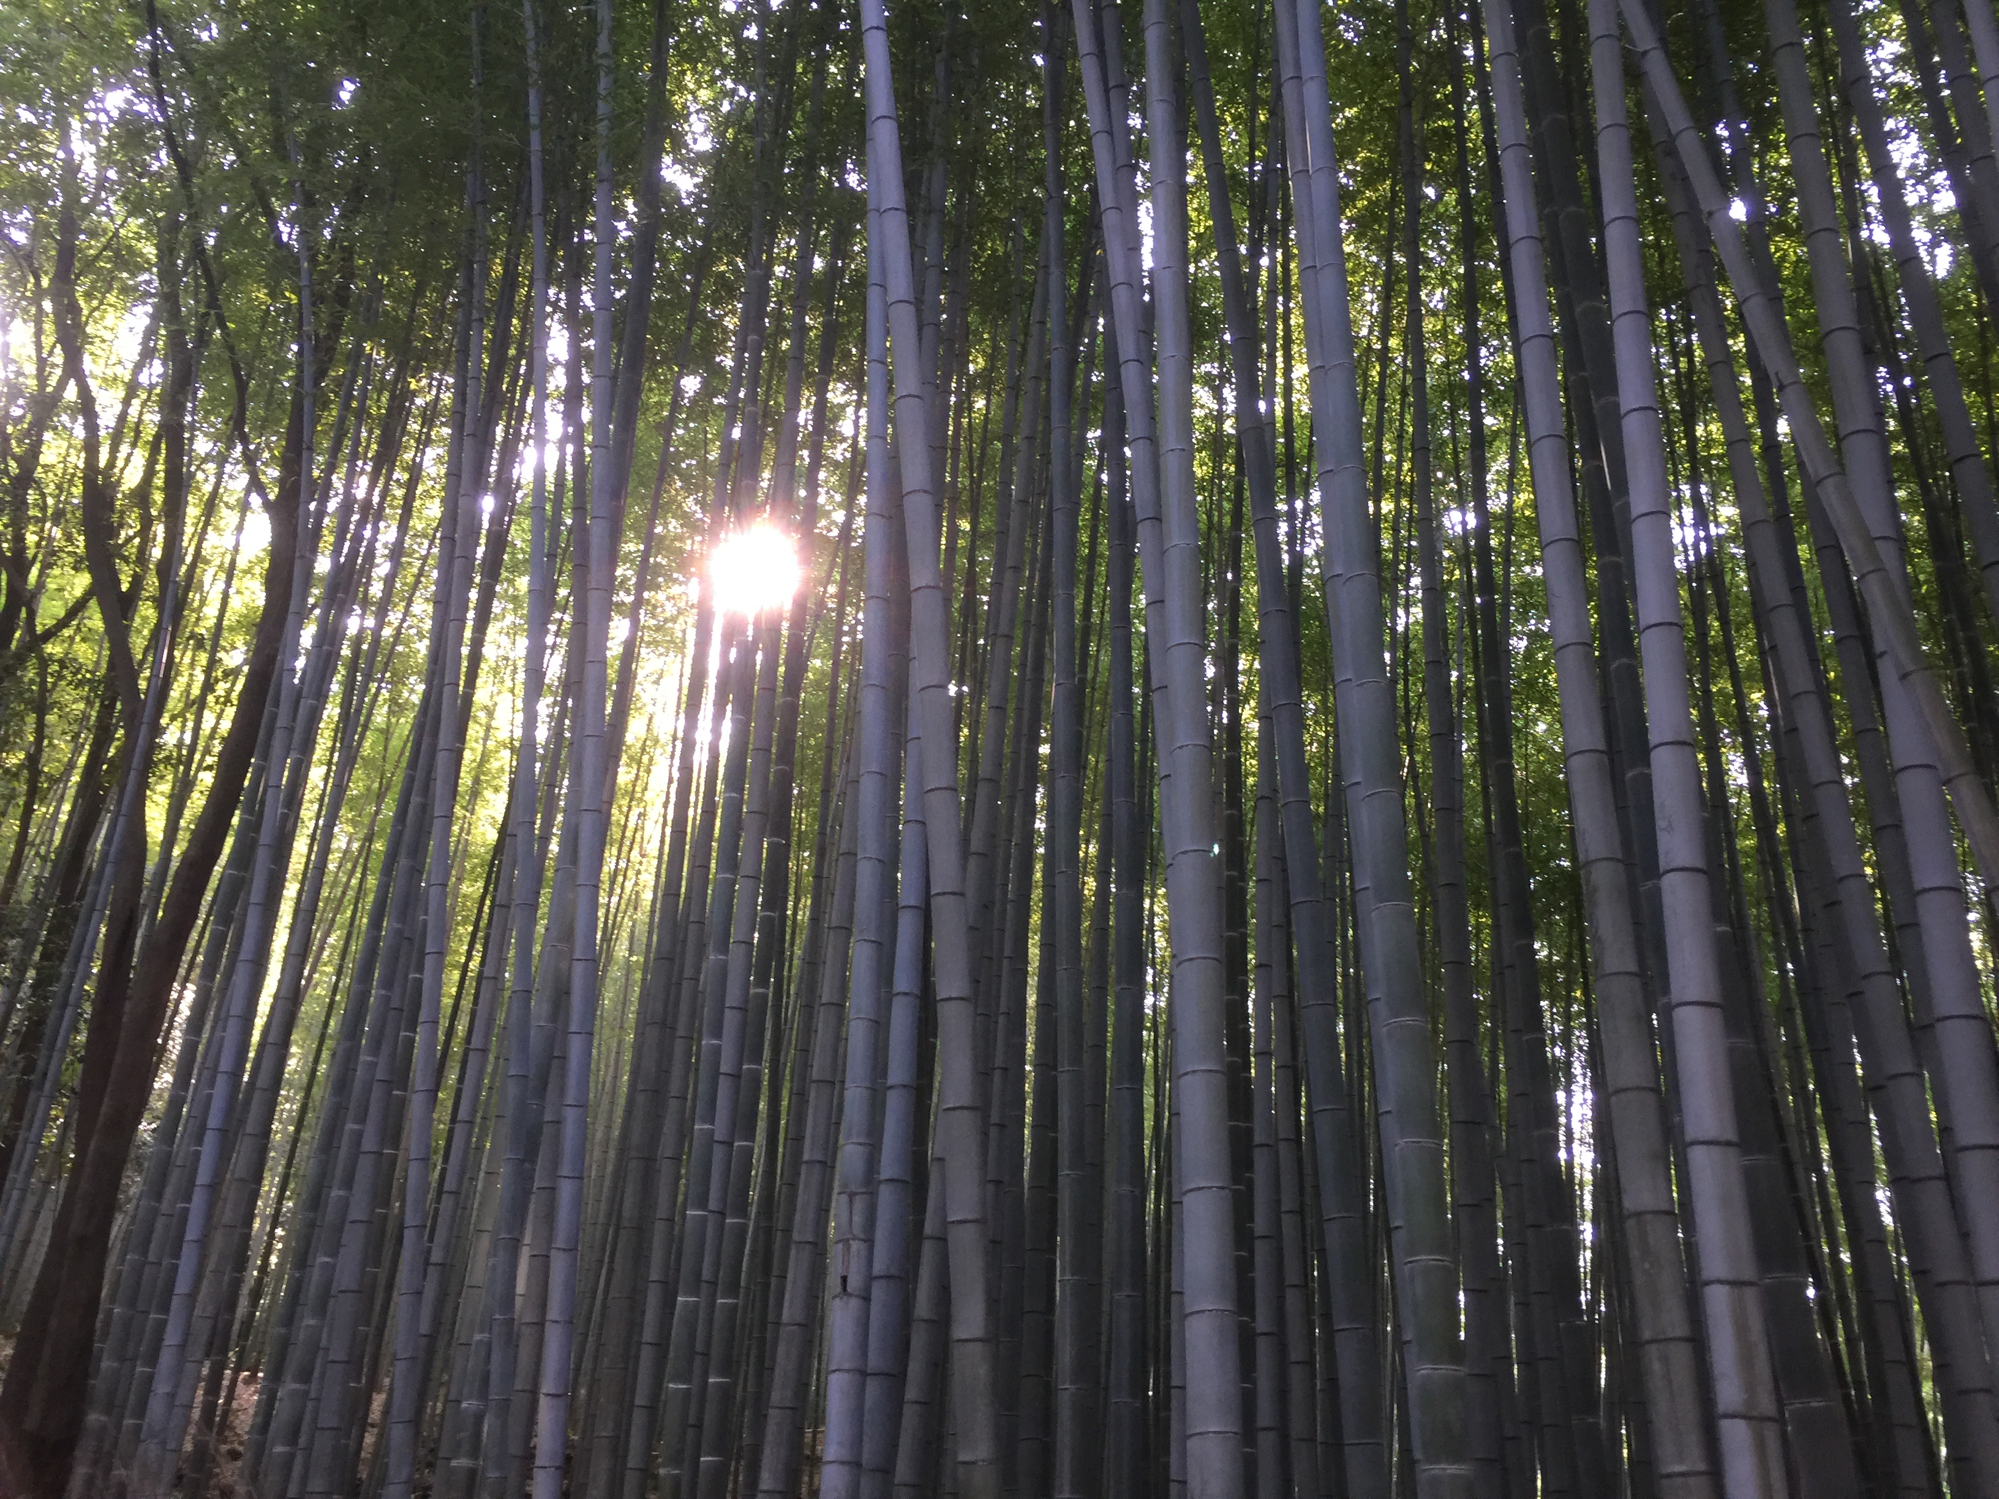

Slide 19
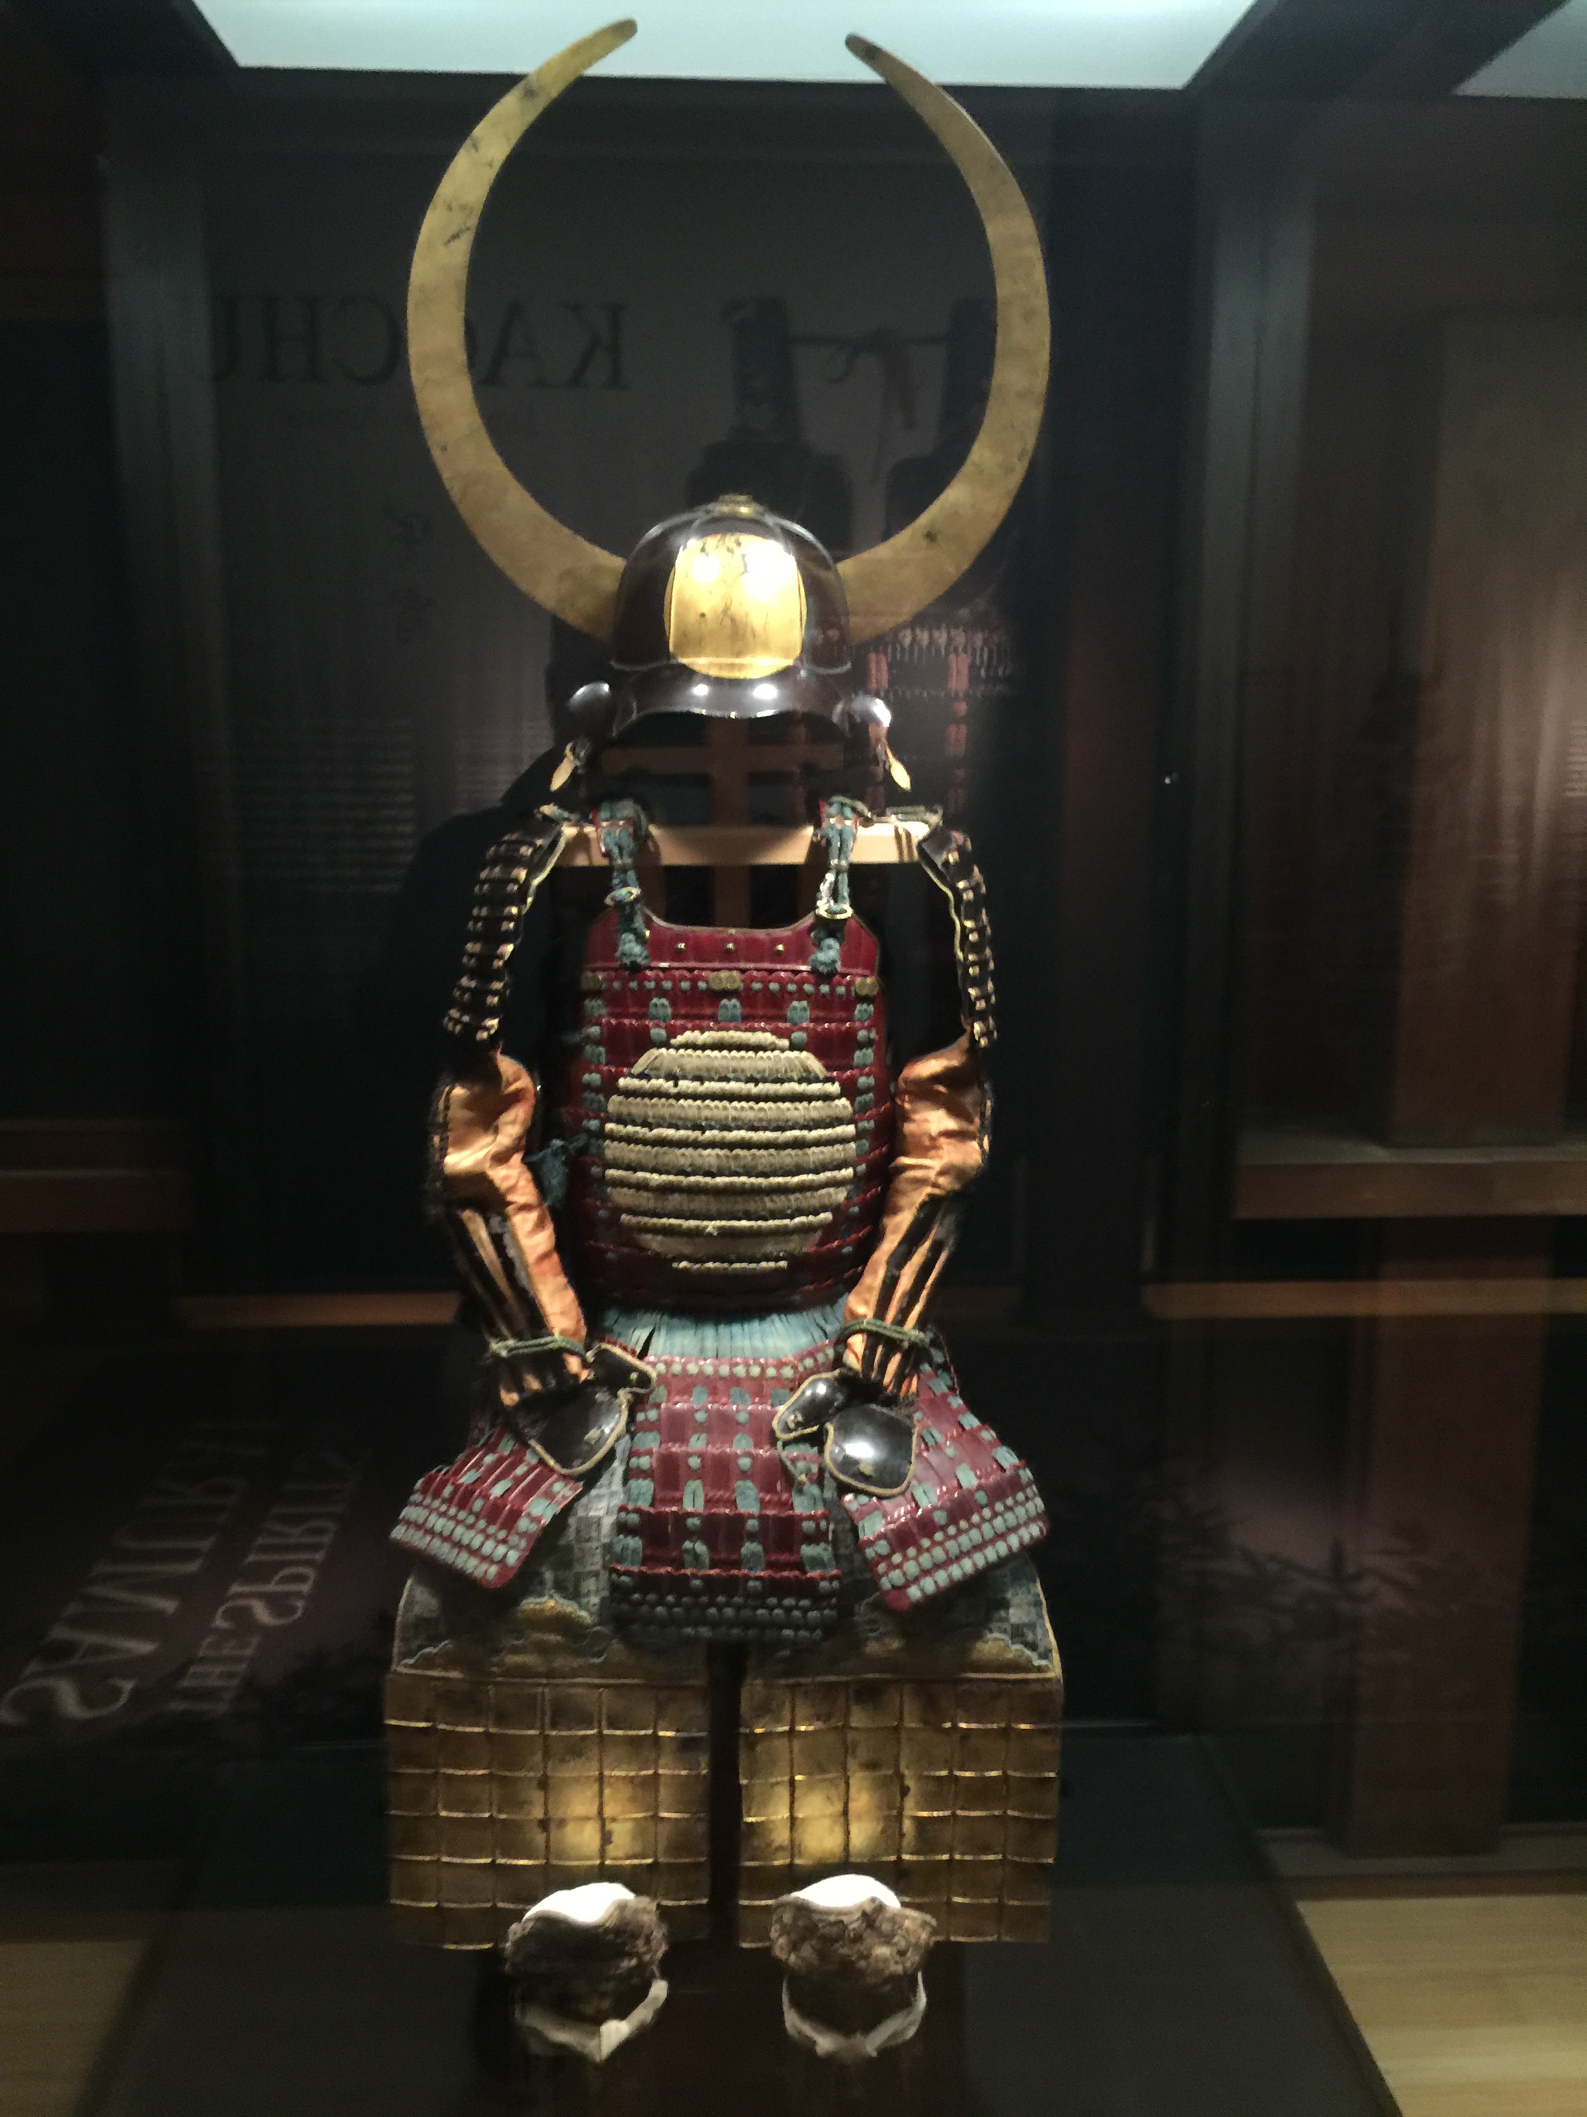

Slide 20
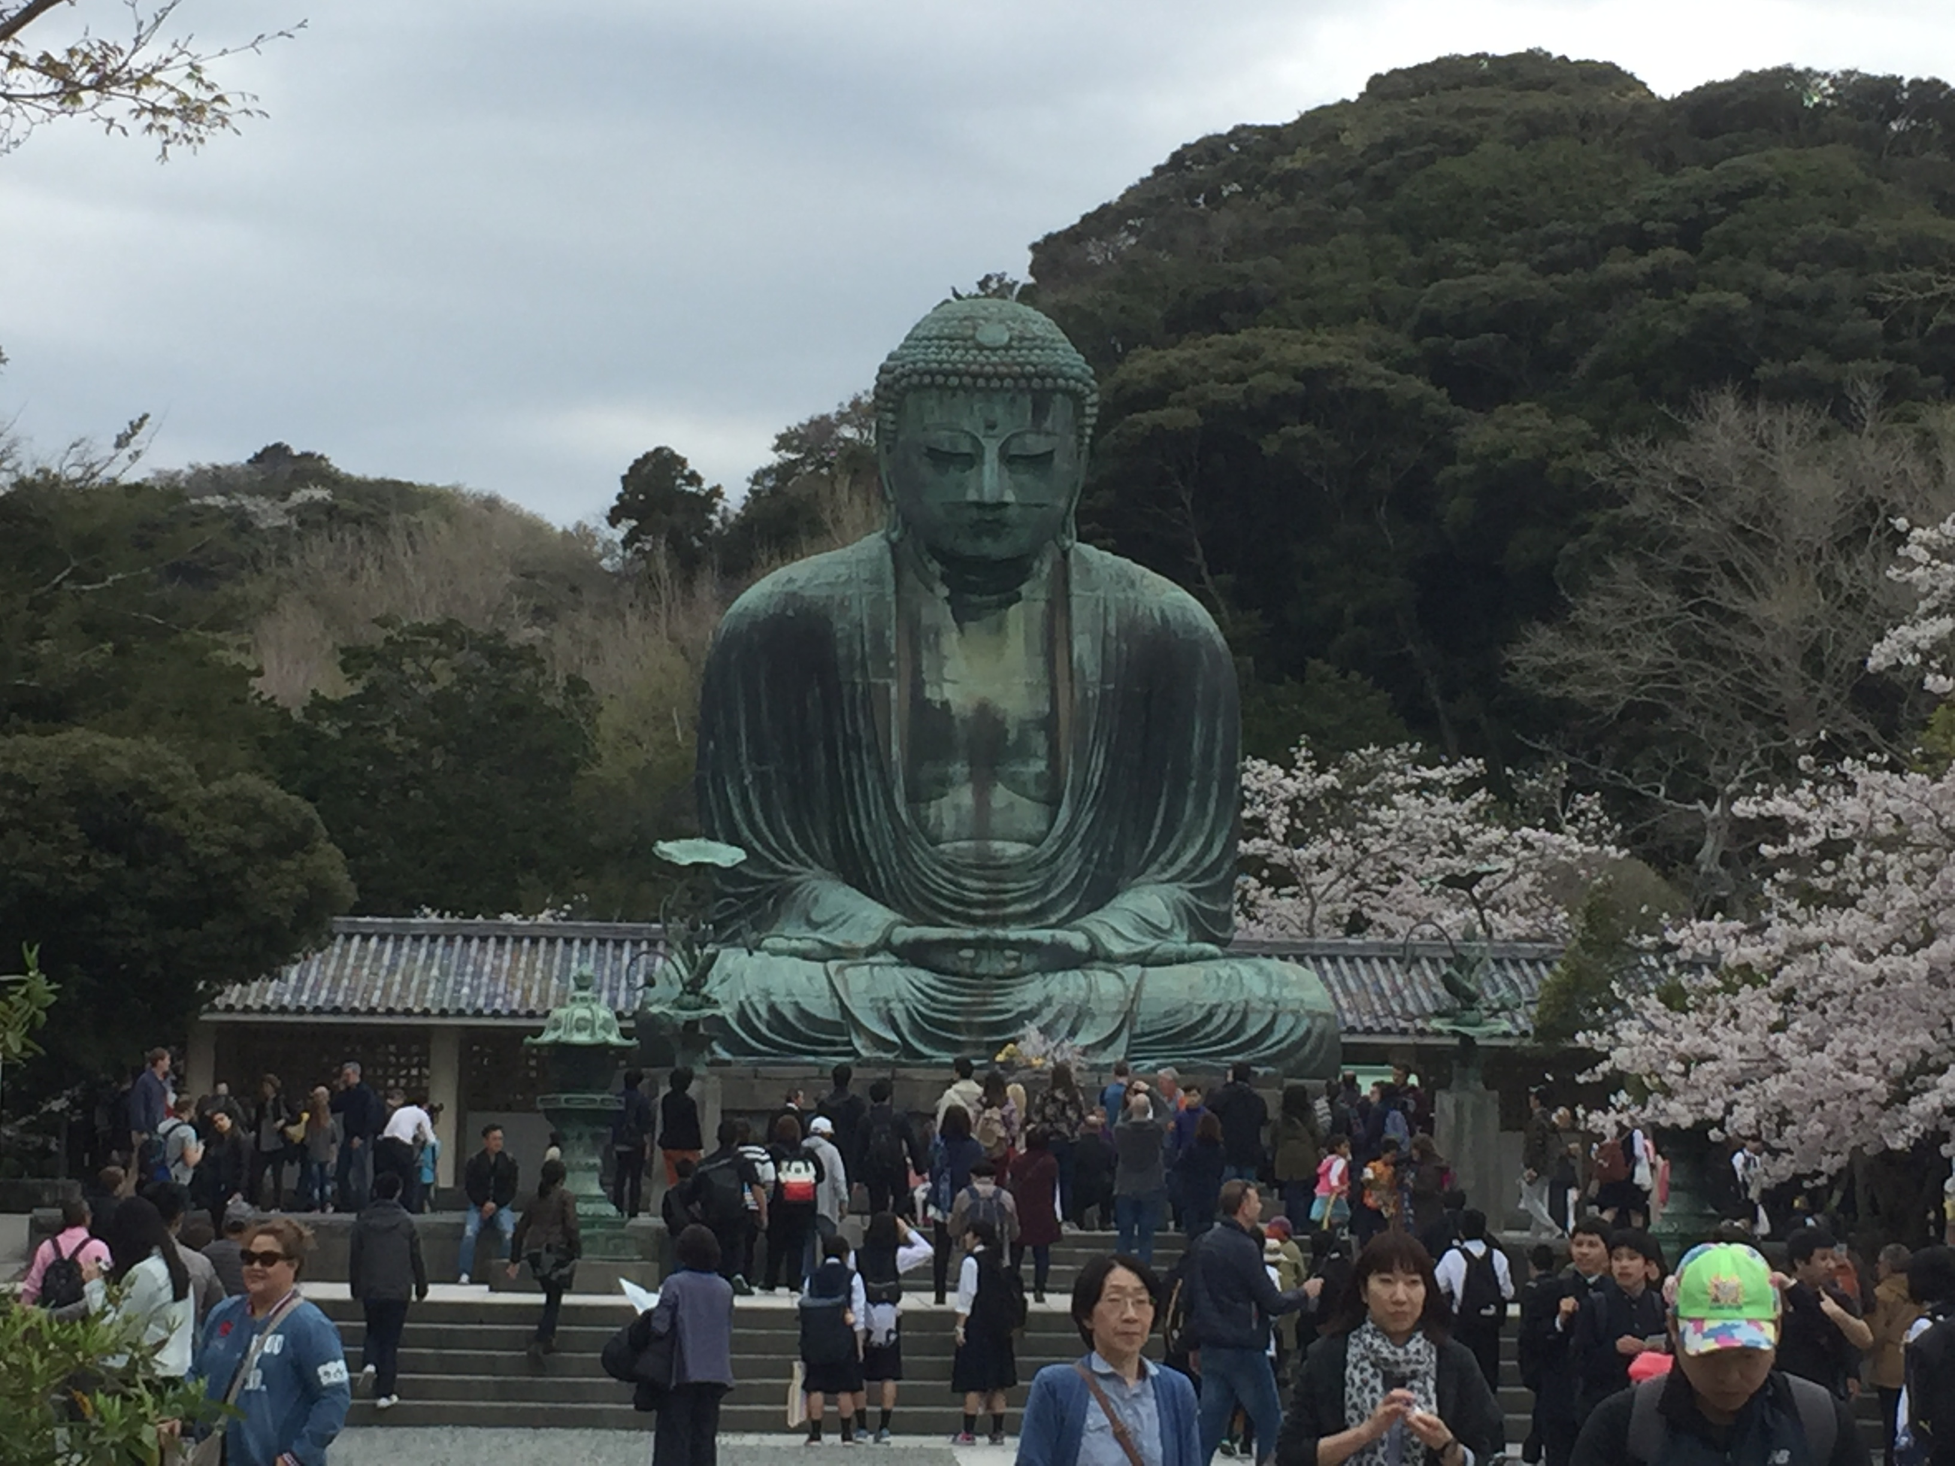

Slide 21
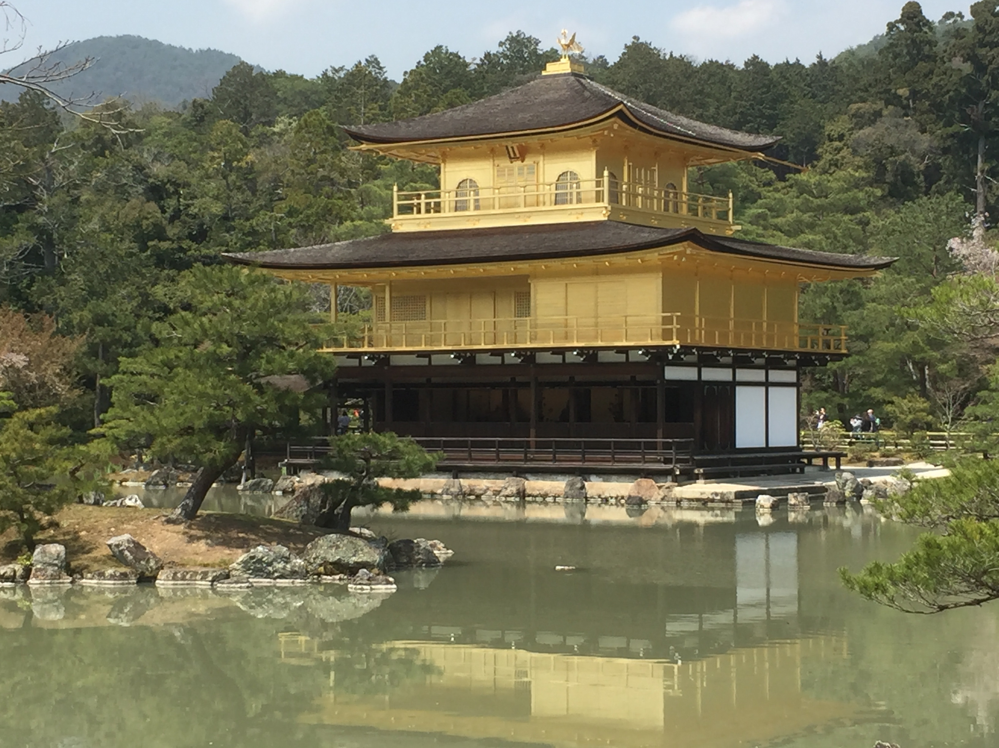

Slide 22
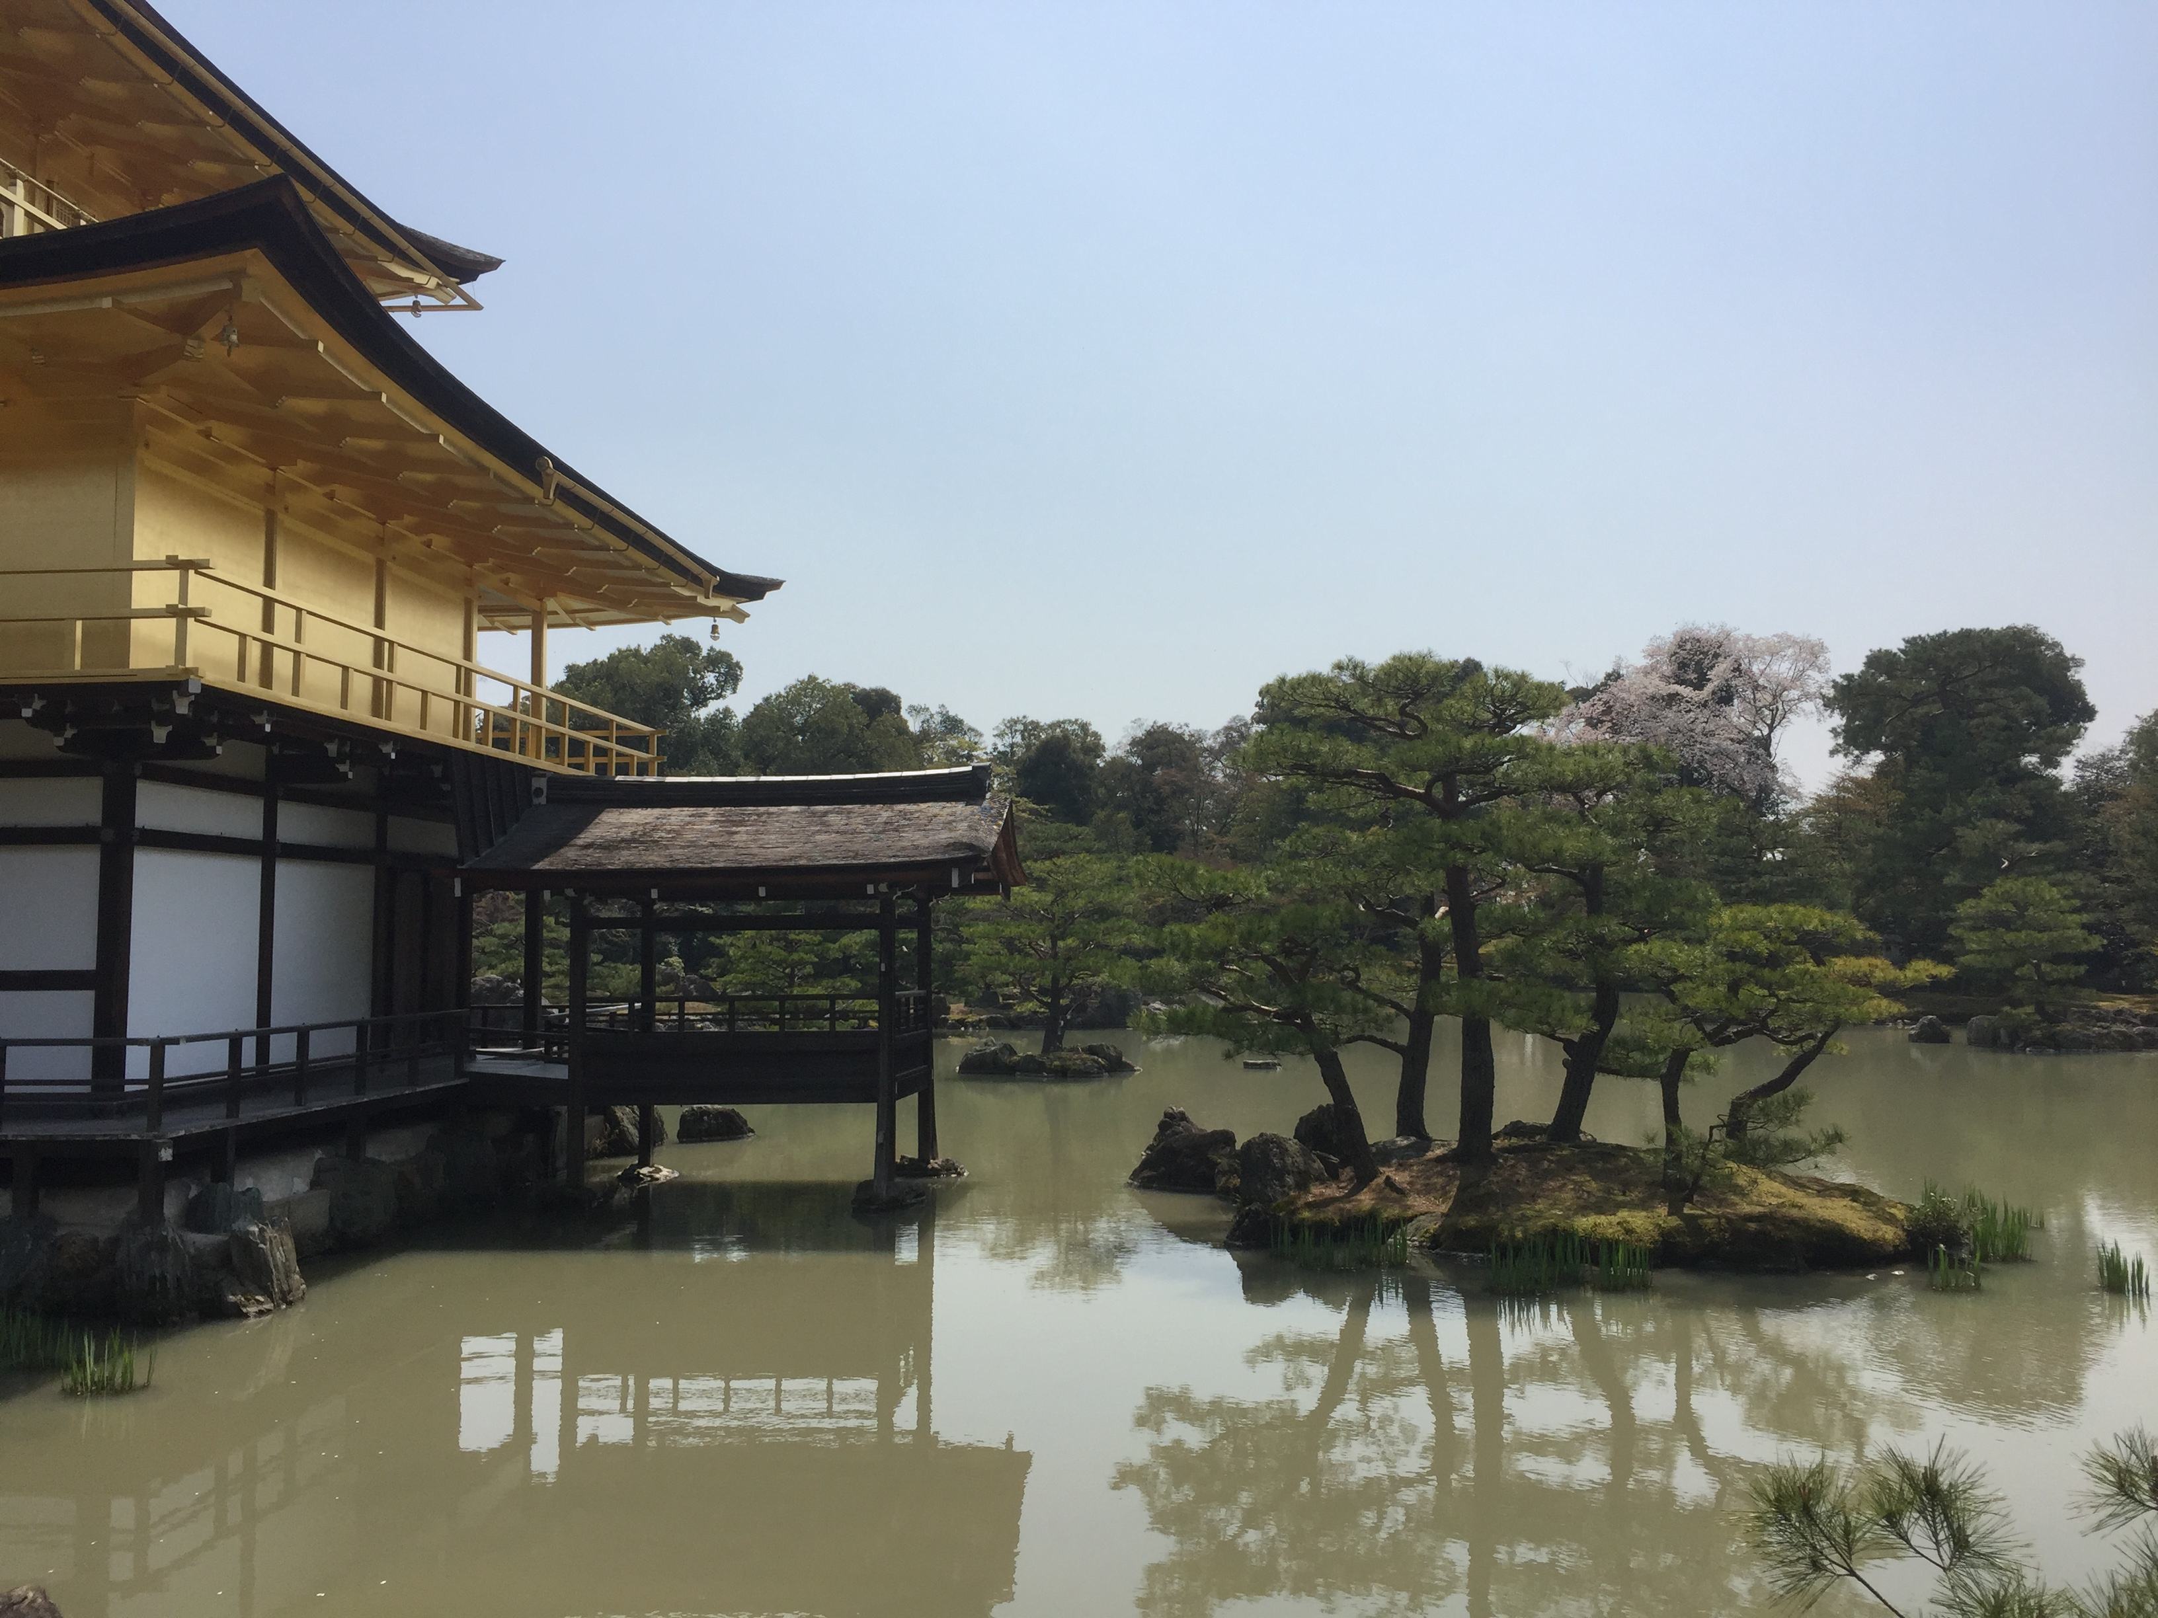

Slide 23
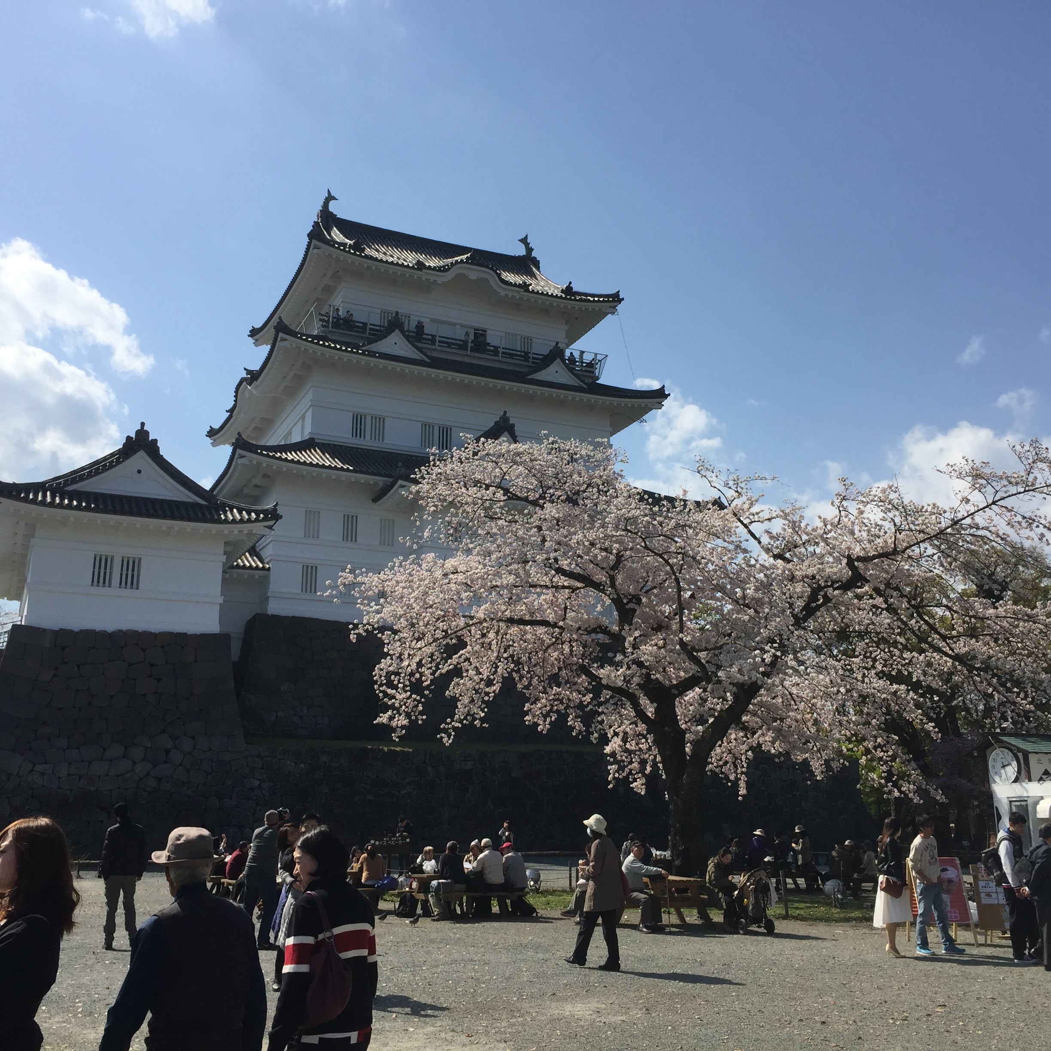

Slide 24
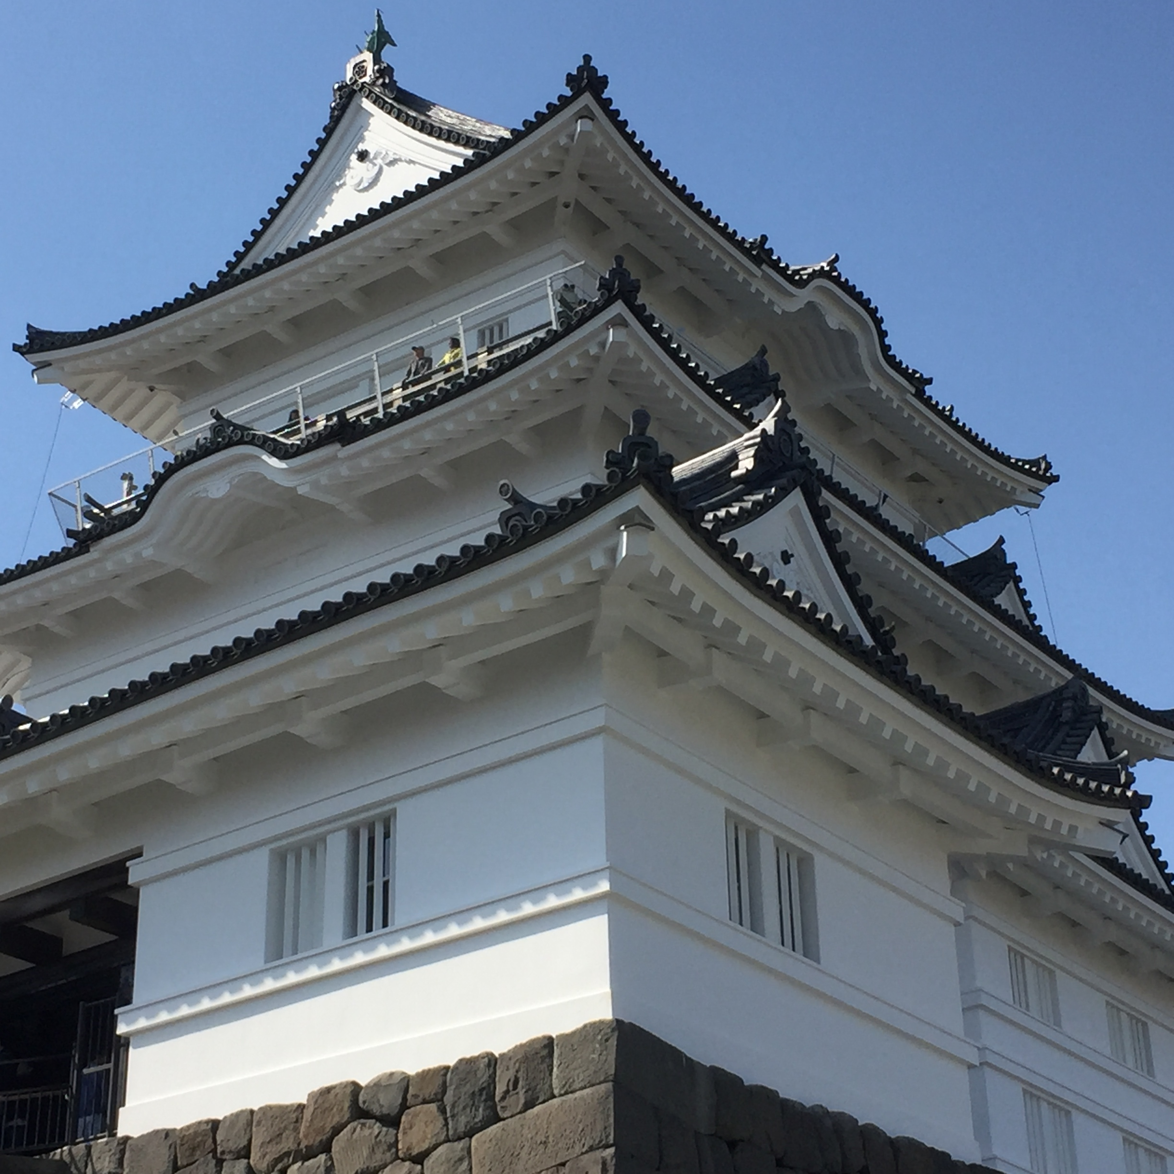

Slide 25
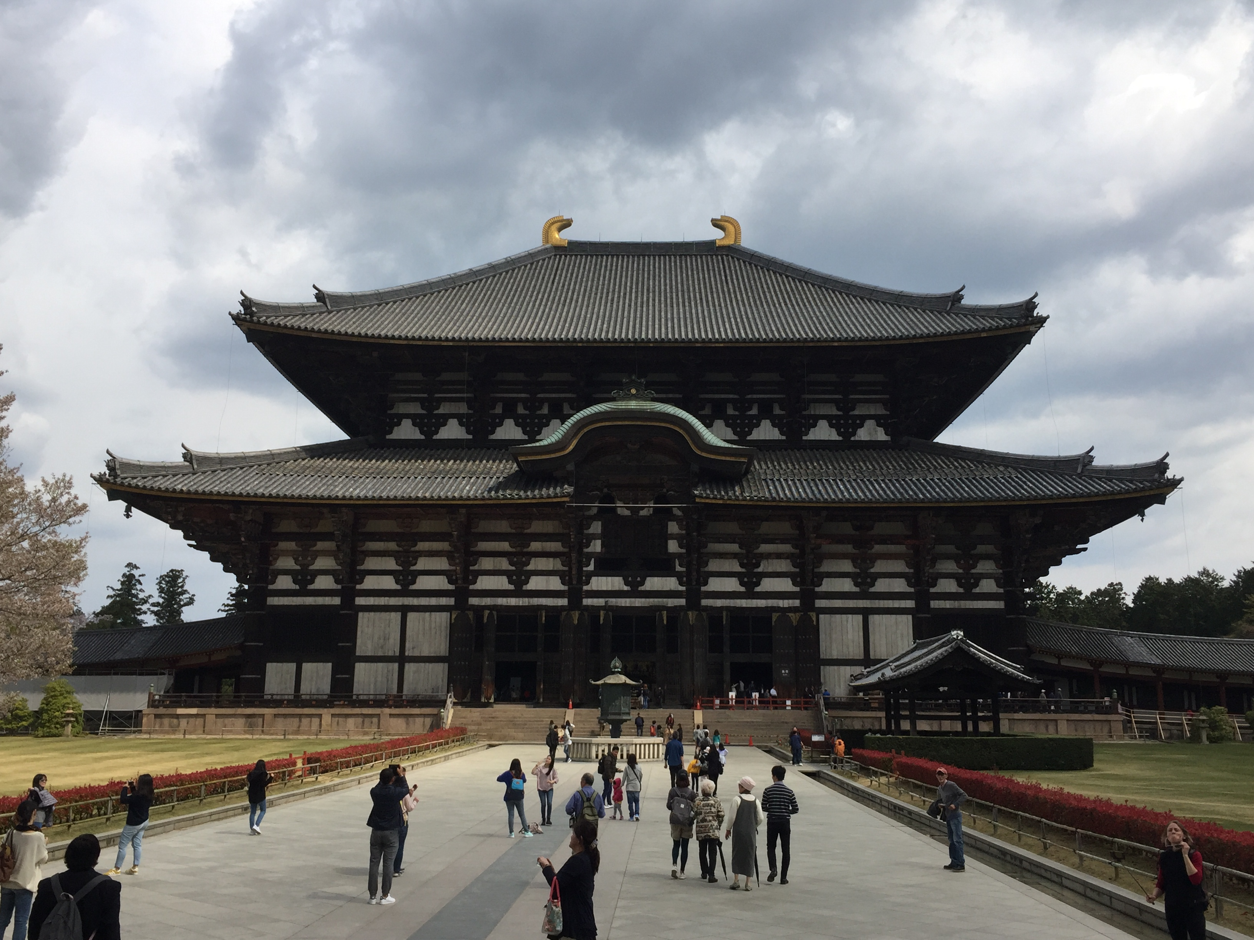

Slide 26
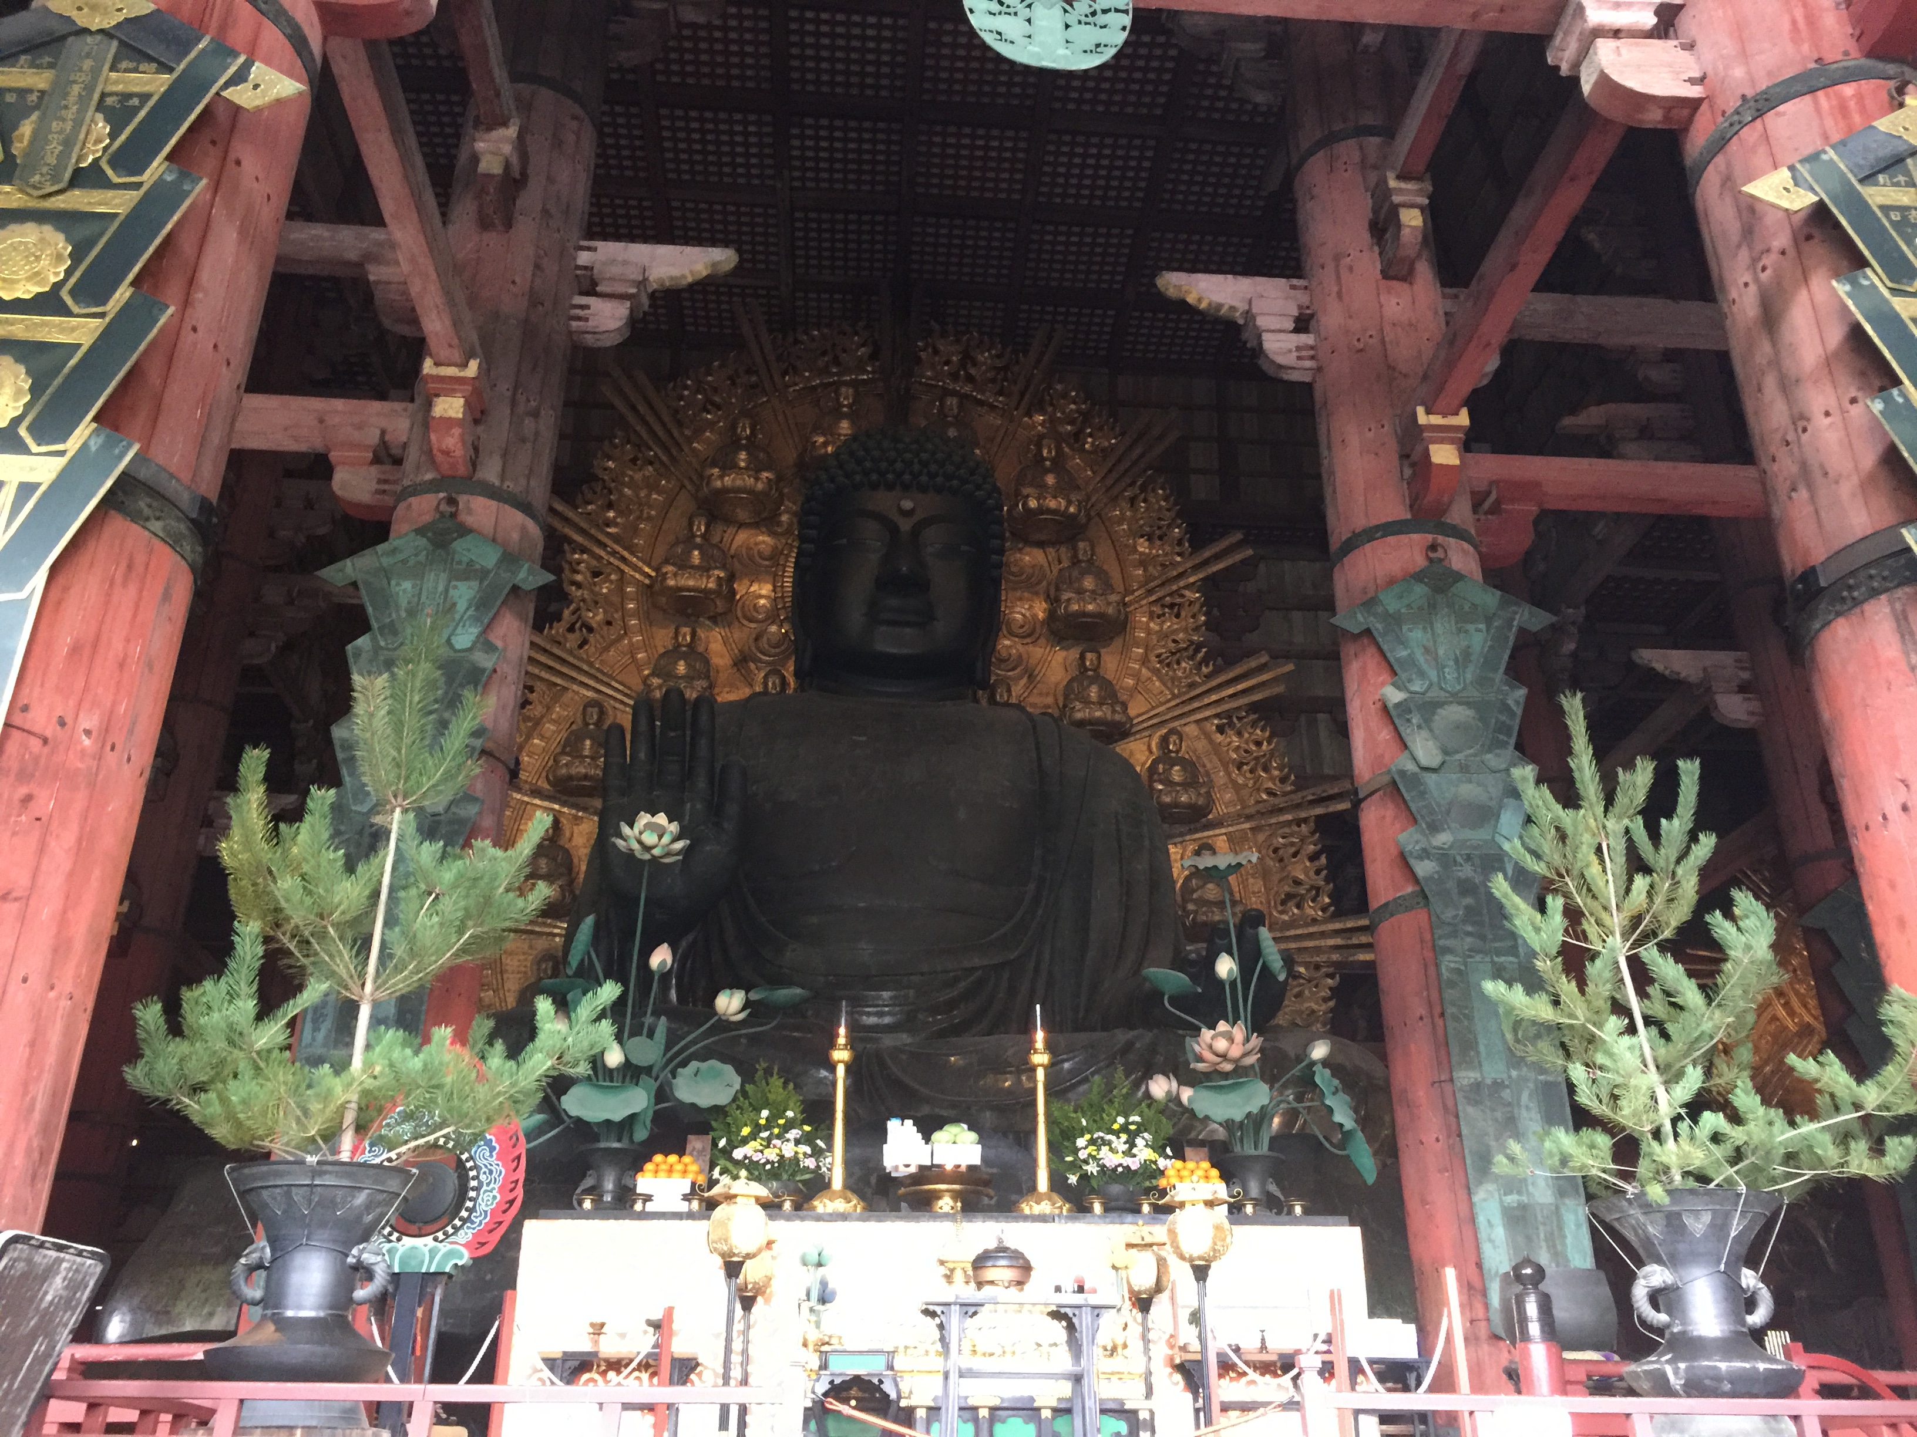

Slide 27
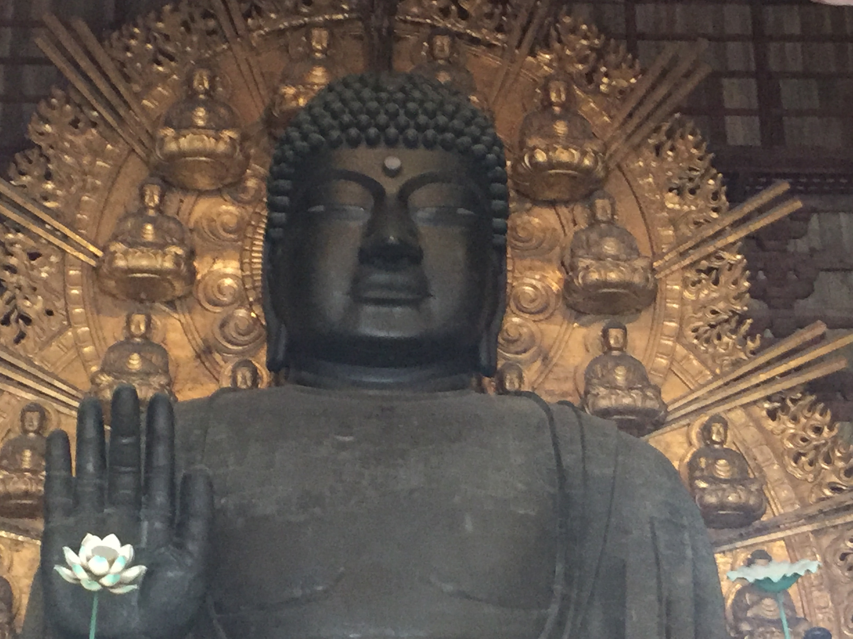

Slide 28
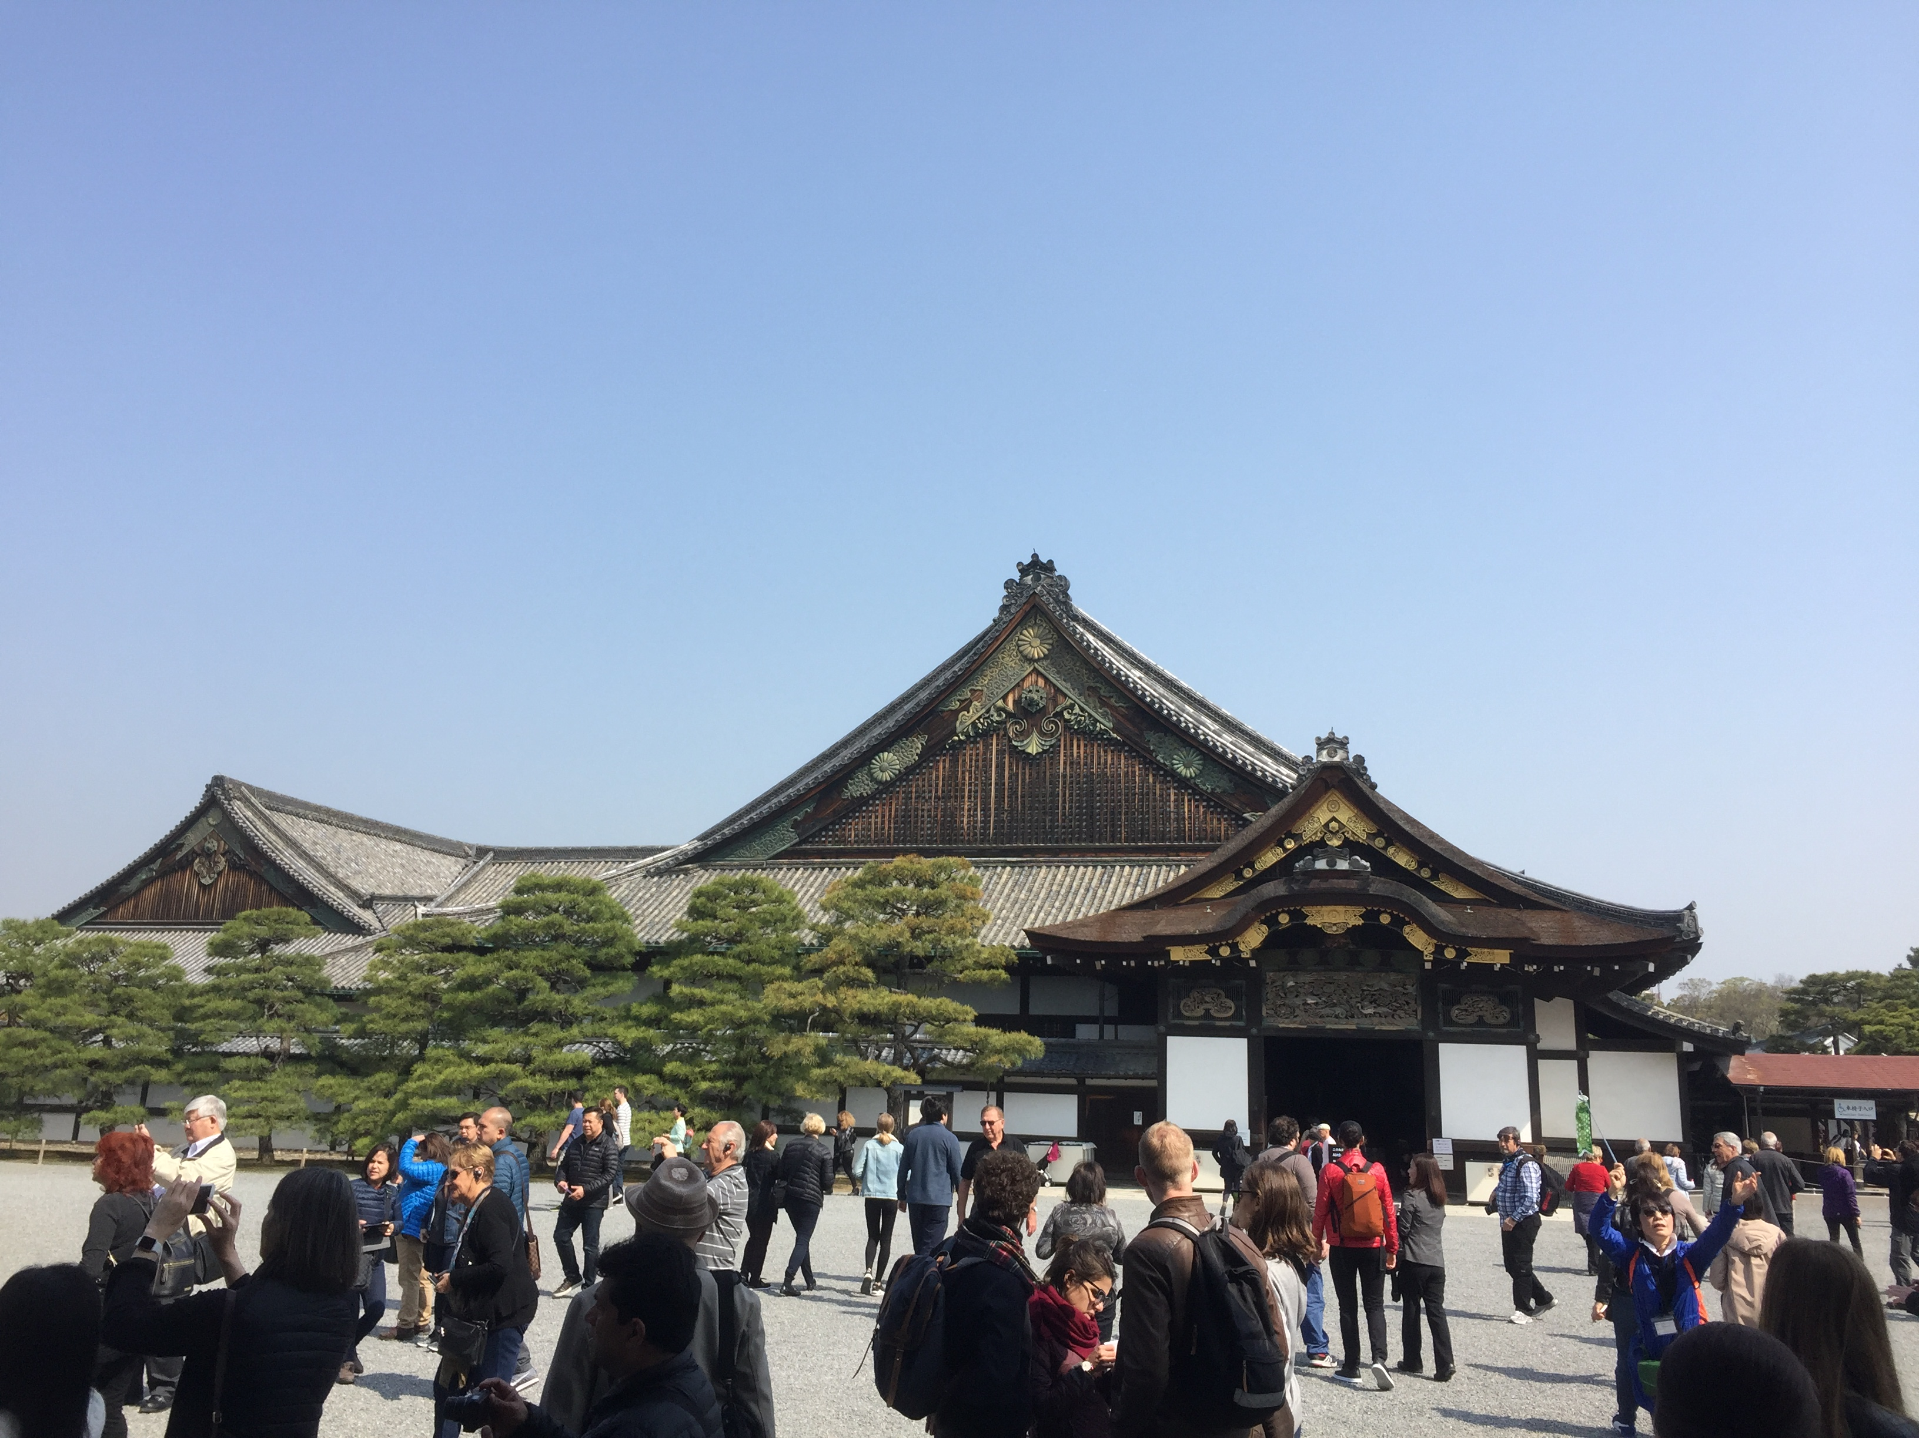

Slide 29
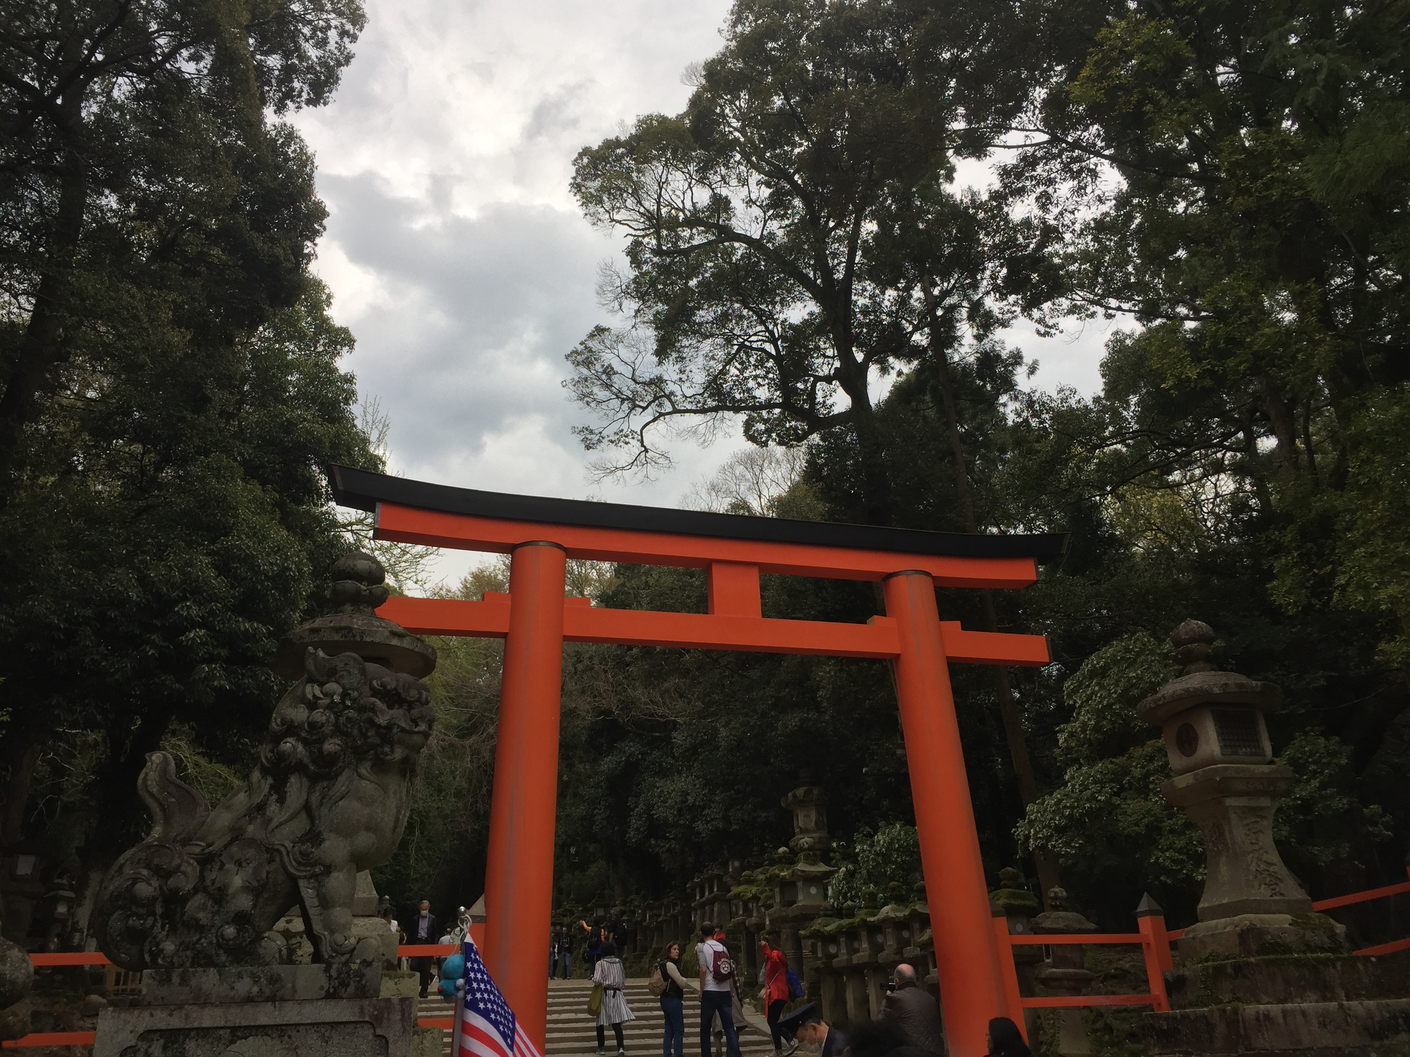

Slide 30
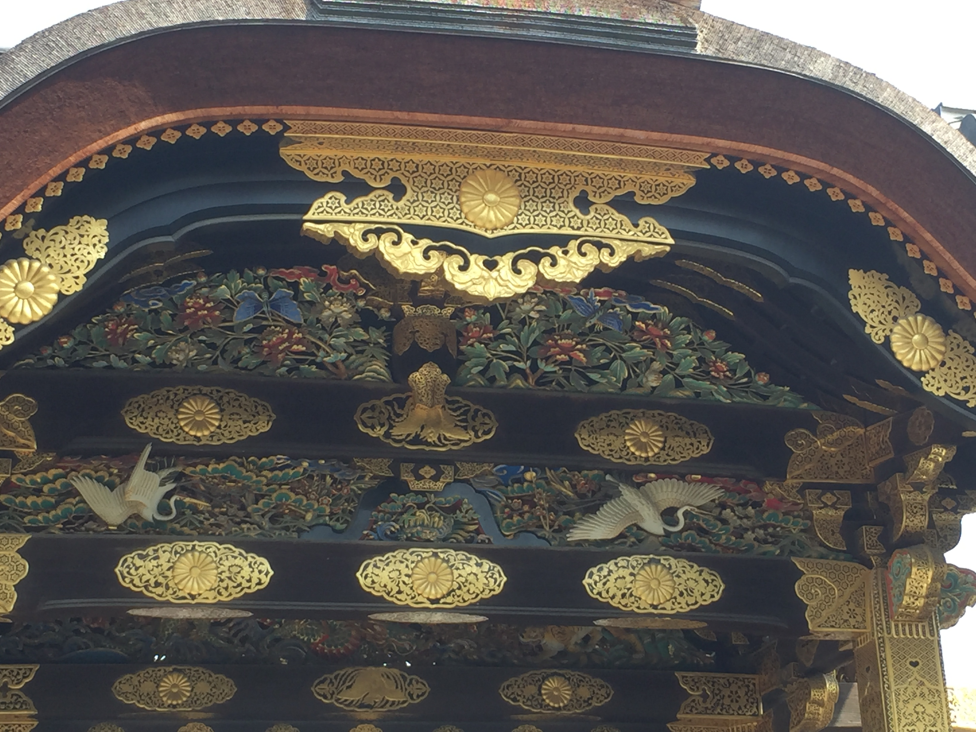

Slide 31
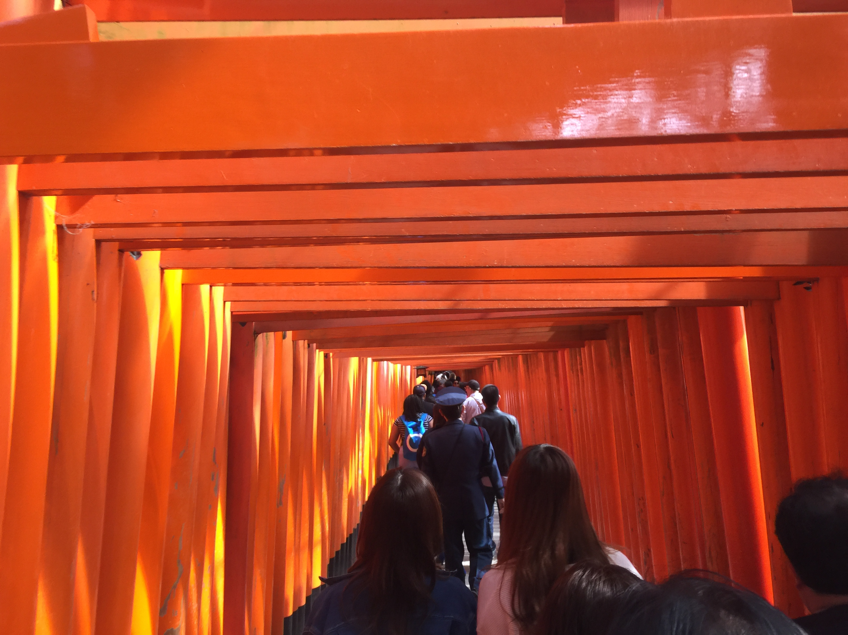

Slide 32
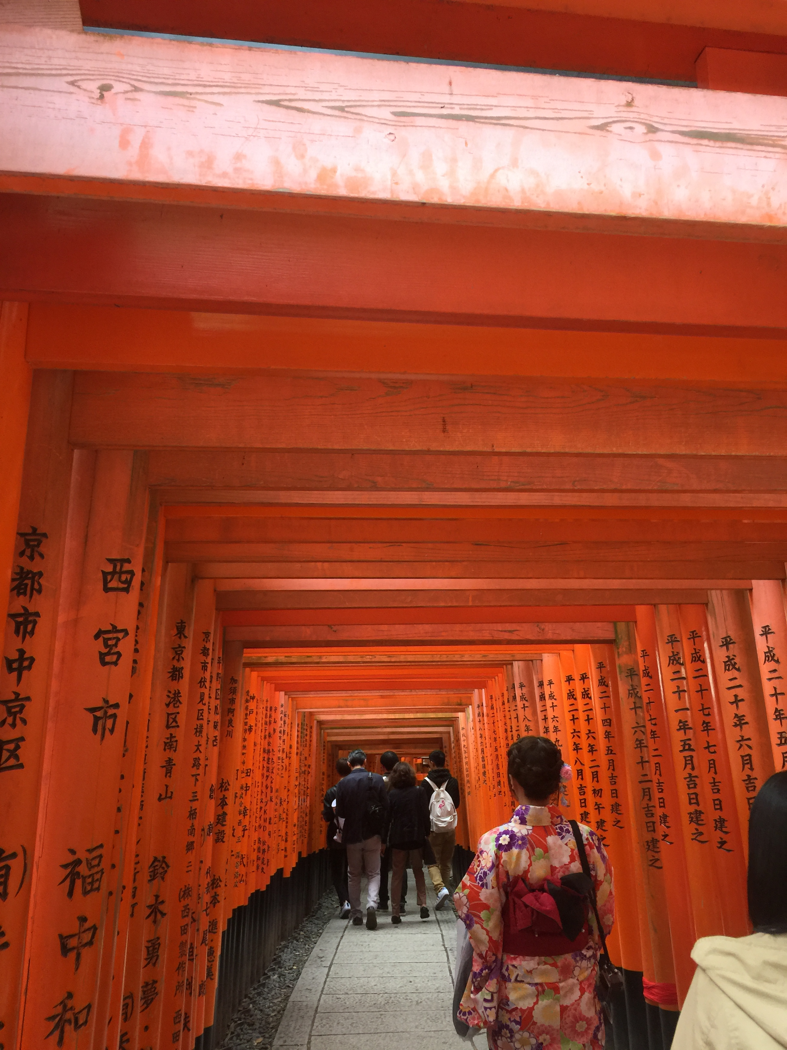

Slide 33
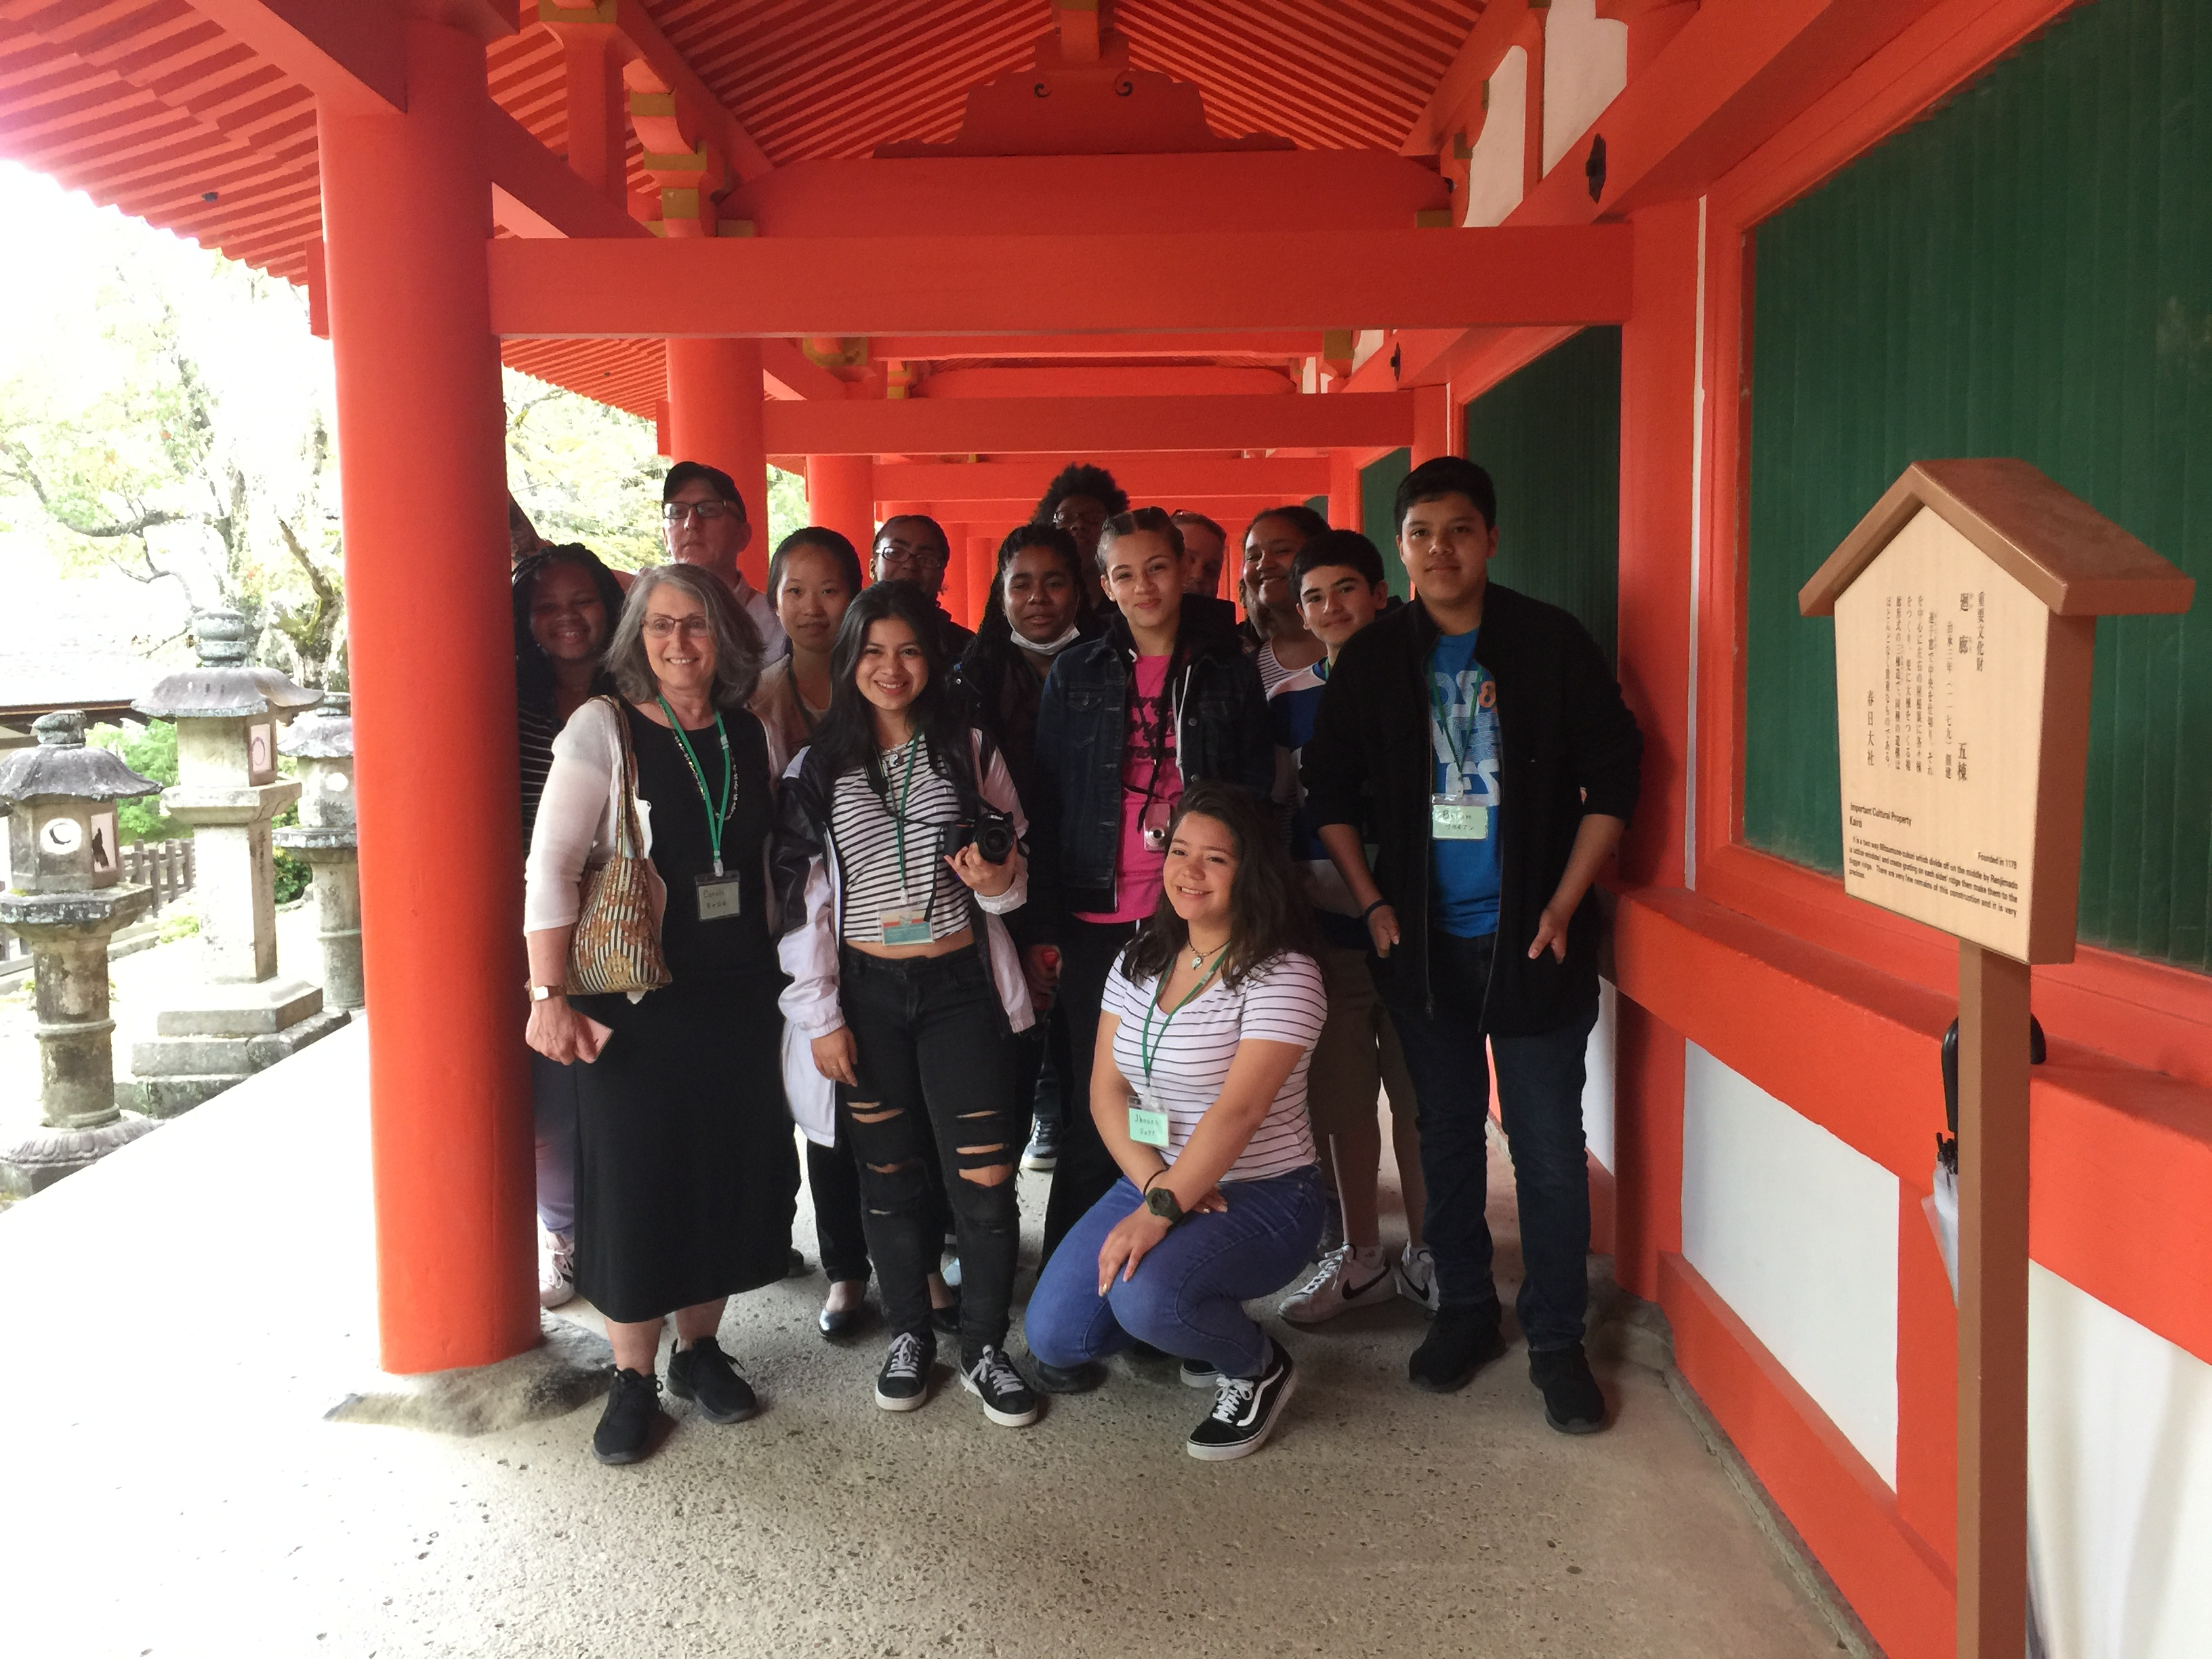

Slide 34
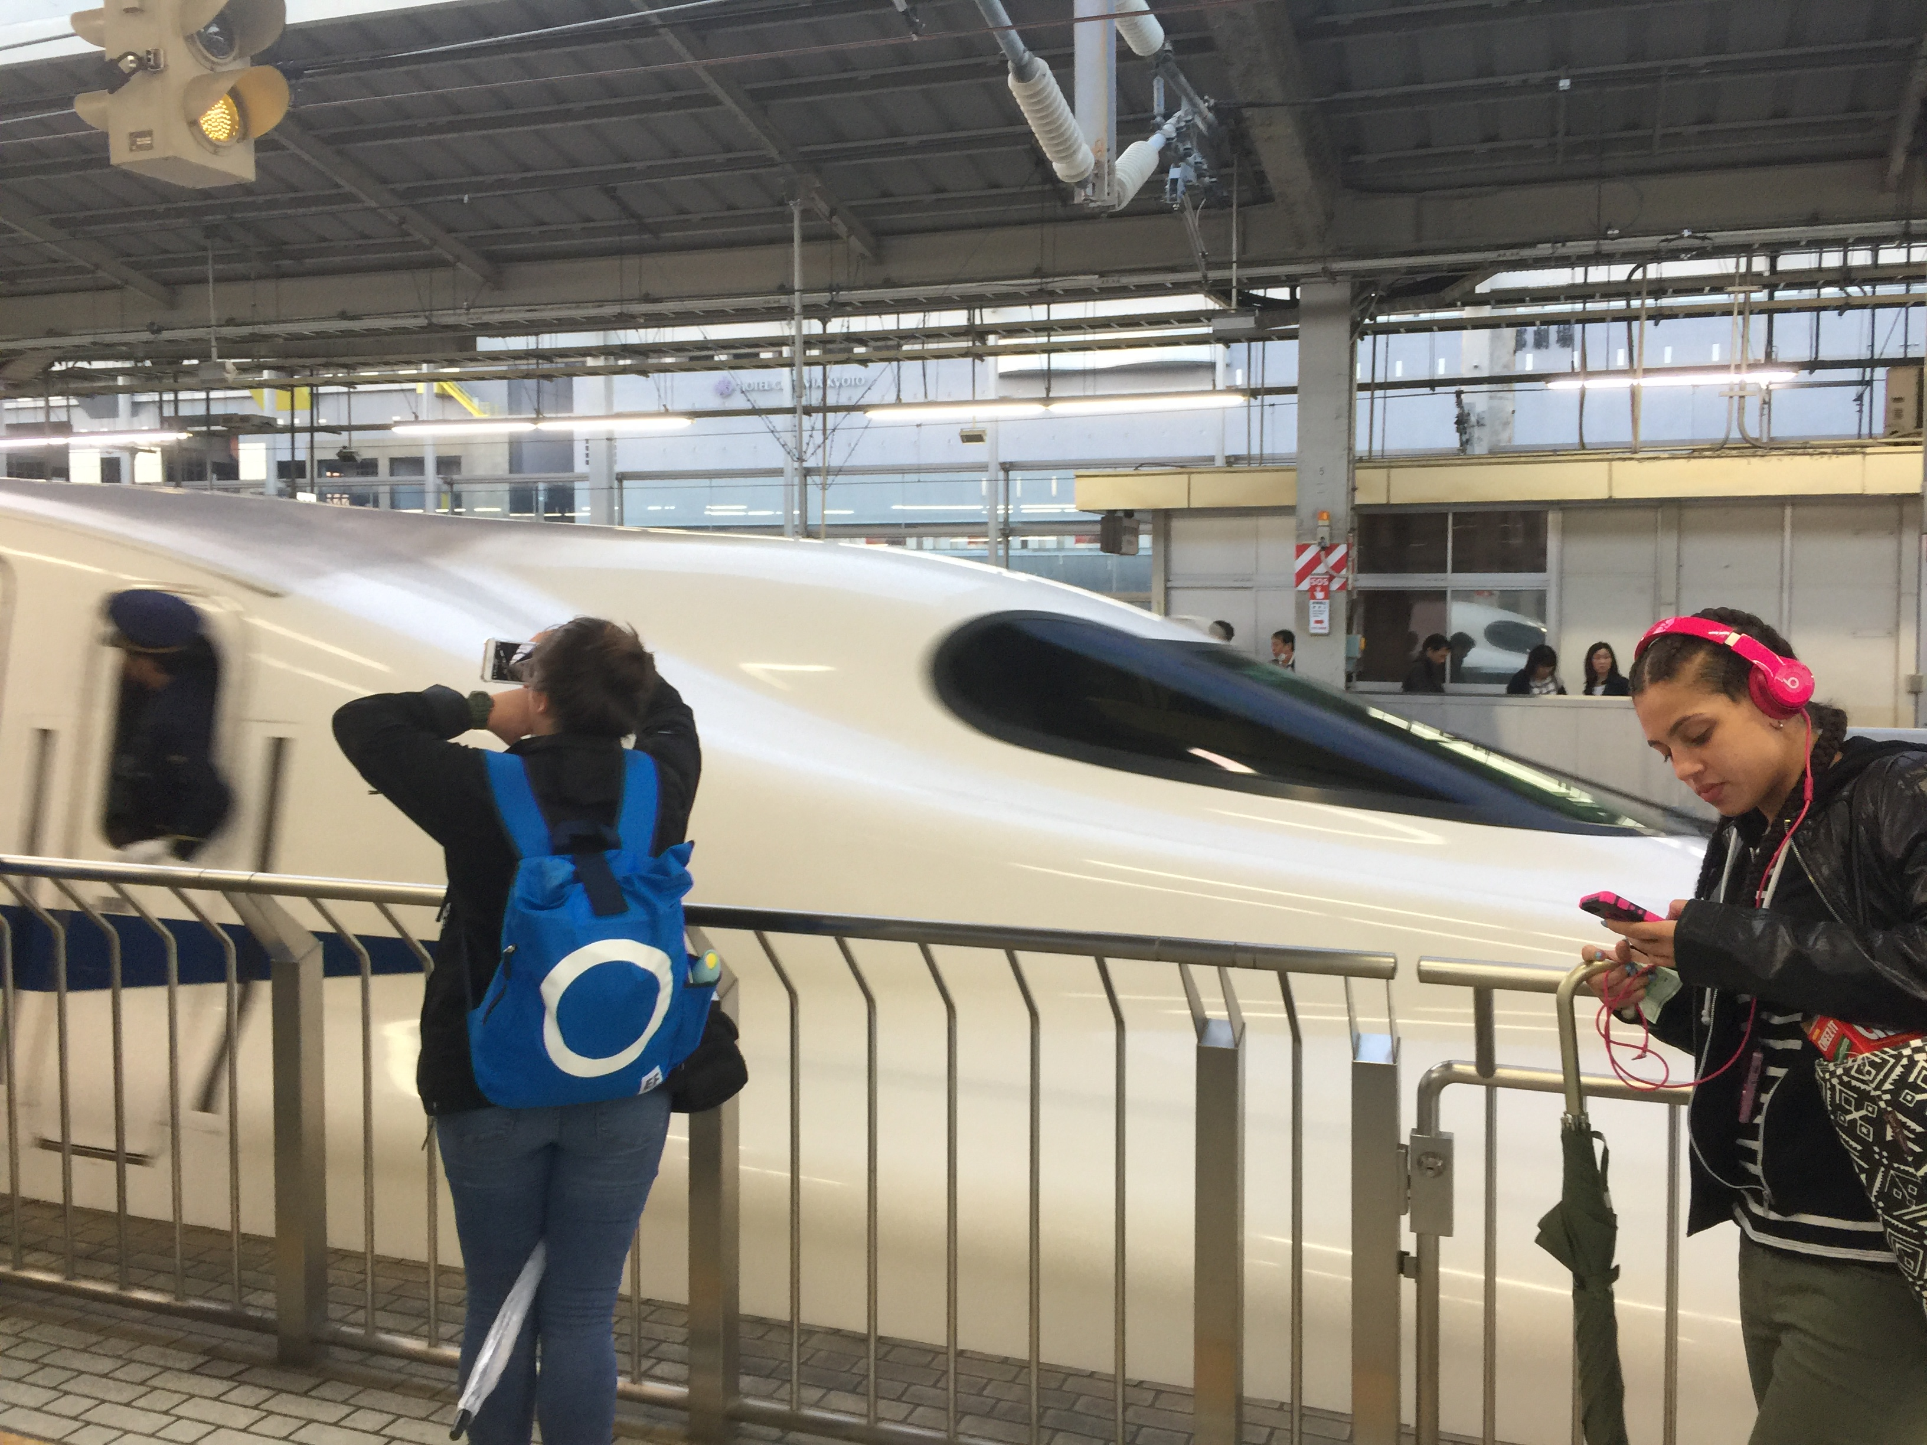

Slide 35
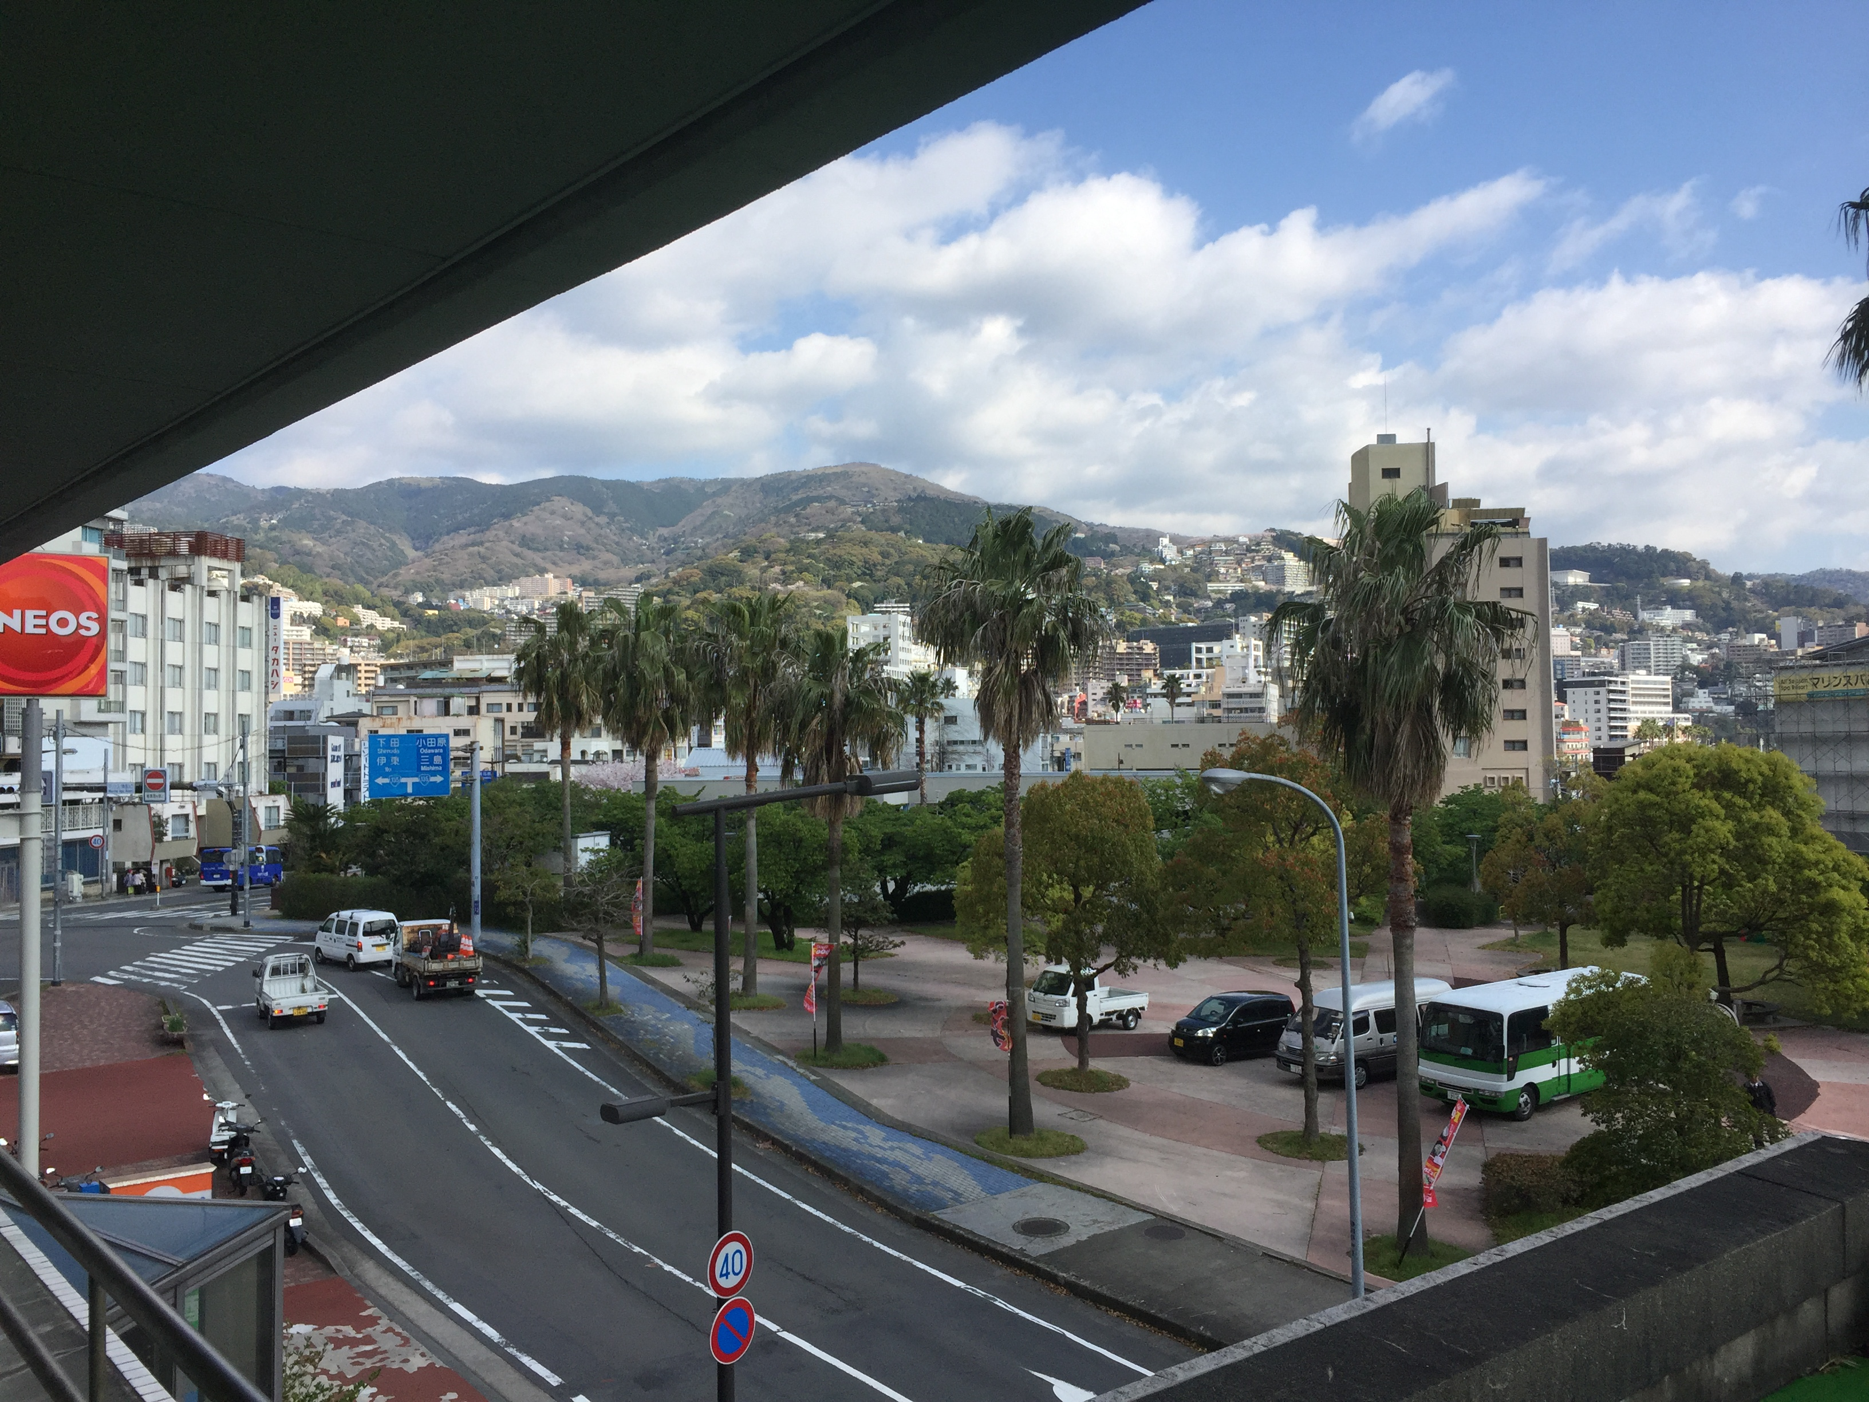

Slide 36
