Slide 1
AGE OF METTERNICH
Reaction, Revolution, Reform, Romanticism
RRRR!!

Slide 2
Conservative Triumph in a Post-Napoleonic Europe
Congress of Vienna (1814-1815)
  Aristocratic reps from countries that helped defeat Napoleon gather as guests of Austrian Emperor Francis I
  2 weeks of partying and diplomacy to bring peace and stability to Europe by reestablishing the Old Order
  Guided primarily by the wishes of Austria, Prussia, Britain, Russia and eventually France

Slide 3
Conservative Triumph in a Post-Napoleonic Europe
Congress of Vienna (1814-1815)
  France would be punished while victorious parties attained desirable territorial gains
  No regard for growing forces of nationalism and liberalism that caused revolution in the first place
    “foreign” control of many places
    Rescaling of liberal government reforms
  Congress did manage to allow Europe to avoid massive wars for nearly a century

Slide 4
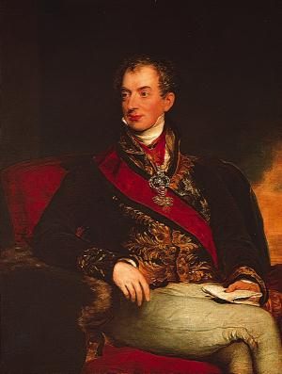
Delegates to Know and Love
Prince Klemens von Metternich – Austria
  Dominated congress and European diplomatic affairs until 1848
  Uber-conservative
  Arrogant
  Preserve Old Regime
  Guiding principle: LEGITIMACY – return Bourbons to France, Spain and Italy
I’m too sexy for bourgeois lowlife

Slide 5
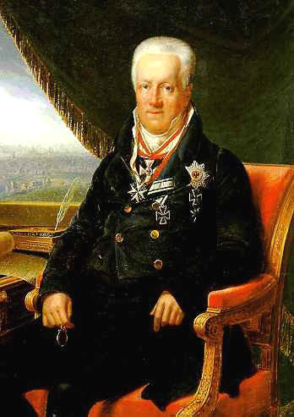
Delegates to Know and Love
Count Karl von Hardenberg (Prussia)
  Past his hey-day as a statesman
  Wife and the Prince of Wales – dissed from George III’s court
  Disgraced over not attaining all of Saxony in the negotiations
Metternich put me to shame.

Slide 6
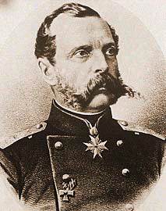
Delegates to Know and Love
Tsar Alexander I (Russia)
  One of the more liberal minded reps
  Just wanted Poland…is that so wrong?
  Very mystical – maybe wandered off to Siberia to be a hermit…nobody knows
  Other reps thought he was nuts – he often acted on a whim
Give me Russia…or give me death!

Slide 7
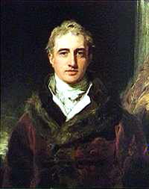
Delegates to Know and Love
Viscount Robert Castlereagh (Britain)
  Wanted to check Russia’s power
  Helped deny Russia all of Poland
  Wanted to strengthen German states and Italy against France
  Became completely paranoid later in life and committed suicide
Russia is watching me…in my house…no really…

Slide 8
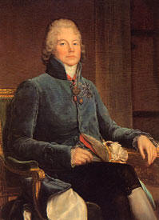
Delegates to Know and Love
My skillful diplomacy saved France from being carved up
Prince Charles-Maurice de Talleyrand
  Skillful diplomat
  Split the interests of the “Big Four” who originally attended the Congress
  Forged alliance with Britain and Austria which saved France from being decimated completely

Slide 9
Congress of Vienna: What Happened?
BALANCE OF POWER was another concern at the Congress
  Polish Question
    Russia, Austria and Prussia ALL have claims
    Prussia and Austria end up keeping parts
    Russia, who wanted it all, got an independent Polish Kingdom, with the Romanov dynasty presiding over all foreign affairs (?)
  Prussia’s loss of parts of Poland compensated by getting 2/5 of Saxony, Germanic Westphalia, and the left bank of the Rhine
  Austria compensated for losing Austrian Netherlands by getting N. Italian provinces of Lombardy and Venetia

Slide 10
Congress of Vienna: What Happened?
Prussia and Austria were strengthened to form a united barrier against possible threat of Russia or France – this appeased the British
France was reduced in size and strength so as to no be a threat
Kingdom of the Netherlands comprised of newly unified Austrian Netherlands and Dutch Republic under King William I of Orange to check France
Piedmont-Sardinia expanded into larger kingdom in SE Europe
In E. Europe, Prussia gains E. bank of Rhine, and a new Germanic Confederation formed to check France
Animated Map is HERE

Slide 11
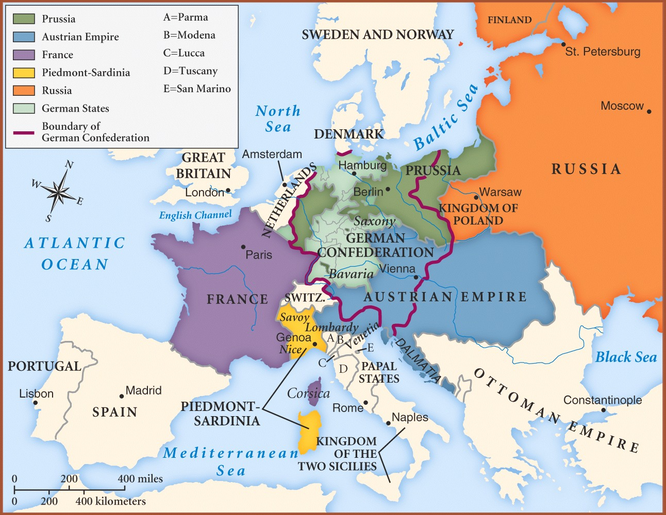

Slide 12
Congress of Vienna: What Happened?
Negotiations at the Congress were delayed by Nappy’s return from Elba and the 100 Days, but his subsequent defeat brought a great desire to PUNISH the French
  Boundaries back to pre-1790
  Forced to pay indemnity
  Foreign army occupation for 5 years
Overall, Congress of Vienna did not account for growing nationalism in Europe, as boundaries were drawn solely for purpose of balance of power, not in interests of people living there

Slide 13
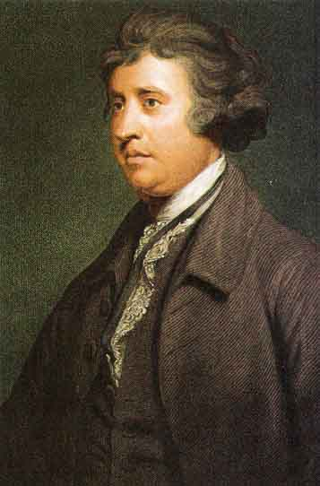
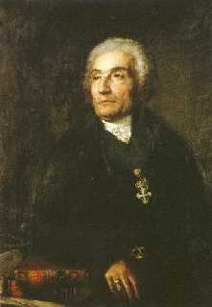
Ideology of Conservatism: Roots
Edmund Burke Reflections on the Revolution in France (1790) and the condemnation of radical revolution
Joseph de Maistre and return of divine right
Revolution is BAD.
Divine right all the way!

Slide 14
Ideology of Conservatism: Tenets
Obey political authority
Organized religion is crucial to social order
Revolution is BAD
Representative government/civil liberties are unnecessary
Nationalism is evil
Community over individual rights
Order is best, and TRADITION creates order

Slide 15
Concert of Europe
Quadruple Alliance (Prussia, Russia, Austria, GB) agrees to meet regularly to maintain balance of power in Europe
  1818 Aix la Chapelle
    Troops withdrawn from France
    France invited to join alliance
    now it’s the QUINTUPLE Alliance

Slide 16
Concert of Europe: Unraveling
1820 Troppau
  Things falling apart
  Italian and Spanish revolutions against the Bourbons necessitated ACTION according to Metternich
    Metternich advocates policy of INTERVENTION – perhaps even MILITARY
    Brits refuse to interfere – only will do so if “peace of Europe” is threatened, not civil unrest
    Russia, Austria and Prussia ignore GB and send troops to crush rebellions to restore Bourbons in both regions

Slide 17
Concert of Europe: Latin America
During Napoleonic Wars, Spanish control of their colonies weakened, opening the door for rebellion
The Concert of Europe turns to Latin America after their victories in Spain and Italy to restore order
  Britain’s lack of support breaks the alliance down and prevents effective intervention in Latin America
  Simon Bolivar and Jose de San Martin lead the fight for LatAm independence
  Brits and U.S. (Monroe Doctrine) act together to prevent intervention
    Spanish colonies gains independence (1824)
    Brazilian independence from Portugal (1825)

Slide 18
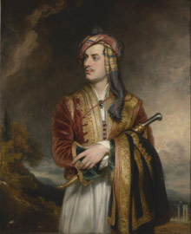
Concert of Europe: Greece
Greeks rebel against Ottoman rule (1821-1829)
European powers THIS TIME rally to the cause and intervene to support the rebellion!
Defeated Ottomans allowed the powers to decide Greece’s fate
  Greece now ruled by a BAVARIAN king (?)
  Old order restored
Greek War showed combination of new values of nationalism and liberalism with old values of balance of power as Greece was ruled by foreigners.
Lord Byron, dressed as a Greek. He died of fever en route to fighting in the war for Greek independence

Slide 19
Conservative Domination of the European States: Britain
GB – ToryTime!
  Tories dominate Whigs in Parliament
  Corn Laws (1815) → Good for land OWNERS, bad for peasants and industrial working class
    St. Peter’s Fields 60k rebellion
    Cavalry sent in → 11 killed (Peterloo Massacre)
    Smack-down on large public meetings/demos and dissemination of pamphlets among the poor
  Further rebellion avoided with Tory party turnover and concessions made to poorer classes – at least until 1830
  Score 1 for the Conservatives…for now…!

Slide 20
Conservative Domination: France
France – Bourbons are BACK!
  Louis XVIII maintained some of Nap’s policies like Concordat w/Pope and Civil Code (Louis XVII died at age 10 in 1795)
  Bicameral Legislature w/king-chosen Chamber of Peers and elite-elected (100k voters) Chamber of Deputies
  2 groups formed to oppose Louis
    ULTRAROYALISTS – L’s compromises stink!
    REVOLUTIONARIES – Perpetuate more Revolutionary reforms!
  Louis dies, leaving throne to Charles X, Count of Artois – uber-Conservative!
  Old Regime enforced as confiscated lands from Revolution returned to aristocracy, and Church control given to schools!
  Public outrage and liberal backlash led to some compromise, but by 1830, France was teetering on edge of another revolution!

Slide 21
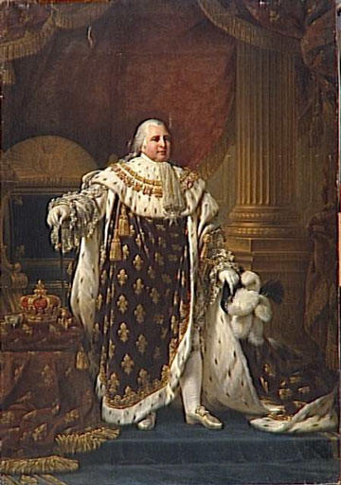
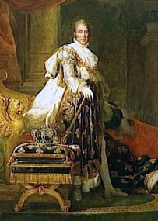
Conservative Domination: France
Anything you can do I can do better…and without cankles!
Louis XVIII and Charles X

Slide 22
Conservative Domination: Italy
Italy: Congress of Vienna gave Austrians control!
In Italy…
    Crush nationalism! Austrians brutally thwarted rebellions in Piedmont-Sardinia and Kingdom of the Two Sicilies made other revolts unlikely
    Secret societies such as Carbonari continued to work toward unification/revolution

Slide 23
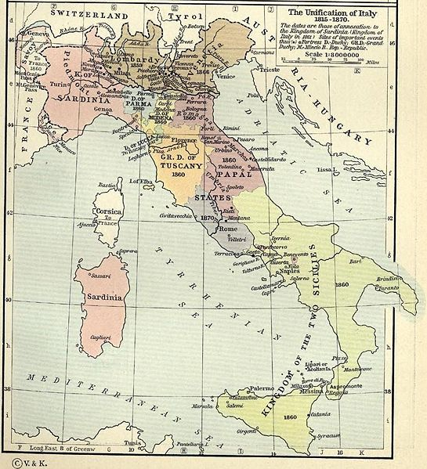
AP European History
Ch22 Lecture Terms
Conservative Domination
Two Sicilies
Piedmont-Sardinia

Slide 24
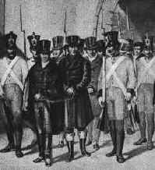
Carbonari: Secret revolutionary society dedicated to a unified and liberal Italy.

Slide 25
Conservative Domination: Spain
Spain
  Bourbon Dynasty reestablished under Ferdinand VII in 1814, who swore to uphold liberal constitution of 1812 and the Cortes, its parliamentary body
  He then tore up the constitution and dissolved the Cortes
  Revolt of army officers, bourgeois merchants, and liberal intellectuals forces him back to constitutional format.
  Metternich and Concert of Europe run in to rescue Ferdi, and force revolutionary forces to disband, advising moderate government for Spain.
  Ferdi ignores and goes “conservative CRAZY” – tortures, imprisons or exiles all supporters of constitutional system!

Slide 26
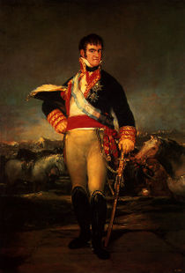
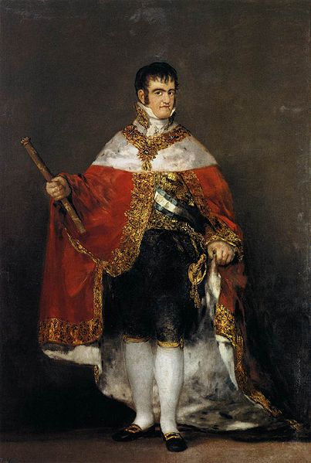
Conservative Domination: Spain
Die, constitution, die!
Ferdinand VII: “I’m a wee man. A wee, wee, man!”

Slide 27
Conservative Domination:
Central Europe
Metternich sees himself as Policeman of Europe, quelling rebellions left and right, but in C. Europe, none really existed!
Prussia and Austria dominated newly formed Germanic Confederation, which had no real power other than as a defensive alliance vs. Russian or French expansion or any “liberal” revolts.
German people were starting to embrace nationalism and looked to Prussia for leadership under King Fred Wm. III.
  Freddie initially liberal, guided by Barons Heinrich von Stein and Karl von Hardenberg, but refused to adopt a legislative assembly or representative government system.
  Fred became increasingly conservative as Metternich’s influence grew.

Slide 28
Conservative Domination: Prussia
Nationalist movements formed such as Burschenschaften comprised of student societies, dedicated to a unified German state under leadership of Friedrich Ludwig Jahn, fervent nationalist.
Freddie Will III passes Karlsbad Decrees (1819) to close Burschenschaften, censor press, and establish government control over universities!

Slide 29
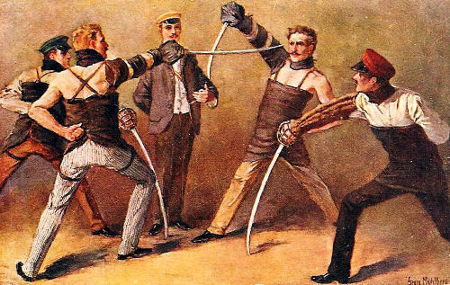
Conservative Domination: Prussia
Burschenshaften!

Slide 30
Conservative Domination:
Austria
Multinational State of Austria a ticking timebomb…
  Magyars, Czechs, Italians, Slovaks, Slovenes, Poles, Serbs, and Germans all under one leader, who favored German customs…
  Nationalism=Death of Austrian Empire
  Metternich knows this, and successfully represses these forces until 1848…

Slide 31
Conservative Domination: Russia
Alexander I was a product of Enlightenment and initially made some liberal reforms…eased censorship, reformed education, freed political prisoners, etc.
Still wants to be “absolute” however…
After defeat of Nappy, like Fred of Prussia, he turned toward conservatism and reneged on reforms, leading to rise of secret societies like the Northern Union, comprised of young aristocrats who fought vs. Napoleon and learned of his reforms wanted some of these for Russia!

Slide 32
Conservative Domination: Russia
When Alex I croaked in 1825, leaders of Northern Union saw opportunity…
  1825 rebellion vs. ascension of new Tsar in December (Decembrist Revolt 12/26/1825) and heir to throne Constantine abdicates in favor of younger brother Nicholas
  Rebellion crushed and leaders executed…Nick goes from conservative to REACTIONARY
    Determined to prevent similar outbursts
    Secret police established

Slide 33
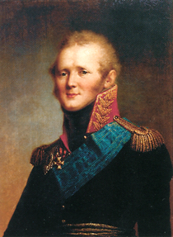
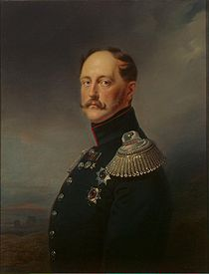
Russian Tsars Alexander I and Nicholas I

Slide 34
Ideologies of Change: Liberalism
Liberalism
  Doctrine of the Industrialist Class – People should be as free as possible!
  Economic Liberalism
    Based on Adam Smith’s Wealth of Nations
    Govmt. Should NOT interfere with economy
    Capitalism is the best system
    Supported by Malthus’ Essay on Population which claimed that working class is inevitable.
    Supported by David Ricardo’s Principles of Political Economy which legitimized practice of paying workers at subsistence level and no more! Iron Law of Wages

Slide 35
Ideologies of Change: Liberalism
Liberalism
  Political Liberalism
    LIBERTY – peaceful enjoyment of private independence and the right to pursue one’s own ends unimpeded
    Limitations must be placed on POWER, the ability of some people to control others.
    Protection of CIVIL LIBERTIES and BASIC RIGHTS.
    Equality before the law, freedom of press, speech, assembly, from arbitrary arrest, religious toleration, separation of church and state, lawmaking by elected assembly, constitutional state with power of minister above that of the king, LIMITED suffrage and office holding for men with property.
    John Stuart Mill’s On Liberty says absolute freedom of opinion! Censorship=Tyranny! Also, included WOMEN (On the Subjection of Women written w/his wife)

Slide 36
Ideologies of Change: Nationalism
Nationalism
  Identification with one’s fellow countrymen along the lines of common culture – language, traditions, dress, customs.
    Conservatives say NO to nationalism because it would break up multinational states and then threaten the balance of power in Europe.
    Liberals are all for it! It’s the only way to achieve true liberty – let people rule themselves!
    Georg W.F. Hegel pursued a more aggressive nationalism in Germany – the nation was the most important source of loyalty in a functional civilization.
      Can only be free by identifying w/one’s countrymen!
      Geist – spirit, drive/motivation, a means of comprehending history
      Old Hegelians
        reason and freedom had reached the absolute maximum and were embodied in the Prussian state.
      Young Hegelians
        the purpose and promise of history was the total negation of everything conducive to restriction of freedom and irrationality, therefore it is necessary to continue to mount radical critiques of first religion and then the Prussian political system.
        ignored aspects of his Hegel that suggested the world had essentially reached perfection.
        Marx and Engels were among this group

Slide 37
Ideologies of Change: Socialism
Socialism
  Modify laissez faire practices because industrialization/capitalism is making the rich get richer and the poor sink deeper into poverty!
  Redistribute wealth to even things up!
  Communal attitude toward production and distribution of goods

Slide 38
Ideologies of Change: Socialism
Socialism
  Utopian Socialism questions whether private property and private enterprise for profit is OK
  Charles Fourier
    no competition!
    Produce and live communally!
    Equality for women!
    Communal housework and childcare!
    Distribution of goods and profits should be 5/12 workers, 4/12 capitalists and 3/12 management

Slide 39
Ideologies of Change: Socialism
Socialism
  Robert Owen
    Utopian socialists mills for cotton
    Improved working conditions
    Shorter hours
    No child labor
    Insurance provided
    Emigrated to US to start New Harmony mills in Indiana.

Slide 40
Ideologies of Change: Socialism
Socialism
  Saint-Simon: organize all of society into intellectual leaders and industrial managers – no need for government!
  Louis Blanc: government Must meet basic needs of people! Competition is bad and cooperative system run by government is necessary!
  Flora Tristan: combine socialism and feminism! Pro-UNIONS. See to needs of ALL people – including working WOMEN!

Slide 41
Ideologies of Change: Socialism
Socialism
  Marxian Socialism
    Based on the works of Marx and Engels
    “The history of all hitherto existing society is the history of class struggles.” (Communist Manifesto, 1848)
    Capitalism is a necessary stage in the movement toward the revolution of the proletariat (working class)
    The pinnacle of capitalism = IMPERIALISM, when you can no longer exploit markets at home, you must exploit other areas of the world
    Proletariat would rise up and overthrow the bourgeois class, thus creating a classless society
    “What the bourgeoisie therefore produces, above all, are its own grave-diggers. Its fall and the victory of the proletariat are equally inevitable.” (Communist Manifesto, 1848)

Slide 42
Revolution and Reform 1830-1850: France
France
  Charlie X calls for new elections in 1830 and LIBERALS are victorious, galvanized by C’s oppressive politics.
  Pissed, C. revokes Charter of 1814 and issues July Ordinances in its place:
    Rigid censorship
    Dissolves legislative assembly
    Reduces electorate
  Instigates July Revolution (1830), where moderate propertied liberals rebel and set up provisional government Under Louis-Philippe, Duke of Orleans and Charlie’s cousin
  Charles flees for his life to Britain and new monarchy is born!
  Inspired Les Miserables (Hugo, 1862) and Liberty leading the People (Delacroix); also inspired revolutionary activity across Europe.

Slide 43
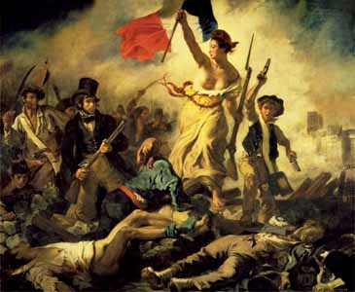
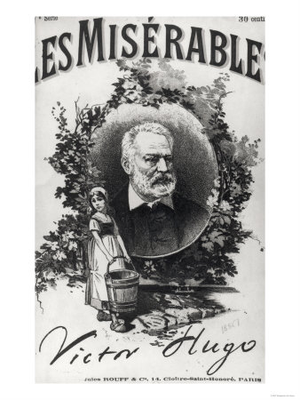
Revolution and Reform 1830-1850: France
Liberty Leading the People by Delacroix and Les Miserables by Hugo.

Slide 44
Revolution and Reform 1830-1850: France
France
  Louis-Phil is the darling of the upper middle class – even dresses like them!
  Expands the electorate to enfranchise them
  Reinstates Charter of 1814
  Upper bourgeoisie happy (but the rest…?)
  Lesser Bourgeoisie pissed – they helped overthrow Charles and didn’t reap any benefit!
  Industrial expansion and urbanization instigated poor working conditions and workers grew increasingly angry
  1831/1834 rebellions in Lyon silk industry caused troops to be unleashed on rebels and government became increasingly reactionary (making the situation even worse)

Slide 45
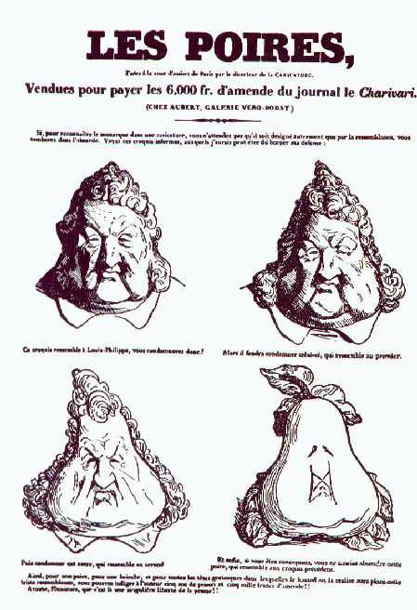
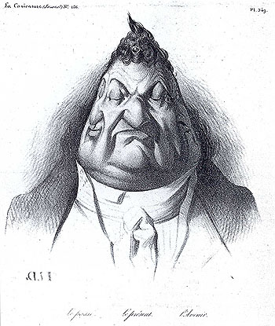
Revolution and Reform 1830-1850: France – Louis Philippe, “Une Poire”
Caricature became an important way to express political discontent. These images attacked both his morbidly obese physique as well as his lack of intellect.

Slide 46
Revolution and Reform 1830-1850: Britain
1830 election brought Whigs to power
Successful July Revolution in France inspired GB to make reforms…
Industrial Revolution had been happening for nearly 80 years in GB and the industrialist class had made the BIG BUCKS – they protested against the limited election system that disenfranchised them
Although mostly landed and wealthy, the Whigs advocated reform to avert a nasty revolution and passed Reform Bill of 1832
  extended voting rights to industrial middle class, increasing voting population from 478k to 814k
  still only 1 in 30 people was represented in parliament
  Effectively killed Chartist Movement

Slide 47
Revolution and Reform 1830-1850: Britain
1830’s and 1840’s brought increasing rivalry between landed aristocrats and industrialists in Parliament
  Aristocrats wanted reform to help working class (and keep them from rebelling)
  Industrialists wanted to protect their own interests through economic liberalism
  Industrialist class triumphed and reform was based on economic liberalism

Slide 48
Reform in Great Britain
Poor Law of 1834
  placed paupers in overcrowded workhouses overworked and miserable
  Intended to make them stop “being lazy” – which is how most industrialists explained poverty at that time
Corn Law repeal 1846
  Due to work of industrialists Richard Cobden and John Bright who formed Anti-Corn Law League in 1838
  They lowered bread prices to help the workers but also removed government restriction on corn trade which helped industrialists
  Corn laws had pretty much prohibited export of corn to keep bread cheap in GB and protect large landowners– now free market allows industrialists to make the big bucks in exporting!

Slide 49
Revolution and Reform 1830-1850: Britain
In GB, then, the liberals and nationalists were successful and satisfied while the working class would have to wait to be enfranchised.
On the continent, the liberals and nationalists were the ones at the forefront of rebellions!

Slide 50
Revolution and Reform 1830-1850: Netherlands
While liberalism fueled the fire in France revolutions, nationalism fueled revolutions elsewhere…
The Netherlands
  Congress of Vienna added area once known as Austrian Netherlands to Dutch Republic.
  These two areas had different language, culture, etc.
  Those in Austrian Netherlands were Belgian and resented absolutist rule of Dutch king Wm. Of Orange.
  Belgians rose up and resisted and successfully established their own independent Belgium with German Prince Leopold Saxe-Coburg as king and a constitutional monarchy.

Slide 51
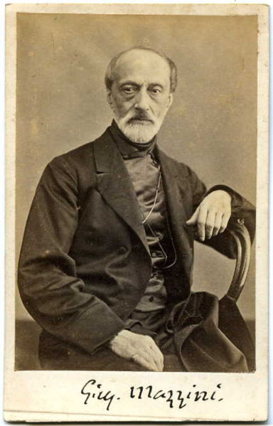
Revolution and Reform 1830-1850: Italy
Italian States – 3 separate Italian states are all crushed by Metternich’s intervention
  Giuseppe Mazzini joined Carbonari in 1830
  Led revolts in 1830’s and was exiled
  Giovine Italia or Young Italy movement for unification
  “One, Independent, Free Republic” was the goal
  Inspired Young Germany and Young Poland Movements for unification as well

Slide 52
Revolution and Reform 1830-1850: Poland
Poland
  1830 nationalist revolt attempted to end Russian control and policy of Russification
  Polish rebels don’t get assistance from French or Brits and get crushed by Russians in 1831
  As a result, Russians establish oppressive military dictatorship in Poland

Slide 53
Revolutions of 1848:
Setting the Stage
Liberalism triumphs in GB
Some liberal/nationalist success in France, Belgium and Greece
Spain, Italian States, German States, Russia and Poland saw no such success in resisting conservative order
  Defenders of liberalism and nationalism fringe groups – junior army officers, liberal nobles, writers, students, professors, and free-thinkers
  Spread of IR across Europe propagated new socio-economic classes and their demands for change!
  1848 – these forces of change erupted once more…

Slide 54
Overview
The 1840s in Europe are also known as the “hungry forties” or the “starving forties” because of the frequent famines
A major drop in demand for goods resulted in high unemployment, especially in the textile industries
This atmosphere was ideal for those who saw an opportunity to challenge the existing political order
Demands:
  The Czechs and Hungarians wanted independence from the Austrian Hapsburgs
  German nationalists wanted unification
  other reformers wanted social changes such as land reform, freedom of the press and freedom to assemble
  most wanted universal manhood suffrage

Slide 55
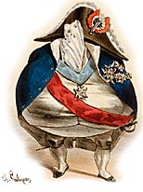
Revolutions of 1848:
France
Another French Revolution?
Revolution of 1848 erupts due to growing dissatisfaction with Louis-Phil’s increasingly conservative policies

Slide 56
France
France had already seen a revolution in 1830
The Orleanist monarch Louis-Philippe (July monarchy) had taken power but had become a ineffective leader
Republicans demanded more changes including electoral reform
In addition the harvest of 1846 was a disaster
In 1848 the Republicans organized a massive banquet to discuss reform (the banquet was because political rallies were prohibited)
French premier François Guizot banned the event
Protestors marched through the streets demanding the resignation of Guizot

Slide 57
France
The National Guard refused to disperse the crowd
Louis-Philippe fired Guizot
That same night the troops panicked and opened fire on the crowd
When it was over 40 people had been killed
The crowd refused to disperse and started to erect barricades throughout the city
Louis-Philippe abdicated – hoping his grandson would be installed as the new monarch – but it was too late
The crowd proclaimed the start of the Second French Republic
The Chamber of Deputies created a provisional government which included Louis Blanc, a socialist
The provisional government prohibited slavery in the colonies and proclaimed universal manhood suffrage

Slide 58
France
The revolution spread from Paris to the provinces
However, there were many political factions that wanted power:
a) Royalists wanted to restore the Bourbon monarchy
b) Orleanists wanted the sons of Louis-Philippe to assume control
c) Radical Republicans opposed the Orleanists
d) Socialists wanted to establish a “social republic” in which the government would provide for the needs of the people
When some French nationalists threatened to annex Nice the other European powers worried that France would try to spread their revolution
Political clubs formed in Paris, trying to garner votes from the newly empowered electorate

Slide 59
France
The political turmoil devastated Paris causing thousands to lose their jobs
The economic crisis spread to the provinces, but as people lost their jobs they moved to Paris looking for relief
In response to the problem the provisional government opened “National Workshops” in an attempt to keep people busy
Almost immediately those who paid taxes complained about having to subsidize the workshops
Women also formed political clubs and demanded equality before the law, the right to divorce, and better working conditions – some even demanded suffrage
In April the elections were held to elect a National Assembly and to write a new constitution

Slide 60
France
The conservatives (many monarchists) won the majority of the 900 seats
When representative from the far left tried to have the Assembly dissolved the government responded by arresting troublemakers
As the Assembly ran out of money it started to close the workshops, which only compounded the problems
On June 23, the Assembly declared the workshops would be shut for three days, unmarried workers would be drafted into the army while married workers would be sent to the provinces
When news of the proclamation leaked to the people the city erupted in rebellion
The “June Days” ravaged the city

Slide 61
France
General Louis Cavaignac, the minister for war, brutally suppressed the rebellion
Thousands of rebels were executed by the army – afterwards many more were deported
Karl Marx saw the June Days as a precursor of future conflict between the bourgeois and the proletariat
The Assembly passed legislation prohibiting political movements and limiting freedoms
On December 10, 1848 Louis Napoleon was elected president of the Second Republic by a landslide!
Louis Napoleon’s only claim was that he was the nephew of Napoleon Bonaparte – this was enough
The romantic idealism of the old Napoleon was enough to give Louis Napoleon a landslide victory…he later staged a coup in 1851 and became EMPEROR LOUIS NAPOLEON III by 1852…the irony!

Slide 62
The German States –
March Days
The revolutionary movement spread eastward from France to the German states
Like most other European nations the German states suffered greatly from the famines of the 1840s
Both radicals and liberals wanted an end to feudal obligations, political repression, freedom of press and assembly, and more participation in the elections
The liberals did not want universal manhood suffrage
The radicals wanted a revolution and hoped it would eventually lead to unification
The revolutions in France forced the Germans to make changes

Slide 63
The German States
Reforms were implemented in the German states were towards the liberals, but everyone watched for Prussia and Austria – the two largest states
Frederick William IV, king of Prussia, replaced his conservative cabinet with a more liberal group
He also promised an end to censorship and create a joint constitution for all the German states
When troops moved to disperse a crowd of demonstrators in front of the palace someone fired a shot
Students and protestors erected barricades in the city
The next day the army moved against the protestors killing several hundred

Slide 64
The German States
As in all revolutions, once the army kills civilians the situation deteriorates
The king, in an attempt to restore order and gain the confidence of the people, sent representatives out into the city
He promised to released imprisoned liberals and that Prussia would be merged with Germany
The German Confederation accepted the idea of a German Constituent National Assembly (the Frankfurt Assembly)
In May, 1848 the 800 elected members took their seats
But the Frankfurt Assembly had no national power and it was not supported by the rulers of Austria or Prussia, nor did it command an army

Slide 65
The German States
Perhaps more importantly, there was no consensus on unification
  Some delegates advocated a kleindeutsch – a Germany that would not include Austria
  Others wanted a grossdeutsch – a Germany that would include all the German states including Austria
Eventually an agreement was reached for the new Germany to include all the German states, but not German states with non-German populations
The United Assembly of Prussia (elected after the March Days) drafted a new constitution for Prussia, which took away many of the traditional rights of the Junkers
Frederick William, inspired by the French, sent the army to Berlin, removed the liberal cabinet, and dissolved the Assembly

Slide 66
The German States
Frederick William declared martial law and set about suppressing the revolutionary movement
Forgetting liberal ideals when the Poles rebelled and demanded independence, the Frankfurt Parliament voted overwhelmingly to use force to crush the rebellion and expressed support for the Hapsburg suppression of a rebellion by the Czechs
The middle class in Prussia were unable to establish a power-base because they feared both the nobles and the peasants

Slide 67
The German States
In December 1848 the Frankfurt Parliament proclaimed the Basic Rights of the German People (influenced by the Americans and French)
The Declaration promised:
  equality for all German citizens
  freedom of speech
  freedom to assemble
  freedom of religion
  the right to private property

Slide 68
The German States
The Austrians refused to accept the Declaration and saw the move as anti-monarchy
Austria said it would only join a unified Germany is all Austrian states could join – not acceptable to the Germans
In 1849 the Frankfurt Parliament proposed a unified Germany with two houses of Parliament and an hereditary emperor – Austria rejected the idea
The only way the plan would work was if the king of Prussia would become the king of a unified Germany
The Parliament asked Frederick William
Because the Parliament had no real authority the king rejected the offer saying he would not accept a “crown from the gutter”
The Frankfurt Parliament had failed – German unification would have to wait…

Slide 69
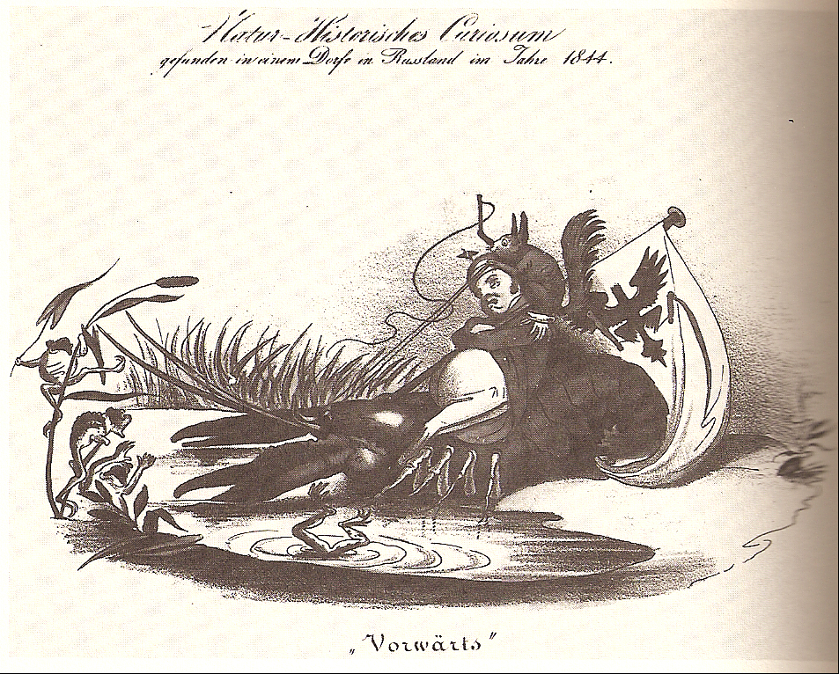
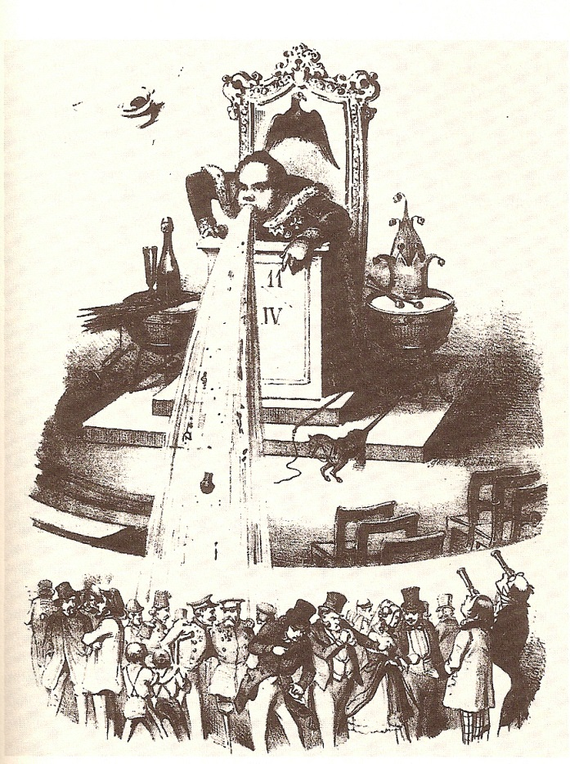
The German States
“Crayfish Cavalier: Curiosity of Natural History, found in a village in Russia.” (fig. 7) These references connect the Prussian king with the backward-walking crayfish as well as backward and despotic Russia
Another later work from 1847 anonymously depicts the king’s reaction to the representatives of the United Prussian Diet’s request for a constitutional monarchy. Titled, “How One Appeals to the People” (fig. 8), it features the Kaiser on a throne, high above his subjects, vomiting all over two crippled retired soldiers (Townsend 166).

Slide 70
Austria-Hungary
In Austria the people wanted an end to autocratic rule – not necessarily Hapsburg rule
Liberals wanted the emancipation of the serfs, freedom of the press, and greater participation in the electoral process
Emperor Ferdinand had no plan to share power
In Hungary, which was also ruled by Ferdinand, the liberals wanted constitutional reform and eventually an independent Hungary
Louis Kossuth became the greatest proponent of Magyar (Hungarian) nationalism

Slide 71
Austria-Hungary
While Kossuth advocated reform he was unable to get the nobility to support changes that would undermine their own privileges
Once the news from France reached Vienna the liberals and the radicals became emboldened
In March, students demanded reforms – troops opened fire and killed several demonstrators
Metternich, dismissed by Ferdinand, knew what the end result would be and left Vienna for the safety of London
The emperor agreed to form the National Guard and opened national workshops to provide employment
The emperor also promised freedom of the press and to expand the electorate
Faced with rebellions throughout the empire from various factions the emperor quickly made concessions and then changed his mind

Slide 72
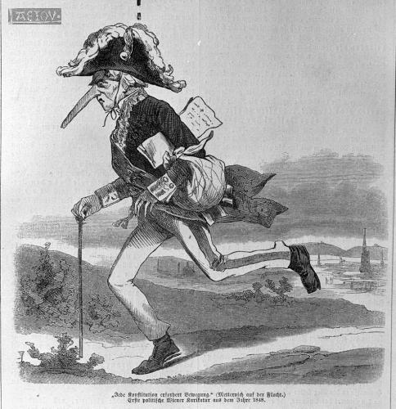
Austria-Hungary
Metternich fleeing Austria for Britain, 1848

Slide 73
Austria-Hungary
As a result of the changes the students erected barricades in the streets of Vienna
Fearing even more widespread rebellions the emperor abolished the robot and an end to seigneurial dues (the nobles would be compensated by the crown)
Hungarian nobles acted as if there was no emperor – Kossuth demanded complete autonomy
Kossuth proclaimed the “March Laws” – delegates of the Hungarian Diet would be elected by male property owners
The emperor would be king of Hungary but Hungary would have a separate army and conduct its own foreign policy
The emperor had no choice but to agree

Slide 74
Austria-Hungary
Immediately the Hungarian Diet declared freedom of the press and ended the robot for peasants who owned land (but not for landless peasants)
Other ethnic groups in Hungary were completely ignored and Kossuth faced growing opposition
The emperor began to mobilize Croatian troops against Hungary
The Hungarians then refused to help the emperor battle Italians
In response the emperor withdrew the concessions he had made to Hungary regarding autonomy
Czech nationalists revolted and demanded freedom from Germany and hosted a Pan-Slav Congress
The Congress was not unified and all that they could agree upon was a joint hatred of the emperor

Slide 75
Austria-Hungary
In June the hungry people of Prague erected barricades to protest the slow reform movement
The imperial governor turned the army on the people and he used cannons to disperse the crowds
When the Croatians defeated the Hungarian army it looked like the stability may be restored in the empire
In August, Ferdinand started to close the workshops
The workers rebelled but were quickly crushed
A few months later the workers rebelled again – expecting help from Hungary (which did not materialize) – again they were crushed and over 3,000 were killed
The emperor ended freedom of the press and imposed martial law (lasted until 1851)

Slide 76
Austria-Hungary
The emperor was persuaded to abdicate the throne in favor of his teenage nephew Francis Joseph
The Hungarian Diet refused to recognize Francis Joseph
Kossuth rallied support against the Austrians and the Hungarian army twice defeated the Austrians
On April 14, 1849 the Hungarian Diet proclaimed Magyar independence and made Kossuth the president
Francis Joseph called on Russia to help suppress the Hungarians
Nicholas I sent 140,000 troops
Kossuth asked the Frankfurt Assembly for help and was refused
The British didn’t want Russian intervention, but wanted Hapsburgs to buffer against the French
The Hungarians were defeated by the Russians and Kossuth fled to Turkey
The emperor executed suspected troublemakers and imposed martial law

Slide 77
Italy
Italy was not unified and much of northern Italy was controlled by either France or Austria
King Charles Albert of Piedmont-Sardinia made some minor concessions by easing censorship and creating a bicameral legislature
The reform movement in Italy was hampered by the many different objectives of the various groups:
  liberals wanted political reform
  radicals wanted to create a republic
  workers wanted benefits
In March, thousands marched on the palace of the Austrian governor-general in Milan demanding liberal reforms

Slide 78
Italy
Almost immediately, like in other cities, barricades were erected
For “Five Glorious Days” street fighting between the Austrian army and the protestors took place
The Austrian army, led by Count Joseph Radetzky, was forced out of the city
Other Italians towns rebelled against Austrian rule
Mazzini took over Risorgimento (resurgence) movement for unification. Formed organization called Young Italy (Giovine Italia) in 1831, which advocated patriotism and nationalism.
Provoked revolts from south in Sicily upward, and almost was successful, as citizens in Lombardy and Venetia rebelled against Austrian control.
Many looked to Charles Albert for leadership
Charles Albert believed the best way to unify the peninsula was through negotiated settlement – not violence – also, if Piedmont attacked the Austrians then the French might join the Austrians against the Italians
Eventually, because of popular appeal, he changed his mind and raised an army

Slide 79
Italy
When he had defeated the Austrians and taken control of several of the regions he decided to consolidate his power rather than chase the Austrians
Tensions between the regions stalled the unification movement
Pope Pius IX released some liberal prisoners and looked like a possible leader, but he was not going to challenge the Catholic Hapsburgs
The pope said he would not support a war against Austria
The French supported the Italians against the Austrians because they wanted to annex Nice and Savoy – but the British persuaded them not to interfere
The reinforced Austrians, led by Radetzky, defeated the Italians at Custoza, near Milan

Slide 80
Italy
Charles Albert fled the city and went to Turin and tried to negotiate a settlement with the Austrians
When the Austrians were forced to deal with the Hungarians, nationalist elements in Piedmont persuaded Charles Albert to start fighting again
When the Piedmont army crossed into Lombardy Radetzky again defeated the Italians in March 1849
Charles Albert asked for an armistice and abdicated the throne to his son Victor Emmanuel II – Piedmont also gave up all claims to Lombardy
When the nationalist Giuseppe Mazzini arrived in Rome in March 1849, Pope Pius IX began to fear the creation of an Italian republic
Louis Napoleon of France sent 10,000 French troops to Rome in order to gain favor with French Catholics
Italian unification would have to wait…

Slide 81
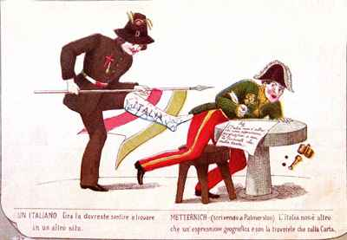
Italy

Slide 82
The Legacy of Revolution
The Revolutions of 1848 raised the hopes of liberals and nationalists from all across Europe
But the sad fact was that while some enjoyed initial success, they all failed, and failed miserably
The repercussions that followed reasserted the old order and served to make European nations even stronger
The volunteer armies proved no match for the professional armies of the counter-revolutionary movement
Yet 1848 did create the idea of workers demanding political rights and that political unrest would only become more evident during the rest of the century
Ironically, the main goal of nationalists in Italy and Germany was realized by unification
On a global scale, the dissemination of committed socialists to areas like the United States and Latin America helped shape the future of those regions
In Austria the monarchy had been able to survive and keep the polyglot empire in tact by using forces from one area on people of different ethnicity

Slide 83
Emergence of an Ordered Society
Police Forces:
  Industrialization and urbanization led to increase in criminal behavior – something had to be done!
  In France, serjents established by prefect of Paris, Louis-Maurice Debelleyme in 1828, whose numbers grew to 4,000 by end of 19th century.
  In Britain, Robert Peel introduced legislation to get police force. Municipal Corporations Act of 1835 established police force “Bobbies”.
  In German states, Schutzmannschaft established, modeled after London police force
Prison Reform
  More cops = more arrests!
  Britain used to ship criminals to Australia, but this slowed in the 1830’s as colonists got increasingly pissed (practice of penal transportation)
  Goals in prisons changed from punishment to rehabilitation and transformation.
  Individual cells replaced communal living, which seemed to make everyone more evil.
  France also did this to make a more ordered and disciplined society.

Slide 84
Romanticism
Romanticism developed as a reaction against Enlightenment thinking and preoccupation with discovering the truth through reason.
Reason not BAD, but you must also use your intuition and emotion to know the world.
Characteristics of Romanticism
  Began in Germany with group of German poets who emphasized emotion and sentiment.
  Inspired by tragic characters such as Goethe’s Werther, in The Sorrows of Young Werther, who was rejected by society and the woman he loved, but let sentiment drive him until he committed suicide.
  individualism or interest in unique traits of each person. Everyone has a geist that makes them unique. (Spirit)
Many romantics rebelled against society’s conventions – wore weird outfits and long hair and crazy beards.
Standing up against society and being an outsider are both heroic things!
Romantics sometimes embraced RELIGION due to its spiritual nature

Slide 85
Romanticism - Literature
Gothic novel and Gothic stories (frightening and fantastic) developed as a genre (Mary Shelley’s Frankenstein or Poe’s stories) – go back to medieval era of heroes and even Gothic architecture.
Many of these romantics sought out-of-the-ordinary in life through drugs, dream interpretation, and suicidal depression.
Many stories and poems about losing one’s love to a fatal disease (Poe)
Romantic Poets
  Percy Bysshe Shelley, Lord Byron, William Wordsworth – love of nature, rebel against society, melancholy romantic heroes.
  Shelley drowned in the Mediterranean
  Byron died on the way to fighting in the war for Greek independence.
  Wordsworth spoke out against reducing nature to a cold scientific explanation, as did Mary Shelley in Frankenstein – dangers of trying to conquer nature with science.

Slide 86
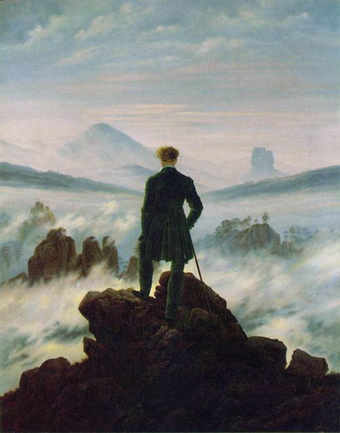
Romanticism - Art
All artistic expression a reflection of artist’s inner feelings
Reject principles of classicism.
Caspar David Friedrich (left)
Malford William Turner
Eugene Delacroix
exotic, misty, nature emphasis, emotion-driven, landscapes, FEELING is key.

Slide 87

Romanticism - Music
Beethoven bridged gap bet. Classicism and romanticism – his early 18th century compositions were like Haydn and Mozart, but Eroica broke the mold in 1800.
Beethoven battled his deafness from 1800 on and composed the chorale finale of the lively 9th while totally deaf!
Berlioz followed in the romantic tradition – Symphonie Fantastique was the story of an affair equipped with opium induced witch gatherings!

Slide 88
Religious Revivalism
Catholicism
  Catholic revival occurred as a result first of conservative/reactionary restoration of aristocratic power
  A second revival came as a result of romanticism, which looked to Middle Ages and Christianity as awe-inspiring, expecially in Germany, where many catholic conversions occurred.
  Francois-Rene de Chateaubriand spearheaded this in his work Genius Of Christianity where he notes tat Catholicism is the most sentimental o religions.
Protestant revival too – Awakening
  Methodism in GB that spread to France and Switzerland and Scotland
  Pietism in Germany – hellfire and brimstone style – appeal to emotion for the “educationally challenged.”

