Slide 1
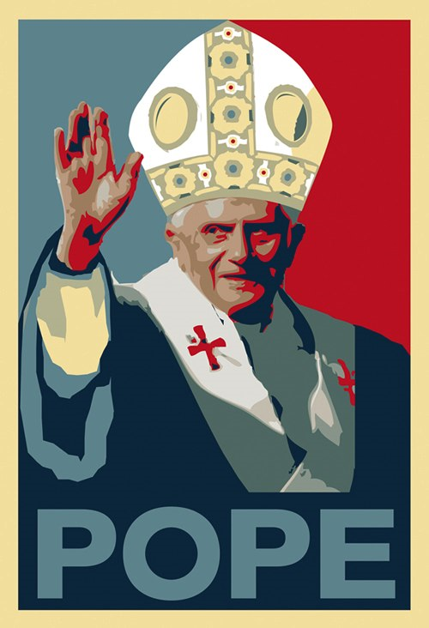
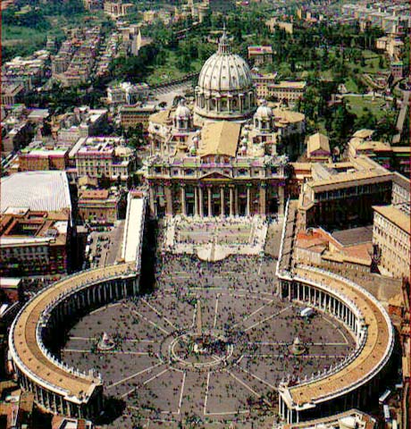

Protestant Reformation
What was the Protestant Reformation?
TO
Protest
Reform
What/Who?
Roman Catholic Church

Slide 2
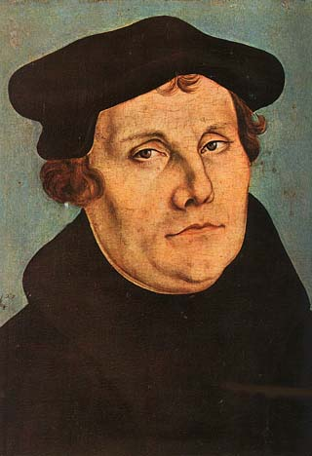
Martin Luther- 1517
German monk
Questioned Churches practices
Sale of indulgences
“ selling forgiveness for sins” (Automatic trip to heaven in the after-life by paying the church to forgive your sins)

Slide 3
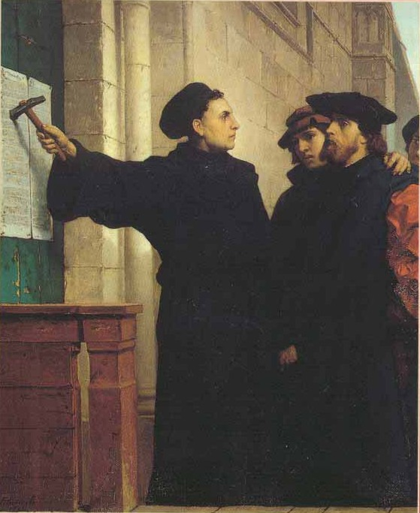
95 Theses
Luther was so upset at church he decided to write down the 95 Theses (95 things church is doing wrong) and nails them to the church in Wittenberg (Germany)

Slide 4
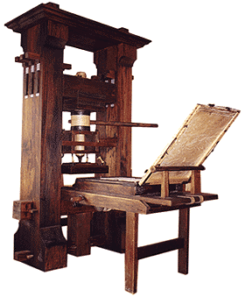
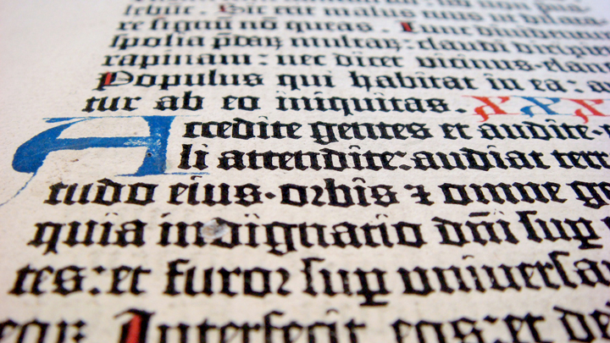
How did this become such a big deal?
Effect of the printing press – ideas are spread faster
Opened people’s eyes to church malpractices (wrong doings)

Slide 5
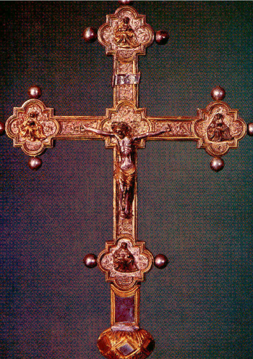
Martin Luther
“Faith Alone” will save you
All should read the Bible in their own vernacular (language)
Priests do not have special powers
Religious Education for all

Slide 6
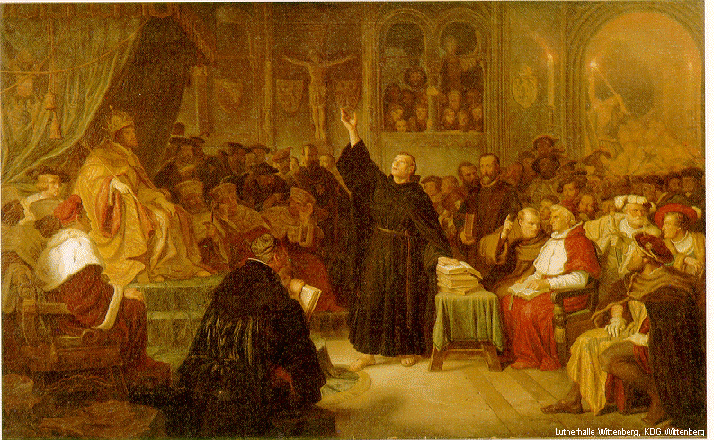
Church’s Reaction?
Let him say what he wants
Nope!
Want Martin Luther to recant (take back) what he said @ Diet of Worms
Diet – group/assembly
Worms is a place in Germany
Don’t let him get away with it
Yup! Punish Him

Slide 7
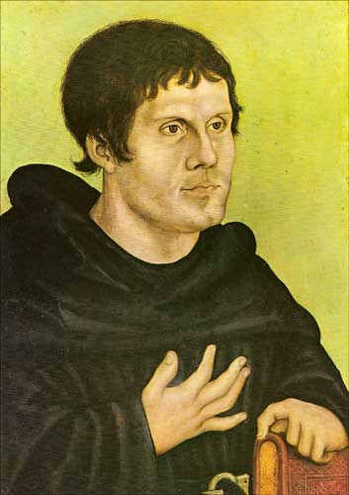
Luther’s Response to the Church
NO WAY DUDE! Hier stehe ich. Ich kann nicht anders. Gott helfe mir. Amen." ("Here I stand. I can do nothing else. God help me.)
He is excommunicated (banned) from the church and forced into hiding for the rest of his life

Slide 8

The Enlightenment
AIM: What was the Enlightenment?
Do Now: What era/revolution led to the Enlightenment?
Mr. Ott - Global History & Geography @ BETA

Slide 9

What do you think the word Enlightenment means?
The belief that man could use logic and reason to solve the social problems of the day.

Slide 10
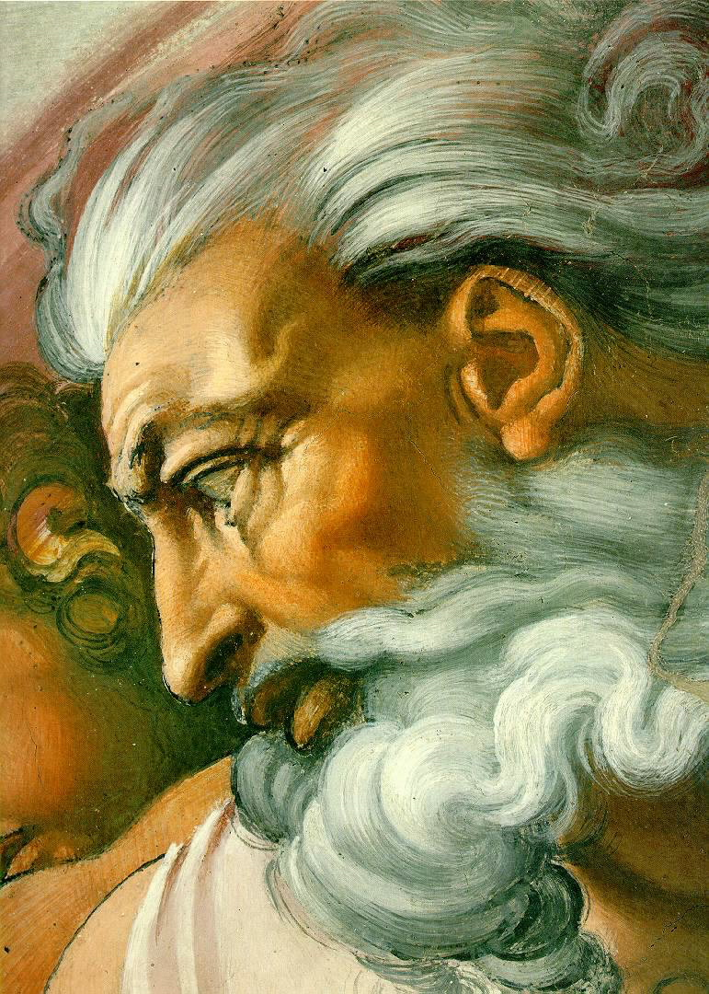
Before the Enlightenment…
Until then, most people believed that god controlled the universe.
What made people start to think differently?
Renaissance
Humanism
Scientific Revolution

Slide 11
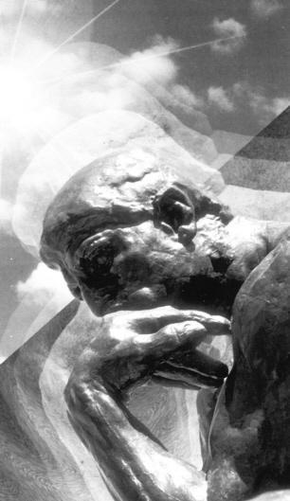
Enlightenment thinkers
Queen Elizabeth I
Thomas Hobbes
John Locke
King Louis XIV
Baron de Montesquieu
Jean Jacque Rousseau
Adam Smith

Slide 12
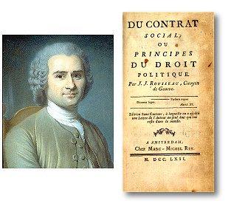
The Social Contract (1651)
During the scientific revolution the social contract was invented by Jean Jacques Rousseau. The idea behind the contract was that a ruler would have absolute power given to him by the people who were under absolute control.
Rousseau was a believer in Absolute Monarchy.
Jean Jacques Rousseau

Slide 13
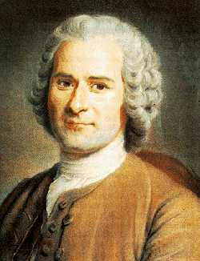
Jean-Jacques Rousseau
“Bottom Up” model
All individual rights are from nature or from God NOT from government
A non-written social contract exists between the people and government

Slide 14
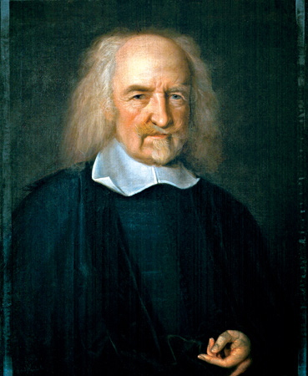
Thomas Hobbes
“Top Down” model
All individual rights come from government NOT nature or from God
Life is brutish, miserable & short

Slide 15
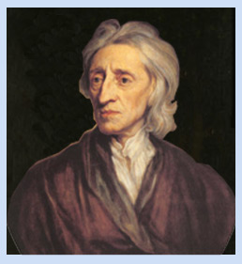
John Locke
“Bottom Up” model
All individual rights come from nature or from God NOT Government
A government exists because it received the consent of the governed (people)

Slide 16

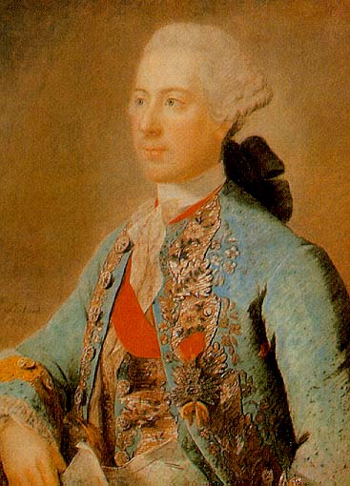
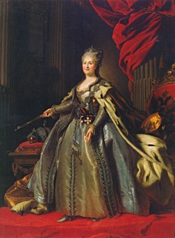
Enlightened Despot (1700)
The philosophers tried to convince monarchs to rule justly.
Some monarchs embraced the new ideas and made reforms that reflected the Enlightenment spirit.
They became known as Enlightened Despots. (Despot means absolute ruler)
The enlightened depots supported the philosophers ideas. But they also had no intention of giving up any power.
The foremost of Europe's’ enlightened despots were Frederick II of Prussia and Catherine the Great of Russia.
Notes:
In the 1700s, Paris was the cultural and intellectual capital of Europe.
Young people from around Europe-and also from the Americas-came to study, philosophize, and enjoy fine culture.
The brightest minds of the age gathered there. From their circles radiated the ideas of the Enlightenment.
…the Enlightenment spirit also swept through Europe’s royal courts.
Many philosophers believed that the best type of government was a monarchy in which the ruler respected the people’s rights.

