Slide 1
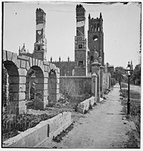
Reconstruction
What or Whom was the government trying to reconstruct? Why?
Do Now: If you were a parent and your children ran away, how would you treat them when they returned?
What is meant to reconstruct something?
(1865-1877)
Aim: What was the goals of political reconstruction?

Slide 2
Key Questions
1. How do we bring the South back into the Union?
4. What branch of government should control the process of Reconstruction?
2. How do we rebuild the South after its destruction during the war?
3. How do we integrate and protect newly- emancipated black freedmen?

Slide 3
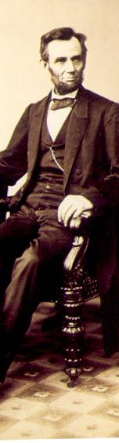
President Lincoln’s Plan
10% Plan
Proclamation of Amnesty and Reconstruction (December 8, 1863)
Replace majority rule with “loyal rule” in the South.
He didn’t consult Congress regarding Reconstruction.
Pardon to all but the highest ranking military and civilian Confederate officers.
When 10% of the voting population in the 1860 election had taken an oath of loyalty and established a government, it would be recognized.

Slide 4
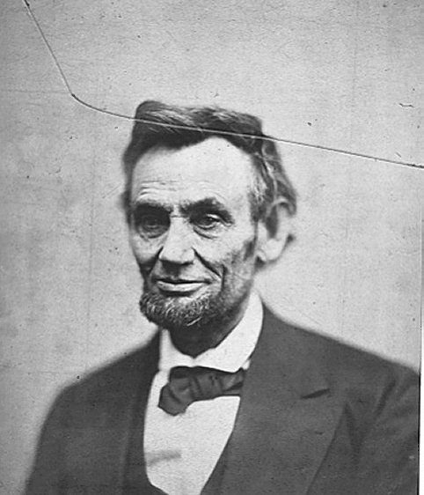
President Lincoln’s Plan
1864 → “Lincoln Governments” formed in LA, TN, AR
“loyal assemblies (legislatures)”
They were weak and dependent on the Northern army for their survival.

Slide 5
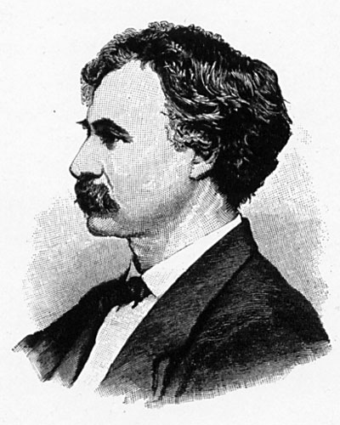
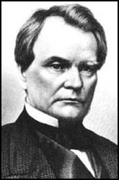
Wade-Davis Bill (1864)
Congress wants a new plan, not Lincoln’s.
Required 50% of the number of 1860 voters to take an “iron clad” oath of allegiance (swearing they had never voluntarily aided the rebellion ).
Required a state constitutional convention before the election of state officials.
Enacted specific safeguards of freedmen’s liberties.
Senator Benjamin Wade (R-OH)
Congressman Henry W. Davis (R-MD)
Pocket Veto
President Lincoln
Wade-Davis Bill

Slide 6
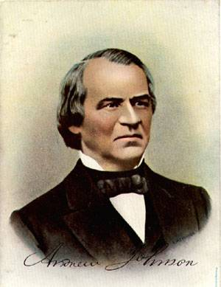
President Andrew Johnson
Jacksonian Democrat.
Anti-Aristocrat.
White Supremacist.
Agreed with Lincoln that states had never legally left the Union.
Damn the negroes! I am fighting these traitorous aristocrats, their masters!

Slide 7
President Johnson’s Plan (10%+)
Offered amnesty upon simple oath to all except Confederate civil and military officers and those with property over $20,000 (they could apply directly to Johnson)
In new constitutions, they must accept minimum conditions repudiating slavery, secession and state debts.
Named provisional governors in Confederate states and called them to oversee elections for constitutional conventions.
1. Disenfranchised certain leading Confederates.
EFFECTS?
2. Pardoned planter aristocrats brought them back to political power to control state organizations.
3. Republicans were outraged that planter elite were back in power in the South!

Slide 8
Growing Northern Alarm!
Many Southern state constitutions fell short of minimum requirements.
Johnson granted 13,500 special pardons.
Revival of southern defiance.
BLACK CODES

