Slide 1
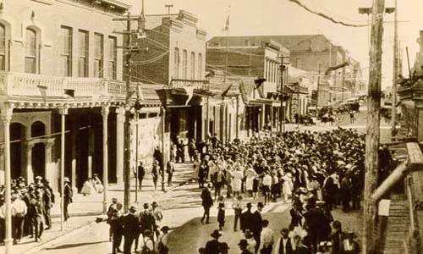
Building the West
AIM: What were the results of Mining and Railroads on America?
Do Now: What was America’s expansion from sea to shining sea
called?
Manifest Destiny

Slide 2
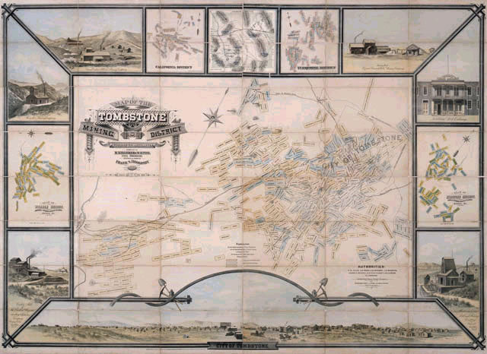
Miners, Ranchers, and Railroads
As more settlers moved West, mining, ranching, and railroads soon transformed the western landscape.
A mining boom brought growth to the West.
The demand for cattle created a short-lived Cattle Kingdom on the Great Plains.
East and West were connected by the transcontinental railroad.

Slide 3
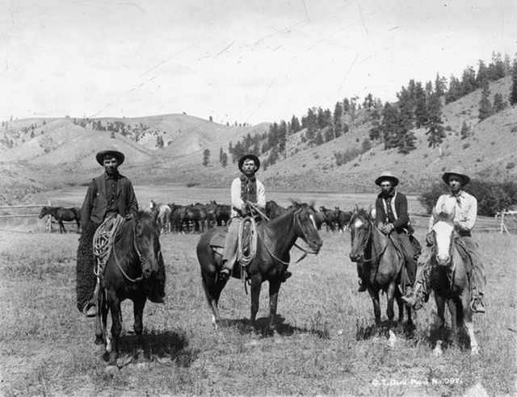
Cowboys & Cattle
Cowboys were workers who took care of ranchers’ cattle.
They borrowed many techniques from vaqueros, who were Mexican ranch hands.
One of their most important duties was the cattle drive.
  The Chisholm Trail was a popular route for cattle drives.
Life in cattle towns was often rough and violent.

Slide 4
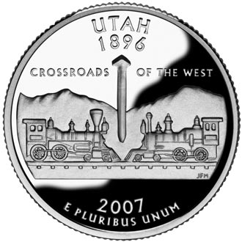
The Great Race
In the race to complete a transcontinental railroad, the Central Pacific started in San Francisco and worked east, and the Union Pacific started in Omaha and worked west.
Large numbers of Irish and Chinese immigrants worked on the railroads.
Geography and weather posed many challenges to building the railroads.
On May 10, 1869, the railroad lines met and joined the two tracks with a golden spike at Promontory, Utah.
Companies continued building railroads throughout the West.

Slide 5
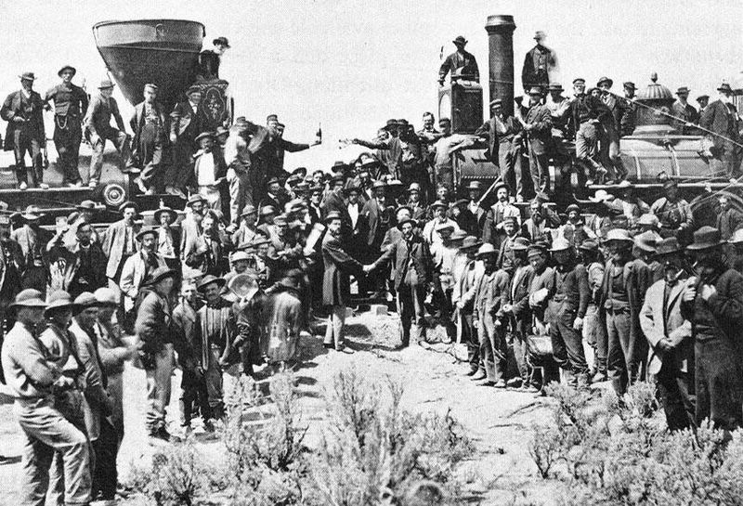
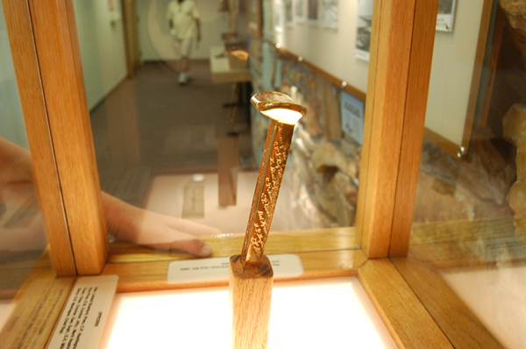
East and West were connected by the transcontinental railroad.
The growth of the West created a need for communication across the country.
  The Pony Express carried messages on a route 2,000 miles long.
  Telegraph lines put the Pony Express out of business.
Demand for a transcontinental railroad grew.
  Congress passed the Pacific Railway Acts of 1862 and 1864, giving railroad companies loans and land grants.
  The railroads agreed to carry mail and troops at a lower cost.

Slide 6
Results of the Railroad
Growth
Economic growth and population in the West increased.
Railroads provided better transportation for people and goods
They also encouraged people to move west.
Railroads became one of the country’s biggest industries.
Panic of 1873
Railroad speculation increased.
The collapse of railroad owner Jay Cooke’s banking firm helped start the Panic of 1873.
Many small western railroads were deeply in debt by the 1880s.

Slide 7
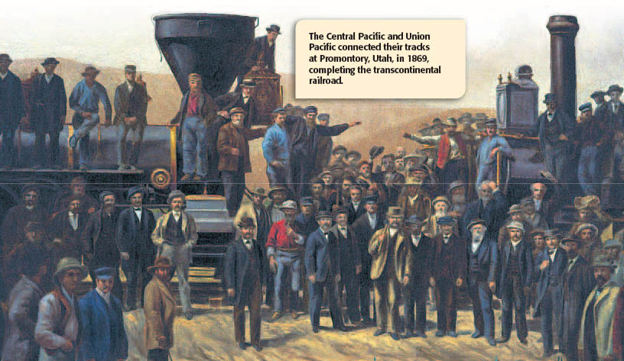

Slide 8
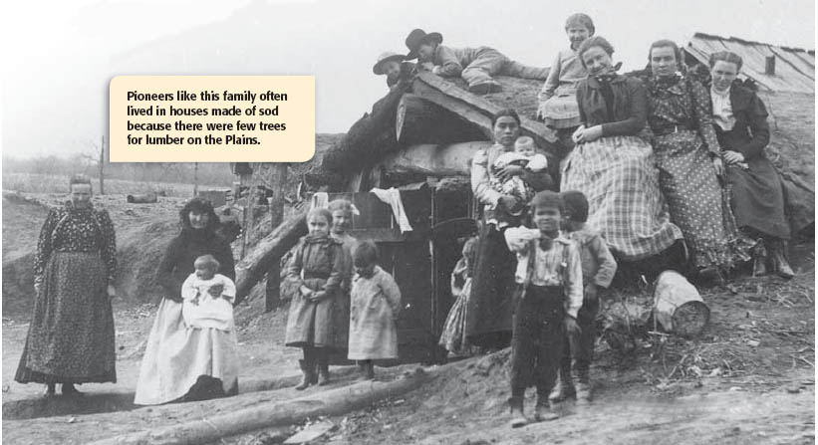

Slide 9
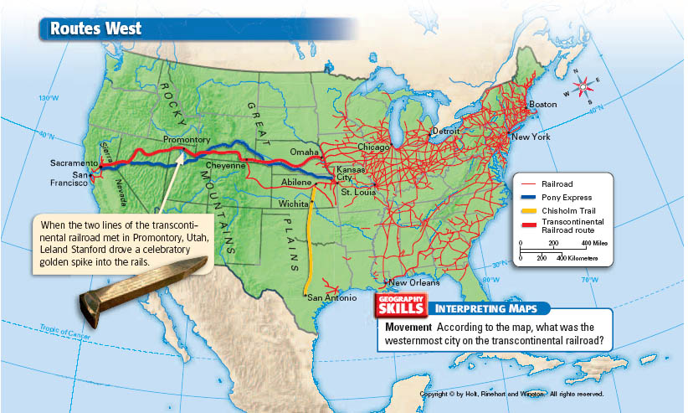

Slide 10
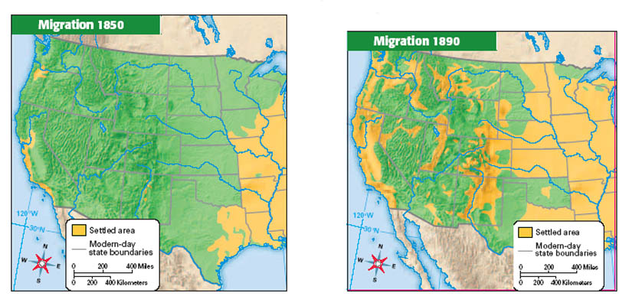

Slide 11
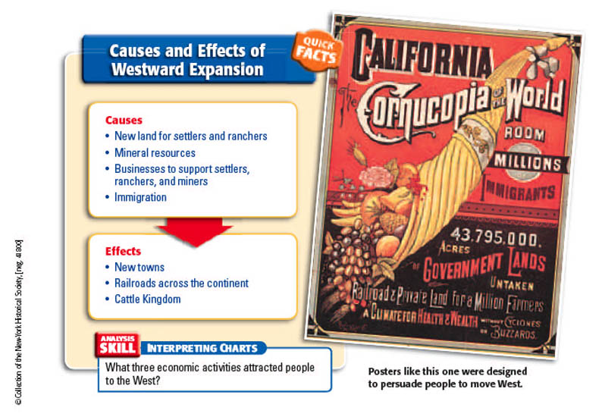

Slide 12
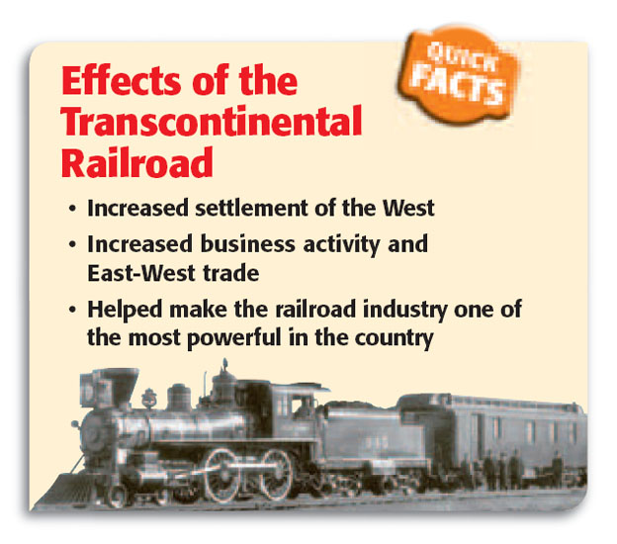

Slide 13
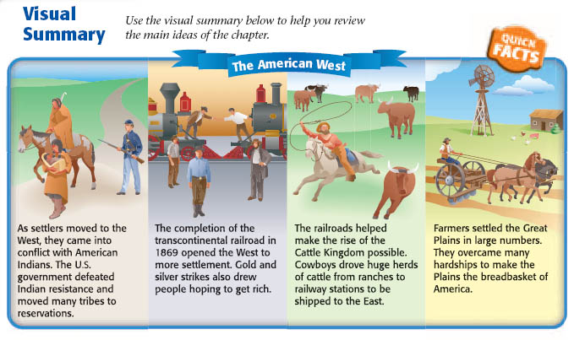

Slide 14
Classwork/Homework:
Write a paragraph of the effects of the railroads and mining on the American West. (5 – 6 Sentences)

