Slide 1
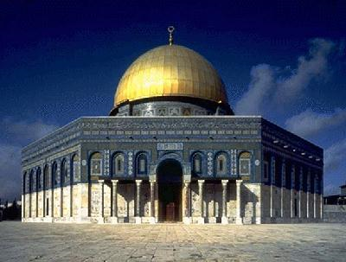
The Role of the Islam in the Dark & Middle Ages
Aim: What are the tenets of Islam?
Do Now: What are the main beliefs of; 1) Christianity? 2) Judaism? 3) The Ten Commandments?

Slide 2
Islam
Islam is a religion that came about in the early 600s.
The founder was a merchant named Muhammad Ali.
He claimed that one night the voice of Allah (God) spoke to him, and thus he began the religion.
To be a Muslim (a submitted one) or a follower of Islam, followers must obey the five pillars or five duties to Allah. They are known as the religions tenets.

Slide 3

Allah
IS THE MUSLIM GOD
HE IS THE ONE GOD OF ISLAM
WORSHIPED MOSTLY THE MIDDLE EAST, AFRICA, and ASIA

Slide 4

Five Pillars (tenets) of Islam
Faith
To become muslin, you need to testify to the statement of faith: “there is no god but Allah, Muhammad is the messenger of Allah.
Prayer
Muslims must face Mecca and pray five times a day.
Alms
Muslims have been taught to support the less fortunate.
Fasting
During the Muslim month of Ramadan, Muslims fast. Fasting is eating and drinking nothing from sun up to sun down.
Pilgrimage
Muslims must go on a pilgrimage to
Mecca (Saudi Arabia) at least once in their lifetime.

Slide 5
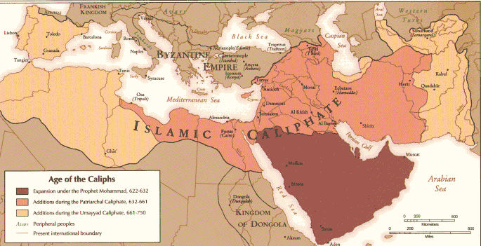
Spread of Islam

Slide 6
