Slide 1
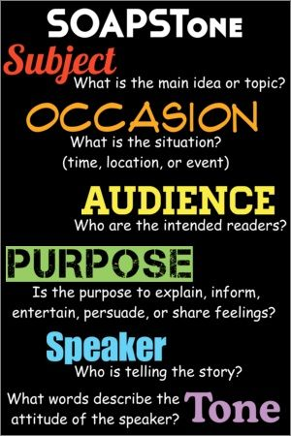
SOAPSTone
Speaker
Occasion
Audience
Purpose
Subject
Tone
Mr. Ott – Park East 2015-16

Slide 2
SOAPSTone
Speaker
The voice that tells the story.

Slide 3
SOAPSTone
Occasion (aka Context)
The time and the place of the piece; the context that prompted the writing.

Slide 4
SOAPSTone
Audience
The group of readers to whom this piece is directed.
BE CAREFUL: Secondary Text Audience is usually the General Public

Slide 5
SOAPSTone
Purpose
The reason behind the text.
They ask themselves, "What do I want my audience to think or do as a result of reading my text?"

Slide 6
SOAPSTone
Subject
The central topic or main idea.

Slide 7
SOAPSTone
Tone
The attitude of the author.
With the written word, it is tone that extends meaning beyond the literal, and authors must convey this tone in their
diction (choice of words)
syntax (sentence construction)
imagery (metaphors, similes, and other types of figurative language).

Slide 8
SOAPSTone
More about
Tone
Tone is the author’s/narrator’s attitude toward the subject. It’s not about mood, but rather his reasons why
he/she wrote the document.

