Slide 1

Aim: Why is the Declaration of Independence such a crucial document to U.S. history?
John Adams at 2nd Continental Congress in Philadelphia, PA 1776

Slide 2
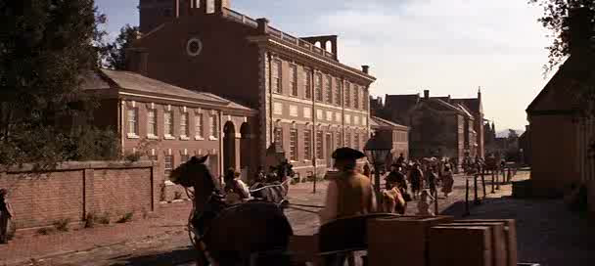
2nd Continental Congress in Philadelphia, PA 1776

Slide 3
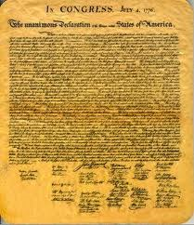
What is the Declaration of Independence?
States the colonial grievances against British rule.
List of reasons for separating from Great Britain (Laundry List)
One of America’s Founding Documents

Slide 4
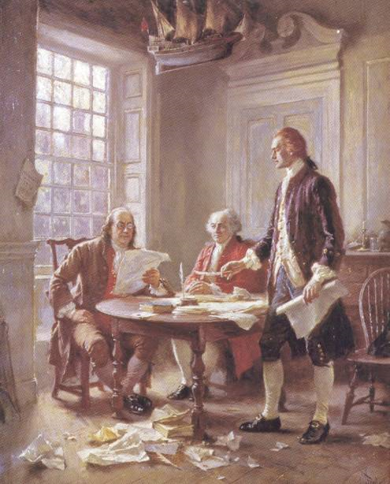
Declaration of Independence
Written by Thomas Jefferson who was most influenced by the writers of the Enlightenment.

Slide 5
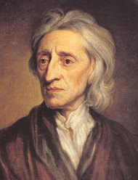
Declaration of Independence
Takes ideas from John Locke’s theory of natural rights- power to govern belongs to the people (“consent of the governed”
Ideas from John Locke (Consent of the governed).

Slide 6
Declaration of Independence
Social contract theory of government
The fundamental purpose of government is to secure the natural rights of the people.
If a government denies its people certain basic rights, that government can be overthrown.

Slide 7
Declaration of Independence
NO TAXATION WITHOUT REPRESENTATION
Many colonists believed they could not be taxed by the British because they had no representatives in the British government, which means that the British did not have consent of the governed.
British don’t have consent of the governed.

Slide 8
Foundation of U.S. Government
Contains ideas that support limitations on governmental power and stress the importance of individual liberty, which become major pillars of the U.S. government structure.

Slide 9
Summary Paragraph
Why is the Declaration of Independence such a crucial document to U.S. history?

