Slide 1
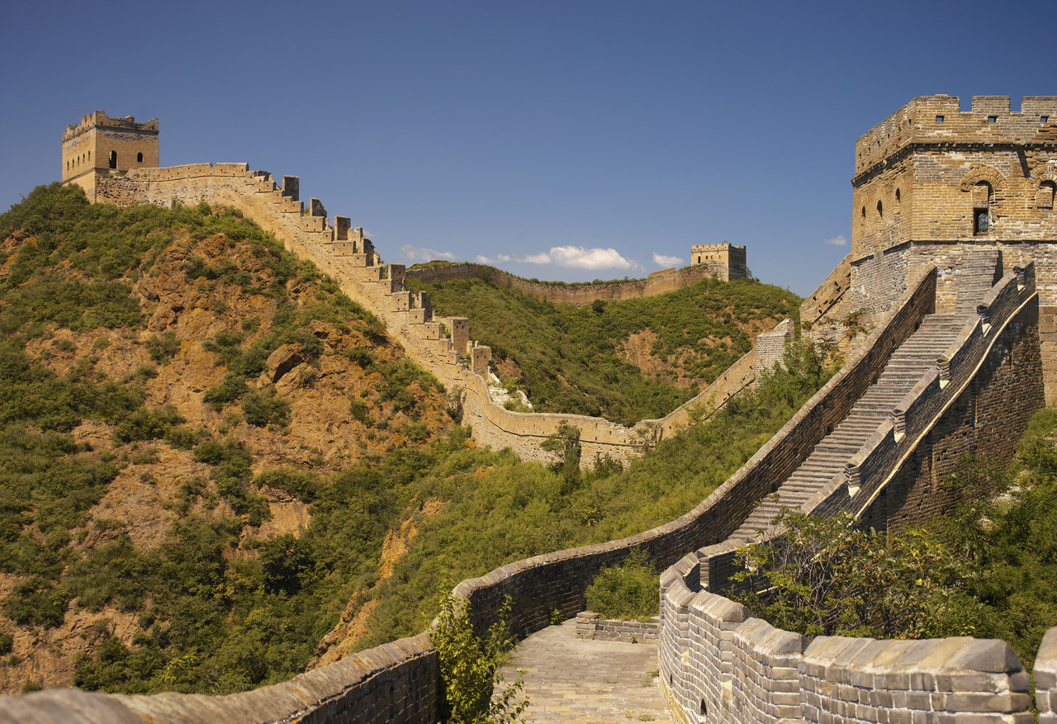
Imperialism in China
AIM: How did China react to foreign influence and control?
Do Now: how would imperialism affect people under colonial rule?
© Student Handouts, Inc.
www.studenthandouts.com

Slide 2
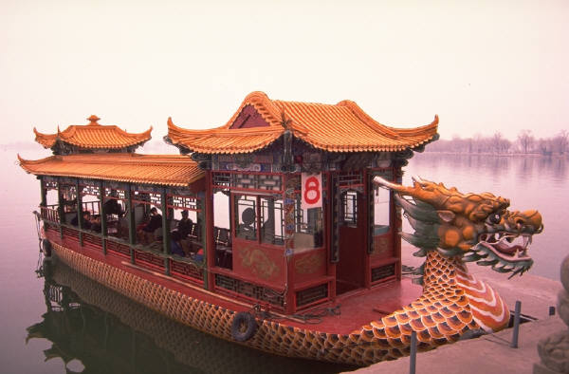
Early Contacts with Europeans
16th century – Portuguese traded for silk and tea
Portuguese followed by the Dutch and English

Slide 3
First Opium War (1839-1842)
British brought opium from India to Canton
Many Chinese became addicts
Chinese emperor forbade opium imports
War between British and Chinese
Treaty of Nanking (1842)
Four additional British ports in China
Amoy, Ningpo, Foochow, Shanghai
British control over Hong Kong 100 year lease – Ended in 1997

Slide 4

Imperialism in China

Slide 5
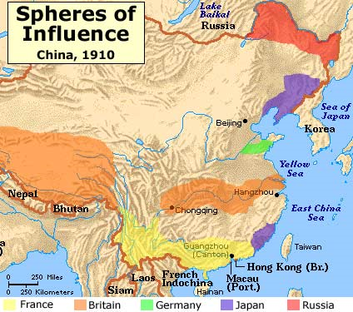

Slide 6
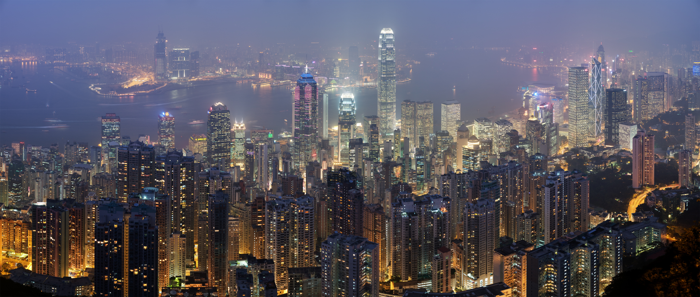
Other Westerners in China
Belgium, France, Holland (Netherlands), Portugal, Prussia (Germany), United States

Slide 7
More Foreign Control of China
Vietnam
Merged into French Indo-China (1883)
Burma (Myanmar)
Annexed by British (1886)
Formosa (Taiwan)
Attacked and taken by Japanese (1895)
Korea
Annexed by Japanese (1910)
Manchuria
Concessions to Japanese (1910)

Slide 8
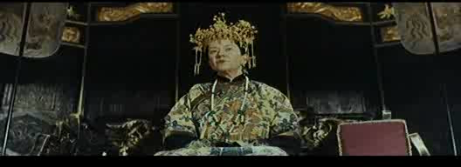
55 Days at Peking (1953)
Continually frustrated with foreigners taking China’s wealth and westernization, some Chinese rebel against foreign influence. This was known as the Boxer Rebellion.
This clip shows the Empress Dowager Cixi with Sir Arthur Robinson of Britain expressing China’s feelings towards foreign influence.
Take special note of the use of metaphors such as the cow comparing it to China.

Slide 9
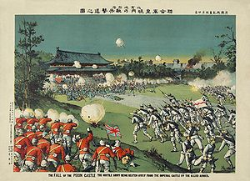
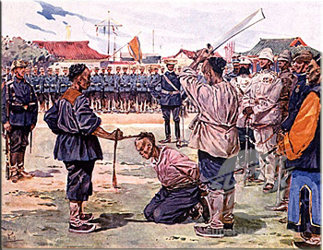
Boxer Rebellion (1900)
Chinese people resented foreign influence and power
Called “Boxers” by Westerners
Demanded that foreigners leave China
Killed circa 300 and vandalized foreign property
European imperialists, Americans, and Japanese put down the rebellion
China paid $333,000,000 in damages and had to permit military forces in Peking (Beijing)

Slide 10
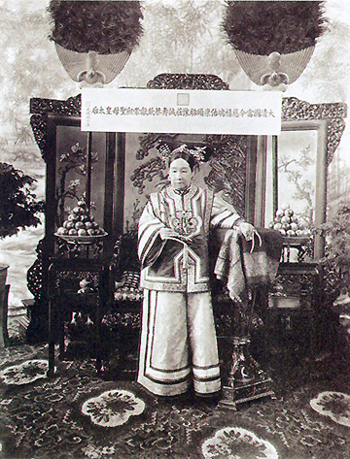
Fall of the Qing (Manchu) Dynasty
Empress Dowager Cixi (1835-1908)
De facto Chinese monarch (1861-1908)
“Make me unhappy for a day and I will make you unhappy for a lifetime.”
Conservative and anti-foreign
Blamed by many Chinese for foreign imperialist power in China

Slide 11
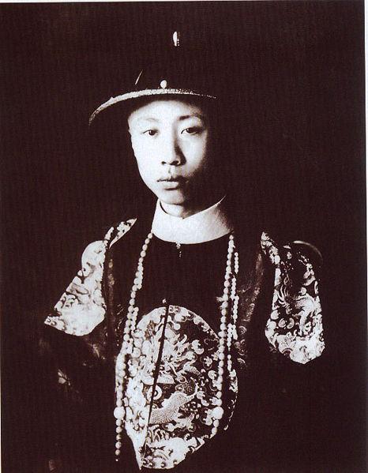
Fall of the Qing (Manchu) Dynasty
Emperor Puyi – the “Last Emperor”
Lived 1906-1967
Ruled China 1908-1912, and as a puppet for 12 days in 1917
Puppet emperor of Manchukuo (Japanese-ruled Manchuria) 1932-1945
Spent ten years in a Soviet prison after WWII
Lived a quiet life as a regular citizen in communist China
Died of disease during the Cultural Revolution (1967)

Slide 12
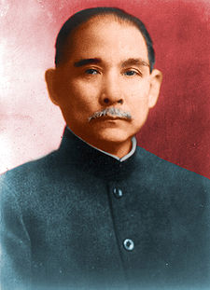

Republican Revolution
Sun Yat-sen (Sun Yixian)
Founded Nationalist party
Overthrew Manchu (Qing) dynasty
Established a republic
Nationalist party symbol

Slide 13
Three Principles of the People
Book published by Sun Yat-sen before his death in 1925
Principle of Mínquán
Democracy – the people are sovereign
Principle of Mínzú
Nationalism – an end to foreign imperialism
Principle of Mínshēng
Livelihood – economic development, industrialization, land reform, and social welfare – elements of progressivism and socialism

Slide 14

Growth of Communism
Sun Yat-sen appealed for Russian (Soviet) aid following the Versailles Conference
1921-1925 – China received advisors, arms, communist propaganda, and loans
Russia revoked its imperialist rights in China
Chinese flag, 1912-1928

Slide 15
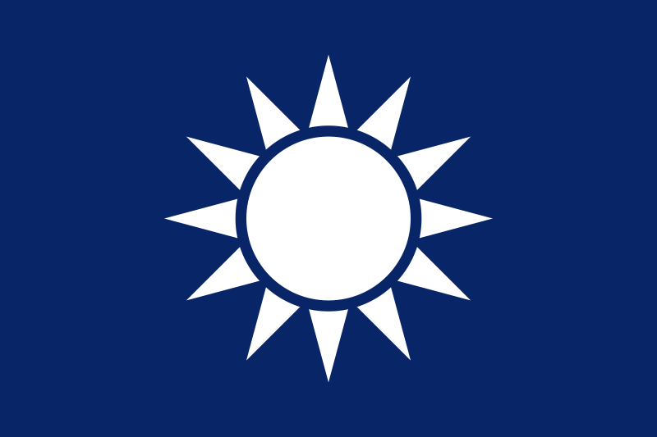
The Nationalist Party Splits
Right wing
Business people
Politicians
Left wing
Communists
Intellectuals
Radicals
Students

Slide 16
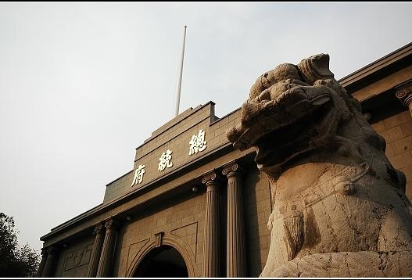
Nationalist Revolution
Presidential Palace under Kuomintang Government in Nanjing
Sun Yat-sen succeeded by Chiang Kai-shek
Communists expelled by Kuomintang
1926-1928 – war to control the warlords
Capital moved from Peiping (a.k.a. Peking, today’s Beijing) to Nanking (Nanjing)
Notes:
Possible anecdote: The Kuomintang changed the name of Peking/Beijing to Peiping (or Beiping) in 1928.

Slide 17
Civil War in China
1927-1932 and 1933-1937 – war between Communists and Nationalists
Communists – Mao Tse-tung (Mao Zedong)
Nationalists – Chiang Kai-shek
War halted 1932-1933 and 1937-1945 to fight Japanese aggression
Communists were victorious in 1949
Nationalists retreated to Formosa (Taiwan)
End of imperialism in China
Hong Kong returned to China in 1997

