Slide 1
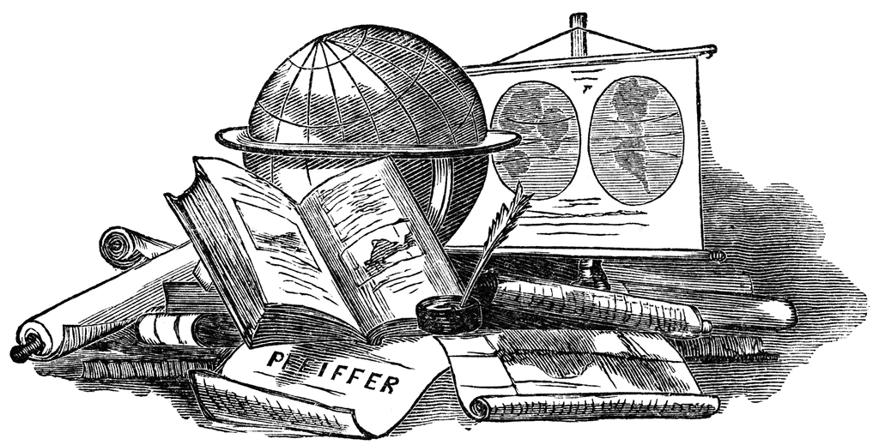
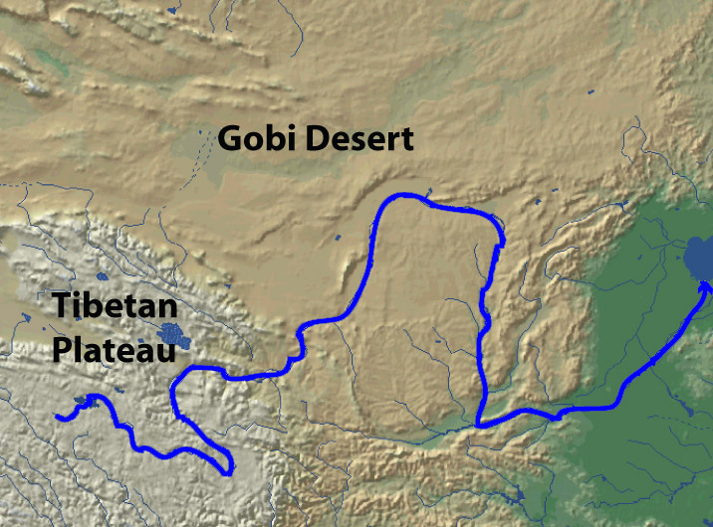
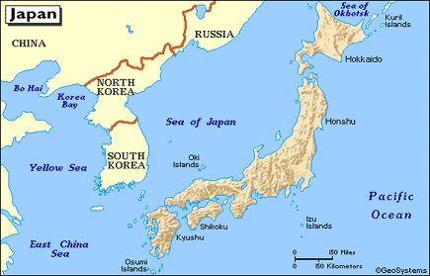
Geographic Features
Aim: How do geographic features affect societies?

Slide 2
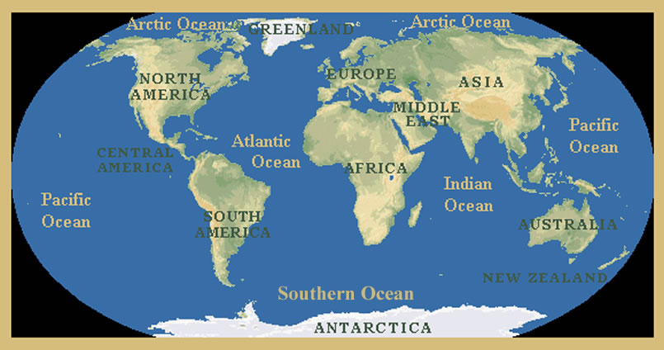
Oceans
Isolates Civilizations
China from Europe
India from Europe
Americas from Europe
Trade
Triangle Trade
Columbian Exchange
Asian Trade

Slide 3
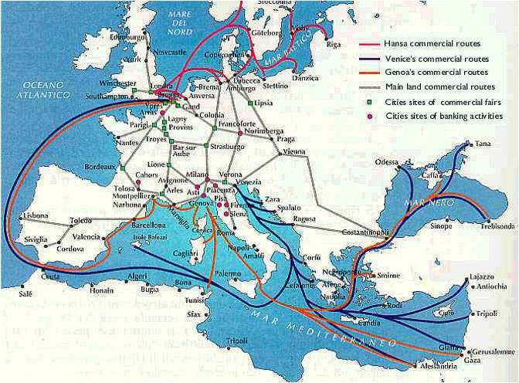
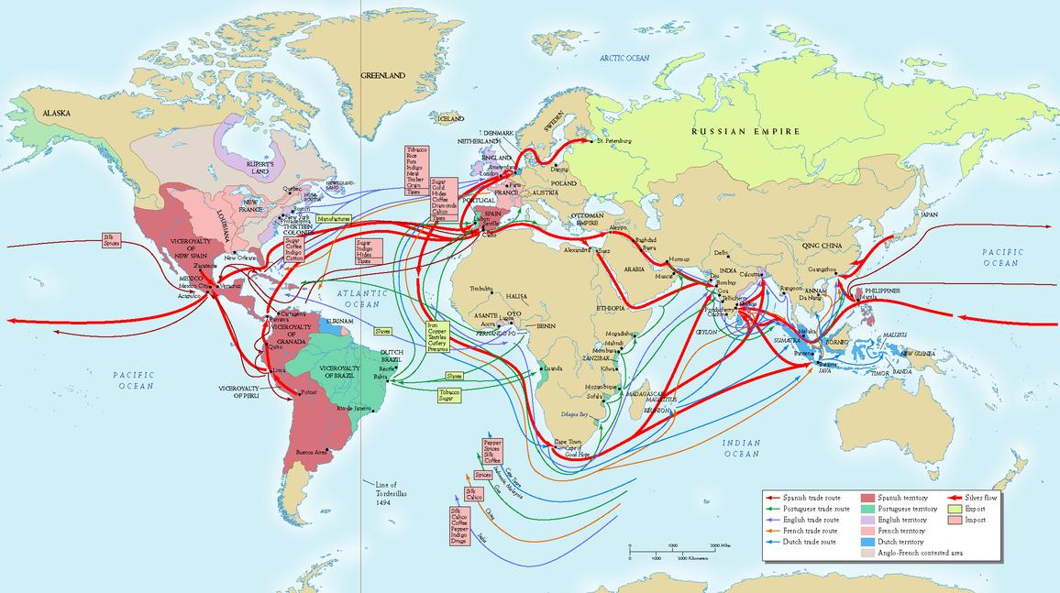
Seas
Trade Routes
Cultural Diffusion
Mediterranean Sea
Phoenicians
Greeks
Romans
Italian City States
Byzantine Empire
Ottoman Empire
British Empire
Spanish Empire
Atlantic Ocean
Triangle Trade
Columbian Exchange

Slide 4
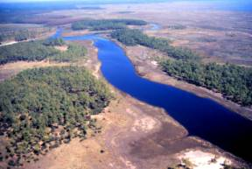
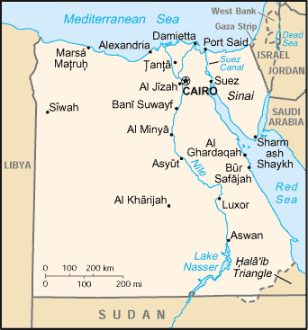
River Valleys
Fertile Soil for Farming
Irrigation for Watering Fields
Waterway for Trade
Indus River – India/Pakistan
Nile River – Egypt
Huang He (Yellow) River – China
Tigris & Euphrates River – Mesopotamia (Present Day IRAQ)

Slide 5
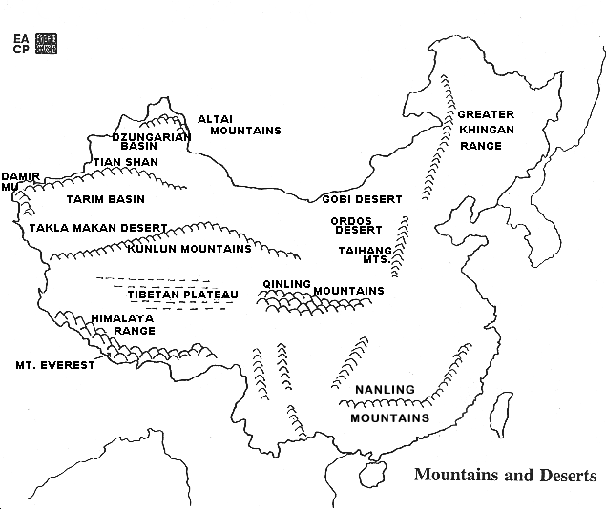
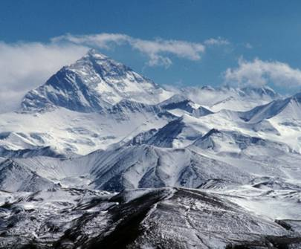
Mountains
Provides Protection
Isolates Civilizations
China & Tibet
Prevents Cultural Diffusion

Slide 6
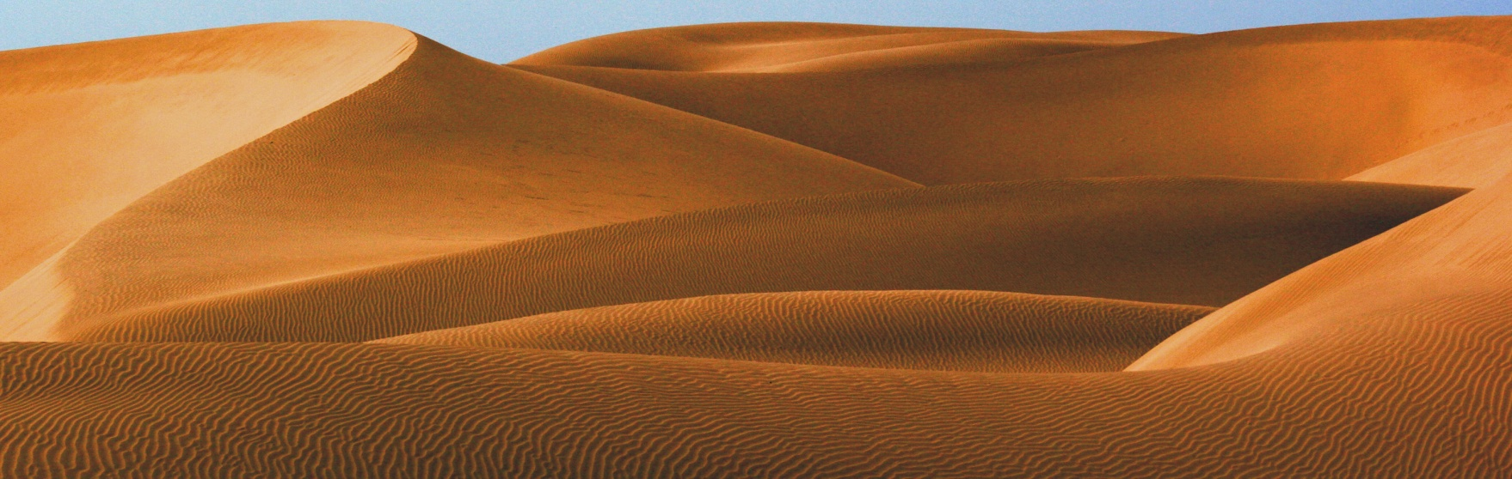
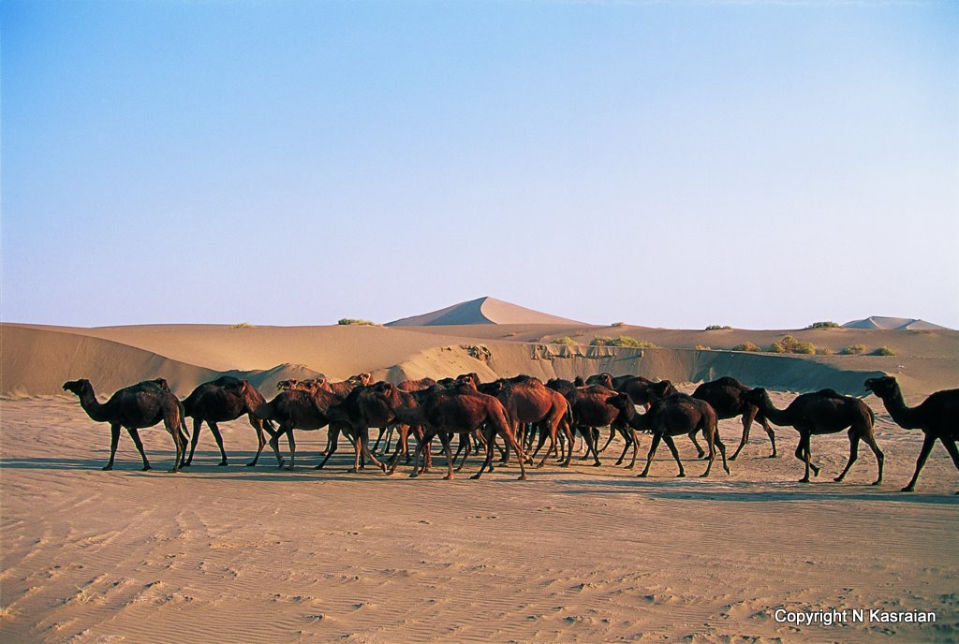
Deserts
Provides Protection
Isolates Civilization
China & Tibet (Gobi)
Egypt (Sahara)
Sub Saharan Africa
Prevents Cultural Diffusion

Slide 7
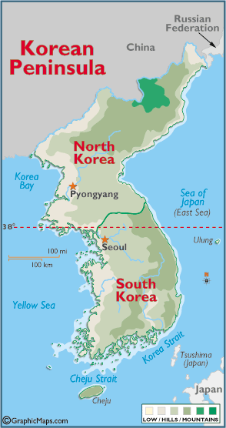
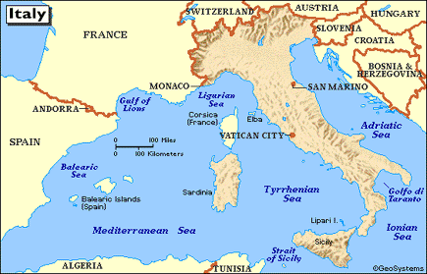
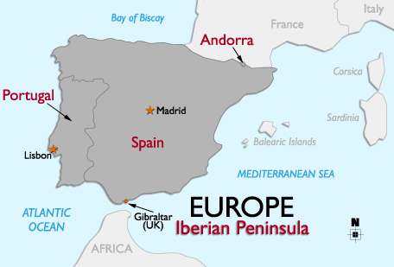
Peninsulas
Italian Peninsula
Land Surrounded on 3 Sides by Water

Slide 8
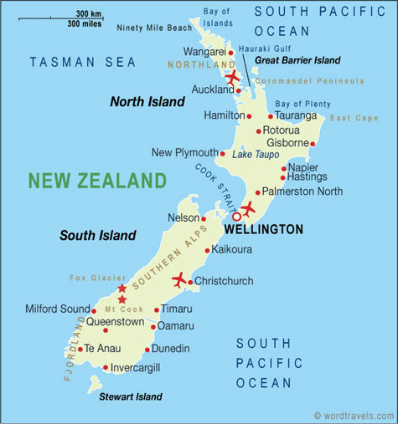
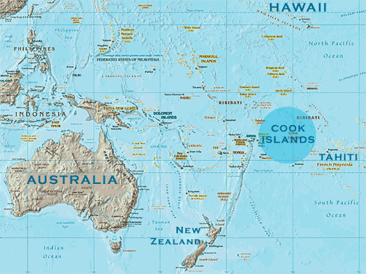
Islands
Land Surrounded by Water
Isolated
Prevents Cultural Diffusion
Promotes Sea Trade
Promotes Ship Building

Slide 9
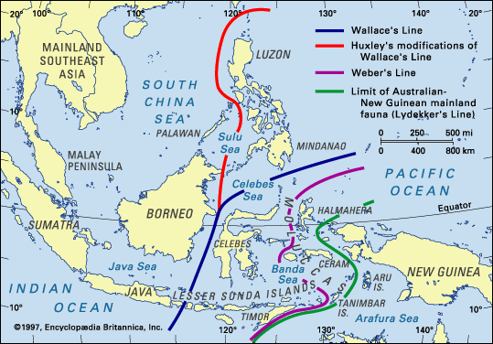
Archipelago
Isolated
Could Prevent Cultural Diffusion
Promotes Sea Trade
Promotes Ship Building
Japan
Indonesia
Chain of Islands

Slide 10

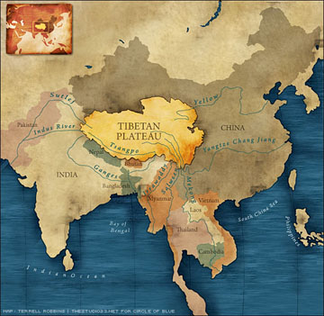
Plateau
High Elevated Flat Land
Deccan Plateau (India)
Tibetan Plateau (China)

Slide 11
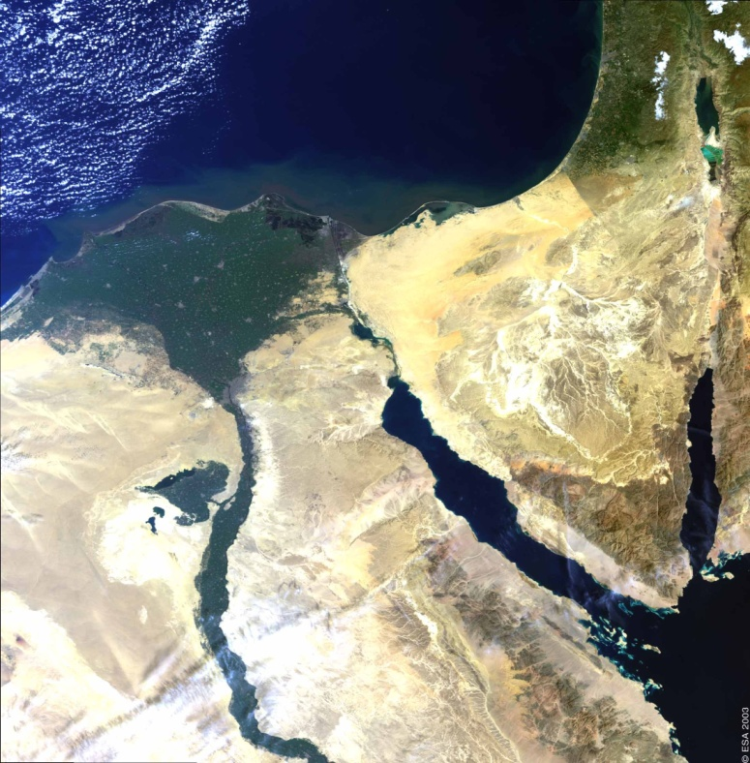
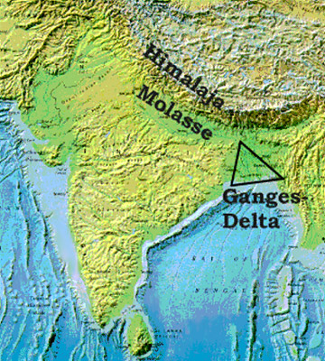
Delta
Part of the river where it flows into a lake, ocean, sea, etc.
Nile Delta
Ganges Delta

Slide 12
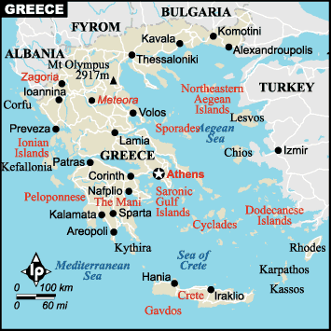
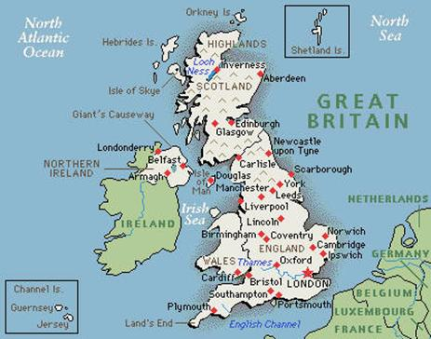
Irregular Coastlines
Creates harbors for ships
Increases trade
Can have navy

Slide 13
