Slide 1
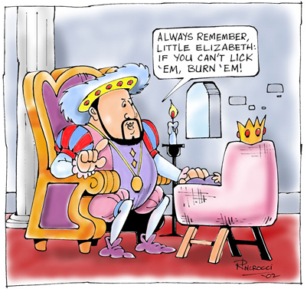
The Rise of Absolute Monarchies
(1400’s-1700’s)
AIM: How did Absolute Monarchs justify their rule?
Do Now: How did Monarchs Justify their rule worksheet (Doc #1 ONLY)

Slide 2
  What is an Absolute Monarchy?
  Absolute = All Powerful
  Monarch = King or Queen
Absolute Monarch = An all-powerful king or queen
  Also, kings and queens handed their power down to their children.
  It was a line of succession that stayed in the family

Slide 3
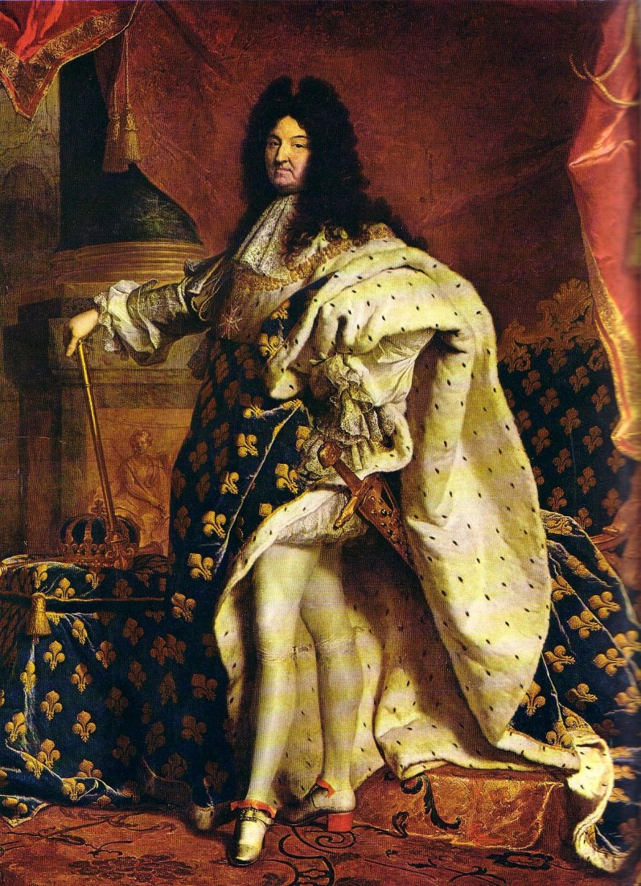
Characteristics of Absolute Monarchs
“I am the state”
It’s GREAT to be the King!
They made
all the laws
They were NOT subject to the laws.

Slide 4
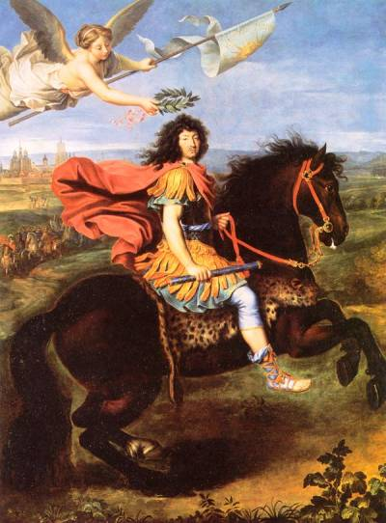
They Ruled by “Divine Right
They believed that they derived their right to rule directly from GOD.
Accountable only to GOD.
Not the people!

Slide 5
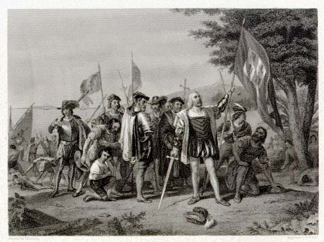
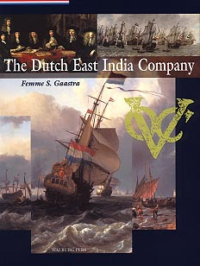
Accumulated Vast Sums of Wealth
How?
By seizing new territories in the New World and the Far East
Expanding trade overseas and within Europe
Taxing the growing wealth of their people

Slide 6
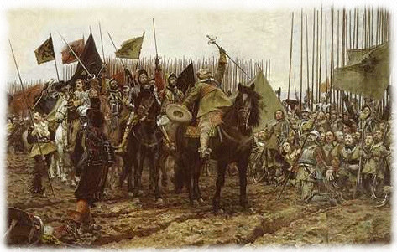
They used their wealth to build LARGE, PERMANENT ARMIES!
No more need to depend on feudal contracts with their vassals
These armies were loyal to the King, NOT to the Country!

Slide 7
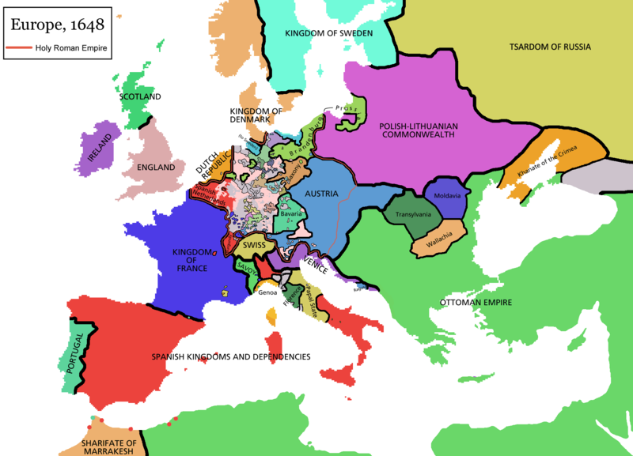
They used these armies to wage war against each other of course!

