Slide 1
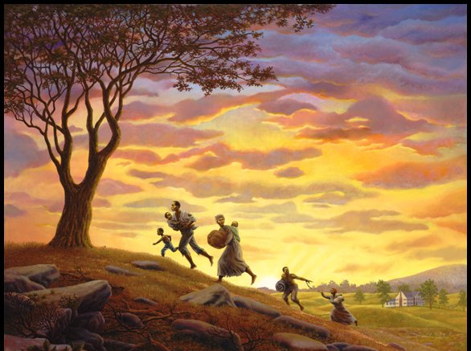

ABOLITION AND THE
UNDERGROUND RAILROAD

Slide 2
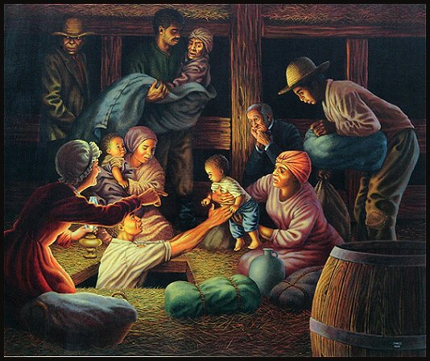
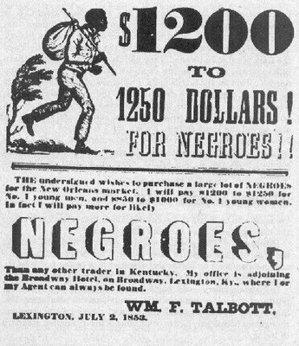
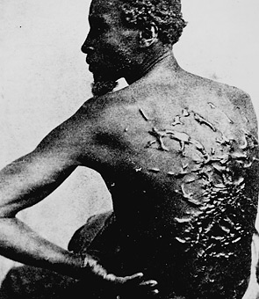
ABOLITION:
The movement to end slavery

Slide 3
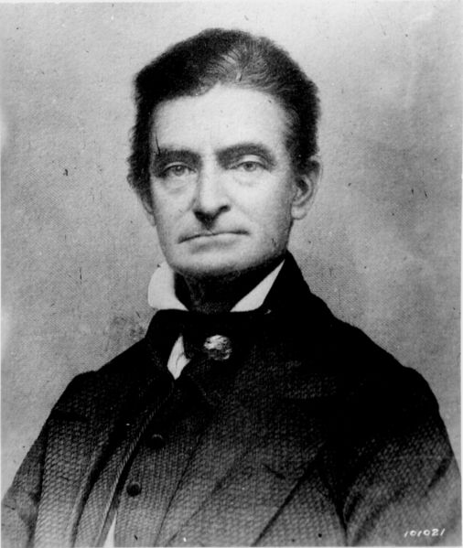
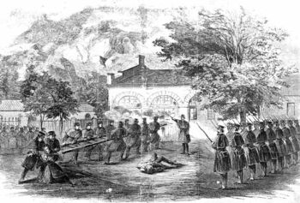
JOHN BROWN
Promoted Uprising to Stop Slavery
“Bleeding Kansas” 1854 - 1858
Harper’s Ferry Raid – Federal Armory
Caught, Tried, Convicted, Hanged Dec 1859
John Brown
"I, John Brown, am now quite certain that the crimes of this guilty land will never be purged away but with blood. I had, as I now think, vainly flattered myself that without very much bloodshed it might be done."
1800 –1859

Slide 4
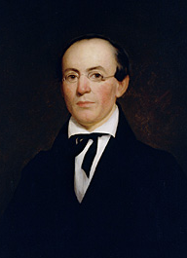
WILLIAM LLOYD GARRISON
Abolitionist who publishes a newspaper called The Liberator
William Lloyd Garrison

Slide 5
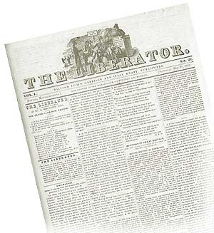
The Liberator was printed in Boston
Spread the word of the abolition movement in the North

Slide 6
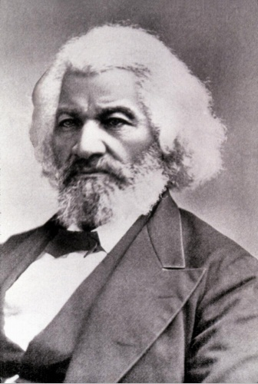
FREDERICK DOUGLASS – Ex-slave who was an emotional and charismatic abolitionist speaker
Frederick Douglass

Slide 7
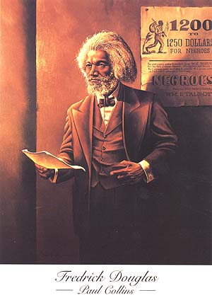

Slide 8
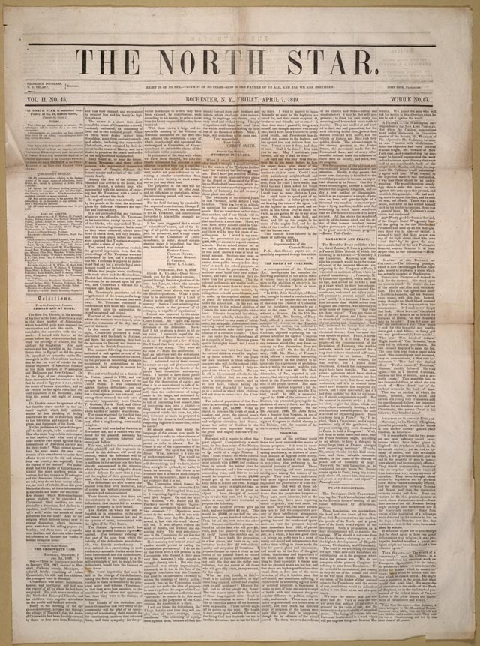
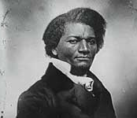
Published a biography of his life to prove he was once a slave and was now a free man
1851 - Newspaper

Slide 9
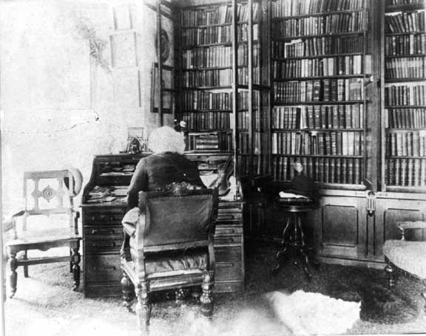

Slide 10
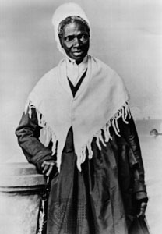
SOJOURNER TRUTH:
Ex-slave, she was a speaker against slavery
Sojourner Truth
Isabella Baumfree

Slide 11
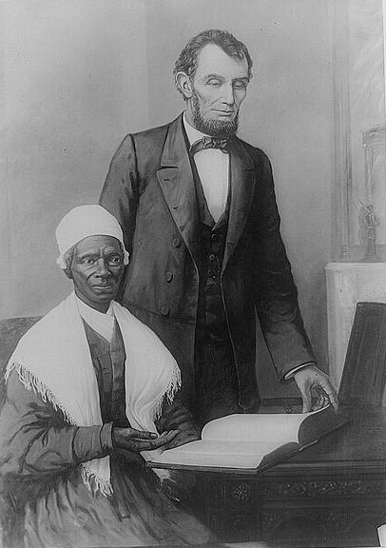
Sojourner Truth
and
Abraham Lincoln

Slide 12
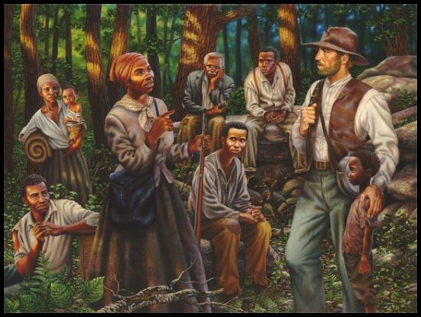

Slide 13
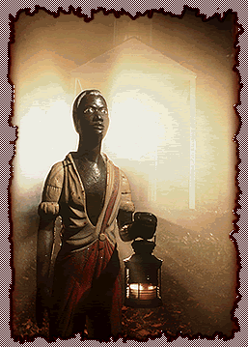
UNDERGROUND RAILROAD: A network of people that helped runaway slaves reach freedom in the North

Slide 14
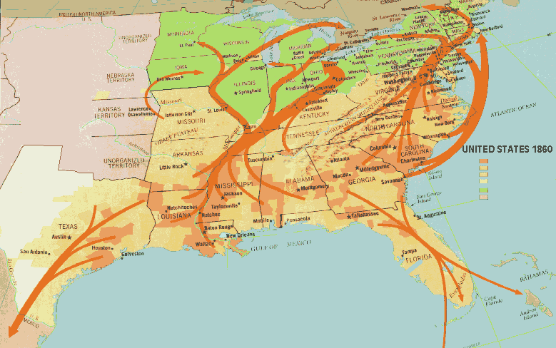
THE UNDERGROUND RAILROAD

Slide 15
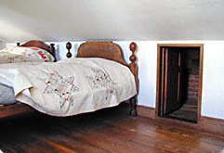
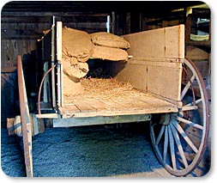
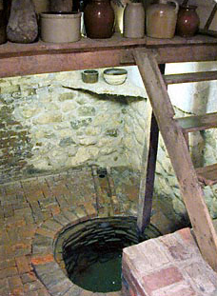
THE UNDERGROUND RAILROAD – hiding places

Slide 17
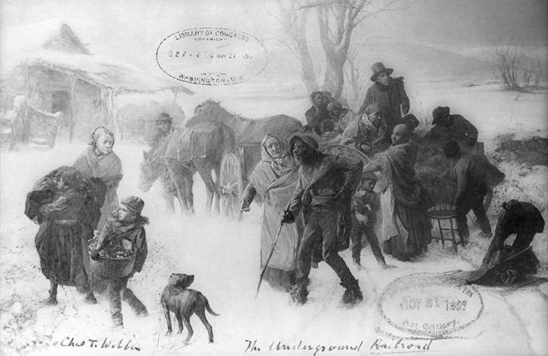

Slide 18
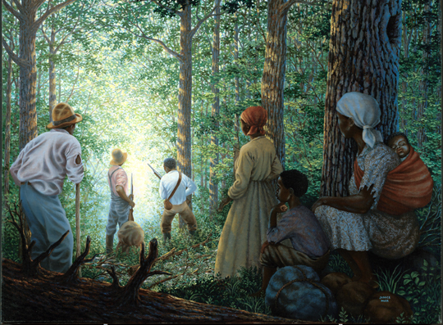

Slide 19
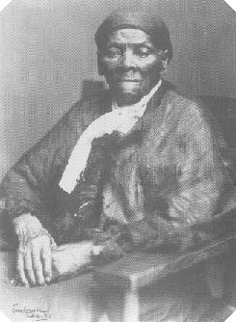
HARRIET TUBMAN: A former slave who helped large numbers of slaves to freedom through the underground railroad
Harriet Tubman

Slide 20
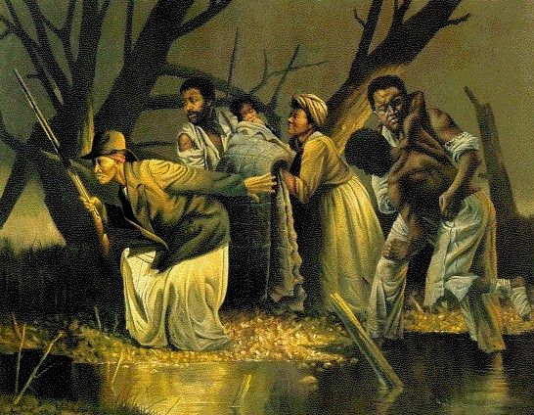

Slide 21
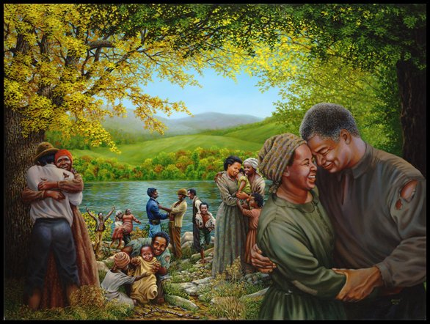
THE
END

