Slide 1
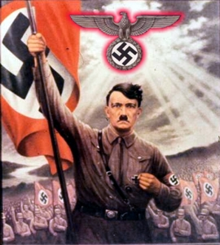
Hitler and the Rise of Nazi Germany

Slide 2
Struggles of the Weimer Republic
In November 1918, Kaiser William of Germany abdicated because he feared revolution. A moderate group took power and signed the Treaty of Versailles ending World War I. They created a democratic republic which because known as the Weimer Republic

Slide 3
The Weimar government faced many problems
Political Unrest
Many Germans blamed Weimar for signing the Treaty of Versailles.

Slide 4
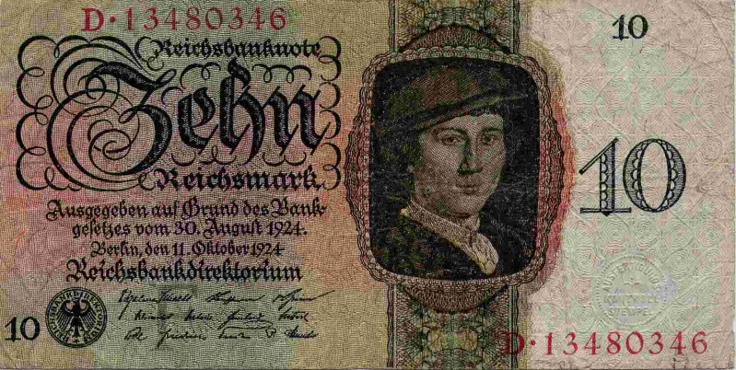
Inflation. In order to pay the reparation payments the Weimar government printed huge amounts of marks, paper money. The mark because worthless. 1924, The U.S. stepped in to help Germany with the Dawes Plan, in which reparation payments were reduced, France withdrew forces from the Rhine and American loans helped with the economy.

Slide 5
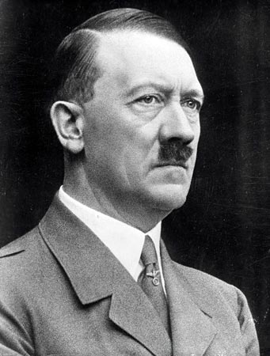
Because of the Dawes Palm, Germany begain to prosper until the American’s called in their loans because of the stock market crash/Depression
Adolf Hitler used this time of misery to seize support

Slide 6
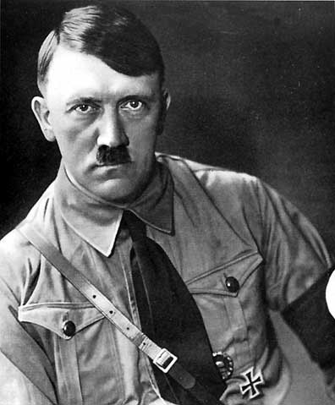
Adolf Hitler
Born in Austria, Hitler fought in the German army during WWI. He despised the Jews, Serbs, Poles and Weimar Government.

Slide 7
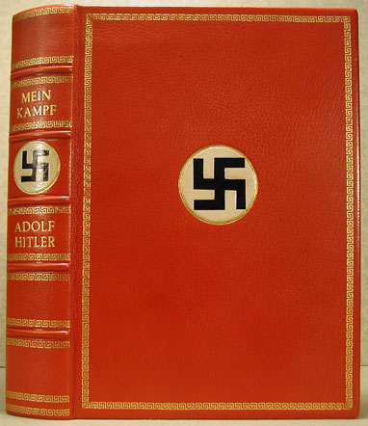
He wrote Mein Kampf while he was in jail for trying to overthrow the government.
In the book he wrote Nazi goals and ideology Extreme nationalism, racism and anti-Semitism
He blamed Marxists, Jews and corrupt politicians not the German people for the loss of WWI

Slide 8
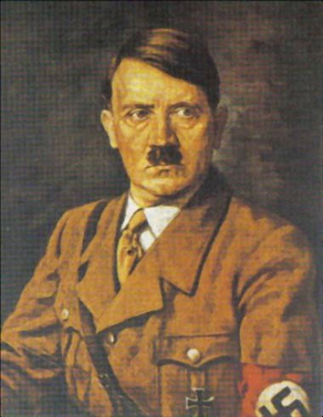
Hitler took the title Fuhrer meaning strong leader
As Fuhrer, Hitler found enthusiastic followers among veterans and lower-middle class who felt frustrated about the future.

Slide 9
The Great Depression helped Hitler because unemployment rose. He promised to end reparations, create jobs and rearm Germany.
Hitler gained popularity in the Reichstag, and conservative politicians planned to use him for their own means. Hitler became head of state through legal means.

Slide 10
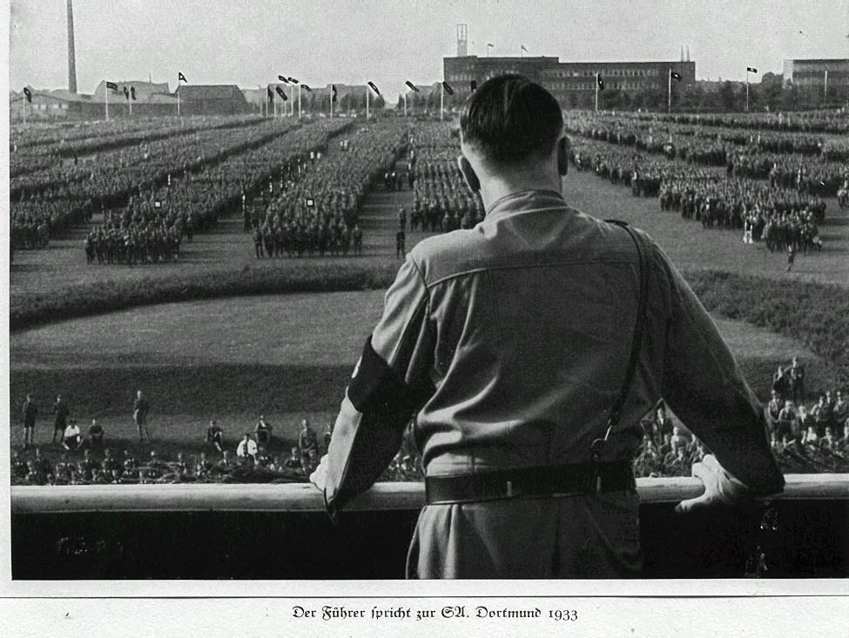
Hitler’s Third Reich
Hitler ruled Germany as totalitarian state meaning the Nazi’s controlled all areas of German life – From government to religion to schools. Elite, black-uniformed SS troops enforced Hitler’s will. His secret police, the Gestapo got rid of opposition.

Slide 11
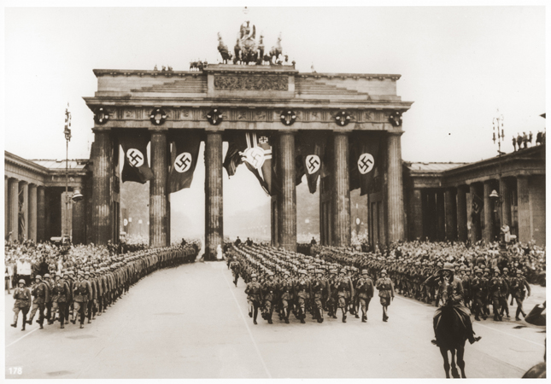
Hitler began to rearm Germany, which helped the unemployment, but it was in violation of the Treaty of Versailles
How do you think the other countries in Europe are going to react?
What do you think Hitler is preparing for?

Slide 12
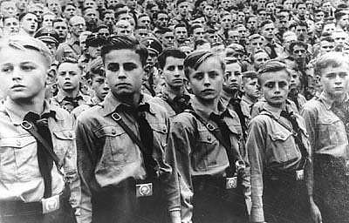
The Nazis used indoctrinated German youth with racist ideology, and urged young people to destroy their “enemies” “Hitler’s Youth” pledged absolute loyalty to Germany and undertook physical fitness programs to prepare for war.

Slide 13
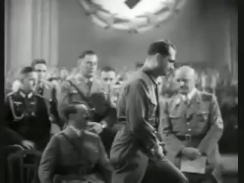
Hitler Speaking
What do you notice about Hitler’s public speaking?
How did people react when he spoke?

Slide 14
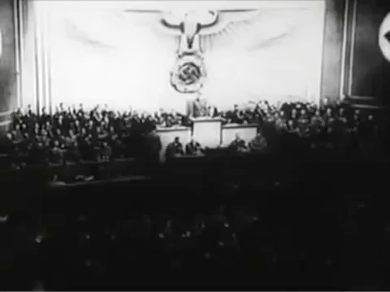
Hitler Speaking
What do you notice about Hitler’s public speaking?
How did people react when he spoke?

