Slide 1

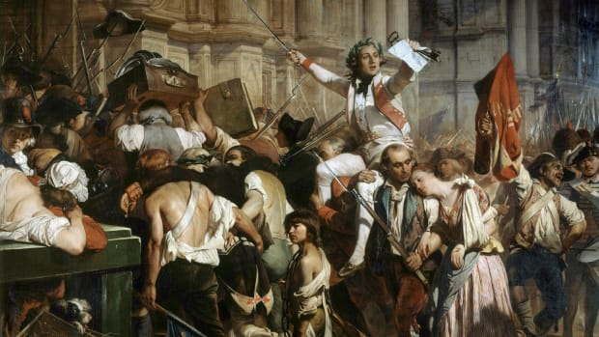
The French Revolution
Do Now: Define Revolution in your notebooks
Are revolutions always violent?
1789-1799

Slide 2

Vocabulary
Levied – to impose, or to put on
Taxes – revenue (funds) collected by the government from the people
Censorship – to silence the voice of an individual or group
Warrant – a piece of paper to charge someone of a crime or to arrest them
Arbitrarily – without cause at anytime
Discontent – dissatisfied, unhappy
Clergy – members of the hierarchy of a church (RCC, or Protestant Church)
Nobility – The land owning class, also might have been given title such as lord, prince, etc by the monarch
Mare – a female horse
Symmetry – similar parts usually opposite to each other
Attribute – feature or characteristic

Slide 3
Document #1
1. Students will have 7-8 minutes for Document #1
2. Students will work on Document #1 in their pairs and individually completing the question as well as PERSIA analysis.
3. Students will share their answers with each other.
4. Students will share answers with class.

Slide 4
Document #2
1. Students will have 8-10 minutes for Document #2
2. Students will work on document #2 in their pairs and individually completing the question as well as a HAPPY analysis.
3. Students will share their answers with each other.
4. Students will share answers with class.

Slide 5
Extension: Document #3
1. Students will have 4-5 minutes for Document #3
2. Students will work on document #2 in their pairs and individually completing the question as well as a PERSIA analysis.
3. Students will share their answers with each other.
4. Students will share answers with class.

Slide 6
Assignment
Create a structured paragraph of the Historical Context of the Causes of the French Revolution
Due Tomorrow at beginning of class.
We will share-out selected paragraphs and discuss.

