Slide 1
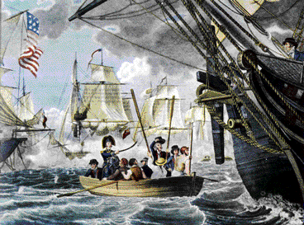
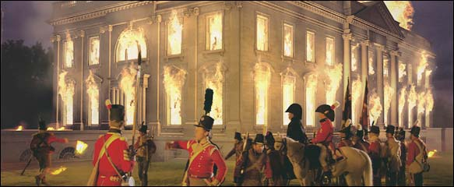
Presidency of James Madison & The War of 1812
Do Now: Define Nationalism
The Rise of Nationalism
Aim: What were the causes & results of the War of 1812?

Slide 2
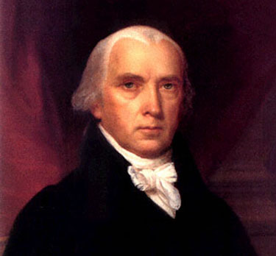
4th President: 1809 - 1817
Democratic-Republican
Supporter of Embargo Act in 1807
Asked Congress for Declaration of War against Britain in 1812
James Madison

Slide 3
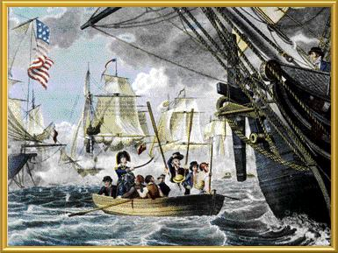
Causes of the War of 1812
Embargo Act 1807 Britain & France (Jefferson)
Britain helping American-Indians on Canadian Borders fight the U.S.
Britain’s Policy of Impressment of American Sailors

Slide 4
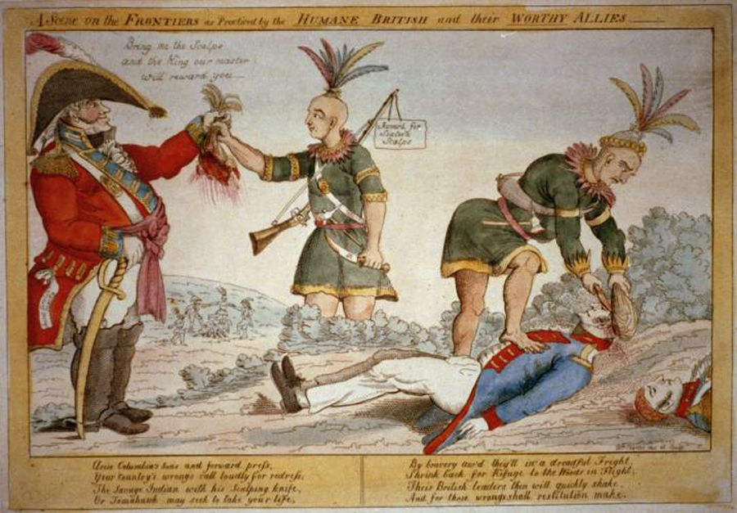
WAR

Slide 5
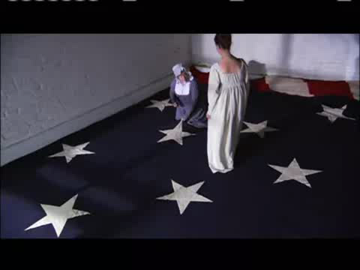
War of 1812 (Between U.S. & Britain)
Lasts 3 years
Begins because of British Impressment policies
Treaty of Ghent Ends War
Ends before the last battle (Battle of New Orleans)
Called America’s 2nd War of Independence
Results:
Westward Expansion
Nationalism
Control of Great Lakes

Slide 6
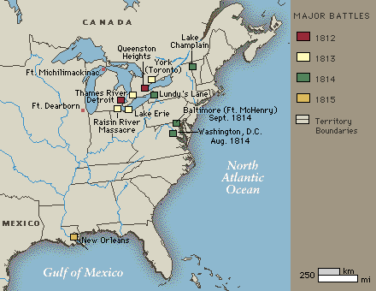
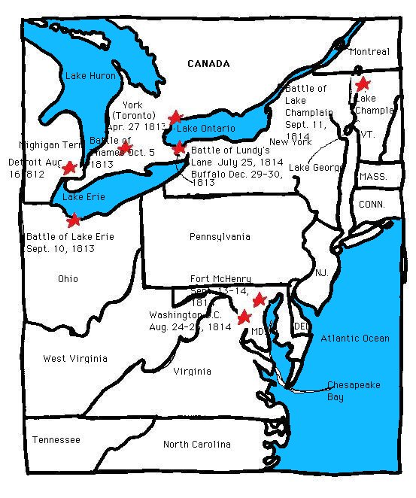

Slide 7
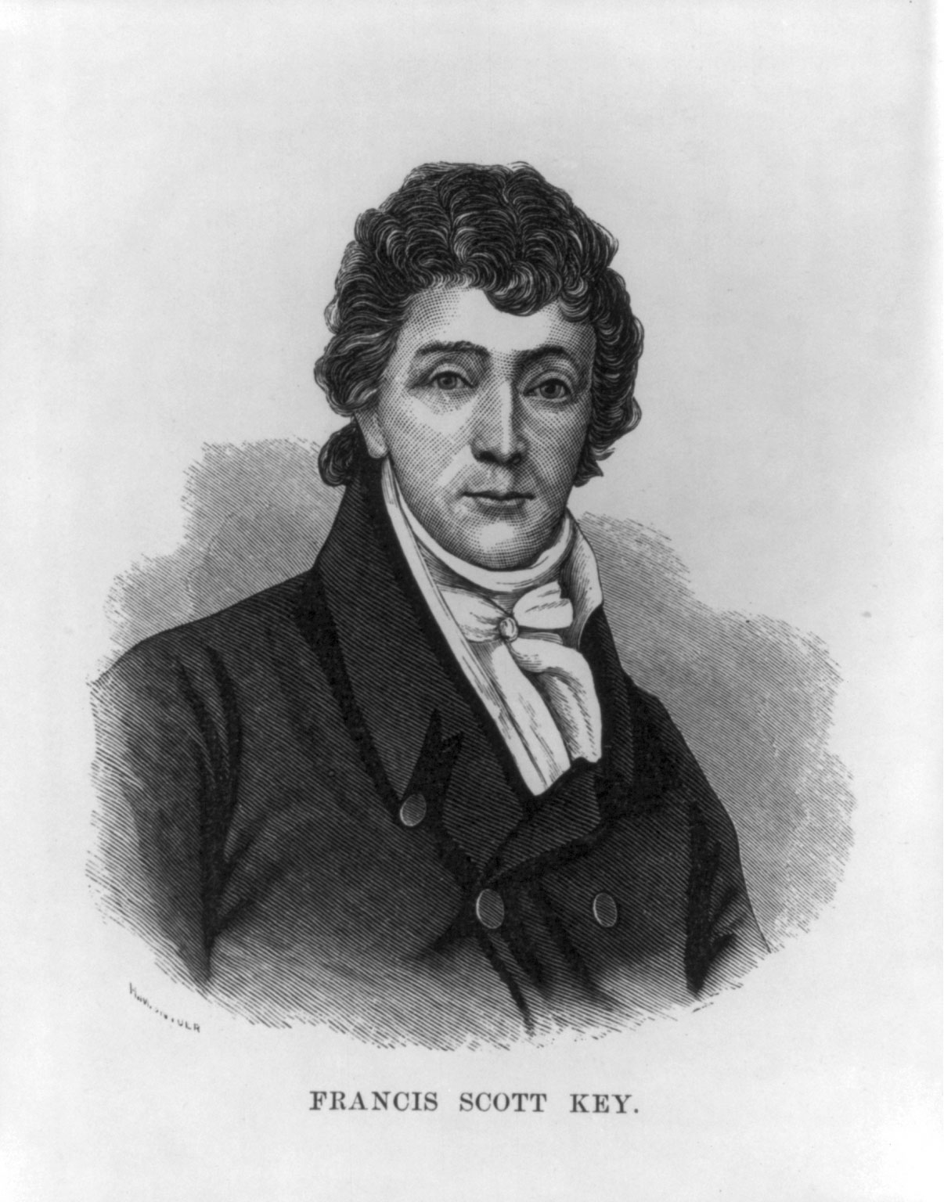
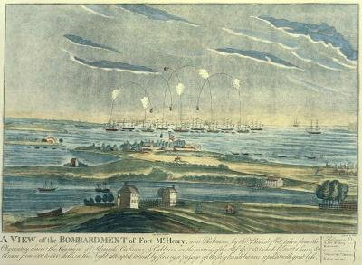
After seeing the bombardment of Fort McHenry from a ship in the harbor, this lawyer writes a poem called the STAR SPANGLED BANNER

Slide 8
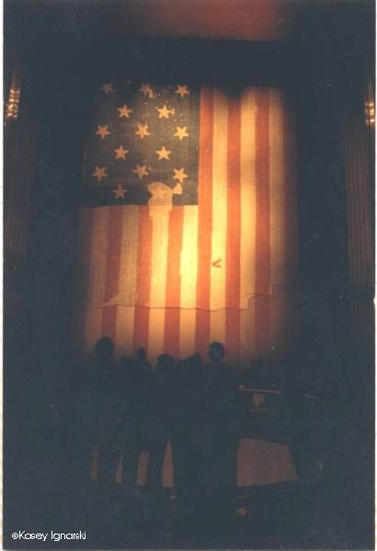
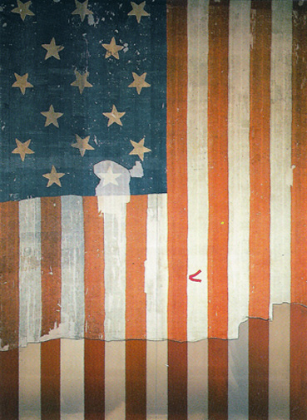

Slide 9
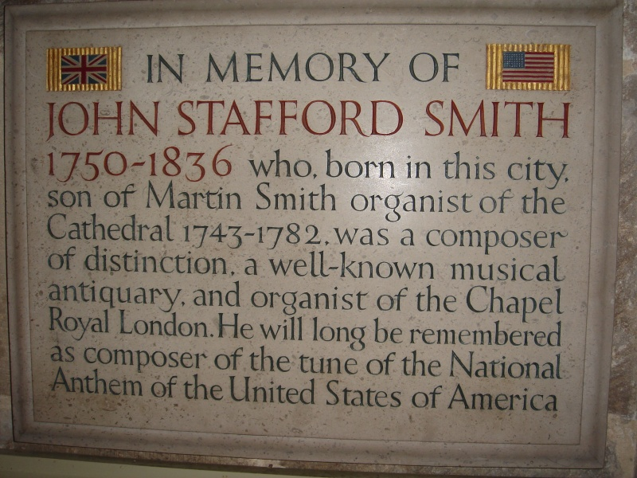
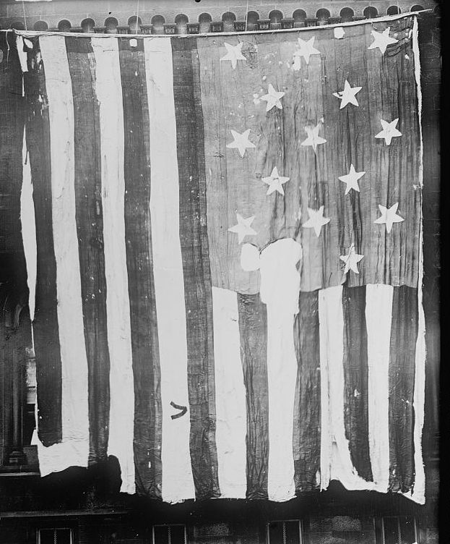

Oh, say can you see by the dawn's early light What so proudly we hailed at the twilight's last gleaming?
Whose broad stripes and bright stars thru the perilous fight. O'er the ramparts we watched were so gallantly streaming?
And the rocket's red glare, the bombs bursting in air, Gave proof through the night that our flag was still there.
Oh, say does that star-spangled banner yet wave O'er the land of the free and the home of the brave?
Francis Scott Key – 1812
Tune: Anacreon in Heaven

Slide 10
What about the rest of the poem?
On the shore, dimly seen through the mists of the deep, Where the foe's haughty host in dread silence reposes, What is that which the breeze, o'er the towering steep, As it fitfully blows, half conceals, half discloses? Now it catches the gleam of the morning's first beam, In full glory reflected now shines in the stream: 'Tis the star-spangled banner! Oh long may it wave O'er the land of the free and the home of the brave! And where is that band who so vauntingly swore That the havoc of war and the battle's confusion, A home and a country should leave us no more! Their blood has washed out their foul footsteps' pollution. No refuge could save the hireling and slave From the terror of flight, or the gloom of the grave: And the star-spangled banner in triumph doth wave O'er the land of the free and the home of the brave! Oh! thus be it ever, when freemen shall stand Between their loved home and the war's desolation! Blest with victory and peace, may the heav'n rescued land Praise the Power that hath made and preserved us a nation. Then conquer we must, when our cause it is just, And this be our motto: "In God is our trust." And the star-spangled banner in triumph shall wave O'er the land of the free and the home of the brave!
Oh, say can you see by the dawn's early light What so proudly we hailed at the twilight's last gleaming?
Whose broad stripes and bright stars thru the perilous fight.O'er the ramparts we watched were so gallantly streaming?
And the rocket's red glare, the bombs bursting in air, Gave proof through the night that our flag was still there.
Oh, say does that star-spangled banner yet wave O'er the land of the free and the home of the brave?
In a version hand-written by Francis Scott Key in 1840, the third line reads "Whose bright stars and broad stripes, through the clouds of the fight,
Francis Scott Key - 1

Slide 11
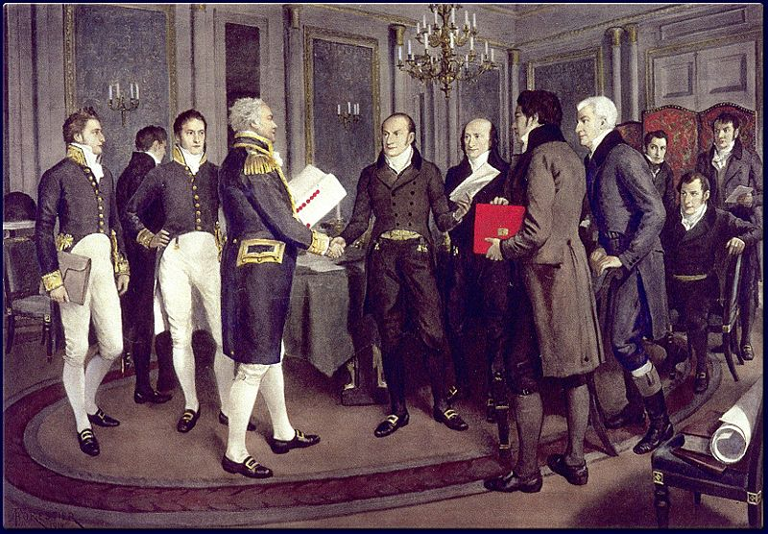
War Ends – Treaty of Ghent - 1814

Slide 12
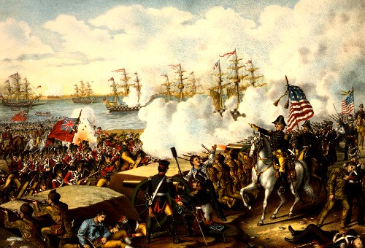
One Last Battle
1815 – Battle of New Orleans General Andrew Jackson

Slide 13
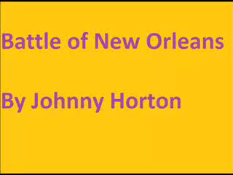
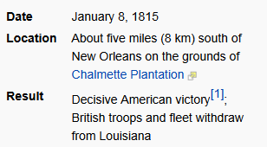
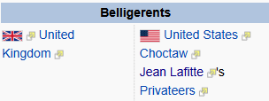
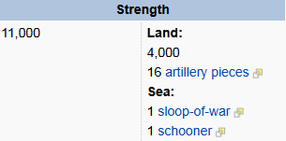
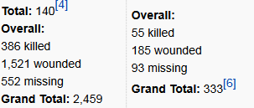
Although the Battle of New Orleans had no influence on the terms of the Treaty of Ghent, the defeat at New Orleans did compel Britain to abide by the treaty.

Slide 14
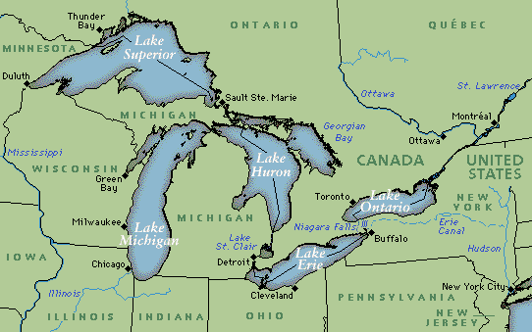
Results of the War of 1812
Nationalism
Westward Expansion
Control of the Great Lakes
H uron
O ntario
M ichigan
E rie
S uperior
Superior
Huron
Ontario
Michigan
Erie

