Slide 1
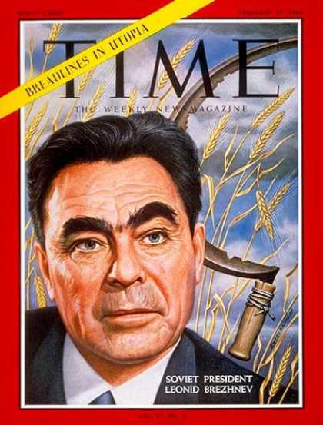
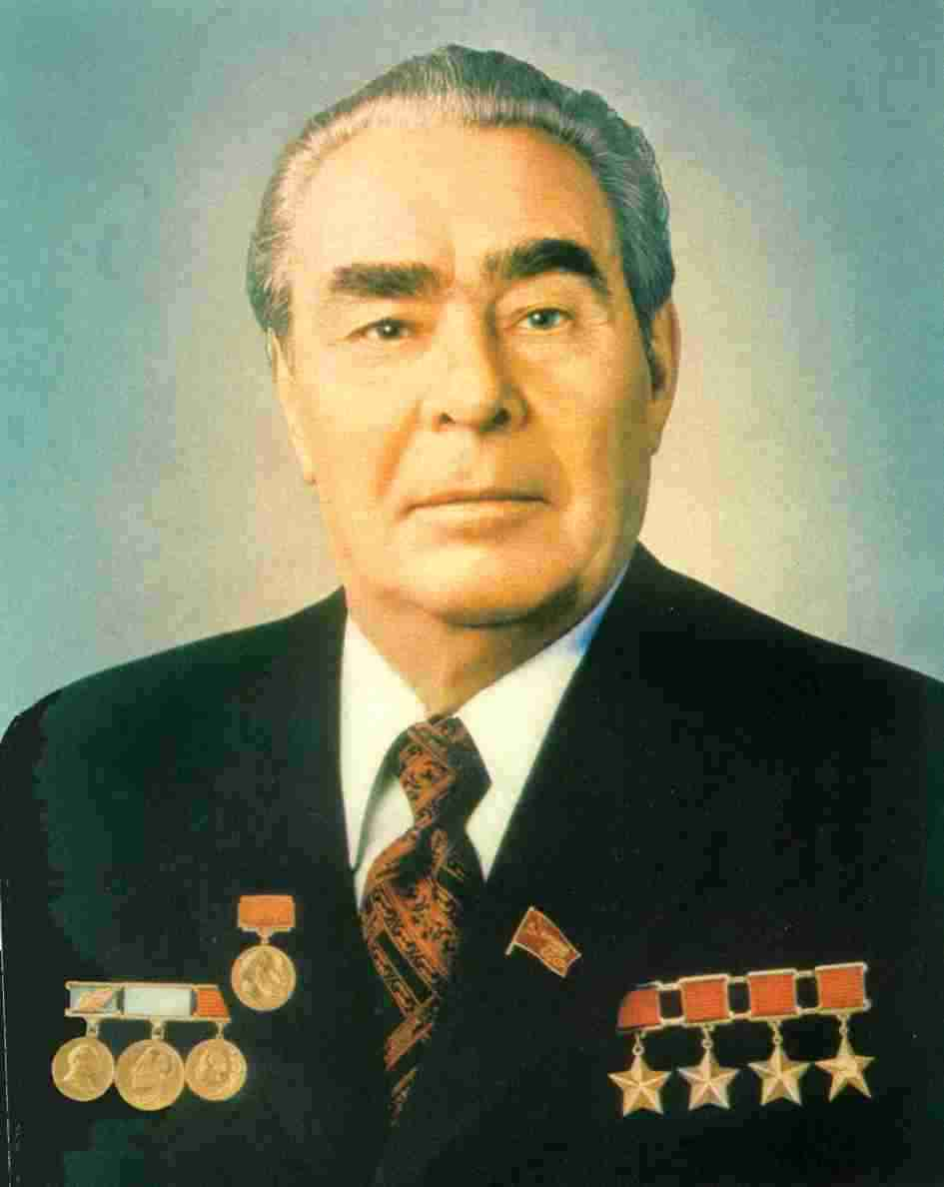
Soviet Society During Brezhnev

Slide 2
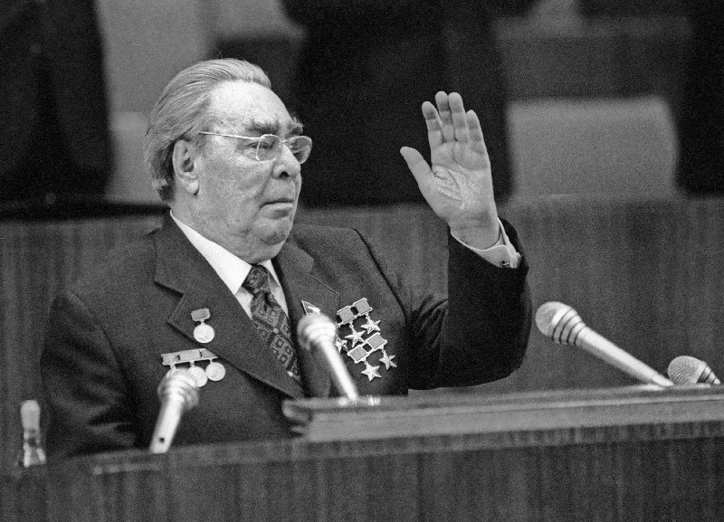
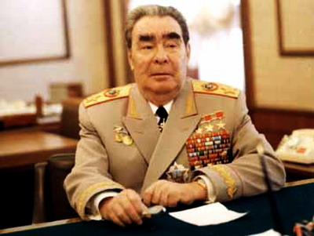
Brezhnev as “ruler”
Party Secretary with Aleksei Kosygin as President, takes over as tough, colorless
“Thaw” quickly ended and “dissidents” were repressed again
Brezhnev’s rule marked years of cultural and economic stagnation, but…
Détente (lessening of tension) with the West

Slide 3
Gains
Greatly expanded military and naval strength at the expense of consumer goods: “metal eaters alliance”
Soviets were world’s leading producer of coal, steel, pig iron, cement, cotton, natural gas and oil
  By 1950 Soviet GNP was only 30% of US
  By 1975 Soviet GNP was 60% of US
Major strides in space exploration continued- 1st satellite 1957, 1st man in space, 1st multi-person launch. (started under Khrushchev)

Slide 4
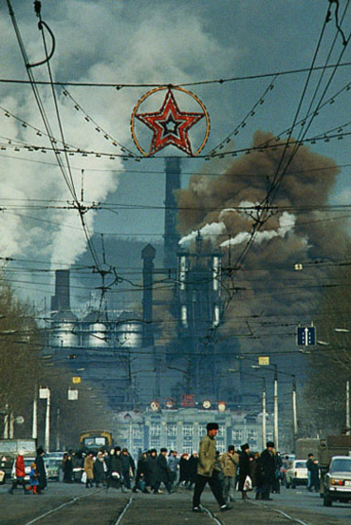
But…
Environmental and safety issues were ignored
  Water pollution, air pollution, acid rain, fuel spills
Consumer goods ignored-
  Goods were shoddy, scarce and there were few choices, (could purchase only 2/5th the goods and services available to Americans)
  Most people waited years to buy a car, stood in lines to buy food

Slide 5
The Cracks in the Ice…
Agriculture remained the weakest part of the Soviet economy
  Bad weather
  Lack of incentive
  Poor transport: harvests rot in fields (no trucks, no silos)
Soviet economy breaks down
  By 1972 imported grain from US
  Black Market-widespread-underground economy-bribery, corruption, embezzlement, absenteeism and drunkenness meant poor quality goods and few of them

Slide 6
Despite KGB, increased criticism …
“Samizdat” privately printed manuscripts were circulated underground
Solzhenitsyn published his famous Gulag Archipelago
Andrei Sakharov: nuclear physicist turned dissident was banished from Moscow
Soviet Jews protested emigration restrictions
Soviet invasion of Afghanistan in December 1979 –détente collapsed

