Slide 1
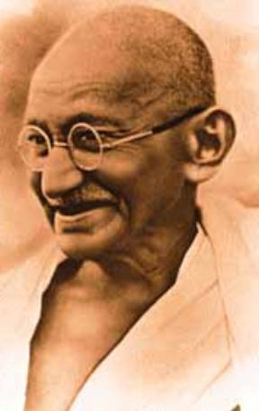
MAHATMA GANDHI
1869-1948

Slide 2
Mohandas Karamchand Gandhi was born on 2 October 1869 in Porbandar, a coastal town in present-day Gujarat, India. His father, Karamchand Gandhi (1822–1885), who belonged to the Hindu Modh community, was the diwan (Prime Minister) of Porbander state, a small princely state in the Kathiawar Agency of British India.

Slide 3
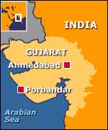
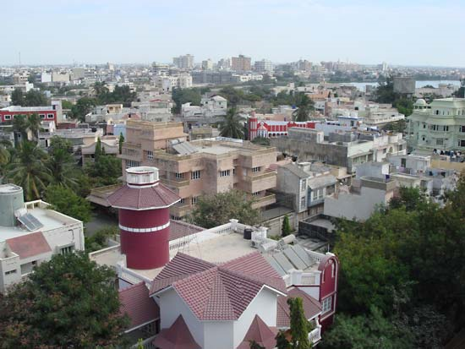
Social Position
Gandhi was born into the second highest caste in Hindu society – the Ruler-Warrior Caste.
Modern Porbandar, India

Slide 4
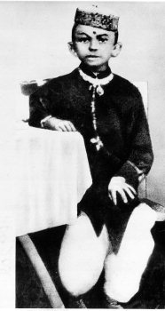
As a youth (about 15-years-old)
He had his schooling in nearby Rajkot, where his father served as the adviser or prime minister to the local ruler. In May 1883, the 13-year old Mohandas was married to 14-year old Kasturbai Makhanji in an arranged child marriage, as was the custom in the region. In 1885, when Gandhi was 15, the couple's first child was born, but survived only a few days;

Slide 5
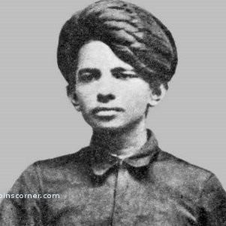
Later Teen Years
On 4 September 1888, less than a month shy of his 19th birthday, Gandhi traveled to London, England, to study law at University College London and to train as a barrister. His time in London, the Imperial capital, was influenced by a vow he had made to his mother in the presence of the Jain monk Becharji, upon leaving India, to observe the Hindu precepts of abstinence from meat, alcohol, and promiscuity.

Slide 6
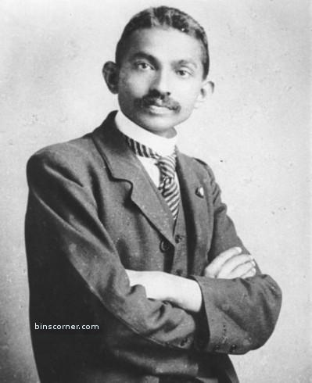
The London Years 1888-1891
Although Gandhi experimented with adopting "English" customs—taking dancing lessons for example—he could not stomach the bland vegetarian food offered by his landlady and he was always hungry until he found one of London's few vegetarian restaurants. Influenced by Salt's book, he joined the Vegetarian Society, was elected to its executive committee^{[10]}, and started a local Bayswater chapter.^{[4]} Some of the vegetarians he met were members of the Theosophical Society, which had been founded in 1875 to further universal brotherhood, and which was devoted to the study of Buddhist and Hindu literature. They encouraged Gandhi to join them in reading the Bhagavad Gita both in translation as well as in the original.^{[10]} Not having shown a particular interest in religion before, he became interested in religious thought and began to read both Hindu as well as Christian scriptures.

Slide 7
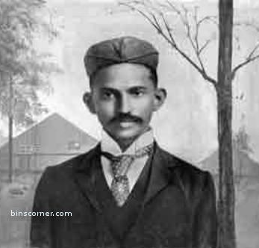
Attempting to Establish a Career in India: 1891-1893
His attempts at establishing a law practice in Mumbai failed. Later, after failing to secure a part-time job as a high school teacher, he ended up returning to Rajkot to make a modest living drafting petitions for litigants, a business he was forced to close when he ran afoul of a British officer. In his autobiography, he refers to this incident as an unsuccessful attempt to lobby on behalf of his older brother. It was in this climate that, in April 1893, he accepted a year-long contract from Dada Abdulla & Co., an Indian firm, to a post in the Colony of Natal, South Africa, then part of the British Empire

Slide 8
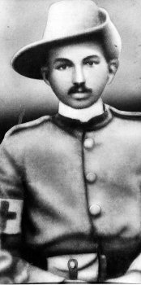
Gandhi in South Africa: 1893- 1914
In South Africa, Gandhi faced discrimination directed at Indians. He was thrown off a train at Pietermaritzburg after refusing to move from the first class to a third class coach while holding a valid first class ticket. Traveling farther on by stagecoach he was beaten by a driver for refusing to travel on the foot board to make room for a European passenger. These events were a turning point in his life, awakening him to social injustice and influencing his subsequent social activism.
Gandhi while serving in the Ambulance Corps during the Boer War.

Slide 9
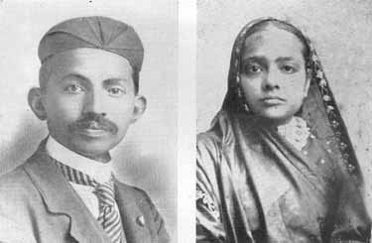
Maturing in South Africa
Gandhi and his wife Kasturba in South Africa (1902)

Slide 10
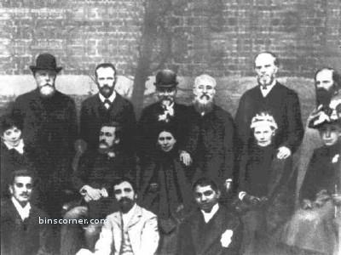
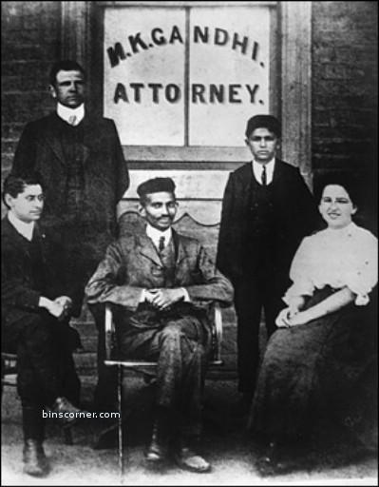
The South Africa Years
Gandhi and his legal colleagues.
Gandhi and his South African friends.
Gandhi served in and lead an Ambulance Corps Unit in both the Boer War 1899-1892 and the Zulu War of 1906. By supporting the British government, Gandhi hoped to gain full citizenship for Indians in South Africa, a goal he did not achieve.

Slide 11
Struggle for Indian Independence (1915–1945)

Slide 12
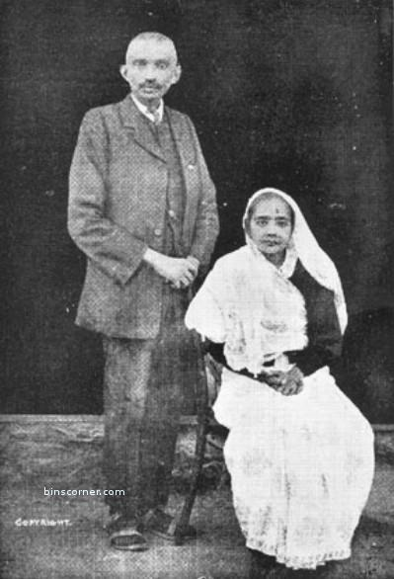
Returning to India in 1915
In 1915, Gandhi returned from South Africa to live in India. He spoke at the conventions of the Indian National Congress, but was primarily introduced to Indian issues, politics and the Indian people by Gopal Krishna Gokhale, a respected leader of the Congress Party at the time.

Slide 13
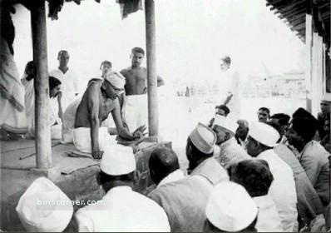
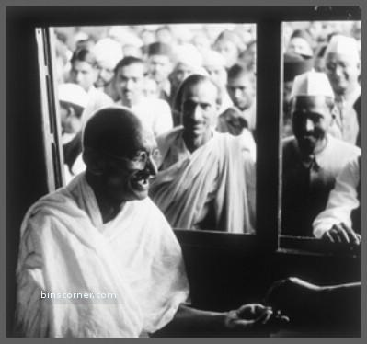
Gandhi takes a leadership role
Gandhi preaching a group of people
Gandhi in a train interacting with his followers

Slide 14
Role in World War I
In April 1918, during the latter part of World War I, Gandhi was invited by the Viceroy to a War Conference in Delhi. Perhaps to show his support for the Empire and help his case for India's independence, Gandhi agreed to actively recruit Indians for the war effort. In contrast to the Zulu War of 1906 and the outbreak of World War I in 1914, when he recruited volunteers for the Ambulance Corps, this time Gandhi attempted to recruit combatants.

Slide 15
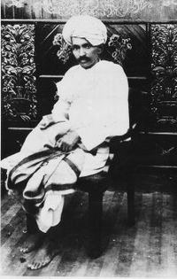
Between the Wars
In 1918, in Champaran, a district in state of Bihar, tens of thousands of landless serfs, indentured laborers and poor farmers were forced to grow indigo and other cash crops instead of the food crops necessary for their survival. Gandhi proposed satyagraha - non-violence, mass civil disobedience. While it was strictly non-violent, Gandhi was proposing real action, a real revolt that the oppressed peoples of India were dying to undertake. His main assault came as he was arrested by police on the charge of creating unrest and was ordered to leave the province. Hundreds of thousands of people protested and rallied outside the jail, police stations and courts demanding his release, which the court unwillingly did.
Gandhi in 1918, when he led the Kheda Satyagraha.

Slide 16
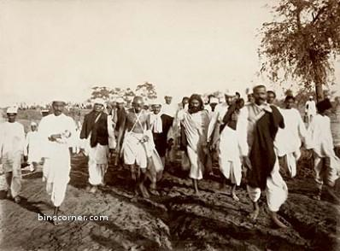
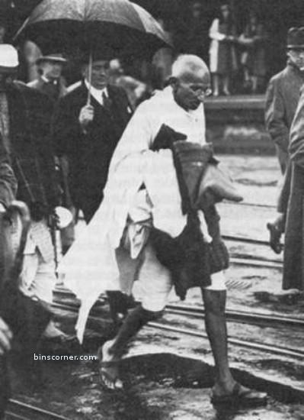
Gandhi’s Tactics
Gandhi employed non-cooperation, non-violence and peaceful resistance as his "weapons" in the struggle against British. In Punjab, the Jallianwala Bagh massacre of civilians by British troops (also known as the Amritsar Massacre) caused deep trauma to the nation, leading to increased public anger and acts of violence. Gandhi criticized both the actions of the British Raj and the retaliatory violence of Indians. When he was arrested, he continued his non-violent protest through hunger strikes.
Gandhi on the Salt March.
Gandhi on Dandi March

Slide 17
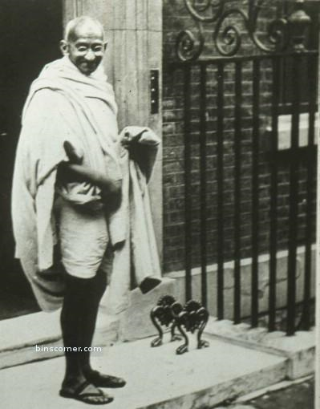
Gandhi is called to London for “talks.”
Gandhi became internationally known, so the British government could not afford to have him harmed or have him die while under arrest (this included dying from a self-imposed hunger strike too). He became a respected world figure without ever doing anything violent. The British couldn’t ignore him; they had to talk with him.
At the Prime Minister’s Home on Downing Street , London , UK

Slide 18
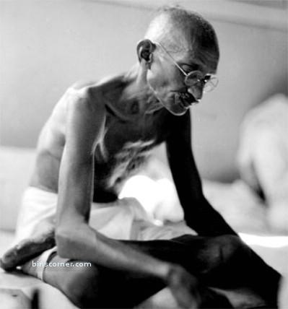
Imprisonment
Gandhi was arrested on 10 March 1922, tried for sedition, and sentenced to six years' imprisonment. He began his sentence on 18 March 1922. He was released in February 1924 for an appendicitis operation, having served only 2 years. Without Gandhi's uniting personality, the Indian National Congress began to splinter during his years in prison, splitting into two factions. Furthermore, cooperation among Hindus and Muslims, which had been strong at the height of the non-violence campaign, was breaking down. Gandhi attempted to bridge these differences through many means, including a three-week fast in the autumn of 1924, but with limited success.
Gandhi on a “fast.”

Slide 19
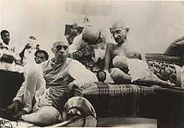
World War II interrupted the independence process.
After long deliberations, Gandhi declared that India could not be party to a war ostensibly being fought for democratic freedom, while that freedom was denied to India itself. As the war progressed, Gandhi intensified his demand for independence, drafting a resolution calling for the British to Quit India. This was Gandhi's and the Congress Party's most definitive revolt aimed at securing the British exit from India.
Jawaharlal Nehru sitting next to Gandhi at the AICC General Session, 1942.

Slide 20
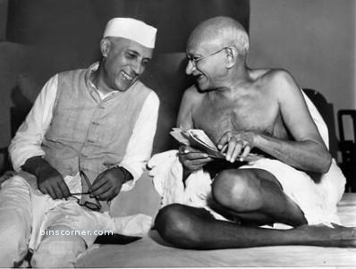
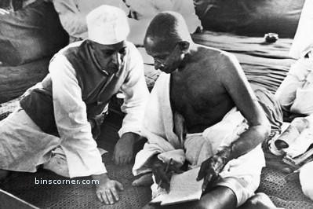
Gandhi and Jawaharlal Nehru work to prepare for independence.
Gandhi-Nehru in a happy mood
Gandhiji and Nehruji on serious discussions for attaining independence to India

Slide 21
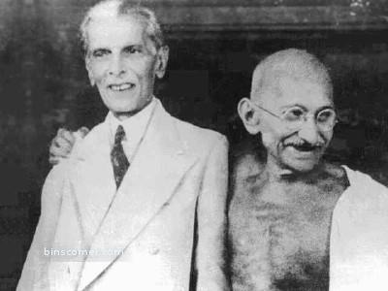
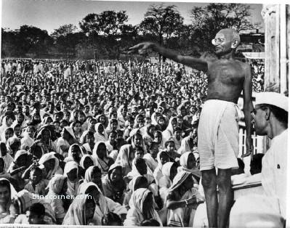
Gandhiji with Jinnah, leader of the Muslim faction in 1944
Gandhiji addressing a huge gathering

Slide 22
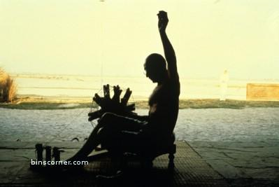
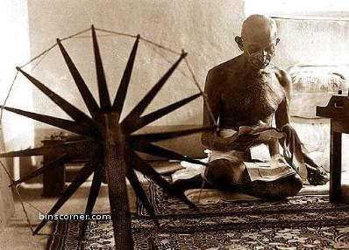
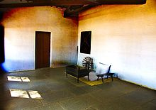
Gandhi led a very simple life
Gandhi spinning thread
Gandhi reading a newspaper
Mahatma Gandhi's room at Sabarmati Ashram

Slide 23
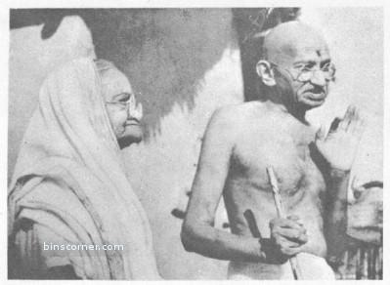
Much older, but still together

Slide 24
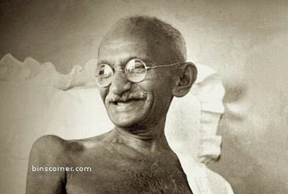
Independence
When the moment of freedom came, on 15 August 1947, Gandhi was nowhere to be seen in the capital, though Nehru and the entire Constituent Assembly were to salute him as the architect of Indian independence, as the 'father of the nation'.

Slide 25
Partitioning India into India & Pakistan.
Hindu and Sikh refugees had streamed into the capital from what had become Pakistan, and there was much resentment, which easily translated into violence, against Muslims. It was partly in an attempt to put an end to the killings in Delhi, and more generally to the bloodshed following the partition, which may have taken the lives of as many as 1 million people, besides causing the dislocation of no fewer than 11 million, that Gandhi was to commence the last fast unto death of his life. The fast was terminated when representatives of all the communities signed a statement that they were prepared to live in "perfect amity", and that the lives, property, and faith of the Muslims would be safeguarded.

Slide 26
Gandhi’s response to threats
Gandhi, quite characteristically, refused additional security, and no one could defy his wish to be allowed to move around unhindered. In the early evening hours of 30 January 1948, Gandhi met with India's Deputy Prime Minister and his close associate in the freedom struggle, Vallabhai Patel, and then proceeded to his prayers. Gandhi commenced his walk towards the garden where the prayer meeting was held. As he was about to mount the steps of the podium, Gandhi folded his hands and greeted his audience with a namaskar; at that moment, a young man came up to him and roughly pushed aside Manu. Nathuram Godse (a Brahmin Hindu) bent down in the gesture of an obeisance, took a revolver out of his pocket, and shot Gandhi three times in his chest.

Slide 27
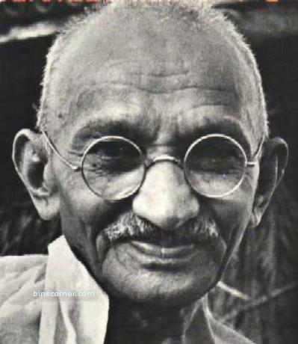
Mahatma Gandhi – The Father of India (1869-1948)

