Slide 1
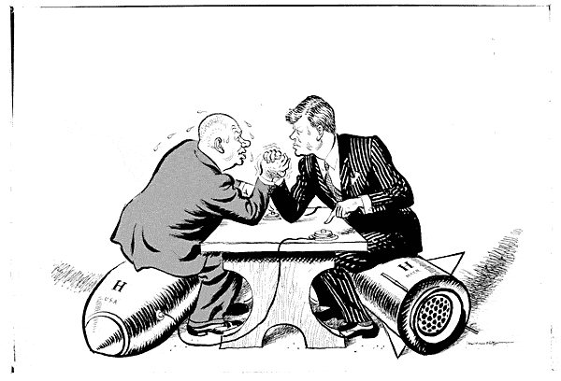
The Cold War
AIM: How did the Cold War affect the world from 1945-1991 and does it still affect the world today?
Do Now: Cold War worksheet

Slide 2
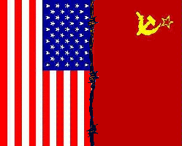
THE TWO SUPERPOWERS
U.S. A. vs U.S.S.R.

Slide 3

MTV Video
Two Tribes - Frankie Goes to Hollywood
Early 1980s – US President Ronald Reagan vs. Soviet Union leader Leonid Brezhnev

Slide 4
So why were these two super powers so distrustful of the other?
America | Soviet Union
Free elections | No elections or fixed
Democratic | Autocratic / Dictatorship
Capitalist | Communist
‘Survival of the fittest’ | Everybody helps everybody
Richest world power | Poor economic base
Personal freedom | Society controlled by the NKVD (secret police)
Freedom of the media | Total censorship

Slide 5
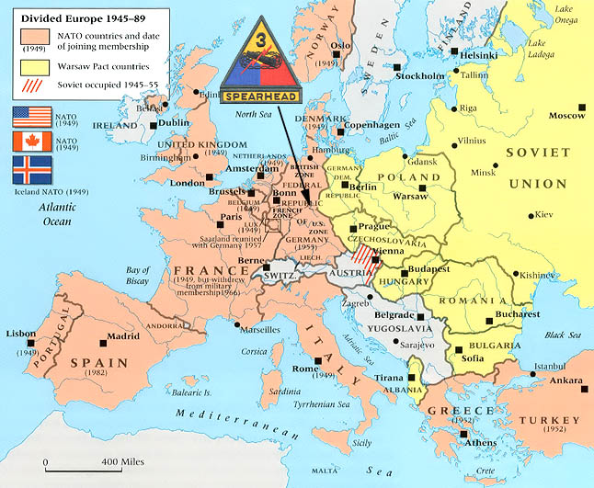
Notes:
As we learned, the United States, Canada and other Western European nations formed a military alliance called NATO, where they pledged to help each other if one country was attacked. In response the USSR set up their military alliance of their satellite states to counter NATO. We have said that the Cold War was not a traditional war, but instead a period of heightened tension and hostility between the two superpowers. What measures do you think were taken by each side to ensure them victory in case of an attack?

Slide 6
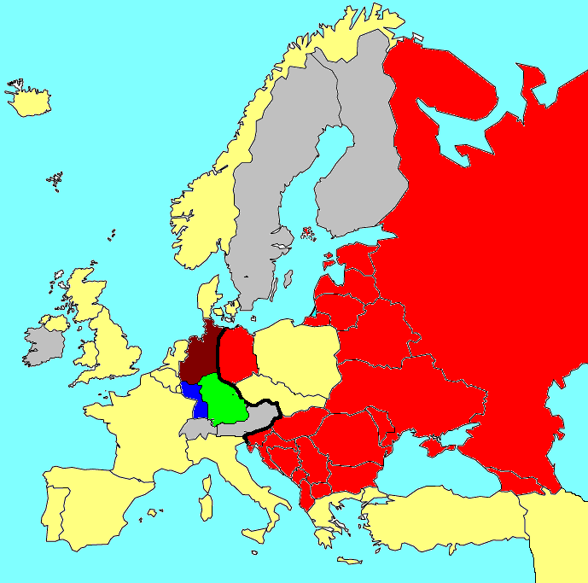

1945

Slide 7
1946

Slide 8
1946

Slide 9
1947

Slide 10
1947

Slide 11
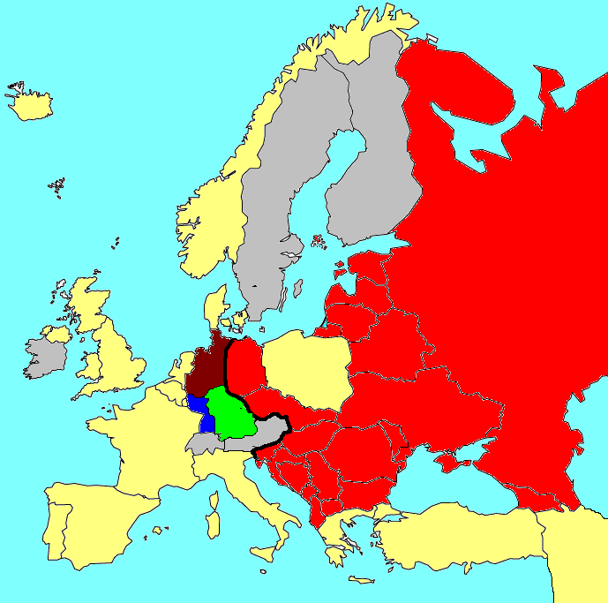
1948
Communist Coup in Czechoslovakia

Slide 12
1948
Communist Coup in Czechoslovakia

Slide 13
1948
Communist Coup in Czechoslovakia

Slide 14
1948
Communist Coup in Czechoslovakia

Slide 15
1948

Slide 16
1948

Slide 17
1948
June 1948: The Berlin Airlift Begins

Slide 18
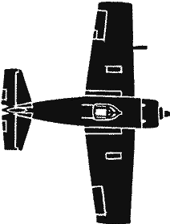
1948
June 1948: The Berlin Airlift Begins

Slide 19
1948
June 1948: The Berlin Airlift Begins

Slide 20
1948
June 1948: The Berlin Airlift Begins

Slide 21
1948
June 1948: The Berlin Airlift Begins

Slide 22
1948
June 1948: The Berlin Airlift Begins

Slide 23
1948
June 1948: The Berlin Airlift Begins

Slide 24
1948
June 1948: The Berlin Airlift Begins

Slide 25
1948
June 1948: The Berlin Airlift Begins

Slide 26
1948
Tito breaks from the Soviet Union

Slide 27
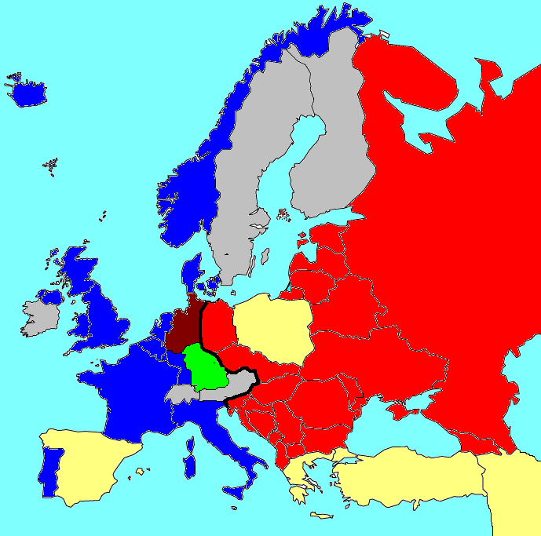
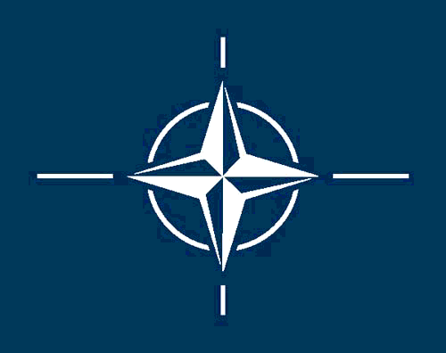


1949
April 4, 1949: NATO founded

Slide 28
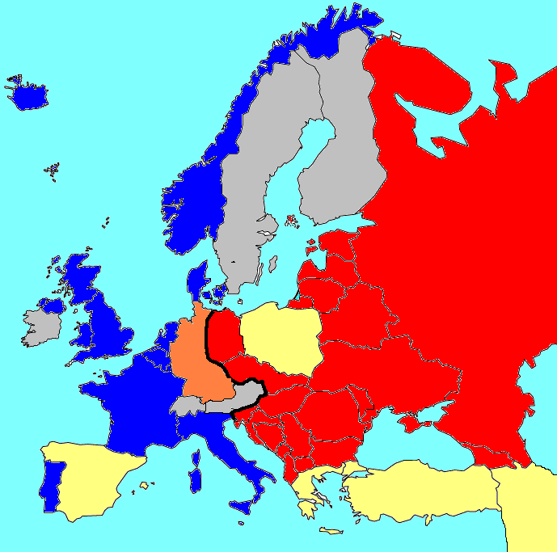
1949
May 23, 1949: West Germany founded

Slide 29


1949
US deploys nuclear weapons to defend Western Europe

Slide 30
1949
US deploys nuclear weapons to defend Western Europe

Slide 31
1949
US deploys nuclear weapons to defend Western Europe

Slide 32
1949
US deploys nuclear weapons to defend Western Europe

Slide 33
1949
US deploys nuclear weapons to defend Western Europe

Slide 34
1950

Slide 35
1950

Slide 36
1951

Slide 37
1951

Slide 38
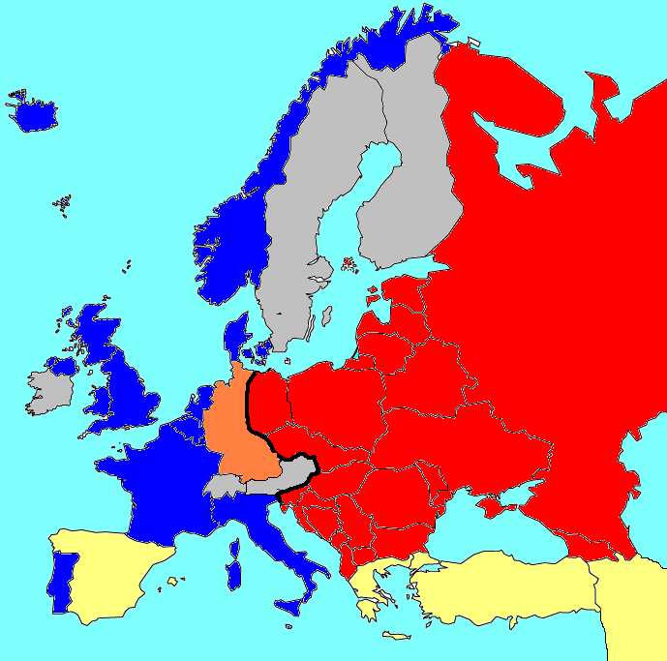
1952
Communists take over Poland

Slide 39
1952
Communists take over Poland

Slide 40
1952

Slide 41
1952

Slide 42
1952

Slide 43
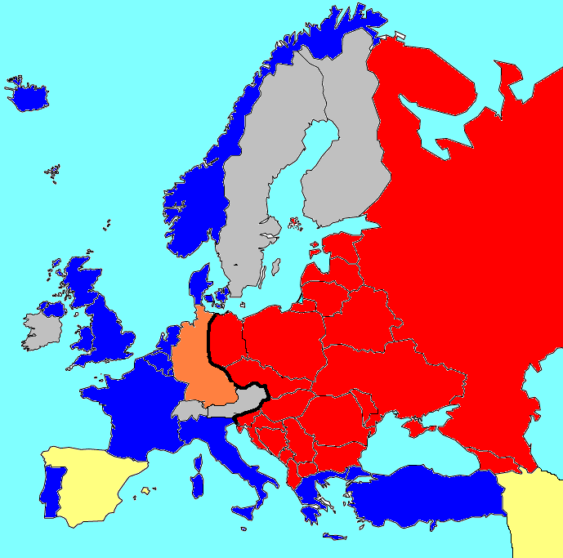
1952
Greece and Turkey join NATO

Slide 44
1952
Greece and Turkey join NATO

Slide 45
1952
Greece and Turkey join NATO

Slide 46
1952
Greece and Turkey join NATO

Slide 47
1953

Slide 48
1953

Slide 49
1954

Slide 50
1954

Slide 51
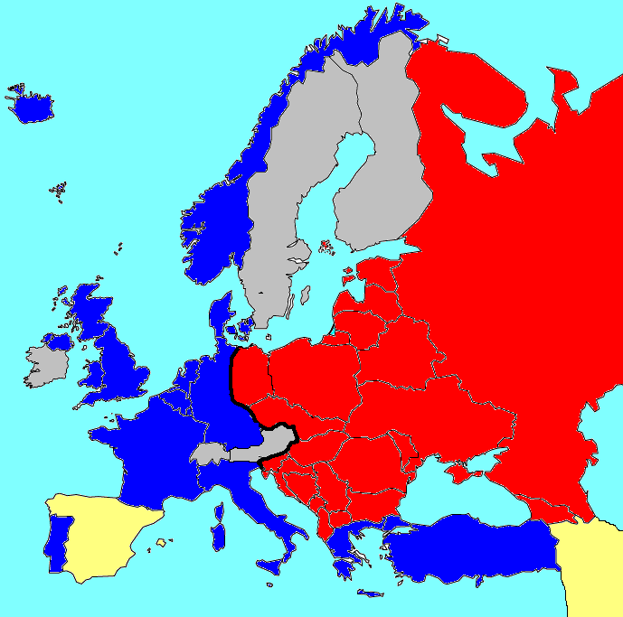
1955
The Warsaw Pact is formed
West Germany joins NATO

Slide 52
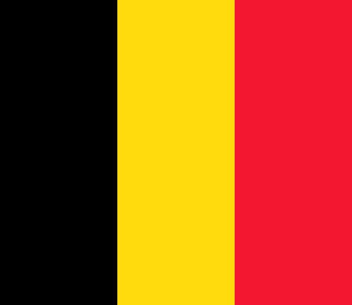
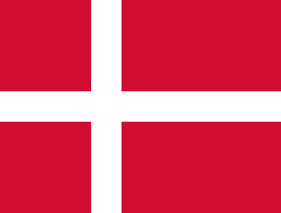

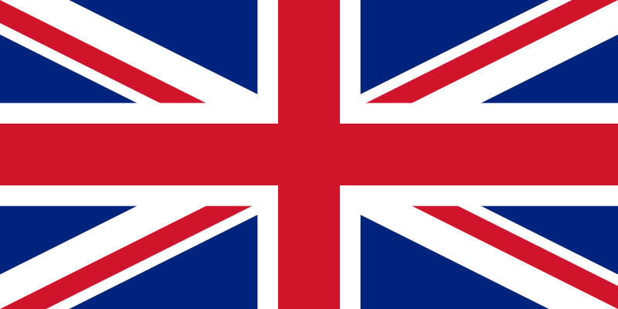
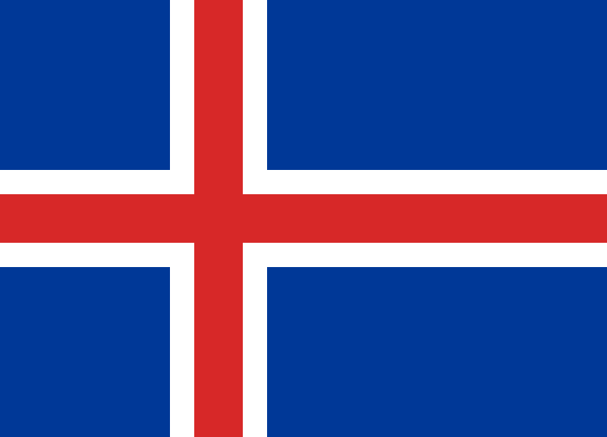


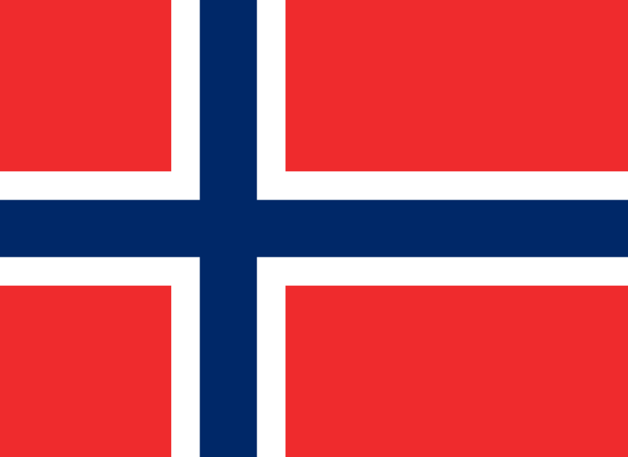
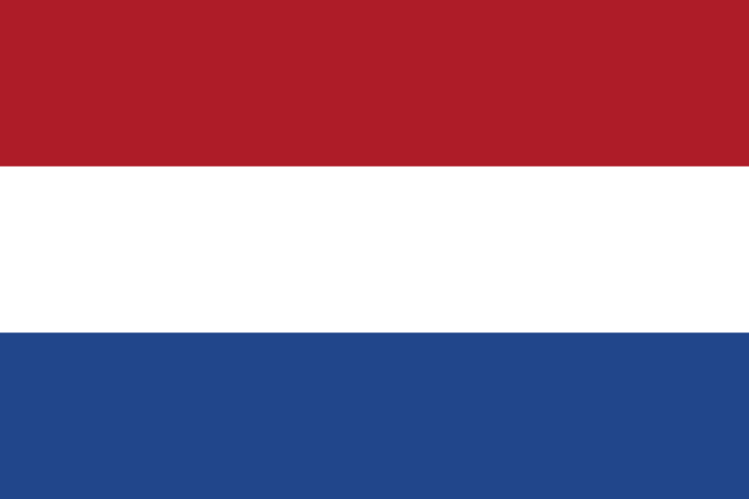
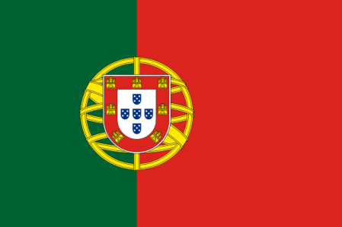
North Atlantic Treaty Organization (NATO)

Slide 53
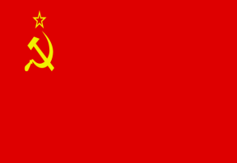
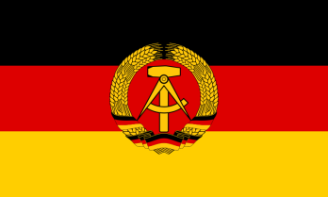
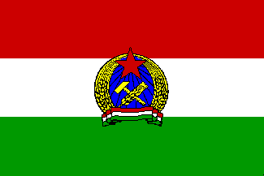
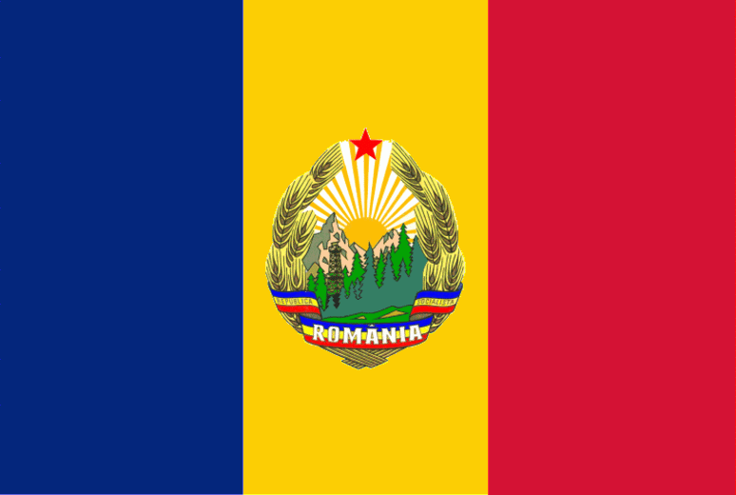
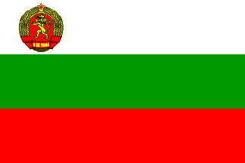
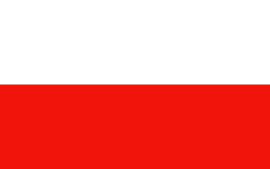
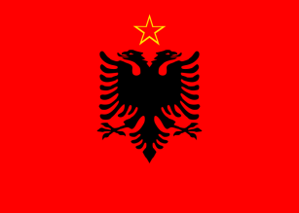
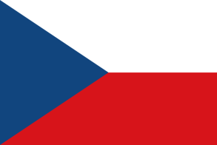
The Warsaw Pact is Formed
The Soviets were afraid of an American attack once West Germany built an army
They made a military alliance with the other communist countries in Europe to defend each other in case NATO attacked them

Slide 54


Slide 55
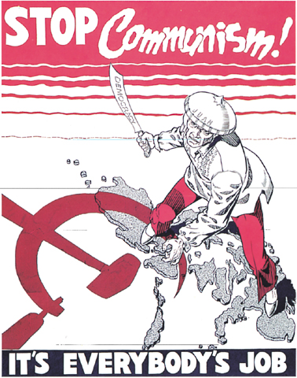
Propaganda
Misinformation was used in the newspapers, radio, TV, posters, movies, etc.
Subversion = The act of undermining (weakening) or overthrowing a government
Notes:
Cold War propaganda poster warning of Sviet-backed encroachment in the Phillippines

Slide 56
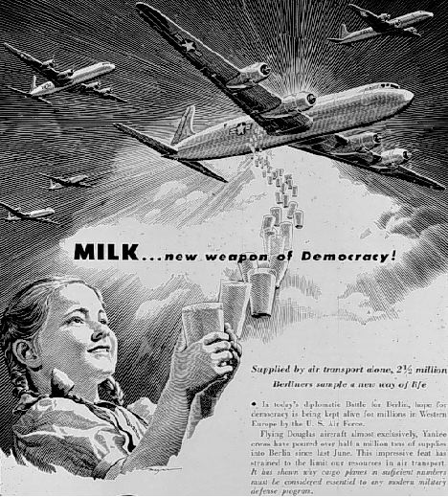
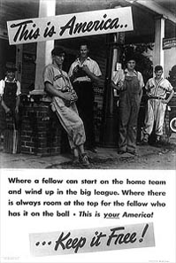

Slide 57
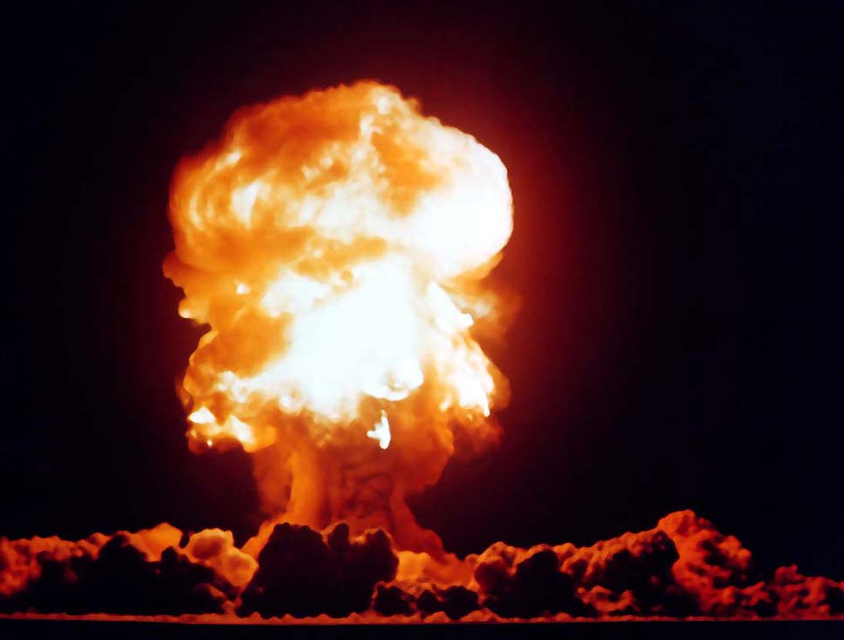

Notes:
To end WWII with Japan, the United States unleashed two atomic bombs on Hiroshima and Nagasaki. Four years later the Soviet Union tested their first nuclear weapon.

Slide 58
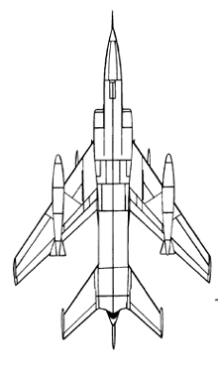
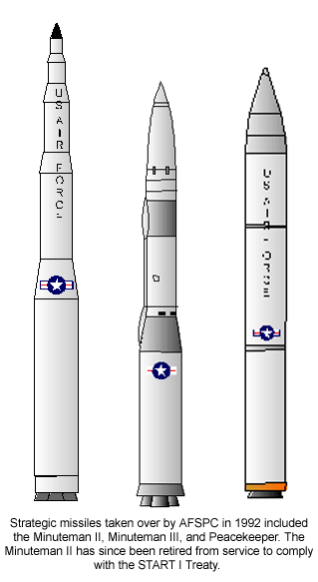
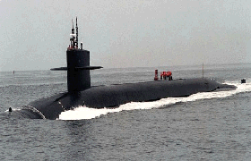
The Arms Race
Both the US and USSR armed themselves to withstand an attack by the other.
1950’s-1990, the two superpowers spent huge sums of money to develop new, more deadly nuclear and conventional weapons.
Delivery systems- different ways to ‘deliver’ and launch the weapons (bombers, missiles, submarines, etc.

Slide 59
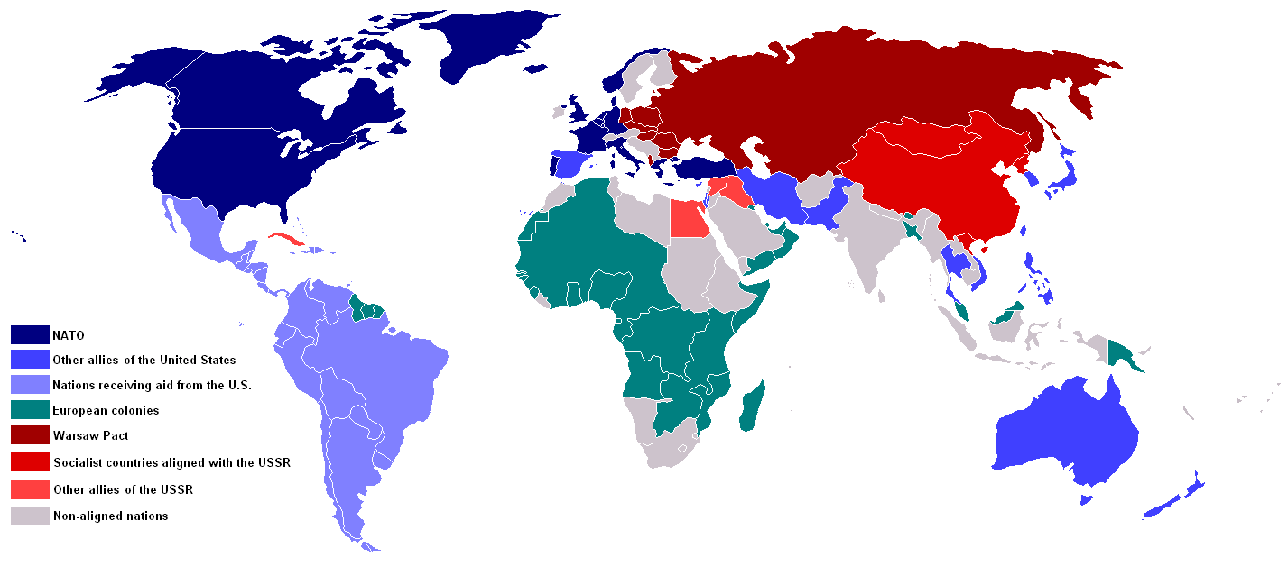
Non-aligned nations: Nations that chose not to ally themselves with either the US or USSR; the goal of nonalignment was to reduce tension and promote economic policies that would help developing nations (ex: India got financial help from both the US and USSR

Slide 60
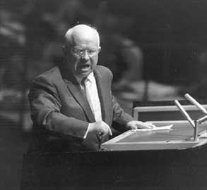
Khrushchev
He became the leader of the USSR in 1956
“We shall bury you!!”
Publicly denounced Stalin’s abuse of power, and started to ‘de-Stalinize’ the USSR
He called for a “peaceful coexistence” with the West.

Slide 61
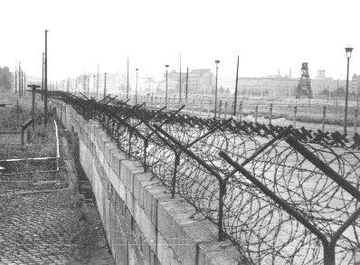
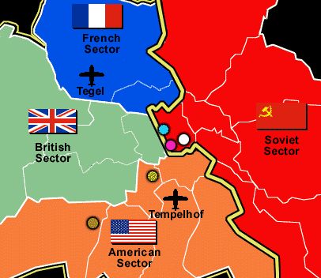
The Berlin Wall
Divided East Berlin (Communist) & West Berlin (Democratic)
Built in 1961 with funding from the USSR.
It remained standing until 1989.
Notes:
In 1946, one year after the end of the World War II the Soviet Military administration begun to safeguard the demarcation lines of the Soviet sectors to the West. Traveling between all sectors of Germany was restricted and an "Interzonenpass" (Inter-zone passport) was required to travel from one sector to another. The Interzonenpass was 30 days valid and travellers had to apply for that pass at the authorities which could refuse the application. Crossing the border between East and West Germany without permission was possible but became more and more dangerous. Thousands of East German citizen had escaped to the West over the borders between East and West Germany, East Germany and Berlin and within Berlin. On May 26, 1952 the East German government decided to close the border and to build up a frontier area between East and West Germany and between West Berlin and East Germany. After May 26, 1952 there was only one quite safe way to escape to the West: Berlin. Although many border crossing points were closed in Berlin and controls at the border happened, it was quite easy to leave the Eastern sector of Berlin to the Western sector. Many East German citizen went to Berlin, bought a S-Bahn (suburban train) or U-Bahn (subway) ticket and left East Berlin. On August 13, 1961 the East German government decided to close the 'last gap' in the border to West Berlin and the Berlin Wall was build up. East German citizen were not allowed to leave the country without permission. However, during the first days many people could escape through the border but day by day it became more dangerous. At the beginning people tried to climb over the Wall or the fences, they jumped out of the houses which were in the border area or tunnels were build to escape. During the first days several people lost their live or were killed by the Eastern border guard . Günter Litwin was the first victim who was shot down by East German border guard in Berlin on August 24, 1961. 171 people were killed or died attempting to escape at the Berlin Wall between August 13, 1961 and November 9, 1989.

Slide 62

U.S. President Ronald Reagan challenged the Soviet Union leader, Gorbachev during the 1980s to bring peace to Eastern Europe under Soviet control since the end of WWII

Slide 63
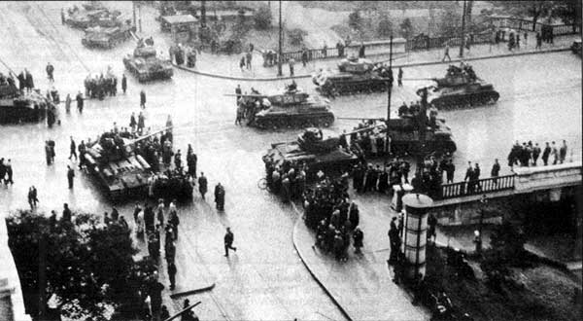
Budapest, Hungary 1956
The USSR sent in troops when Hungarians revolted in 1956 against communist rule.
Notes:
Hungarian people revolted for the removal of USSR troops, full national independence
Imre Nagy became head of government and appointed non-communists to his cabinet; he announced Hungary’s removal from the Warsaw pact and their neutrality in the Cold War. Khrushchev responded by sending in troops to suppress the Hungarian freedom fighters- thousands were killed or deported to Siberia; almost 200,000 fled

Slide 64
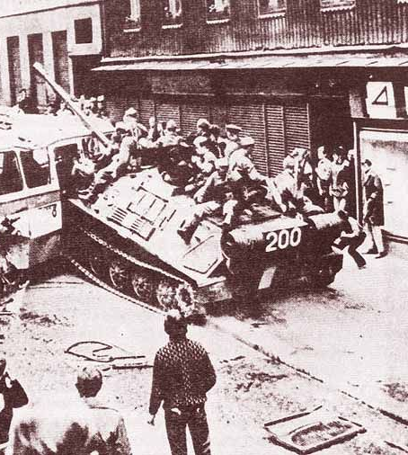
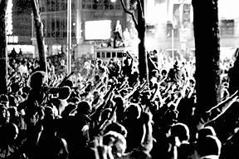
Alexander Dubcek became First Secretary of the Communist Party in Czechoslovakia. Dubcek instituted a new program-- what he called "Communism with a Human Approach". Dubcek's reforms included freedom of speech and of the press. The period became known as the "Prague Spring". (1968)
The Spring came to a sudden end when Soviet troops invaded Czechoslovakia and arrested Dubcek and his government.

Slide 65
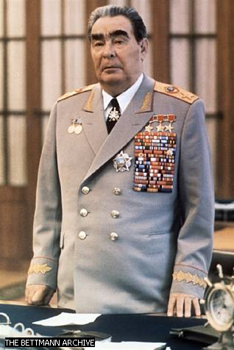
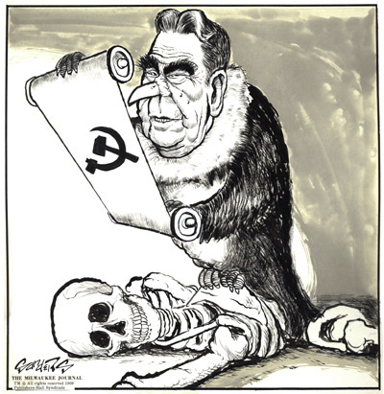
Brezhnev
1964 Brezhnev took over USSR
He held power until his death in 1982
Suppressed dissidents (people who spoke out against the communist government)
Notes:
Bill Sanders transforms Leonid Brezhnev into a vulture to commemorate the one-year anniversary of the Soviet invasion of Czechoslovakia. On August 20-21, 1968, troops from the Soviet Union and four Warsaw Pact countries entered Czechoslovakia, crushing efforts to democratize the country. Before the invasion was over, as many as 200,000 troops were deployed in and around the capital of Prague, journalistic and artistic freedoms were rolled back, many governmental reforms were rescinded. The so-called "Prague spring" was over. One year later, Czechs protested the anniversary of the event they labeled "the Day of Shame" by participating in work stoppages and a one-day economic boycott. As many as 50,000 Czechs gathered in St. Wenceslas Square in Prague.

Slide 66
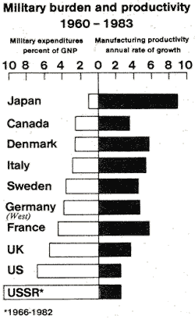
Problems with the
Soviet Economy
Neither Khrushchev nor Brezhnev could solve USSR’s economic problems
Consumer goods, (Clothes, shoes, TV’s, frozen foods, washing machines, cars, etc. remained rare in the USSR and were far inferior to those made in the West.
Notes:
1930’s

Slide 67
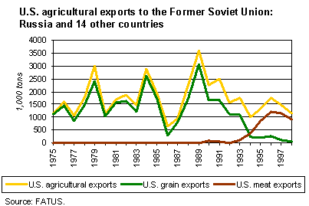
USSR- agriculture was so unproductive that it had to import grain just to feed its population

Slide 68
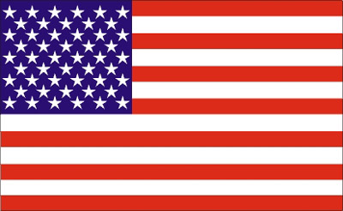
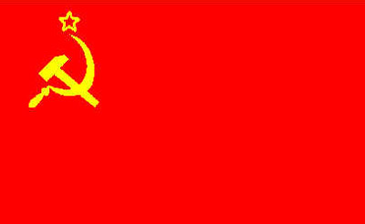
VS.
Throughout the Cold War, relations between the US and USSR shifted between confrontation to ‘détente’.
Détente = a relaxation of tensions between the two superpowers
Some countries did not take either side; they chose to remain nonaligned because they wanted to reduce global tensions and be able to receive financial support from both the US and the USSR. (Example- India)

Slide 69
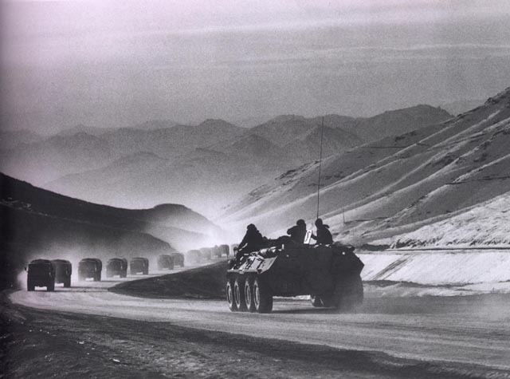
Détente came to an abrupt end in 1979 when the Soviets invaded Afghanistan to ensure their communist influence.

Slide 70

1980s TV Commercial During Cold War

Slide 71
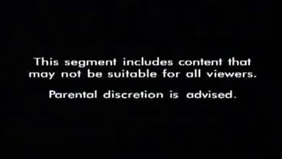

Slide 72
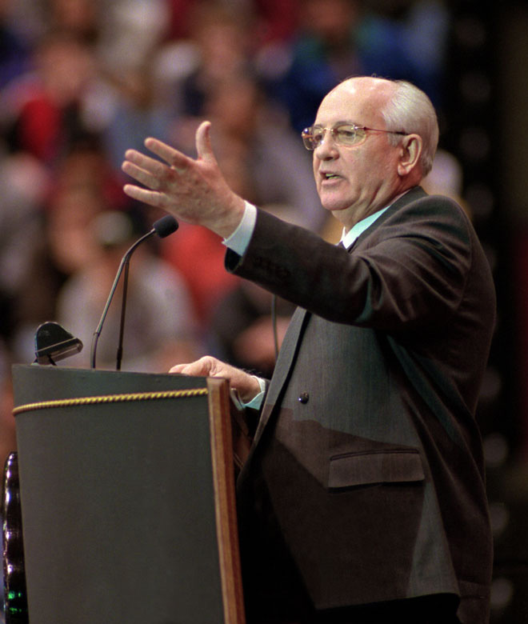
Mikhail Gorbachev
Became leader of the USSR in 1985.
Eager to reform the government and its inefficiencies, but also wanted it to remain a communist nation.
Foreign Policies: Renounced the Brezhnev Doctrine, signed treaties with the US to control the arms race, and pulled Soviet troops out of Afghanistan.

Slide 73

Glasnost = openness; policy of being open to non-Communist policies; instituted by Gobachev in the 1980’s
Perestroika = restructuring of the Soviet and economy in the 1980’s. (Allowed some private ownership of businesses, but wanted to keep the essence of communism).

Slide 74


Slide 75

1989: Fall of the Berlin Wall
1990- East and West Germany reunited into one Germany
1981: Workers strike for better pay, freedom for religious groups, & right to strike
1989: First free elections since 1947
1989: Mass demonstrations
1990: Multiparty elections
1991: Splits into Czech Republic and Slovak Republic
1991: Multiparty elections
91-92- War between Croats and Serbs
1992: Fighting begins between Serbs and Bosnian Muslims
1992: First multiparty elections
1996: First non-communist government

Slide 76
The Collapse of Communism in Eastern Europe
Most of the ‘satellites’ of the USSR began to revolt and break away following a similar pattern:
Giving into public pressure, the old Communists would step down in favor of younger ‘reform-minded’ Communists
These new leaders would agree to let other political parties to exist and compete for seats in the country’s legislature
In free, multiparty elections, member of non-Communist parties would win over Communist party members
By 1989 the first two stages of this process were peacefully accomplished in Hungary, Bulgaria, East Germany, and Czechoslovakia

Slide 77

Unexpected Results:
Rapid changes brought about by glasnost and perestroika brought about economic turmoil
Some leaders spoke out against Gorbachev, while others called for even more democratic and capitalist reforms.
In 1991 hard-line communists tried to overthrow Gorbachev in a military coup; the coup failed but it weakened his rule.
By the end of 1991, most of the republics in the USSR had declared their independence and the USSR ceased to exist.

Slide 78

THE USSR is broken up into 15 independent republics
RUSSIA
1-Russia 2-Estonia 3-Latvia 4-Lithuania 5-Belarus 6-Ukraine 7-Moldova 8-Georgia 9-Armenia 10-Azerbaijan 11-Turkmenistan 12-Uzbekistan 13-Tajikistan 14-Kyrgyzstan 15-Kazakhstan.

