Slide 1
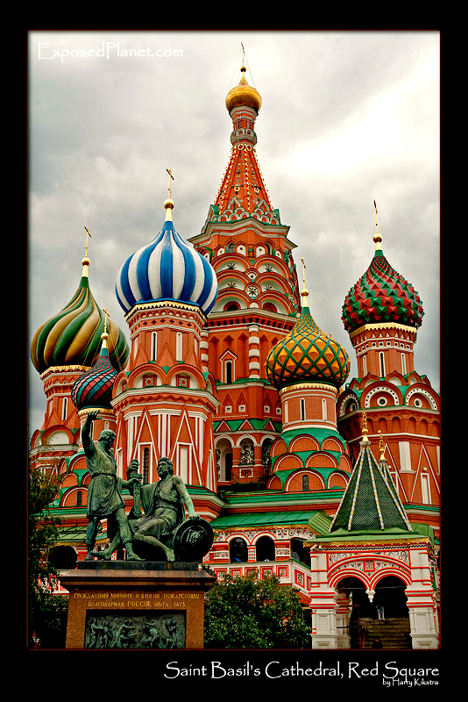
Russian Czars Increase Power
The Emergence of Absolutism
in Russia
AIM: How did Russia compete in the emerging western world?
Do Now: What empire took over Russia during the Middle Ages?

Slide 2
Definitions - Review
Czar/Tsar
Ruler of an Empire/Emperor
Absolute monarchs
kings or queens who believed that all power within their state’s boundaries rested in their hands
Divine right
idea that God created the monarchy and the monarch acted as God’s representative on earth

Slide 3
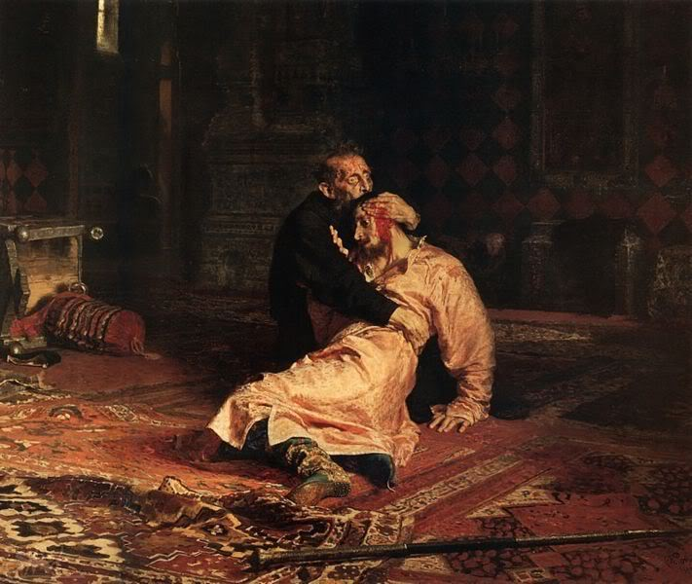
Background History of Russia
Russia was liberated (freed) from Mongol rule in 1462 by Ivan III of Moscow
Setup a centralized government
Russia had been
isolated from the
Renaissance and
Age of Exploration
by Mongol rule

Slide 4

Ivan the Terrible – Russian Monarch

Slide 5
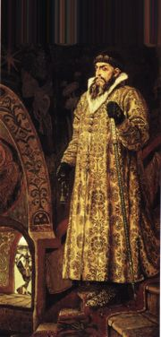
Ivan the Terrible (1533-
Ivan IV (Ivan the Terrible) came to power when he was only 3
Since he was so young, the nobles (known as the Boyars) wanted to take control.
Ivan took over officially when he was 16 and gave himself the name “Czar” or “Tsar” (1st to use term)
Had two periods: the good period and the terrible

Slide 6
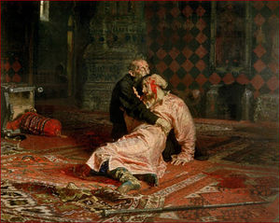
Ivan the Terrible - Ruling by Terror
Made own police force that would kill people that Ivan considered traitors
Killed thousands of people – you had to stay loyal or he’d kill you
He also killed his oldest son and only heir

Slide 7

Peter the Great – Russian Monarch

Slide 8
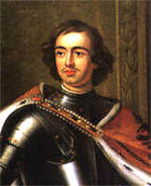
Peter the Great
He expanded Russia’s territory and added Russia’s first open water port with Western Europe.
Modernized Russia by adopting Western European technology and science. Forced Russian people to adopt Western European culture and customs.
Used brutal methods of ruling, including mass execution, to
maintain power.
Over 90% of Russians remained landless peasant farmers.
Westernization

Slide 9
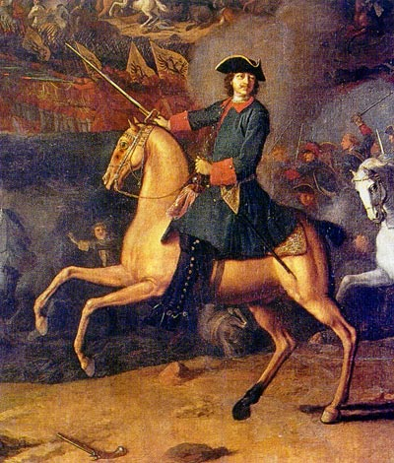
Westernizing Russia
Introduced the potato to Russia
Started first Russian newspaper
Allowed women to attend social gatherings

Slide 10
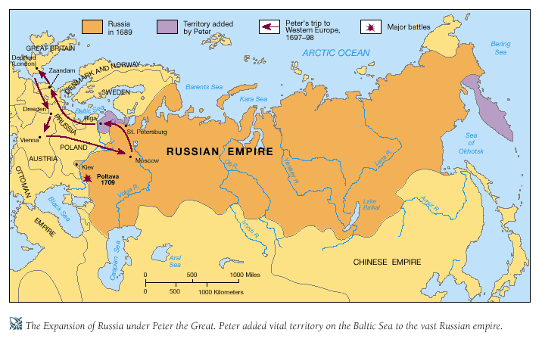

Slide 11
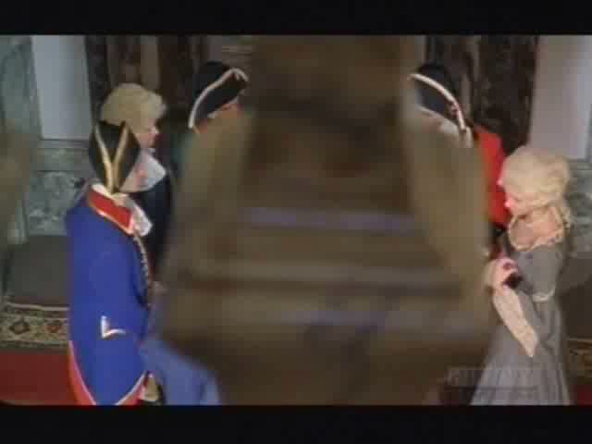
Catherine the Great – Russian Monarch

Slide 12
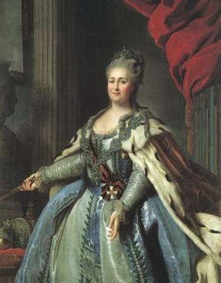
Catherine the Great
Ascended to throne in 1762
Husband Peter III murdered.
Ruthless and strong ruler
Gained land in the Baltic
Partitioned Poland:
Broken up between Russia, Prussia and Austria
Gained a Warm Water Port – Free from Ice All Year Round

