Slide 1
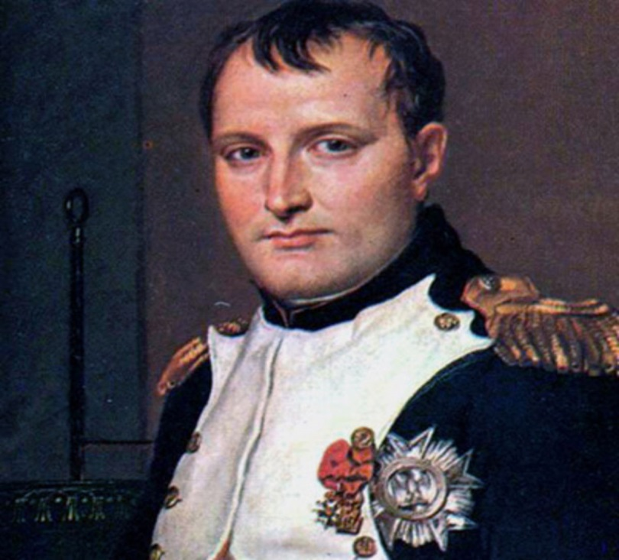
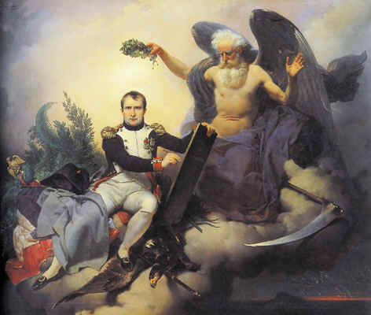
The Napoleonic Wars (1792-1815) & Napoleon’s Empire (1804-1815)
AIM: What was Napoleon’s lasting impact on the world today?
Do Now: How tall/short do you think Napoleon was?

Slide 2
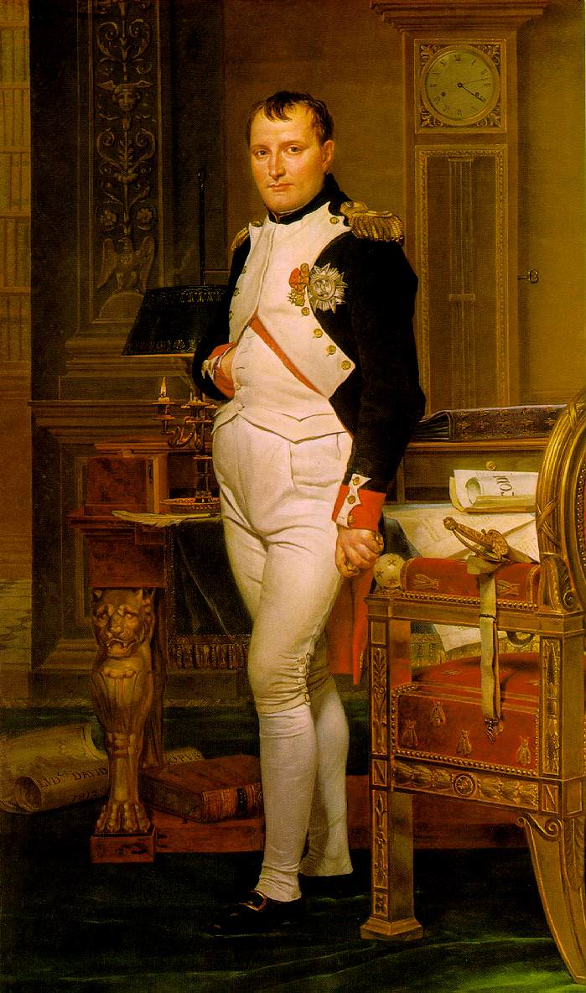
The British press sometimes depicted Napoleon as much smaller than average height, and this image persists.
Confusion about his height also results from the difference between the French pouce and British inch 2.71 and 2.54 cm respectively; he was about 1.7 meters (5 ft 7 in) tall, average height for the period.

Slide 3
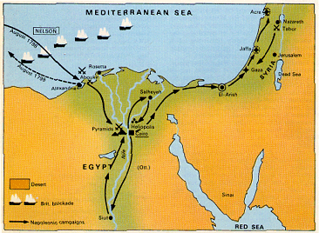
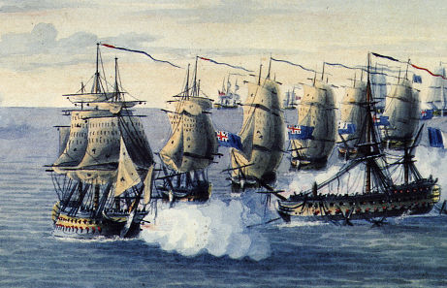
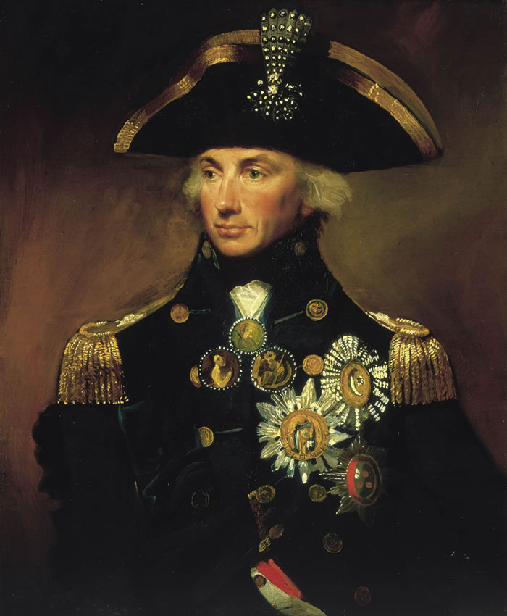
Napoleon’s Rise to Power
Earlier military career → the Egyptian Campaign:
1798 → he was defeated by a British navy under Admiral Horatio Nelson, who destroyed the French fleet at the Battle of the Nile.
Abandoning his troops in Egypt, Napoleon returned to France and received a hero’s welcome!

Slide 4
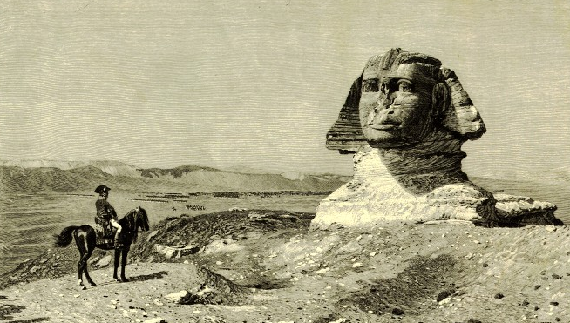
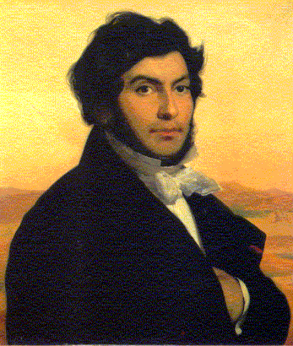
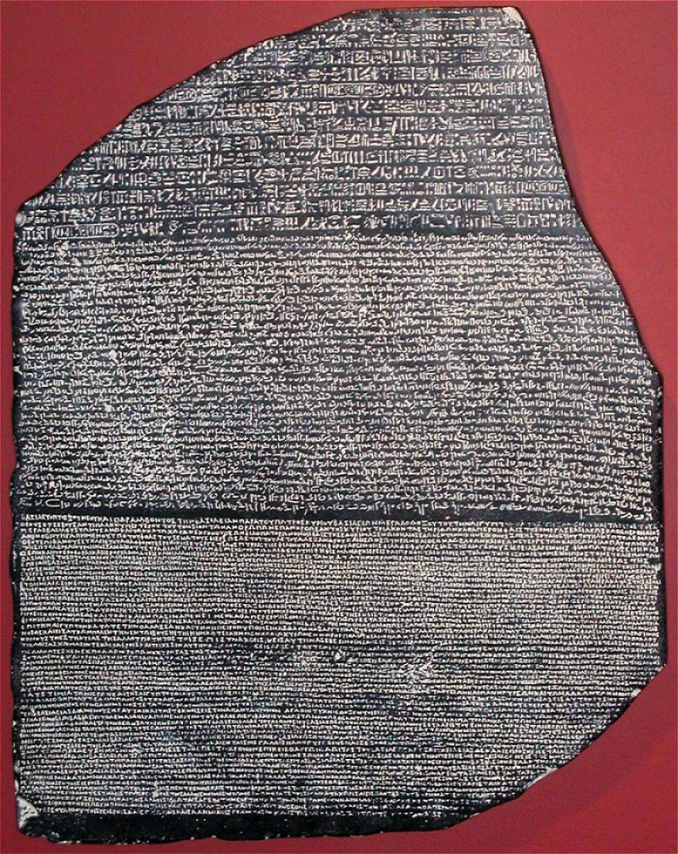
The Rosetta Stone
Jean Francois Champollion

Slide 5
The Rise of Napoleon
1795: Called to Paris by Directory
1799: Napoleon becomes ‘First Counsel’ coup d’ etat - a sudden overthrow
1802: Declares self ‘Counsel for Life’ –
1804: Napoleon Crowned Emperor (to stop a return of the Bourbon Dynasty)

Slide 6
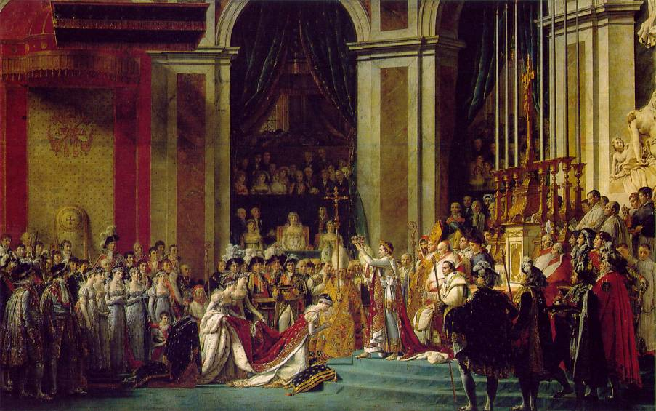
“Consecration of the Emperor Napoleon & the Empress Josephine,” 1806 by David
December 2, 1804

Slide 7
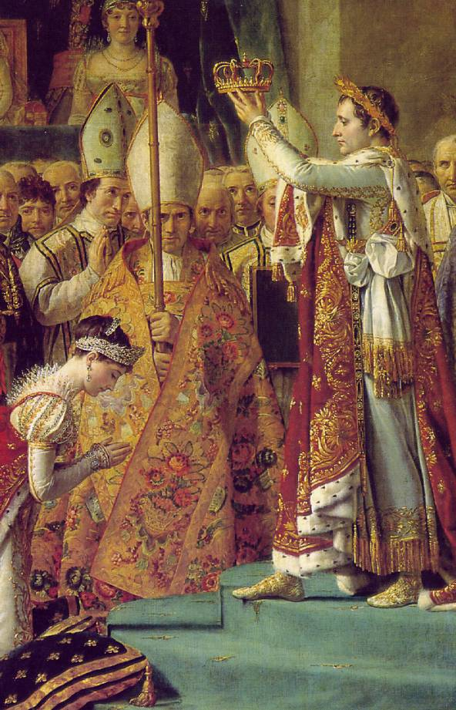
“Consecration of the Emperor Napoleon & the Empress Josephine,”
1806 by David

Slide 8
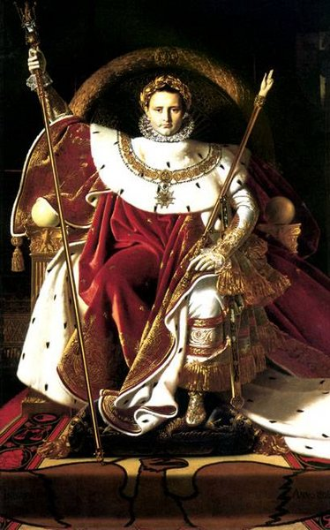
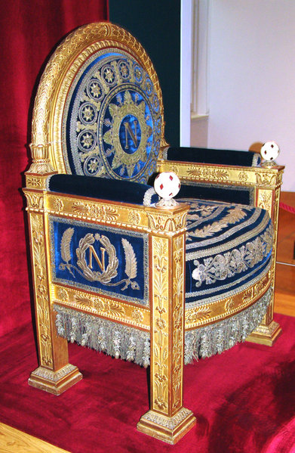
Napoleon’s Throne
Napoleon’s Reforms
Established orderly and uniform taxation
Napoleonic Code (Law Code)
Gender Equal Educational System
But…
Limited women’s property rights

Slide 9

Code Napoleon, 1804
Its purpose was to reform the French legal code to reflect the principles of the French Revolution.
Create one law code for France.
Some Issues:
Married Women were neither independent or equal to men
Women lacked all political rights
Women had to follow a social hierarchy and subordination

Slide 10
Napoleon and His Code

Slide 11
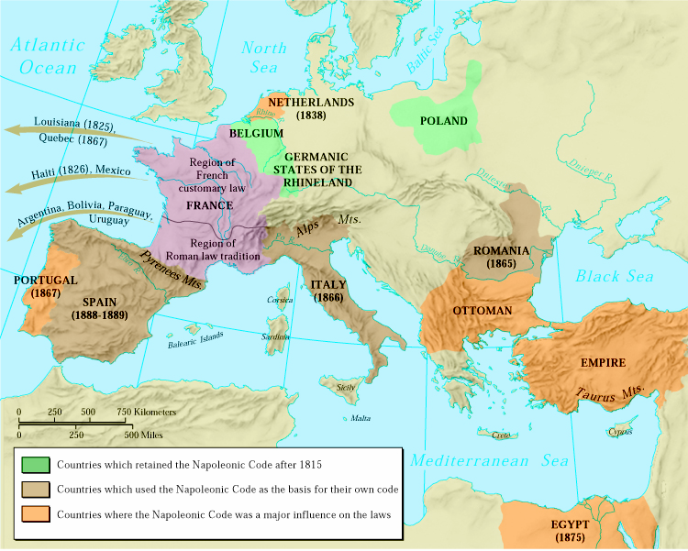
The Influence of the Napoleonic Code
Wherever the code was implemented in the conquered territories, the code swept away feudal property relations.
Lord to Peasant/Serf

Slide 12
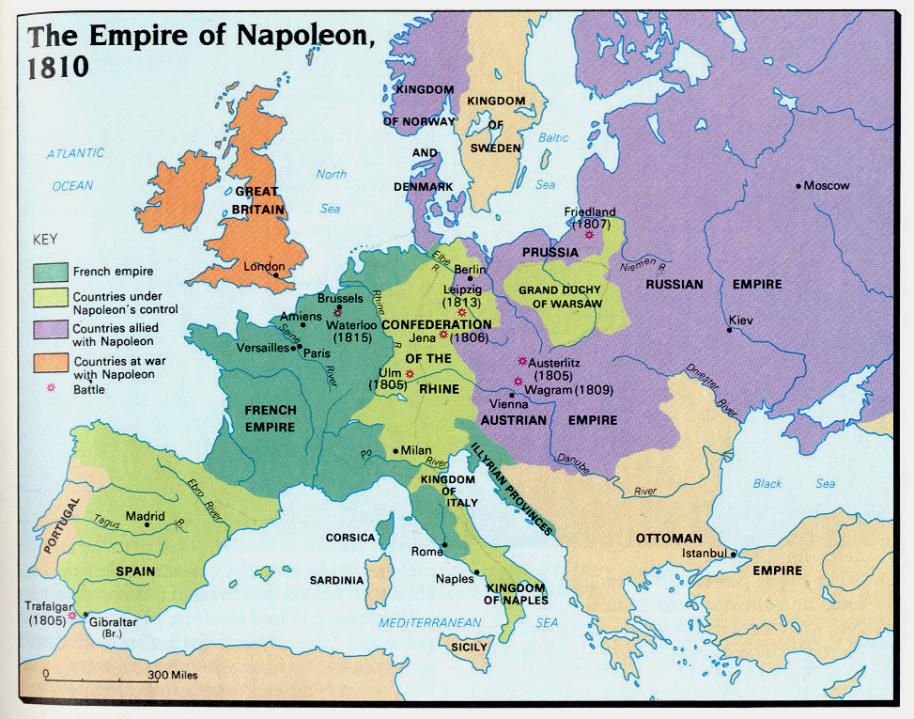

Slide 13
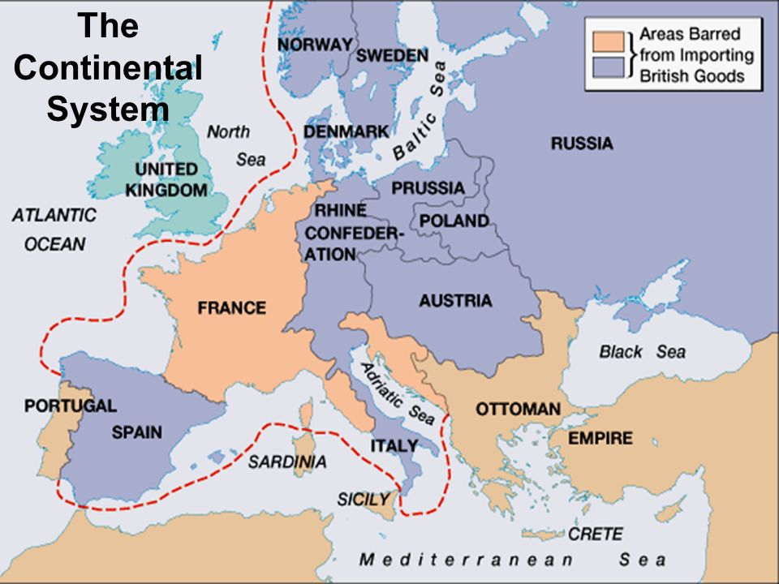
The Continental System (1806)

Slide 14
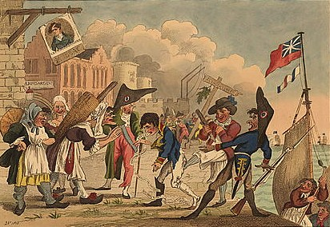
The Continental System (1806)
Economic Warfare against Great Britain
Blocked British trade with the Continent’s nations
Failure:
Hurt Continent’s Nations
more than Britain
Not honored by Napoleon’s Allies
Forced Napoleon to ‘police’ Europe
Led to War with Russia

Slide 15
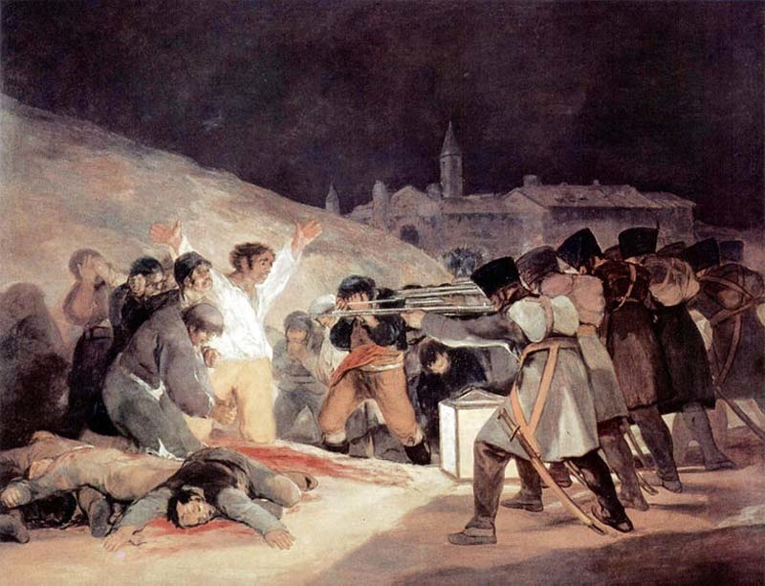
Napoleon’s Military Victories
War: 1803-1814
1805 - Austria
1806 - Prussia
1807 - Russia
1808 - Spain
The 3rd of May1808
Francisco Goya depicting the Brutality of French Troops on the Spanish Resistance

Slide 16
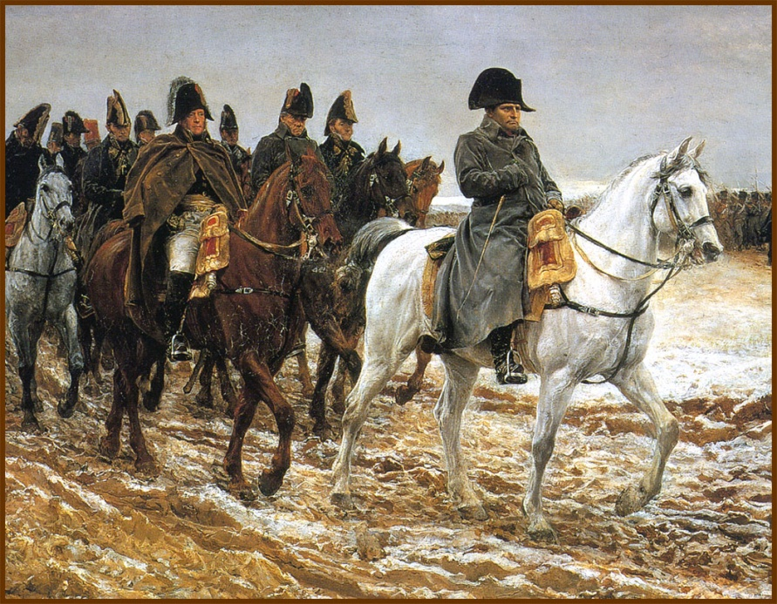
The “Big Blunder” -- Russia
In July, 1812 Napoleon led his Grand Armee of over 600,000 men eastward across central Europe and into Russia.
The Russians avoided a direct confrontation with Napoleon.
The Russians retreated to Moscow, drawing the French into the interior of Russia [hoping that it’s size and the weather would act as “support” for the Russian cause]. (They use their Geography as a weapon)
The Russian nobles abandoned their estates and burned their crops to the ground, leaving the French to operate far from their supply bases in territory stripped of food. Scorched Earth Policy/Strategy

Slide 17
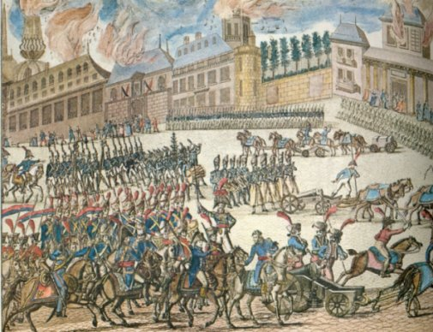
Napoleon’s Troops at the Gates of Moscow
September 14, 1812 → Napoleon reached Moscow, but the city had largely been abandoned.
AND…
The Russians had set fire to the city.
Scorched Earth Policy/Strategy

Slide 18
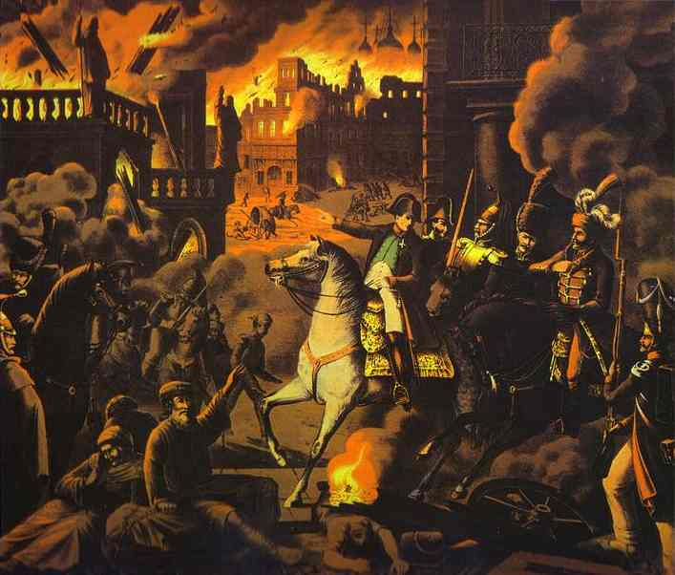
Napoleon in Moscow, Russia

Slide 19
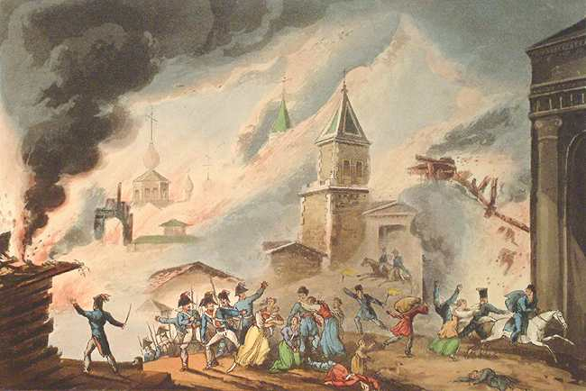
Moscow Is On Fire!

Slide 20
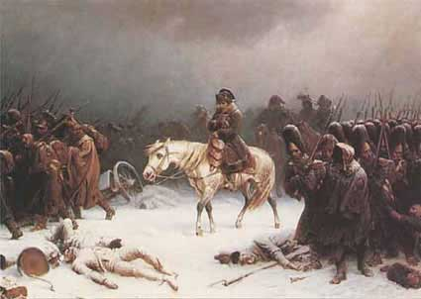
Napoleon’s Retreat from Moscow (Early 1813)
100,000 French troops retreat—40,000 survive!

Slide 21
Napoleon’s Retreat from Moscow

Slide 22
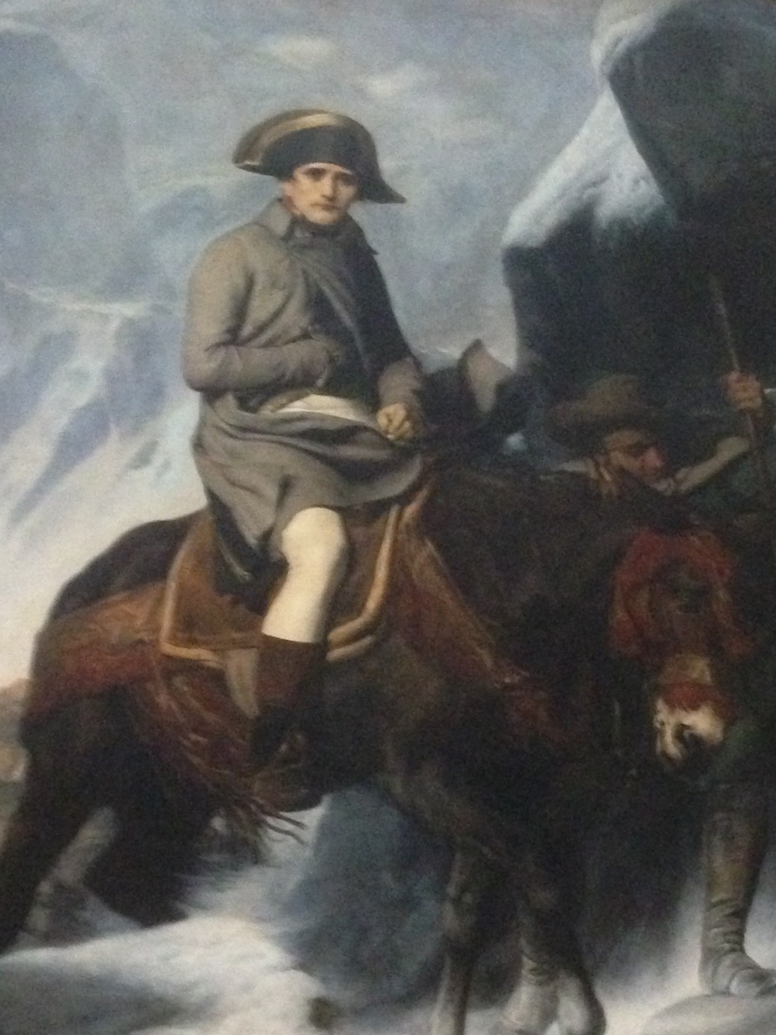

Slide 23
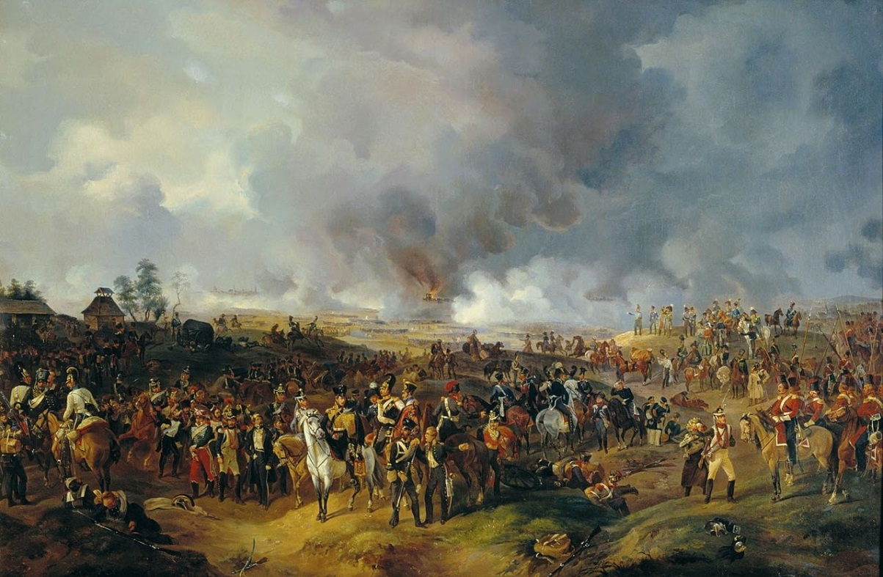
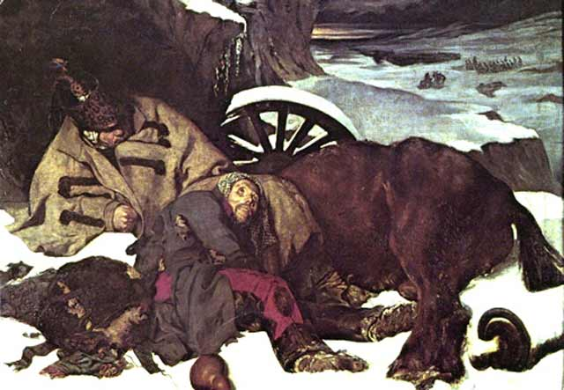
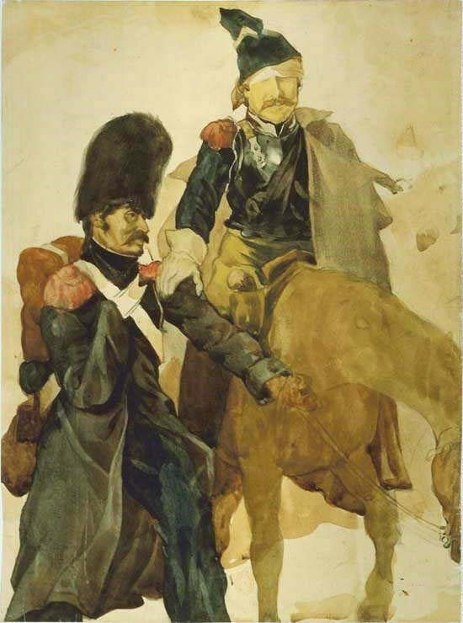
The Battle of the Nations
1813-1814
Napoléon’s Defeat
France →
And the Winner Is?
← Britain, Russia. Spain, Portugal, Prussia, Austria, Sweden, smaller German states

Slide 24
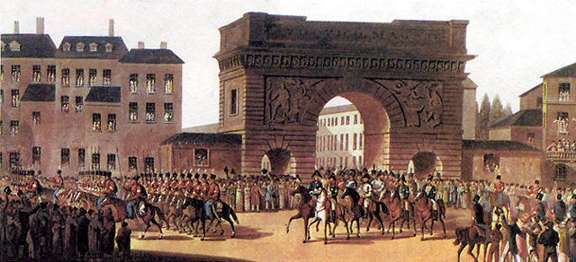
Russians Entering Paris, 1814

Slide 25
Napoleon Abdicates!
Allied forces occupied Paris on March 31, 1814.
Napoléon abdicated on April 6 in favor of his son, but the Allies insisted on unconditional surrender.
Napoléon abdicated again on April 11.
Treaty of Fontainbleau → exiles Napoléon to Elba with an annual income of 2,000,000 francs.
The royalists took control and restored Louis XVIII to the throne.

Slide 26
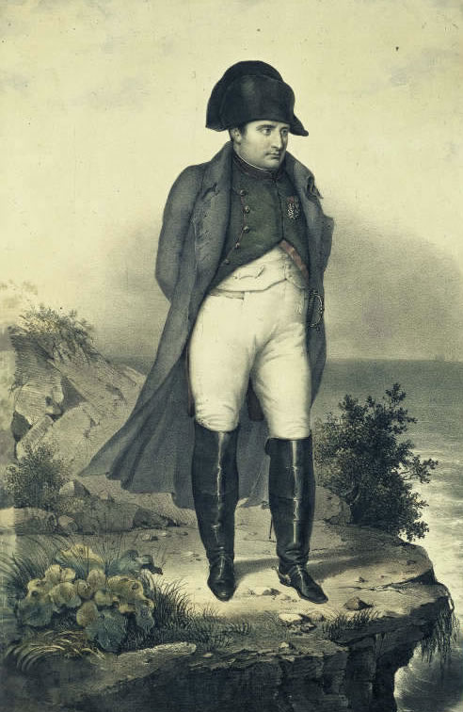
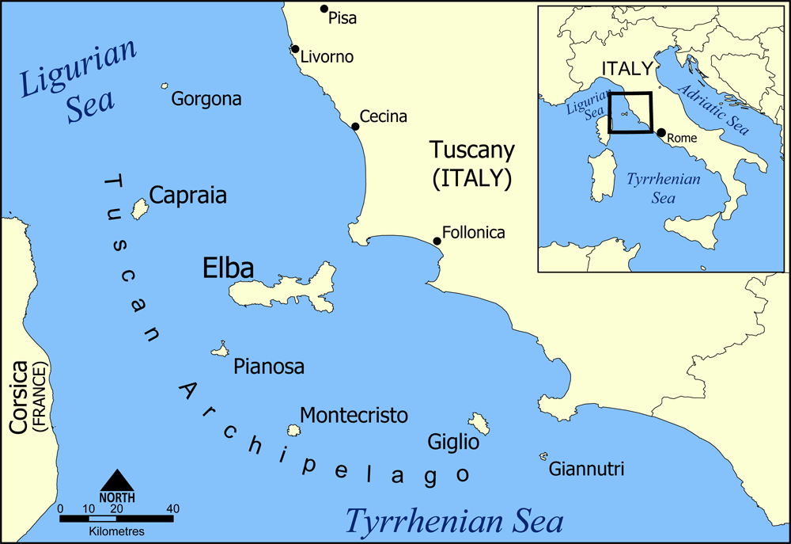
Napoleon in Exile on Elba
Napoléon escaped Elba and landed in France on March 1, 1815
The beginning of his 100 Days.

Slide 27
“The Battle of Waterloo”
1815
Napoleon’s Final Defeat
France →
And the Winner Is?
← Britain, Russia. Prussia, Austria, Sweden, smaller German states
Marie Louise & his son were safe in the hands of the Austrians who were allied with Napoleon.
Napoleon flees to Paris only to be asked to abdicate once again for the final time!

Slide 28
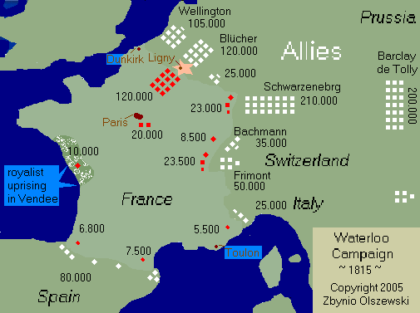
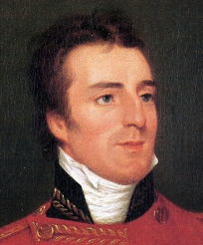
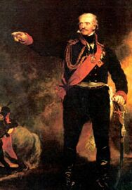
Napoleon’s Defeat at Waterloo (June 18, 1815)
Duke of Wellington
Prussian General Blücher

Slide 29
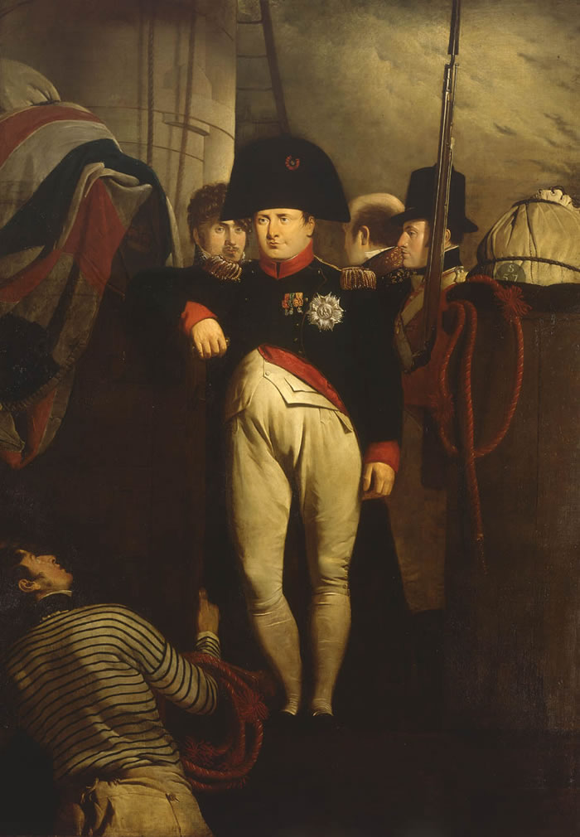
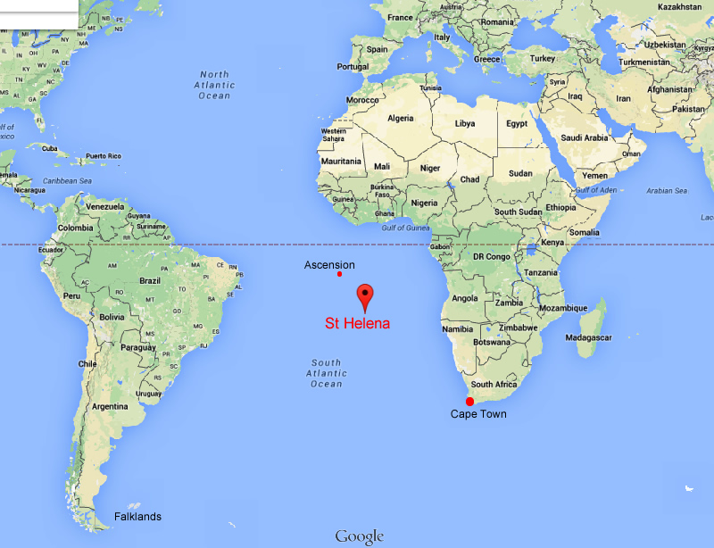
Napoleon on His Way to his Final Exile on St. Helena

Slide 30
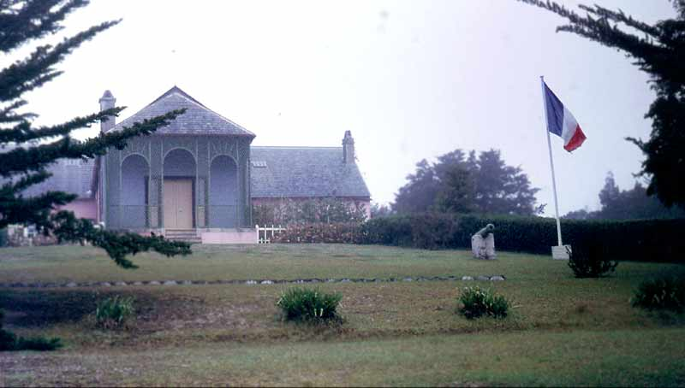
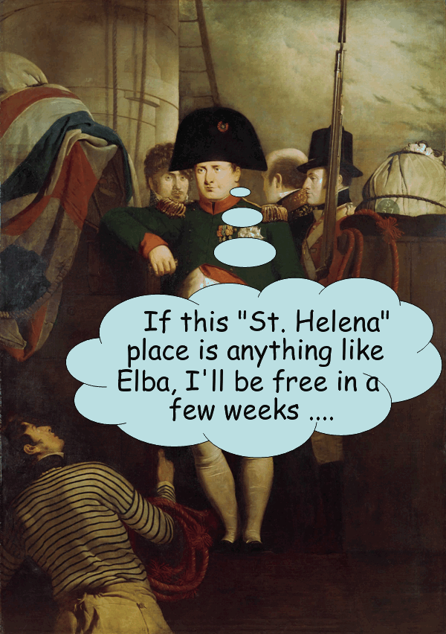
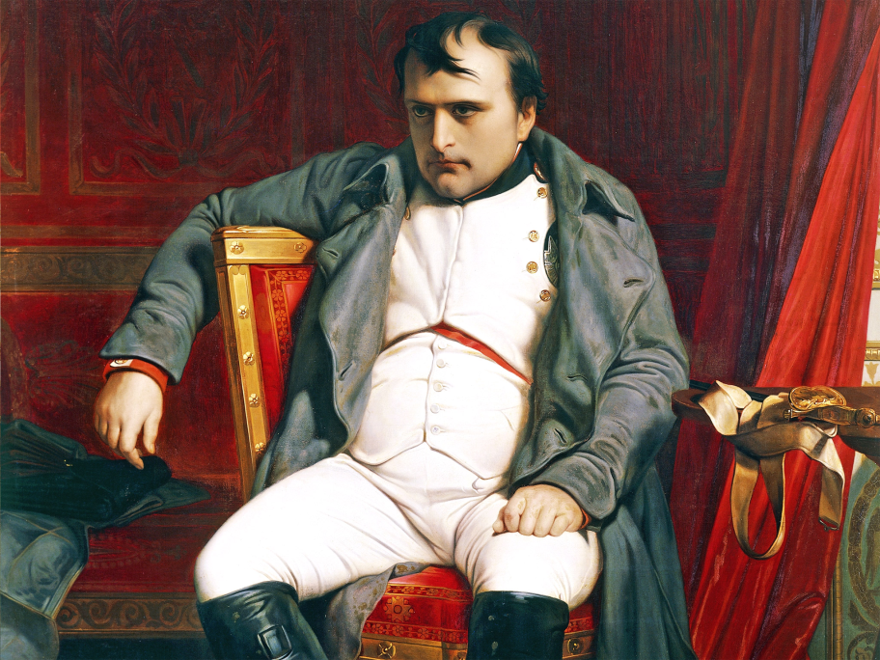
Napoleon’s Residence on St. Helena
Napoleon would live on St. Helena for 6 Years
He would die there on May 5th, 1821. Never to see his beloved France again.

Slide 31
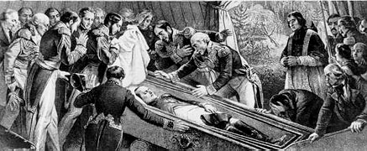
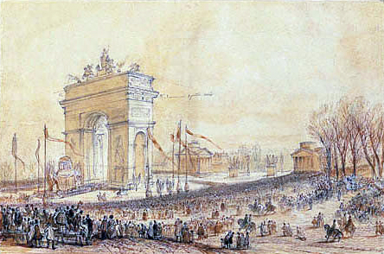
The Retour des Cendres (“Return of the Ashes“)
In 1840, Louis Philippe I obtained permission from the British to return Napoleon's remains to France.
On 15 December 1840, a state funeral was held. The hearse proceeded from the Arc de Triomphe down the Champs-Élysées, across the Place de la Concorde to the Esplanade des Invalides and then to the cupola in St Jérôme's Chapel, where it remained until the tomb designed by Louis Visconti was completed.
In 1861, Napoleon's remains were entombed in a porphyry stone sarcophagus in the crypt under the dome at Les Invalides.

Slide 32
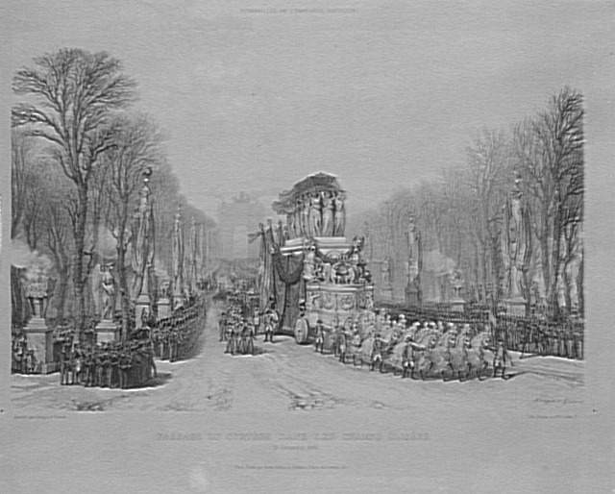
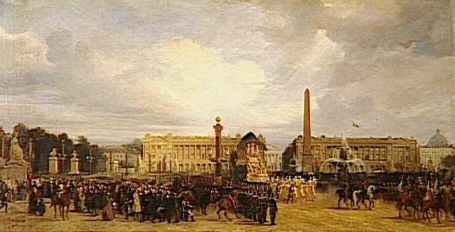
Napoleon’s Funeral Procession through Paris

Slide 33
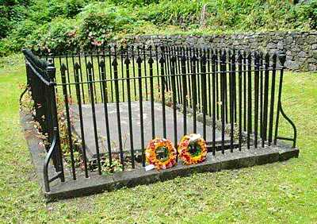
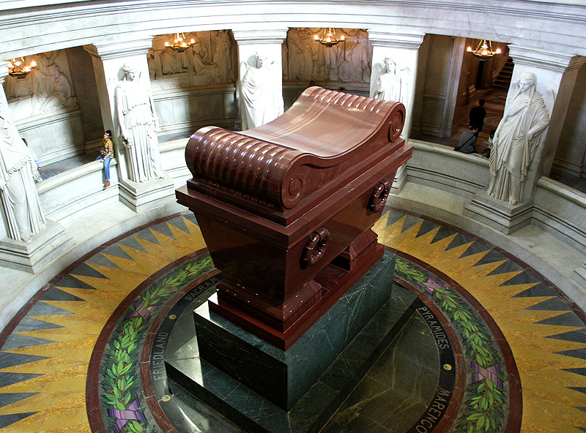
Napoleon’s Tomb

Slide 34
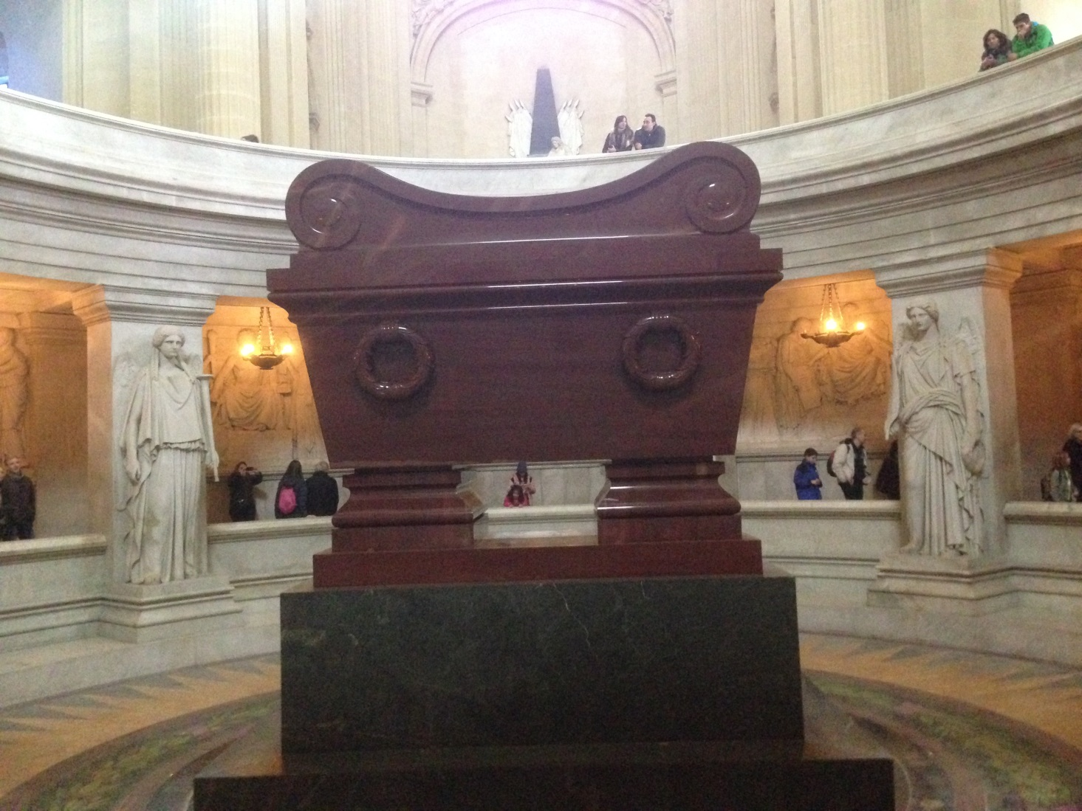
Photo Credit: Mr. Ott, Paris 2014

Slide 35
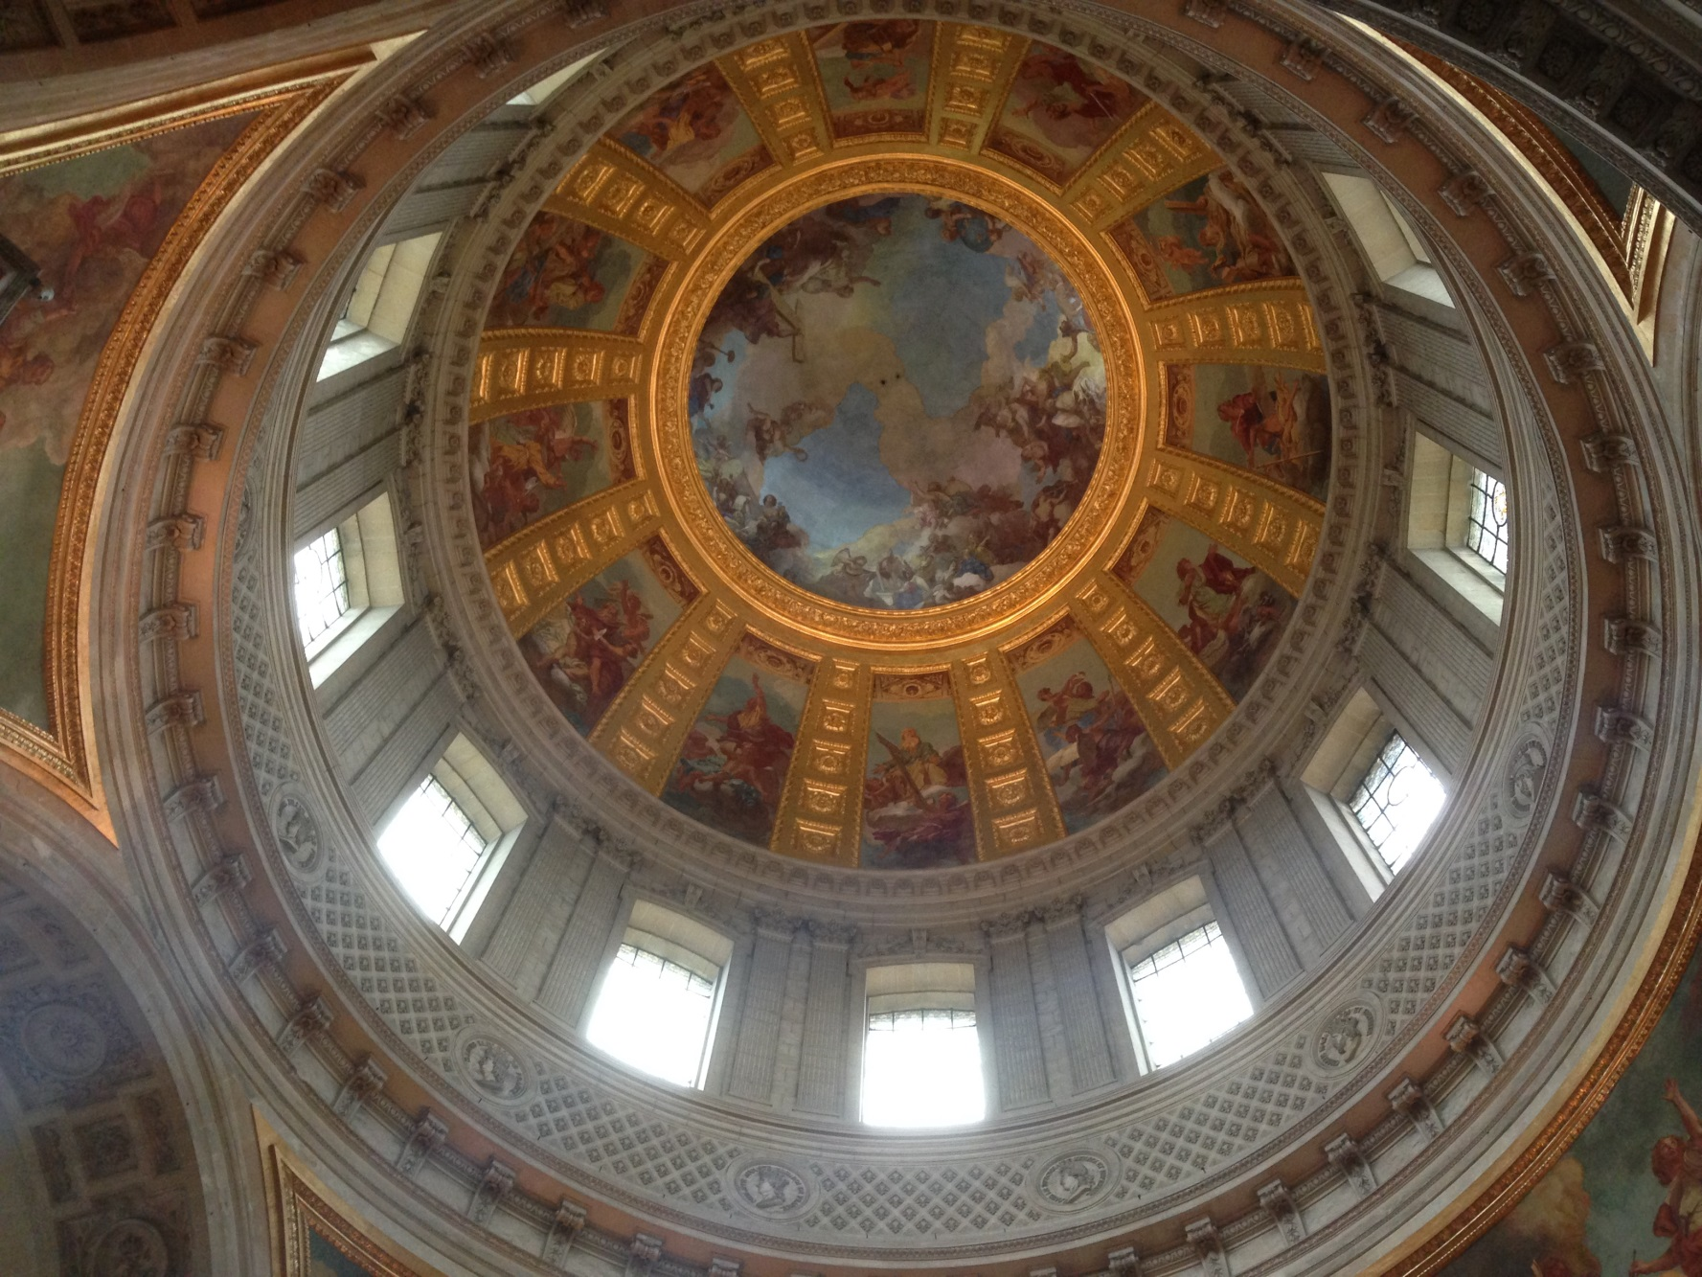
Photo Credit: Mr. Ott, Paris 2014

Slide 36
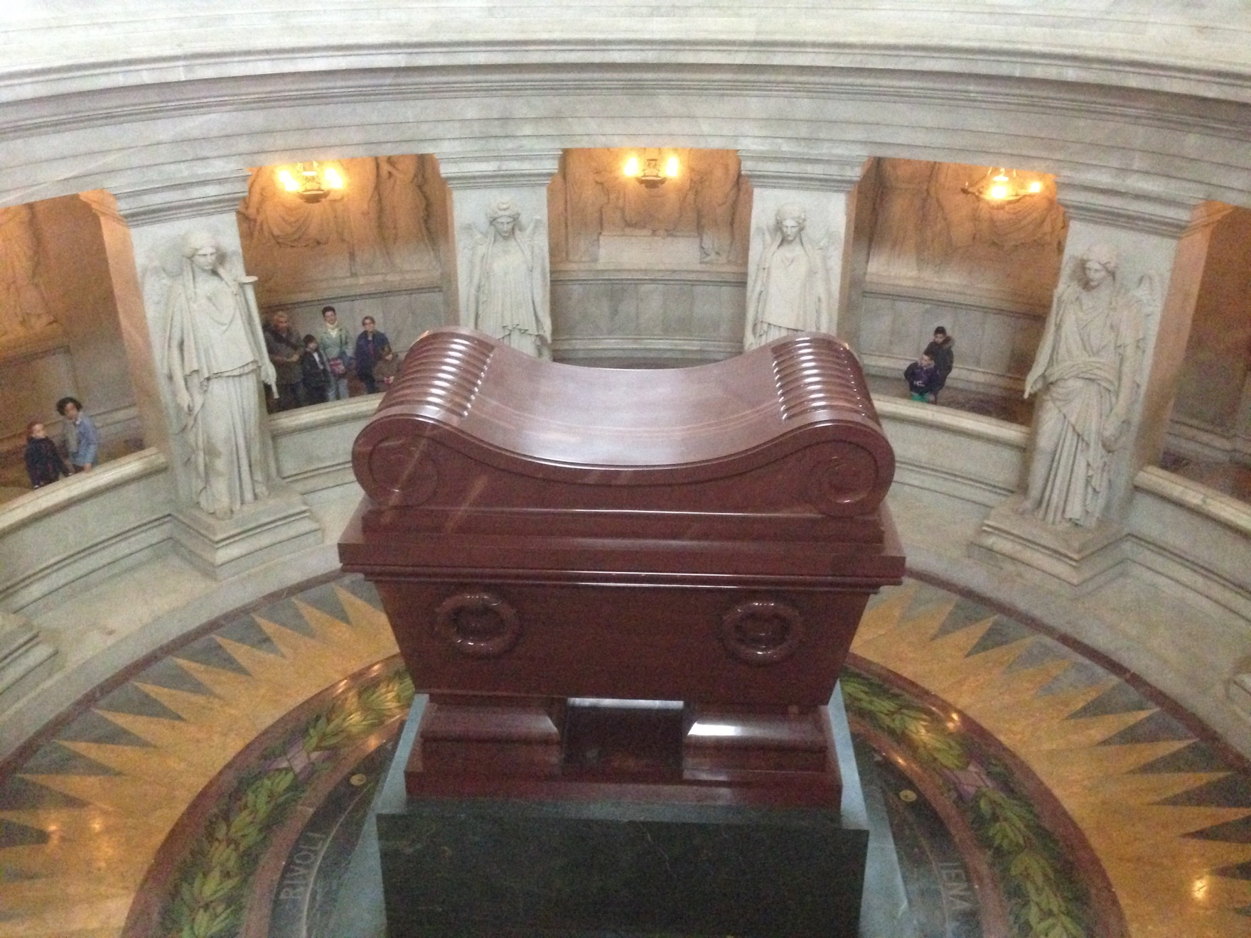
Photo Credit: Mr. Ott, Paris 2014

Slide 37
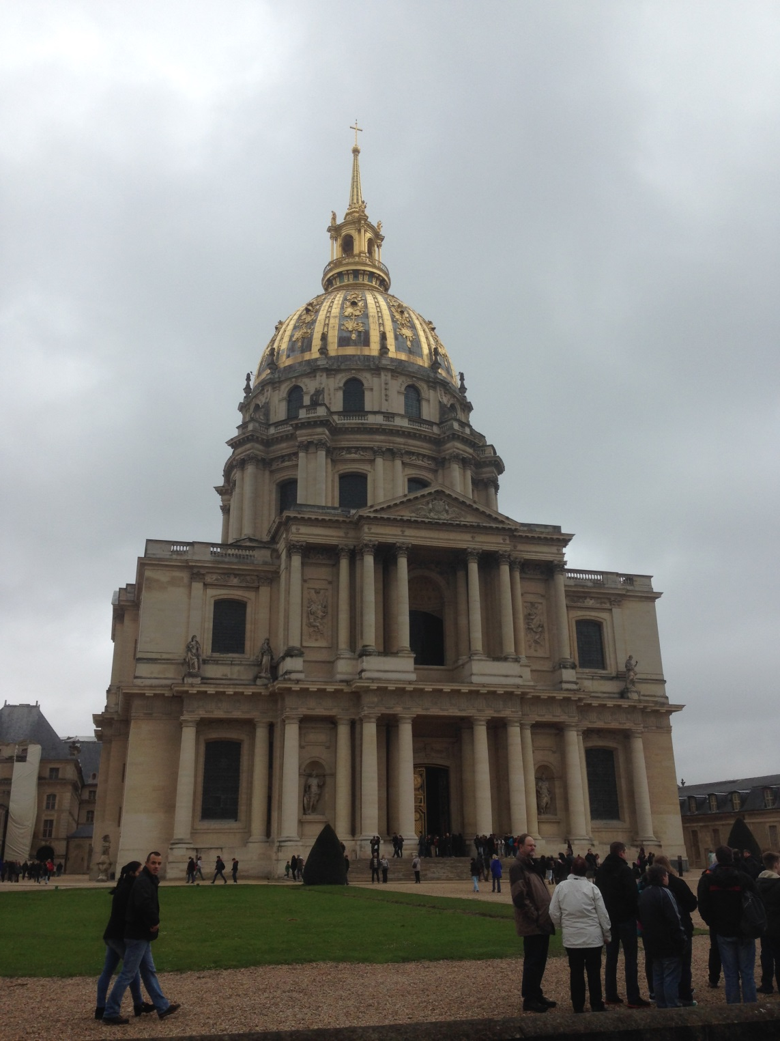
Dôme des Invalides
French pronunciation: ​[lezɛ̃valid]
Photo Credit: Mr. Ott, Paris 2014

Slide 38
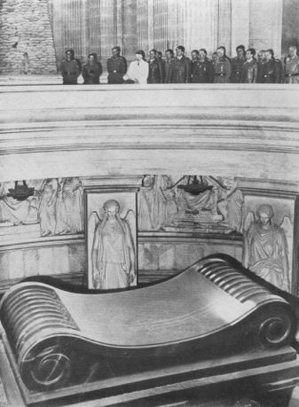
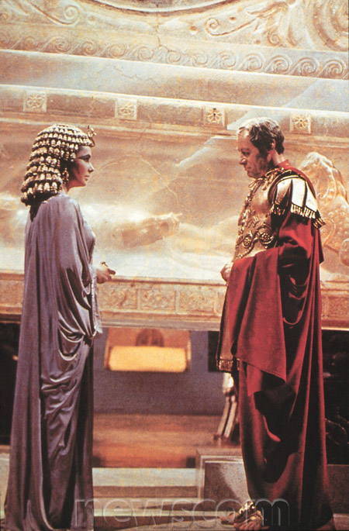
Hitler Visits Napoleon’s Tomb
June 28, 1940

Slide 39
Legacies of Revolution and War
Britain emerges most powerful nation
Rise of Nationalism (nations will develop out of city-states, especially Germany & Italy in the mid 1800s)
Birth of Modern Democratic (Republican) Movements
End of Absolutism (Only Russia left)
Birth of Modern Citizenship (Popular Sovereignty)

Slide 40
What is Napoleon’s Legacy?
Write the answers to the questions on the worksheet "Napoleon - hero or tyrant/villain?“
Use a separate piece of paper and write in paragraph format for each
You must back up your answers with at least 3 examples from the movie and the PowerPoint.

Slide 41
Case Study: What is Napoleon’s Legacy?
Directions: Answer the Question Below in Paragraph Format
Was Napoleon Successful or Unsuccessful in fulfilling the ideas and values of the French Revolution?
You must back up your answers with at least three (3) examples from the film, your notes, your handouts, and/or your knowledge of social studies.

