Slide 1
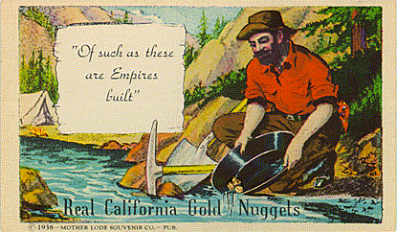
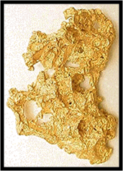
California here I come!!
The California GOLD RUSH

Slide 2
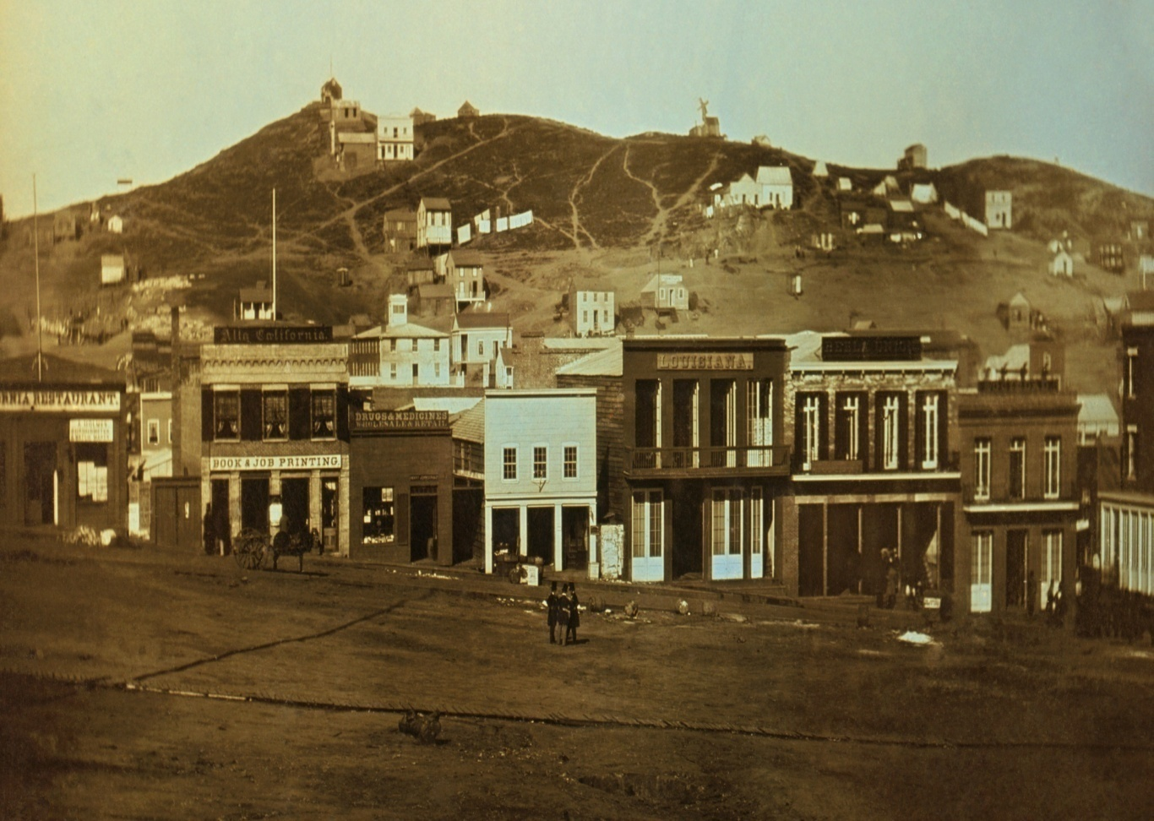
Why was discovering gold in California important to the U.S. ?
It made over 300,000 people move west in search of their fortunes and help create cities in the west.

Slide 3
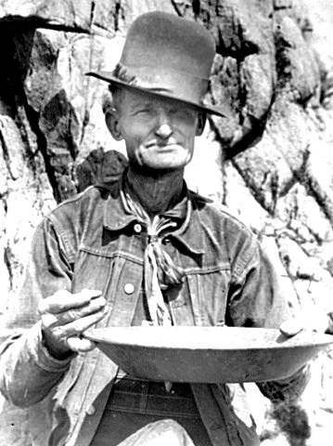

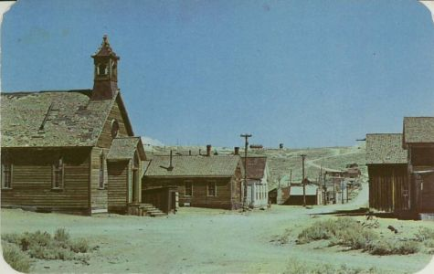
Gold discovered AT Sutter’s Mill - 1848

Slide 4
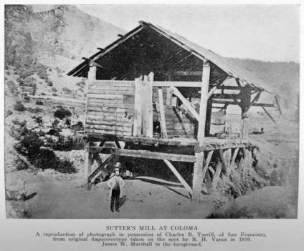
Sutter’s Mill

Slide 5
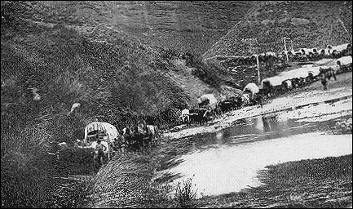
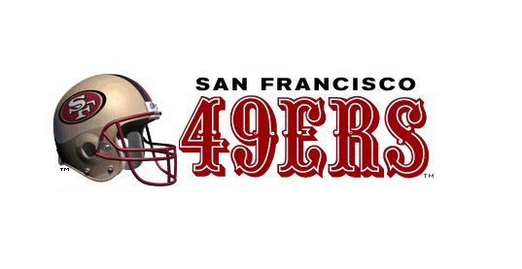
Gold discovered AT Sutter’s Mill - 1848
The California Gold Rush occurred in 1849 drawing over 300,000 people to the West to strike it rich
“Go West Young Man” …. And get RICH!

Slide 6
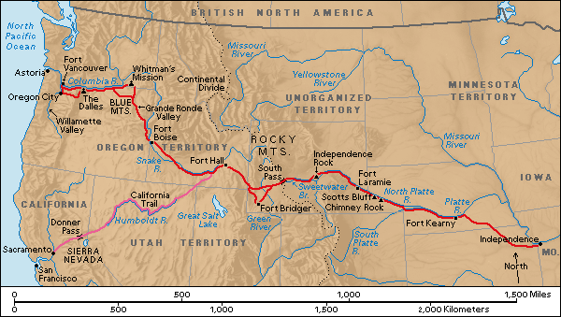
Oregon Trail & California Trail

Slide 7
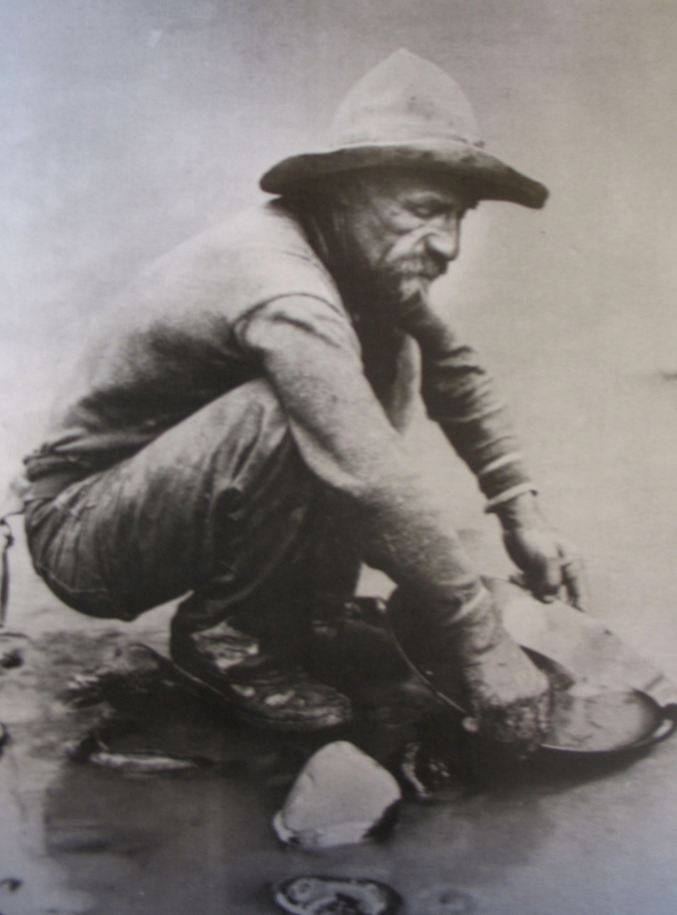
California gold rush
Many people traveled to California. The gold in California was easy to get and was free for the taking.

Slide 8
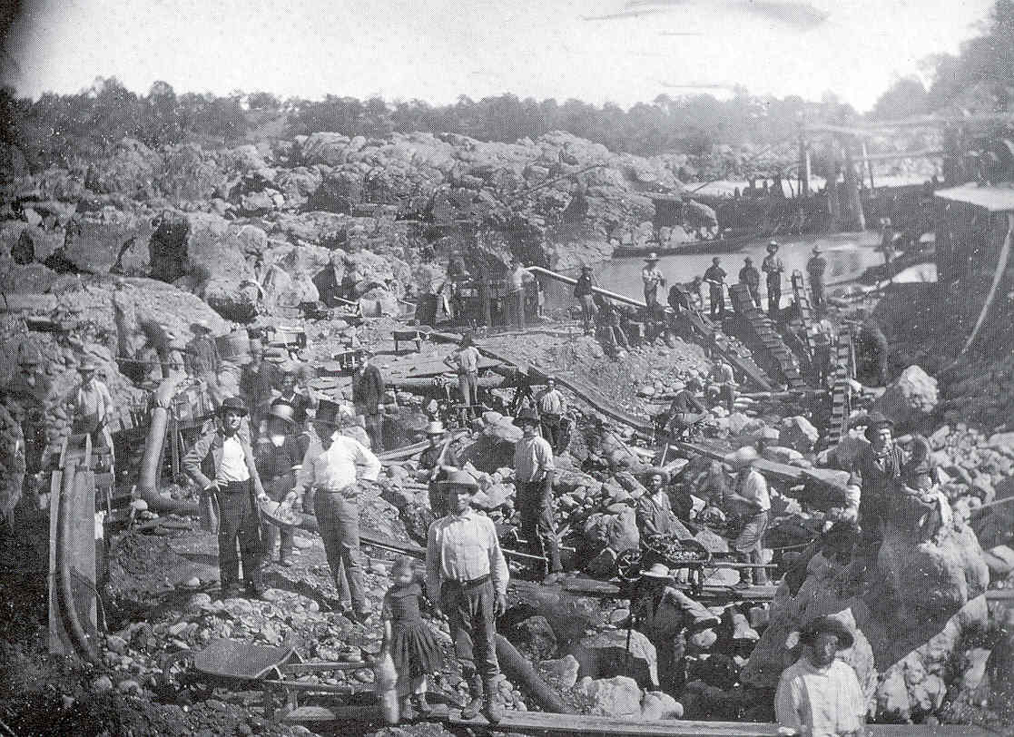
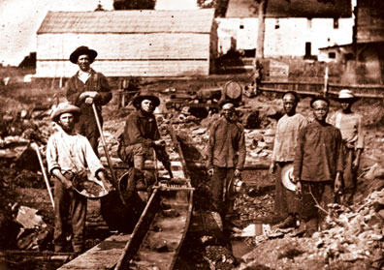
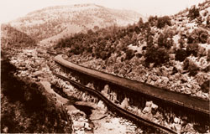
WHY Travel & risk your life going to California?
The people that came to California thought they could get rich quick. Back home they may only make $1.00 and in California they could make $25.00.

Slide 9
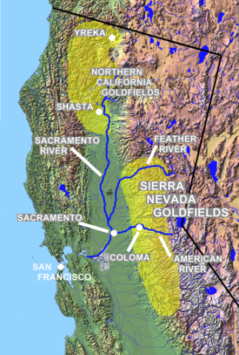
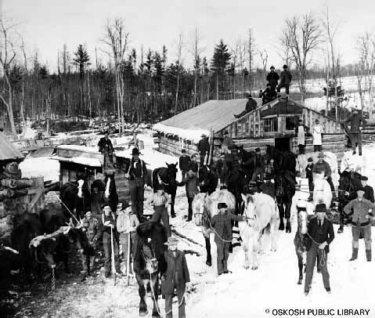

GOLD FEVER!

Slide 10
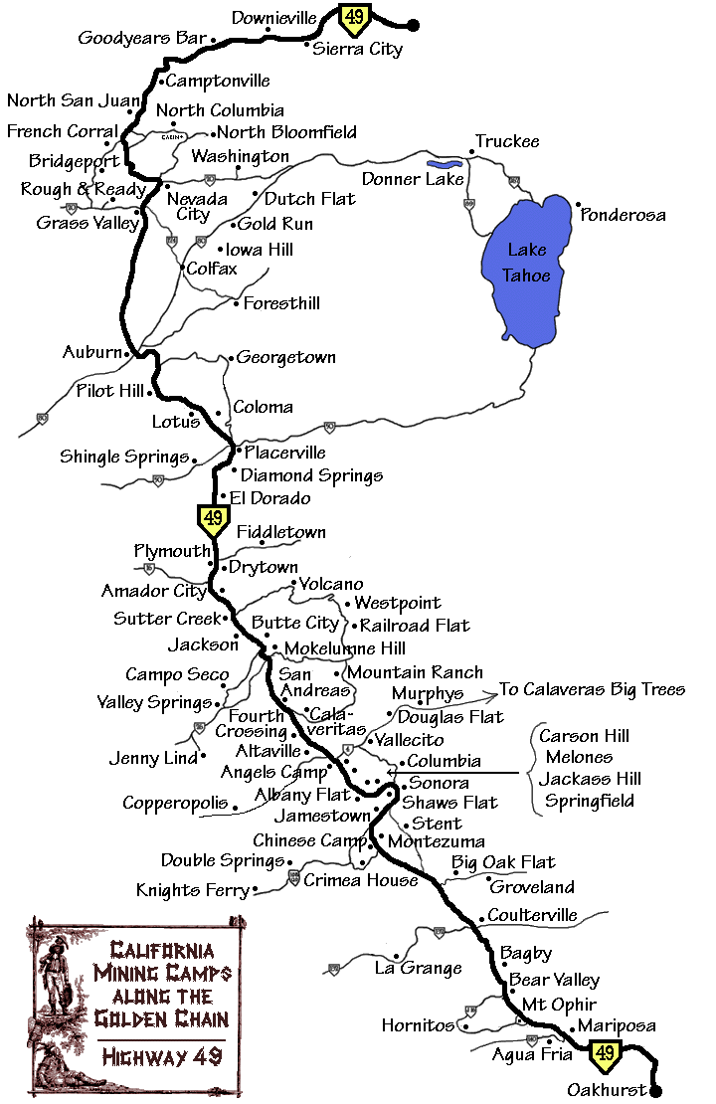
Mining Camps
Towns and Mining Camps Sprang Up Everywhere Near a Water Source

Slide 11
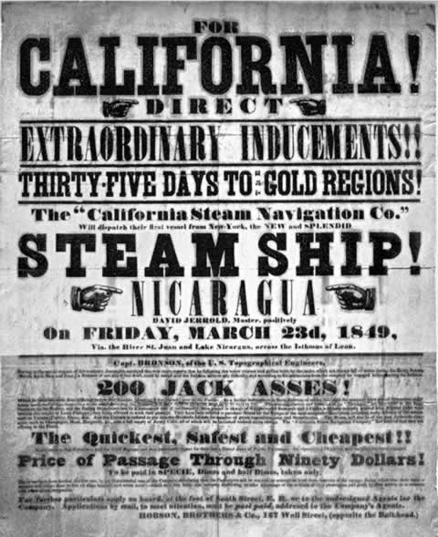

Slide 12
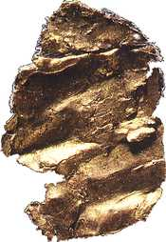
Results of the California Gold Rush
Many People Go West to Find Their Fortunes
California Becomes a State - 1850
Immigrants Came to California for the California Dream
First Gold Nugget found on Jan 24, 1848

Slide 13
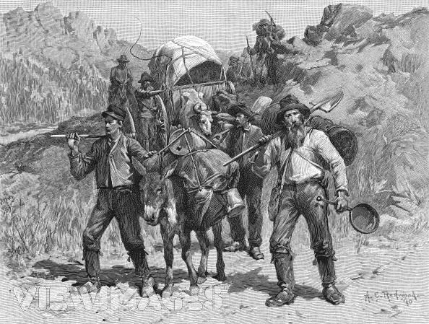
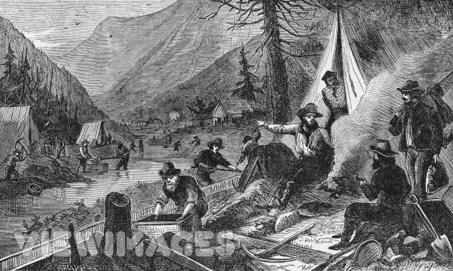
Some Lost Their Lives
Most Lost Everything They Had
Very Few Got Rich
But, the West Was Officially
Open for Business

Slide 14
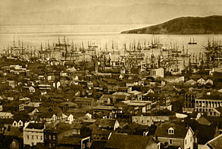
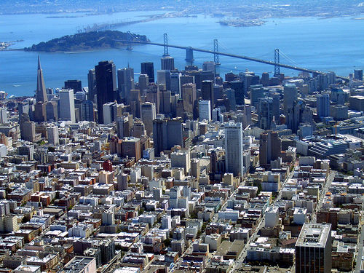
Included among the modern legacies of the California Gold Rush are the California state motto…
1851
"Eureka" "I have found it“

