Slide 1
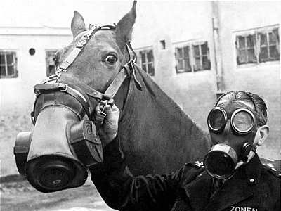
WWI

Slide 2
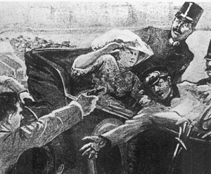
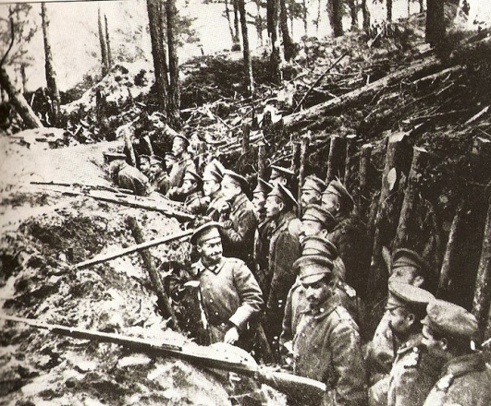
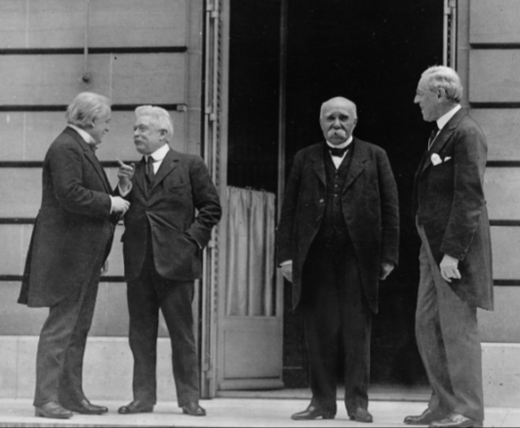
TABLE OF CONTENTS
PART I
PART III
PART III
Causes
Course
Consequences

Slide 3
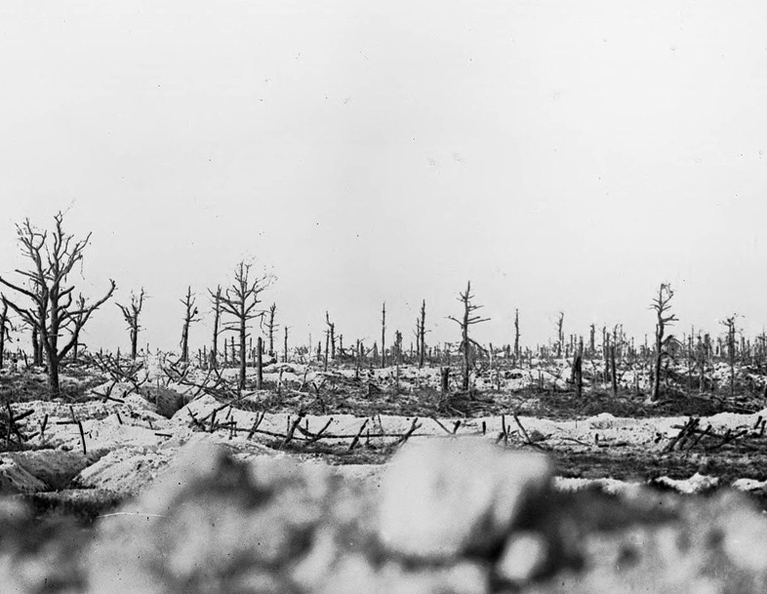
CAUSES OF WWI
Battlefield in the Marne between Souain and Perthes, 1915. (Bibliotheque nationale de France)

Slide 4
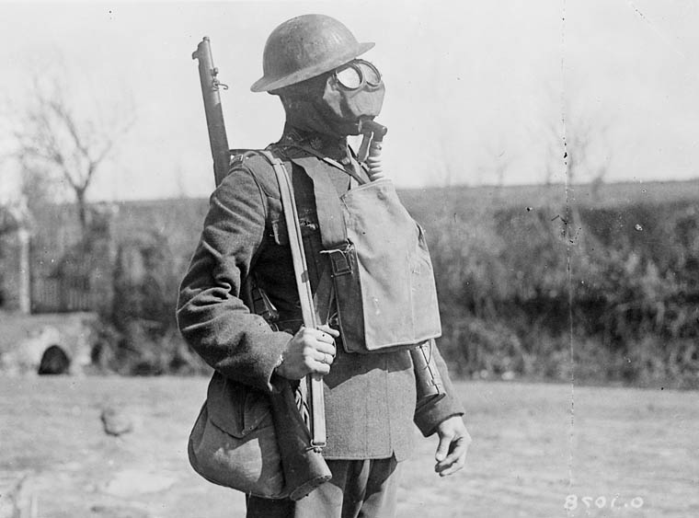
What started this mess?
Notes:
http://4acre.wordpress.com/2010/12/06/mustard-gas/

Slide 5
CAUSES of World War I
M
A
I
N
ILITARISM
LLIANCES
MPERIALISM
ATIONALISM

Slide 6
MILITARISM

Slide 7
Anglo-German ARMS
Race

Slide 8
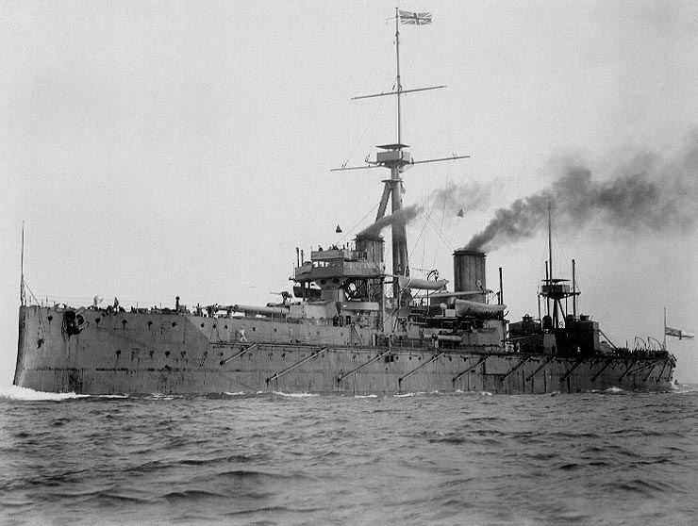
H.M.S. Dreadnought

Slide 9
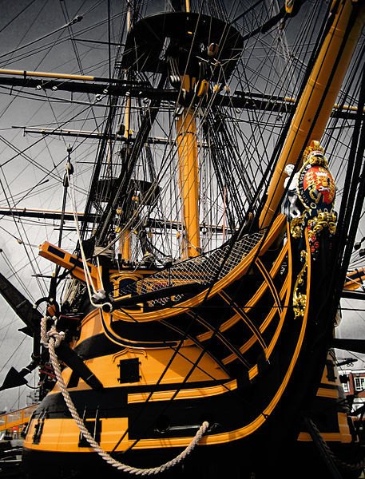
Royal
Navy
Ship Names
H.M.S. Arrogant
H.M.S. Gladiator
H.M.S. Unbeaten
H.M.S. Unbending
H.M.S. Unbroken
H.M.S. Undaunted
H.M.S. Valiant
H.M.S. Vampire
H.M.S. Vanquisher
H.M.S. Vehement
H.M.S. Vengeance
H.M.S. Victory
CLICK TO SEE MORE!
Credit: Jamie Campbell

Slide 10
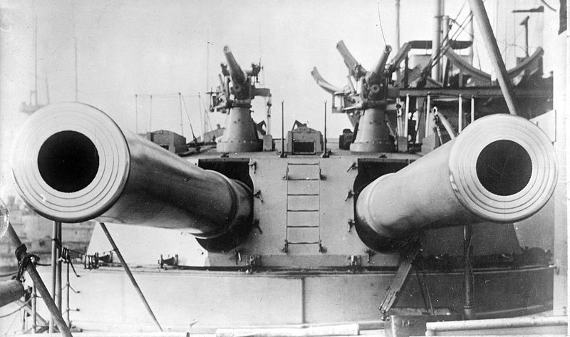
H.M.S. Dreadnought
(1906)
12 in.

Slide 11
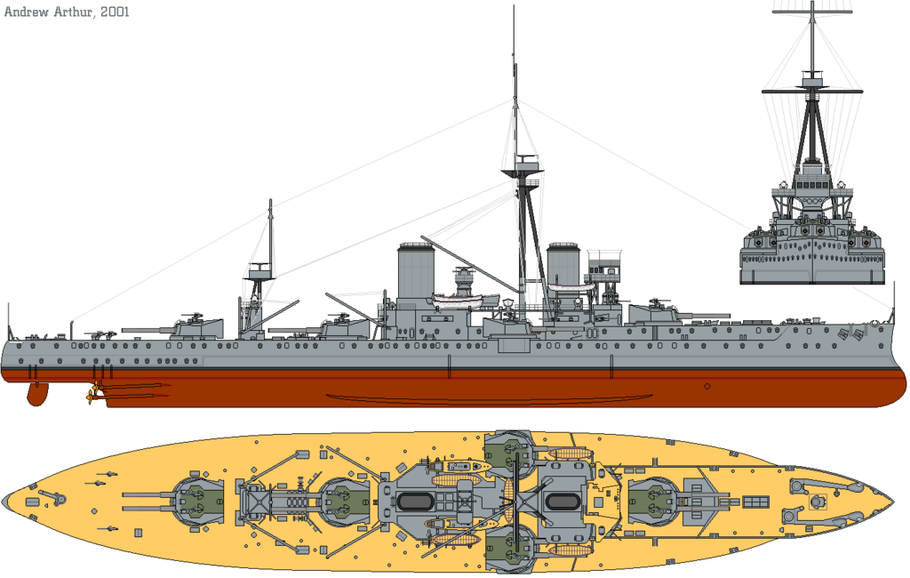
"HMS Dreadnought (1911) profile drawing" by Emoscopes

Slide 12
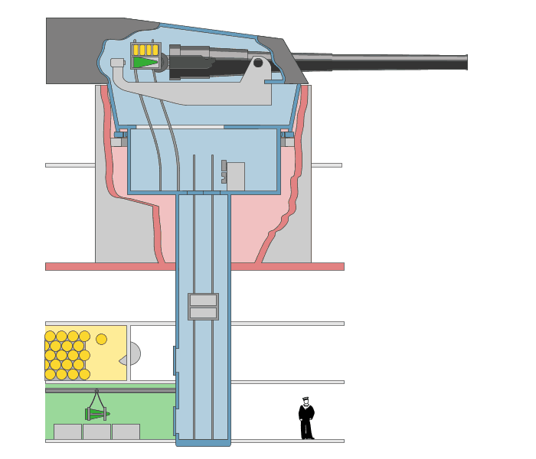
FULLY AUTOMATED
A Revolution in Weaponry
Art Credit: Emoscopes

Slide 13

Percentage Distribution of the World's Manufacturing Production
 | 1870 | 1913
USA | 23.3 | 35.8
Germany | 13.2 | 15.7
U.K. | 31.8 | 14.0
France | 10.3 | 6.4
Russia | 3.7 | 5.5
Italy | 2.4 | 2.7
Others | 15.3 | 19.9
Source: http://www.fordham.edu/halsall/mod/indrevtabs1.asp

Slide 14
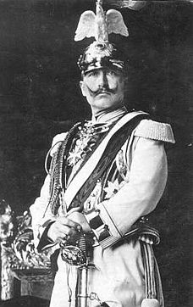

The Daily Telegraph Affair
LINK
Photo by @Doug88888
A PR move gone seriously wrong!
Wilhelm II “Kaiser Bill”

Slide 15

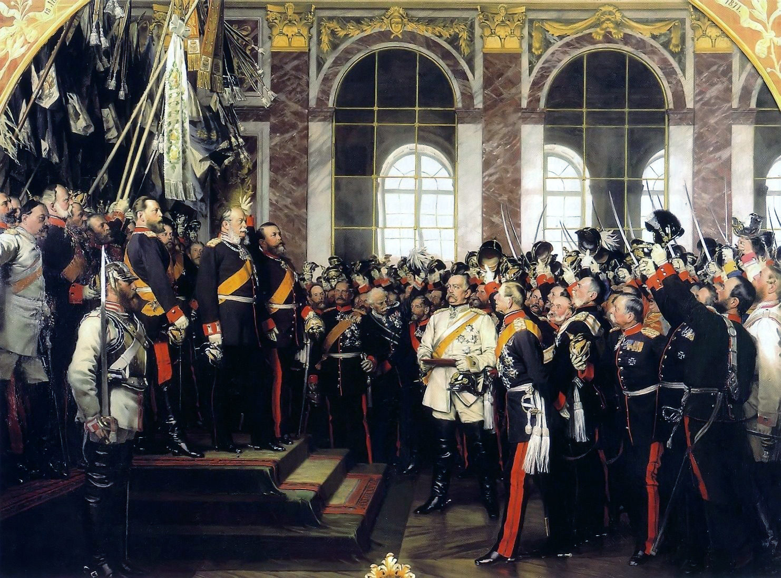
FRANCO-GERMAN TENSIONS

Slide 16
The
ALLIANCE System

Slide 17

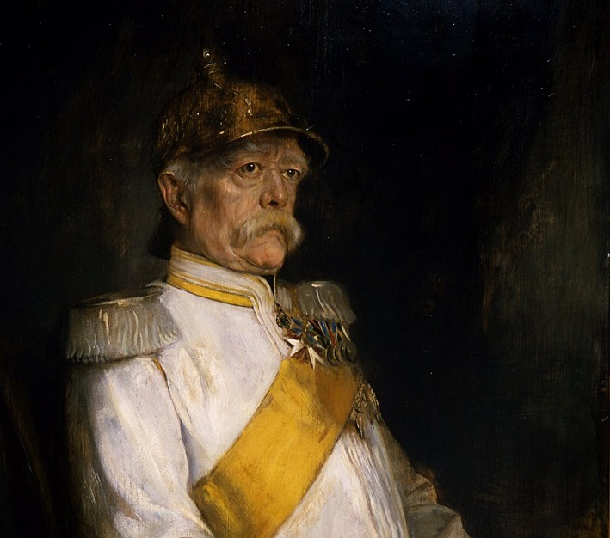
ARCHITECT

Slide 18
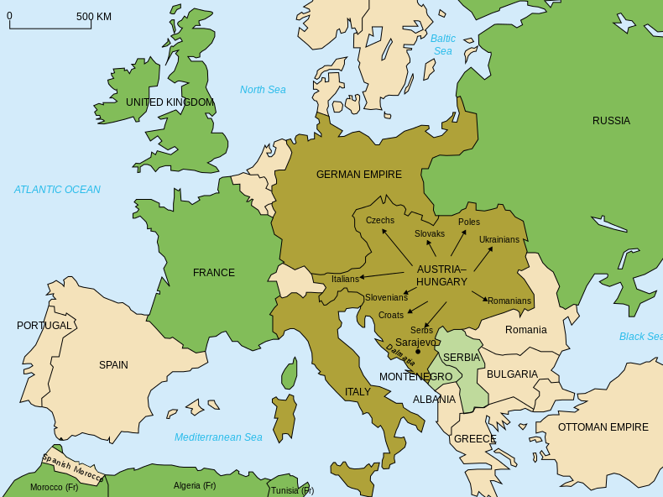
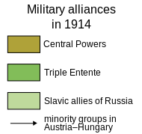
Alliances
Map Credit: historicair

Slide 19
Triple Entente
Britain France Russia
Central Powers
Germany Austria-Hungary Ottoman Empire Italy
Map Credit: historicair

Slide 20
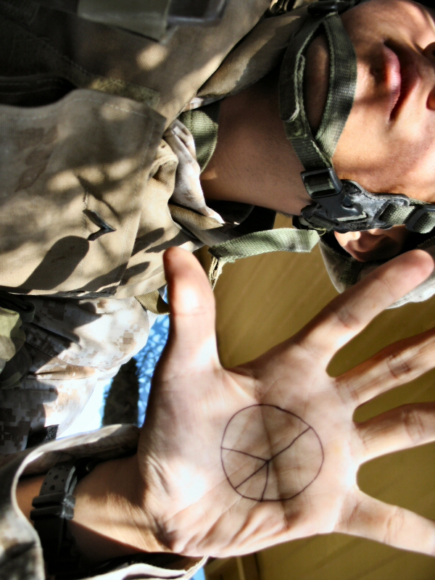
Photo by Jayel Aheram

Slide 21
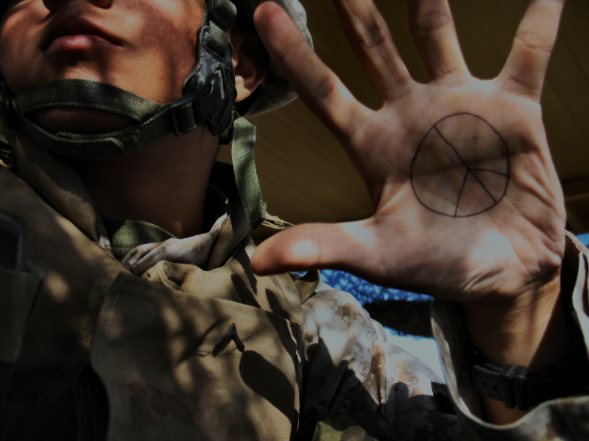
The objective was
NOT to go to war.
Photo by Jayel Aheram

Slide 22
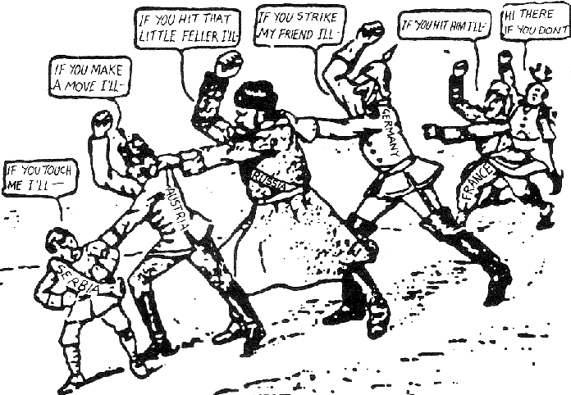
1914 American Cartoon

Slide 23
IT WORKS!!!

Slide 24
IT WORKS!!!
...until it doesn’t.

Slide 25
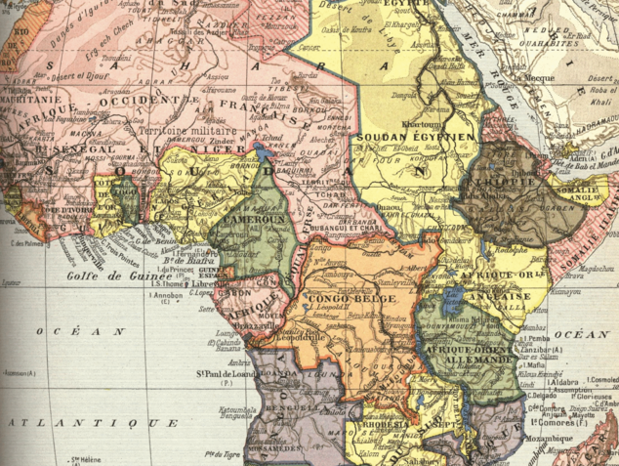
IMPERIALISM
National Rivalry Goes Global

Slide 26
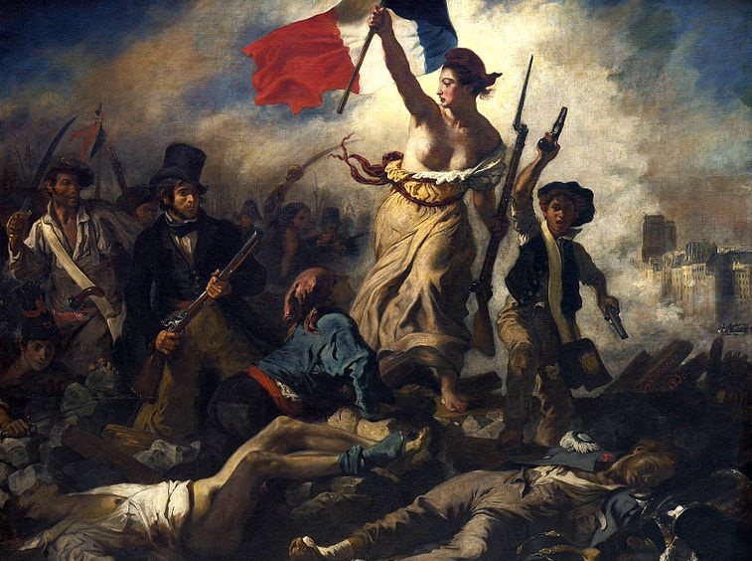
NATIONALISM
Liberty Leading the People (Eugène Delacroix, 1830)

Slide 27
Self-Determination on the Basis of Ethnicity
Liberty Leading the People (Eugène Delacroix, 1830)

Slide 28
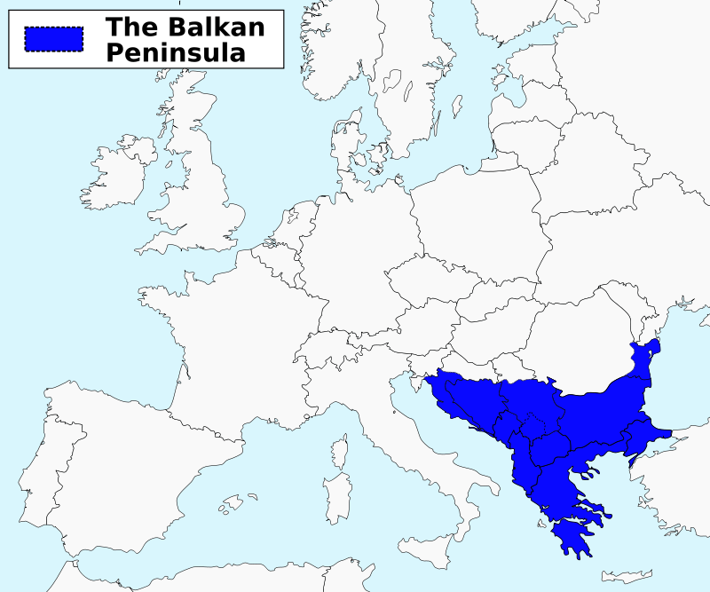
Map Credit: ArnoldPlaton

Slide 29
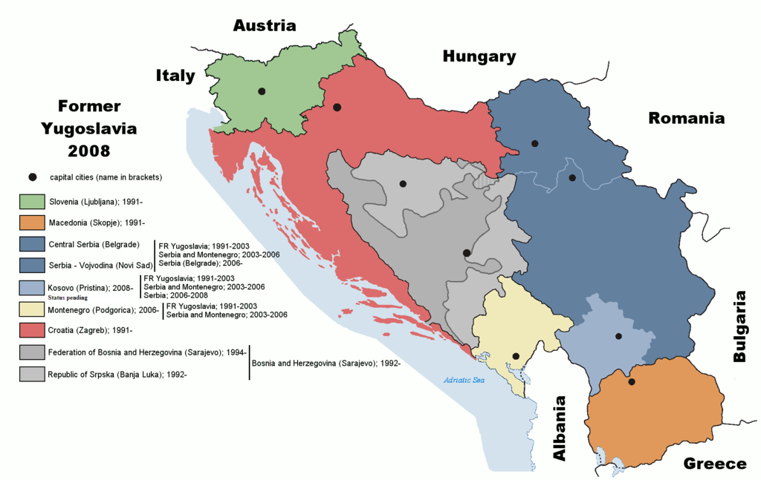
The “Former Yugoslavia”
Map Credit: Ijanderson977

Slide 30
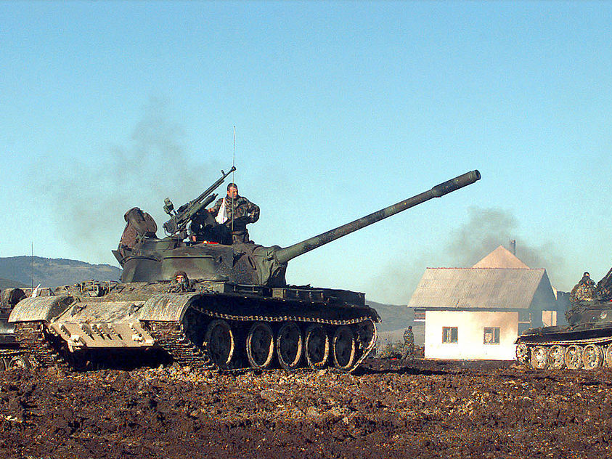
DON’T BE FOOLED

Slide 31
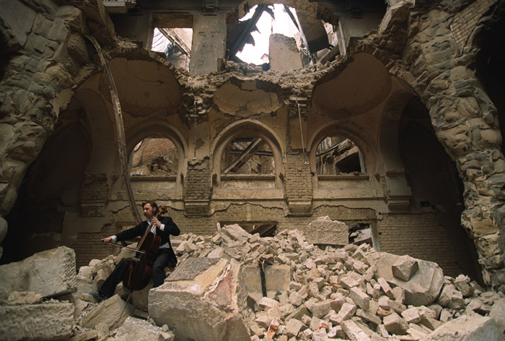
Vedran Smailović playing on top of the ruins of the National library (1992)
Photo Credit: Mikhail Evstafiev

Slide 32
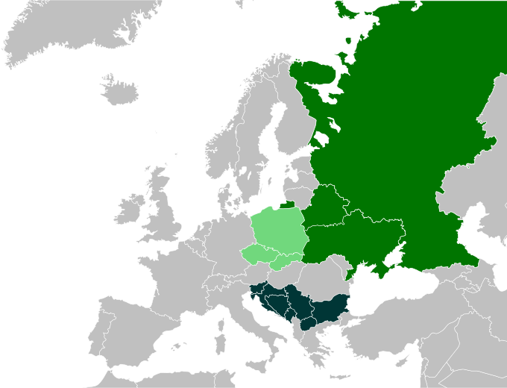
PAN-SLAVISM
Map Credit:
CrazyPhunk

Slide 33
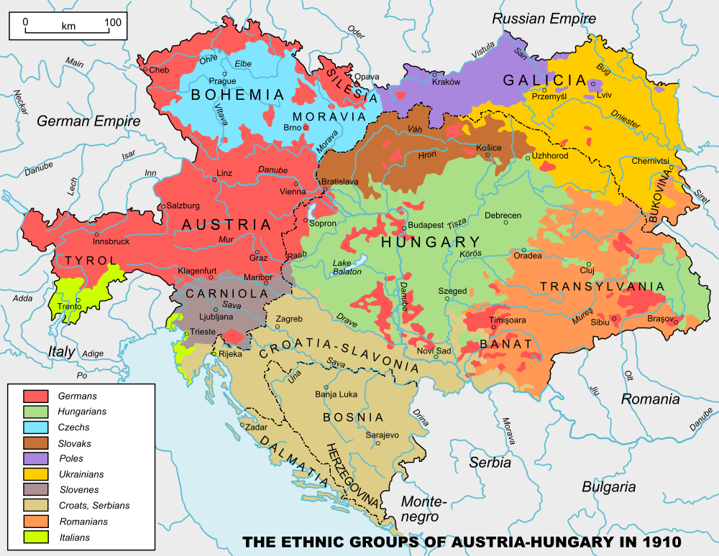

Slide 34

The Black Hand
Serbian Nationalists
Photo by
FotoRita [Allstar maniac]

Slide 35
SLAVS

Slide 36
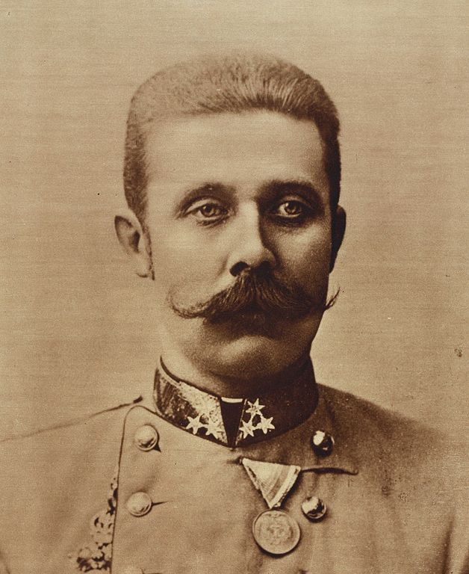
HEIR
Archduke Franz Ferdinand of Austria

Slide 37
ARCHDUKE

Slide 38
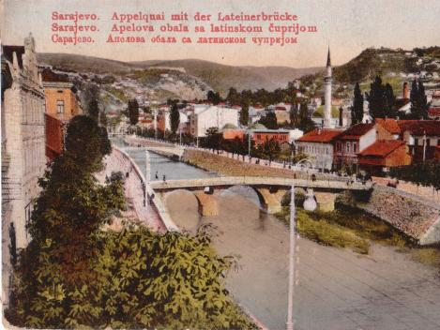
SARAJEVO
Picture Credit: Aloysius

Slide 39
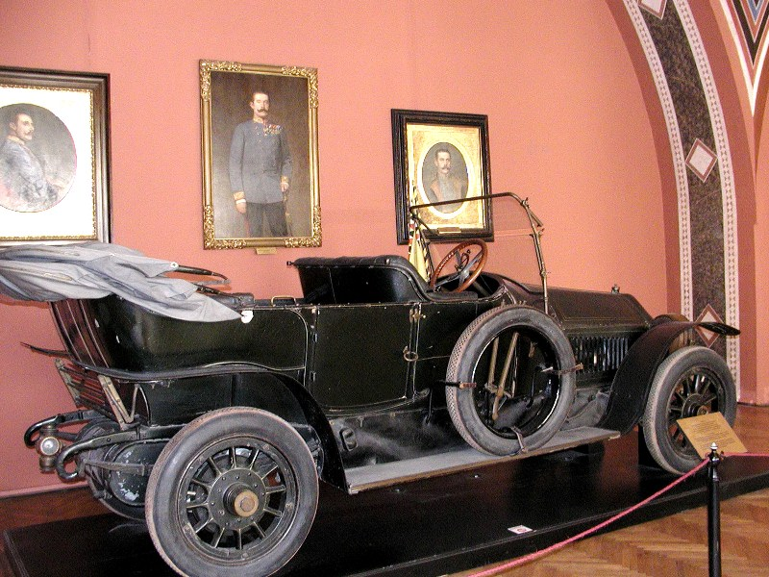
Photo by Alexf

Slide 40
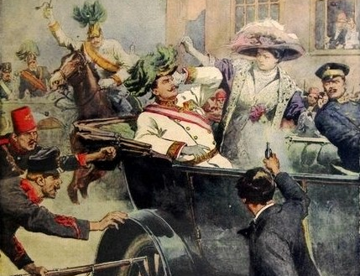

Slide 41
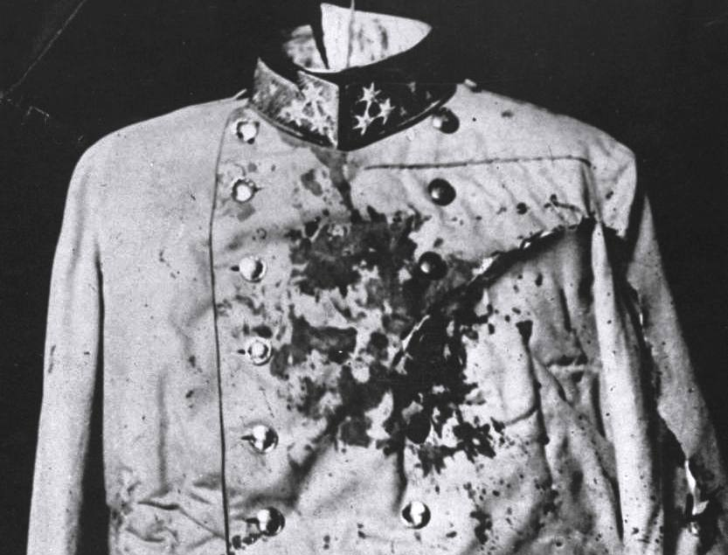

Slide 42

IGNITE
Photo by ☻☺

Slide 43
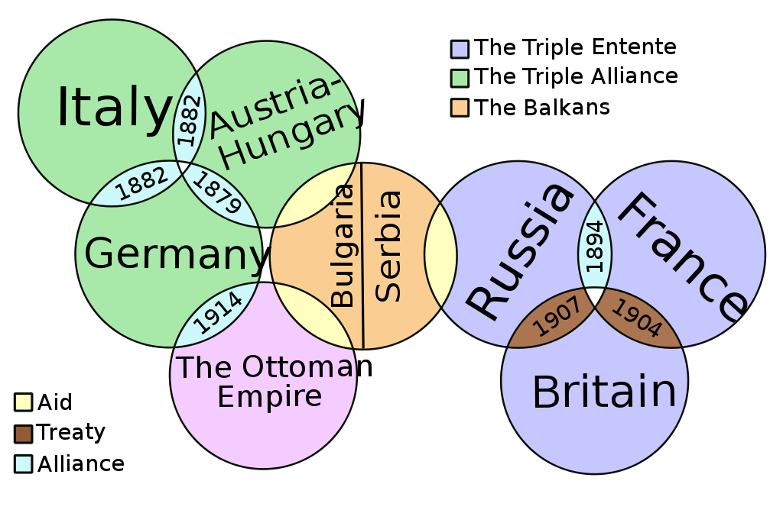
The Web of Alliances
Art Credit: It Is Me Here Xiaphias

Slide 44
Triple Entente
Britain France Russia
Central Powers
Germany Austria-Hungary Ottoman Empire Italy
Map Credit: historicair

Slide 45
Modern Warfare
The advent of World War I introduced several new military technologies that were used for the first time.

Slide 46
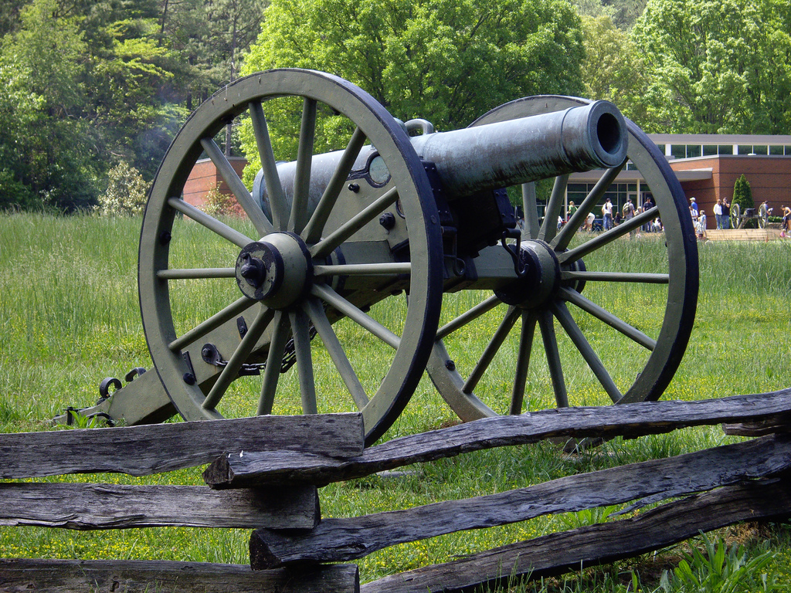
Civil War Cannon
Photo by terra2055

Slide 47
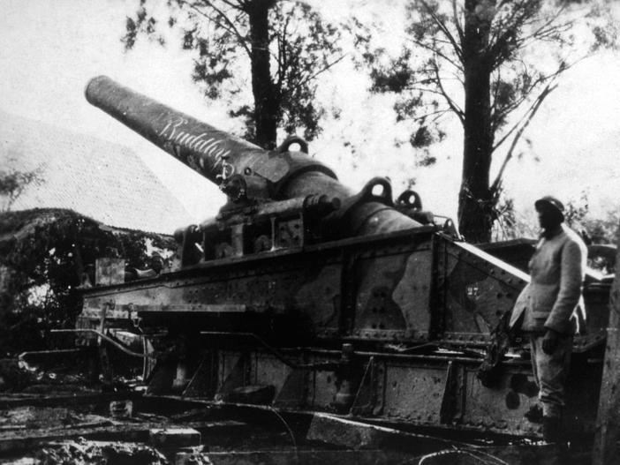
WWI Artillery Piece

Slide 48
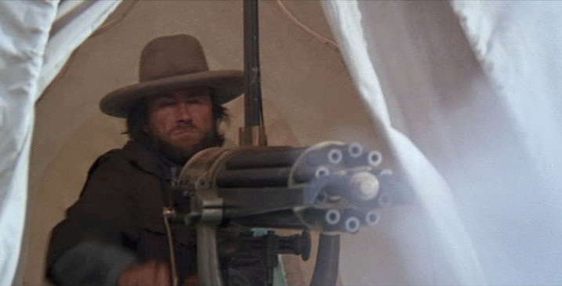
Civil War Gatling Gun
Screenshot from The Outlaw Josey Wales

Slide 49
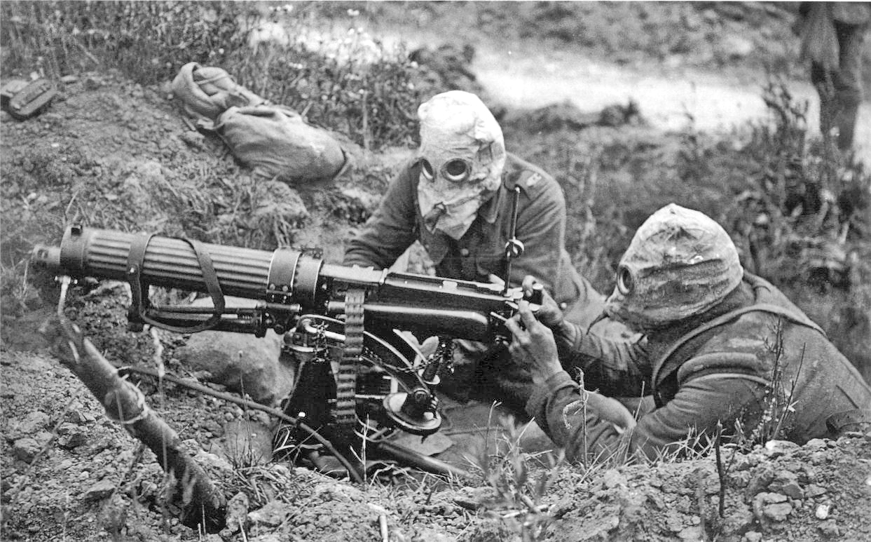
WWI Machine Gun

Slide 50
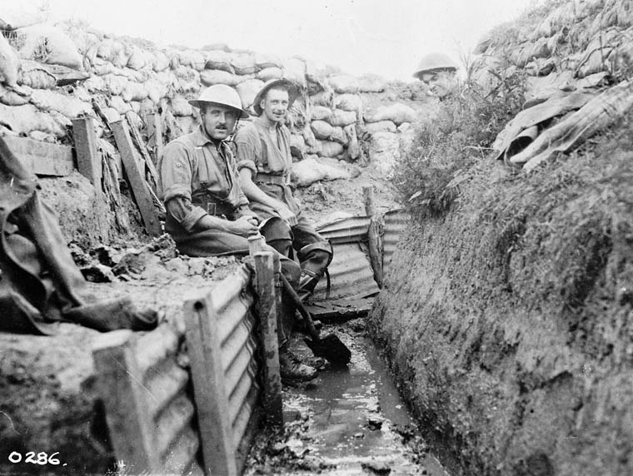
Trench Warfare

Slide 51
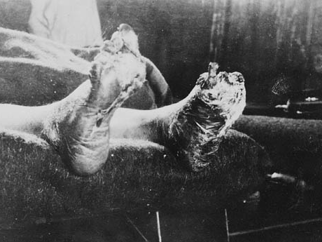
Trench Foot
Photo by BiblioArchives / LibraryArchives

Slide 52

STALEMATE

Slide 53

World War I was marked by prolonged battles that resulted in high casualties and little territorial gain.

Slide 54
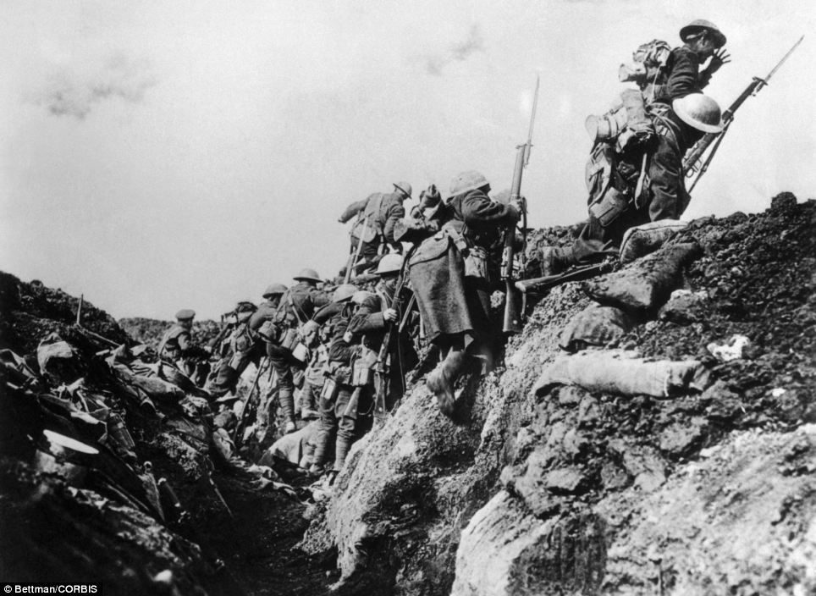
Over The Top

Slide 55
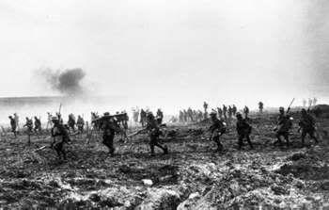
FUN!

Slide 56
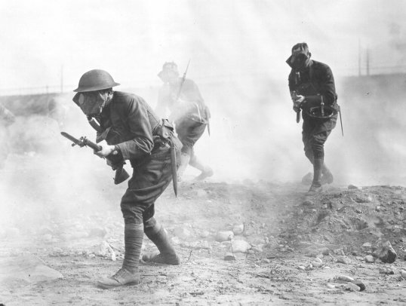

Mustard Gas

Slide 57
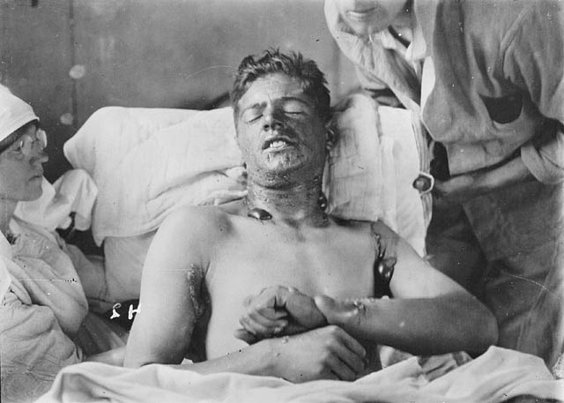
Should’ve
worn my
gas mask!

Slide 58
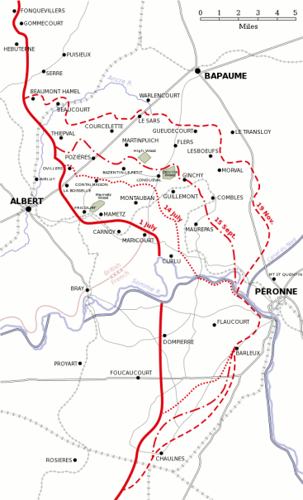
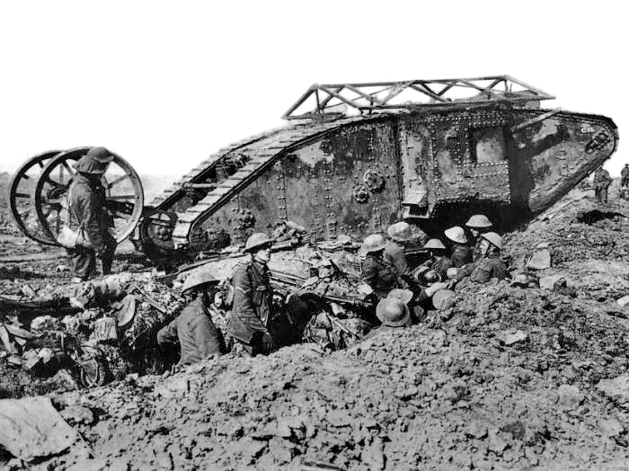
Battle of the Somme
July-November, 1916
Casualties (>1M)
Debut

Slide 59

The British Offensive
6
Miles

Slide 60
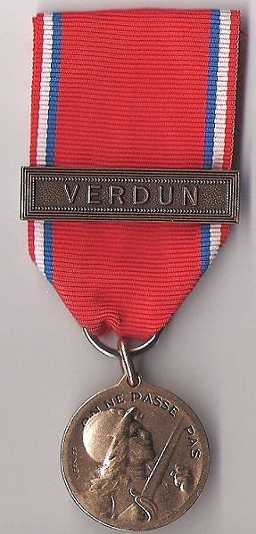
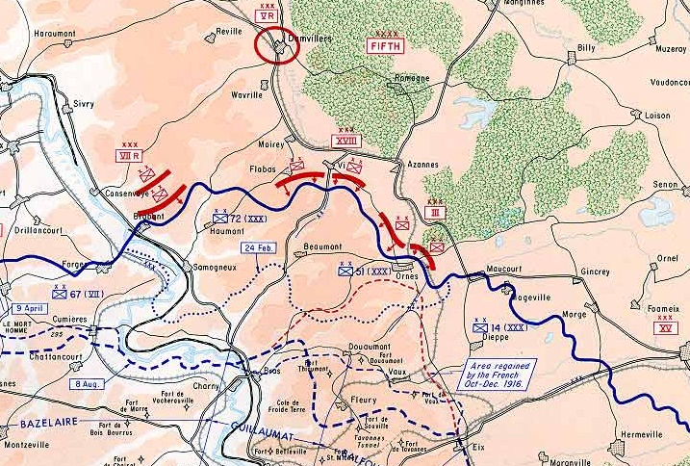
Battle of Verdun
February-December, 1916
The French repulse a German attack
> 700,000 Casualties

Slide 61
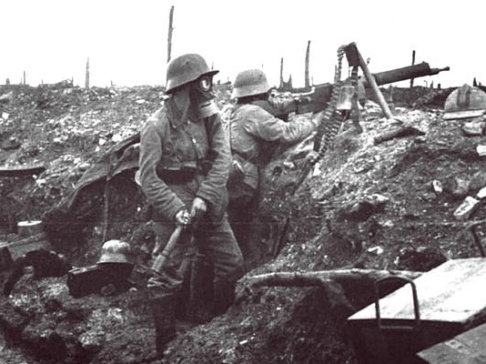
German Soldiers at Verdun

Slide 62
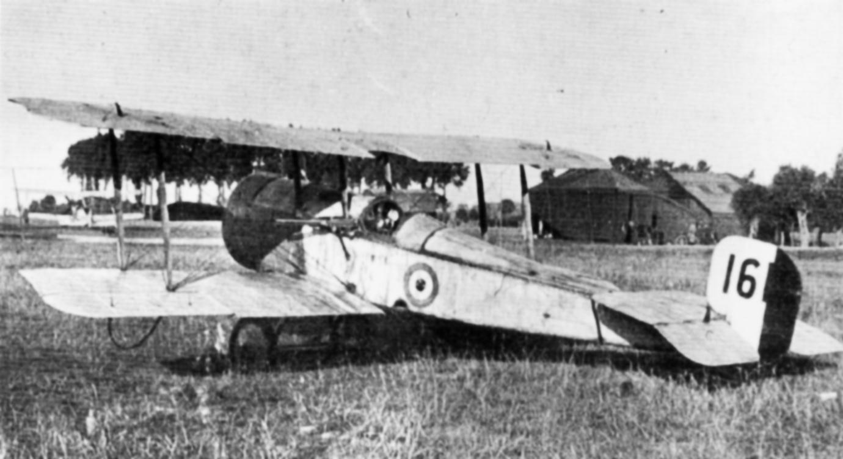
Aircraft in World War I

Slide 63
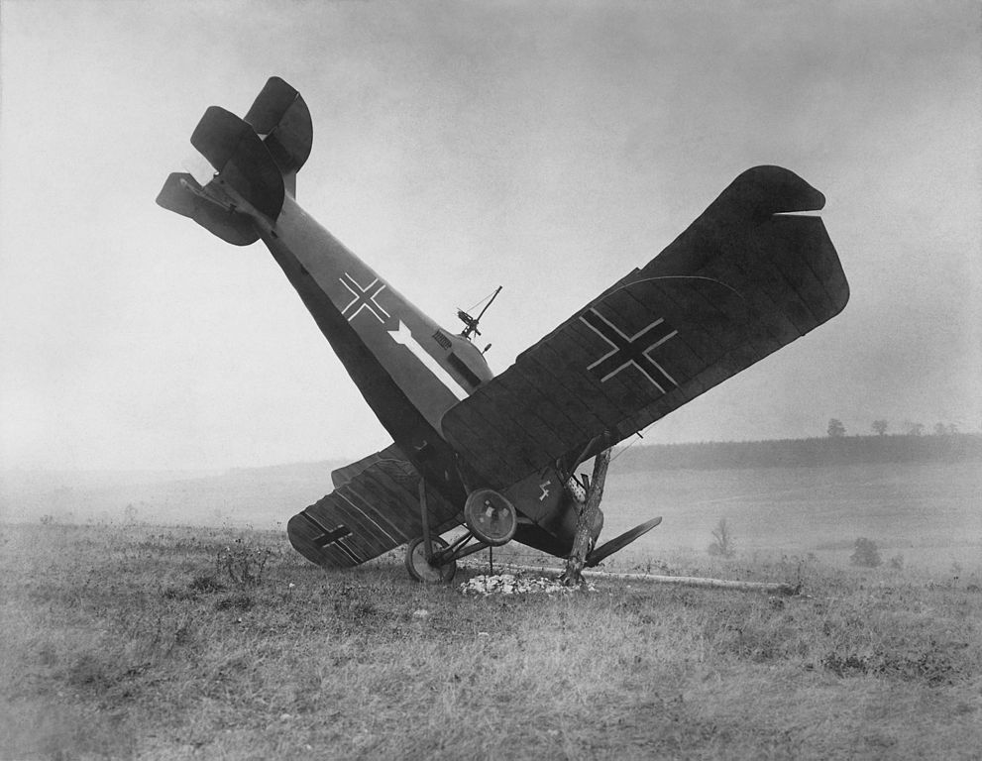
FAIL

Slide 64

The Red Baron
80 Air Combat Victories
KIA 1918
Manfred Albrecht Freiherr
von Richthofen

Slide 65

Zeppelin Raids
Germans used Zeppelins to bomb British cities.

Slide 66


Slide 67

German Gotha G.V Bomber

Slide 68
RESPONSES to Total War

Slide 69

“I am staring at a sunlit picture of Hell.”
-- Siegfried Sassoon (British Poet)

Slide 70

“Dulce et decorum est pro patria mori.”
-- Horace

Slide 71

If you could hear, at every jolt, the blood
Come gargling from the froth-corrupted lungs,
Obscene as cancer, bitter as the cud
Of vile, incurable sores on innocent tongues,
My friend, you would not tell with such high zest
To children ardent for some desperate glory,
The old Lie; Dulce et Decorum est
Pro patria mori.*
“Dulce et Decorum Est”
Wilfred Owen
1893-1918
*It is sweet and right to die for your country.

Slide 72

A German Soldier
Writes Home
From German Students’ War Letters
(Pine Street Books, 2002)

Slide 73


SHELLSHOCK
Psychological response to prolonged helplessness under artillery fire.
Further Reading
Shellshock vs. PTSD

Slide 74

The Thousand Yard Stare

Slide 75
The War at Home

Slide 76

Propaganda Campaigns
Both sides used war propaganda to motivate people to support the war effort.
CLICK HERE
to see more posters.

Slide 77
Propaganda Campaigns
PURPOSES:
ENLIST
DEHUMANIZE
the enemy
FINANCE the war
CONSERVE resources

Slide 78

Women and the
War Effort
Women worked in munitions factories while men were at the Front.

Slide 79


Slide 80


Slide 81

Suffrage
The Legacy
1918 Germany
  Austria
1919 Belgium
1920 Czechoslovakia
United States
1928 United Kingdom
Emmeline Pankhurst, a radical suffragette, is arrested in 1914

Slide 82

Russian Revolution
1917
Russian government pulls out of the war, then collapses.
Lenin and Stalin

Slide 83

Treaty of Brest-Litovsk
March, 1918
Russia cedes territory to Germany.

Slide 84

A German U-Boat

Slide 85

Sinking of the Lusitania
1915
Germany sparked an outrage by sinking a passenger ship (that was carrying armaments), killing British and American civilians.

Slide 86

Unrestricted Submarine Warfare
(1917)
A major factor leading to U.S. involvement in the war

Slide 87

The U.S. Enters the War
Fresh troops
for the war-weary Entente Powers.

Slide 88

Armistice
11/11
(1918)
11:00 AM

Slide 89


The Treaty of Versailles
Photo by wallyg

Slide 90


Slide 91

Wilson’s Fourteen Points
PRINCIPLES:
Freedom of the Seas
Reduction of Arms
Open Treaty Negotiations
Self Determination
of Peoples
League of Nations
14

Slide 92

PEACE
Without
Victory

Slide 93

Entente Military Deaths
More Info

Slide 94





Paris Peace Conference
“The Conference was an affair of three sides – the victors, the vanquished, and Wilson.”
-- Richard Hofstadter

Slide 95


“I was seated between Jesus Christ and Napoleon.”
David Lloyd George (British Prime Minister)

Slide 96


Slide 97

Article 231
The
“War Guilt” Clause
Britain and France
wanted Germany to
claim responsibility for
the war and pay reparations to the allies.

Slide 98
Wilson’s Fourteen Points
PRINCIPLES:
Freedom of the Seas
Reduction of Arms
Open Treaty Negotiations
Self Determination
of Peoples
League of Nations
14

Slide 99

HOW
can the two ideas
be reconciled???
14
231

Slide 100


Slide 101
EASY!!!
WHY NOT BOTH?
14
231

Slide 102





LINK TO MAPS

Slide 103
LINK TO MAPS

Slide 104
LINK TO MAPS

Slide 105
LINK TO MAPS

Slide 106
Proclamation of the German Empire
18 January 1871

Slide 107


Signing of the
Treaty of Versailles
June 28, 1919
Five years to the day of the assassination of Archduke Franz Ferdinand
Look Familiar???

Slide 108

League Membership
1920-
1946
Map Credit: Maps & Lucy
The United States never joined the League.
Wilson’s mission to intimately involve the U.S. in global affairs was a failure.

Slide 109
decolonization

Slide 110


League of Nations
Mandates
Former colonies administered by Britain and France
Notes:
Map: Geoffrey Gaudreault, NPR; Source: A History of the Arab Peoples by Albert Hourani
http://www.npr.org/news/specials/mideast/the_west/mandates_map.html

Slide 111

League of Nations Mandates
Former colonies administered by Britain and France
Map: Geoffrey Gaudreault, NPR; Source: A History of the Arab Peoples by Albert Hourani
Notes:
Map: Geoffrey Gaudreault, NPR; Source: A History of the Arab Peoples by Albert Hourani
http://www.npr.org/news/specials/mideast/the_west/mandates_map.html

Slide 112



1919
I went to Versailles and all I got was this lousy
peace prize.

Slide 113








