Slide 1
Absolute Monarchies in
Austria-Hungary
& Prussia
Warm Up: Define 1. divine right
2. absolute monarch

Slide 2
Definitions
1. Divine Right:
Belief that a ruler’s authority comes directly from God.
2. Absolute Monarch:
Ruler with complete authority over the government and lives of the people he or she governs.

Slide 3
Absolute Monarchies in Europe 1550-1800
Spain
France
England
Austria
Prussia
Russia

Slide 4
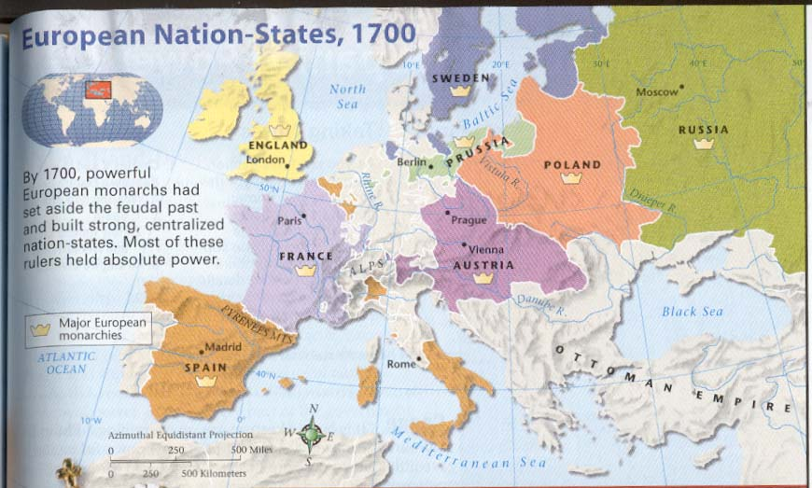
Absolute Monarchies in Europe
1550-1800
From World History: Connections to Today Prentice Hall, 2003

Slide 5
Thirty Years’ War
1618-1648 (page 427)
1640: Holy Roman Empire has broken down into several Prussian (German) principalities.
Electors from the 7 major German states elect the Holy Roman emperor. Many other German states no longer recognize the power of the Holy Roman emperor.
1641: Ferdinand of Bohemia (Hapsburg king) elected emperor. He is Anti – Protestant. Tried to return Prussia (Germany) to Catholicism. Spain, Poland supported Ferdinand. Protestant countries – Sweden, Netherlands – sent troops into Prussia to protect Protestants. France comes in on side of Sweden to protect Alsace from Prussian control.
Over thirty years alliances continually changed.
War led to starvation, famine and disease. Area severely depopulated.
1648: Peace of Westphalia signed. France is clear winner, gains territory from Spain and Prussia, including Alsace. Prussia remains fragmented and Hapsburgs lose much power.

Slide 6
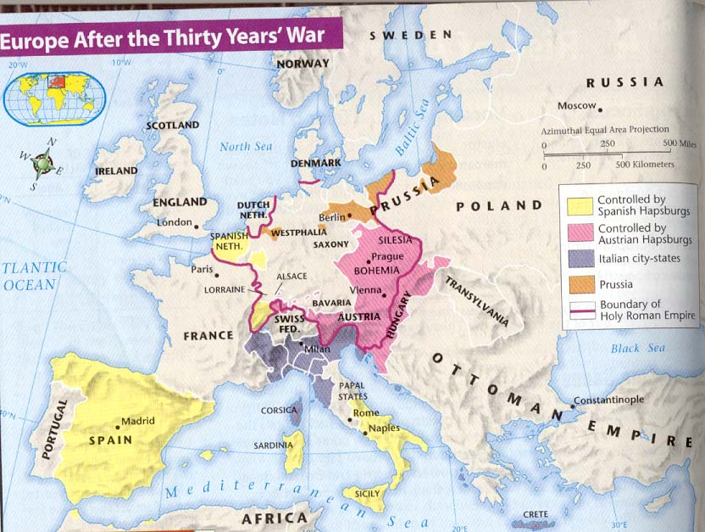
From World History: Connections to Today Prentice Hall, 2003

Slide 7
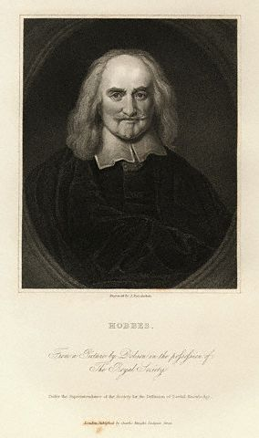
The Philosopher Behind the Age
Thomas Hobbes
1660 – Wrote the Leviathan (Giant)
Discussed the perfect government
People first lived in anarchy
Needed a “social contract”
Required an absolute monarch to maintain order
People retained the right only to maintain their lives.

Slide 8
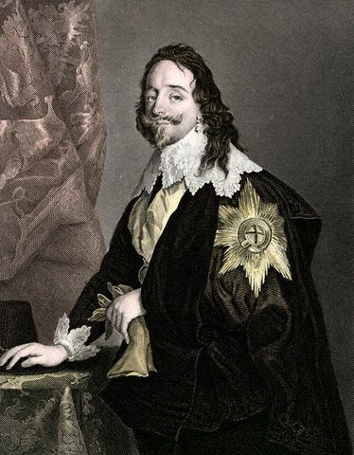
England – Charles I
1625 - 1649
Charles I of England
Absolute monarch - had no problem with putting his enemies in prison without trial
Ran up a huge debt
Dissolved Parliament in 1629
Touched off a massive English Civil War between supporters of Charles and supporters of Parliament led by Oliver Cromwell.
Charles I beheaded in 1649.

Slide 9
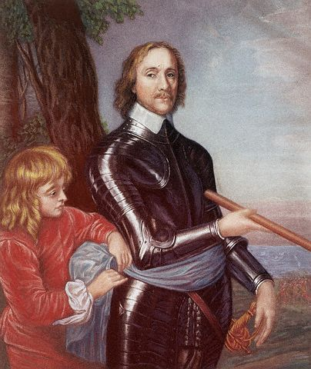
England – Oliver Cromwell
1649 - 1658
Oliver Cromwell: Lord Protector – England
Ruled through the army
Exiled Catholics to Ireland
Strict Puritan laws passed – theaters closed, Sunday set aside for worship, no lewd dancing, taverns or gambling
Religious freedom for everyone else
When Cromwell died, Restoration began.

Slide 10
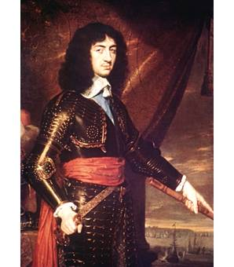
England – Charles II
The Restoration
1660 - 1685
Charles II - Popular ruler
Monarchy restored – Hence: Restoration
Bowed to the wishes of Parliament
Restored the Church of England
Stabilized government

Slide 11
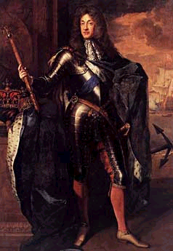
England – James II
1685 - 1688
James II - Absolute Ruler
Antagonized Parliament
Ran up a huge debt
Openly Catholic
Forced from throne in what came to be called the Glorious Revolution.
Glorious Revolution

Slide 12
England – William and Mary
English Bill of Rights
1689
William and Mary were given the throne after the English Bill of Rights was passed.
Guaranteed supremacy of Parliament over the monarchy.
Parliament had to meet on a regular basis
Monarchy could neither make nor suspend laws
Trial by jury reinstated.
Abolished fines and cruel and unusual punishment.
Affirmed “writ of habeas corpus” – no person can be held in prison without first being charged with a specific crime. Due process of laws.
Laid groundwork for American system of laws.

Slide 13
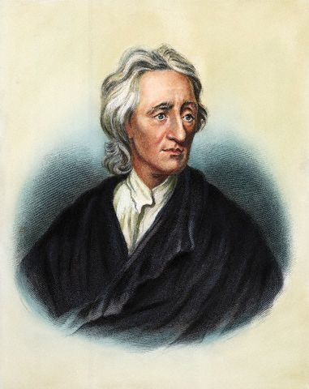
The Philosophy Advances
John Locke
1690
People first lived in anarchy
Needed a “social contract”
People gave up only SOME of their individual rights.
Kept the right to:
- Live
- Enjoy Liberty
- Own Property
Rulers who violated these rights broke the social contract and could be overthrown.

Slide 14
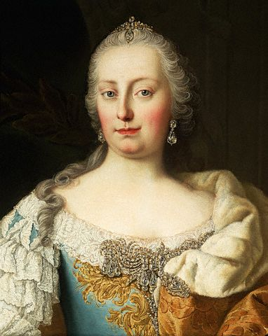
Austria – Maria Theresa r.1740 - 1780
Absolute monarch of Austria
Fought Frederick II of Prussia for control of Hungary and Silesia
Reorganized the government
Enlightened Despot
Eased tax burden on her people
Gave more rights to her subjects
Gave birth to 16 children while in power

Slide 15
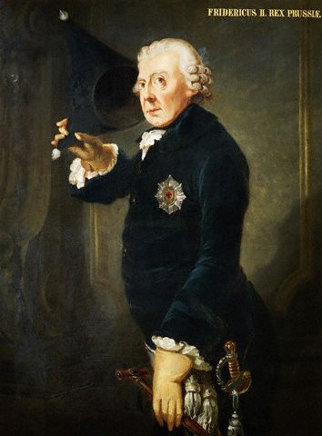
Prussia – Frederick II r.1740-1786
Absolute ruler of Prussia (Germany)
Attacked Austria, sparking the War of Austrian Succession
Unified Prussia, part of the Holy Roman Empire, into one nation

