Slide 1
A WORLD OF EMPIRES 1450-1750 CE

Slide 2
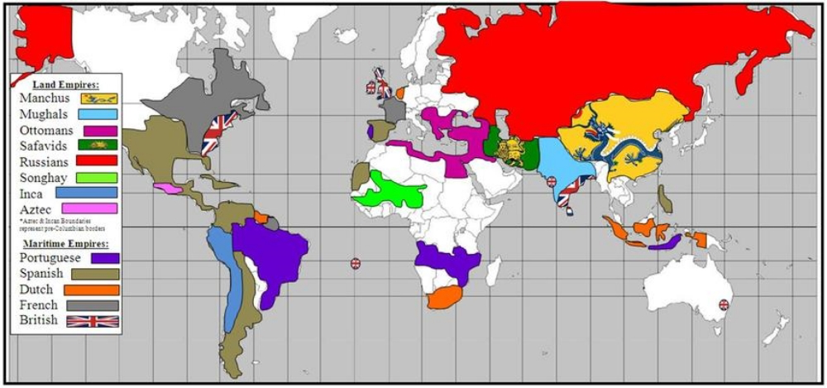
World Empires - 1750

Slide 3
American Empires 1300-1800
Rise of Incas
Continued rise of Aztecs
Conquest – Arrival of Spanish in western hemisphere
Population impacts: disease, racial intermingling, war
Columbian exchange
Colonial societies
Notes:
Incas/Aztecs..do lessons about them. (ex: time capsule assignment: draw 3 things on a “space ship” that they think are items from these cultures that could benefit the future socieites: ex: calendars)
Conquest: Do picture comparisons from both perspectives. There is also poetry from book: Broken Spears.
Impacts on Population: mestizos/mulattos/disease, racial, intermingling, war
In my file: good reading “Indian Givers”
Transition into colonail societies

Slide 4
Inca Empire—1438-1525
Highly centralized government
Diverse ethnic groups
Extensive irrigation
State religion/ancestor cult
Rope suspension bridges
Metallurgy – copper and bronze
No use of wheel
Roads and tunnels for tax collection, labor, and mail system.
Notes:
S to the 3rd (Sugar/Silver/Slaves) Do a case study ,one day, on transataltic slave trade and a day on columbian exchange….focus on Brazil.
200 different varieties of potatos…europeans took back 2…

Slide 5
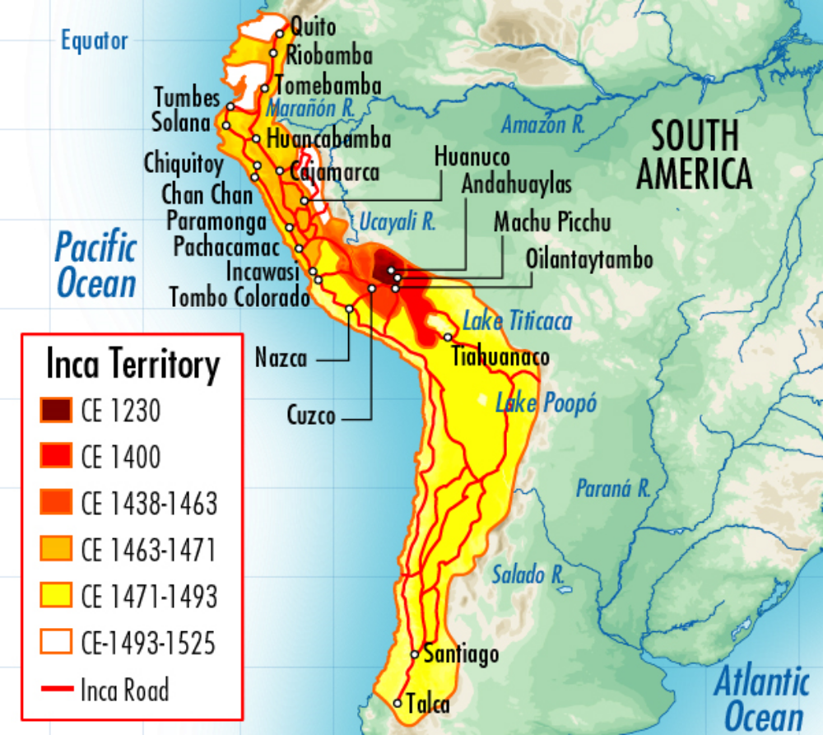
Incan Empire

Slide 6
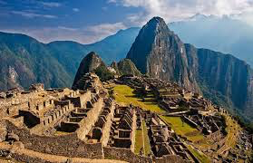
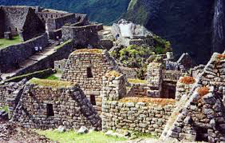
The Incan Empire

Slide 7
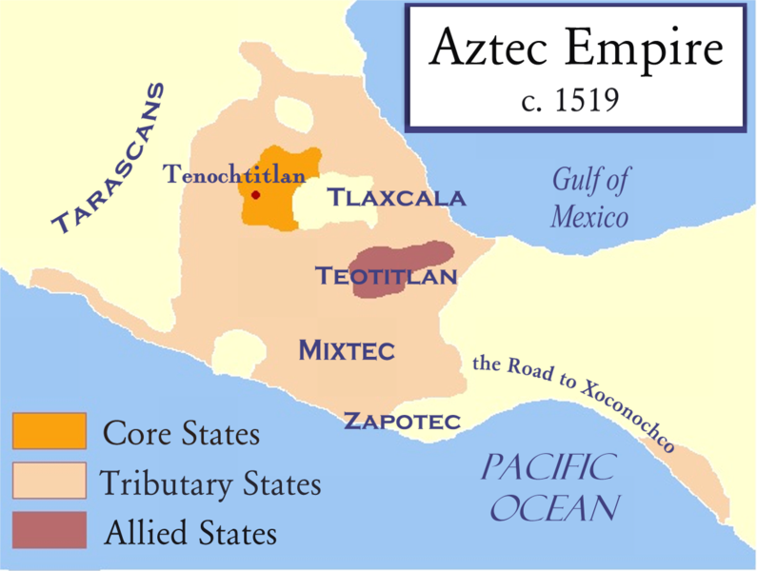
The Aztec Empire

Slide 8
Aztec Empire 1325-1520
Capital City of Tenochtitlan - “Foundation of Heaven”
By 1519, metropolis of 150,000-five square miles
Island location
Tribute empire based on agriculture
State control of market – redistributes all goods - socialism
Notes:
State controlled market

Slide 9
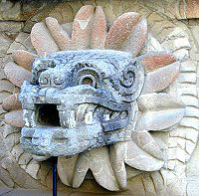
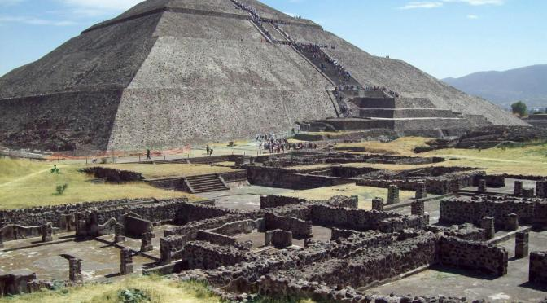
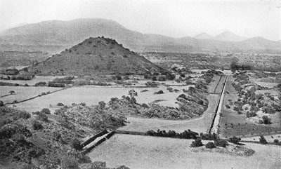
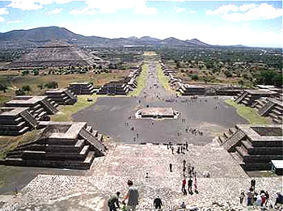
Aztec Empire

Slide 10
Changes in Trade, Technology and Global Interactions
Exploration
Gold, Glory and God
Commodities - valuable resources
Cartography – Map making
Empire Building
Notes:
Exploration: a major theme during this time. Gold Glory and God (3G’s)
Cartography – look at ptomoly map from “foundations” and how the image of the world was changing…because there are different purposes of map needed. Not just an art…but also a scieince
Commodities: Have students read the boo ”The world that trade created” Readings and Assignments is in my file. Commodity Jigasaw.

Slide 11
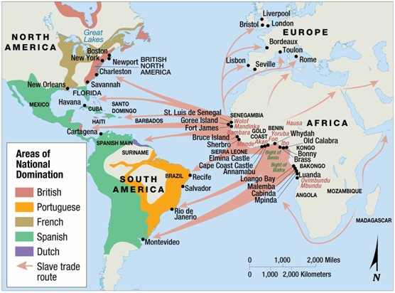
African Slave Trade

Slide 12
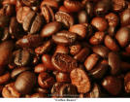
Commodities/Natural Resources
Coffee Beans used first in Yemen and then later in Europe and Americas
European used chocolate technology from Aztecs in 17th Century
Notes:
Story of Yemen sheep herder.
Chocolate: aztecs to europeans and was accepted when they put sugar in it

Slide 13
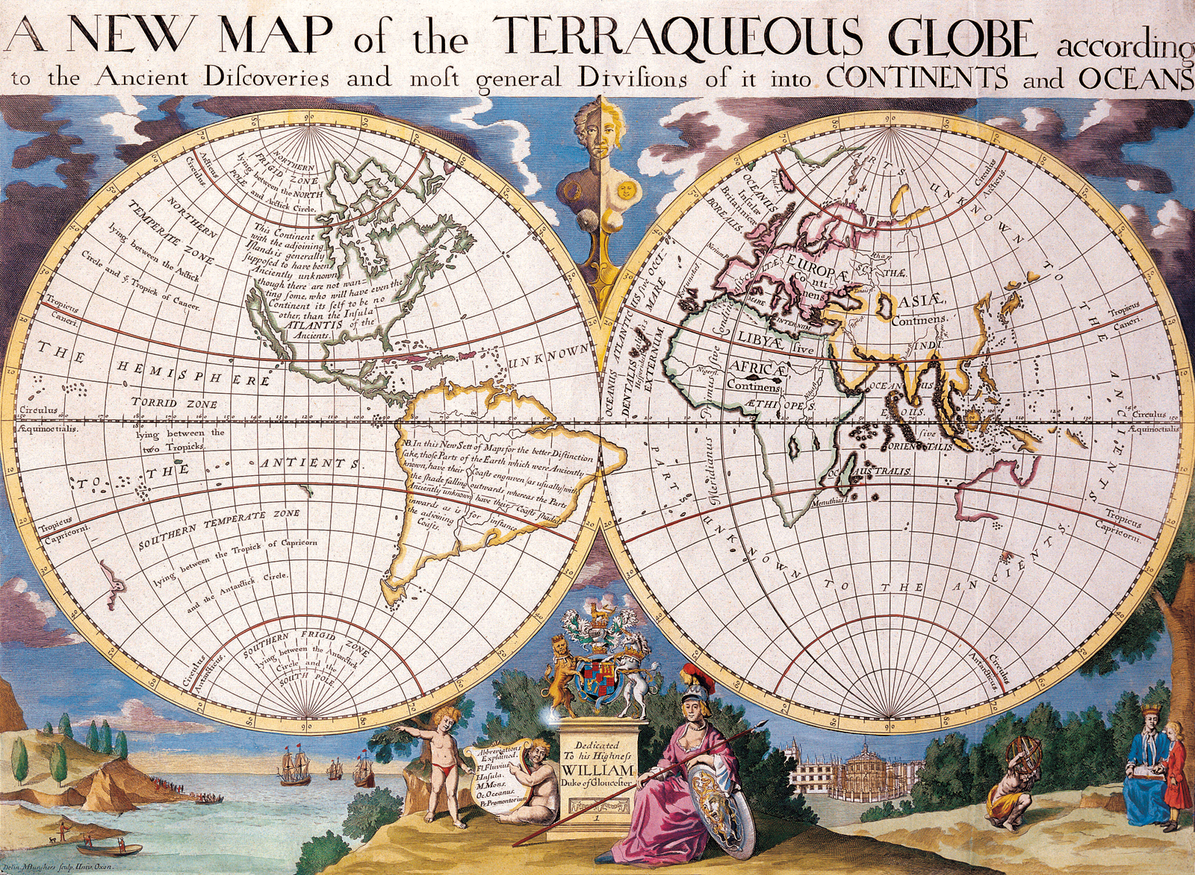
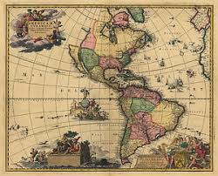
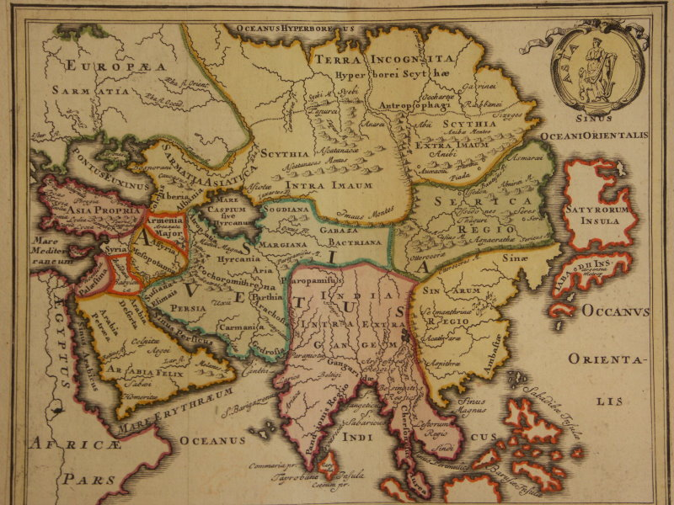
Cartographic (Map making) Changes

Slide 14
Africa
Characteristics:
Stateless societies-organized around kinship (family), often larger than states, forms of government
Large centralized states–increased. Unity based on Language and Religion–Bantu, Christianity and Islam, as well as indigenous beliefs.
Trade–markets, international commerce, taxed trade of unprocessed goods – Salt, Ivory, gold…

Slide 15
African Kingdoms
Large states emerged and prospered near the west coast as a result of the Atlantic slave trade
States competed with each other for control of the trade
Major states involved
Benin
Ashanti (Asante)
Dahomey

Slide 16
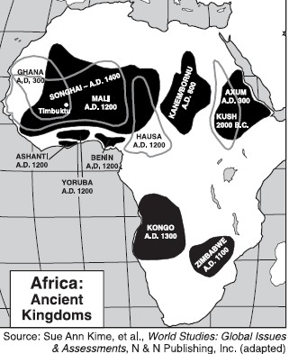
Benin
Involved in slave trade, but did not allow it to dominate the economy
Also traded textiles, pepper, ivory
Existed as powerful state before European influence
At height of power when Europeans arrived
Had well developed culture before European arrival

Slide 17
Ashanti (Asante)
Located on Gold Coast
Originally 20 small states, united around 1650
Osei Tutu claimed title of asantehene
Supreme ruler (pol. and rel.)
Advised by council members from the various tribal groups
Took advantage of guns and used them to expand borders
Remained powerful until 1820’s
Controlled gold and slave trade for many years
Slaves large part of economy= 2/3 of trade

Slide 18
Dahomey
More dependent upon slave trade
Development of the state
Centered about 70 miles from coast, building power since 17th century
Involvement in slave trade:
1720’s: use of guns to create autocratic state built upon slave trade
Imposed their own culture on the people they conquered
Royal court controlled slave trade and used military to raid neighbors for captives

Slide 19
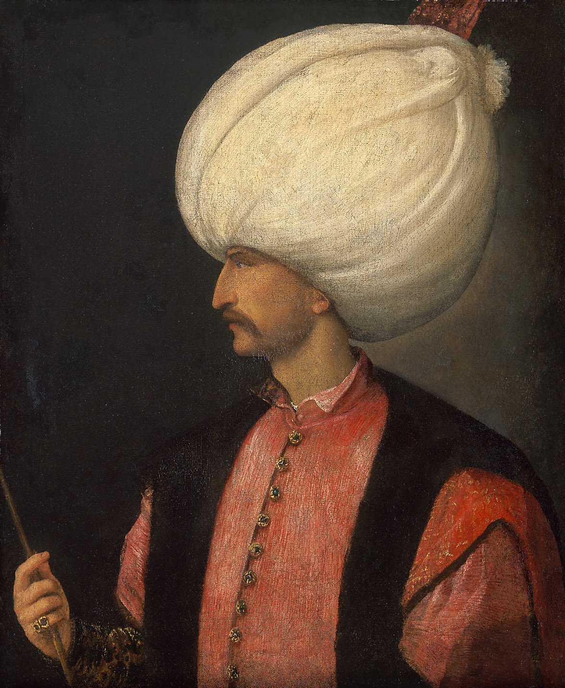
Ottoman Empire 1281-1914
1350s – Initial Ottoman invasion of Europe
1453 – Ottoman capture of Constantinople
1683 – Ottoman siege of Vienna (failed)
Religious Toleration under Suleiman the Magnificent

Slide 20

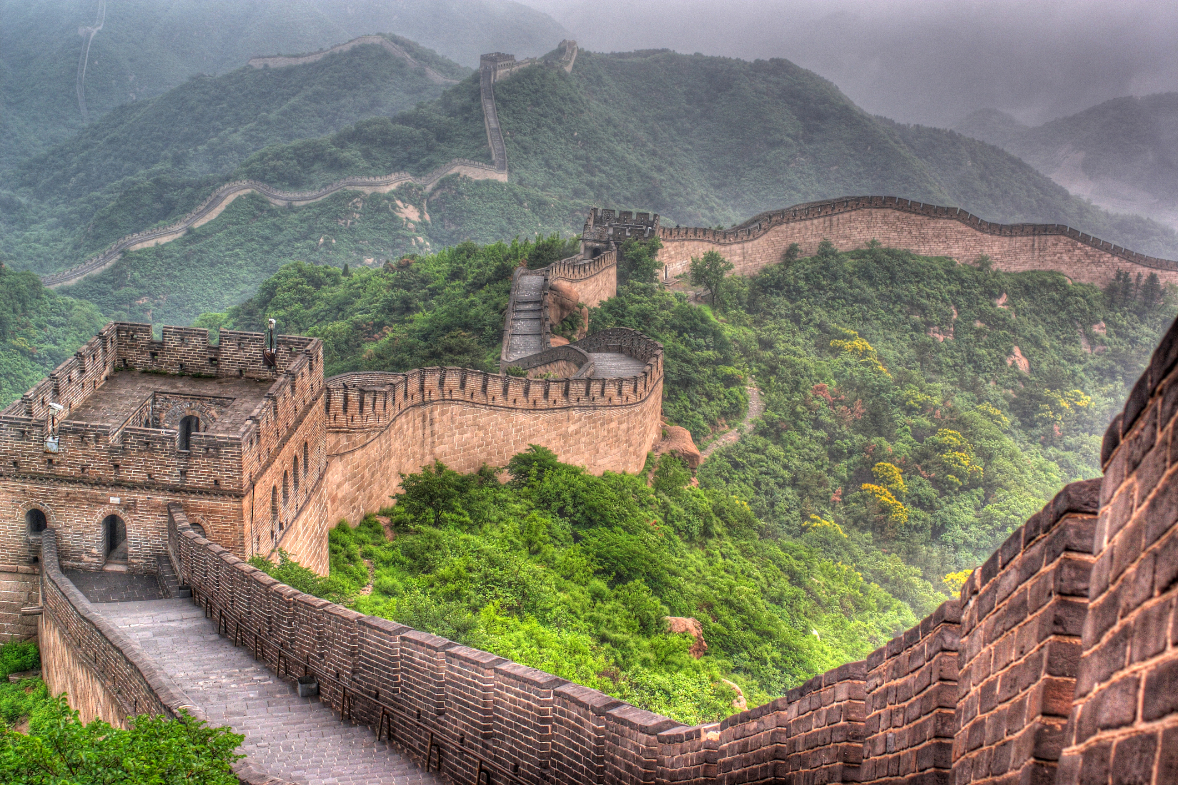
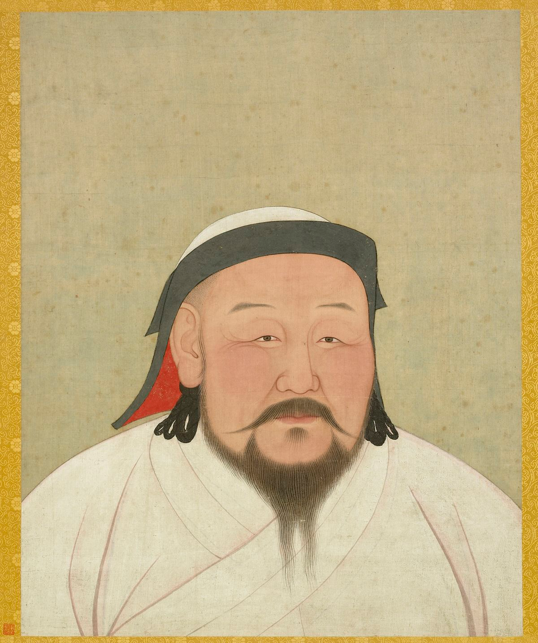
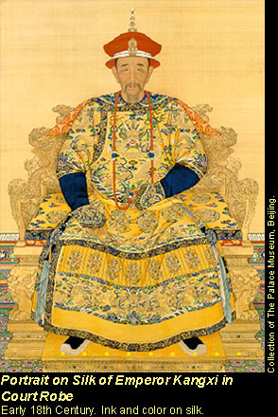
Ming China (Mongol) 1368-1644 Manchu Qing Dynasty 1644-1912

Slide 21
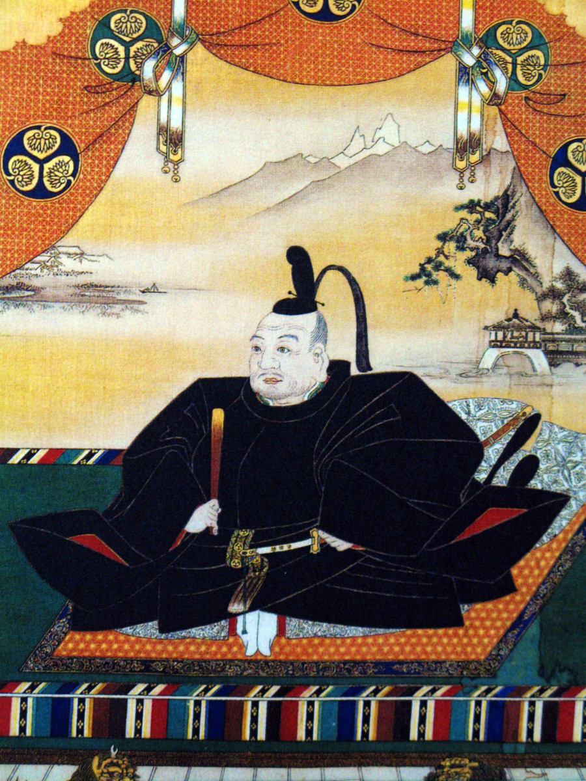
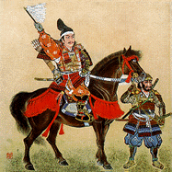
Japan – Tokugawa Shogunate
1600-1868

Slide 22
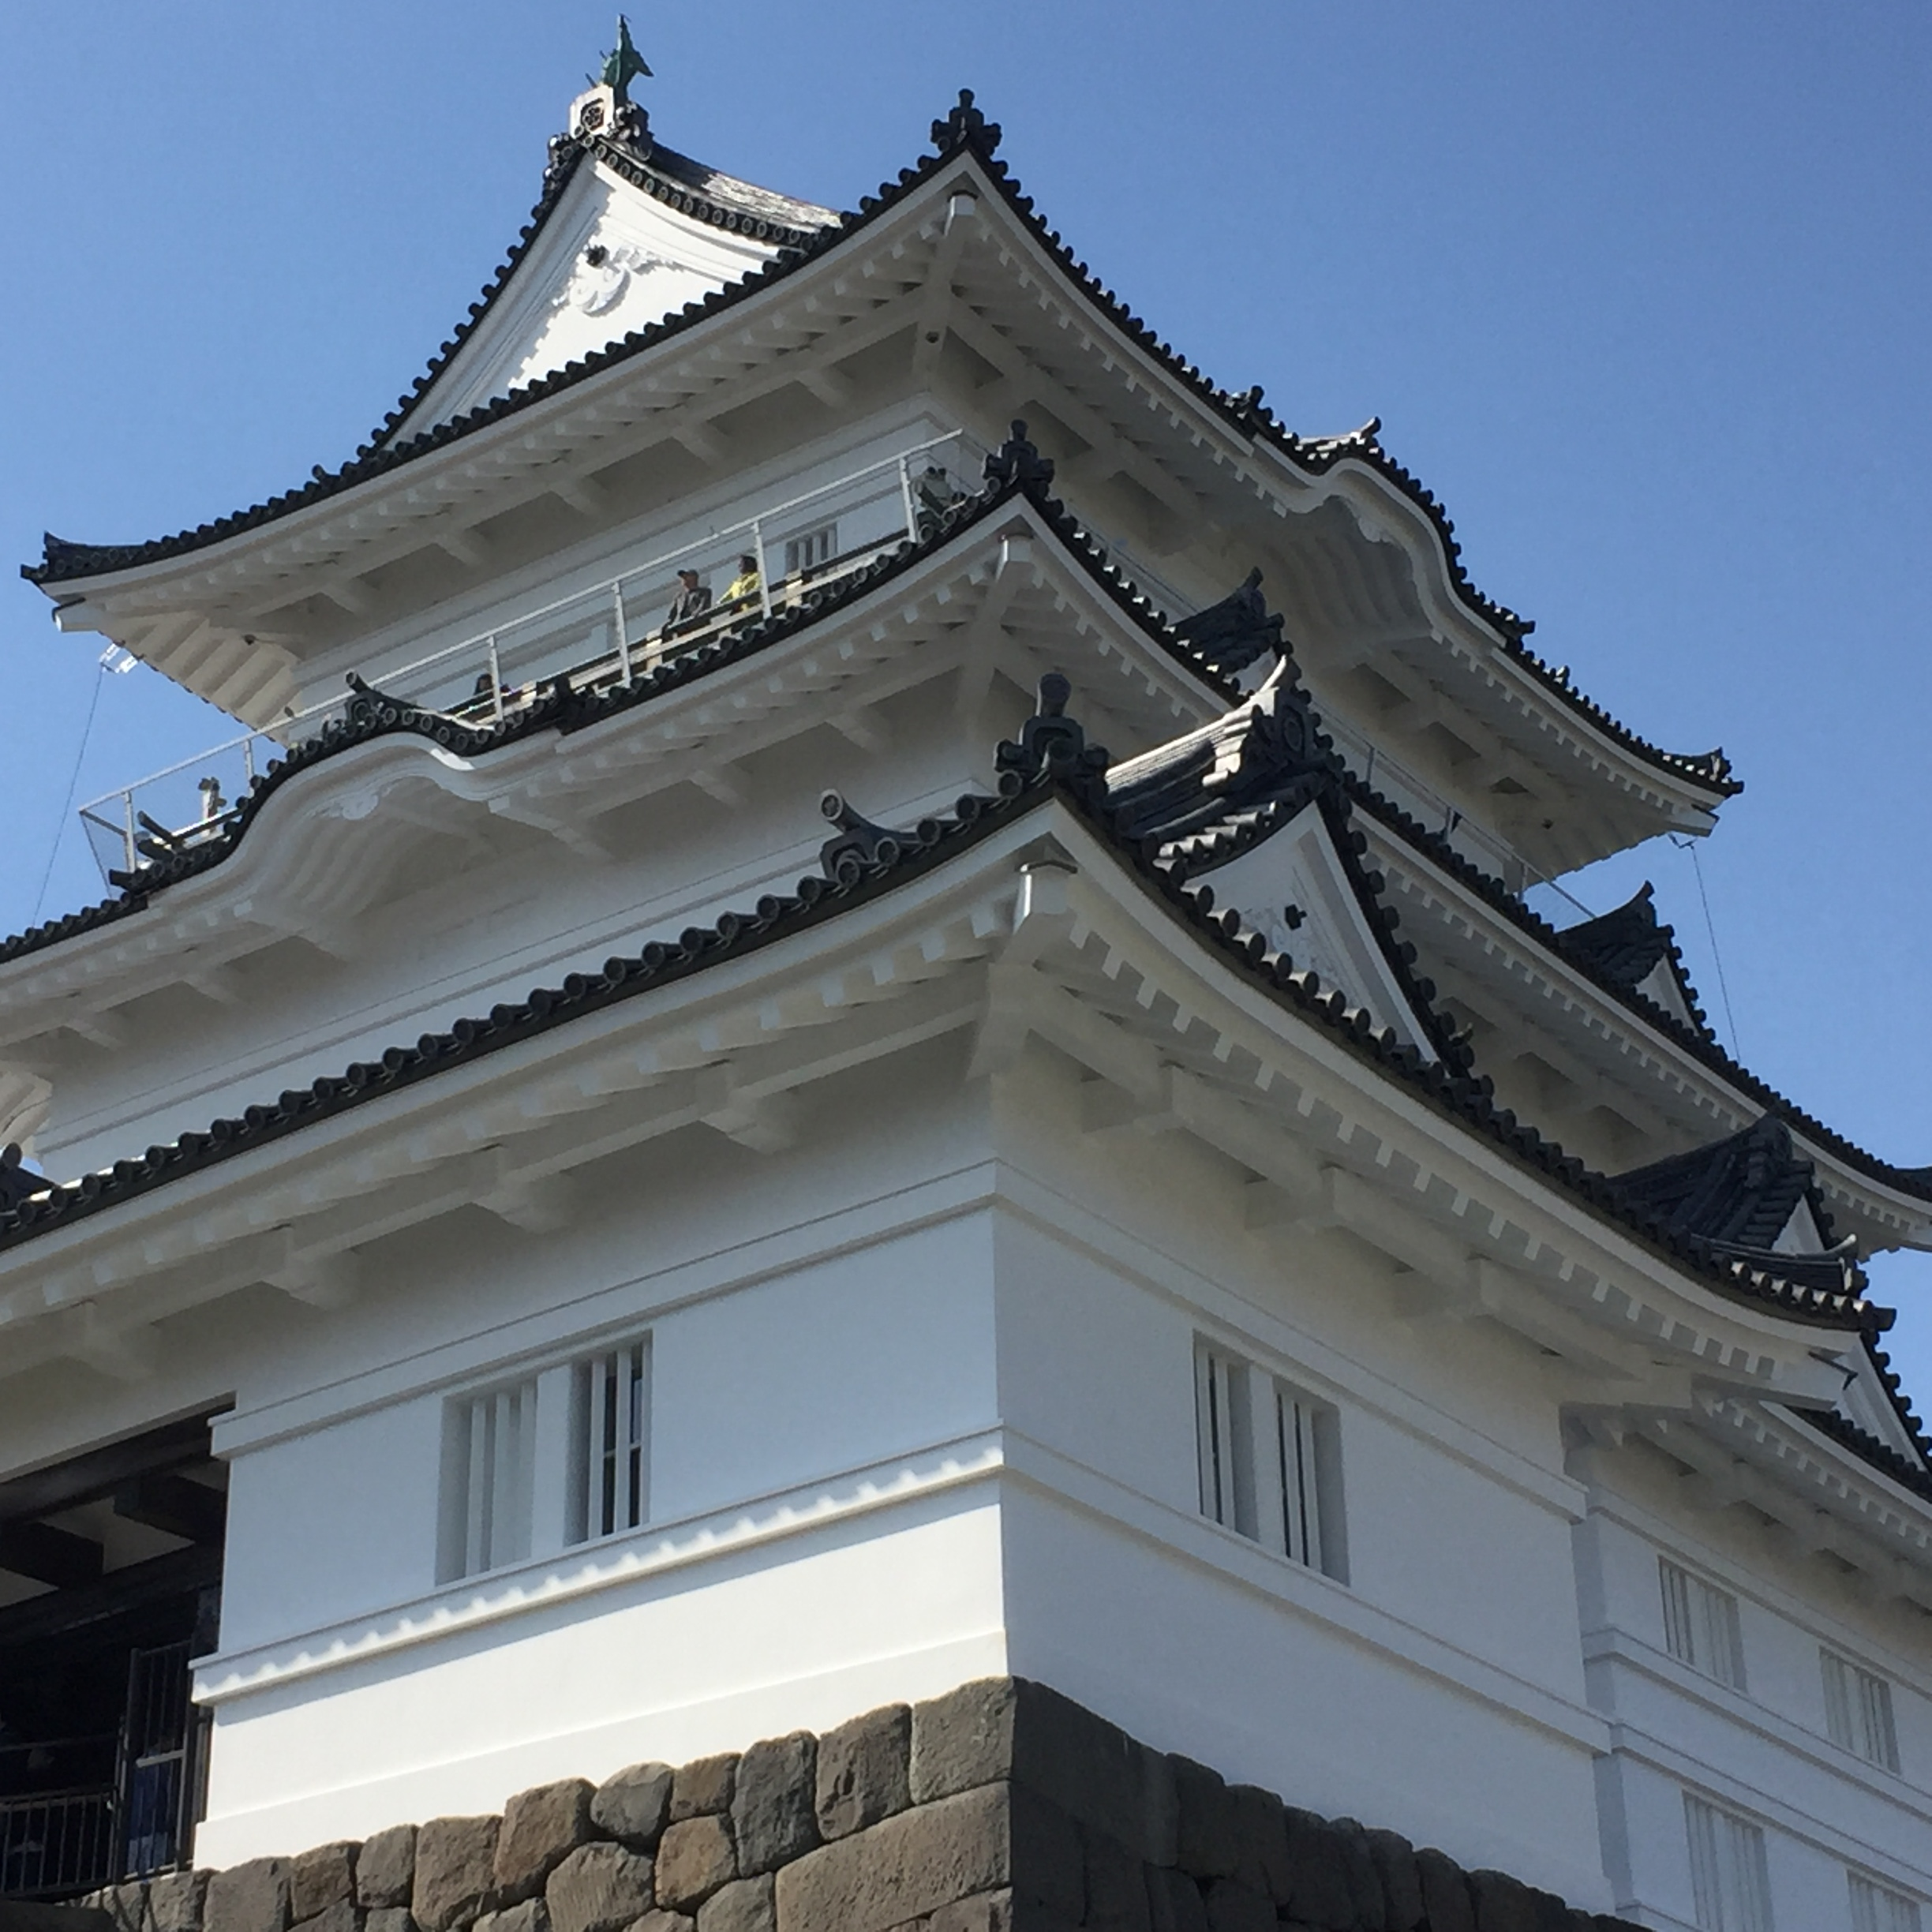

Slide 23
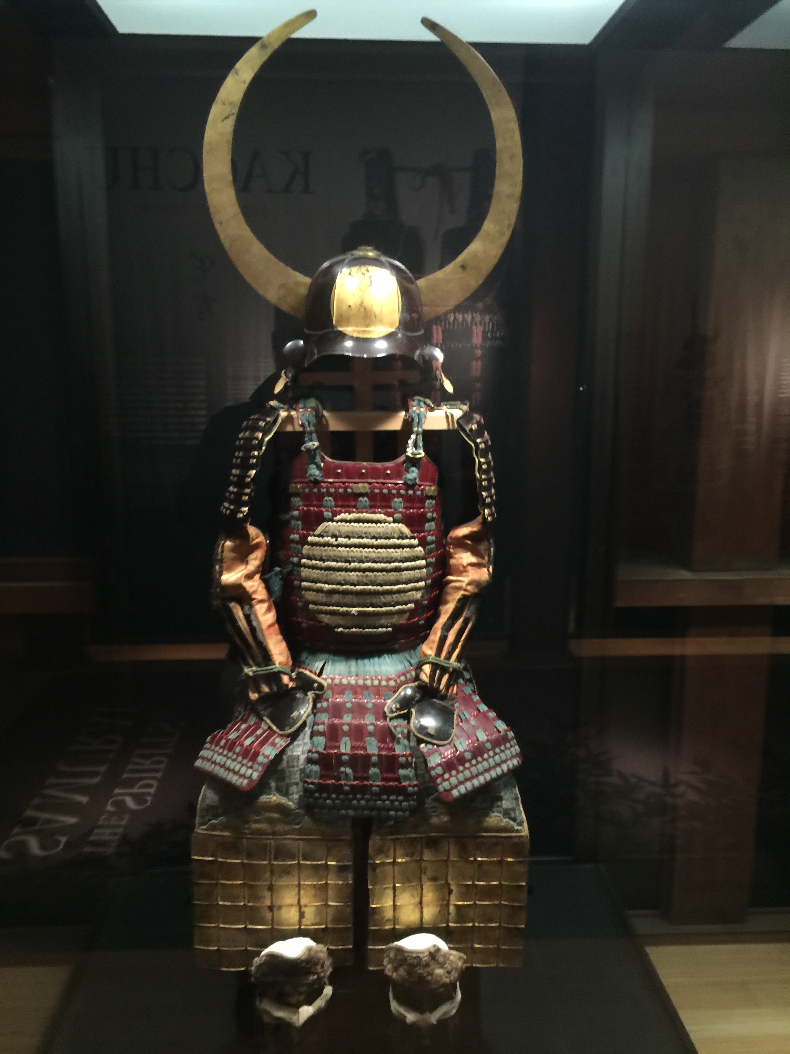
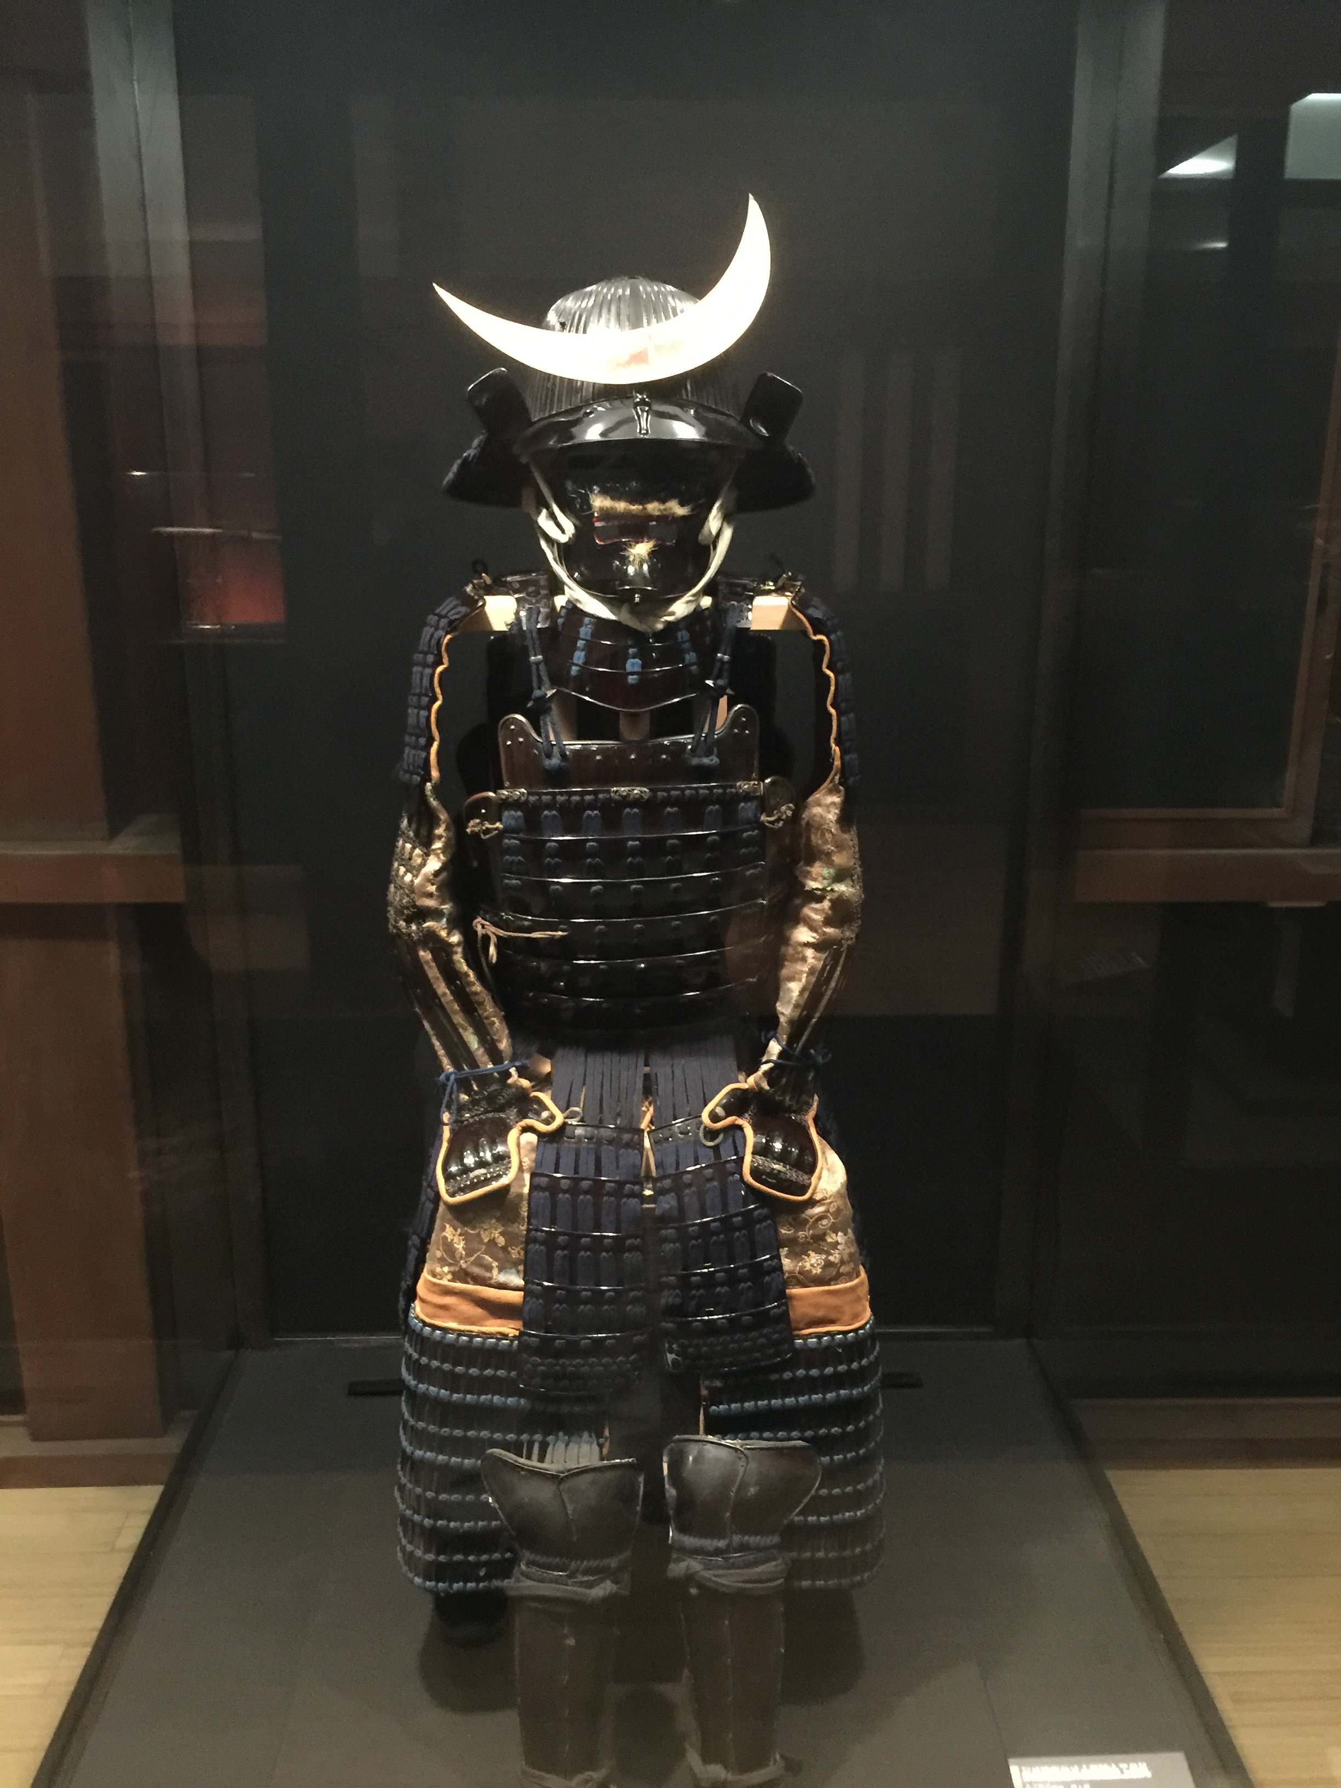

Slide 24


Slide 25
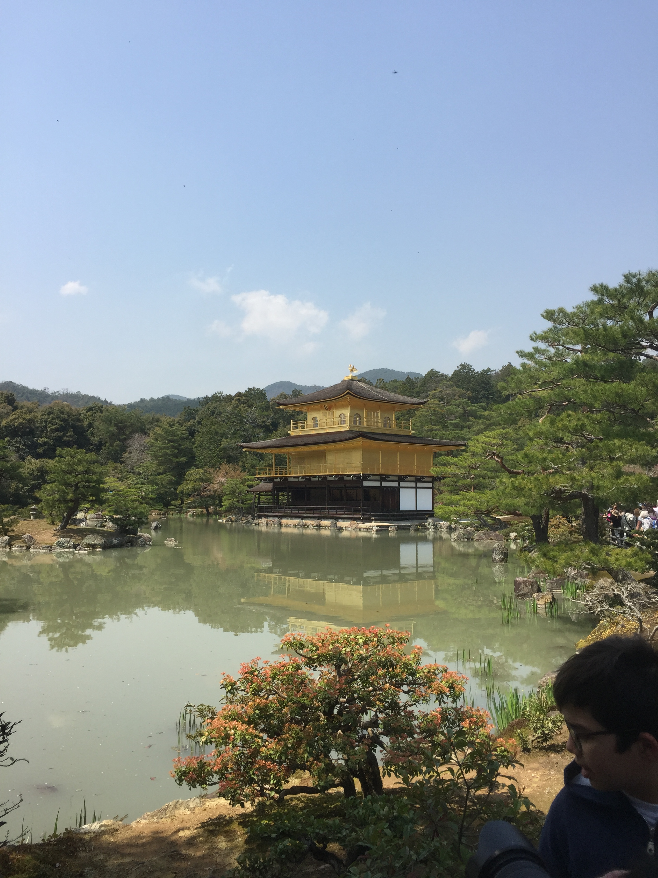

Slide 26
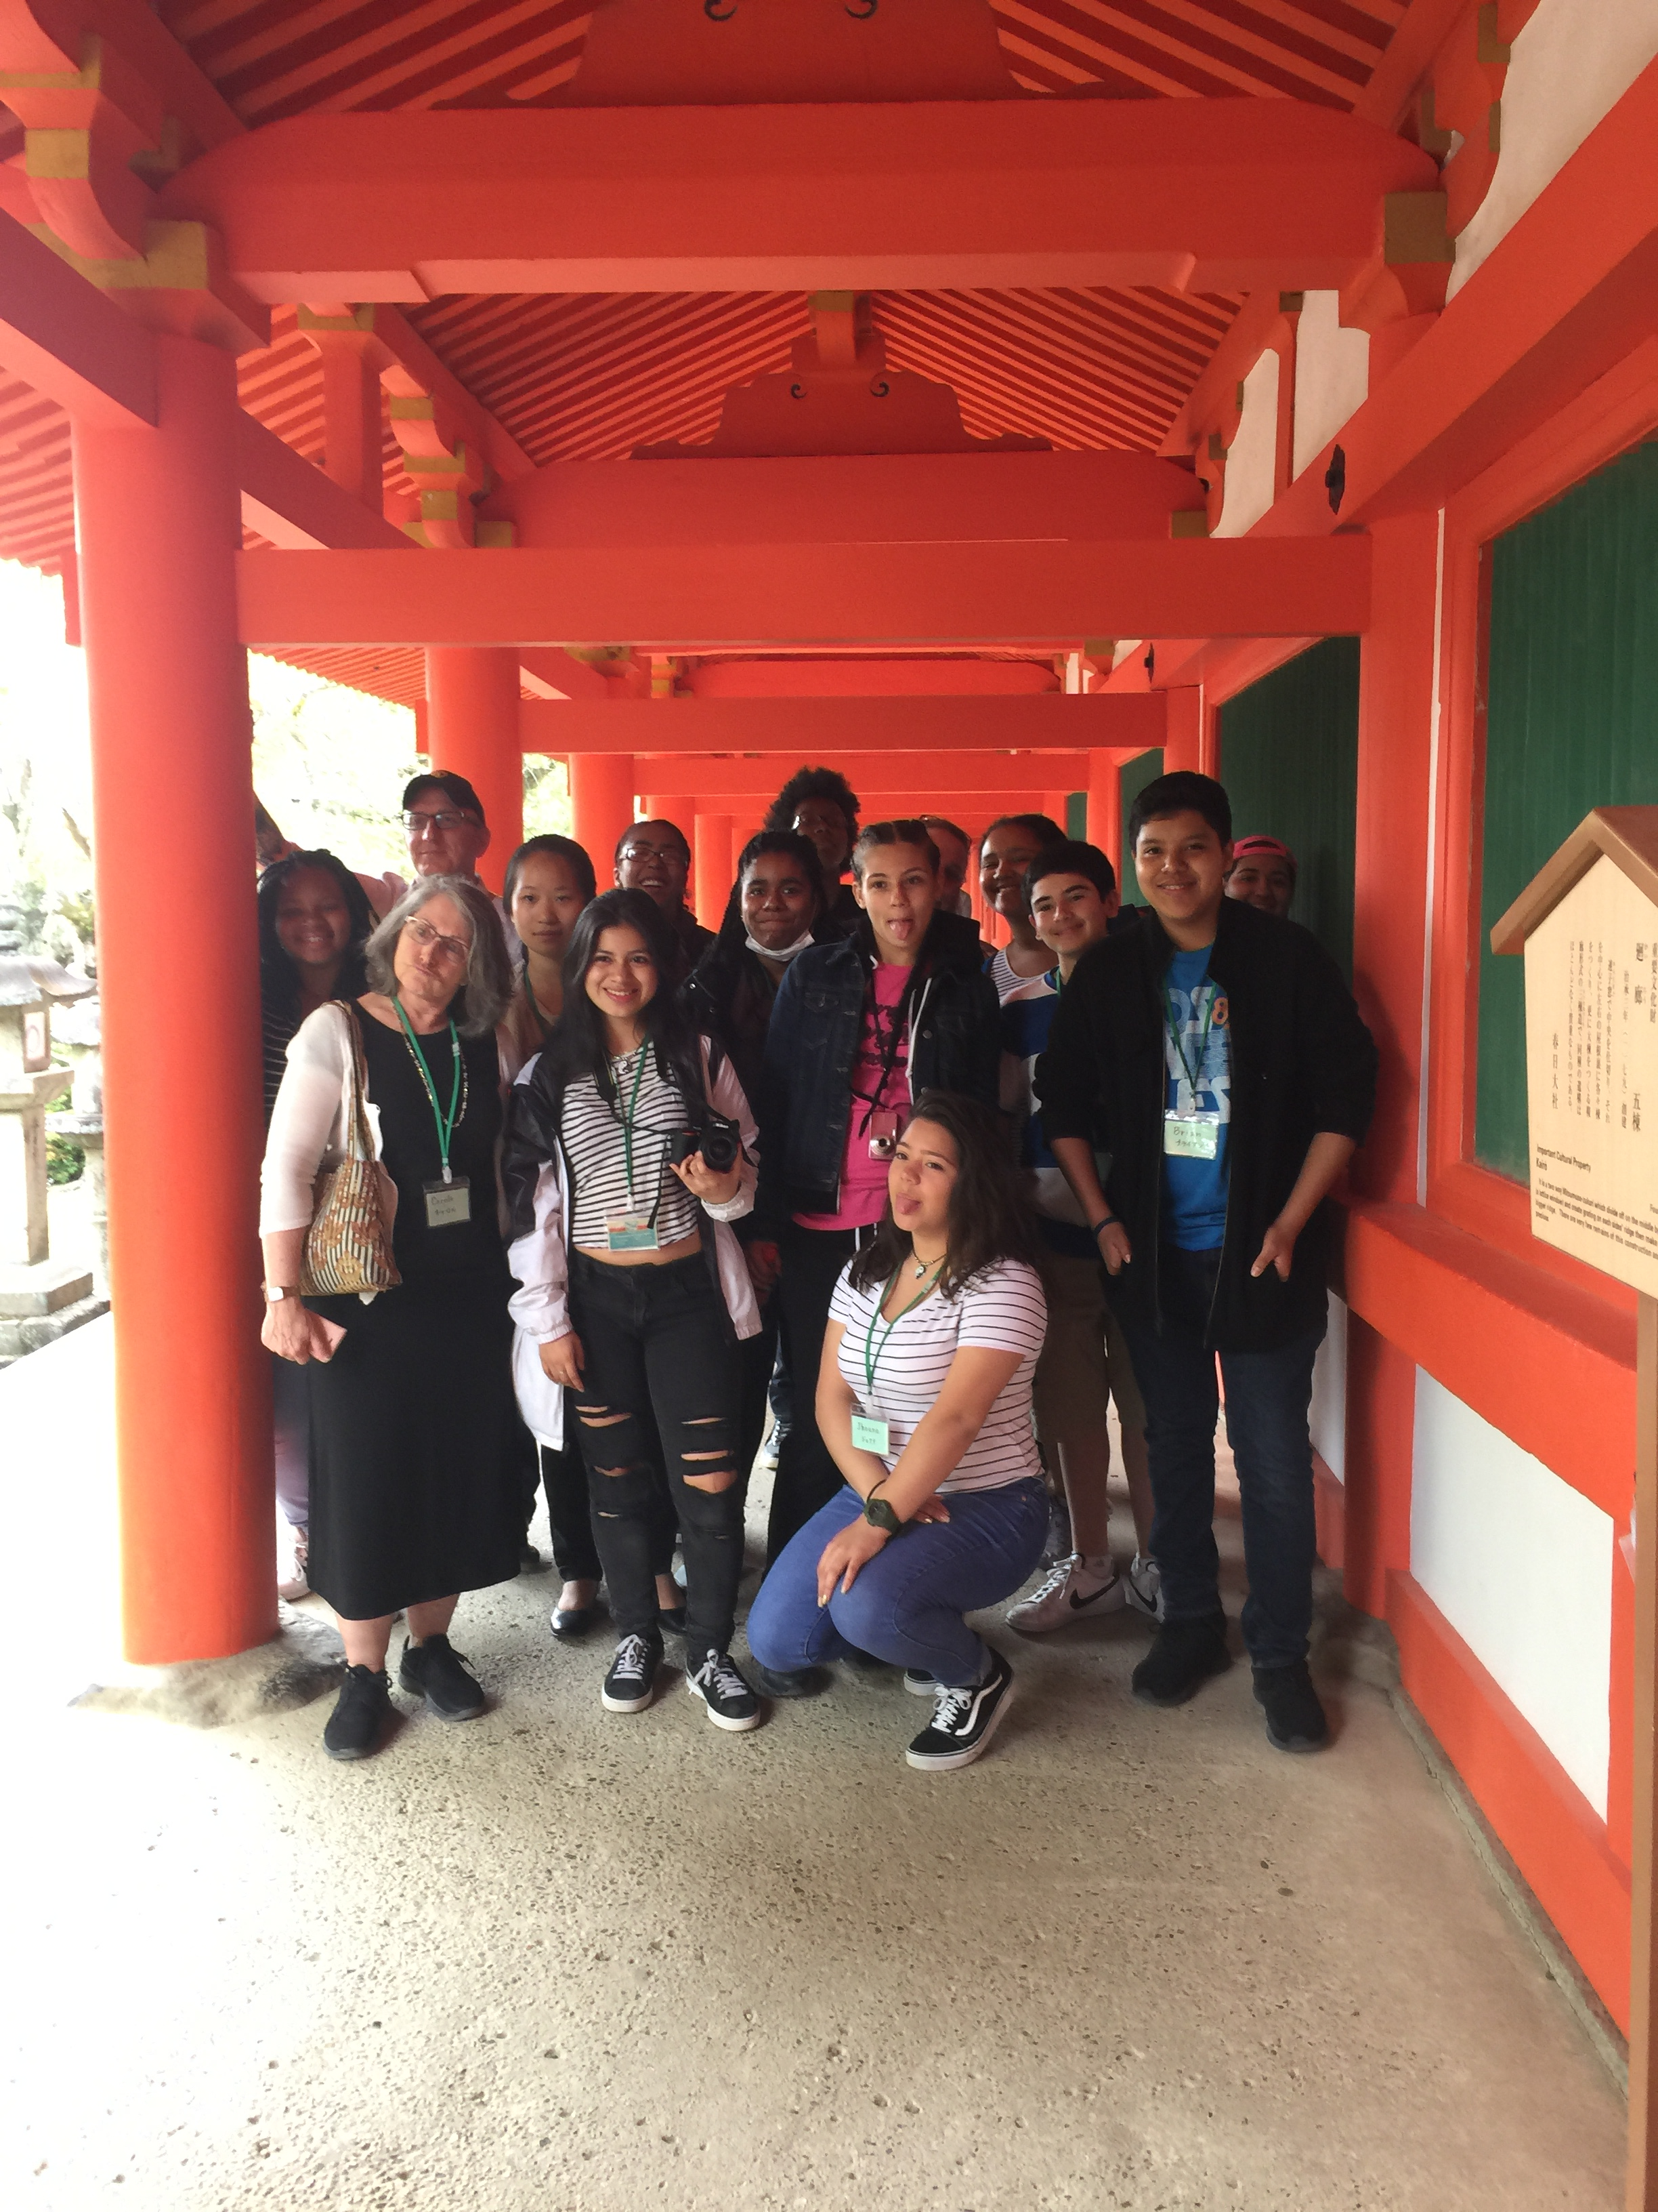
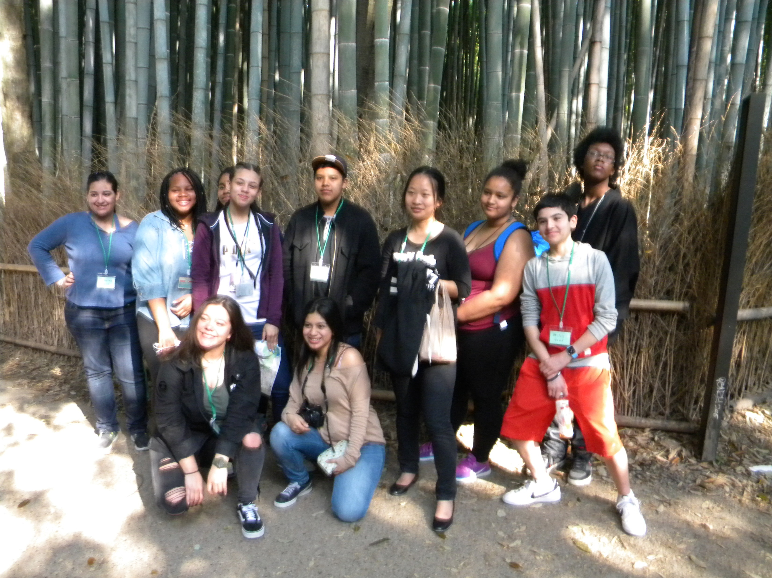

Slide 27
Feudalism Under Tokugawa Shogunate
Feudalism is a social system based on the ownership of land and service to an Emperor or King.
Used in Medieval Europe, and in Traditional Japan.
The Last Shogunate in Japanese History was the Tokugawa.

Slide 28
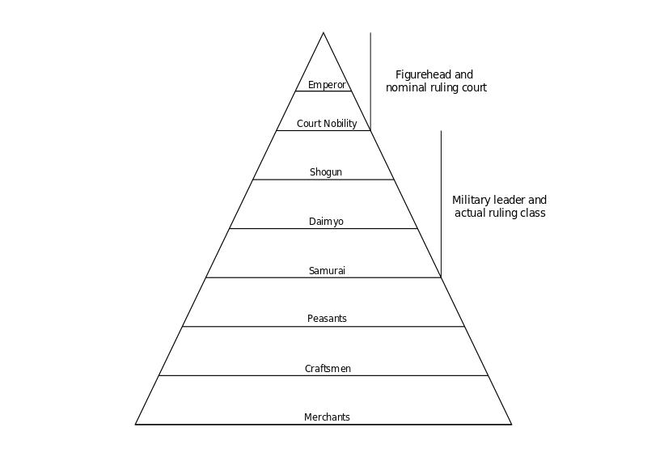
Japanese Feudal System

Slide 29
Tokugawa Japan 1600-1853
Cultural borrowing from China
Emergence of warrior class and increasing civil wars
Encounter with Portuguese-1543
“Isolation” from West; rise of Tokugawas
Tokugawa elite followed development in West (contrast to China’s “hairy barbarian” mentality)

Slide 30
Mughal India 1556-1739
Empire based on military strength
Akbar the Great–-combined beliefs into new religion to unite Hindus and Muslims – religious tolerance
Indian textile trade–value to Europeans
Patron of the arts— Shah Jahan – built Taj Mahal as a mausoleum

Slide 31
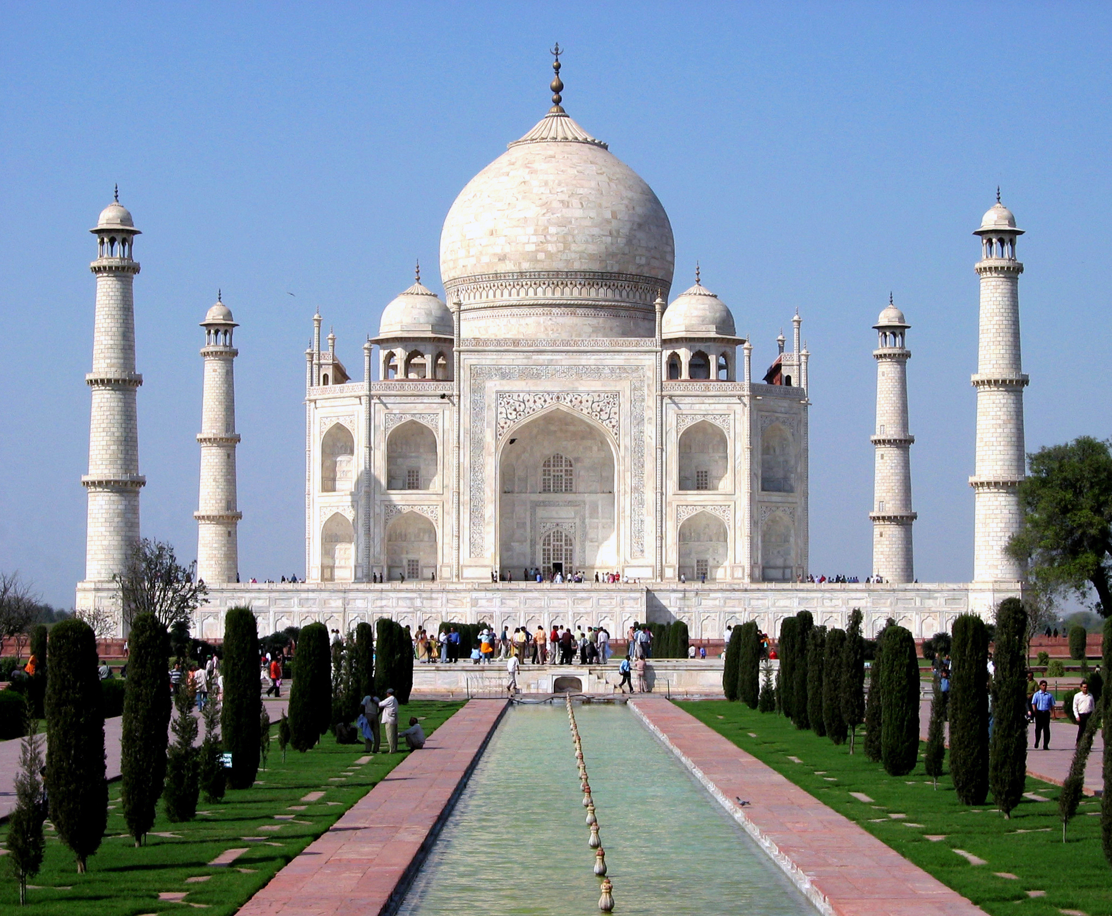

Slide 32
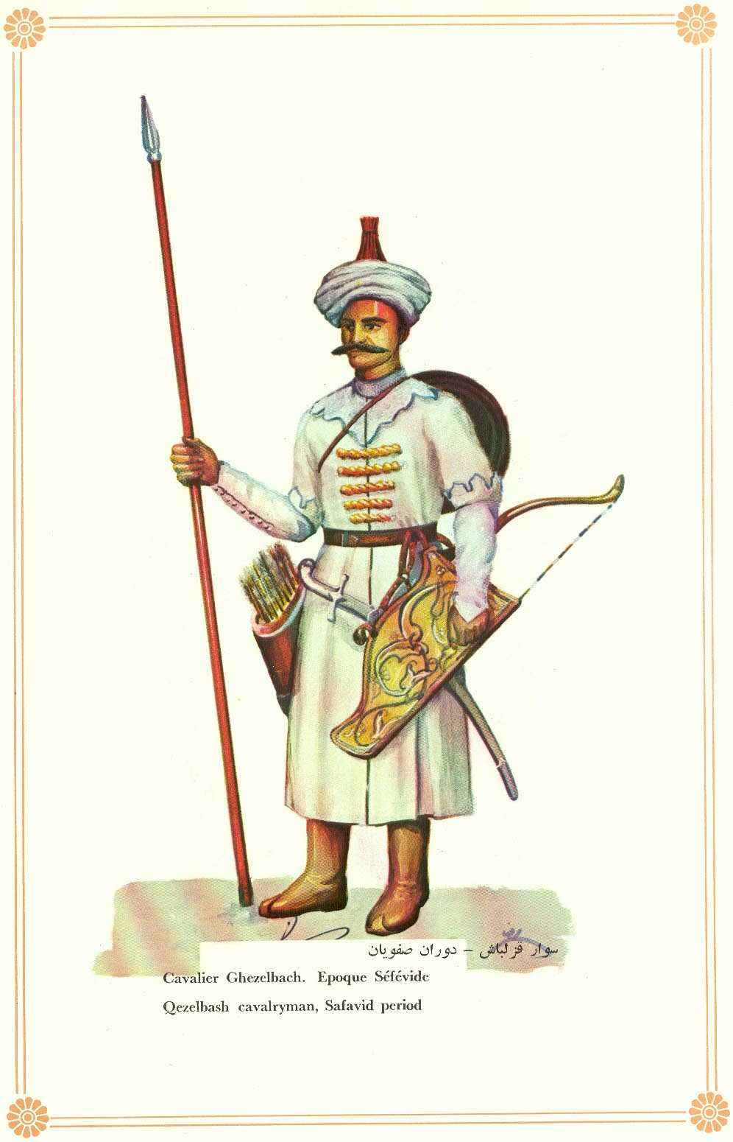
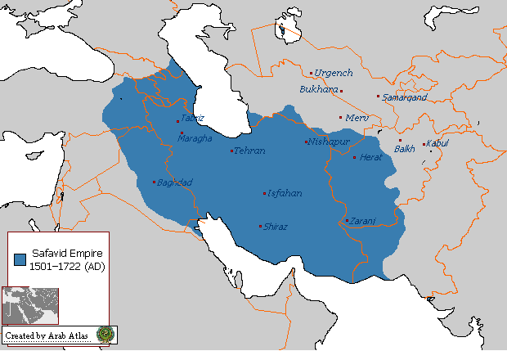
Safavid Persia 1334-1722

Slide 33
Safavid Persia 1334-1722
Considered the most significant ruling dynasty of Persia (Modern day Iran)
Established Shi’a Islam as the official religion of the Middle East.
Created an economic stronghold between Asia and Europe which still exists today.

Slide 34

Empires: Russia
Mongol occupation stalled Russian unification (come together) and development
Mongol rule isolated Russia from European Renaissance
Increasing absolutist rule and territorial expansion by 16th Century – Ivan the Terrible
Peter the Great accelerated the westernization process
Notes:
Connected to Fur Trade….
Empire is expanding East

Slide 35
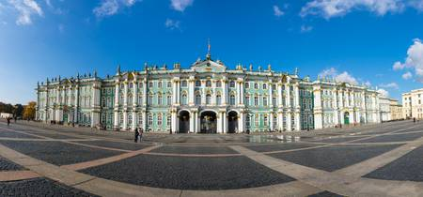
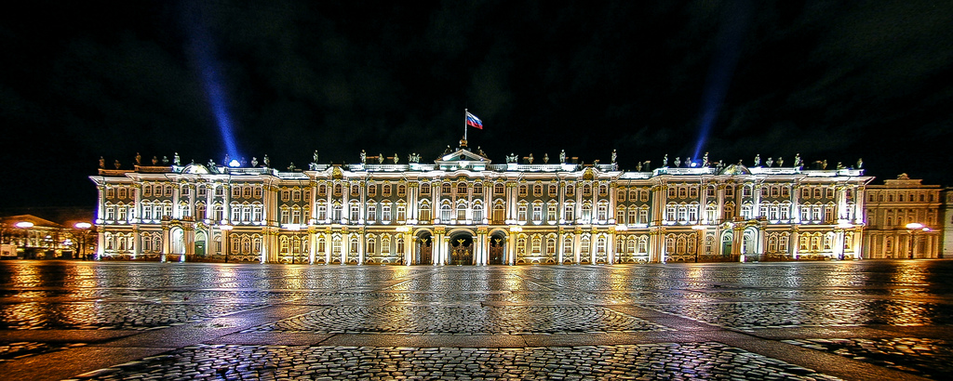

Slide 36
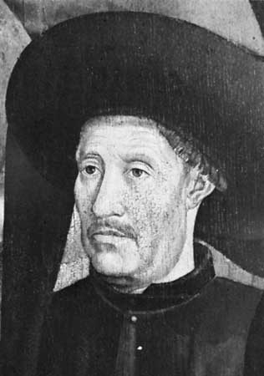
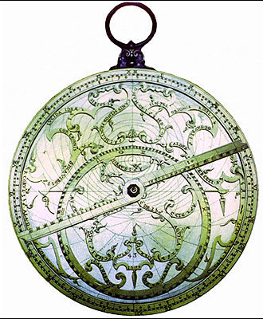
Portugal
Search for all water route to Asia
Prince Henry Naval school
Advanced naval technology: caravels, carracks, astrolabe and compass

Slide 37
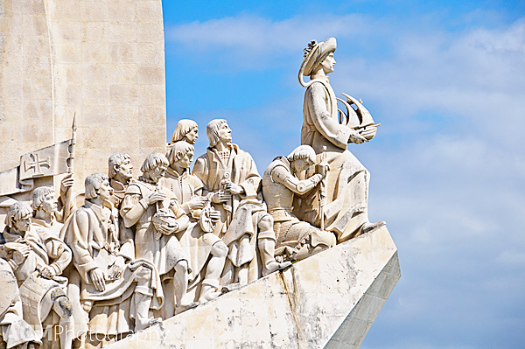

Slide 38
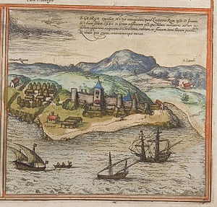
Portugal
Established fortresses along the African Gold Coast – sugar plantations and African slave labor

Slide 39
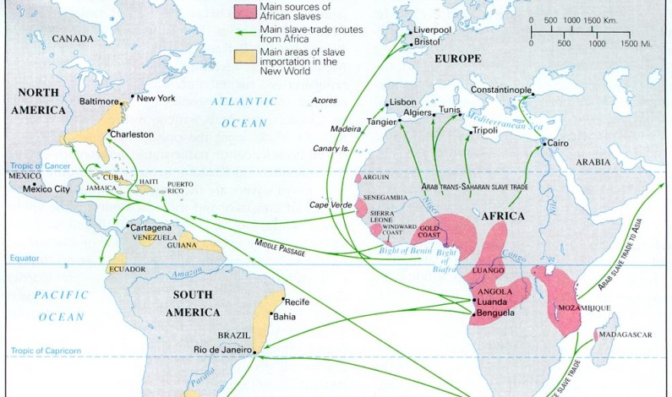
Portugal

Slide 40
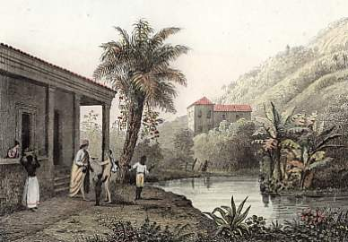
Brazil: Plantation colony
Colonized by
Portuguese
African slave labor used to support plantation complexes (sugar)
Largest producer of sugar in the world during the first half of 17th C.

Slide 41
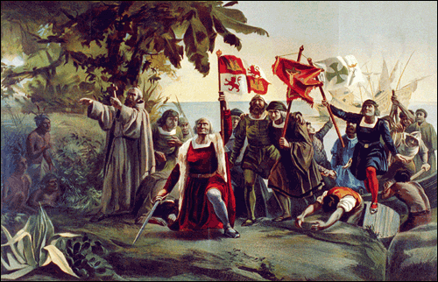
Spain
Spanish Inquisition
Columbus’ voyage
Cortez in Mexico and Pizarro in Peru
Took over existing tributary empires: labor, silver, gold, and foodstuffs.
Demographic impact: disease, death, and mestizos (European and American decent).

Slide 42
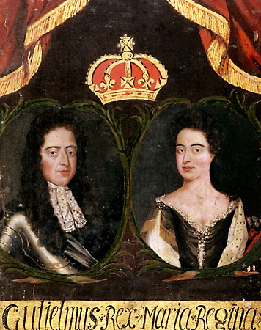
England
Limited/constitutional monarchy
Civil Wars
Commonwealth
Charles II
James II
Glorious Revolution
Bill of Rights
Enlightenment ideas
Colonies in Americas

Slide 43
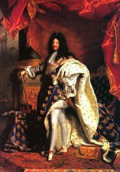
France
Absolute Monarchy
King Louis XIV
“I am the State”
Palace of Versailles
Mercantilism
Territorial expansion in Europe and fur-trading colonies in Saint Domingue (Haiti) and New France (Quebec)

Slide 44
Dutch
Dutch East India Company
1660—employed 12,000 people with 257 ships
Sought monopolies and large profits
North America (fur trade-Hudson River, New Amsterdam)
Caribbean islands for plantations
Capetown, South Africa – weigh station
Southeast Asia – Spice trade (nutmeg, cloves and pepper)

