Slide 1
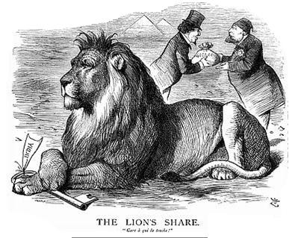
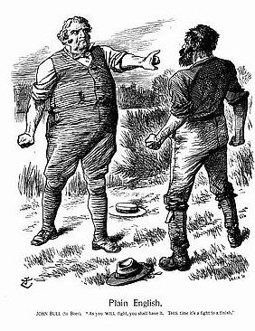
The Scramble for Africa
The Heart of Darkness
AIM: Why did European countries scramble for Africa?
Do Now: What revolution would cause countries to scramble for Africa, any why?

Slide 2
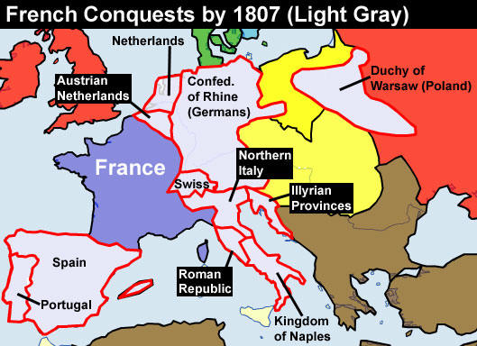

Slide 3
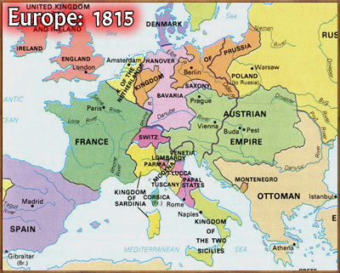

Slide 4
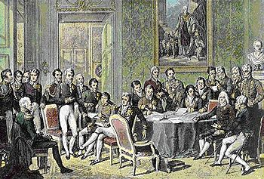
Post-Napoleonic Wars
The major nations in Europe convened to discuss what should happen to France after the fall of Napoleon.
They also convened to discuss what the make up of Europe should be from 1814 forward.
In 1815 a convention was held known as the Congress of Vienna

Slide 5
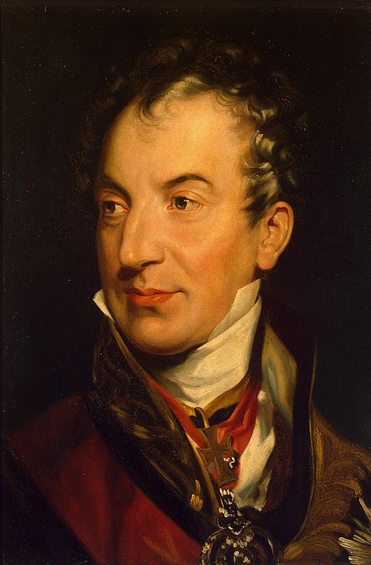
Klemens von Metternich
The goals of the Congress were constructed by Klemens von Metternich, an Austrian diplomat.
He sought to set up changes that would weaken France and ensure that no other country could duplicate the actions of Napoleon

Slide 6
Goals of the Congress of Vienna
These goals became agreements during the Congress of Vienna and would dictate the political landscape of Europe for the 19th Century and beyond.
Balance of power → rules constructed to ensure that no nation becomes stronger militarily than any other nation in Europe, later called the Concert of Europe
Principle of Legitimacy → belief that absolute monarchy was the most stable form of government for European nations, hence the monarchy should be restored where possible. (ex. France)

Slide 7
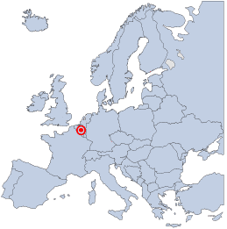
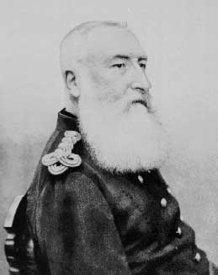
King Leopold II
Belgium

Slide 8
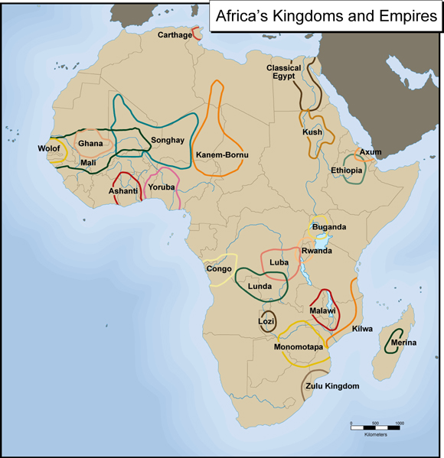

Slide 9
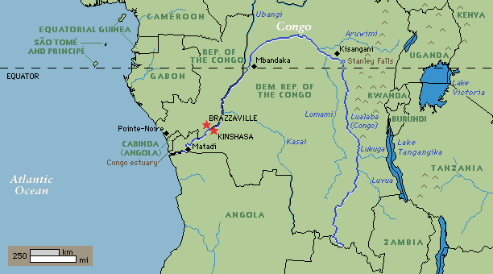
The Congo River
The Congo is the Earth's second largest river by volume and has the world's second largest rainforest (18% of the planet's remaining tropical rainforest). The Congo Basin represents 70% of the African continent's plant cover and makes up a large portion of Africa's biodiversity with over 600 tree species and 10 000 animal species.
Notes:
The Congo is the Earth's second largest river by volume and has the world's second largest rainforest (18% of the planet's remaining tropical rainforest). The Congo Basin represents 70% of the African continent's plant cover and makes up a large portion of Africa's biodiversity with over 600 tree species and 10 000 animal species. Six nations -- Cameroon, the Central African Republic, the Republic of Congo, the Democratic Republic of Congo, Equatorial Guinea and Gabon -- share the 1.5 million square mile Congo basin. The Congo is one of the world's most threatened ecosystems. Commercial logging, clearing for subsistence agriculture, and widespread civil strife has devestated forests, displaced forest dwellers, and resulted in the expansion of the "bushmeat" trade. Since the 1980s, Africa has had the highest deforestation rates of any region on the globe.

Slide 10
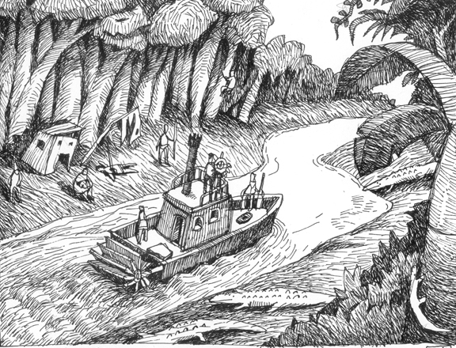
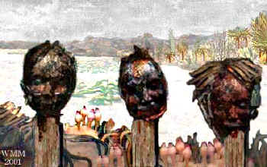
Joseph Conrad's
Heart of
Darkness

Slide 11
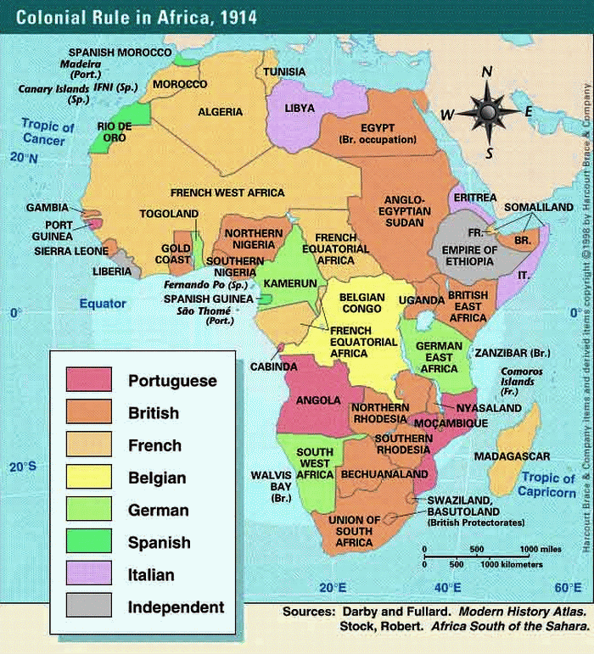
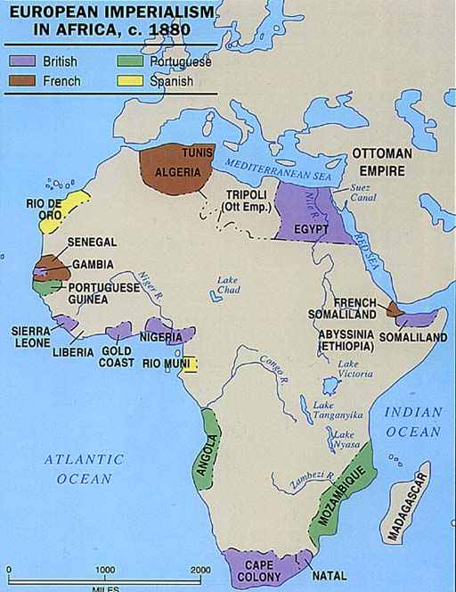
The Dark Continent
16th-18th Centuries, Europeans had looked to Africa for:
Bases to supply their ships sailing to the Far East
Slaves to sell to the New World
By early 19th century, Europeans lost interest in Africa due to:
Advent of the steamship (lessened the need for African supply bases)
Outlaw of the slave trade
Until the Middle/Late 19th century, Africa’s seemingly inhospitable (very rugged/harsh ) interior discouraged exploration.

Slide 12
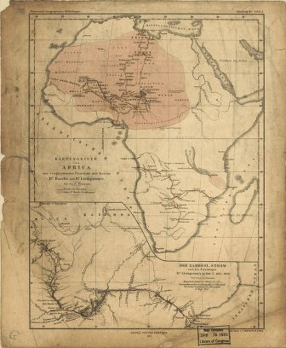
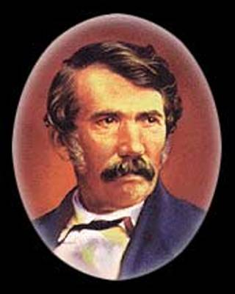
The "New" Age of Imperialism
David Livingstone: Missionary, and doctor; spent 33 years exploring the interior lands of Africa
Notes:
With a penchant for languages, medical training, and a high tolerance for the discomforts of nineteenth century travel, David Livingstone was a uniquely well-equipped explorer.
Livingstone was born in Blantyre, Scotland on March 19, 1813. He began earning a living at an early age, and his religious faith drew him to a career as a missionary. As it turned out, his achievements in exploration would surpass his missionary successes.
Moved by a friend, Robert Moffat, who told him, "I have sometimes seen, in the morning sun, the smoke of a thousand villages, where no missionary has ever been," Livingstone trained at the London Missionary Society, and specialized in medicine. His first trip to South Africa began in December of 1840. That was not the only influence Moffat would have on his life; Livingstone married Moffat's daughter, Mary, in 1844.
Although popular among native tribes in Africa, Livingstone made enemies of some white settlers there because he learned African languages and had an unusually keen understanding and sympathy for native people and cultures. In 1843, while settling the Mabotsa valley, Livingstone shot a lion. Before it died, however, the lion attacked Livingstone, costing him the use of his left arm.
Livingstone's travels in Africa made him the first white man to see Victoria Falls, and also an esteemed visitor among the natives. According to one biographer, the Scotsman added about one million square miles to the known portion of the globe. Livingstone received a gold medal from the London Royal Geographical for being the first to cross the entire African Continent from west to east.
Remembered as an explorer, Livingstone is still more distinguished for his humanity. At a time when slavery was taken for granted, he condemned the slave trade, alerting his fellow countrymen to the issue.
While he was away in darkest Africa, at home, Livingstone was considered lost and possibly dead. Henry Morton Stanley, a staff reporter for The New York Herald, was sent to look for the explorer. It took Stanley just over a year to find Livingstone, and his comically understated words upon meeting the explorer, "Dr Livingstone, I presume?" are now familiar to everyone.
Livingstone had been in poor health for months before his death in May of 1873. His crew had gone away to get supplies, and came back to find him in a kneeling position, apparently praying when he died. Susi and Chuma, two of his companions, embalmed Livingstone's body and carried it for five months to Unyanyembe, believing their master would want to be buried in England.
Today, visitors to Zambia can see a memorial to Livingstone where his heart was buried beneath a tree. Interested travelers are escorted to the site by the present Chief Chitambo, whose great-grandfather received Dr. Livingstone on his deathbed.

Slide 13
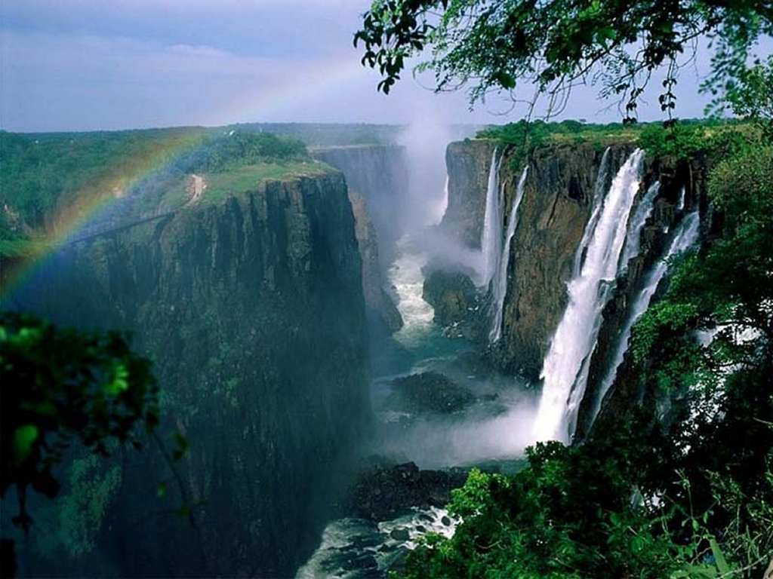
Notes:
Falls of Shongwe
Victoria Falls

Slide 14
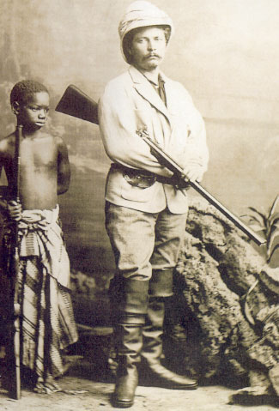
Henry M. Stanley
Dr. Livingston, WHERE ARE YOU?
Welsh-born journalist; sent out to “find” Livingstone.
Lavishly funded by the “New York Herald; secret expedition

Slide 15
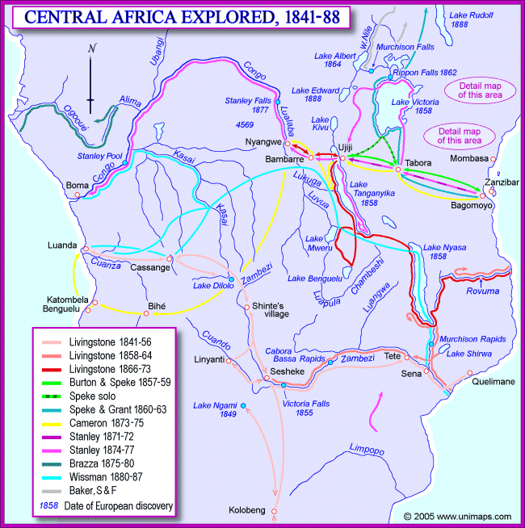

Slide 16
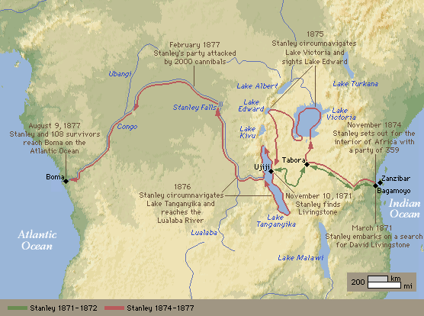
Notes:
I would have run to him, only I was a coward in the presence of such a mob--would have embraced him, but that I did not know how he would receive me; so I did what moral cowardice and false pride suggested was the best thing--walked deliberately to him, took off my hat, and said: "DR. LIVINGSTONE, I PRESUME?" "Yes," said he, with a kind, cordial smile, lifting his cap slightly. (from How I Found Livingstone)

Slide 17
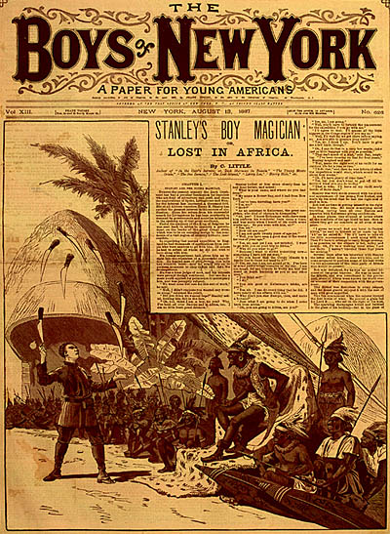
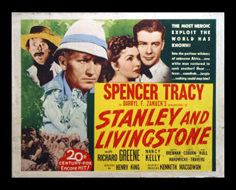
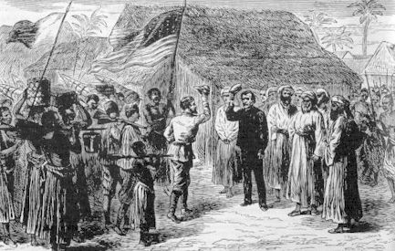
YES
Dr. Livingston,
I PRESUME
Notes:
David Livingstone, the Scottish missionary who set out to find the source of the Nile, was among the explorers who attempted to penetrate the continent's vast, uncharted territories. The journalist Henry Morton Stanley, charged by the New York Herald to find Livingstone, located the great explorer near Lake Tanganyika in 1871. Stanley led a number of expeditions after Livingstone's death in 1873; the last took place during 1887-89 and helped bring Uganda firmly under British influence. The story "Stanley's Boy Magician" appeared in Boys of New York in August 1887, at the time of Stanley's last African journey. The story recounts how Robert Ray, a precocious, young magician from New York, accompanied Stanley to Africa and was captured. Taken before Zambesi, a great African chief, the young Ray performs a skillful sleight of hand, juggling a handful of deadly knives as the chief and his tribesmen look on attentively.
Though he had been ill and without supplies when Stanley found him, Livingstone expected his researches in the Nile basin to take a further two years, and declined to return with his rescuer. Just over a year later, in April 1872, still pushing onwards, he was dead from dysentery. Remarkably, his African servants embalmed the body and carried it, with his journals and other effects, through hostile territory for a journey of over a thousand miles, down to the British consul at the coast. It took them nine months. He was buried as a national hero in Westminster Abbey, early in 1874.

Slide 18
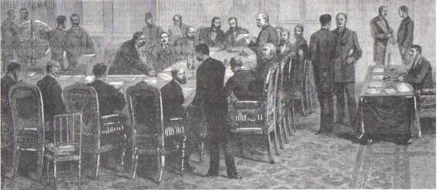
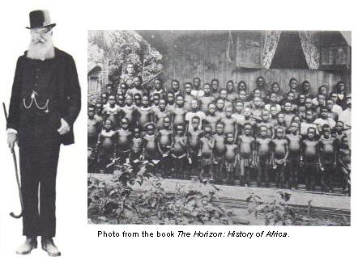
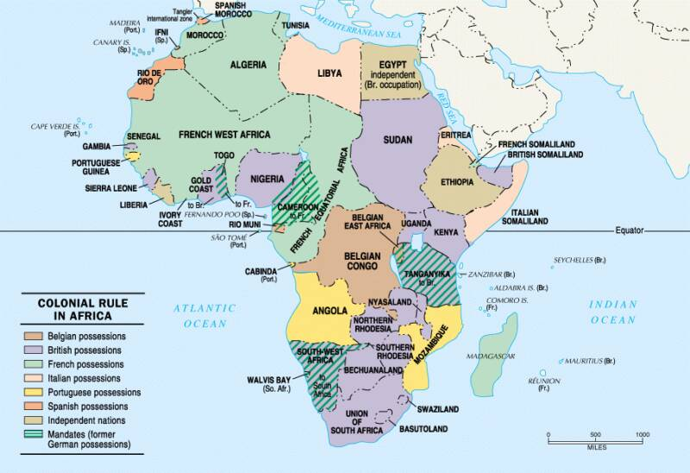
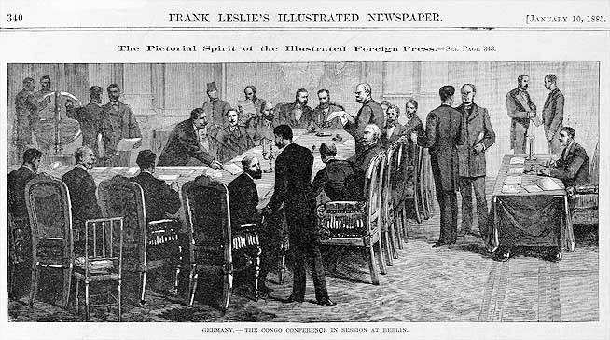
The Scramble for Africa: Berlin Conference of 1884-1885 to Divide Africa
Meeting at the Berlin residence of Chancellor Otto von Bismarck in 1884, the foreign ministers of fourteen European powers and the United States established ground rules for the future exploitation of the "dark continent." Africans were not invited or made privy to their decisions.
Photo from the book The Horizon: History of Africa, American Heritage Publishing Co., New York, 1971, page 452.
Result of Colonization:
The European colonial powers shared one objective in their African colonies; exploitation. But in the way they governed their dependencies, they reflected their differences. Some colonial powers were themselves democracies (the United Kingdom and France); others were dictatorships (Portugal, Spain). The British established a system of indirect rule over much of their domain, leaving indigenous power structure in place and making local rulers representatives of the British Crown. This was unthinkable in the Portuguese colonies, where harsh, direct control was the rule. The French sought to create culturally assimilated elites what would represent French ideals in the colonies. In the Belgian Congo, however, King Leopold II, who had financed the expeditions that staked Belgium's claim in Berlin, embarked on a campaign of ruthless exploitation. His enforcers mobilized almost the entire Congolese populations to gather rubber, kill elephants for their ivory, and build public works to improve export routes. For failing to meet production quotes, entire communities were massacred. Killing and maiming became routine in a colony in which horror was the only common denominator. After the impact of the slave trade, King Leopold's reign of terror was Africa's most severe demographic disaster. By the time it ended, after a growing outcry around the world, as many as 10 million Congolese had been murdered. In 1908 the Belgium government administrators, and the Roman Catholic Church each pursued their sometimes competing interest. But no one thought to change the name of the colonial capital: it was Leopoldville until the Belgian Congo achieved independence in 1960.
The following material is from the book Geography: Realms, Regions and Concepts, by H. J. de Blij, Peter O. Muller, 2003
1884-1885 - Berlin West African Conference carves Africa into spheres of control
In the second half of the nineteenth century, after more than four centuries of contact, the European powers finally laid claim to virtually all of Africa. Parts of the continent had been "explored," but now representatives of European governments and rulers arrived to create or expand African spheres of influence for their patrons. Competition was intense. Spheres of influence began to crowd each other. It was time for negotiation, and in late 1884 a conference was convened in Berlin to sort things out. This conference laid the groundwork for the now familiar politico-geographical map of Africa.
In November 1884, the imperial chancellor and architect of the German Empire, Otto von Bismarck, convened a conference of
14 states (including the United States) to settle the political partitioning of Africa. Bismarck wanted not only to expand German spheres of influence in Africa but also to play off Germany's colonial rivals against one another to the Germans' advantage. Of these fourteen nations, France, Germany, Great Britain, and Portugal were the major players in the conference, controlling most of colonial Africa at the time.
The Berlin Conference was Africa's undoing in more ways than one. The colonial powers superimposed their domains on the African Continent. By the time Africa regained its independence after the late 1950s, the realm had acquired a legacy of political fragmentation that could neither be eliminated nor made to operate satisfactorily. The African politico-geographical map is thus a permanent liability that resulted from the three months of ignorant, greedy acquisitiveness during a period when Europe's search for minerals and markets had become insatiable.
The French dominated most of West Africa, and the British East and Southern Africa. The Belgians acquired the vast territory that became The Congo. The Germans held four colonies, one in each of the realm's regions. The Portuguese held a small colony in West Africa and two large ones in Southern Africa.
The Congo Free State, conceived as a "neutral" zone to be run by an international association in the interest of bringing science, civilization, and Christianity to the indigenes, received the Berlin Conference's blessings. Belgium's King Leopold II (far left) soon took control, reaping fabulous personal profits through the sale of land and development rights. Scandalously little was reinvested in schools like the one shown here.
BBC News site:
A man who exploited Congo's resources and contributed to up to 10 million deaths.
One man told the BBC: "He left us in poverty. He exploited our raw materials and left us with nothing."
Leopold's Legacy of Violence
References:
The Berlin Conference
1884-1885
Notes:
"The Berlin Conference was Africa's undoing in more ways than one. The colonial powers superimposed their domains on the African continent. By the time independence returned to Africa in 1950, the realm had acquired a legacy of political fragmentation that could neither be eliminated nor made to operate satisfactorily."* In 1884 at the request of Portugal, German chancellor Otto von Bismark called together the major western powers of the world to negotiate questions and end confusion over the control of Africa. Bismark appreciated the opportunity to expand Germany's sphere of influence over Africa and desired to force Germany's rivals to struggle with one another for territory.
At the time of the conference, 80% of Africa remained under traditional and local control. What ultimately resulted was a hodgepodge of geometric boundaries that divided Africa into fifty irregular countries. This new map of the continent was superimposed over the one thousand indigenous cultures and regions of Africa. The new countries lacked rhyme or reason and divided coherent groups of people and merged together disparate groups who really did not get along.
Fourteen countries were represented by a plethora of ambassadors when the conference opened in Berlin on November 15, 1884. The countries represented at the time included Austria-Hungary, Belgium, Denmark, France, Germany, Great Britain, Italy, the Netherlands, Portugal, Russia, Spain, Sweden-Norway (unified from 1814-1905), Turkey, and the United States of America. Of these fourteen nations, France, Germany, Great Britain, and Portugal were the major players in the conference, controlling most of colonial Africa at the time.
The initial task of the conference was to agree that the Congo River and Niger River mouths and basins would be considered neutral and open to trade. Despite its neutrality, part of the Congo Basin became a personal kingdom for Belgium's King Leopold II and under his rule, over half of the region's population died.
At the time of the conference, only the coastal areas of Africa were colonized by the European powers. At the Berlin Conference the European colonial powers scrambled to gain control over the interior of the continent. The conference lasted until February 26, 1885 - a three month period where colonial powers haggled over geometric boundaries in the interior of the continent, disregarding the cultural and linguistic boundaries already established by the indigenous African population.
Following the conference, the give and take continued. By 1914, the conference participants had fully divided Africa among themselves into fifty countries.

Slide 19
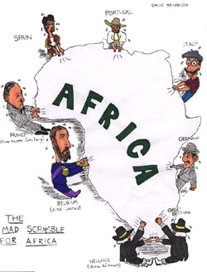
The Scramble for Africa
The exploration and reports by Livingstone and Stanley spark renewed interest in Africa
Groups interested in Africa:
Business leaders saw economic opportunities;
Missionaries wanted to convert Africans to Christianity
Nationalists dreamed of empire building
Notes:
It was not until after the mid-nineteenth century that the imperialist great powers of Europe showed renewed interest in the continent of Africa, particularly in the hitherto unexplored central regions comprising modern-day Zaire, Zambia and Zimbabwe. This interest was heightened by the expected opportunities for raw materials and investment that these territories could provide for Europe's continuing industrialization. There was competition, of course, among the powers as they eyed the opportunities and set the stage for intrusion. Much interest was concentrated on the Congo region (modern Zaire) upon which King Leopold II of Belgium had set his sights (it later turned out to be a lucrative source of rubber). However, the old colonial nation of Portugal, with African interests in Angola and Mozambique extending back over three centuries, also saw the Congo region as its historical sphere of influence. International rivalry and diplomatic infighting such as developed out of this competition for influence prompted France and Germany to suggest the notion of a European conference to resolve contending claims and provide for a more orderly ‘carving up’ of the continent. The Conference met at Berlin from November 1884 through Februart 1885 and resulted in the following agreement--The Berlin Act of 1885. It was attended by representatives of Great Britain, Austria-Hungary, France, Germany, Russia, U.S.A., Portugal, Denmark, Spain, Italy, the Netherlands, Sweden, Belgium and Turkey. The Act allotted "spheres of influence" to the relevant powers and established the Congo basin as the Congo Free State under the sovereignty of Leopold II in his personal capacity as head (and chief financial backer) of the private International Congo Association. Some of the main provisions of the Act are as follows; note in particular the doctrine of "effective occupation" as prescribed in Art. XXXV.

Slide 21
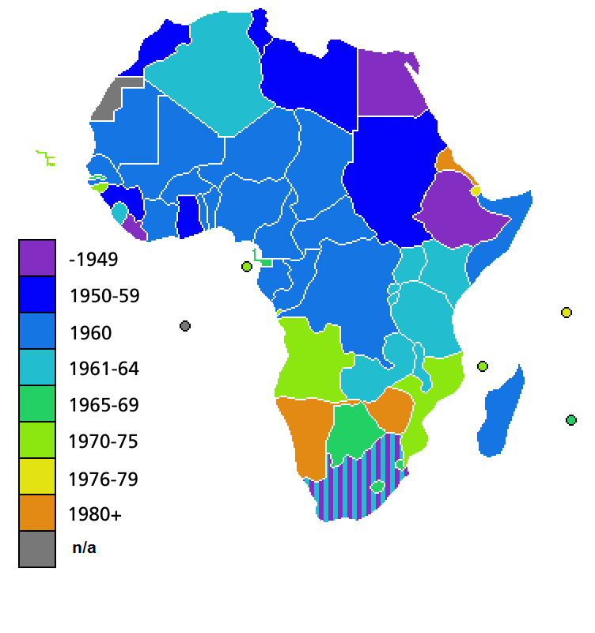
African Independence
The decolonization of Africa started with Libya in 1951. (Although Liberia, South Africa, Egypt and Ethiopia were already independent.) Many countries followed in the 1950s and 1960s, with a peak in 1960 with independence of a large part of French West Africa. Most of the remaining countries gained independence throughout the 1960s, although some colonizers (Portugal in particular) were reluctant to relinquish sovereignty, resulting in bitter wars of independence which lasted for a decade or more.
Independence after WWII in 1945.

Slide 22
Effects of Imperialism on Africa
Introduction of European medicine and improved nutrition led to an expansion of population (Positive Effect)
A divided Africa and ignored the tribal, ethnic, and cultural boundaries of the African people. This has led to tribal conflicts even today. (Negative Effect)
African peoples were treated as inferior to Europeans (Negative Effect)
Introduction of modern transportation and communication systems, such as telegraphs, railroads, and telephones (Positive Effect)

Slide 23
Review Questions
On a separate piece of paper. Please answer the questions below in paragraph form.
What was the “Scramble for Africa”?
What Turning Point in History caused the Scramble for Africa?
Why did the Berlin Conference occur?
What European nations gained control of Africa?
What were the positive effects of European imperialism on Africa?
What were the negative effects of European imperialism on Africa?
Evaluate (take a position) whether the Scramble for Africa was Positive or Negative?

