Slide 1
THE
SCIENTIFIC
REVOLUTION
ON THE SHOULDERS OF GIANTS

Slide 2
CAUSES of the Scientific Revolution:
Renaissance scholars & artists
    Hermeticism
    Neoplatonism
    Rediscovery of Ancient Greek mathematical texts
Transformation of universities included the study of “natural philosophy”
Navigational needs during the Age of Exploration
Articulation of Scientific Method
The spread of Protestantism
TWO factors for the spread of the new science
    Adopted by literate mercantile & propertied elites
    Political interests used it to bolster stability

Slide 3
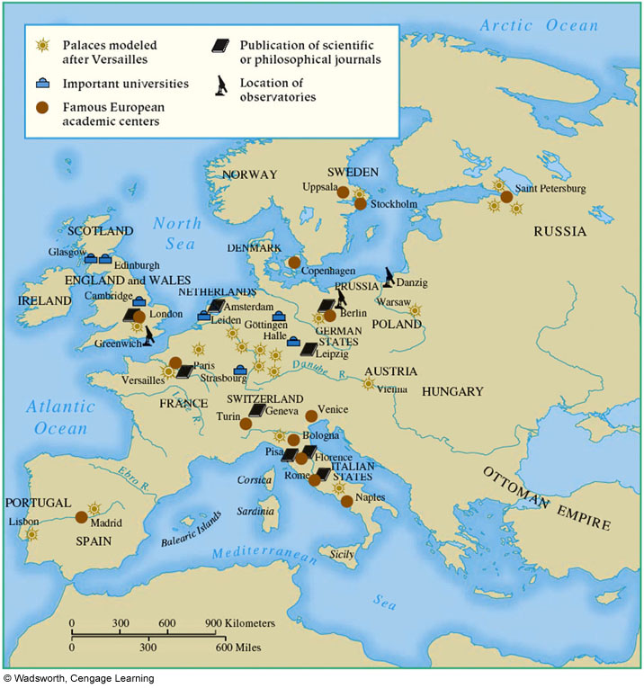

Slide 4
TOWARDS A
NEW
HEAVEN
A REVOLUTION IN ASTRONOMY

Slide 5
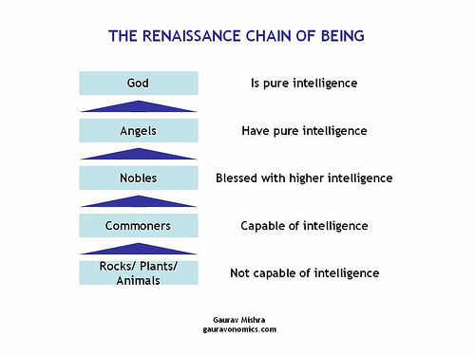
Medieval Worldview: The Great Chain of Being

Slide 6
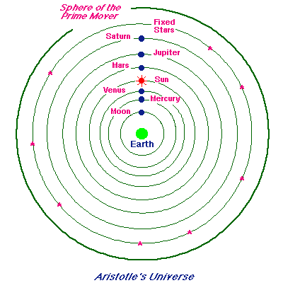
Medieval Cosmology:
A synthesis of ideas from Aristotle, Ptolemy & Christian thought
Ptolemaic or geocentric conception of the universe

Slide 7
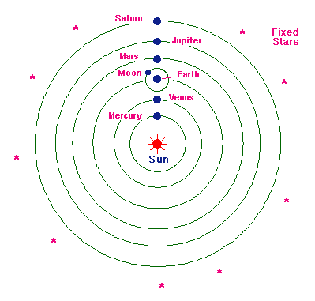
Nicolaus Copernicus (1473-1543):
Wrote On the Revolutions of the Heavenly Spheres (1543)
Introduced Heliocentric conception of the universe

Slide 8
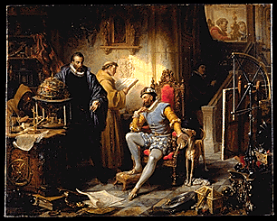
Tyco Brahe (1546-1601):
Danish astronomer rose to fame with discovery of new star in 1572.
Had huge observatory built for him by Danish king
Amassed a huge collection of amazingly accurate data from his expensive telescope (20 years’ worth)

Slide 9
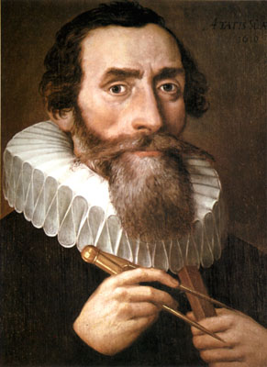
Johannes Kepler (1571-1630):
Three laws of planetary motion:
    planets’ orbits are elliptical
    Speed of planets vary due to their distance from the sun
    Direct relationship exists b/t planet’s orbit & distance from Sun
Invalidated the theories of Aristotle & Ptolemy for good

Slide 10
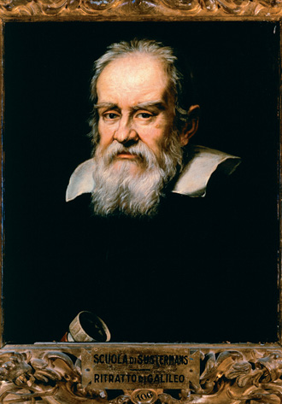
Galileo Galilei (1564–1642)
formulated law of inertia
1st to use telescope to study heavens – universe composed of material substances
became high-profile Copernican advocate
articulated concept of a universe governed by mathematical laws

Slide 11
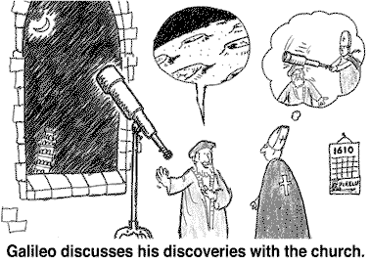
Galileo’s most significant contribution:
Seperated science from philosophy & theology
Reliance on classical/religious authorities replaced by experimentation:
    Reliance on repeatable & reliable experiments
    Observations that could be expressed mathematically

Slide 12
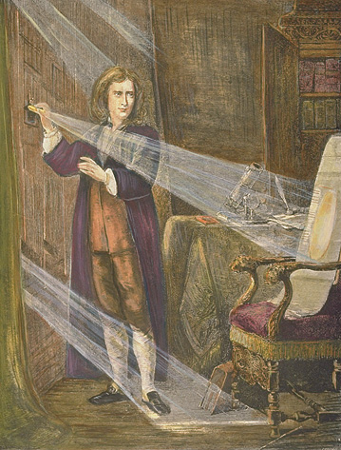
Isaac Newton (1642–1727):
Universal law of gravitation
  Explained gravity mathematically
  all physical objects in the universe move through mutual attraction (gravity)
  One law could explain all motion in the universe
Explained in his Principia (1687)
Developed idea of world machine

Slide 13
TOWARDS A
NEW
EARTH
A REVOLUTION IN MEDICINE

Slide 14
Medieval Ideas on Medicine:
Dominated by teachings of Galen (Greek physician, 2nd c. AD)
    relied on animal dissection to understand human anatomy
    Two separate blood system (muscular & digestive)
    Doctrine of the Four Humors for treating disease

Slide 15
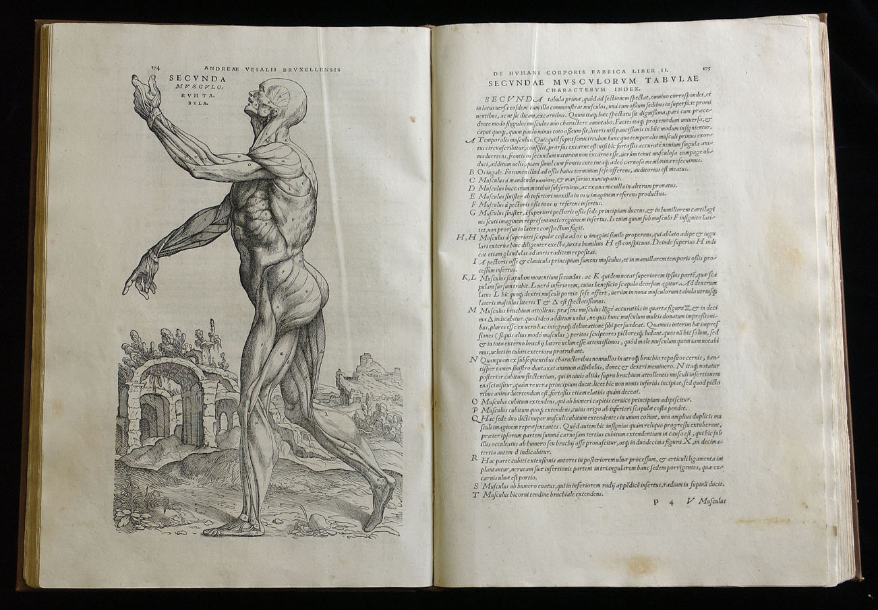
Andreas Vesalius (1514-1564):
Professor of surgery @ University of Padua
On the Fabric of the Human Body (1543) – most comprehensive anatomical book of its time in Europe

Slide 16
New ideas regarding Medicine:
Paracelsus (1493-1541)
  Disease caused by chemical imbalances in organs
  could be treated by chemical remedies
  “like cures like”
William Harvey (1578-1657)
  wrote On the Motion of Heart & Blood (1628)
  Heart is beginning point of circulation
  Same blood flows in both veins & arteries
  Blood makes complete circuit as it passes through body

Slide 17
Development of Chemistry:
Became a science in 16th c.
Robert Boyle (1627-1691)
  Boyle’s law
  Matter is composed of atoms (chemical elements)
Antoine Lavoisier (1743-1794)
  Founder of modern chemistry
  Invented system of naming chemical elements

Slide 18
Science & Society
THE IMPACT OF THE SCIENTIFIC REVOLUTION

Slide 19
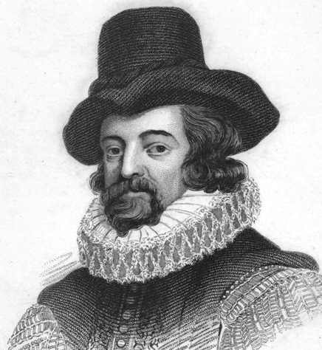
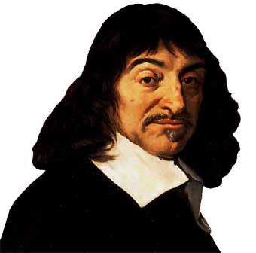
Two ideas on the Scientific Method:
Empiricism
Cartesian Dualism
Advocated by Francis Bacon
Experimental research
Inductive reasoning
Empirical truths can be confirmed through senses
Formulated by René Descartes
First doubt everything
Deductive reasoning
Only two types of substances – matter & mind

Slide 20
Scientific Societies:
New phenomenon – international community of scientists connected through scientific journals & scientific societies
Kings set up academies of science in London, Paris & Berlin in late 17th c.
    Promote scientific endeavors & the dissemination of scientific work
    Work vetted through critical examination by other scientists
    Gov’t supported research by funding scientific work or building observatories

Slide 21
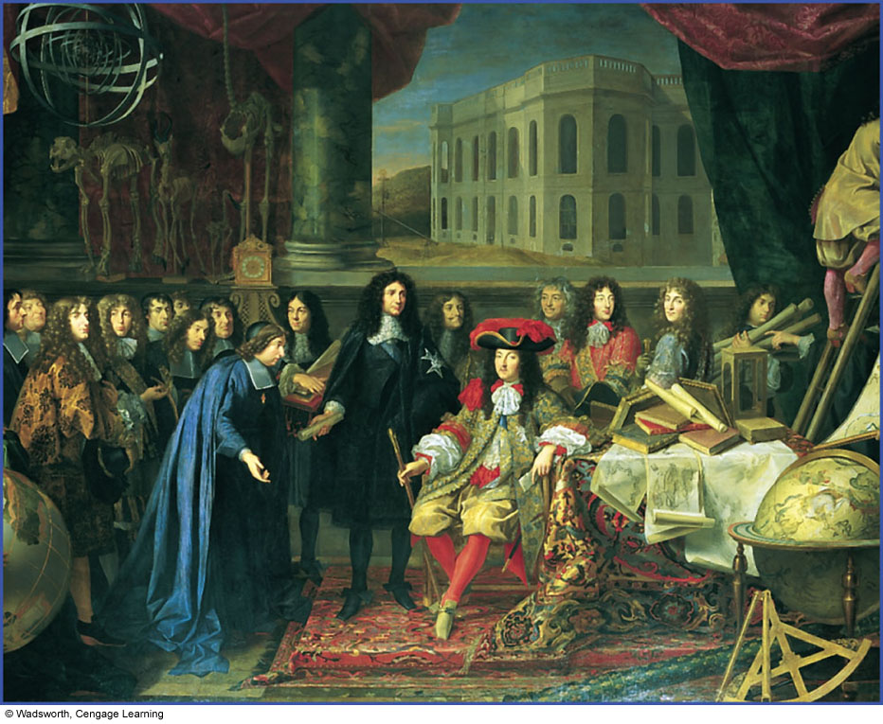
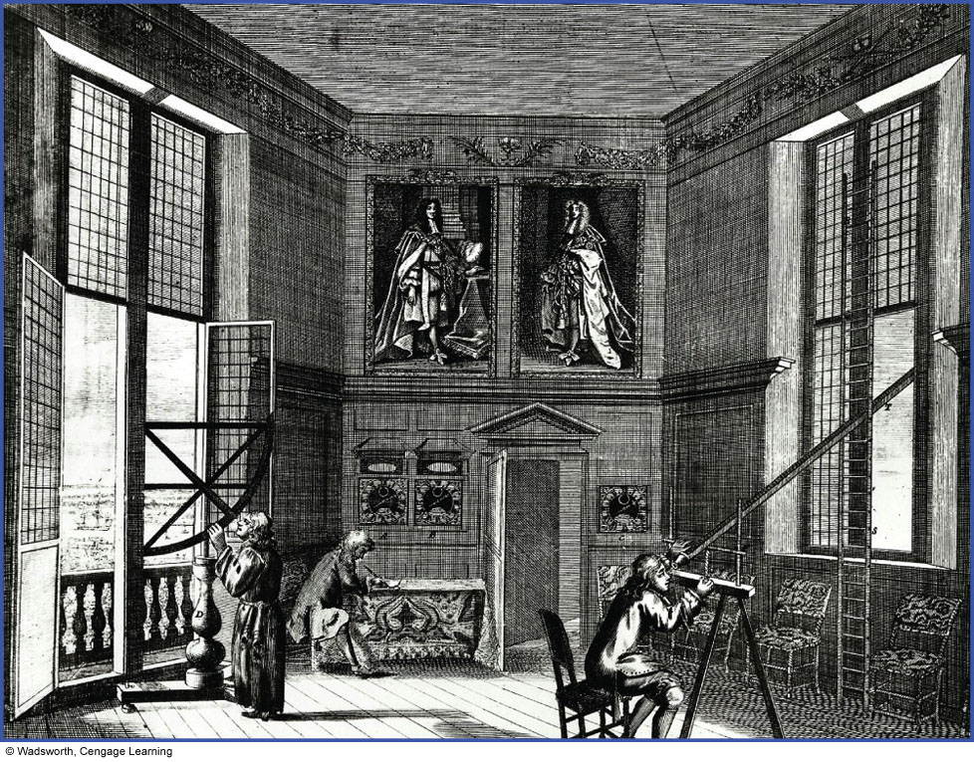
TWO examples of scientific societies:
French Royal Academy of Sciences
English Royal Observatory at Greenwich

Slide 22
Women & Science:
Science used to support traditional & stereotypical views about women at the time
  Women inferior by nature
  Best-suited for domestic roles & as mothers
  Males professionalized the role of midwife
Excluded from membership in scientific academies
A number of women still did important scientific work in 17th & 18th c.
  Maria Merian studied insects & botany in Surinam
  Margaret Cavendish wrote books on the philosophical debates about scientific knowledge
  Maria Winkleman Kirsch worked w/ husband & discovered comets

Slide 23
Science & Religion (3 different ideas):
René Descartes (1596-1650)
  Separation b/t infinite God & finite world of mater
  Religion & science were separate spheres; little or nothing to do w/ each other
Benedict de Spinoza (1632-1677)
  Monism – God & everything in universe are one & the same
  Through reason man can find true happiness
Blaise Pascal (1623-1662)
  Keep science & religion (Christianity) united
  Humans are frail creatures who are misled by reason, their senses & their emotions
  Came to side with faith; reason can only take you so far

