Slide 1
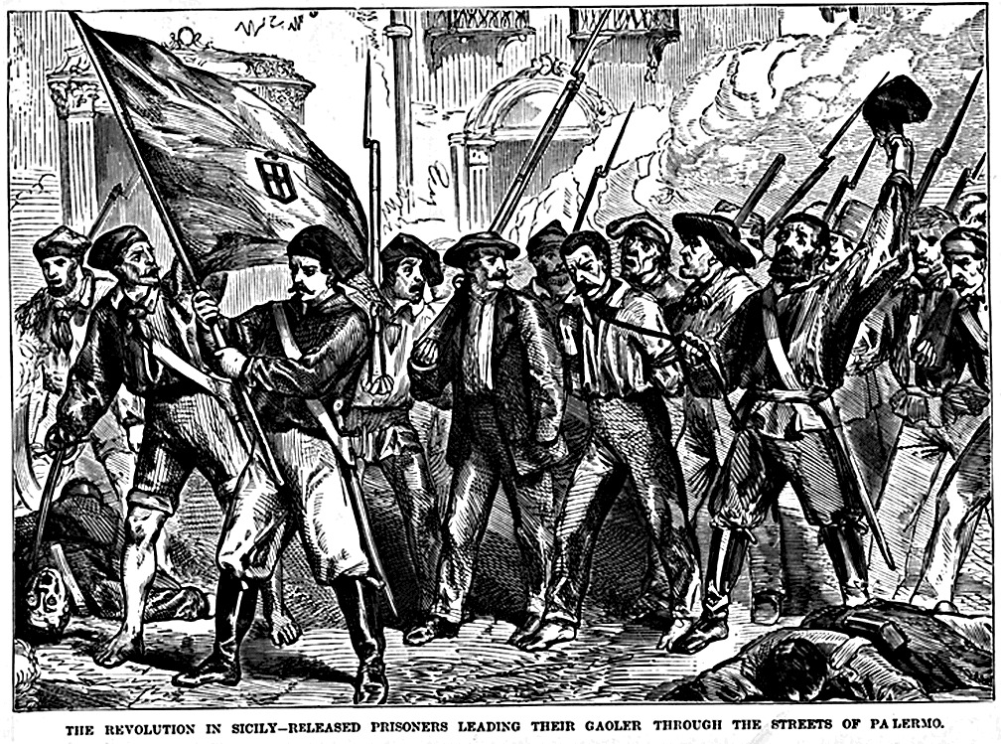
19th-Century Nationalism & Revolutions

Slide 2
The Nineteenth Century
The 18th century was a time of relative stability
1780s-1790s: growing social and political unrest
Society plagued by bad harvests
Industrialization revealed growing disparity between rich and poor
Increasing literacy in lower classes raised hopes and expectations

Slide 3
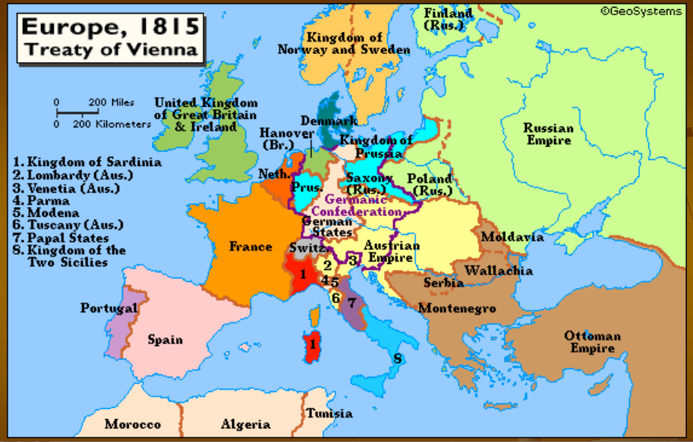
Review
After the French Revolution, Napoleon Bonaparte was given power in France, and quickly conquered most of Europe. Upon his defeat, the Congress of Vienna balanced power in Europe by redrawing the boundary lines
However, Napoleon’s invasions had sparked Nationalism throughout Europe, leading to a number of unification and independence movements.
-Italy
-Greece
-Germany

Slide 4
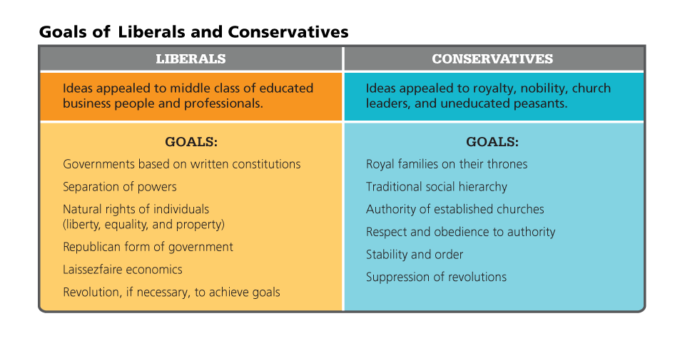
Liberalism and Nationalism Spur Revolts
Today we call this Classic Liberalism, unlike today’s liberalism which is associated with progressivism

Slide 5
A World within the World
The globe opened to its full scale
No longer possible to comprehend the commonality of all humankind, but to understand the differences among cultures
Humboldt
A new nationalism post-French Revolution
A country is more than where you live, it is a spiritual essence that grounds your whole being

Slide 6
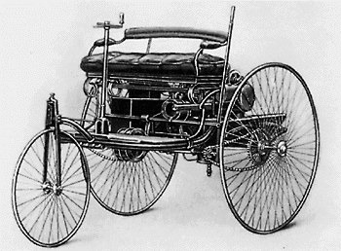
A World within a World
Rapid Progress
19th century began with coaches and ended with automobiles
A photograph of the original Benz Patent Motorwagen, first built in 1885 and awarded the patent for the concept

Slide 7
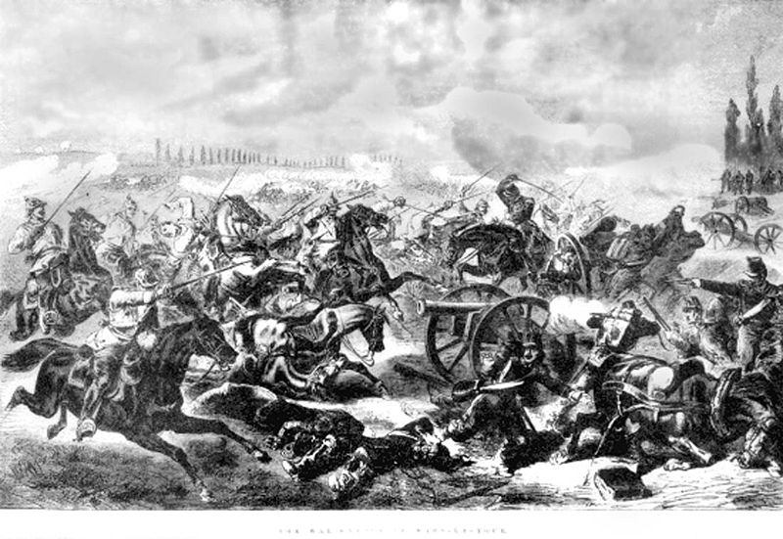
The Nineteenth Century
Century of Warfare
Greek War of Independence | French Revolution of 1830
Continent-wide revolutions of 1848 | Franco-Prussian War
Crimean War
Battle of Mars-la-tour [The War], From "Canadian Illustrated News" Date: 19 November, 1870 , Pagination: vol.II , no. 21 , 336, Franco-Prussian War, 1870-71

Slide 8
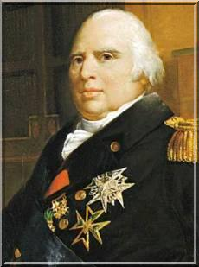
French Revolution of 1830
Congress of Vienna restored Louis XVIII to the French throne (Younger brother of Louis XVI)
Issued a constitution
Two house legislature
Limited freedom of the press
King retained much power

Slide 9
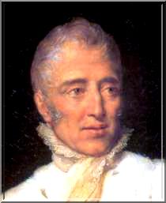
Charles X
When Louis XVIII dies in 1824 he’s succeeded by his younger brother Charles X
An absolute monarch
Ignored and rejected constitution
July 1830, he suspends the legislature, limits the right to vote, and restricts the press

Slide 10
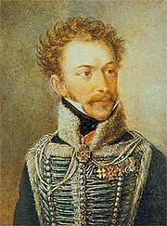
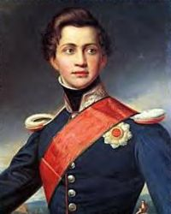
Independence of Greece
Part of Ottoman Empire from 1456 (400 yrs)
1821: Revolt began under the leadership of Alexander Ypsilanti
The Concert of Europe officially backed the Ottoman Empire, but, in 1827 Britain, France, and Russia entered the war
Greece achieved independence in 1830
1833: A prince from Bavaria was installed as the King of Greece, Otto
Alexander Ypsilanti
Otto King of Greece

Slide 11
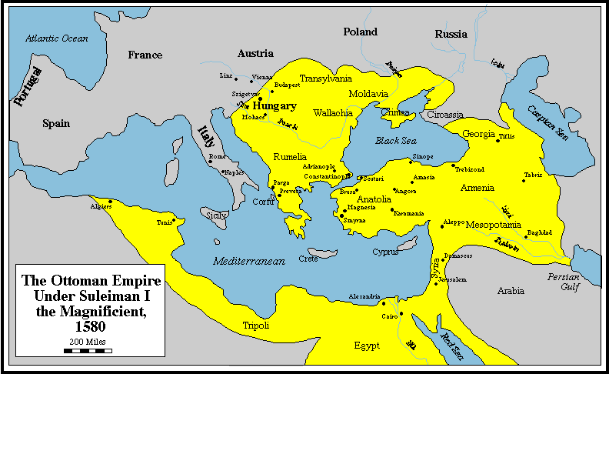
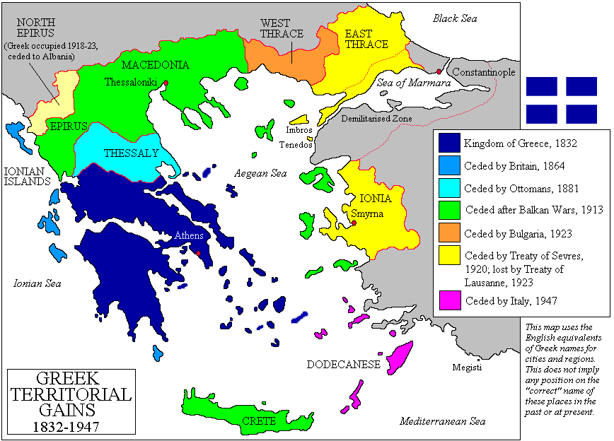
GREECE

Slide 12
The Crimean War [1854-1856]
Russia [claimed protectorship over the Orthodox Christians in the Ottoman Empire]
Ottoman Empire
Great Britain
France
Piedmont-Sardinia

Slide 13
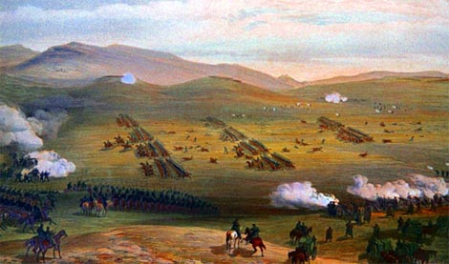
The Charge of the Light Brigade: The Battle of Balaklava [1854]
Half a league, half a league, Half a league onward, All in the valley of Death Rode the six hundred. "Forward, the Light Brigade! "Charge for the guns!" he said: Into the valley of Death Rode the six hundred…
A romanticized poem of the battle by Alfred Lord Tennyson

Slide 14
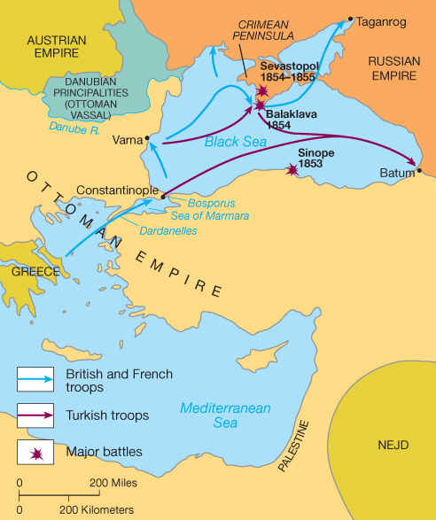
The Crimean War [1854-1856]

Slide 15
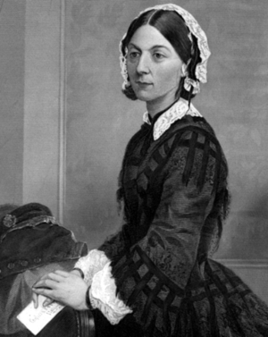
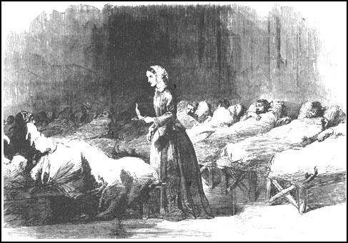
Florence Nightingale [1820-1910]
“The Lady with the Lamp”

Slide 16
Treaty of Paris [1856]
No Russian or Ottoman naval forces on the Black Sea.
All the major powers agreed to respect the political integrity of the Ottoman Empire.

Slide 17
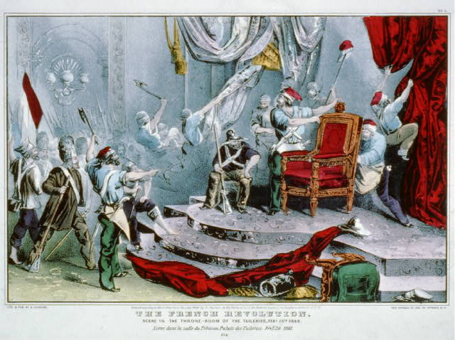
The Revolutions of 1848
Broke out across Europe and beyond
“Springtime of peoples” seemed to promise the democratic ideals of the French Revolution and to address the discontents of a new industrial working class
The French revolution: scene in the throne-room of the Tuileries, Feb. 24th, 1848 Library of Congress Prints and Photographs Division

Slide 18
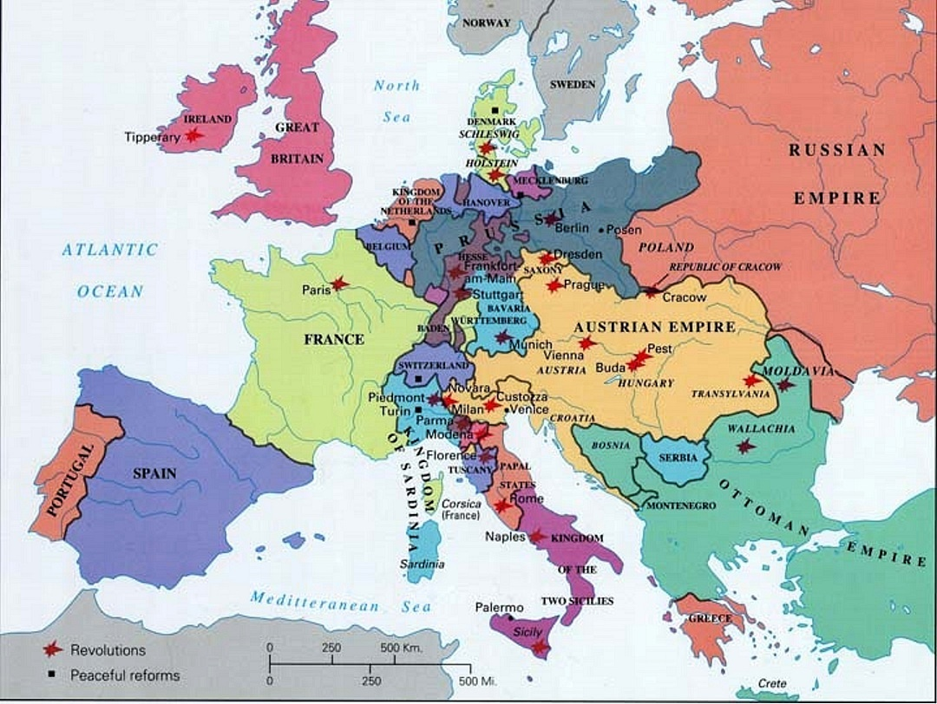
The spread of popular uprisings in 1848: Bad harvests & unemployment created fuel for an explosion
Feb 22: Paris
Feb 27: Baden (Offenburg Program)
Mar 13: Vienna
Mar 15: Budapest
Mar 18: Berlin
Mar 18: Milan
Mar 19: Munich
May 3: Dresden
June 9: Bucharest
Notes:
SOURCE: http://www.uiowa.edu/~c016003a/map1848.jpg

Slide 19
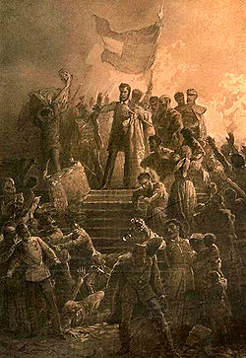
THE AUSTRIAN EMPIRE
A. French Inspiration: Revolution in France resulted in popular upheaval throughout central Europe.
B. Vienna: Inspired by the Magyar nationalist, Louis Kossuth, beginning on March 13, 1848, students and workingmen engaged in riots and invaded the imperial palace. The army failed to contain the disturbances. The government, fearful that urban unrest would cause an uprising of the serfs in the countryside, abolished serfdom. Metternich resigned and fled in disguise to England.

Slide 20

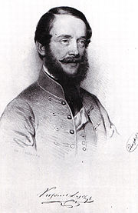
THE AUSTRIAN EMPIRE
C. Hungary
1. Led by Louis Kossuth, the Hungarians (Magyars) demanded national autonomy, civil liberties, and universal suffrage.
2. Emperor Ferdinand I promised reforms and a liberal constitution. Serfdom was abolished by the end of March, 1848

Slide 21
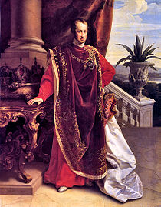
THE AUSTRIAN EMPIRE
3. The revolution lost steam due to conflict among different nationalities (Hungarians vs. Croats, Serbs, Romanians; Czechs vs. Germans) which was encouraged by the Austrian monarchy. The leaders of the revolution wanted to restructure the country according to ethnic language and culture.

Slide 22
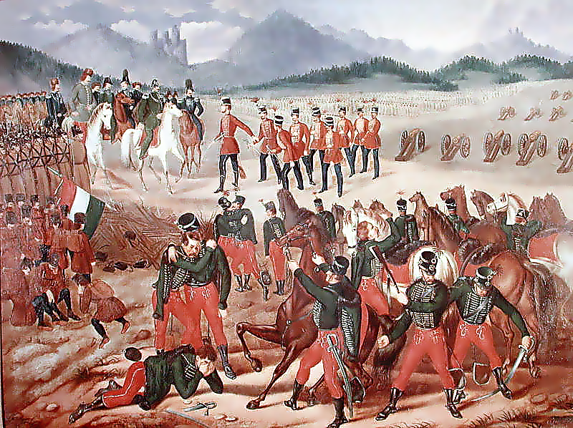
THE AUSTRIAN EMPIRE
4. The alliance of the working and middle classes collapsed. The conservative aristocrats crushed the revolution.
5. Francis Joseph was crowned emperor in 1848.
6. The Russian army helped to defeat the Hungarians.

Slide 23
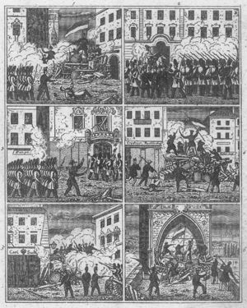
THE AUSTRIAN EMPIRE
D. Bohemia: In April, 1848 an uprising broke out in Prague. Czech nationalists met at an all-Slav congress. They called for a constituent assembly for Bohemia. They demanded that the Czech language be used along with German in schools and government offices. In June, 1848 imperial troops bombarded Prague and crushed the Czech rebellion.

Slide 24
Italian
Unification

Slide 25
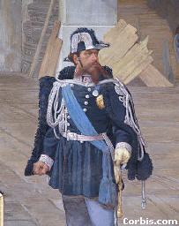
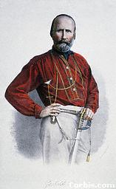
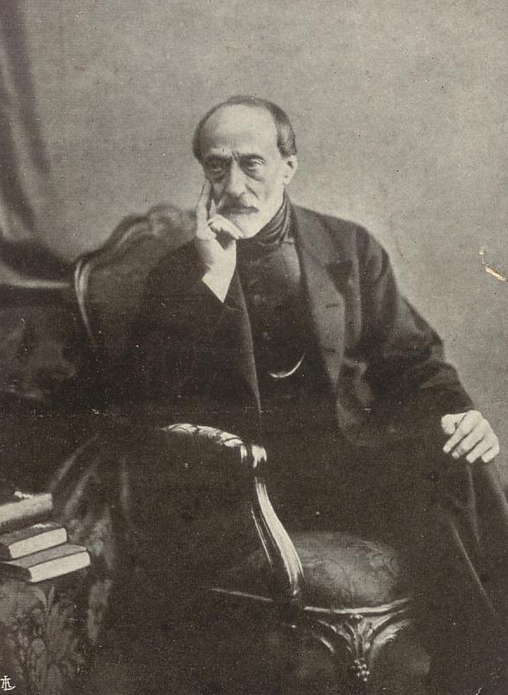
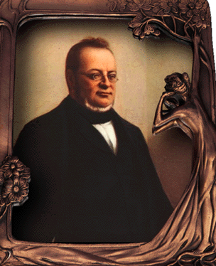
Italian Nationalist Leaders
King Victor Emmanuel II
Giuseppi Garibaldi [The “Sword”]
Count Cavour [The “Head”]
Giuseppi Mazzini [The “Heart”]

Slide 26
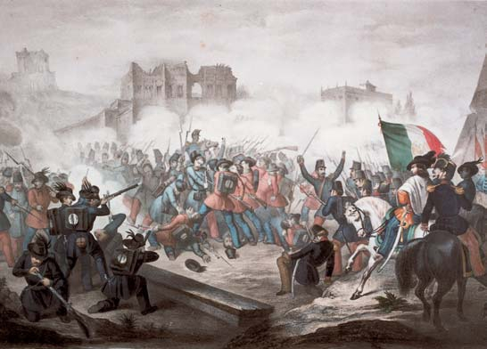
Garibaldi Defends Rome Against the French, (April 30, 1849)

Slide 27
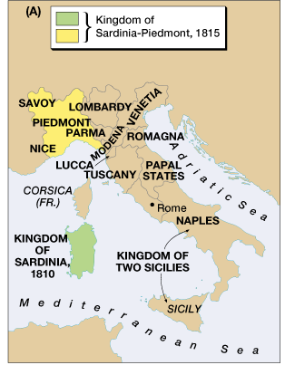
Sardinia-Piedmont: The “Magnet”
Italian unification movement: Risorgimento [“Resurgence”]

Slide 28
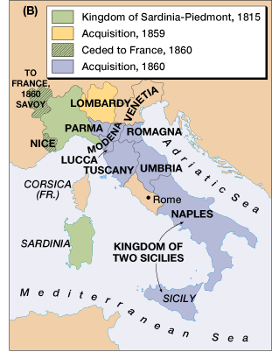
Austro-Sardinian War 1859

Slide 29
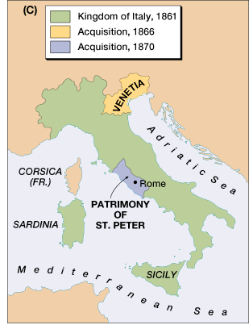
Austro-Prussian War 1866
Austria loses control of Venetia.
Venetia is annexed to Italy.

Slide 30
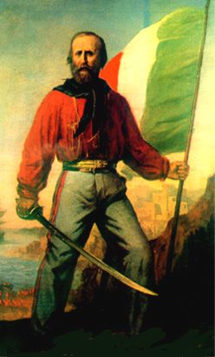
Garibaldi & His “Red Shirts” Unite with Cavour

Slide 31
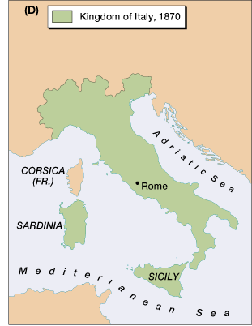
French Troops Leave Rome 1870
Italy is united!

Slide 32
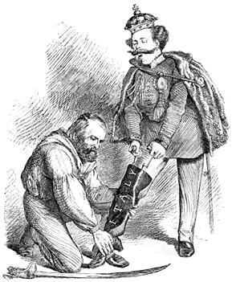
A Unified Peninsula!
A contemporary British cartoon, entitled "Right Leg in the Boot at Last," shows Garibaldi helping Victor Emmanuel put on the Italian boot.

Slide 33
The Kingdom of Italy: 1871

Slide 34
German
Unification

Slide 35
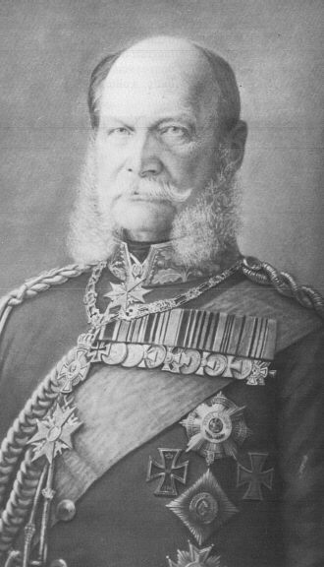
Kaiser Wilhelm I

Slide 36
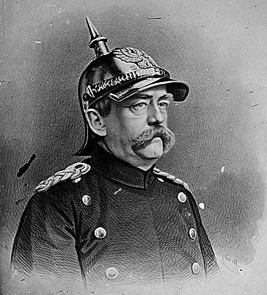
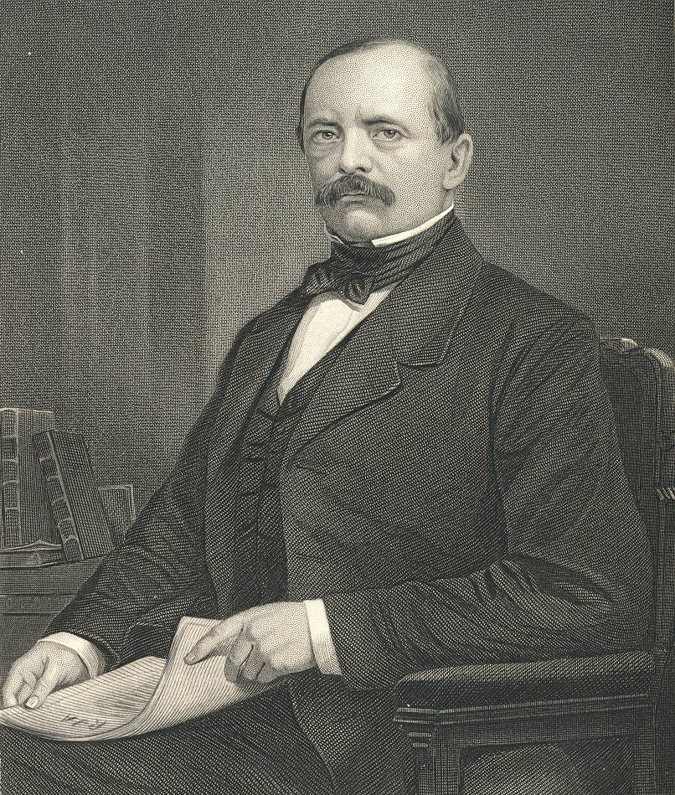
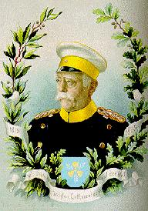
Chancellor Otto von Bismarck
The “Iron Chancellor”
Realpolitik
“Blood & Iron”

Slide 37
Otto von Bismarck . . . .
The less people know about how sausages and laws are made, the better they’ll sleep at night.
Never believe in anything until it has been officially denied.
The great questions of the day will not be settled by speeches and majority decisions—that was the mistake of 1848-1849—but by blood and iron.

Slide 38
Otto von Bismarck . . . .
I am bored. The great things are done. The German Reich is made.
A generation that has taken a beating is always followed by a generation that deals one.
Some damned foolish thing in the Balkans will provoke the next war.

Slide 39
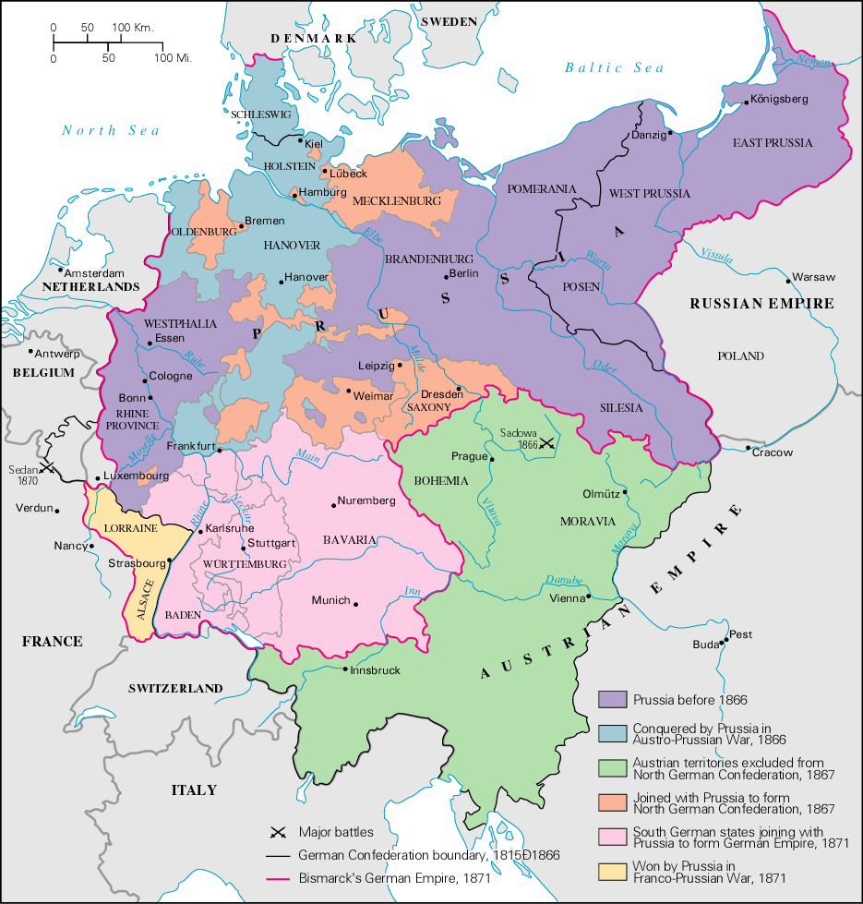
The German Confederation

Slide 40
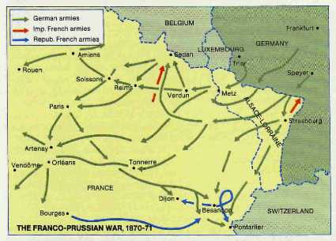
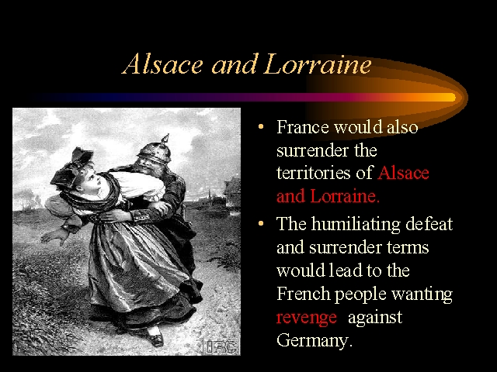
Franco-Prussian War [1870-1871]
German soldiers “abusing” the French.

Slide 41
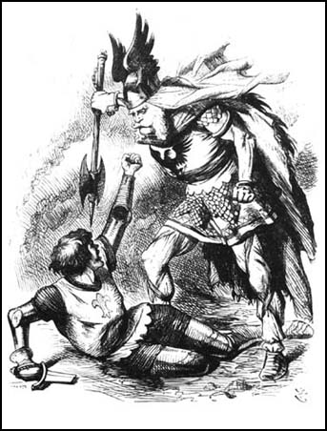
Franco-Prussian War [1870-1871]

Slide 42
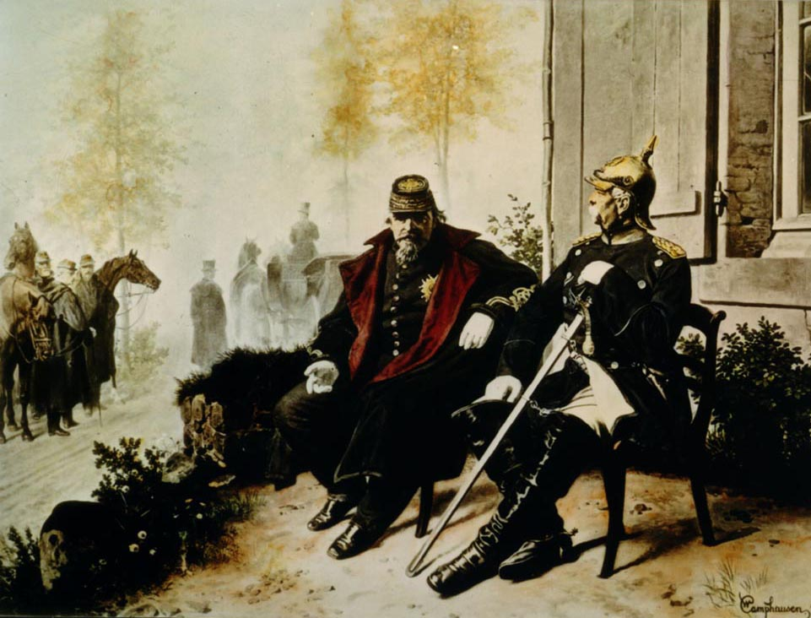
Bismarck & Napoleon III After Sedan

Slide 43
Treaty of Frankfurt [1871]
The Second French Empire collapsed and was replaced by the Third French Empire.
The Italians took Rome and made it their capital.
Russia put warships in the Black Sea [in defiance of the 1856 Treaty of Paris that ended the Crimean War]. -------------------
France paid huge reparations and was occupied by German troops until it was paid.
France ceded Alsace-Lorraine to Germany [a region rich in iron deposits with a flourishing textile industry].

Slide 44
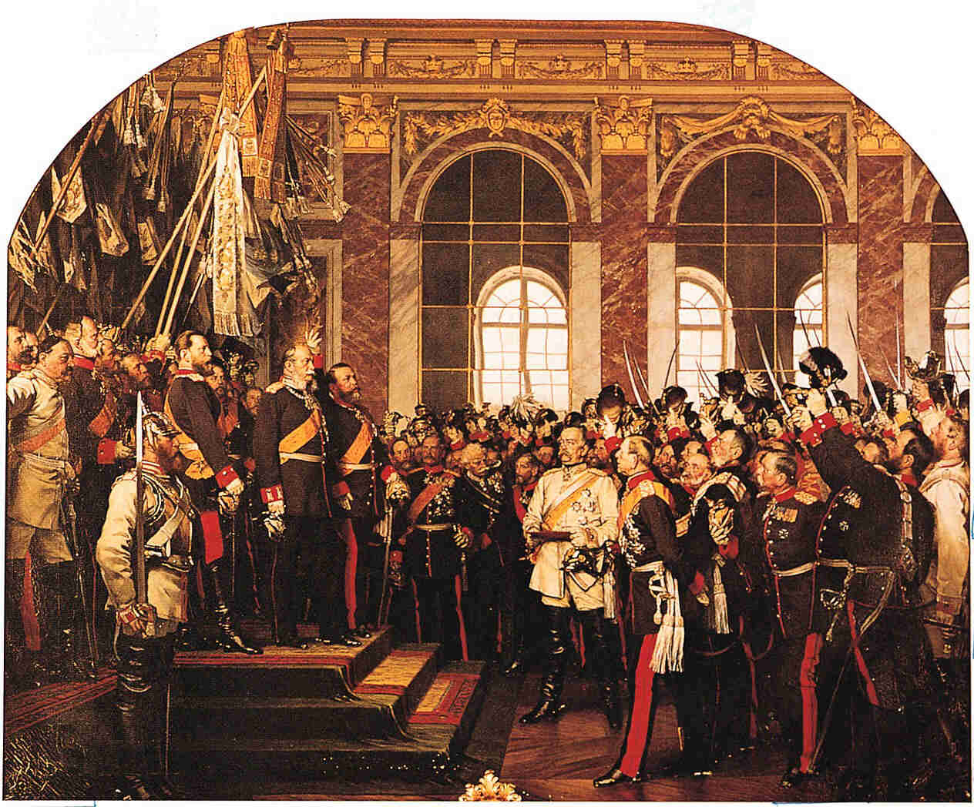
Coronation of Kaiser Wilhelm I [r. 1871–1888]

Slide 45

German Imperial Flag
German for “Empire.”

Slide 46
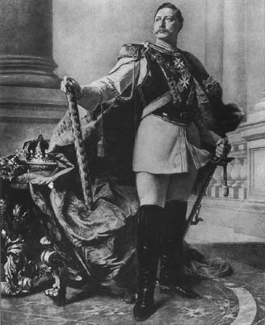
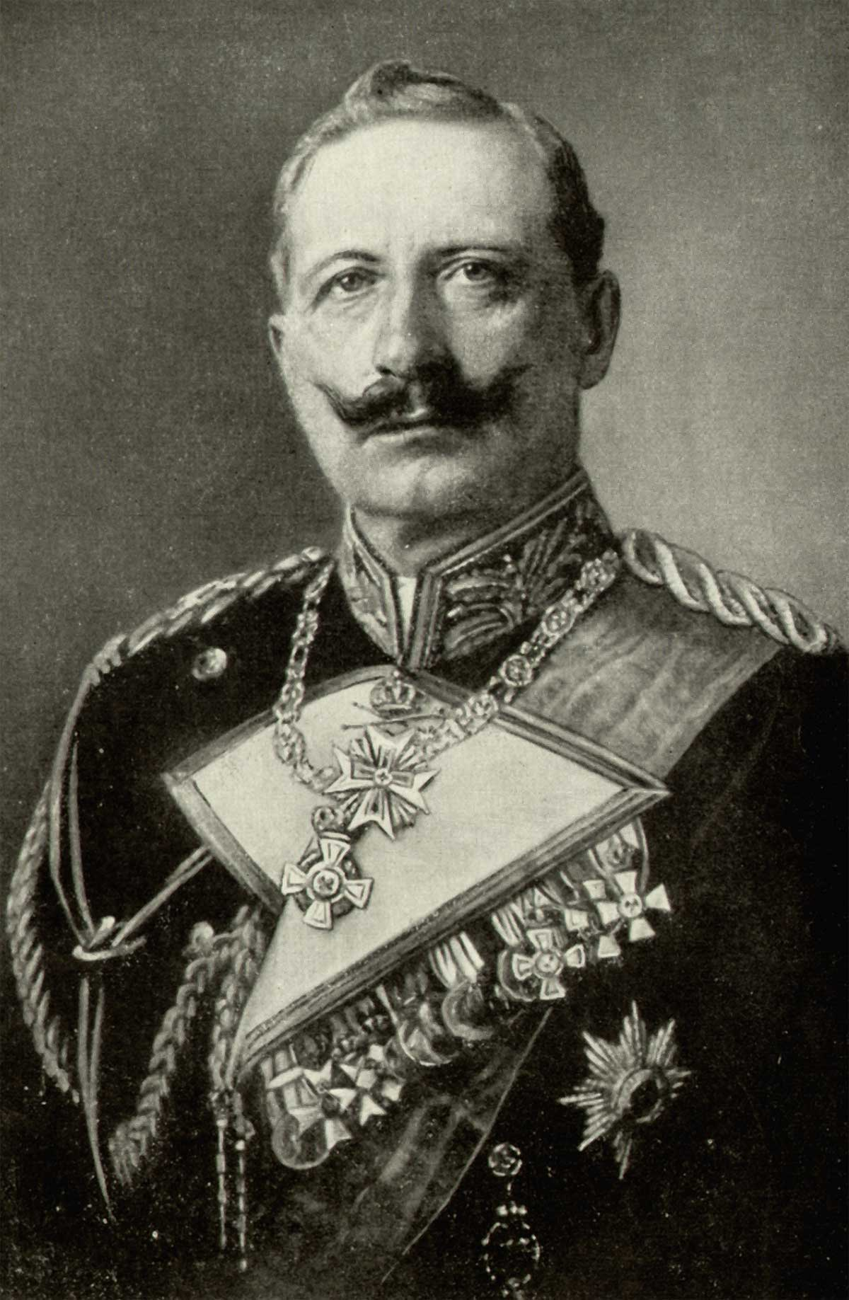
Kaiser Wilhelm II [r. 1888-1918]

Slide 47
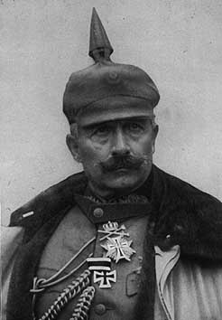
Kaiser Wilhelm II

Slide 48
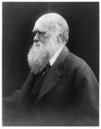
Science and Technology
Scientific revolutions
Darwin: Evolution
Lister: Antiseptics
Pasteur: Pasteurization
Maxwell: electromagnetic theory of light
Mendeleyev: periodic table of elements
Scientific discoveries were gradually improving the daily lives of the people: health, transportation, communication
Science also source of dangerous abuses
Social Darwinism
Portrait of Charles Darwin. Library of Congress.

Slide 49
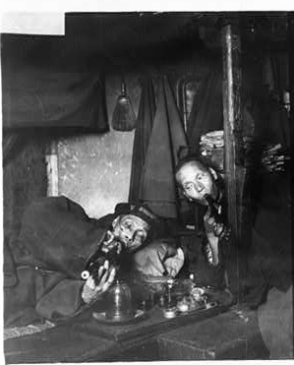
An Age of Empire
After the revolutions of 1848, European nations returned their attention to colonization
Africa: Ethiopia left as only African nation unconquered
Asia: China forced to cede Hong Kong to British after the Opium War of 1840-1842
India: British took control after the so-called Mutiny of 1857-1859
Iran, Georgia, Azerbaijan: Seized by Russia
Two Chinese men, on narcotics in opium den . Library of Congress.

Slide 50
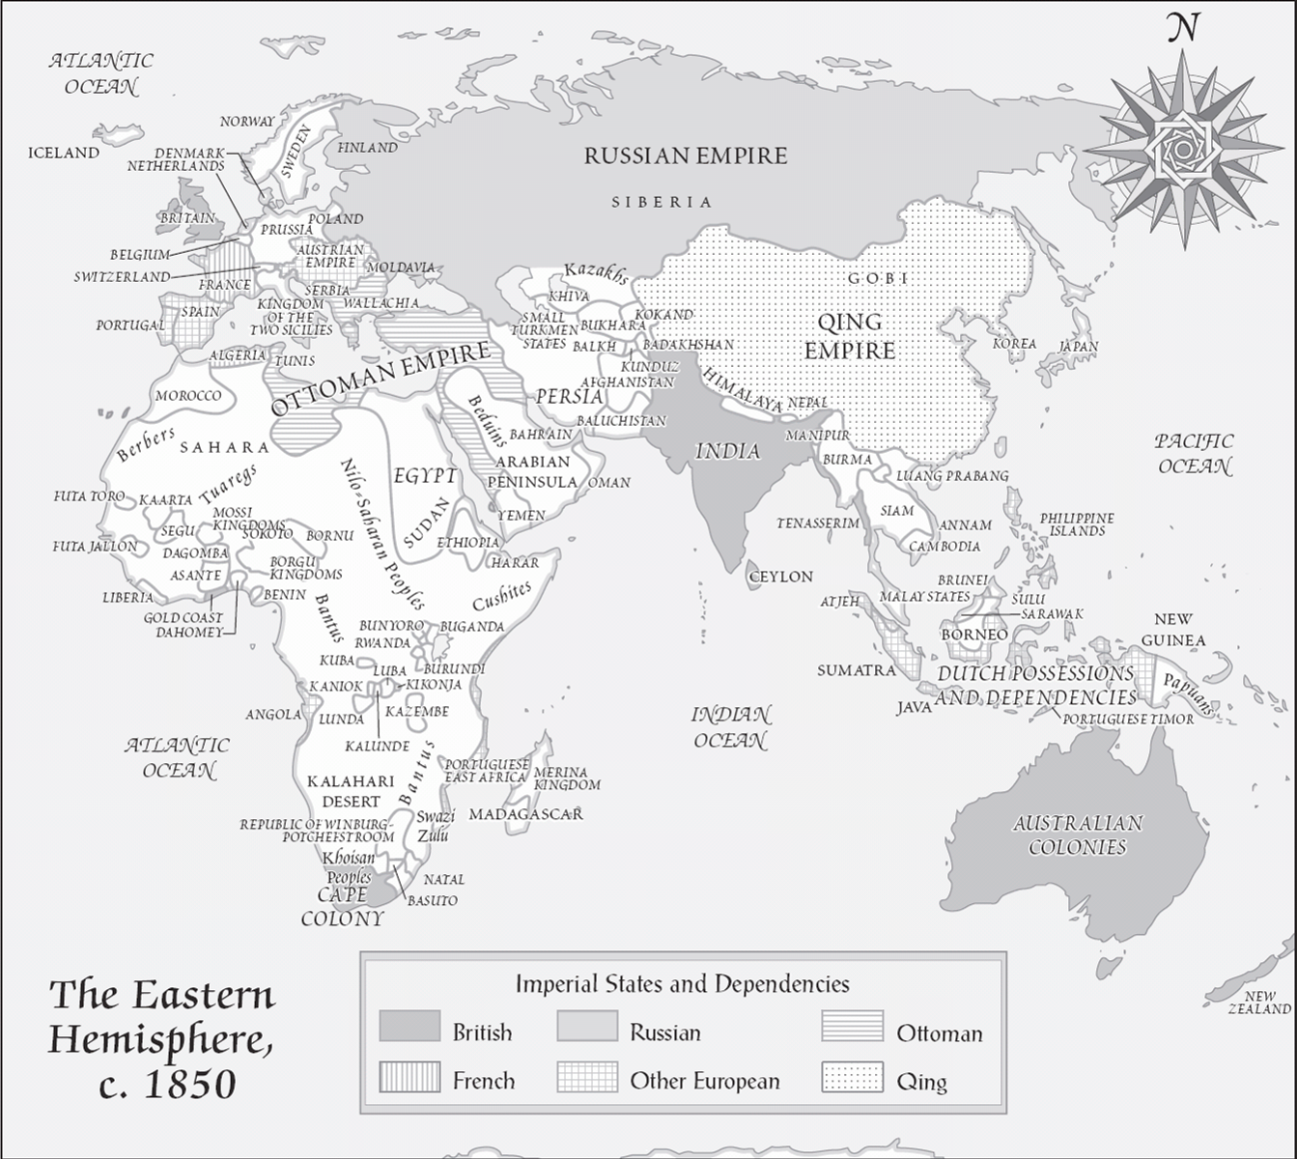

Slide 51
The Western hemisphere was engaged in revolutions of its own.
South American independence movements
The American Civil War

Slide 53
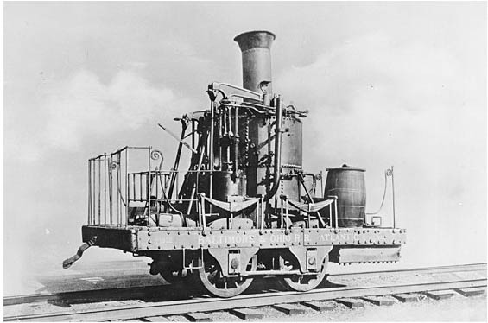
An Age of Empire
By the end of the century, railroads were forging connections across large areas
Growing sense of interconnectedness
Imperialist enjoyment of the exotic permeated European lifestyle
Yet, possible to ignore Potato Famine in nearest colony - Ireland
Early B&O Railroad Locomotive of the 1830s-1840s. Prints and Photographs Division. Library of Congress.

Slide 54
An Age of Empire
The global triumph of European culture was not a cause of celebration, even in Europe
British writers identified with independence movements even at Britain’s expense

Slide 55
An Age of Empire
Literary cultures became more varied
Writers inspired by contact with new cultures
Romanticism and Nationalism moved in waves; arriving earlier in some places and later in others

Slide 56
Cities, Women, Artists
One common theme in literature of 19th century is the tension between city and country
Modernizing tendencies of city
Traditional culture of country
Writers in the second half of the century explored the urban

Slide 57
Cities, Women, Artists
Cities helped to free women from some childcare responsibilities
Compulsory education
Children less of a financial asset
Lowers birthrate
Suffrage, the emancipation of women, was imagined and acted on with new energy

Slide 58
Cities, Women, Artists
Artists reluctantly submitted to market forces
Mass production led artists to the feeling that their was a cheapening of the arts
Art turned to “art for art’s sake” and artists boasted about their lack of success
Artists became interested in “primitive” art of Africa and Oceania

