Slide 1
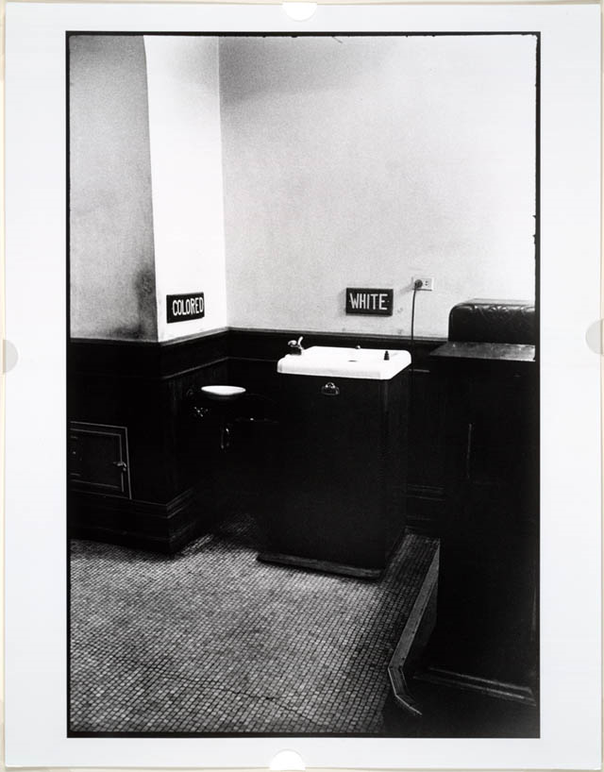
1. What region/section of the
country is the event taking place?
2. Describe what is happening in this picture?
3. Why is this occurring?
4. How is this a reaction to Reconstruction and the 13th, 14th, and 15th amendments?

Slide 2
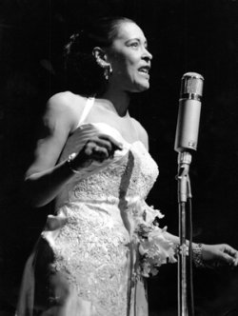
Strange Fruit (1937)
by Lewis Allen
Southern trees bear a strange fruit,
Blood on the leaves and blood at the root,
Black body swinging in the Southern breeze,
Strange fruit hanging from the poplar trees.
Pastoral scene of the gallant South,
The bulging eyes and the twisted mouth,
Scent of magnolia sweet and fresh,
And the sudden smell of burning flesh!
Here is a fruit for the crows to pluck,
For the rain to gather, for the wind to suck,
For the sun to rot, for a tree to drop,
Here is a strange and bitter crop.
Where is the action of this poem taking place?
What is the practice being described in this poem?
3. What group(s) could be responsible for these actions?
*4. What Reconstruction events could have been the catalyst for these reactions?

Slide 3
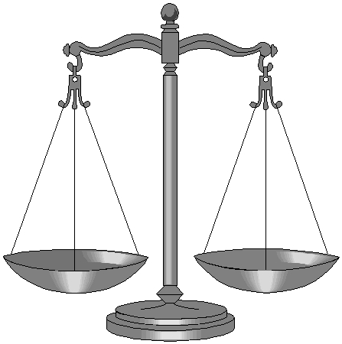
The Long Road To Equality
In the late 1800s, the federal and state governments played major roles in determining how easily freed slaves would be assimilated into American culture. Name at least two significant events that would hinder (hold back) African American assimilation?
And Why?
  a.
  b.

Slide 4
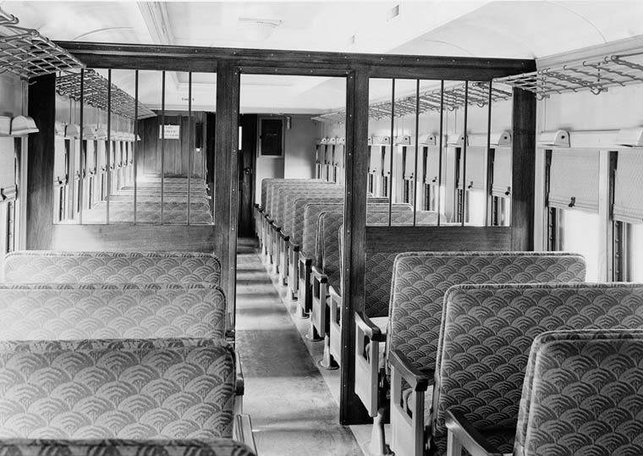
What was the topic of the speech?
2. What were they calling for?
3. What events contributed to the reason why this speech was give?

Slide 5
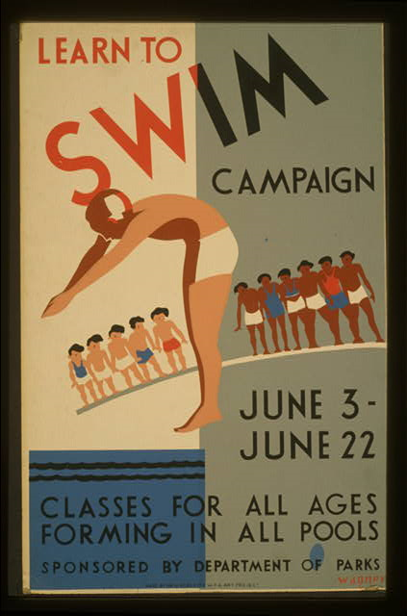
1. What is the main theme of this NYC Department of Parks Pool poster?
2. Who can participate?
3. Can they participate equally?
4. How can they?

Slide 6
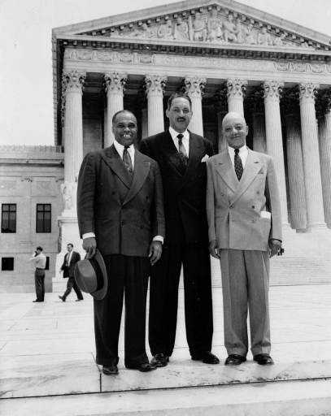
What is the over all theme of this DBQ?
SEPARATE BUT EQUAL or
LEGAL SEGREGATION

Slide 7
2. _____________________________________________ Year: ___________
Homer Plessy boarded a car on a train that was designated for whites only.
He was an African-American (1/8th)
He refused to leave the white only car and was arrested.
Sued saying Railroad Company denied him his rights under 13th & 14th amendments.
Judge was John Ferguson who ruled the State of Louisiana had the right to regulate railroad companies.
Appealed to the Supreme Court
Court decides: ________________________________________________
Plessy v. Ferguson
1896
You can legally have separate but equal places for
African Americans and Whites

Slide 8
One Supreme Court Justice Disagreed:
Justice John Marshall Harlan said, "Our Constitution is colorblind, and neither knows nor tolerates classes among citizens."

