Slide 1
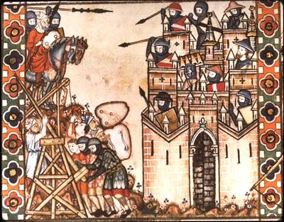
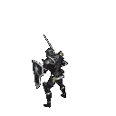
The
Crusades
Aim: What was the goal of the crusades?
Did the Crusaders achieve their goal?
Do Now: Goal of Crusades Worksheet

Slide 2
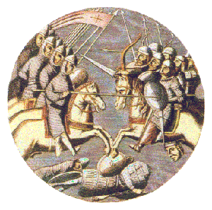
Crusades
The Crusades were a series of battles between Christians and Muslims in the Middle East.
Christian knights wanted to take the Holy Land and give it back to Christians.

Slide 3
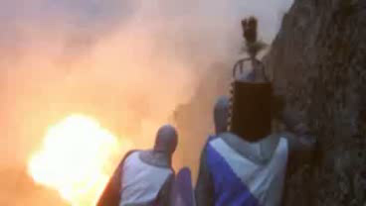
The Crusaders were also looking for the relics (holy artifacts) of Christianity.
Can you name any?
The Holy Grail (cup that held some of Christ’s blood from cross)
Spear of Destiny (spear which Roman Soldier poked Christ on cross)
Ark of the Covenant (held the 10 Commandments)
Christ Burial Shroud (cloth that covered Christ in tomb)
Cross (Christ’s) Pieces scattered all throughout the world
and many others

Slide 4
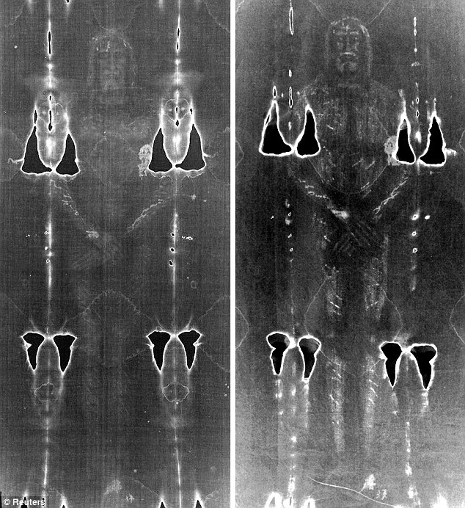
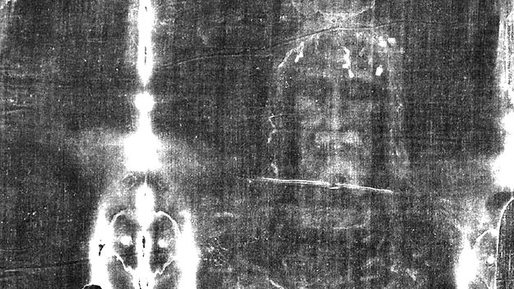
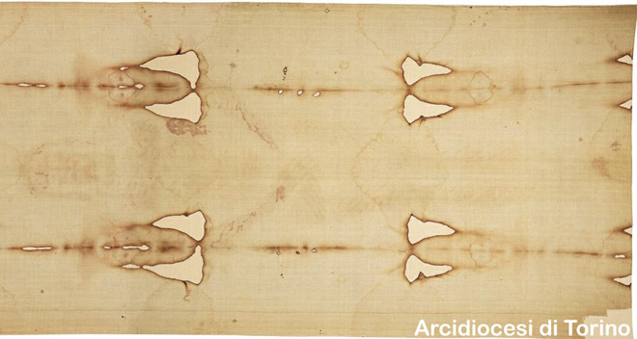
The Shroud of Turin

Slide 5
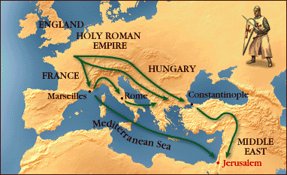
Why was Constantinople so important geographically?

Slide 6
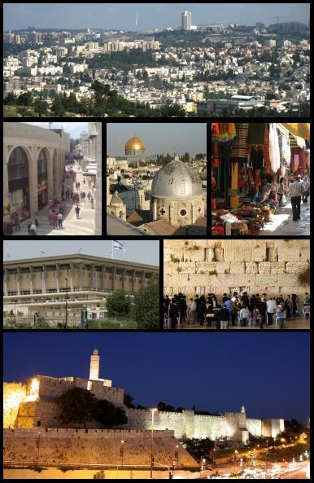
Prior to Crusades
Jerusalem itself was a multicultural city. Jews, Moslems and Christians all lived together harmoniously.
Christians on pilgrimages to Jerusalem were freely allowed across to the Holy Places

Slide 7
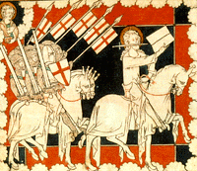
Crusades
Thousands of knights and “barbarian” soldiers united under Christianity attacked Muslims and Jews in Turkey and Jerusalem to gain the land for Christians.

Slide 8
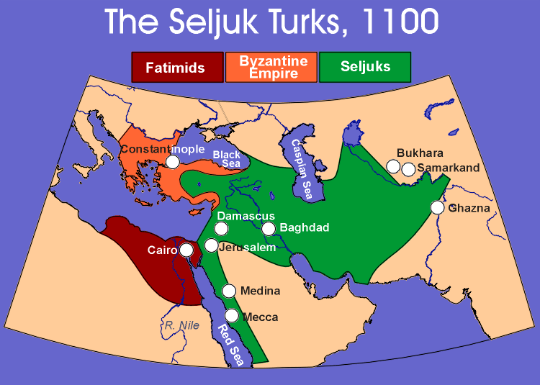

Slide 9
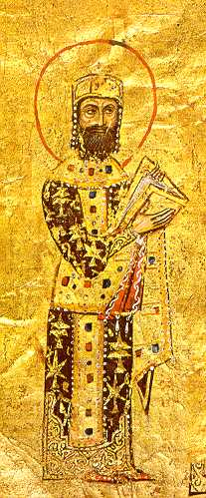
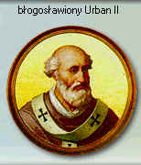
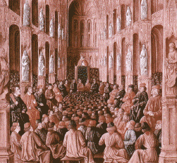
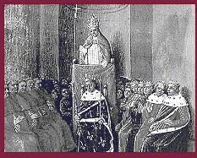
Alexius I of Byzantine Empire
Asked For Help and
Pope Urban II Called
For the 1st Crusade

Slide 10
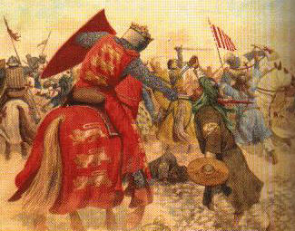
The Crusades
The Crusades were a series of eight (8) military campaigns to the Holy Land and Jerusalem.
The Christians (Crusaders) were fighting the Muslims for control of Jerusalem, the Christians most holy city. The Christians took control of Jerusalem, but then lost it again.

Slide 11
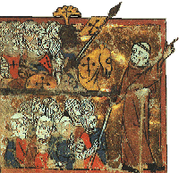
Impact of the Crusades
Persecution of Jews and Muslims
Economic development via trade (Italian City-States) Genoa & Venice
Kings and popes, gained power as a result & beginning of the breakdown of Feudalism
Improvements in Technology

Slide 12


