Slide 1
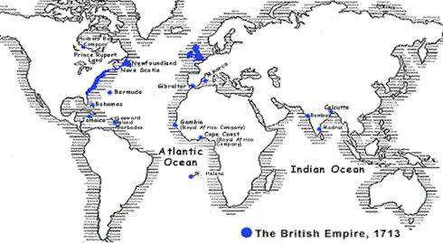
The British Empire
1713 – the ‘first British Empire still includes America

Slide 2
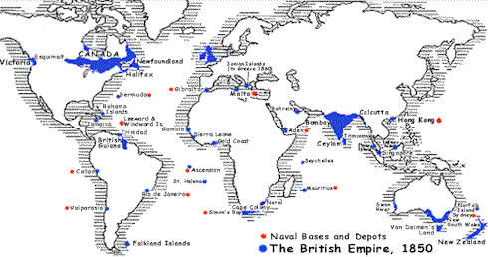
The British Empire
1850 – most British people consider an ‘empire’ worthless

Slide 3
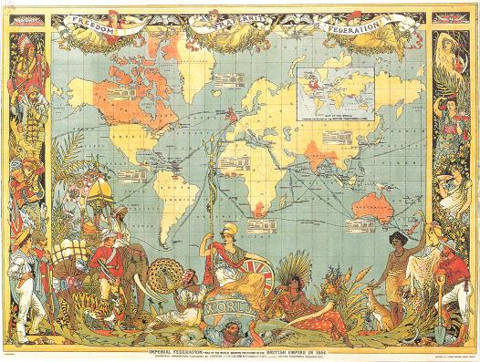
The British Empire
1886 – ‘the pink bits’; the Imperial Federation is fascinated with the range of peoples and cultures in the Empire.

Slide 4
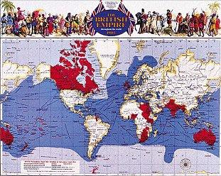
The British Empire
1905 – again, the thrill of many different peoples; Mercator’s projection and red shading emphasises SIZE.

Slide 5
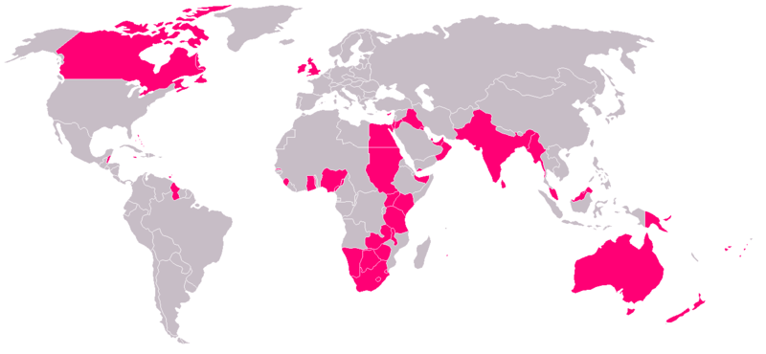
The British Empire
1921 – the British Empire is at its greatest extent.

Slide 6
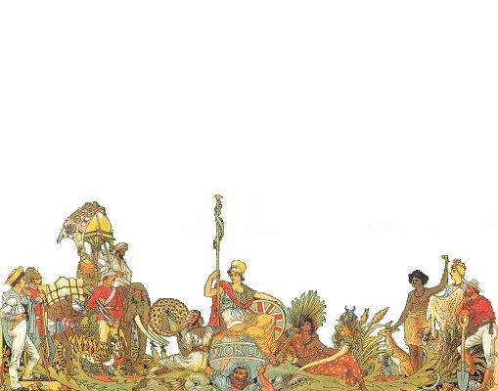
The British Empire
By 1921, the British Empire ruled about 458 million people, approximately one-quarter of the world's population.
It covered about 36.6 million km² (14.2 million square miles), about a quarter of earth's total land area.

Slide 7
The British Empire
It was the greatest empire the world has ever known…
… by landmass
British Empire - 36.6 million km² (in 1921)
Mongol Empire - 33.2 million km²
Russian Empire - 22.8 million km²
Spanish Empire - 19 million km²
Arab Empire - 13.2 million km²

Slide 8
The British Empire
It was the greatest empire the world has ever known…
… by population
British Empire - 531 million (in 1937)
Qing Empire (China) - 432 million
Russian Empire - 176 million
Mughal Empire (India) - 175 million
Ming Empire (China) – 160 million

Slide 9
The British Empire
The British Empire was the largest in all history: the nearest thing to world domination ever achieved.
Its territories ran the alphabet from Aden to Zambia.
It crossed the Equator and the international date line.

Slide 10
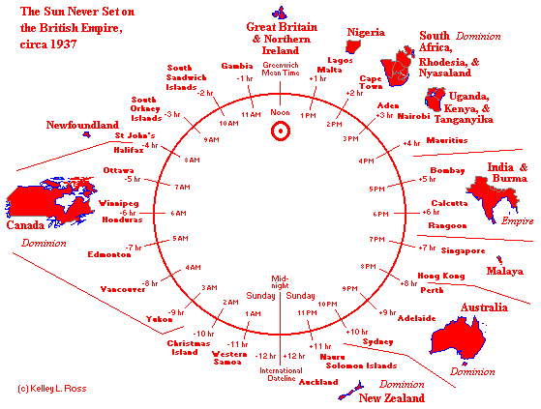
The British Empire
It was ‘the empire on which the sun never set’:

Slide 11
The British Empire
It included:
land on every continent;
a continuous line of colonies from Cairo to Cape Town;
lands which today are some of the largest, wealthiest, most populous and most powerful countries in the world – the USA, Canada, South Africa, India and Australia;

Slide 12
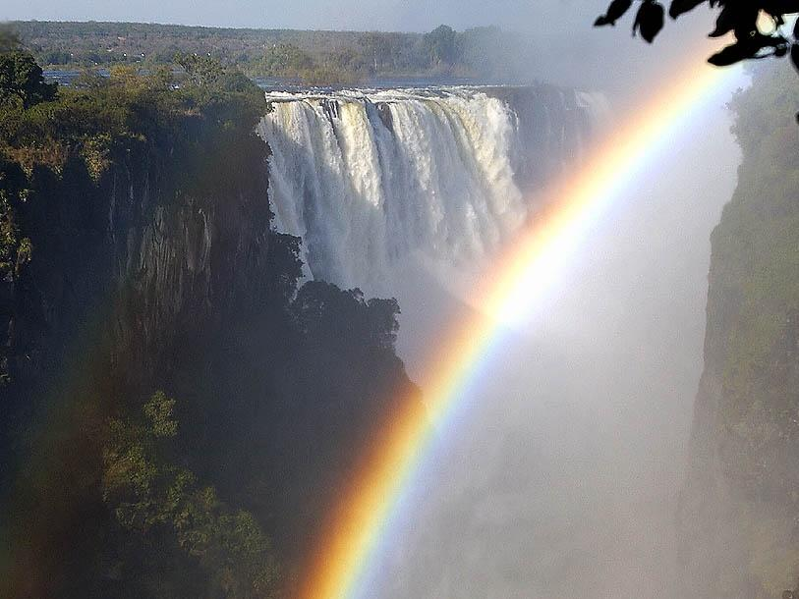
The British Empire
Victoria Falls
It included:
all the known climates of the world;
some of the highest mountains, the biggest lakes, the greatest rivers…

Slide 13
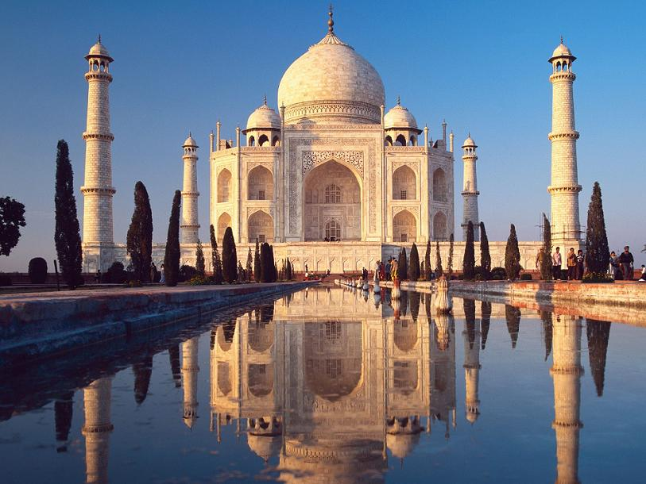
The British Empire
Taj Mahal
It included:
… and the most famous landmarks.

Slide 14
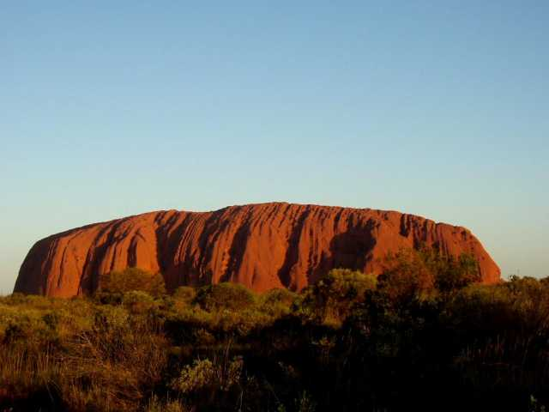
The British Empire
Ayres Rock
It included:
… and the most famous landmarks.

Slide 15
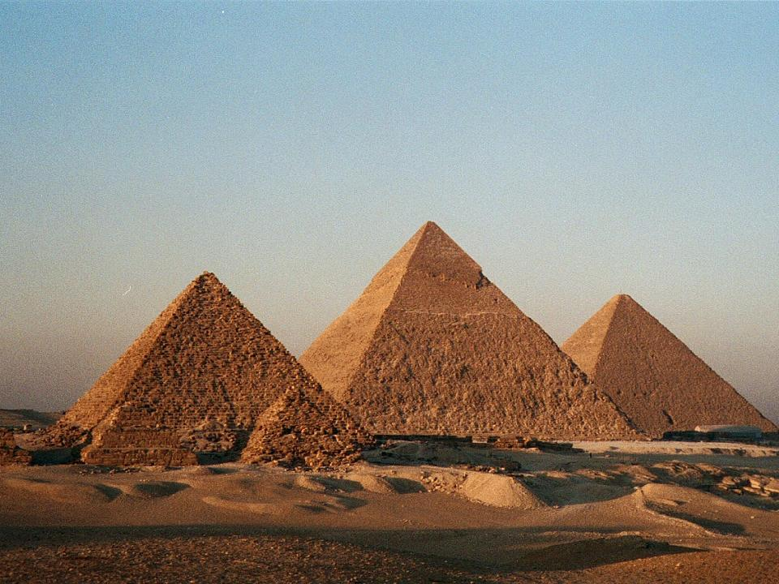
The British Empire
Pyramids
It included:
… and the most famous landmarks.

Slide 16
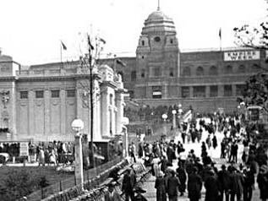
The British Empire
Wembley Stadium – built for the 1924 Empire exhibition
It included:
… and the most famous landmarks.

Slide 17
The British Empire
Places at one time in the British Empire include:
- England
  - Wales
  - Scotland
  - Ireland
    - Northern Ireland
- Isle of Man
Channel Islands
Jersey
  - Guernsey
  - Alderney
  - Sark

Slide 18
The British Empire
Places at one time in the British Empire include:
Gibraltar
Heligoland
- Hanover
- Ionian Islands
- Minorca
- Malta
Cyprus
Egypt
- Transjordan
- Iraq
- Kuwait
- Bahrain
- Muscat & Oman
- Qatar
- United Arab Emirates
  - Abu Dhabi
  - Ajman
  - Dubai
  - Al Sharqah
  - Umm al Qawain
  - Ras al Khaimah
  - Fujairah
- Aden
  - Socotra Island
- Afghanistan

Slide 19
The British Empire
Places at one time in the British Empire include:
India
Pakistan
Bangladesh
Hyderadbad
Jammu & Kashmir
Mysore
Orchha
Bahawalpur
Travancore
Rajputana
  Jodhpur
  Jaisalmer
  Bikaner
  Jaipur
  Udaipur
Raigarh
Dir
Patna Khairpur
Palanpur
Las Bela
Morvi
Partabgarh
Surguja
Changbhakar
Korea
Kolhapur
Bundi
Bastar
Narsinghgarh
Porbandar Sheopur
Bahawalpur
Saraikela
Rajkot
Kapurthala
Rewa
Dhenkanal
Raj Nandgaon
Bharatpur
Jhabua

Slide 20
The British Empire
Places at one time in the British Empire include:
Andaman Islands
Nicobar Islands
Sikkim
Bhutan
Burma
Ceylon
Seychelles
Mahé Island
Amriante Isles
Farquhar Group
Cosmoledo Group
British Indian Ocean Territory
Chagos Archipelago
Salomon Islands
Peros Banhos Atoll
Three Brothers Island
Eagle Island
Danger Island
The Egmont Islands
Diego Garcia
Maldives
Mauritius
Rodrigues
Cargados Carajos Shoals
Agalega Island
Malaysia
Straits Settlements
Singapore
Penang
Malacca
Labuan
Malaya
Johore
Kedah
Kelantan
Negri Sembilan
Pahang
Perak
Perlis
Selangor
Trengganu
British North Borneo
Sarawak

Slide 21
The British Empire
Places at one time in the British Empire include:
Canada
Ontario
Quebec
Nova Scotia
New Brunswick
Prince Edward Island
Northwest Territories
Yukon Territory
Manitoba
Alberta
Saskatchewan
British Columbia
Newfoundland
United States
New Hampshire
Massachusetts
Delaware
Pennsylvania
New Jersey
New York
Georgia
Connecticut
Maryland
South Carolina
North Carolina
Virginia
Rhode Island
Vermont
Florida
Mosquito Coast
Surinam
Guyana
Belize
Bahamas
Grand Turk Is.
Salt Cay
Grand Caicos Island
Bermuda
Cayman Islands
British Virgin Is.
Leeward Islands
Anguilla
Montserrat
Antigua
St. Kitts
Windward Islands
St. Lucia
Grenada
St. Vincent
Dominica
Barbados
Jamaica
Trinidad

Slide 22
The British Empire
Places at one time in the British Empire include:
Australia
Queensland
New South Wales
Victoria
South Australia
Western Australia
Tasmania
Northern Territory
Coral Sea Islands Territory
Norfolk Island
Philip Island
Lord Howe Island
Ball's Pyramid
Cocos Islands
Christmas Island
McDonald Islands
Shag Island
Heard Island
Nauru
Papua
New Guinea
Bismark Archipelago
Solomon Islands
Fiji
New Zealand
Cook Islands
Rarotonga
Aitutaki
Atiu
Mitiaro
Mangaia
Suwarrow Atoll
Nassau
Palmerston Atoll
Niue Island
Tokelau Islands
Atafu
Nukunono
Fakaofo
Rakahanga Atoll
Penrhyn Atoll
Manihiki Atoll
Auckland Islands
Campbell Island
Antipodes Islands
Bounty Islands
Chatham Islands
Kermadec Islands
Sunday Island
Macauley Island
Curtis Island
L'Esperance Rock
Western Samoa
Tonga
Hew Hebrides

Slide 23
The British Empire
Places at one time in the British Empire include:
Vanuatu
Gilbert Islands
Elice Islands
Pitcairn Island
Oeno Island
Henderson Island
Ducie Island
Phoenix Island
Sydney Island
Hull Island
Gardner Island
Canton Island
Enderbury Island
Christmas Island
Fanning Island
Washington Island
Starbuck Island
Malden Island
British Virgin Islands
Leeward Islands
Anguilla
Montserrat
Antigua
St. Kitts
Windward Islands
St. Lucia
Grenada
St. Vincent
Dominica
Barbados
Jamaica
Trinidad
South Africa
Cape Colony
Natal
Orange Free State
Transvaal
Prince Edward Is.
Walvis Bay
Southwest Africa
Swaziland
Basutoland
Botswana
Kenya
Tananyika
Zanzibar
Uganda,
Zambia
Zimbabwe
Malawi
British Somaliland
Eritrea
Sierra Leone
Ghana
Gambia
Nigeria
Cameroon
British Cameroon
Falkland Islands
South Sandwich Islands
South Georgia
Antarctic Peninsula
South Shetland Islands
South Orkney Islands St. Helena
Ascension Island
Tristan da Cunha
Nightingale Island
Gough Island
and…

Slide 24
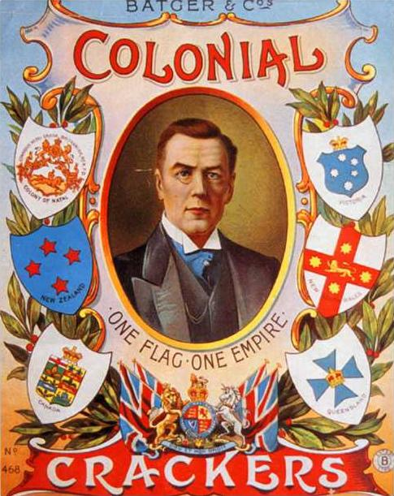
The British Empire
The Empire caught the imagination of the British public:
It was used to sell
everything from
crackers…

Slide 25
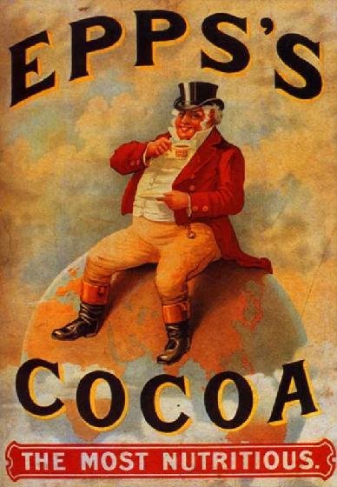
The British Empire
The Empire caught the imagination of the British public:
… to cocoa.

Slide 26
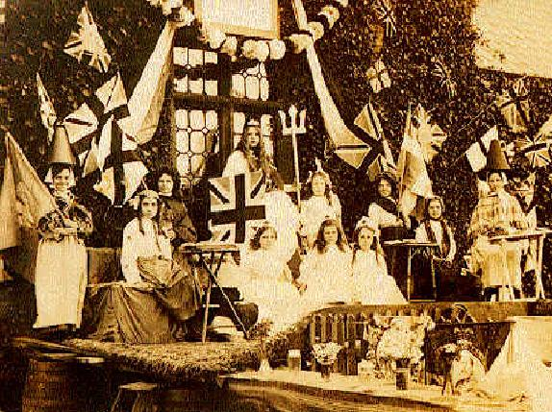
The British Empire
The British were very proud of their Empire.

Slide 27
The British Empire
Legacies of the British Empire include:
Cricket, football and rugby are played the world over.

Slide 28
The British Empire
Legacies of the British Empire include:
English is the universal language of trade.

Slide 29
The British Empire
Legacies of the British Empire include:
The belief that parliaments, freedom, democracy and the rule of law are GOOD THINGS.

Slide 30
The British Empire
Legacies of the British Empire include:
School, universities and a liberal system of education.

Slide 31
The British Empire
Legacies of the British Empire include:
A cure for malaria.

Slide 32
The British Empire
Legacies of the British Empire include:
The Christian faith and the worldwide Anglican Church.

Slide 33
The British Empire
Legacies of the British Empire include:
Bureaucracy, and trains.

Slide 34
The British Empire
Legacies of the British Empire include:
World trade, capitalism and globalization.

Slide 35
The British Empire
Legacies of the British Empire include:
Publicity – the Empire Press Rate.
  Because the British government wanted the different parts of the empire to know about each other, journalists were allowed to use the cable lines for only a penny a word.
  Journalists from all over the world used this facility, with the result that some countries knew more about what was going on in the British Empire than they did about their own country.

Slide 36
The British Empire
Legacies of the British Empire include:
Britain’s multi-cultural society.
  Britain has more than 300 languages and at least 14 faiths, and the Empire has permanently affected our language, sport, food, dress and politics.

Slide 37
The British Empire
Legacies of the British Empire include:
The Commonwealth.
  Formed mainly from the former countries of the Empire, the Commonwealth is a voluntary association of 54 independent states. It consists of 1.7 billion people - 30% of the world's population - and over a quarter of its land surface.
  It includes Mozambique (a former Portuguese colony).

Slide 38
The British Empire
Negative consequences of the British Empire include:
More than 40 wars.
  Contrary to popular belief the ‘Pax Britannica’ (a time of peace during which trade prospered) never happened.
  Instead, Britain was constantly at war throughout most of the second half of the 19th century.

Slide 39
The British Empire
Negative consequences of the British Empire include:
Atrocities.
  Contrary to popular belief the British Empire was not a benign and gentle democracy.
  The British committed some of the most famous atrocities in history (such as the Amritsar Massacre in India, and concentration camps in South Africa).

Slide 40
The British Empire
Negative consequences of the British Empire include:
Racism.
  The British Empire was partly to blame for apartheid in South Africa.
  Britons also developed theories of racial supremacy and eugenics which were later put into practice by the Nazis.

Slide 41
The British Empire
Negative consequences of the British Empire include:
Political instability.
  When the British Empire came to an end, some of the fledgling countries which were formed did not have the skills to self-govern successfully, and they have been subject to dictatorships and military coups.
  Political unrest in Africa and the Middle East can be traced back to the British Empire.

Slide 42
The British Empire
Negative consequences of the British Empire include:
Mistakes.
  In 2002 Britain’s foreign secretary Jack Straw admitted that the British Empire had made ‘some quite serious mistakes’, and he said:
    “A lot of the problems we are having to deal with now - I have to deal with now - are a consequence of our colonial past .”

