Slide 1

Understanding & Using
Bloom’s Taxonomy
Questioning, Critical Thinking, and Creating in High School and Beyond
AIM: How do you use Bloom’s Taxonomy to assist you in developing and retaining higher-level thinking needed for High School and beyond?
Do Now: In your notebooks, define; higher-level thinking
Mr. Ott @ BETA 2013-14

Slide 2
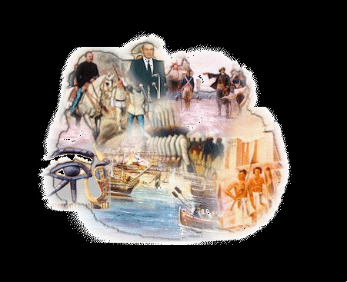
“Learning is not attained by chance, it must be sought for with ardor and attended to with diligence”
Abigail Adams
1780

Slide 3
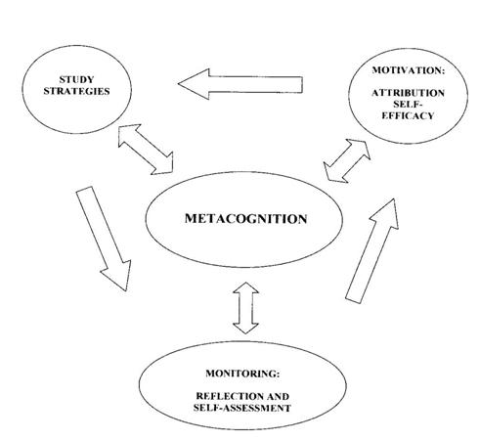
How do we think?
Is there a process you
should use in order to reach higher-level thought?
Why is this important?
According to the diagram, what do you believe is:
METACOGNITION
Cognition = Thinking

Slide 4
Benjamin Bloom’s Taxonomy
Leveled List
Taxonomy for Educational Objectives (1956)
Knowledge/Remembering
1
Cognition
(Thinking)
Levels
2
Comprehension/Understanding
3
Application/Applying
4
Analysis/Analyzing
5
Evaluation/Evaluating
6
Synthesis/Creating

Slide 5
Overlay of Bloom’s Taxonomy
Synthesis/Creating
Evaluation/Evaluating
Analysis/Analyzing
Application/Applying
Comprehension/Understanding
Knowledge/Remembering

Slide 6
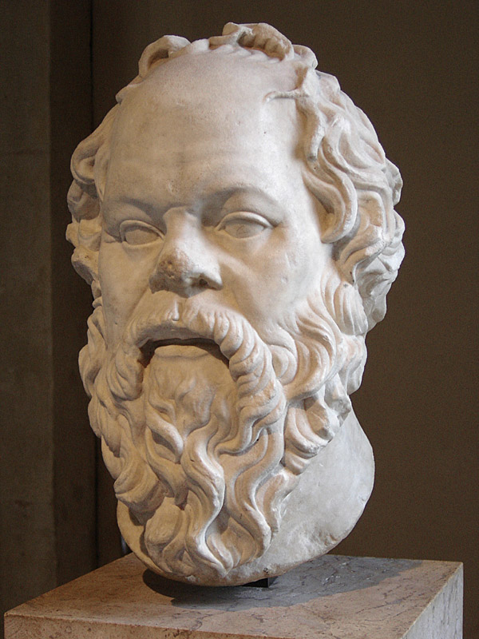
Knowledge: remembering or recalling appropriate, previously learned information to draw out factual (usually right or wrong) answers.
Socrates – Greek Philosopher

Slide 7
Knowledge
List
Define
State
Recall or Recognize Information
Identify
Name
Underline
Arrange, Relate, Reproduce, Select, Match
Questions to ask yourself? Who, What, Where, When

Slide 8
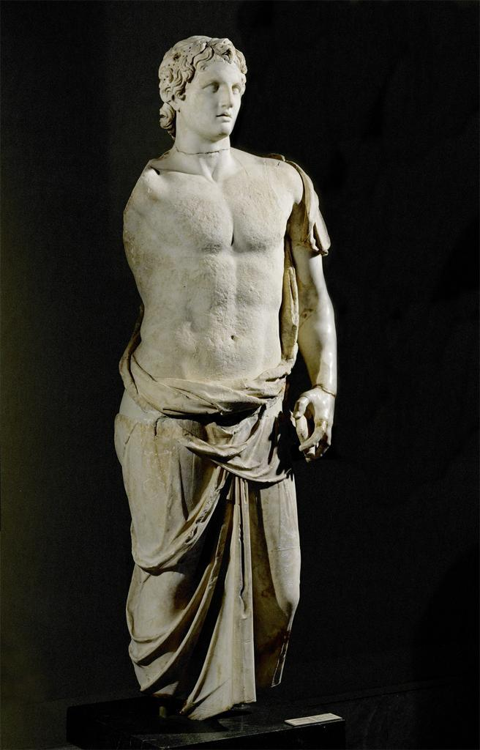
When?
In 336BCE., A PROUD, INTELLIGENT, AND SUPREMELY
ambitious young man rose to become king of Macedonia, which is a kingdom on the northern border of modern-day Greece. He was only 20
years old and already wanted to take over the mighty Persian Empire to
the east. He accomplished this feat and much more, despite the wealth,
power, and military strength of his opponents. And he did it in just
under 12 years. This illustrates his extraordinary gifts as a leader and
military strategist (a person who sets strategy). It has also kept his name
at the top of the list of legendary “action figures” even into the 21st
century, more than 2,300 years later. He is still known throughout the
world as Alexander the Great.
Where?
What?
Who?
Source: Great Empires of the Past: Empire of Alexander the Great, Skelton & Dell, 2009.

Slide 9
Knowledge
Activity:
In your groups Identify the important knowledge aspects of your document(s) by utilizing the strategies previously discussed.

Slide 10

Comprehension: grasping or understanding the meaning of
informational materials.

Slide 11
Comprehension
Describe
Explain
Estimate
Understanding the Meaning
Predict
Identify
Separate
translate, interpret, and extrapolate (pull out)
Questions to ask yourself? Why?

Slide 12
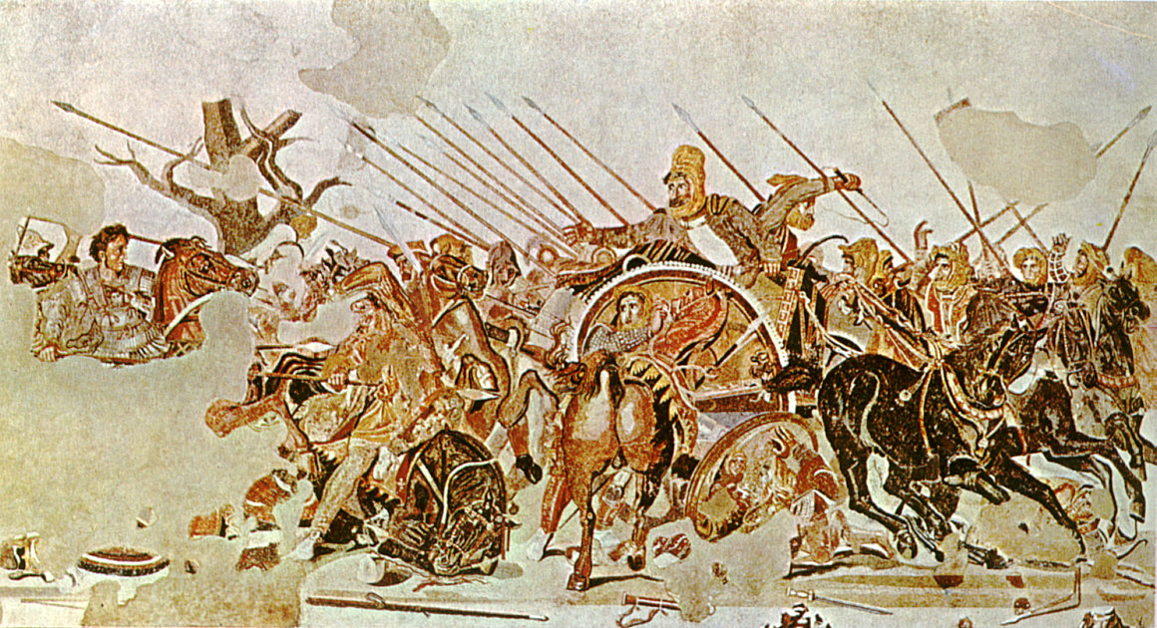
Interpret?
Explain?
The young prince had the best possible background for someone with great ambitions. King Philip II was an aggressive leader who set an example for his son by conquering neighboring lands when Alexander was just an infant. Alexander spent much of his childhood among the soldiers of his father’s army. Philip was also a great diplomat. He married seven times, and each new marriage made a new alliance with his neighbors.
Another important influence on the young prince was his teacher Aristotle (384–322 b.c.e.), one of the greatest Greek philosophers ever to have lived. Aristotle, who wrote or edited several hundred books, taught the young prince geography, botany (the study of plants), zoology (the study of animals), logic (the study of the rules and tests of
sound reasoning), and many other subjects.
Source: Great Empires of the Past: Empire of Alexander the Great, Skelton & Dell, 2009.

Slide 13
Comprehension
Activity:
In your groups Identify the important comprehension aspects of your document(s) by utilizing the strategies previously discussed.

Slide 14
Application: applying previously learned information (or knowledge) to new and unfamiliar situations

Slide 15
Application
Demonstrate
Classify
Illustrate
Applying Previously Learned Info
Connect
Solve
Examine
Apply to previous or new situations
Questions to ask yourself? Why, How, and What If?

Slide 16
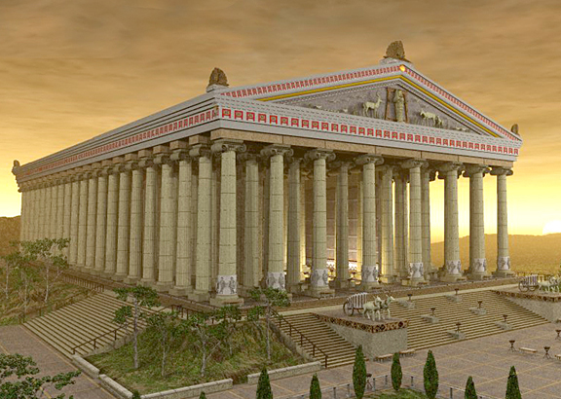
Alexander was born the sixth of Hecatombaeon, which month the Macedonians call Lous, the same day that the temple of Diana at Ephesus was burnt; which Hegesias of Magnesia makes the occasion of a conceit, frigid enough to have stopped the conflagration. The temple, he says, took fire and was burnt while its mistress was absent, assisting at the birth of Alexander. And all the Eastern soothsayers who happened to be then at Ephesus, looking upon the ruin of this temple to be the forerunner of some other calamity, ran about the town, beating their faces, and crying that this day had brought forth something that would prove fatal and destructive to all Asia.
Explain?
Examine?
Source: Alexander, Plutarch, (75CE)

Slide 17
Application
Activity:
In your groups Identify the important application aspects of your document(s) by utilizing the strategies previously discussed.

Slide 18

Analysis: breaking down information into parts, or examining (and
trying to understand the organizational structure of) information.

Slide 19
Analysis
Explain
Compare
Separate
Breaking Down Information Into Parts
Arrange
Contrast
Classify
Similarities, Differences, Positive, Negative
Questions to ask yourself: How are these parts connected or disconnected?

Slide 20
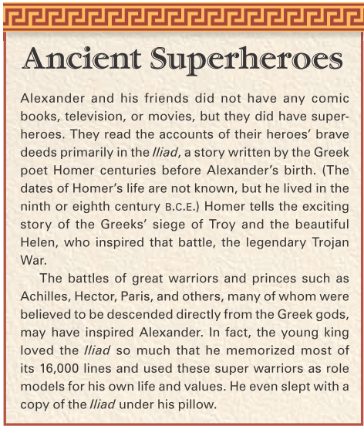
Compare?
Contrast?
Positive?
Negative?

Slide 21
Analysis
Activity:
In your groups Identify the important analysis aspects of your document(s) by utilizing the strategies previously discussed.

Slide 22
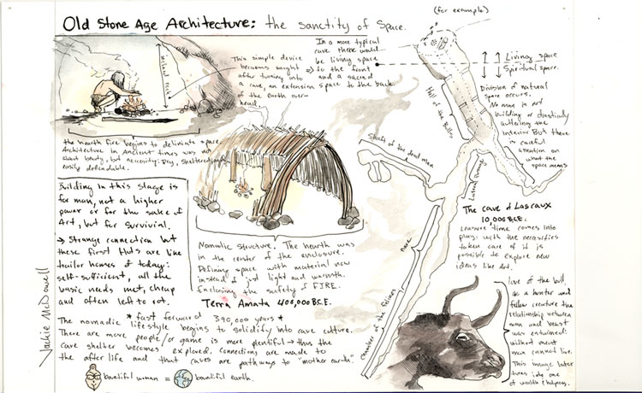
Synthesis: applying prior knowledge and skills to combine elements into a pattern not clearly there before.

Slide 23
Synthesis
Combine
Rearrange
Substitute
Create a New Pattern
Create
Design
Invent
Applying Prior Knowledge and skills to combine them into a pattern not clearly there before
Questions to ask yourself: Were the connections I’m making there before? What if?

Slide 24
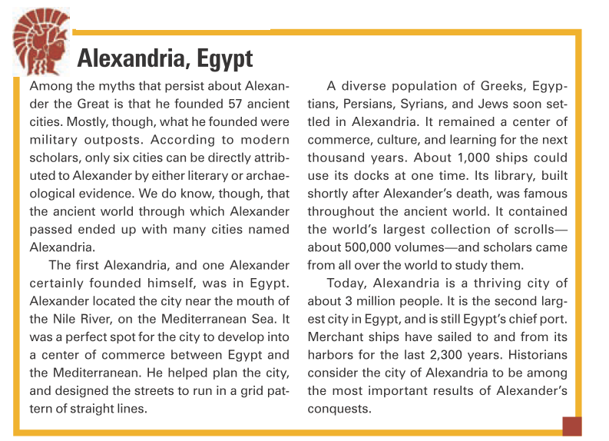
Cultural Diffusion
What happens when many cultures come together?
What are the positive effects of these trading centers?

Slide 25
synthesis
Activity:
In your groups Identify the important synthesis aspects of your document(s) by utilizing the strategies previously discussed.

Slide 26
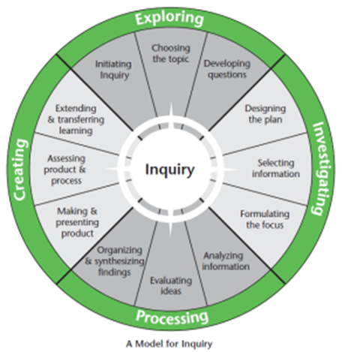
Evaluation: judging or deciding according to some set of criteria,
without real right or wrong answers.

Slide 27
Evaluation
Assess
Decide
Select
Based Upon Evidence
Compare
Summarize
Conclude
Judging or deciding according to some set of criteria.
Questions to ask yourself: What kind of conclusions can be made based upon the evidence?

Slide 28
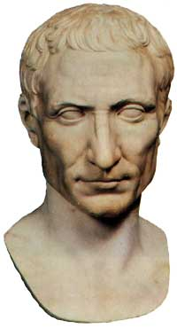
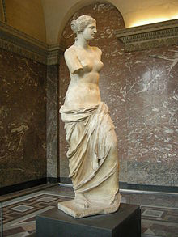
In the final analysis, when evaluated as an influence
for the development of future leaders, Alexander the Great
was both a positive and negative influence for such rulers as Julius Caesar, Napoleon, and Hitler. Each utilized Alexander’s
military tactics, and leadership skills, albeit in different ways. Julius Caesar visited and prayed at Alexander’s tomb in Alexandria, Egypt, and looked to Alexander for guidance. He wept and prayed that he could be only one-half of a ruler that Alexander was in his lifetime. He became one of the most
brilliant military leaders of all time.
The repository at Alexandria, Egypt held the known western world’s knowledge. The mixing of cultures in Alexandria often led to a plethora of cultural diffusion, increasing the knowledge gained for centuries after Alexander’s death. The rise of Hellenism is directly attributed to this spread of Greek culture because of Alexander’s military campaigns and victories. Greek culture and learning spread all over the known world. This would eventually lead to the rise of Rome and its combined influence of both Roman and Greek culture, of which the positive effect we still see today in our cultures and civilizations.

Slide 29
evaluation
Activity:
In your groups Identify the important evaluation aspects of your document(s) by utilizing the strategies previously discussed.

