Slide 1
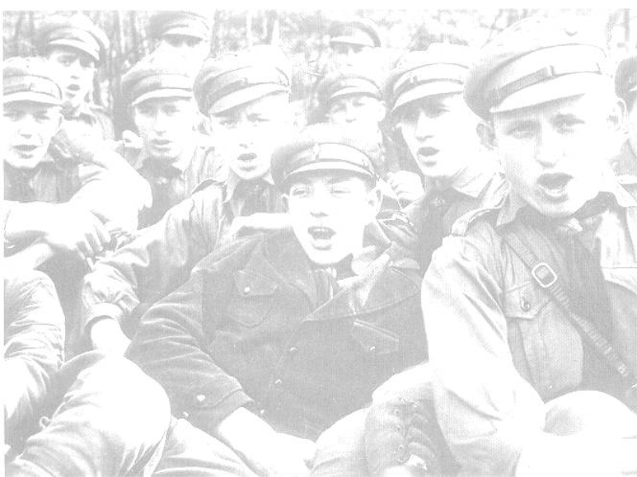
Changing Life In Germany 1933-39
The Hitler Youth
‘Those who have youth on their side control the future.’

Slide 2
How youths were organised
Boys
10 – 14 Years Old
Deutsches Jungvolk – DJ (Pimpfen)
German Young People (Cubs)
Girls
10 – 14 Years Old
Jungmadelbund – JM
League of Young Girls
Boys
14 - 18 Years Old
Hitler Jugend – HJ
Hitler Youth
Girls
14 - 18 Years Old
Bund Deutscher Madel – BDM
League of German Girls
The Hitler Youth (HJ) was formed in 1926 and by 1932 108,000 youths between the ages of 10 and 18 had joined.

Slide 3
Highlight the words and phrases which illustrate the dedication of youths within Nazi Youth organisations?
Why do you think that Hitler and the Nazis made young people repeat these promises over and over again while in the Hitler Youth?
“In the presence of this blood banner which represents the Fuhrer, I swear to devote all my energies and my strength to the saviour of our country, Adolf Hitler. I am willing and ready to give up my life for him, so help me God.”
An oath taken by 10 Year Olds when they entered the Deutsches Jungvolk
“I promise to do my duty in love and loyalty to the Fuhrer and our flag.”
The Pledge of Allegiance taken by all members of the Hitler Youth

Slide 4
What do you think a Heim was and why do you think that the members of the Nazi Youth Groups liked it so much?
“We were very proud of our new Heim. It stood on one of the most beautiful spots in our part of the town, close to the park. The Hitler Youth, the Bund Deutscher Madel (League of German Maidens), the Jungmadel (Young Maidens), and the Jungvolk could all do their duty there simultaneously. Each unit had a business room and a large room for indoor duty. Wide windows and pale furniture made the rooms light. Books stood on the wall shelves in easy reach of everybody. Parlour games lay in the open cupboard; table-tennis tops were propped in the corner. We had a fully equipped workshop in the cellar, as well as showers. A caretaker couple looked after the cleaning and the heating.”
Taken from ‘I Was There’ by Hans Peter Richter (Puffin Books, 1987)

Slide 5
Hans Peter Richter commented that ‘many found the new Heim nicer than home’. He also goes on to describe ‘War Games’ practiced by the Hitler Youth Unit that he was part of in 1937.
“We marched to the works. ‘Works’ was the name given to a large area outside of town. Someone had at one time started to build vast factory halls there. But the work had been broken off and the tract of land had lain fallow ever since. Mounds of earth, excavated pits, all were overgrown with grass and underbrush, in between lay piles of stone, remnants of walls, broken train tracks. A perfect spot for war games!”
Taken from ‘I Was There’ by Hans Peter Richter (Puffin Books, 1987)
Why do you think that the Hitler Youth were taken to such areas to participate in ‘War Games’?
Does this help you to understand the aims of the HJ as an organisation?

Slide 6
Why do you think that it was necessary for the Nazis to pass Laws concerning the Hitler Youth?
Think about:
* The Nazi vision of the future of Germany
* Rebellious youths and parents
The future of the German nation depends upon its youth and must be prepared for its future duties…The whole of German youth is organised in the Hitler Youth. All German young people, apart from being educated at home and at school, will be educated in the Hitler Youth physically, intellectually, and morally in the spirit of National Socialism to serve the nation and the community.
Taken from the Nazi Youth Law, 1st December 1936

Slide 7
Hitler Youth
Rules
Members of the HJ must not be seen in uniform with girls
Next Rule
Rules taken from Nazi Power in Germany by Greg and Jean Thie, Hutchinson, 1989

Slide 8
Hitler Youth
Rules
Members of the HJ must not be seen in uniform with girls
Members of the HJ must not buy things at Jewish shops
Next Rule
Rules taken from Nazi Power in Germany by Greg and Jean Thie, Hutchinson, 1989

Slide 9
Hitler Youth
Rules
Members of the HJ must not be seen in uniform with girls
Members of the HJ must not buy things at Jewish shops
HJ members must ignore friends and parents whilst marching along
Question
Rules taken from Nazi Power in Germany by Greg and Jean Thie, Hutchinson, 1989

Slide 10
Hitler Youth
Rules
Members of the HJ must not be seen in uniform with girls
Members of the HJ must not buy things at Jewish shops
HJ members must ignore friends and parents whilst marching along
After reading through these rules, how much control do you think that the HJ had over the lives of young people within Nazi Germany?
Rules taken from Nazi Power in Germany by Greg and Jean Thie, Hutchinson, 1989

Slide 11
Hitler Youth
Facts
Fact 1

Slide 12
You experienced outdoor activities such as hiking and camping
Hitler Youth
Facts
Fact 2

Slide 13
You experienced outdoor activities such as hiking and camping
You had to swear an oath of allegiance to the Fuhrer
Hitler Youth
Facts
Fact 3

Slide 14
You experienced outdoor activities such as hiking and camping
You had to swear an oath of allegiance to the Fuhrer
The abbreviation used for Hitler Youth is HJ
Hitler Youth
Facts
Fact 4

Slide 15
You experienced outdoor activities such as hiking and camping
You had to swear an oath of allegiance to the Fuhrer
The abbreviation used for Hitler Youth is HJ
At 14 girls joined the League of German Girls - BDM
Hitler Youth
Facts
Fact 5

Slide 16
You experienced outdoor activities such as hiking and camping
You had to swear an oath of allegiance to the Fuhrer
The abbreviation used for Hitler Youth is HJ
At 14 girls joined the League of German Girls - BDM
Hitler Youth
Facts
By 1932 there were 108,000 members of The Hitler Youth
Fact 6

Slide 17
You experienced outdoor activities such as hiking and camping
You had to swear an oath of allegiance to the Fuhrer
The abbreviation used for Hitler Youth is HJ
At 14 girls joined the League of German Girls - BDM
Hitler Youth
Facts
The aim of the HJ was to prepare boys for military service and to be strong future leaders of Germany
By 1932 there were 108,000 members of The Hitler Youth
Fact 7

Slide 18
You experienced outdoor activities such as hiking and camping
You had to swear an oath of allegiance to the Fuhrer
The abbreviation used for Hitler Youth is HJ
At 14 girls joined the League of German Girls - BDM
Hitler Youth
Facts
The aim of the HJ was to prepare boys for military service and to be strong future leaders of Germany
By 1932 there were 108,000 members of The Hitler Youth
Emphasis in the HJ and BDM was placed upon physical fitness, group activities and obedience to the Nazi Party
Fact 8

Slide 19
You experienced outdoor activities such as hiking and camping
You had to swear an oath of allegiance to the Fuhrer
The abbreviation used for Hitler Youth is HJ
At 14 girls joined the League of German Girls - BDM
Hitler Youth
Facts
The aim of the HJ was to prepare boys for military service and to be strong future leaders of Germany
By 1932 there were 108,000 members of The Hitler Youth
The Hitler Youth Law was passed in 1936 and stated that all youths should belong to the Hitler Youth. Joining the Hitler Youth became compulsory in 1939
Emphasis in the HJ and BDM was placed upon physical fitness, group activities and obedience to the Nazi Party
Fact 9

Slide 20
You experienced outdoor activities such as hiking and camping
You had to swear an oath of allegiance to the Fuhrer
The abbreviation used for Hitler Youth is HJ
At 14 girls joined the League of German Girls - BDM
Hitler Youth
Facts
The aim of the HJ was to prepare boys for military service and to be strong future leaders of Germany
By 1932 there were 108,000 members of The Hitler Youth
The Hitler Youth Law was passed in 1936 and stated that all youths should belong to the Hitler Youth. Joining the Hitler Youth became compulsory in 1939
Emphasis in the HJ and BDM was placed upon physical fitness, group activities and obedience to the Nazi Party
The aim of the BDM was to prepare girls for motherhood
Fact 10

Slide 21
You experienced outdoor activities such as hiking and camping
You had to swear an oath of allegiance to the Fuhrer
The abbreviation used for Hitler Youth is HJ
At 14 girls joined the League of German Girls - BDM
Hitler Youth
Facts
The aim of the HJ was to prepare boys for military service and to be strong future leaders of Germany
By 1932 there were 108,000 members of The Hitler Youth
The Hitler Youth Law was passed in 1936 and stated that all youths should belong to the Hitler Youth. Joining the Hitler Youth became compulsory in 1939
By 1939 there were 7.3 million members of The Hitler Youth
Emphasis in the HJ and BDM was placed upon physical fitness, group activities and obedience to the Nazi Party
The aim of the BDM was to prepare girls for motherhood

Slide 22
How did young people
within Germany react
to the HJ?
Reaction 1

Slide 23
Many young people enjoyed the excitement of the HJ – camping, hiking, weapons training…
How did young people
within Germany react
to the HJ?
Reaction 2

Slide 24
Many young people enjoyed the excitement of the HJ – camping, hiking, weapons training…
Many young people liked the feeling of importance – the uniform, the respect, the adoration…
How did young people
within Germany react
to the HJ?
Reaction 3

Slide 25
Many young people enjoyed the excitement of the HJ – camping, hiking, weapons training…
Many young people liked the feeling of importance – the uniform, the respect, the adoration…
How did young people
within Germany react
to the HJ?
Lots of youths resented the fact that their old clubs and youth groups were banned
Reaction 4

Slide 26
Many young people enjoyed the excitement of the HJ – camping, hiking, weapons training…
Many young people liked the feeling of importance – the uniform, the respect, the adoration…
How did young people
within Germany react
to the HJ?
Lots of youths resented the fact that their old clubs and youth groups were banned
Many youths disliked the strict regimentation – being told what to do and when to do it
Reaction 5

Slide 27
Many young people enjoyed the excitement of the HJ – camping, hiking, weapons training…
Many young people liked the feeling of importance – the uniform, the respect, the adoration…
How did young people
within Germany react
to the HJ?
Lots of youths resented the fact that their old clubs and youth groups were banned
Many youths disliked the strict regimentation – being told what to do and when to do it
Alternative youth groups sprang up across Germany –
e.g. The Edelweiss Pirates, The Navajos Gang, The Kittelbach Pirates…
Reaction 6

Slide 28
Many young people enjoyed the excitement of the HJ – camping, hiking, weapons training…
Many young people liked the feeling of importance – the uniform, the respect, the adoration…
How did young people
within Germany react
to the HJ?
Lots of youths resented the fact that their old clubs and youth groups were banned
Many youths disliked the strict regimentation – being told what to do and when to do it
Alternative youth groups sprang up across Germany –
e.g. The Edelweiss Pirates, The Navajos Gang, The Kittelbach Pirates…
Alternative youth groups ambushed Hitler Youth patrols and beat them up. Some girls resented the fact that they were ‘trained’ to be housewives and mothers at such a young age.
Reaction 7

Slide 29
Many young people enjoyed the excitement of the HJ – camping, hiking, weapons training…
Many young people liked the feeling of importance – the uniform, the respect, the adoration…
How did young people
within Germany react
to the HJ?
Lots of youths resented the fact that their old clubs and youth groups were banned
Many youths disliked the strict regimentation – being told what to do and when to do it
Alternative youth groups sprang up across Germany –
e.g. The Edelweiss Pirates, The Navajos Gang, The Kittelbach Pirates…
Alternative youth groups ambushed Hitler Youth patrols and beat them up. Some girls resented the fact that they were ‘trained’ to be housewives and mothers at such a young age.
Lots of youths wanted to listen to Jazz, try out new fashions and hair styles, smoke and drink alcohol. All of these activities were banned in The Hitler Youth

Slide 30
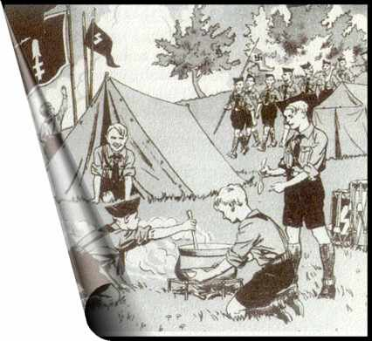
What can we learn about HJ activities from this picture?
What can I see?

Slide 31

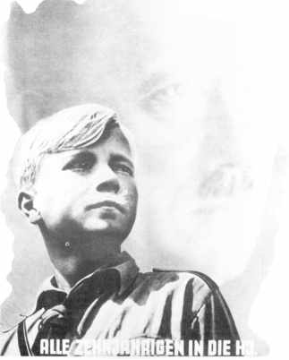
What I can see
Key Questions
Hitler in the background
Young HJ boy.
Aryan in appearance, serious, looking ahead
(in awe?)
Military/ Smart Uniform
“Youth Serves the Führer”
All 10-year-olds into the Hitler Youth."
Left hand mouse click to check your response before moving on
Caption in Bold

Slide 32
What I can see
Key Questions
Who is this poster aimed at?
Hitler in the background
Young HJ boy.
Aryan in appearance, serious, looking ahead
(in awe?)
Military/ Smart Uniform
“Youth Serves the Führer”
All 10-year-olds into the Hitler Youth."
Caption in Bold

Slide 33
What I can see
Key Questions
Who is this poster aimed at?
Why was this poster produced?
Hitler in the background
Young HJ boy.
Aryan in appearance, serious, looking ahead
(in awe?)
Military/ Smart Uniform
“Youth Serves the Führer”
All 10-year-olds into the Hitler Youth."
Caption in Bold

Slide 34
What I can see
Key Questions
Who is this poster aimed at?
Why was this poster produced?
What does this poster tell you about Nazi attitude towards youth?
Hitler in the background
Young HJ boy.
Aryan in appearance, serious, looking ahead
(in awe?)
Military/ Smart Uniform
“Youth Serves the Führer”
All 10-year-olds into the Hitler Youth."
Caption in Bold

Slide 35
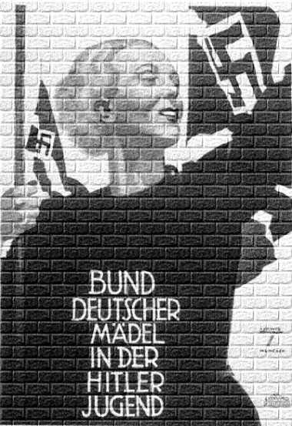
What I can see
Key Questions
Nazi Party Flag
Smiling, happy
Aryan and healthy in appearance
Flag bearer
Caption/
message in bold
Left hand mouse click to check your response before moving on

Slide 36
What I can see
Key Questions
Who is this poster aimed at?
Nazi Party Flag
Smiling, happy
Aryan and healthy in appearance
Flag bearer
Caption/
message in bold
Left hand mouse click to check your response before moving on

Slide 37
What I can see
Key Questions
Who is this poster aimed at?
Why was this poster produced?
What makes it so effective?
Nazi Party Flag
Smiling, happy
Aryan and healthy in appearance
Flag bearer
Caption/
message in bold
Left hand mouse click to check your response before moving on

Slide 38
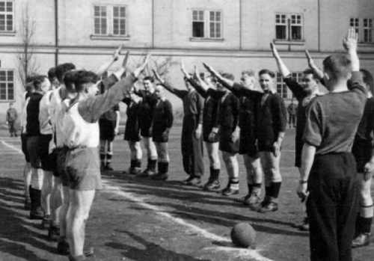
What is happening in the picture?
What does this tell you about the degree to which young people within Germany were exposed to Nazi ideas and beliefs?

Slide 39
Figures showing membership of the Hitler Youth
108,000
3.6 million
5.4 million
7.0 million
7.3 million
Based upon all that you learnt, how do you account for the rapid growth in membership of the Hitler Youth?

Slide 40
Figures showing membership of the Hitler Youth
108,000
3.6 million
5.4 million
7.0 million
7.3 million
Based upon all that you learnt, how do you account for the rapid growth in membership of the Hitler Youth?
It may be worth noting that the total number of 10-18 year olds in Germany in 1939 was 8.9 million.

Slide 41
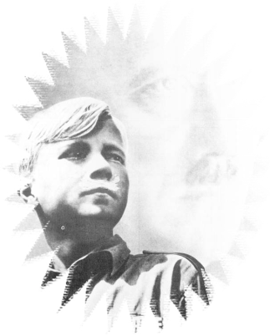
So what have I learnt about the H.J.?
(Some information has already been added for you)
You experienced outdoor activities such as hiking and camping
By 1939 there were 7.3 million members of The Hitler Youth

Slide 42
So what have I learnt about Alternative Youth Groups?
(Some information has already been added for you)
Alternative youth groups sprang up across Germany –
e.g. The Edelweiss Pirates, The Navajos Gang, The Kittelbach Pirates…
END

