Slide 1
A History of Western Society
Tenth Edition
John P. McKay ● Bennett D. Hill
John Buckler ● Claire Haru Crowston
Merry E. Wiesner-Hanks ● Joe Perry
CHAPTER 26
War and Revolution, 1914–1919
Copyright © 2011 by Bedford/St. Martin’s

Slide 2
I. The Road to War
A. Growing International Conflict
1. Germany’s Great Power Status
2. The Alliance Systems
3. The Anglo-German Antagonism
4. First Moroccan Crisis (1905)
5. Triple Entente
Notes:
I. The Road to War (no single cause but many)
A. Growing International Conflict
1. Germany’s Great Power Status – A major cause of the war. Though Bismarck insisted that German had no territorial ambitions and needed to maintain friendly relations with Russia, Kaiser Wilhelm pursued a much more belligerent foreign policy. He refused to renew the nonaggression pact with Russia.
2.The Alliance Systems – The Triple Alliance (Austria, Germany, Italy) faced the Dual Alliance (Russia and France). The German military began preparing for a two-front war.
3. The Anglo-German Antagonism – Though Britain was the only uncommitted Great Power in Europe in 1891, its relations with Germany soured because of commercial rivalries in world markets, Germany’s pursuit of colonies, Germany’s decision to expand its navy and challenge British naval supremacy and German sympathy for the Boers.
4. First Moroccan Crisis (1905) – A colonial dispute in which Wilhelm II declared that Morocco was an independent sovereign state and demanded that Germany receive the same trading rights as France. In response, Britain, France, Russia and even the United States began to see Germany as a potential threat and German leaders began to see plots to block Germany’s development as a great power.
5. Triple Entente – Alliance between Britain, Russia, and France.

Slide 3
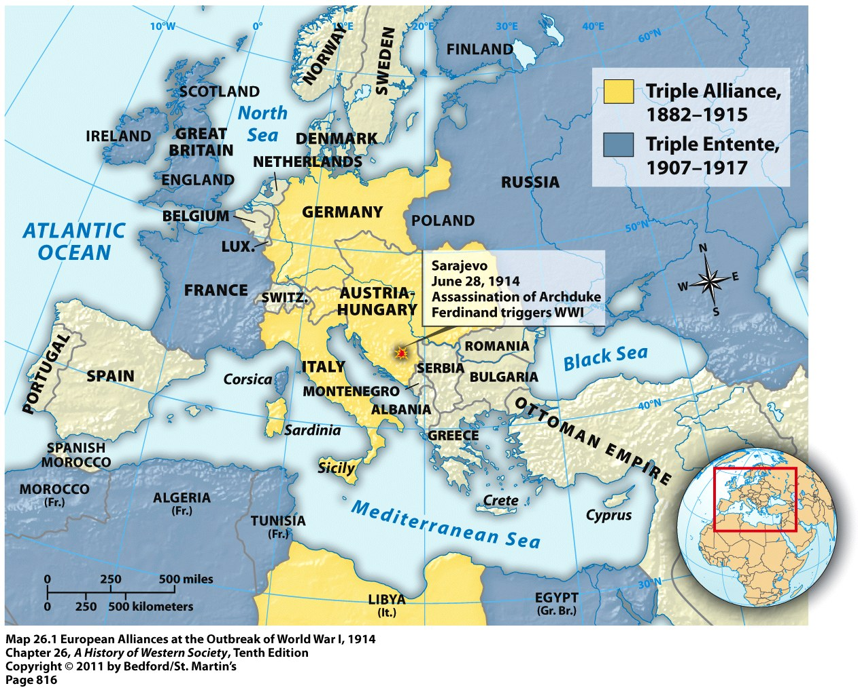

Slide 4
I. The Road to War
B. The Mood of 1914
1. Militarism
2. Nationalism
3. Promoting Nationalism
Notes:
I. The Road to War (no single cause but many)
B. The Mood of 1914
1. Militarism – Especially powerful in Germany but also present in most of the other powers, who relied on conscription and exposed young men to military culture and discipline. Many Europeans saw war as glorious, heroic, and manly. It was a test of strength that would bring about national unity.
2. Nationalism – Drove the arms race and the struggle over colonies and saw antiwar sentiment as a betrayal of the country in its time of need.
3. Promoting Nationalism – Statesmen used war and nationalism to distract from problems like the civil war in Northern Ireland, the women’s movement, the growth of the SPD in Germany and labor and budget problems in France. In the short run, patriotic nationalism unified, but in the long run, led to social revolution.

Slide 5
I. The Road to War
C. The Outbreak of War
1. The Assassination of Archduke Ferdinand
2. The Balkan Powder-Keg
3. The Two Balkan Wars (1912, 1913)
4. The Road to War
5. The Schlieffen Plan
6. Popular Sentiment
Notes:
I. The Road to War
C. The Outbreak of War
1. The Assassination of Archduke Ferdinand – On June 28, 1914, the heir to the Austrian throne was shot in Sarajevo, the capital of Bosnia, by a member of a radical Serbian group who sought to unite all Serbians.
2. The Balkan Powder-Keg – After the Western powers forced the Ottoman empire to give up their European territories between 1900 and 1914, ethnic nationalism grew in the region and threatened the Austro-Hungarian Empire. Serbia wanted to build a state that included all Serbs, including those in the Austro-Hungarian empire.
3. The Two Balkan Wars (1912, 1913) – Serbia joined Greece and Bulgaria to attack the Ottoman Empire (1912) and Bulgaria attacked its former allies, prompting Austrian intervention and Serbia’s relinquishing of Albania (1913).
4. The Road to War – Austria implicated Serbia in the assassination and, with unconditional German support, presented it with an ultimatum that would violate Serbian sovereignty. Serbia turned to Russia for support, but Russian mobilization plans assumed a two-front war against Austria and Germany. Russian mobilization ensured German involvement.
5. The Schlieffen Plan – The German plan for a two-front war that called for a quick victory over France after a lightning invasion of neutral Belgium before turning on Russia.
6. Popular Sentiment – At the end of July and early August, crowds celebrated the impending war in Paris, London, St. Petersburg, Berlin, and Vienna.

Slide 6
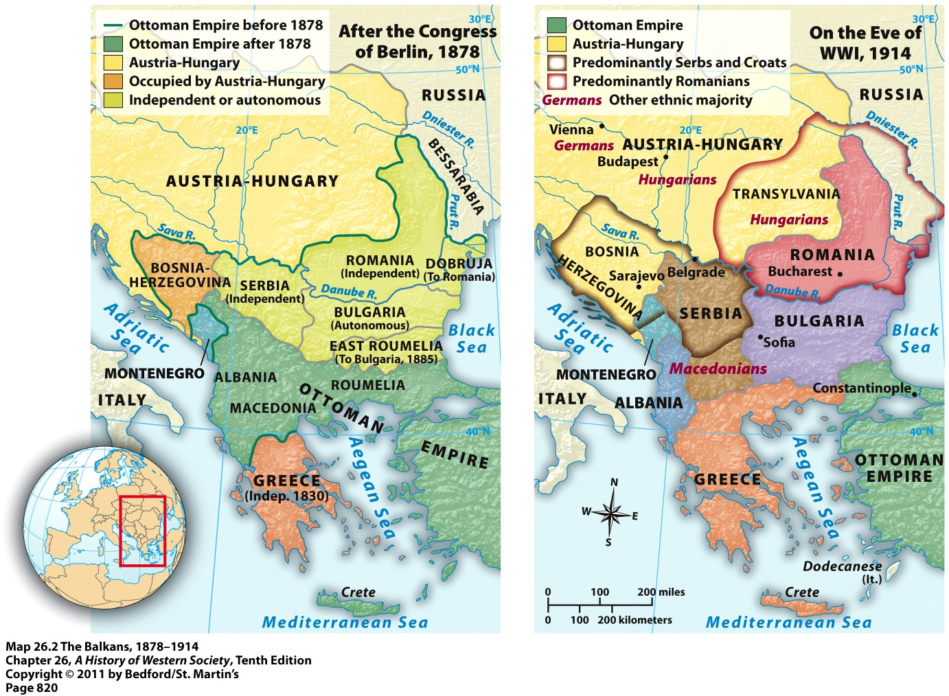

Slide 7
II. Waging Total War
A. Stalemate and Slaughter on the Western Front
1. The Road to Stalemate
2. Trench Warfare
3. The Battles of Verdun and the Somme (1916)
Notes:
II. Waging Total War (expectations of a quick and painless war were dashed)
A. Stalemate and Slaughter on the Western Front
1. The Road to Stalemate – Because of the Russian attack, Germany was forced to transfer troops to the east. After initial advances, the French counterattacked at the battle of the Marne, leading to a stalemate.
2. Trench Warfare – Trenches extended from the Belgian coast to the Swiss border, where soldiers dug in and made use of machine guns, hand grenades, poison gas, flame-throwers, long-range artillery, airplanes and, later, tanks. It was a strange mixture of high-tech warfare and man-to-man combat.
3. The Battles of Verdun and the Somme (1916) – Claimed almost two million lives and resulted in almost no territorial gains.

Slide 8
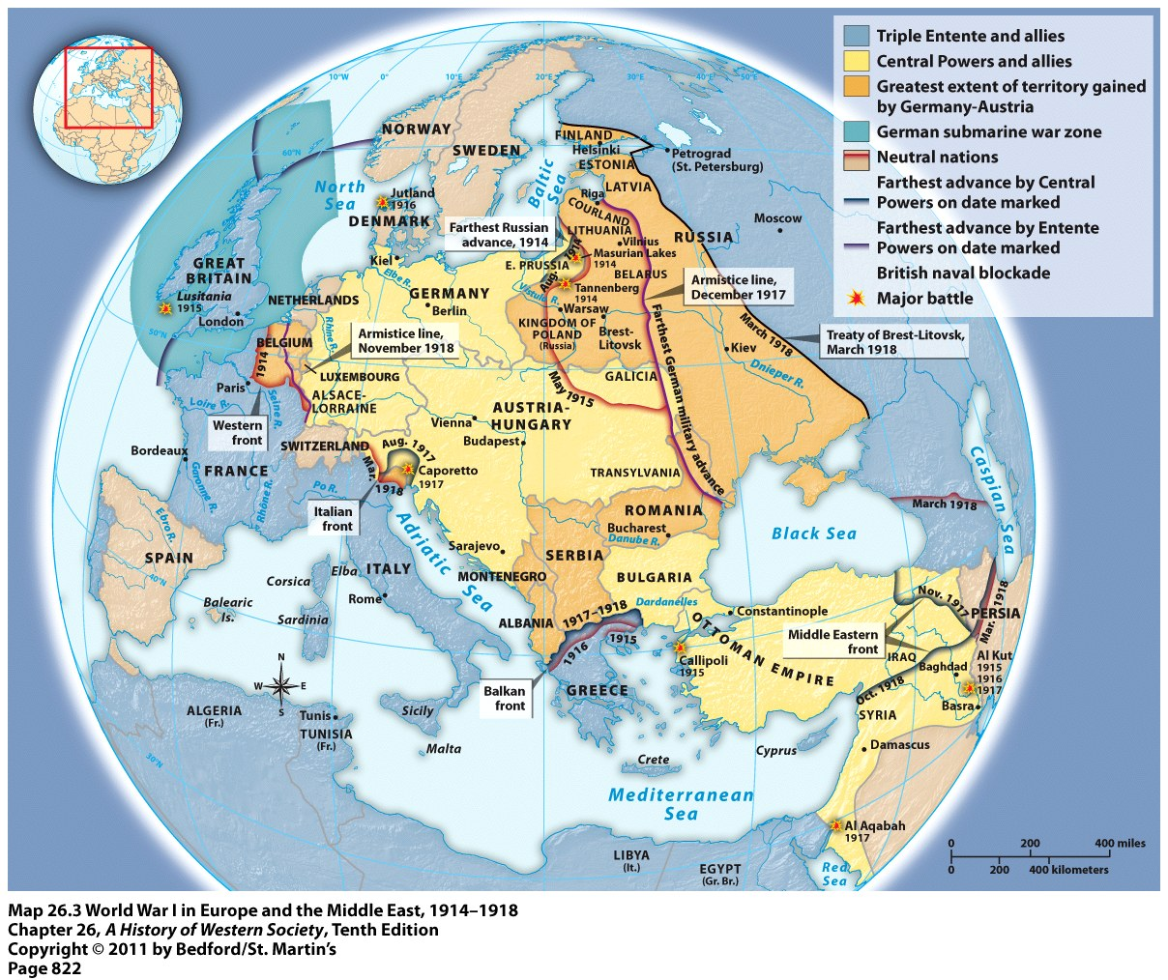

Slide 9
II. Waging Total War
B. The Widening War
1. German Victories and Occupation
2. Italian and Ottoman Entry
3. The Colonial Theater
4. American Intervention
Notes:
II. Waging Total War (expectations of a quick and painless war were dashed)
B. The Widening War
1. German Victories and Occupation – Germans won major victories at the Battles of Tannenberg and the Masurian Lakes (August and September 1914) and by 1915 captured, killed, or wounded 2.5 million Russian soldiers. The German military bureaucracy treated the Slavs as savages and used POWs and refugees as slave laborers. It stole or requisitioned cattle and crops and killed or turned 1/3 of the civilian population into refugees. This was an eerie forerunner of German policies in WWII.
2. Italian and Ottoman Entry – Italy joined the Triple Entente in exchange for future Austrian territory and the Ottomans entered on the side of the Central Powers. The Ottoman entry led to the genocide of more than one million Armenians, battles with the British at Gallipoli and the so-called Arab revolt, in which the British gave vague commitments to the Arab leader, Hussein ibn-Ali (1856–1931) for an independent Arab kingdom and assistance through men like T. E. Lawrence.
3. The Colonial Theater – British and French commanders seized Germany’s colonies around the globe and more than one million Africans and Asians served in the armies of the warring powers.
4. American Intervention – Prompted by general sympathy for the Triple Entente and unrestricted German submarine warfare, under which the Germans sank the British passenger liner, the Lusitania. When the Germans resumed submarine warfare, they gambled that they could win the war before the Americans came to the aid of the British and French.

Slide 10
III. The Home Front
A. Mobilizing for Total War
1. Governmental Management
2. A Planned Economy
3. Military Dictatorship
B. The Social Impact
1. Labor Shortage
2. Labor Unions
3. Women Workers
4. Greater Social Equality
Notes:
III. The Home Front
A. Mobilizing for Total War
1. Governmental Management – Each combatant state established new ministries to mobilize soldiers and arms to provide care for widows and veterans and to censor and control the news.
2. A Planned Economy – Government planning boards set mandatory production goals, established rationing programs, set limits on wages and prices, and created war materials boards. Yet the government refused to tax war profits, a situation that led to deficit financing, inflation, a black market and the reemergence of class conflict.
3. Military Dictatorship – In Germany, Generals Hindenburg and Ludendorff drove Chancellor Bethmann-Hollweg from office and attempted to mobilize for total war. Yet other countries, including France, also suspended parliamentary powers, civil liberties and ignored democratic proceedings.
B. The Social Impact
1. Labor Shortage – Since millions of men were conscripted into the military.
2. Labor Unions – Unions gained power and prestige. They chose to cooperate with wartime governments on workplace rules, wages and production schedule in exchange for real participation in wartime councils.
3. Women Workers – Women moved into skilled industrial jobs and as bank tellers, mail carriers, police officers, firefighters, farm laborers, and auxiliaries and nurses at the front. At the end of the war, women were forced out of the workplace as demobilized soldiers demanded their jobs back and women’s rights movements faded later in the 1920s and 1930s.
4. Greater Social Equality – The result of full employment, labor shortages, and the leveling power of death which knew no class distinctions at the front.

Slide 11
III. The Home Front
C. Growing Political Tensions
1. Propaganda
2. Strains in the Allied Powers
3. Strains in the Central Powers
Notes:
III. The Home Front
C. Growing Political Tensions
1. Propaganda – Helped ensure initial support for most governments, featuring exaggerated accounts of atrocities and patriotic slogans.
2. Strains in the Allied Powers – Included demonstrations by the radical German socialist leader Karl Liebknecht, the Easter rebellion in Dublin, strikes in France (which were ruthlessly suppressed by the French leaders, Georges Clemenceau), and mutinies by French and Italian troops (1917).
3. Strains in the Central Powers – In Austria, the chief minister was assassinated by a socialist while Czech and Yugoslav leaders demanded independent states. In Germany, 750,000 civilians died of starvation because of the British blockade, while moderate socialists in the Reichstag called for a compromise — “peace without annexations or reparations.” After a series of strikes, radicals left the Socialist Party to form the Independent Socialist Party, which would found the German Communist Party.

Slide 12
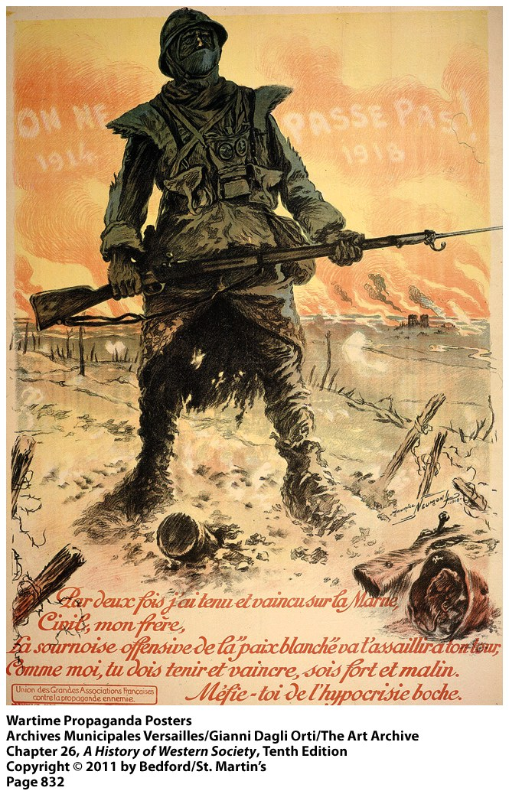
Notes:
Have students discuss these recruiting posters and how propaganda posters appealed to national and gender identities.
1. Based on the French poster, what image does the poster convey about the French soldier?
(Answers: strong, defiant, battle-hardened, proud, overcoming hardship.)
2. What does the poster say about the French people?
(Answers: shows years of suffering, destruction of cities in background, farmland turned to battlefields, but the French still fighting.)
3. What image does the American poster convey about the American soldier?
(Answers: young, enthusiastic, energetic, adventurous, exciting, like a cowboy, fighters)
4. What does the poster say about the American people?
(Answers: haven’t suffered a long war, confident, not threatened with invasion.)
5. How do these images appeal to ideas of masculinity, and how are women’s roles changing at the same time?
(Answers: men are fighting men, real men join the army, women are taking men’s jobs in the factories, suffrage movement)

Slide 13
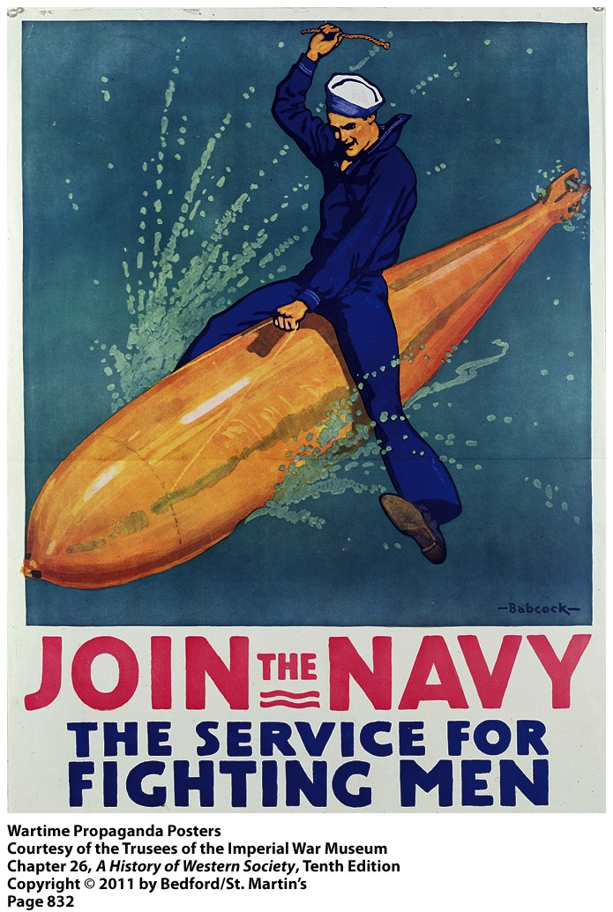
Notes:
Have students discuss these recruiting posters and how propaganda posters appealed to national and gender identities.
1. Based on the French poster, what image does the poster convey about the French soldier?
(Answers: strong, defiant, battle-hardened, proud, overcoming hardship.)
2. What does the poster say about the French people?
(Answers: shows years of suffering, destruction of cities in background, farmland turned to battlefields, but the French still fighting.)
3. What image does the American poster convey about the American soldier?
(Answers: young, enthusiastic, energetic, adventurous, exciting, like a cowboy, fighters)
4. What does the poster say about the American people?
(Answers: haven’t suffered a long war, confident, not threatened with invasion.)
5. How do these images appeal to ideas of masculinity, and how are women’s roles changing at the same time?
(Answers: men are fighting men, real men join the army, women are taking men’s jobs in the factories, suffrage movement)

Slide 14
IV. The Russian Revolution
A. The Fall of Imperial Russia
1. Temporary Unity
2. Problems with the Russian War Effort
3. Weak Leadership
4. The February Revolution
B. The Provisional Government
1. Reforms
2. Petrograd Soviet
3. The Failed Summer Offensive (1917)
Notes:
IV. The Russian Revolution
A. The Fall of Imperial Russia
1. Temporary Unity – At the start of the war, liberals, socialists and conservatives united behind Tsar Nicholas II (r. 1894–1917).
2. Problems with the Russian War Effort – Inadequate armaments and a relatively ineffective mobilization.
3. Weak Leadership - The tsar retained complete control over the bureaucracy and the army, adjourned the Duma to travel to the front to lead the armies. The government was left in the hands of his wife, Tsarina Alexandra, who relied for an adviser on Rasputin, an educated Siberian preacher with supposed healing powers.
4. The February Revolution – After mass desertions, food and fuel shortages, violent demonstrations in St. Petersburg and strike, the Duma declared a provisional government and Nicholas abdicated.
B. The Provisional Government
1. Reforms – The Provisional Government established equality before the law, freedom of speech, religion, assembly, the right of unions to organize and strike. But it also continued the war effort and refused to bring about land reform by confiscating large landholdings and distributing them to peasants.
2. Petrograd Soviet – The workers’ and soldiers’ council modeled after the revolutionary soviet of 1905 that effectively shared power with the Provisional Government. It issued its own radical orders, including Army Order No. 1, which stripped officers of their authority and placed them in the hands of committees of common soldiers.
3. The Failed Summer Offensive (1917) – led to mass desertions by peasant soldiers and the seizure of land in the countryside.

Slide 15
IV. The Russian Revolution
C. Lenin and the Bolshevik Revolution
1. Background
2. Lenin’s Ideas
3. Bolsheviks versus Mensheviks
4. Wartime Activities
D. Trotsky and the Seizure of Power
1. Increased Popular Support
2. Trotsky’s Role
3. Reasons for the Bolshevik Success
Notes:
IV. The Russian Revolution
C. Lenin and the Bolshevik Revolution
1. Background – Lenin was born into the middle class and his older brother was executed for plotting to kill the czar. He studied Marxist socialism and emerged as a radical but pragmatic thinker.
2. Lenin’s Ideas – Only violent revolution could destroy capitalism, and a socialist revolution was possible under certain circumstances even in non-industrialized agrarian nations like Russia. Revolution and the possibility of revolution was determined more by human leadership than historical laws.
3. Bolsheviks versus Mensheviks –The Bolsheviks (majority socialists) wanted a small disciplined elitist party while the Mensheviks (minority socialists) wanted a democratic party with mass membership.
4. Wartime Activities – Lenin opposed the war from the outset and spent the war in Switzerland. The German government offered him safe passage to Russia in 1917 in the hope that he would undermine the war effort. He rejected all cooperation with the provisional government and led an abortive coup in July.
D. Trotsky and the Seizure of Power
1. Increased Popular Support – Party membership soared from 50,000 to 240,000 in the summer and fall of 1917 and the Bolsheviks gained a majority in the Petrograd Soviet.
2. Trotsky’s Role – Leon Trotsky (1879–1940) convinced the Petrograd Soviet to make him the leader of a special military-revolutionary committee, which joined with Bolshevik soldiers to seize government buildings and arrest members of the provisional government on the night of November 6.
3. Reasons for the Bolshevik Success – Democracy had given way to anarchy, the Bolsheviks had superior leaders in Lenin and Trotsky and many soldiers and workers embraced the Bolshevik promise to end the war.

Slide 16
IV. The Russian Revolution
E. Dictatorship and Civil War
1. Consolidating Power
2. Treaty of Brest-Litovsk
3. The Whites
4. Red Victory
5. War Communism and Revolutionary Terror
Notes:
IV. The Russian Revolution
E. Dictatorship and Civil War
1. Consolidating Power – Lenin profited from the peasant revolution in Russia, mandating land reform after the peasants had already seized many aristocratic estates. He also permanently disbanded the Constituent Assembly on January 18, 1918 after free elections on November produced stunning setbacks for the Bolsheviks.
2. Treaty of Brest-Litovsk – Lenin ended the Russian participation in the war by agreeing to give up the western territories largely inhabited by Poles, Finns, Lithuanians, and other non-Russians. This step, though controversial, allowed him to continue consolidating absolute power.
3. The Whites – Opponents of the Bolshevik regime, including many officers of the old army (who rejected the peace treaty) and many other social groups especially in southern Russia, Ukraine, and Siberia. By October 1919, it appeared that they might triumph.
4. Red Victory – Was made possible by superior Bolshevik leadership, better discipline in the Red Army which was reorganized by Trotsky, a better strategic position in central Russia and in the crucial cities of Moscow and St. Petersburg, the lack of coordination among the Whites, the Reds’ determination to grant ethnic minorities substantial autonomy, and foreign intervention by the Poles, United States, Britain, France, and Japan (which allowed the Bolsheviks to appeal to patriotic nationalism).
5. War Communism and Revolutionary Terror – The Bolsheviks nationalized all banks and industries, allowed private property, and seized grain from the peasants to feed the cities. They also imprisoned and executed tens of thousands of political opponents (clergy, aristocrats, liberals, Red Army deserters, the tsar and his family).

Slide 17
V. The Peace Settlement
A. The End of the War
1. Second Battle of the Marne
2. The Stab in the Back
3. The Collapse of the German Empire
B. Revolution in Austria-Hungary and Germany
1. The Break-up of Austria-Hungary
2. The Aborted German Revolution
3. The Spartacus Uprising (January 1919)
4. The Outcome
Notes:
V. The Peace Settlement (the failure of the peace settlement led to economic crisis and violent political conflict.)
A. The End of the War
1. Second Battle of the Marne – Battle where the all out German advance of spring 1918 was stopped, just as American troops began to see action.
2. The Stab in the Back – As British, French, and American troops advanced on all fronts, General Ludendorff looked to invite moderate politicians into the government to sign an armistice and shoulder the blame.
3. The Collapse of the German Empire – After a wave of strike and mutinies, revolution broke out in Germany. Wilhelm II abdicated and fled to Holland. Socialist leaders in Berlin proclaimed a German republic.
B. Revolution in Austria-Hungary and Germany
1. The Break-up of Austria-Hungary – Austria, Hungary, and Czechoslovakia became independent states. Romania gained territory, a greatly expanded Serbian monarchy took the western Balkans and the name Yugoslavia. Hungary became an independent Soviet republic.
2. The Aborted German Revolution– A genuine popular uprising welled up from below, toppled a monarchy, and created a liberal provisional republic. But the moderates held on to power in spite of attempts at a more radical revolution. Reasons: most Marxist politicians in the SPD were not revolutionaries, but moderates who wanted political democracy and civil liberties. The SPD worked out deals with the army and big businesses to prevent Germany from total collapse.
3. The Spartacus Uprising (January 1919) – Radical Communists led by Karl Liebknecht and Rosa Luxemburg attempted to seize power but were crushed by nationalist paramilitary organizations. An attempt to establish a Soviet republic in Bavaria was also crushed.
4. The Outcome – The republican government held on to power but was distrusted by both left (for putting down the uprisings by force) and right (who claimed its pacifist and socialist leaders had stabbed the nation in the back).

Slide 18
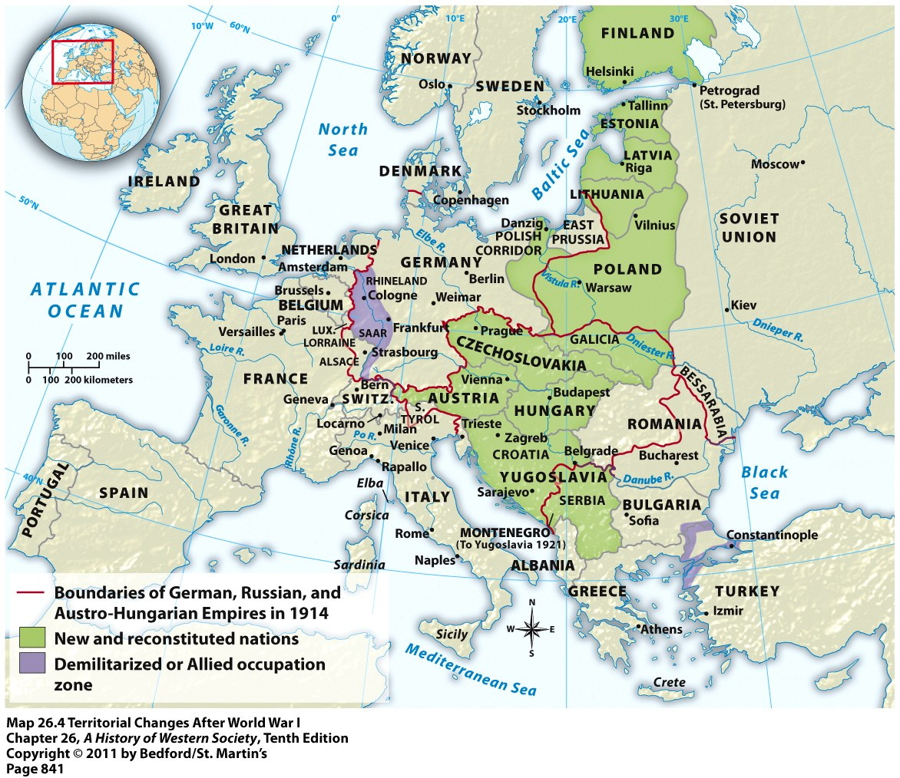

Slide 19
V. The Peace Settlement
C. The Treaty of Versailles
1. The Fourteen Points
2. Disagreements over Germany
3. The Peace Terms
4. The Flawed Peace
D. The Peace Settlement in the Middle East
1. The Sykes-Picot Agreement (1916)
2. Balfour Declaration (1917)
3. The Arab Response
4. The Creation of Turkey
Notes:
V. The Peace Settlement
C. The Treaty of Versailles
1. The Fourteen Points – U.S. President Wilson’s peace proposal that called for open diplomacy, freedom of commerce and trade, the establishment of a League of Nations, self-determination of nations. They inspired hopes that could not be fulfilled.
2. Disagreements over Germany – The Big Three (the U.S., Britain, and France) disagreed over the peace. In contrast to Wilson, Clemenceau wanted revenge, economic retribution, French security, a buffer state (the Rhineland) between France and Germany, and vast reparations payments. The compromise – Clemenceau gave up the demand for a buffer state in exchange for a formal defensive alliance with the U.S. and Britain.
3. The Peace Terms – New independent states were created (Poland, Czechoslovakia, Finland, the Baltic States, Yugoslavia), the Ottoman Empire was split apart; Germany’s African and Asian colonies were given to France; Britain and Japan as League of Nations mandates; Alsace-Lorraine was returned to France; German and ethnic-Polish territories were given to Poland; Germany’s army was limited to 100,000 men; the Rhineland was demilitarized; the “war guilt clause”; and reparations payments were imposed on Germany.
4. The Flawed Peace – The American Senate failed to ratify the treaty, Germany was outraged by the war guilt clause and reparations payments and the principle of national self-determination was often flouted and ignored.
D. The Peace Settlement in the Middle East
1. The Sykes-Picot Agreement (1916) – An agreement between the British and the French to divide up and rule Ottoman territories. The French were to receive Lebanon, Syria, and southern Turkey, while the British were to receive Palestine, Transjordan, and Iraq. This agreement betrayed promises the British made to the Arabs during the war.
2. Balfour Declaration (1917) – British plans for a Jewish homeland in Palestine, even though Jews accounted for only 11% of the population in the territories to become Palestine.
3. The Arab Response – Since only Saudi Arabia was given political independence, Arab groups proclaimed Iraq and Syria independent kingdoms and revolted, prompting military action by the British and the French.
4. The Creation of Turkey – Mustafa Kemal (1881–1938) fought back against Allied attempts at dismemberment of the Ottoman Empire and a Greek invasion. He created a secular, modern republic, and a one-party system, under which he was elected president. He separated church and state, introduced western law codes, and established a secular public school system.

Slide 20
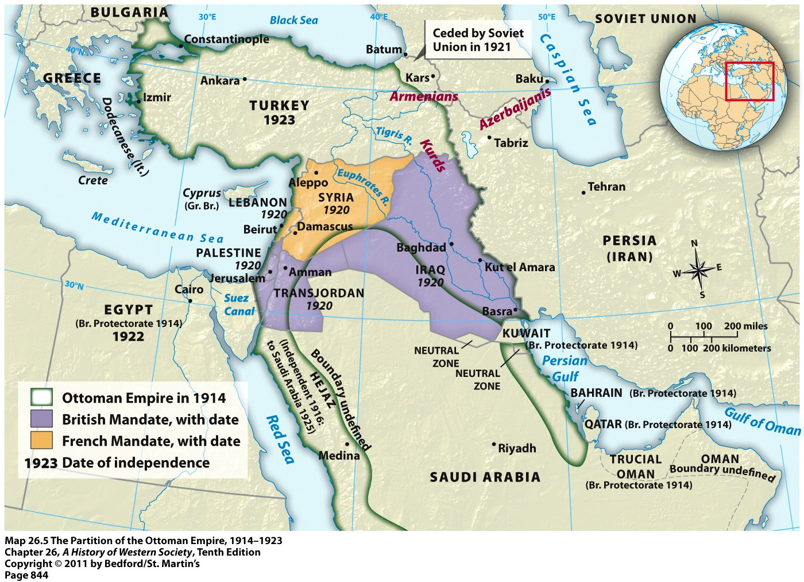

Slide 21
V. The Peace Settlement
E. The Human Costs
1. Casualties
2. Commemorations
3. Veterans
4. Right-Wing Radicalization
Notes:
V. The Peace Settlement
E. The Human Costs
1. Casualties – Ten to thirteen million total deaths on the battlefield, 7-10 million civilians died because of wartime hardship, and 20 million died in the ensuing influenza epidemic. Germany suffered 2 million dead and 4 million wounded; France lost 1.2 million (1/10 adult males).
2. Commemorations – Tomb of the unknown soldier, grand memorials.
3. Veterans – Ten million soldiers returned disfigured or mutilated and governments lacked the money to fund pensions and job training programs. One-third of the budget of the Weimar Republic was tied up in war pensions and benefits, funds that were cut with the onset of the Depression.
4. Right-Wing Radicalization – The National Socialists and Italian Fascists manipulated popular feelings of loss and resentment to undermine parliamentary governments.

Slide 22
