Slide 1

Essay Writing
AIM: How to maximize points on a Thematic or DBQ Essay
Made Easy

Slide 2
Introduction Paragraph
Read Theme or Historical Context
Use Word Replacement Strategy
Add Topic(s) to Discuss
Re-Write Theme Using WRS
Step #1
Step #2
Step #3
Step #4

Slide 3
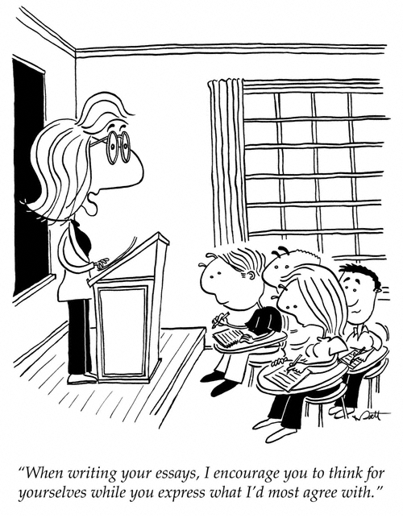
Word Replacement Strategy (WRS)
1. Read the theme or historical
context
2. Circle the important words.
3. Think of replacements for the
most of the important words
and phrases. (Multiple
replacements will be necessary)
4. Paraphrase (put into your own
words) the theme or historical
context using the replacement
words.

Slide 4
Word Replacement Strategy (WRS)
Theme: Culture and Intellectual Life
Intellectuals, philosophers, and leaders have often recorded their ideas in written works. These ideas have been used throughout history to guide societies and influence the course of national and regional development.
Word | Replacement #1 | Replacement #2 | Replacement #3
Intellectuals | smart people | academics | thinkers
philosophers | thinkers | dreamers | truth-seeker
leaders | people in power | people in charge | rulers
written works | literature | texts / words | books
guide | steer | direct | move
society | people | culture | civilization
influence | persuade | affect | shape
national | nationwide | state | countrywide
regional | area | region | province
development | progress | advancement | evolution

Slide 5
Re-Write the Theme
All over the world, thinkers, dreamers, and the people in power use words such as books to move and shape their culture within their state in order to affect the advancement of their society.

Slide 6
Word Replacement Strategy (WRS) Practice
Theme: Belief Systems
A belief system is an established, orderly way that groups or individuals look at religious faith or philosophical principles. These systems have often affected politics, society, and the economy in the nations or regions in which they are practiced.
Word | Replacement #1 | Replacement #2 | Replacement #3

Slide 7
Introduction Paragraph
Read Theme or Historical Context
Use Word Replacement Strategy
Add Topic(s) to Discuss
Re-Write Theme Using WRS
Step #1
Step #2
Step #3
Step #4

