Slide 1
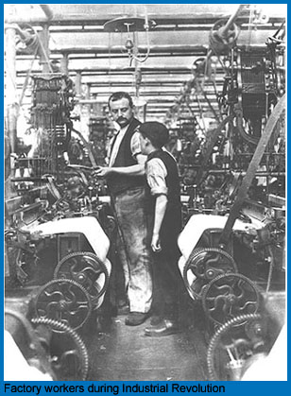
The Industrial Revolution
AIM: What was life like before & during the Industrial Revolution?
Do Now: Beginnings of Change Worksheet
Europe c.1740- Early 1900s

Slide 2

Industrial Revolution

Slide 3
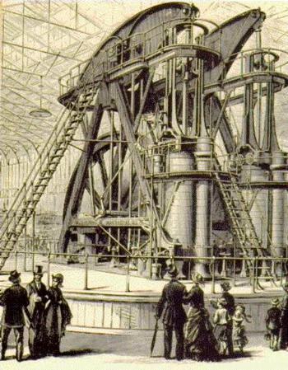
What was the Industrial Revolution?
A shift from home made goods to mass produced factory goods.
Began in Great Britain (England, Wales, Scotland, N. Ireland) in the Middle of the 1700s

Slide 4
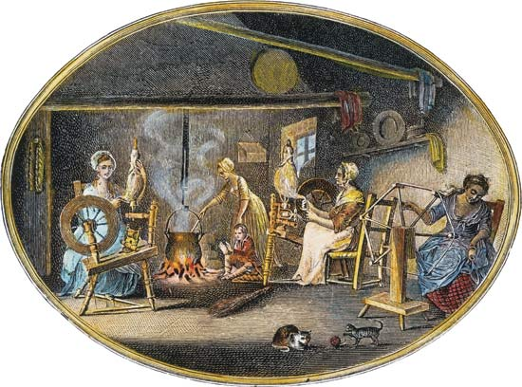
Home/Cottage:
Clothes
Pottery
Leather Goods
Cloth
Work was usually done on the 1st Floor of their home.
Whole Family Participated.
Before: People Worked inside Homes (cottage industry)

Slide 5
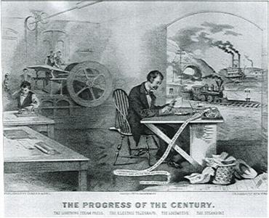
Factories:
Machines operated by People Made Goods.
Work was usually done at factory.
People lived in crowded buildings.
Men, Women, Children worked in Factory.
During/After: Work in Factories

Slide 6
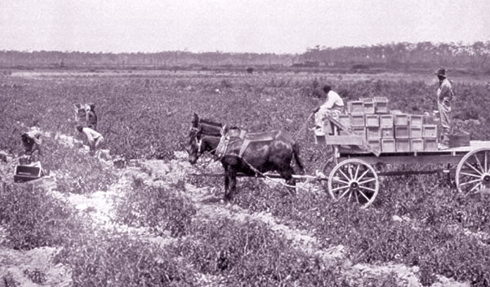
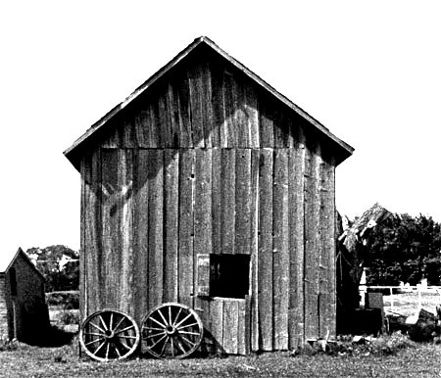
Before: People Lived in Rural (country) Area Farms

Slide 7
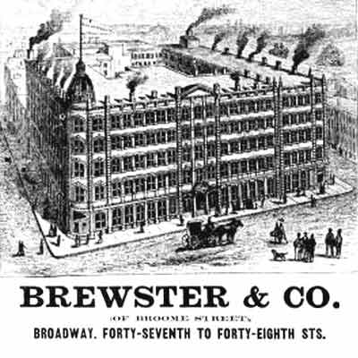
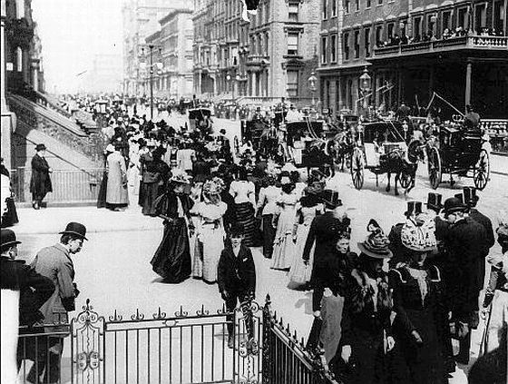
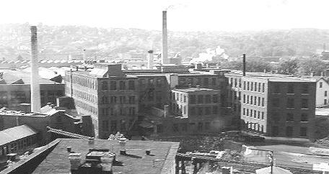
During/ After: People Lived in Urban (cities) near Factories for work.

Slide 8
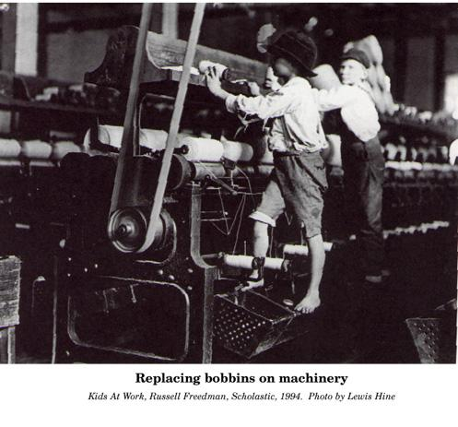
Children Working in Factories

Slide 9
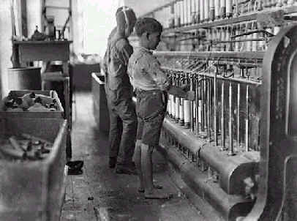
Children Working in Factories

Slide 10
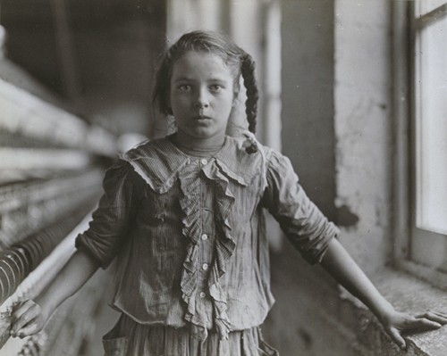
School Age Girl Working in a Factory

Slide 11
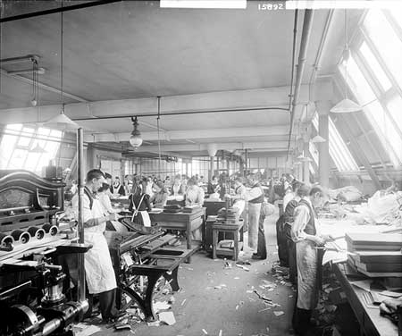
Men & Women Working in Factories

Slide 12
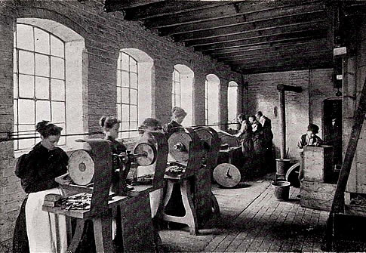
Women & Men Working in Factories

Slide 13
What do machines allow people to do that couldn’t be done by hand?
Factories
Mass Production
More Goods
Consumer Economy
MASS PRODUCTION

Slide 14
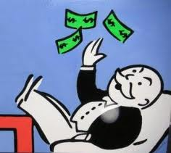
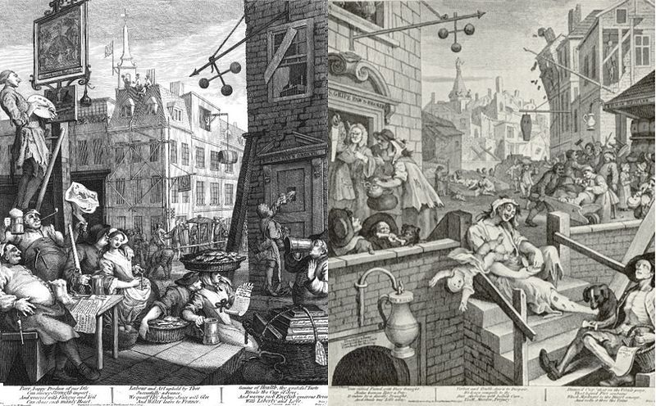
Results of the Industrial Revolution
BIG Business Large Companies develop.
Laizzes-Faire Economics
Government’s Hands-Off the economy.
Urbanization
People moving from rural areas to urban areas as cities develop factories for jobs.

Slide 15
Results of the Industrial Revolution
New Social Class System Develops
Upper Class
Upper Middle Class
Lower Middle Class
Working Class
Very rich industrial & business families. Old Noble class.
Business people & professionals such as, lawyers & doctors.
Other professionals such as, teachers, shop owners, and office workers.
Factory workers and small farmers.

