Slide 1
The Growth
of the
American
Labor Movement
Aim: How did workers react to the growth of industry and America?
Do Now: Take Quiz (5-7 Minutes)
Mr. Ott – BETA 2011-12

Slide 2
1st LAWS TO REGULATE BIG BUSINESS
State representatives voted into office by members of the Grange who in turn represented the interests of farmers and passed state laws regulating railroad prices in 18 states.
Granger State Laws
Munn v. Illinois
(1876)
Supreme Court decision stating that states had the ability to regulate private property if it affected public interest.
Declared that it was unconstitutional for states to regulate interstate commerce. Showed need for Federal regulation of interstate commerce (RR!).
Wabash Case
(1886)

Slide 3
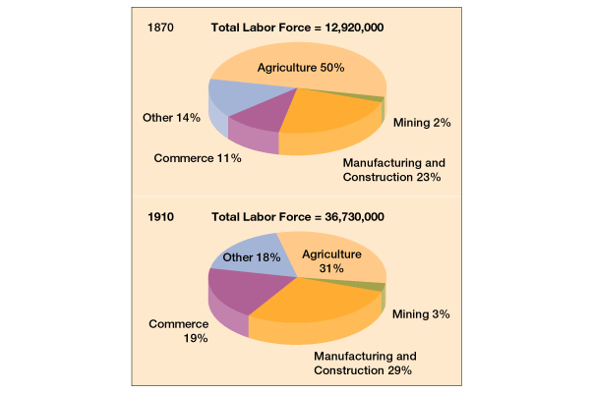
The Changing American Labor Force

Slide 4
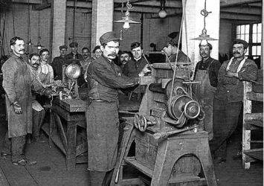
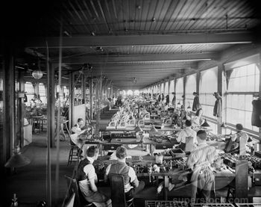
The desire to maximize profits and become more efficient led to poor working conditions.
  Machines and unskilled workers replaced skilled craftspeople.
  These low-paid workers could easily be replaced. They brought costs down and caused production to rise.
  Encouraged managers to view workers as interchangeable parts
  Injuries increased, and conditions worsened.

Slide 5
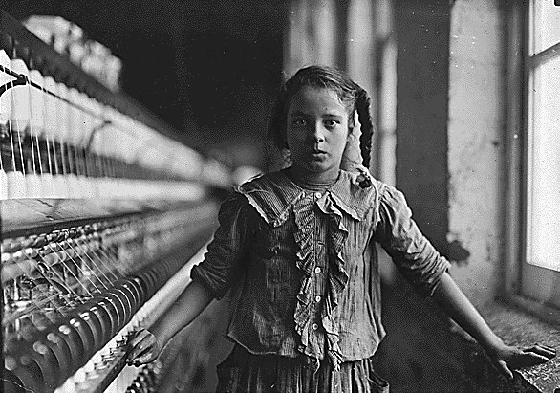
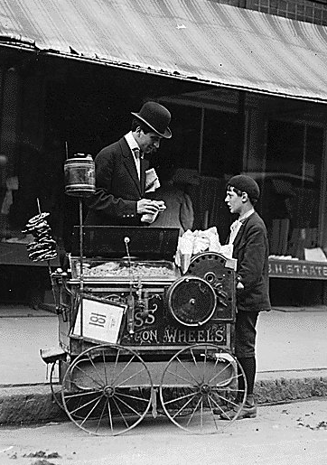
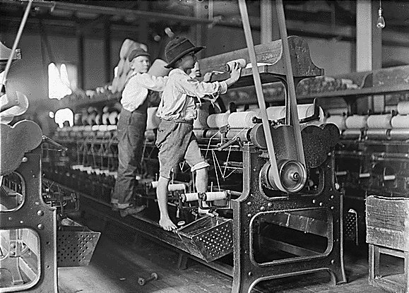
Poor Working Conditions
Small, crowded rooms
Specialization made workers tired, bored, and more likely to be injured.
Managers paid less attention to working conditions.
Stuffy air / Pollution
Unsafe workplaces
Long hours
Low wages
No job security
Child Labor

Slide 6
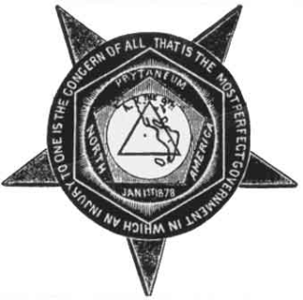
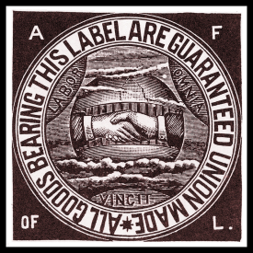
Workers began to organize and demand improvements in working conditions and pay.
Knights of Labor
(1870)
First national labor union
Pushed for eight-hour workday, equal pay for equal work, and end to child labor
Included both skilled and unskilled workers
No contract foreign labor
Doesn’t last
American Federation
of Labor (AFL)
Organized individual national unions, such as mine-workers’ and steelworkers’ unions
Limited membership to skilled workers
Used collective bargaining, in which all workers acted collectively, or together, to negotiate with management
Samuel Gompers
1886

Slide 7
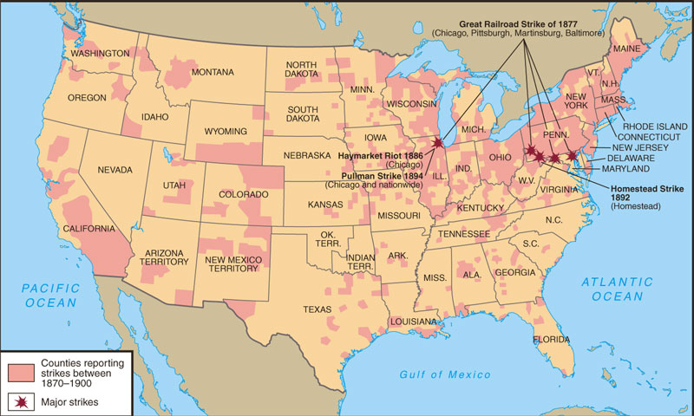
Labor Unrest: 1870-1900

Slide 8

Management vs. Labor
“Tools” of
Management
“Tools” of
Labor
“scabs”
P. R. campaign
Pinkertons (security firm)
lockout
blacklisting
yellow-dog contracts
court injunctions
open shop
boycotts
sympathy
demonstrations
informational
picketing
closed shops
organized
strikes
“wildcat” strikes

Slide 9
Labor strikes often turned violent and
failed to accomplish their goals.
Haymarket Riot
Erupted between protesters and police in Chicago
Resulted in decline of Knights of Labor
Homestead Strike
Strike occurred at Carnegie Steel Company in Homestead, Pennsylvania.
Resulting fight left workers and Pinkerton guards dead.
Pullman Strike
Began with workers who made Pullman train cars
Spread to workers who worked on trains pulling sleeping cars
Federal troops stopped strike. No Mail Delivery!

Slide 10
How the AF of L
Would Help the Workers
Catered to the skilled worker.
Represented workers in matters of national legislation.
Maintained a national strike fund.
Evangelized the cause of unionism.
Prevented disputes among the many craft unions.
Mediated disputes between management and labor.
Pushed for closed shops.

Slide 11
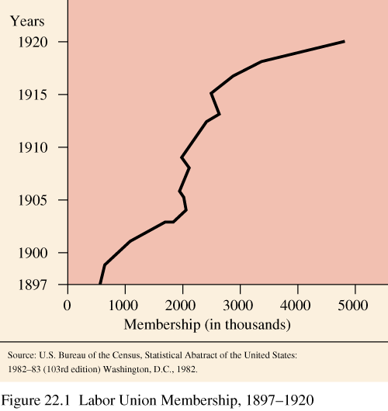
Labor Union Membership

