Slide 1
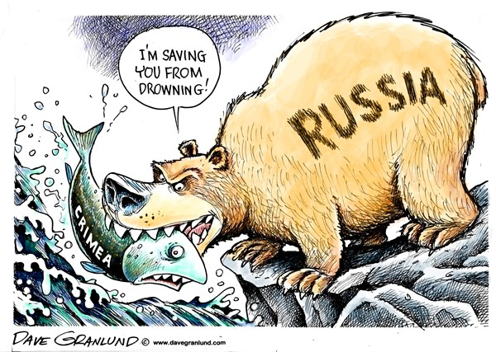


IMPERIALISM
From 1800-1950
AIM: What is Imperialism and how did it effect the world?
Do Now: Complete Political Cartoon Worksheet

Slide 2
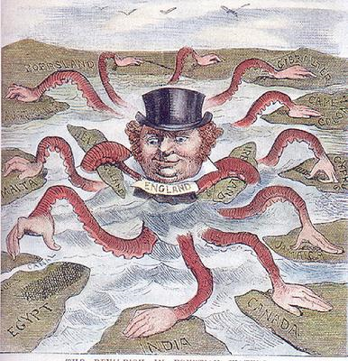
AIM: What is Imperialism and how did it effect the world?
Boersland
Gibraltar
Cape Colony
Malta
New Zealand
Ireland
Cyprus
Jamaica
Egypt
Canada
India

Slide 3
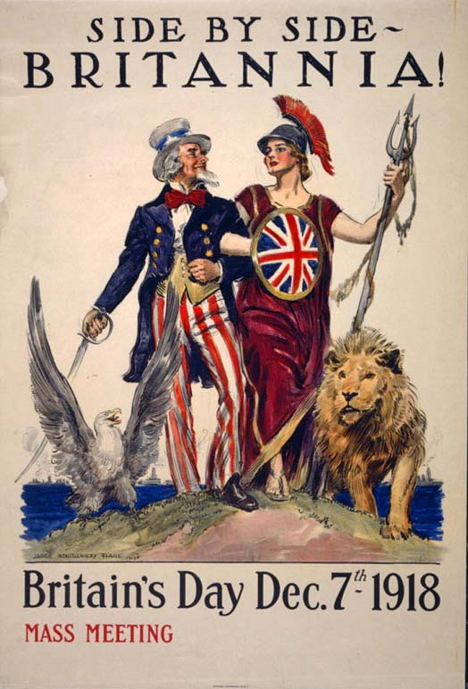
What is imperialism?
The belief in building an Empire
How?
I M P E R I A L I S M
Politically
Economically
Religiously
Socially
Intellectually
Area/Geography

Slide 4
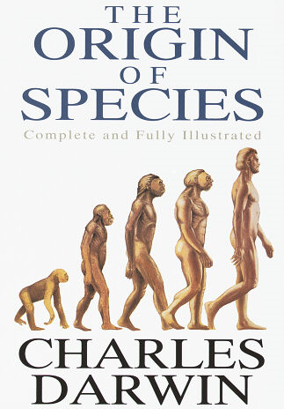
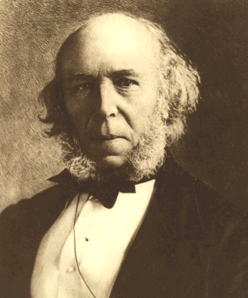
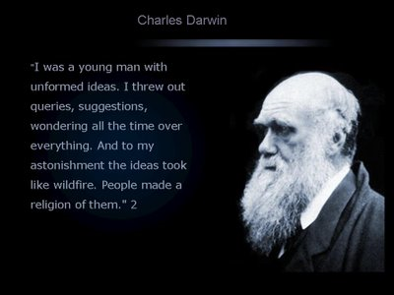
Herbert Spencer
The Industrial Revolution created many changes both positive/negative.
Economic: Wealth, Jobs, Middle Class
Social: Social Mobility, Political Economy, Disposable Income, Consumer Economy

Slide 5
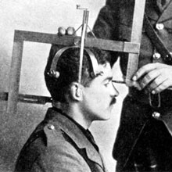
Using Darwinism to fix Social Problems?
Herbert Spencer Applied Darwinism to human society
As in nature, survival properly belongs to the fittest, those most able to survive.
Social Darwinism was used by many people to justify social inequalities based on race, social or economic class, or gender
“survival of the fittest”

Slide 6


Slide 7

People of London’s East End in the 1880s (6 min)

Slide 8
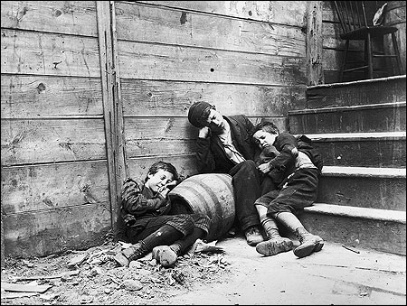

Slide 9


Slide 10


Slide 11
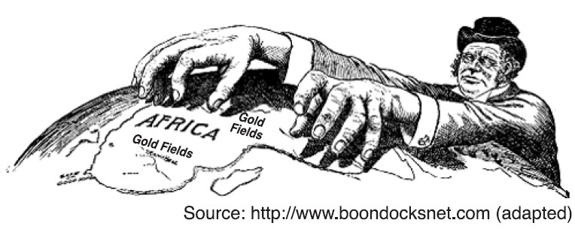
Why would a country want to take over another land? What reasons propelled them to do this?
Causes of Imperialism
Economic Motives | The Industrial Revolution created an insatiable demand for raw materials and new markets.
Nationalism | European nations wanted to demonstrate their power and prestige to the world.
Balance of Power | European nations were forced to acquire new colonies to achieve a balance with their neighbors and competitors.
White Man's Burden | The Europeans’ sense of superiority made them feel obligated to “civilize the heathen savages” they encountered.

Slide 12
How do you think the Europeans viewed the people and the cultures of the lands they were taking over? Vs. How do you think the people of Africa and Asia felt about being taken over by the Europeans?
Point of View?
Question #1
Question #2

Slide 13
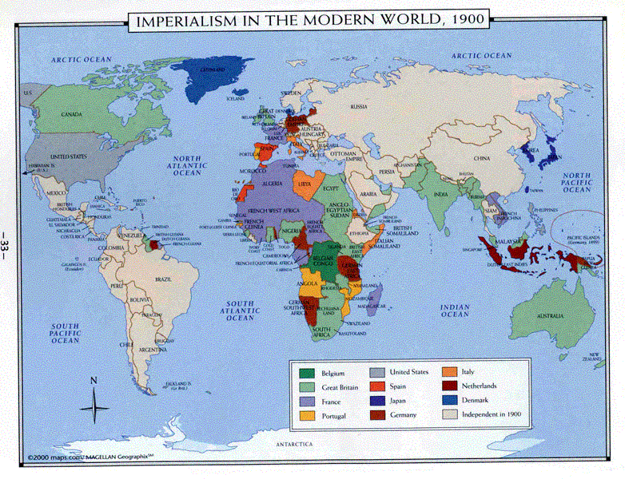

Slide 14
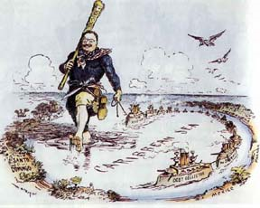
Why were European countries steering away from the Americas and becoming more interested in Africa and Asia?
Monroe Doctrine
Issued by the
Issued by the U.S. (1823)
Announced opposition to re-colonization of independent Latin & South American states
Britain quietly backed the U.S.
Enough to discourage European powers

